Slide 1
Yellowstone Array Earthquake Arrival Clustering and Velocity Analysis
Tessa Czech 5-2-23

Slide 2
Outline
Introduction and Motivation
Earthquake Arrivals Clustering
Linear Regression
Conclusions and Future Work

Slide 3
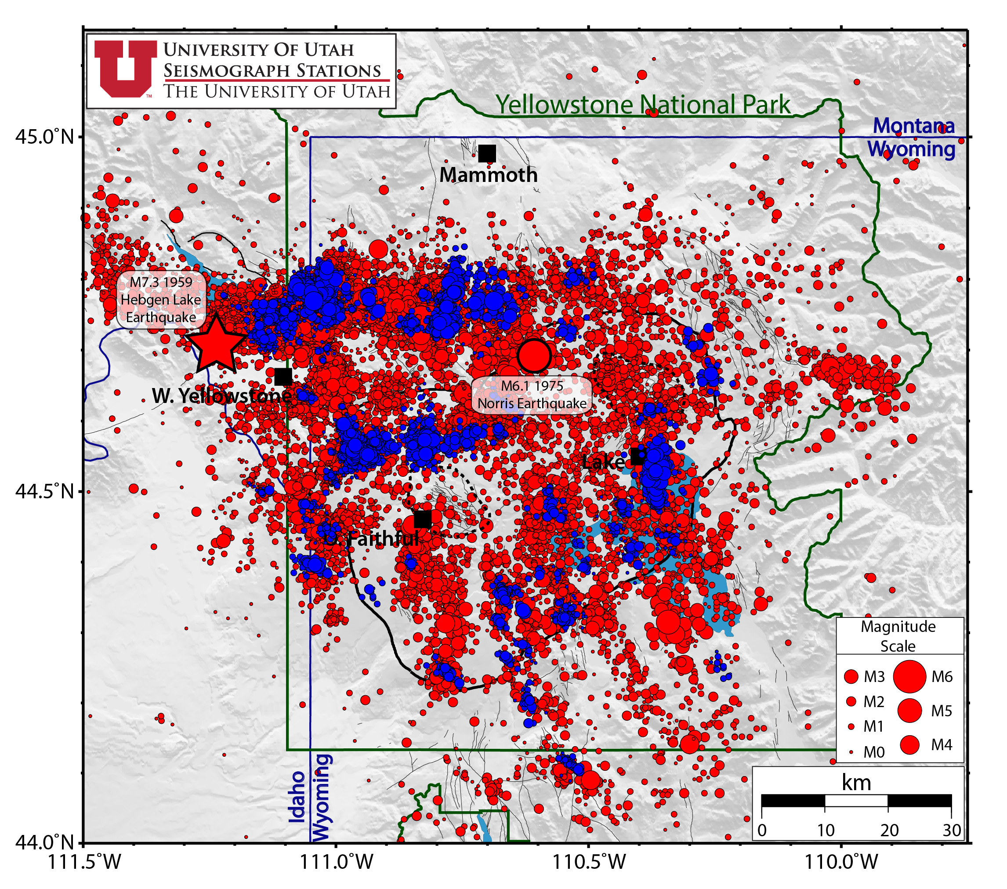
Yellowstone Swarm Events
50% of Yellowstone seismicity
Red circles represent all seismicity
Blue circles represent earthquakes as part of earthquake swarms
In 2020 there were 26 swarms
Largest had 123 events during September 10-16
Sources/Usage: Public Domain.
Monitoring earthquakes in Yellowstone National park. Monitoring Earthquakes in Yellowstone National Park | U.S. Geological Survey. (n.d.).
Retrieved May 1, 2023, from https://www.usgs.gov/volcanoes/yellowstone/monitoring-earthquakes-yellowstone-national-park
Poland, M., et al. "Yellowstone Volcano Observatory 2021 Annual Report." US Geological Survey Circular (2022): 1-60.
Notes:
Since 1973, there have been over 48,000 earthquakes located in the Yellowstone region. Over 99% of those earthquakes are magnitude 2 or below and are not felt by anyone.
Most swarms are small, containing 10-20 earthquakes, and short, lasting for 1–2 days. However, large swarms that can contain 1,000's of earthquakes and last for months do occur on occasion.
The size of the circles is scaled to the magnitude of the earthquake. The 630,000 year old Yellowstone caldera is shown as a bold black line within Yellowstone National Park. Mapped faults are shown as light gray lines.

Slide 4
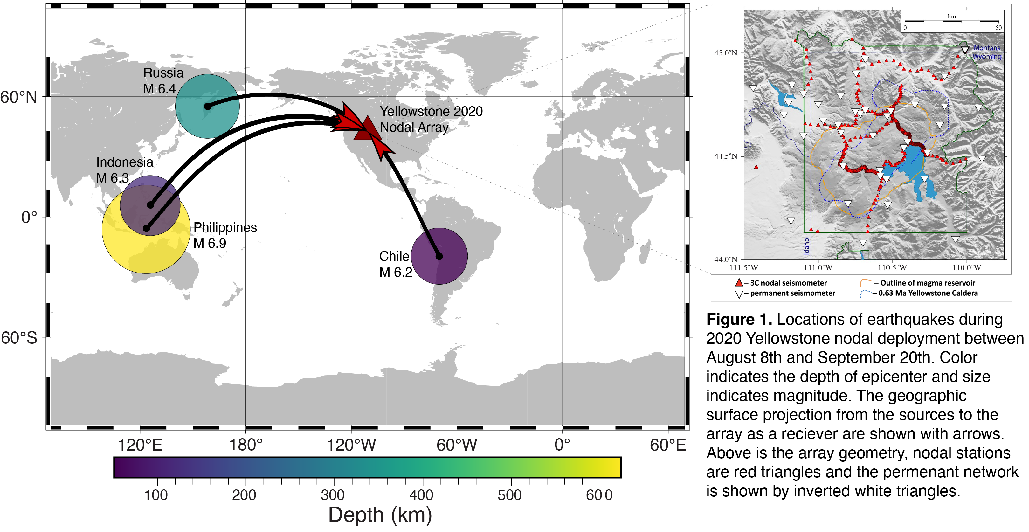
Yellowstone Nodal Deployment

Slide 5
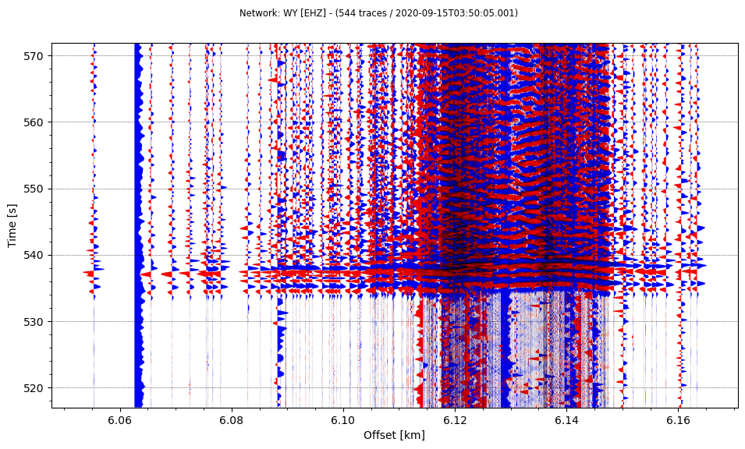
Teleseism Record Section
Esso, Russia M6.4
Depth 344km
09-15-2020
6060 6080 6100 6120 6140 6160
Distance[km]

Slide 6
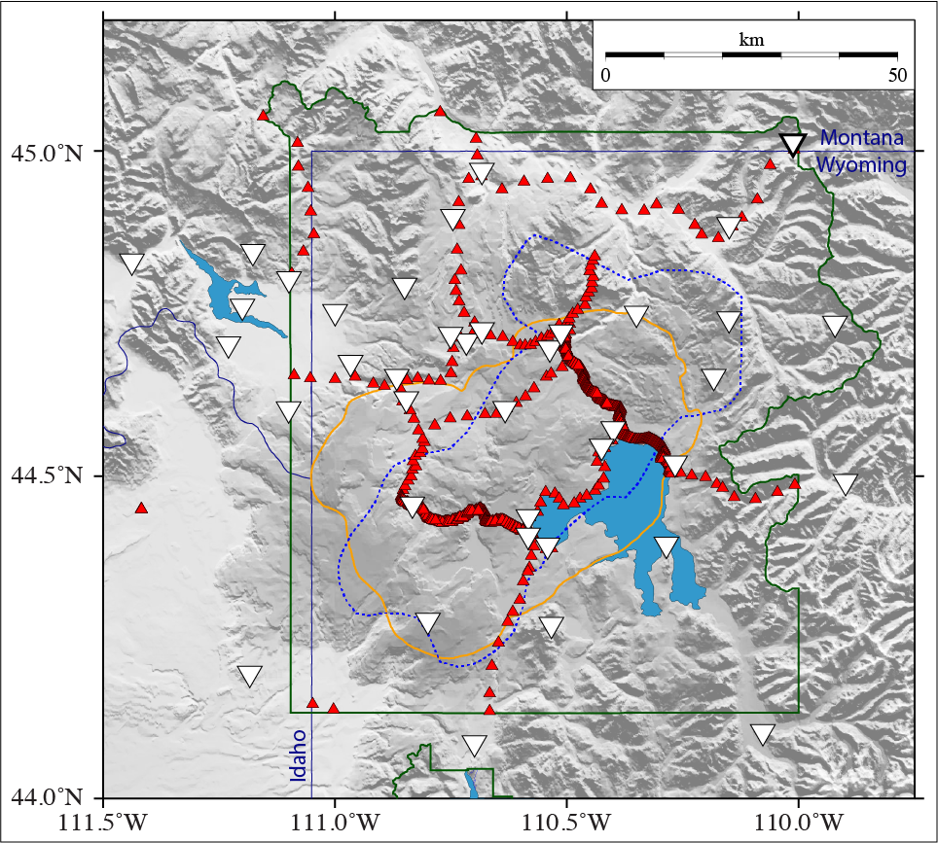
Yellowstone Dataset
630 3-component Magseis Fairfield 5-Hz geophones deployed between 08/17/20 and 09/21/20
Stations deployed along roads except for line of 12 stations connecting two dense lines
Stations spaced ~3.5km outside the caldera to ~200m inside the caldera

Slide 7
Why apply machine learning methods?
Picking arrivals for earthquakes is time intensive
  123 swarm events * 630 seismometers = 77,490 picks of one phase
  225 events total during deployment * 630 seismometers = 141,750 picks of one phase
Filtering out noisy stations
Consistent
Quickly be able to observe variations in velocity
630 3-component Magseis Fairfield 5-Hz geophones deployed between 08/17/20 and 09/21/20
Stations deployed along roads except for line of 12 stations connecting two dense lines
Stations spaced ~3.5km outside the caldera to ~200m inside the caldera
Notes:
My main goal from this project was to test machine learning methods that we had learned to apply to my research in a way that was most useful to this project.
That is why I decided to test multiple clustering methods on

Slide 8
Timeline
Week 1 - get picks and travel time
Week 2 - use silhouette or DBscan method to identify trends
Week 3 - compare between different earthquakes or phases
Week 4 - write up

Slide 9
Outline
Introduction and motivation
Earthquake Arrivals Clustering
Linear Regression
Conclusions and Future Work

Slide 10
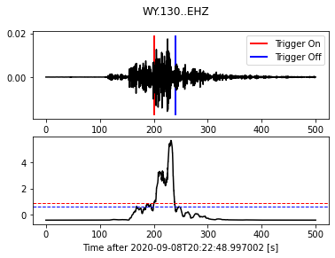
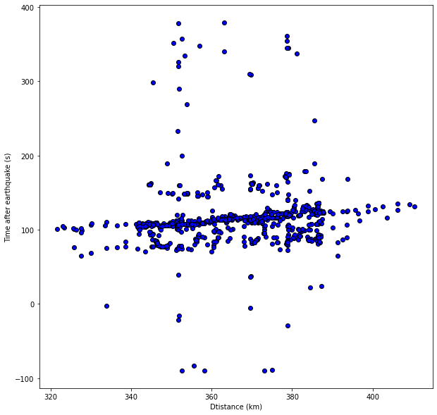
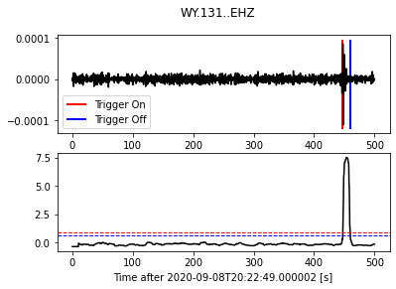
Stanley ID earthquake m4.4
Good Pick
Bad Pick
Z-detect - obspy
Notes:
Since swarm events are inherently close together it is inevitable that there is overlap between multiple events
Before testing on swarm events I tested

Slide 11
Stanley ID earthquake m4.4
Good Pick
Bad Pick
Z-detect - obspy
Notes:
Since swarm events are inherently close together it is inevitable that there is overlap between multiple events
Before testing on swarm events I tested

Slide 12
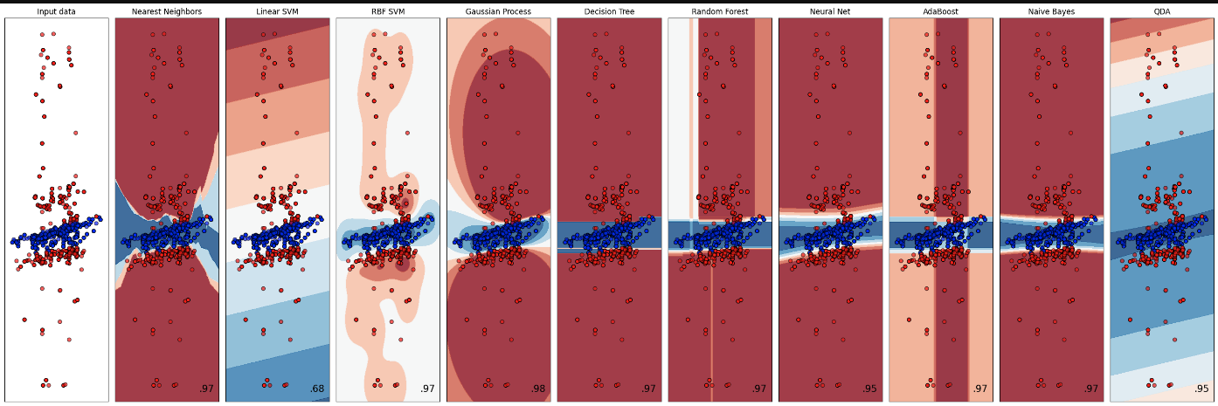

Slide 13
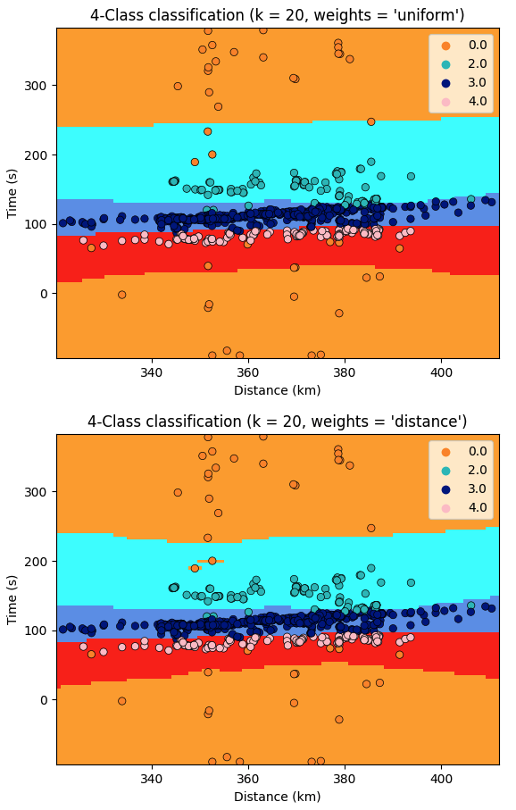
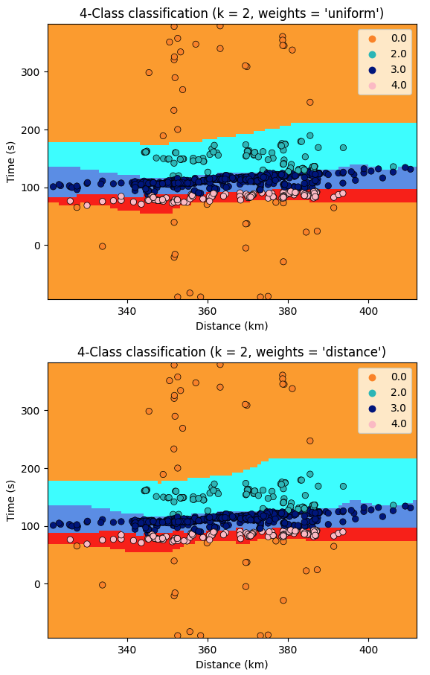
Nearest Neighbors
From scikit

Slide 14
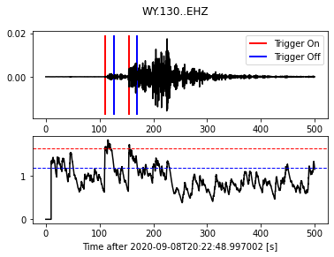
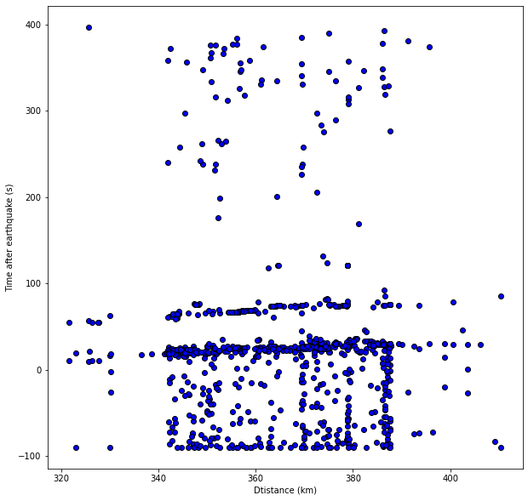
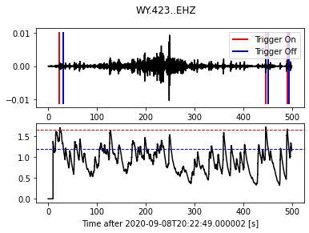
Picking P-Wave Arrivals on Stanley ID earthquake m4.4 and M4.0
Good Picks
Event 1
Event 2
Array Record Section
400
300
200
100
0
-100
Amplitude
(counts)
seismograph
sta/lta ratio
sta/lta window ratio
Time after earthquake (s)
Amplitude
(counts)
seismograph
Event 2
Event 1
sta/lta ratio
sta/lta window ratio
Bad Picks
Recursive STA LTA – 10s window
320 340 360 380 400
Distance (km)
Notes:
Can I pick the good arrivals reliably. Can I cluster them together? Can I tell different arrivals apart?
Amplitude in “counts”
Amplitude sta/lta
Add labels seismogram – sta/lta ratio

Slide 15
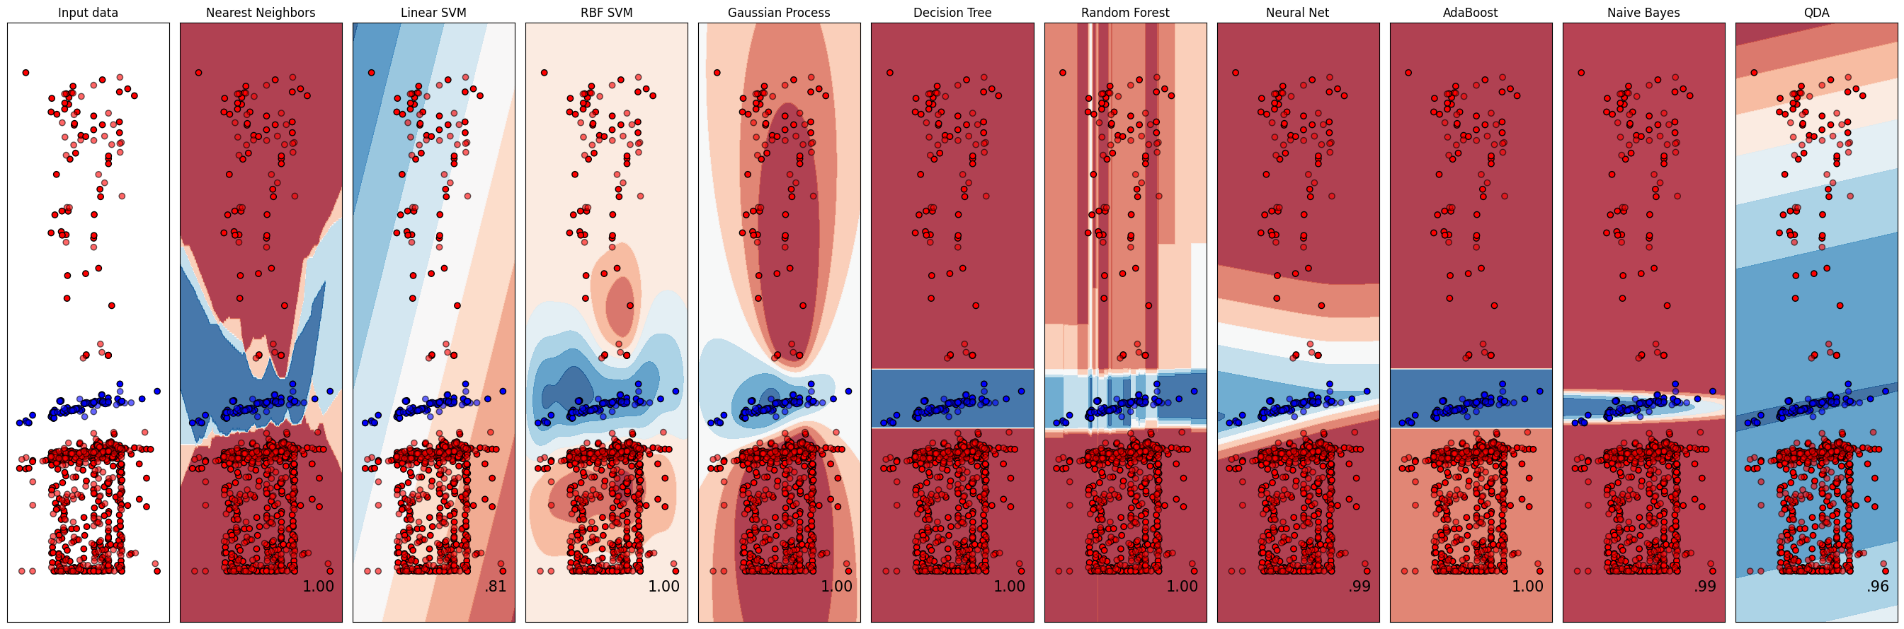
Classifier Comparison on Event 2
Classifier comparison. scikit. (n.d.). Retrieved April 20, 2023, from https://scikit-learn.org/stable/auto_examples/classification/plot_classifier_comparison.html

Slide 16
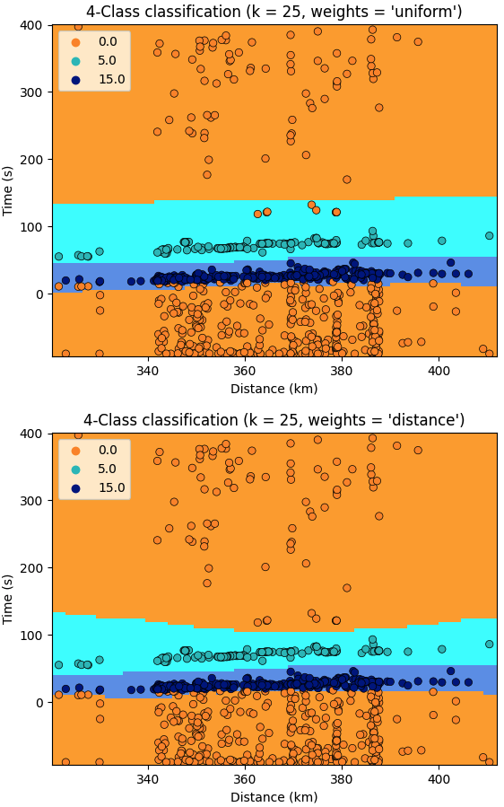
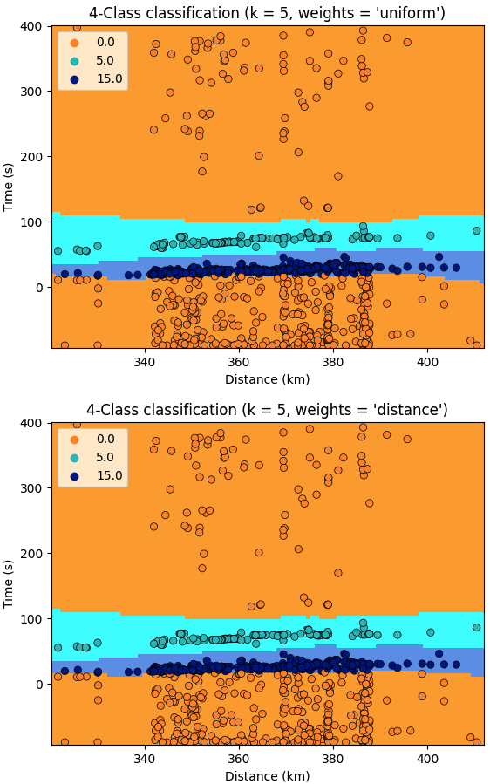
Nearest Neighbor 3-Class Classification on Two Events
3-Class Classification (k=25, weights=uniform)
3-Class Classification (k=5, weights=uniform)
Noise
Event 2
Event 1
Noise
Event 2
Event 1
3-Class Classification (k=25, weights=distance)
3-Class Classification (k=25, weights=distance)
Noise
Event 2
Event 1
Noise
Event 2
Event 1
Nearest Neighbors
From scikit
Notes:
First event second event noise

Slide 17
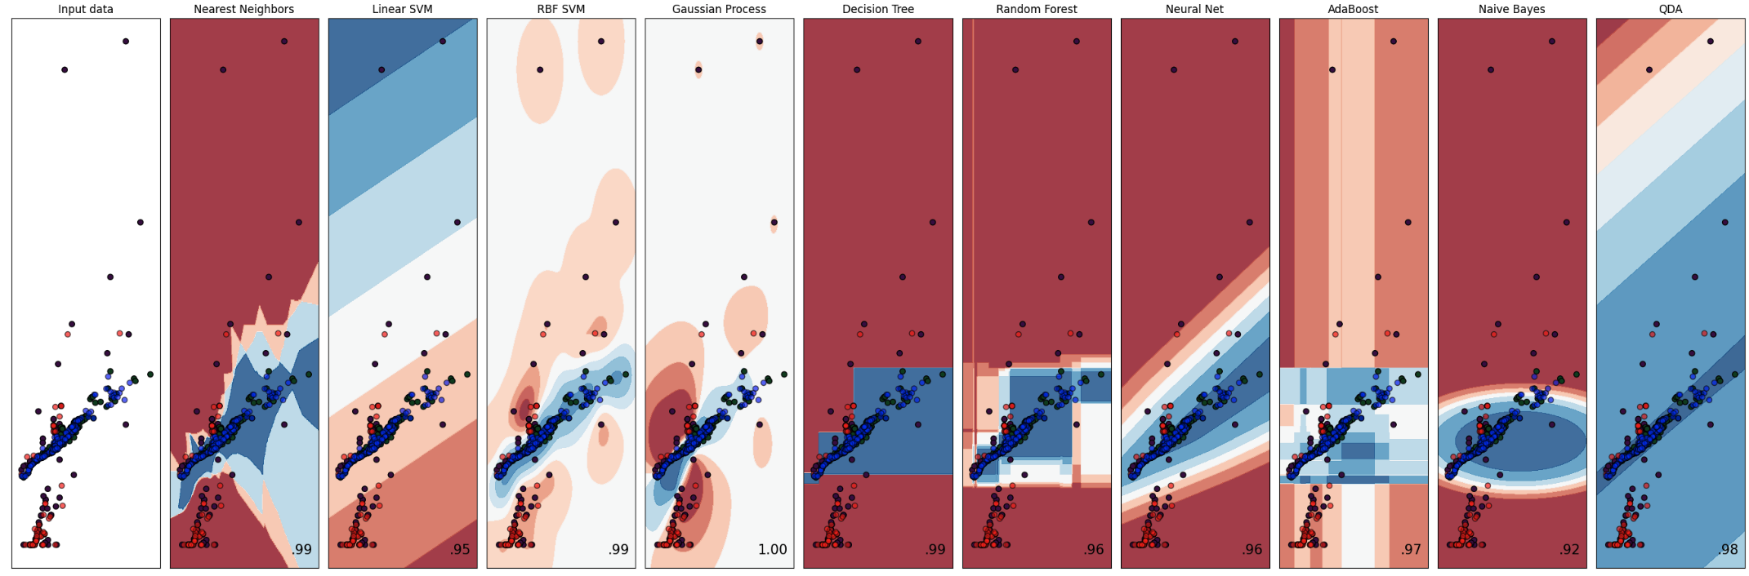
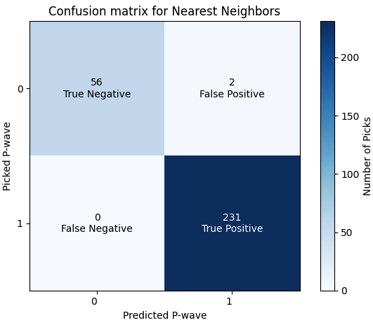


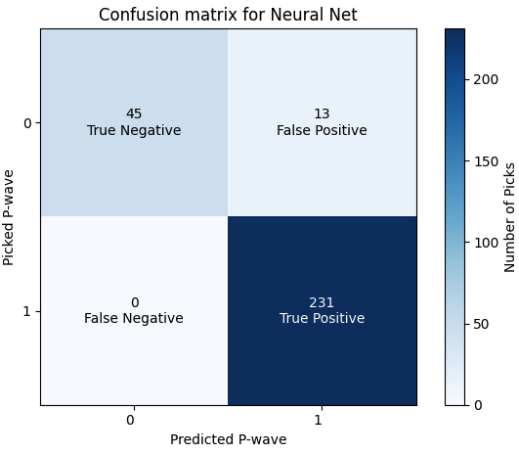
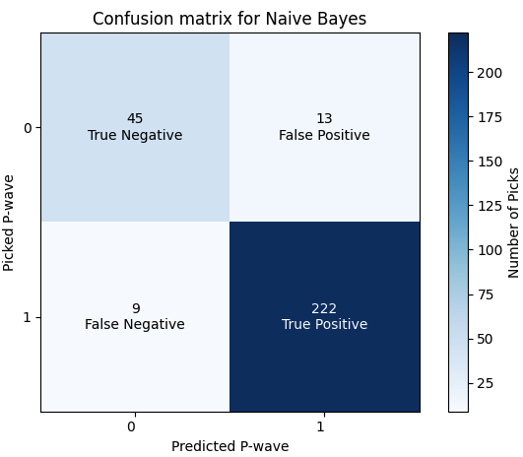

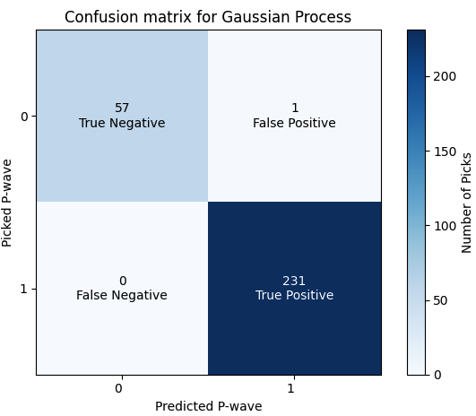

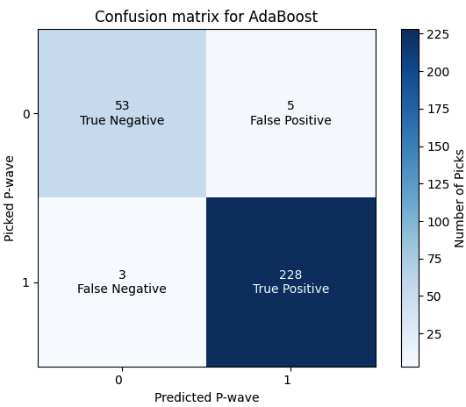


Slide 18
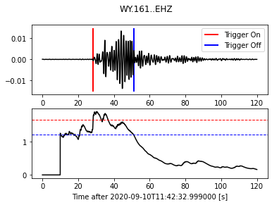
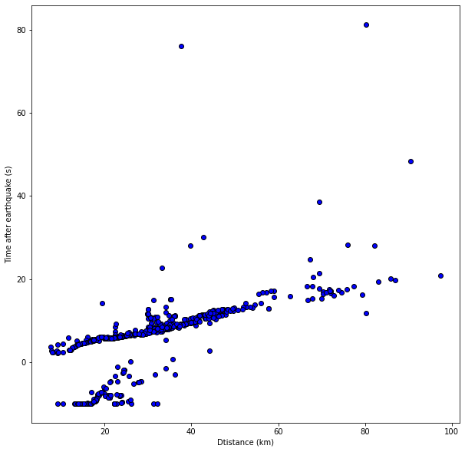
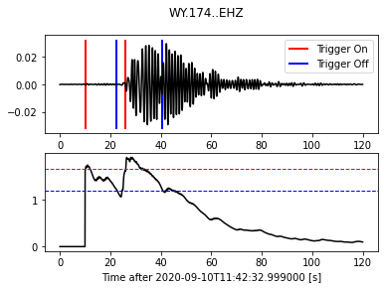
Yellowstone Lake swarm M2.8, 2020-09-10T11:42:53 UTC
Array Record Section
Amplitude
(counts)
seismograph
sta/lta ratio
sta/lta window ratio
Good Pick
Amplitude
(counts)
seismograph
sta/lta ratio
sta/lta window ratio
Bad Pick
Notes:
Band passed 1-3 seconds

Slide 19
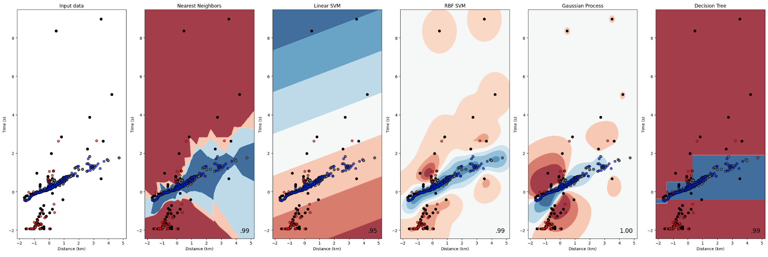
Classifier Comparison on Swarm Event
Input Data
Nearest Neighbors
Linear SVM
RBF SVM (gaussian kernel)
Gaussian Process
Decision Tree
400
300
200
100
0
-100
P-wave - Test
P-wave - Train
Noise - Test
Noise - Train
Time after earthquake (s)
Time after earthquake (s)
Time after earthquake (s)
Time after earthquake (s)
Time after earthquake (s)
Time after earthquake (s)
0 50 100
Distance (km)
0 50 100
Distance (km)
0 50 100
Distance (km)
0 50 100
Distance (km)
0 50 100
Distance (km)
0 50 100
Distance (km)

Slide 20
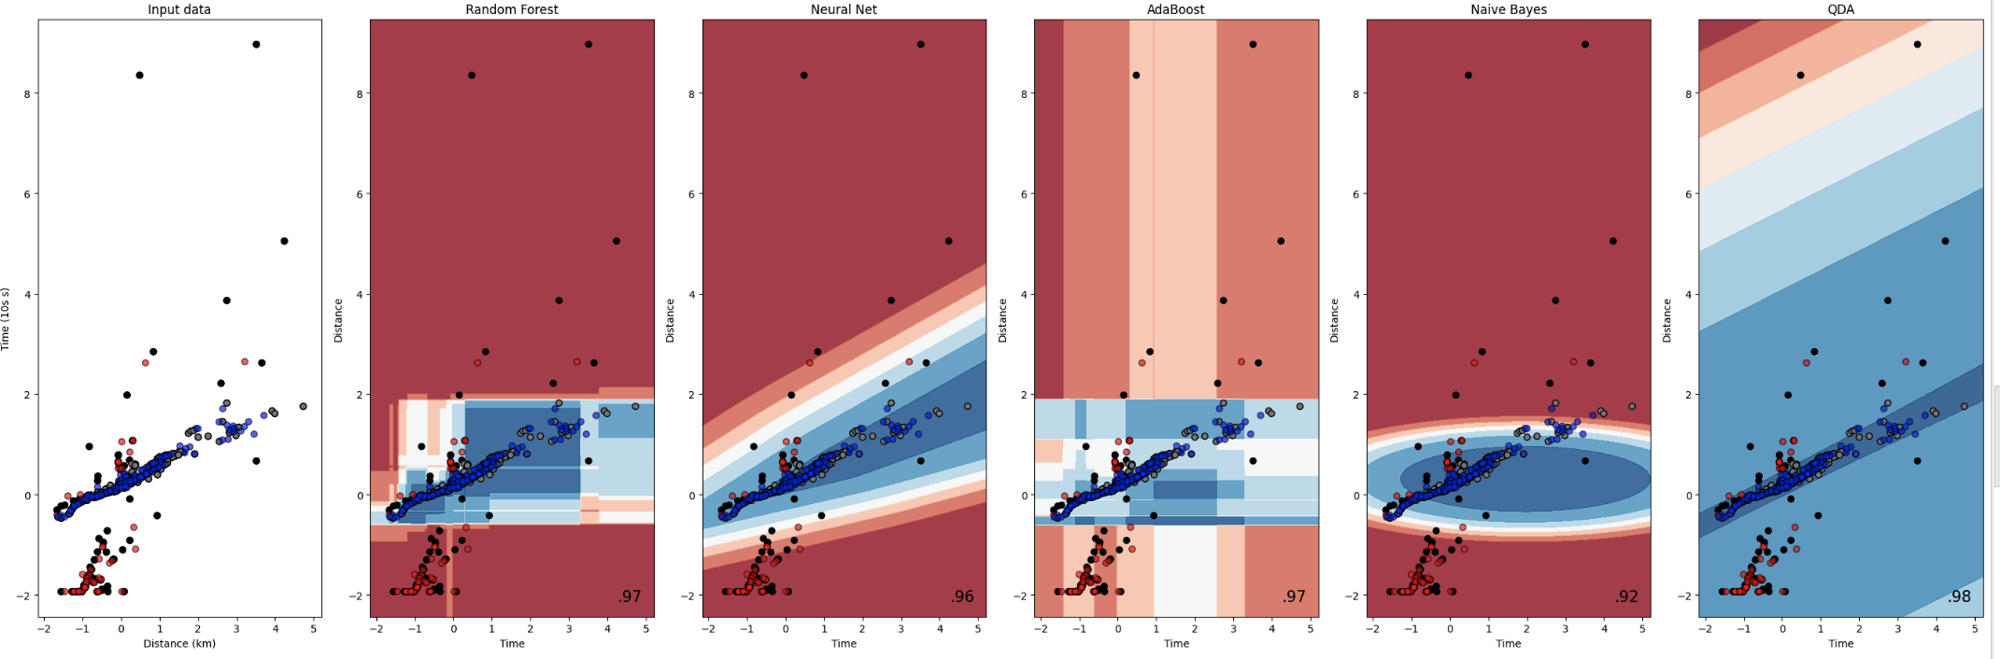
Classifier Comparison on Swarm Event
Input Data
Random Forest
Neural Net
AdaBoost
Naive Bayes
QDA
400
300
200
100
0
-100
P-wave - Test
P-wave - Train
Noise - Test
Noise - Train
Time after earthquake (s)
Time after earthquake (s)
Time after earthquake (s)
Time after earthquake (s)
Time after earthquake (s)
Time after earthquake (s)
0 50 100
Distance (km)
0 50 100
Distance (km)
0 50 100
Distance (km)
0 50 100
Distance (km)
0 50 100
Distance (km)
0 50 100
Distance (km)

Slide 21
Outline
Introduction and motivation
Earthquake Arrivals Clustering
Linear Regression
Conclusions and Future Work

Slide 22
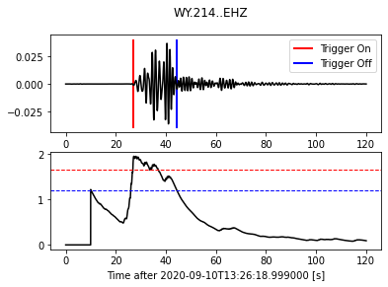
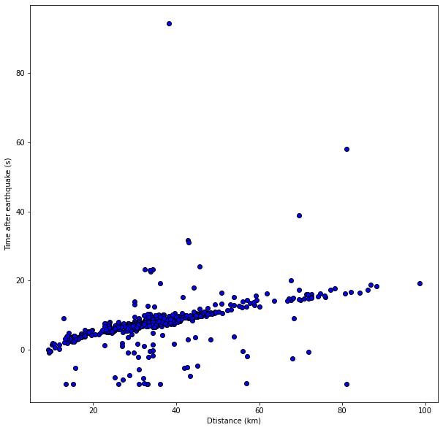
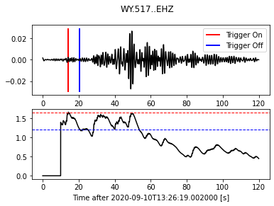
Yellowstone Lake swarm M2.8, 2020-09-10 13:26:39 UTC
Array Record Section
Amplitude
(counts)
seismograph
sta/lta ratio
sta/lta window ratio
Good Pick
Amplitude
(counts)
seismograph
sta/lta ratio
sta/lta window ratio
Bad Pick
Notes:
Band passed 1-3 seconds
Add depth to label

Slide 23
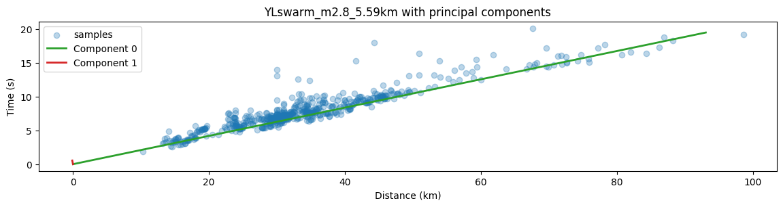
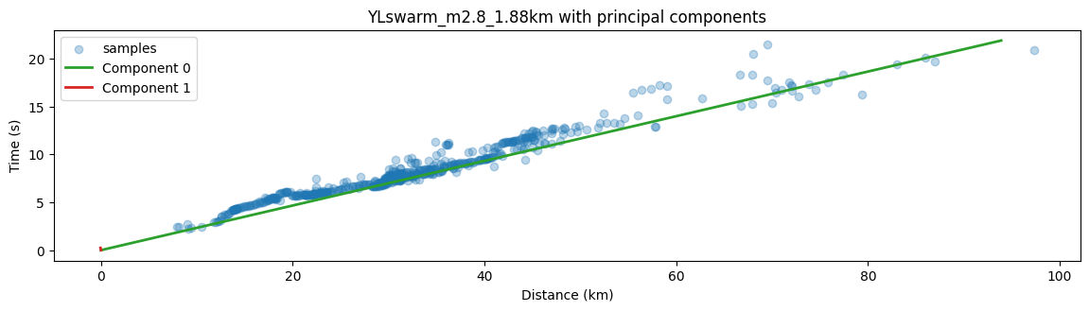
Principle Component Regression of Swarm Events
Slope = 0.20477291
Velocity = 4.883 km/s
Slope = 0.22700384
Velocity = 4.405 km/s

Slide 24
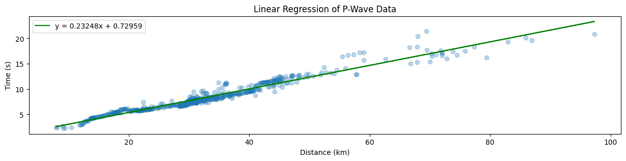
Principle Component Regression vs. Linear Regression
Y= 0.22700384x + 0.97389386
Slope = 0.22700384
Velocity = 4.405 km/s
Velocity = 4.301 km/s
Notes:
Look for uncertenty values

Slide 25
Principle component analysis (PCA) as a linear regressor
PCA built to define new axis that maximize variance along one vector and minimize variance on the corresponding normal vector
  Mainly used for dimension reduction
Linear regression or least squares fitting gets best fit line showing average slope from all points
Both model relationship between target variable and predictor variables
Leung, K. (2022, September 14). Principal component regression - clearly explained and implemented. Medium. Retrieved April 28, 2023, from https://towardsdatascience.com/principal-component-regression-clearly-explained-and-implemented-608471530a2f
Notes:
While researching the relationship between principle component analysis and linear regression I was not able to find satisfying answers to my questions of the accuracy and how density of points affects the slopes. I was also not able to find any many applications to seismology. I wonder if principle component regression would be more applicable to a situation such as a non-uniform seismic array where we have more data where we have high station density but could represents a small subset of ray paths. The areas with less dense station sampling could be less represented in an average velocity estimate from the record section move out in standard linear regression. There could definitely be other ways of tackling this, through downsampling dense areas or adding weights to the linear regressor. However, I think it could prove useful to systematically test principle component regression to see if it does tackle some of these problems

Slide 26
Outline
Introduction and Motivation
Earthquake Arrivals Clustering
Linear Regression
Conclusions and Future Work

Slide 27
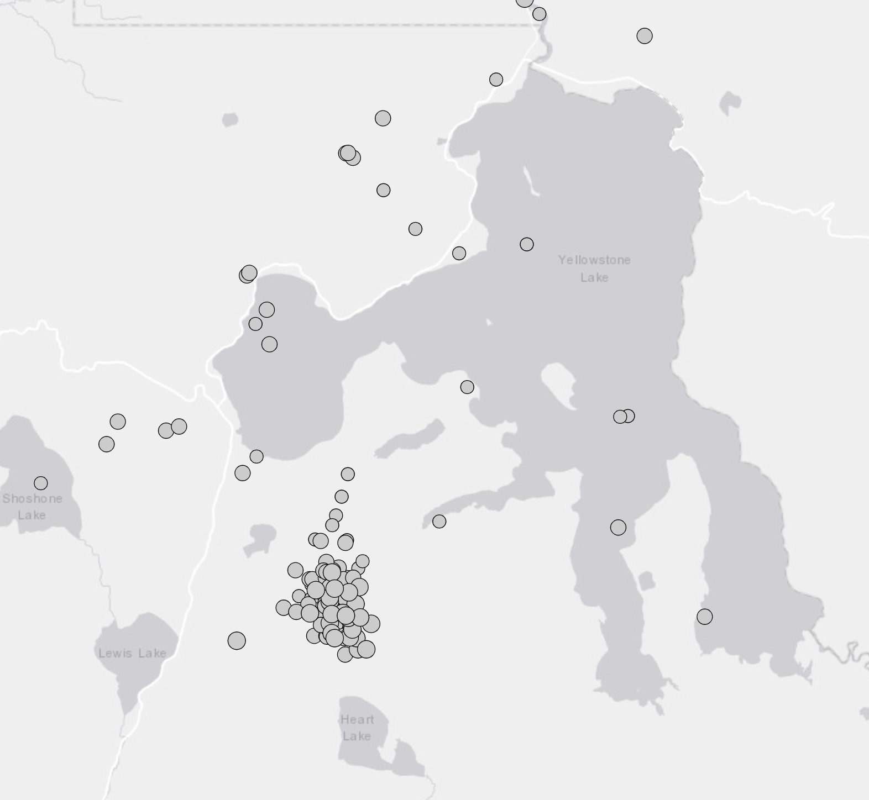
Conclusions and Future Work
Useful testing of different methods before building large scale project
Combine workflows
Run for swarm events
Run for all events in Yellowstone deployment
Find areas of repeating low velocity
Compare paths inside and outside of caldera

Slide 28
Future Workflow
Process
Process raw data
Pick
Use Obspy to pick earthquake arrivals
Assign
Use velocities to classify picks
Cluster
Run gaussian processing clustering from Scikit
Errors
Evaluate errors with confusion matrix
Slope Regression
Use both Linear and Principal Component Regression to get slope
Plot
Plot variances from slope in map view

