Slide 1


Machine Learning in Geosciences
Santiago Jurado
Notes:
We will create physically realistic two-dimensional porous media

Slide 2
Outline
1. Objective and motivation
AlexNet Overview
Methodology
Results
Conclusions

Slide 3
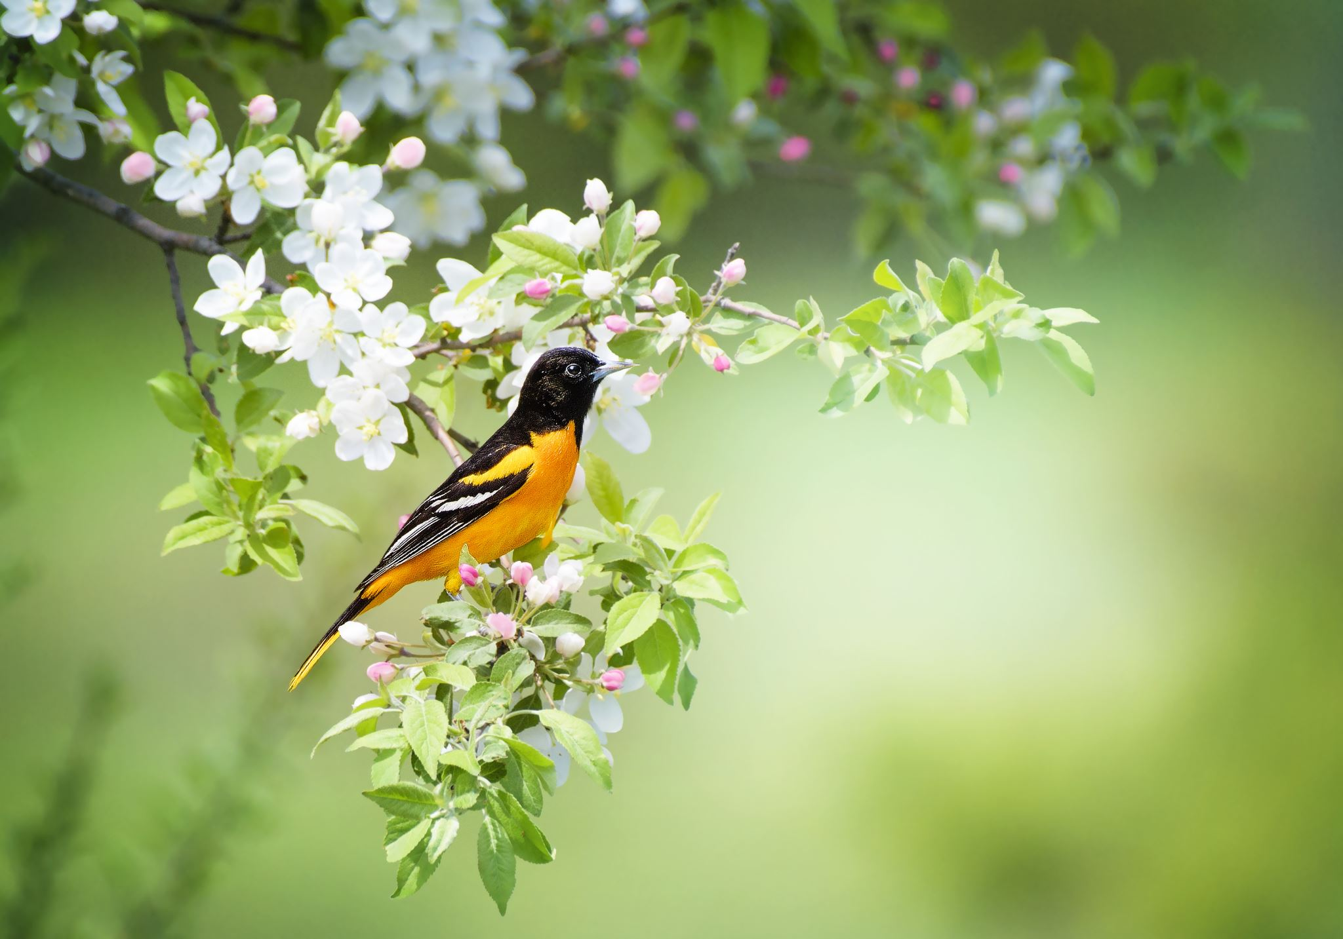
Labeling Bird Pictures from CSUSB’s (California State University San Bernardino) Backyard using a Trained AlexNet CNN
Goal:
Label Bird Pictures from an specific campus location

Slide 4
Motivation
It can help understand and document the diversity of bird species in a specific area.

Slide 5
Motivation
This project can be an excellent opportunity for bird enthusiasts and nature lovers to:
  engage in an activity that not only helps in gaining knowledge about birds
  also contributes to the scientific community's understanding of the local bird population

Slide 6
Motivation
The labeled images can be used to develop machine-learning models for bird species recognition
Practical applications include:
  monitoring bird populations
  bird conservation
  habitat management

Slide 7
Outline
1. Objective and motivation
AlexNet Overview
Methodology
Results
Conclusions

Slide 8
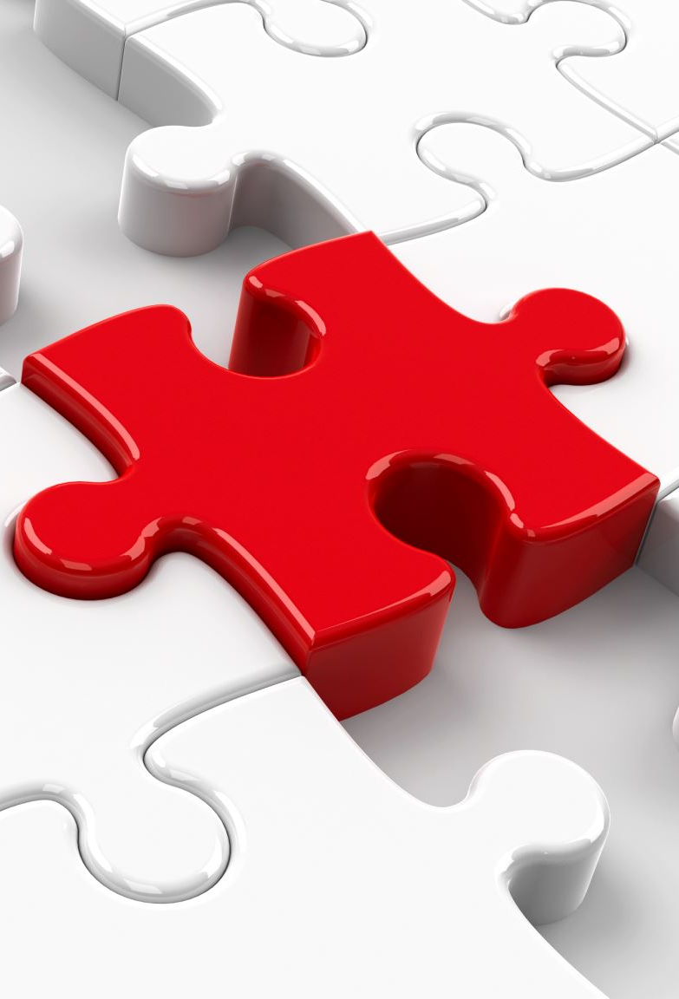
AlexNet Overview
It was one of the first deep convolutional neural networks to achieve the ImageNet Large Scale Visual Recognition Challenge (ILSVRC) dataset
which consists of over 1 million labeled images from 1,000 categories.
Notes:
AlexNet is a type of neural network that can "look" at images and "learn" to recognize different objects in them

Slide 9

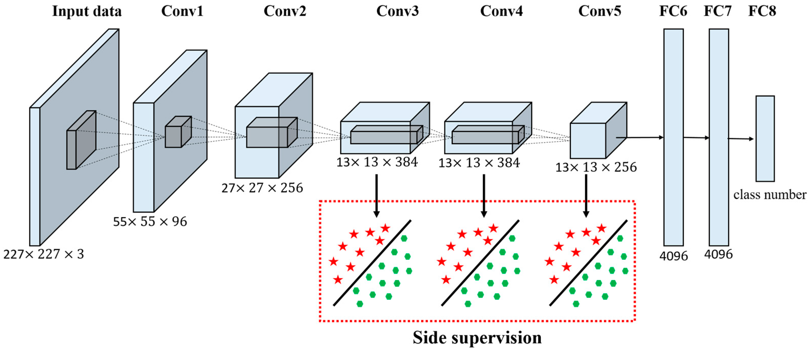
Notes:
First, AlexNet takes an image as input. The image is passed through a series of "layers," which are like filters that extract different features from the image. For example, one layer might look for edges or lines, while another layer might look for curves or textures.
Each layer applies a mathematical operation called a "convolution" to the image. This means that it takes a small part of the image (called a "kernel") and slides it over the entire image, multiplying the pixel values in the kernel with the corresponding pixel values in the image. This produces a new "feature map" that highlights the parts of the image that match the pattern in the kernel.
After each convolutional layer, AlexNet applies a "pooling" operation. This downsamples the feature map by taking the maximum value in each small region of the map. This helps to reduce the size of the data that the network has to process, while preserving the most important information.
After several layers of convolution and pooling, the resulting "feature maps" are flattened into a one-dimensional vector and fed into a series of fully connected layers. These layers act like a traditional neural network, with each neuron receiving inputs from all of the neurons in the previous layer and producing an output based on a weighted sum of those inputs.
The final output layer of AlexNet has one neuron for each possible class of object that the network is trained to recognize. Each neuron produces a number between 0 and 1 that represents the network's "confidence" that the input image belongs to that class. The neuron with the highest output value is taken as the predicted class.
AlexNet learns to recognize different objects by adjusting the weights and biases of its neurons during training. This process involves feeding the network a large dataset of labeled images and adjusting the weights to minimize the difference between the network's predictions and the true labels. Once trained, the network can be used to make predictions on new, unseen images.

Slide 10
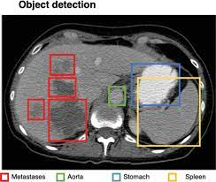
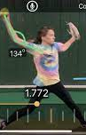
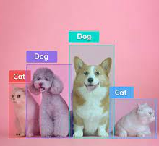
Applications
Object Recognition
Face Recognition:
Medical Imaging
Autonomous Vehicles
Video Analysis
  Object tracking and video classification
    Colloid tracking in a PM

Slide 11
Outline
1. Objective and motivation
AlexNet Overview
Methodology
Results
Conclusions

Slide 12
Labeling Bird Pictures from GTS Backyard
Steps:
  Step 1: Install Keras
  Step 2: Download bird pictures
  Step 3: Label bird pictures and train Keras code for AlexNet (this is not semantic segmentation CNN)
  Step 4: Apply trained CNN to test data.
Week 1
Week 2
Week 3
Week 4
Notes:
Keras is an open-source neural network library written in Python. It provides a user-friendly API for building and training deep learning models,
AlexNet learns to recognize different objects by adjusting the weights and biases of its neurons during training. This process involves feeding the network a large dataset of labeled images and adjusting the weights to minimize the difference between the network's predictions and the true labels. Once trained, the network can be used to make predictions on new, unseen images.

Slide 13
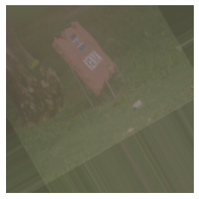
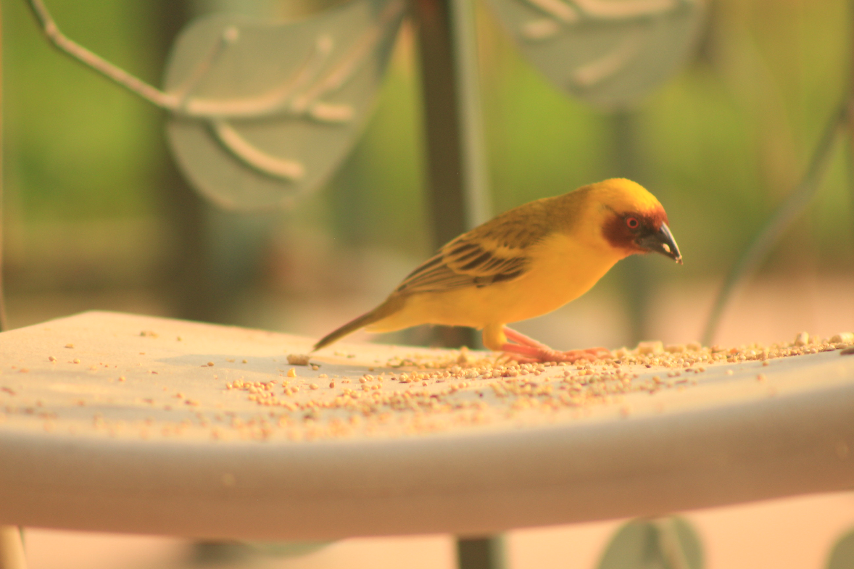
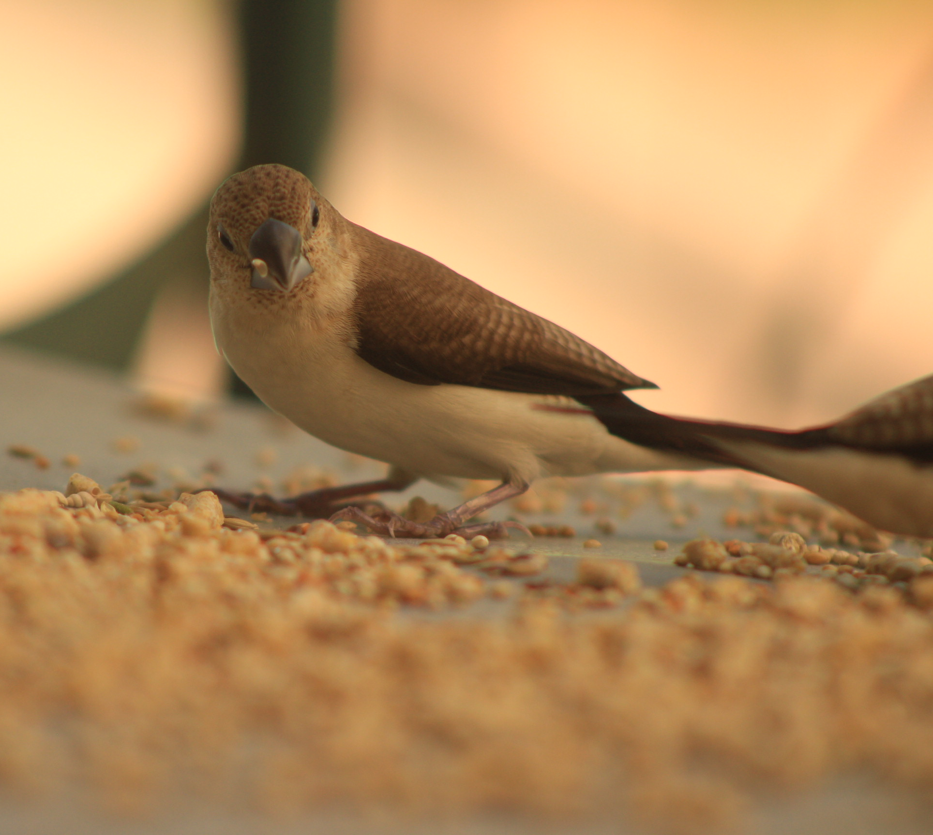
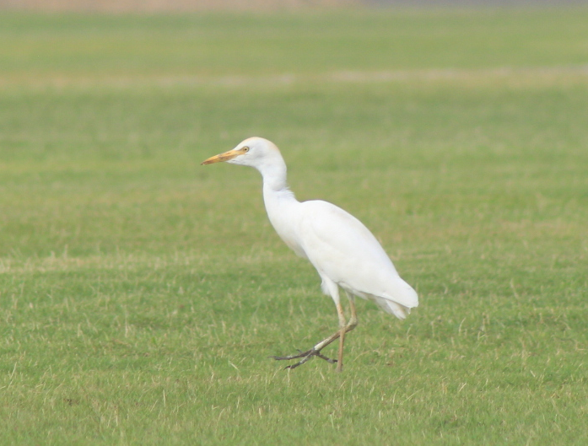
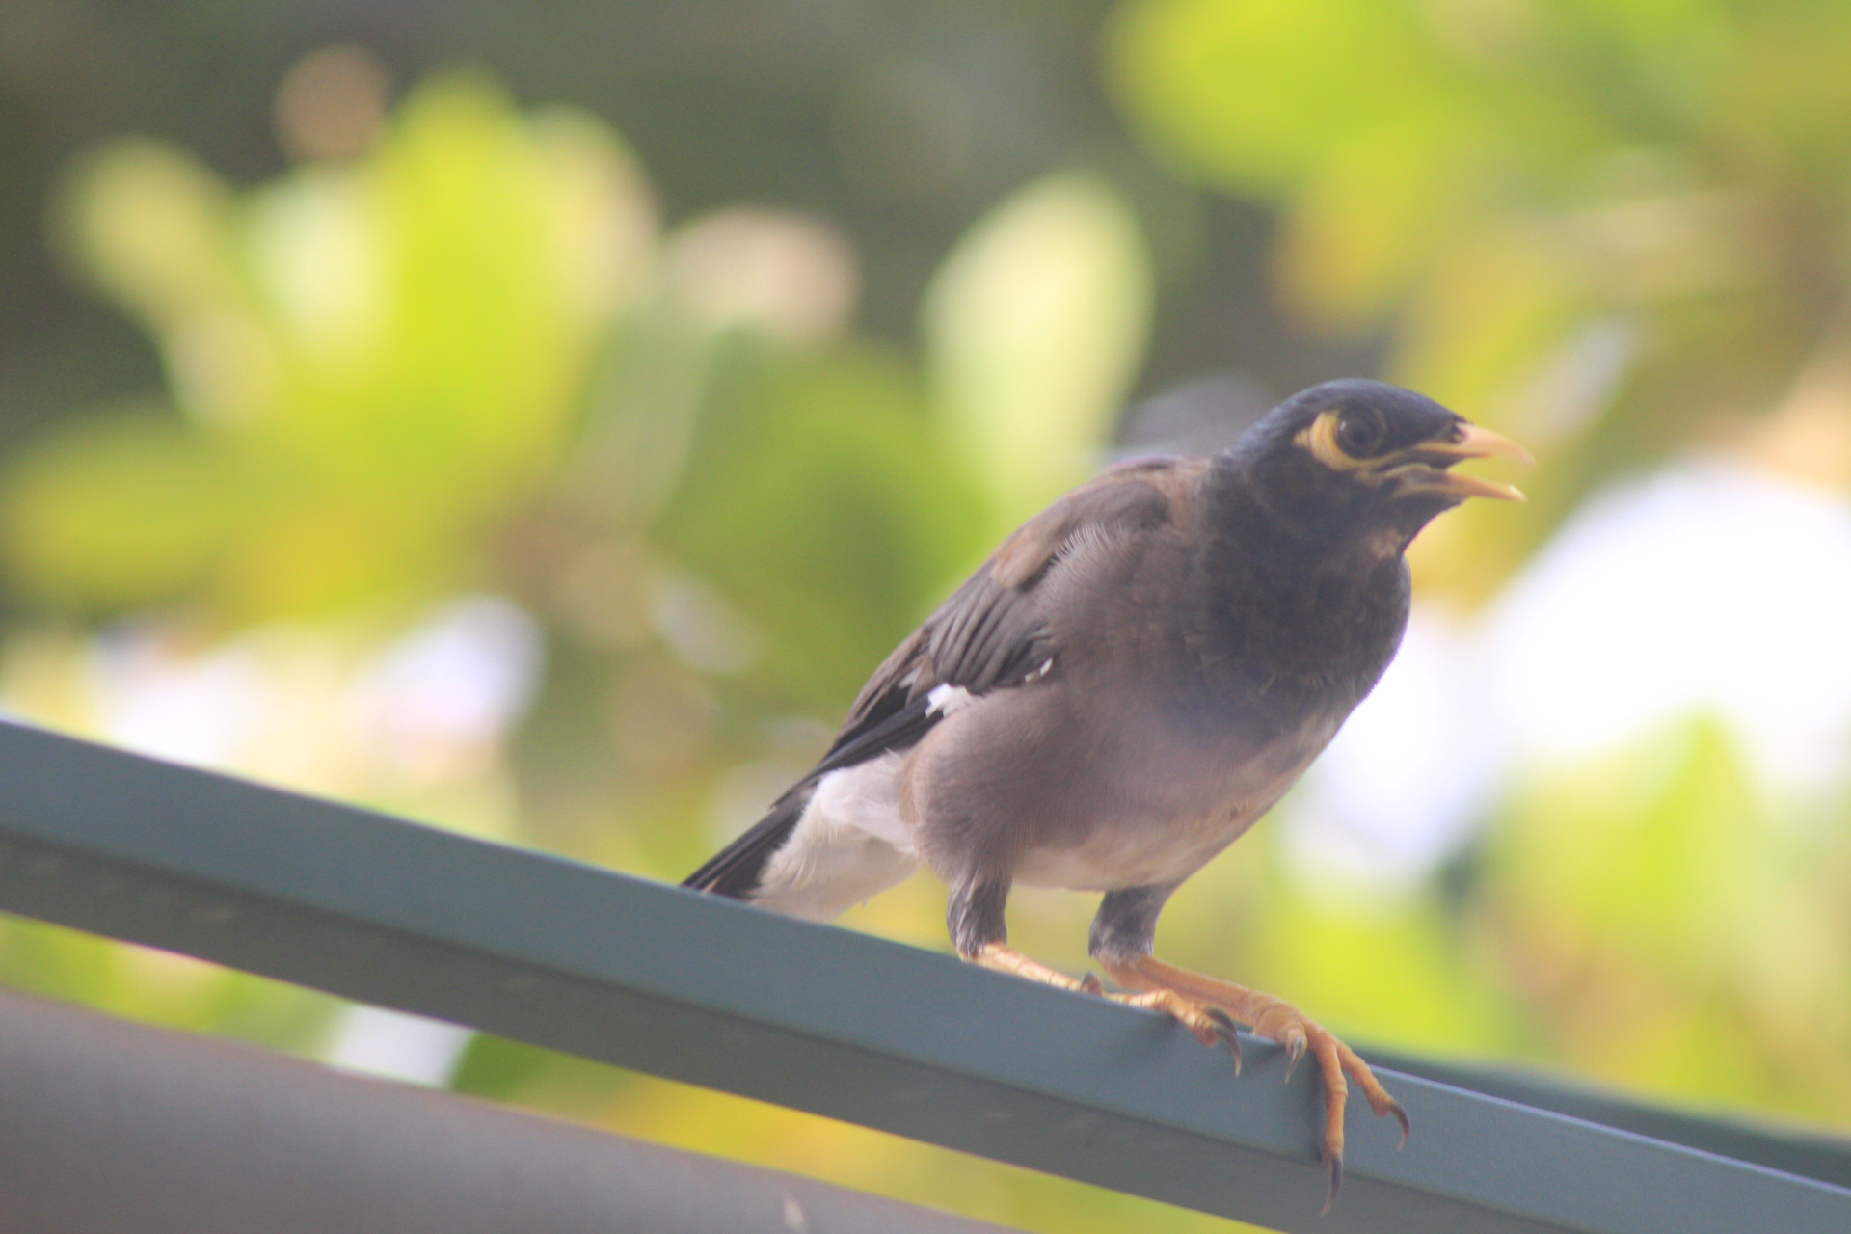
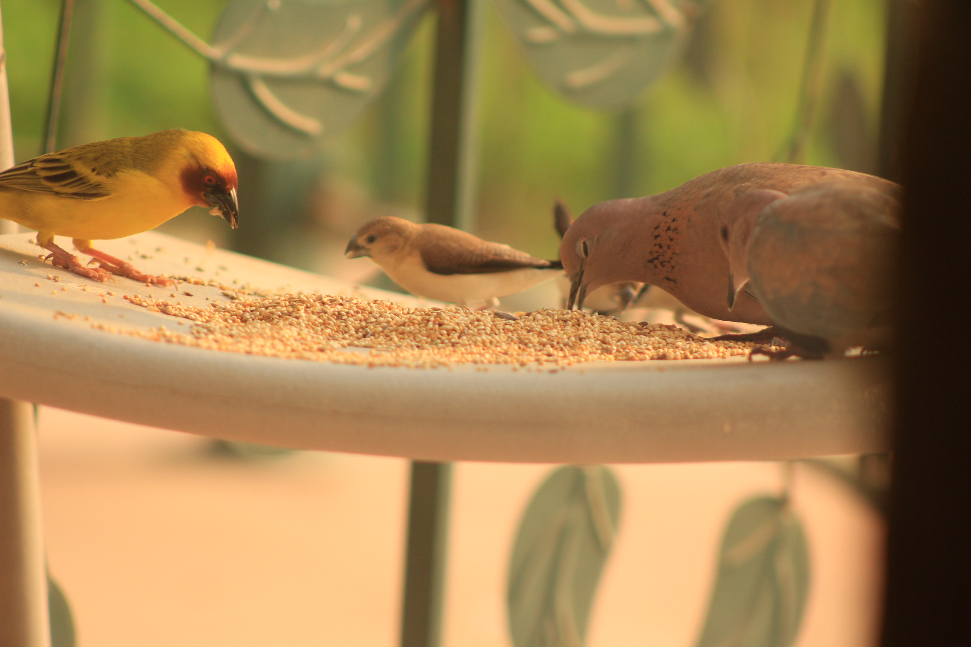
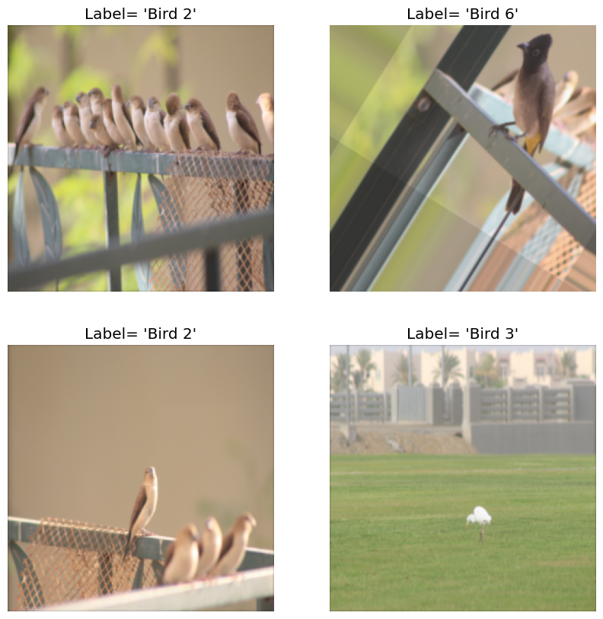
Labeling types of birds
NO bird = Bird 0***
Yellowbird = Bird 1
Flicker = Bird 2
Heron = Bird 3
Starling = Bird 4
Rock pigeon= Bird 5
Black crested starling= Bird 6
Notes:
CATTEGORIES

Slide 14
Label bird images (416)
CATTEGORIES
Rock pigeon
Yellowbird
Northern Flicker
Starling
Heron
Black-crested Starling
Library:
https://www.csusb.edu/biology/birds-campus
(California State University San Bernardino)
Notes:
The Biology Department has a Bird on Campus Library. From this library is where our 6 reference population came from

Slide 15
Set up and Train AlexNet
KERAS for AlexNet
Learning rate: 0.001
Callbacks:
EarlyStopping ---> prevents overfitting of the model
ModelCheckpoint ---> saves the weights of the model – highest accuracy
ReduceLROnPlateau ---> adjust the learning rate
Notes:
Keras is an open-source neural network library written in Python. It provides a user-friendly API for building and training deep learning models, making it easier to work with complex neural networks. Keras also has built-in support for popular deep learning frameworks such as TensorFlow and Theano.
he learning rate is a hyperparameter that controls how quickly the network adjusts its weights during training.

Slide 16
Outline
1. Objective and motivation
AlexNet Overview
Methodology
Results
Conclusions

Slide 17
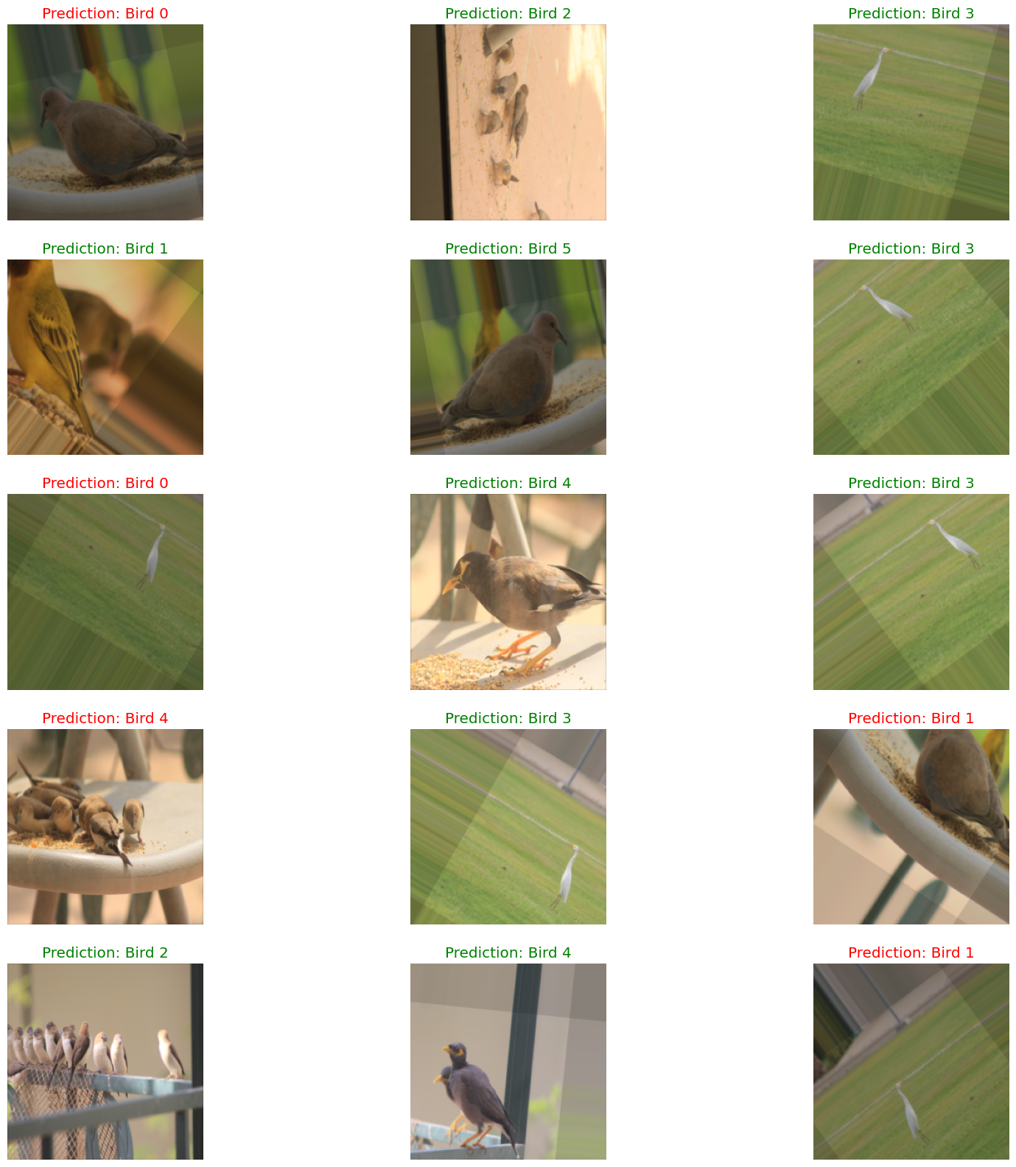
Prediction test

Slide 18
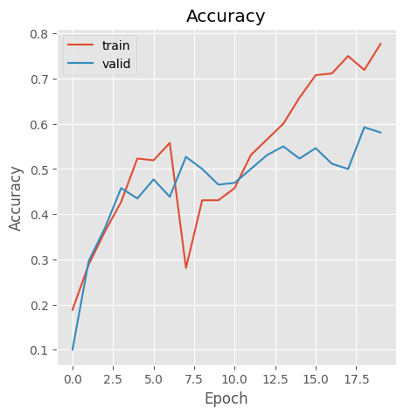
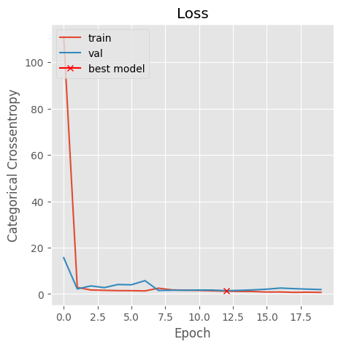
Accuracy - Loss
Total params: 56,349,447 Trainable params: 56,346,695 Non-trainable params: 2,752
Notes:
An epoch refers to a complete pass through a training dataset during the training process of a machine learning model. In other words, an epoch represents one iteration of the training process where the model is exposed to the entire dataset, usually in batches, to update its weights and improve its performance.

Slide 19
Improve AlexNet:
model_wBN: operates without Batch Normalization
model_Adam: employs the Adam optimizer instead of SGD
model_70: applies 70% dropout to 2 of the fully connected layers
model_90: applies 90% dropout to 2 of the fully connected layers
model_f: employs half the number of filters in each of CNN layers

Slide 20
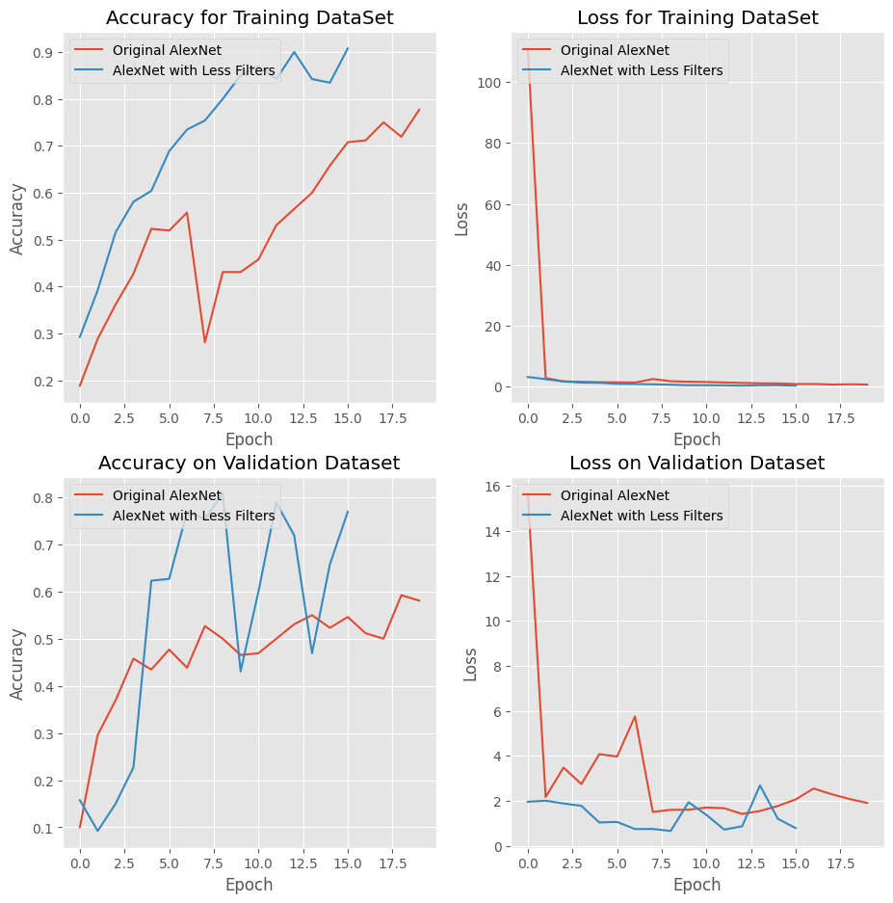

Slide 21
Prediction test

Slide 22
Prediction test

Slide 23
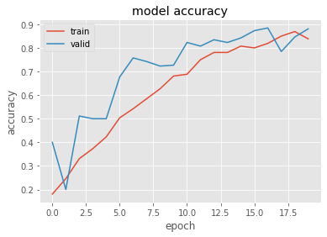
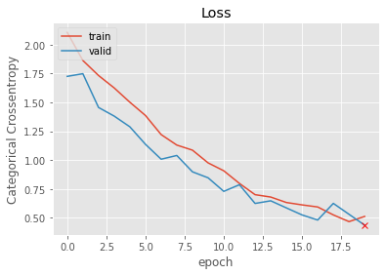
Transfer Learning Using VGG16
Notes:
VGG16 (Visual Geometry Group 16) is a convolutional neural network architecture consisting of 16 layers, developed by the Visual Geometry Group at the University of Oxford. It has achieved state-of-the-art performance in various computer vision tasks, such as image classification, object detection, and segmentation.

Slide 24
Outline
1. Objective and motivation
AlexNet Overview
Methodology
Results
Conclusions

Slide 25
Conclusions
AlexNet has been shown to be highly effective for image recognition tasks, including bird image recognition
AlexNet CNN successfully recognize 7 types of bird from a 416 bird images library from CSUSB “backyard”.
  The recognition included non-orthogonal bird images (relative to the viewer)

Slide 26
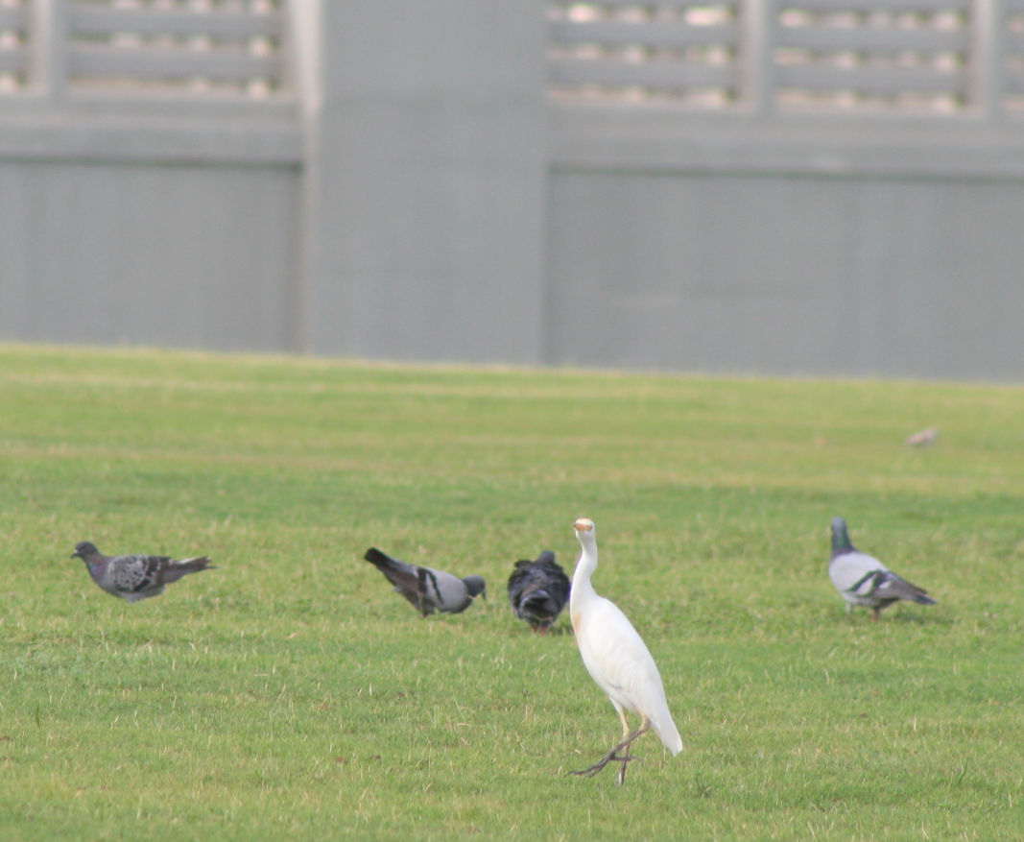
Conclusions
Once trained, the network can be used to predict new, unseen images.
Transfer learning using a higher-level neural network architecture shown greater efficiency in bird recognition than a regular trained AlexNet CNN

Slide 27
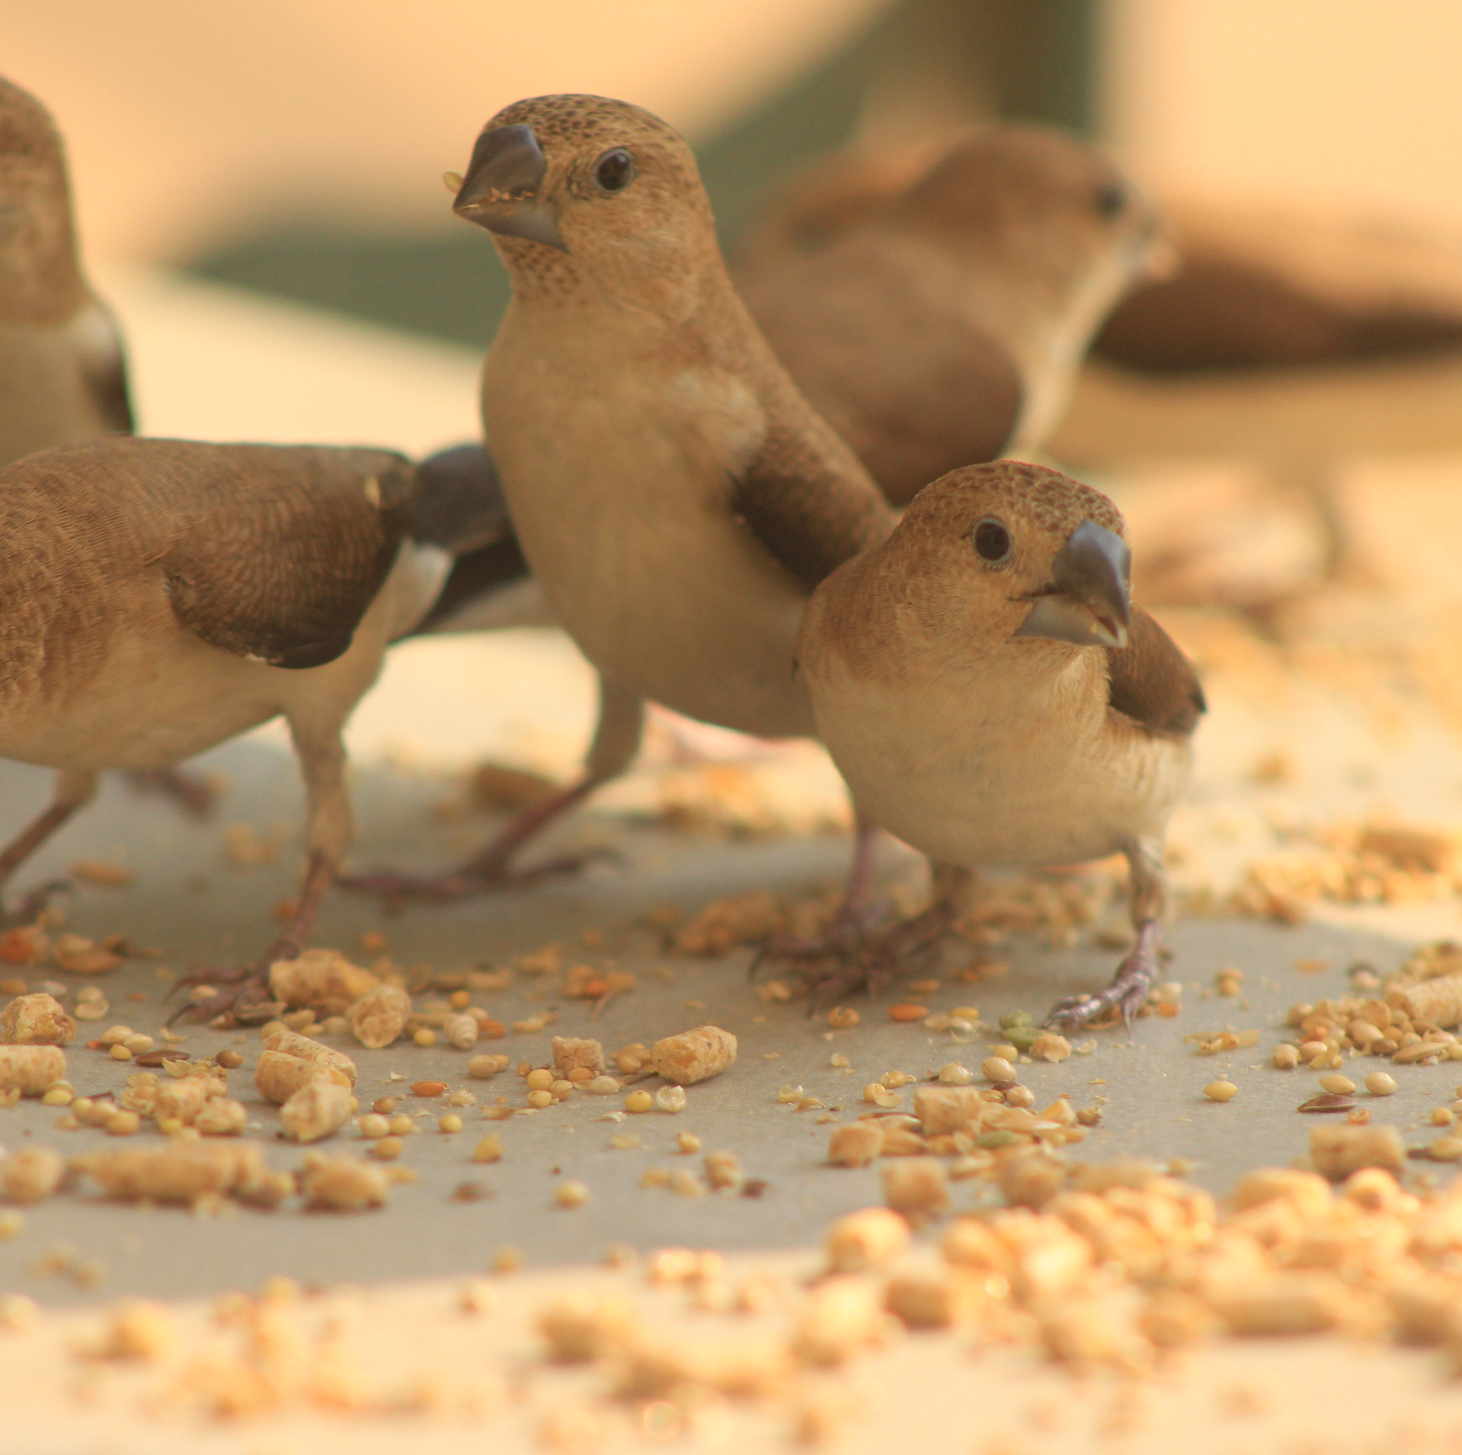
Future work
  Fine-tuning: Fine-tuning is a technique that involves taking a pre-trained neural network (like AlexNet) and training it on a smaller, domain-specific dataset.
  Architecture modifications: Researchers could experiment with modifying the architecture of AlexNet by adding or removing layers, changing the size of the filters used in convolutional layers, or adjusting the number of neurons in the fully connected layers.
Notes:
1. For example, AlexNet could be trained on a dataset of medical images to improve its accuracy in medical image analysis tasks.
2. These modifications could potentially improve the accuracy or speed of the network.

Slide 28
Future work
  Transfer learning: Transfer learning is a technique that involves taking a pre-trained neural network and using it as a starting point for a new network.
  Interpretability: Future work could focus on developing methods to understand better the features and patterns that the network is learning, which could help improve its performance and make it more transparent and interpretable.
Notes:
3. For example, researchers could use the weights learned by AlexNet to train a different neural network for a different task, such as object detection or segmentation.
BASICALLY : Overall, future work in AlexNet could focus on improving its accuracy, speed, interpretability, and applicability to different domains and tasks.

