Slide 1
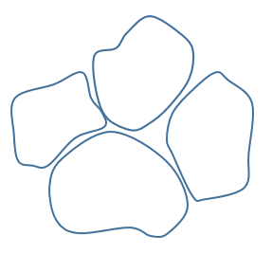
Detection of Internal Fractures in Sandstone Specimens with CNN and U-Net
Changdi He
Department of Mining Engineering
Page 1

Slide 2
THE MAIN CONTENTS
01
Introduction & Objective
02
Methodology & Procedure
03
Results & Discussion
04
Conclusions & Future work

Slide 3
1
Part
Introduction & Objective

Slide 4
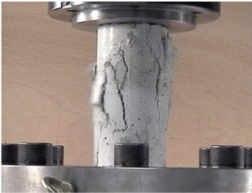
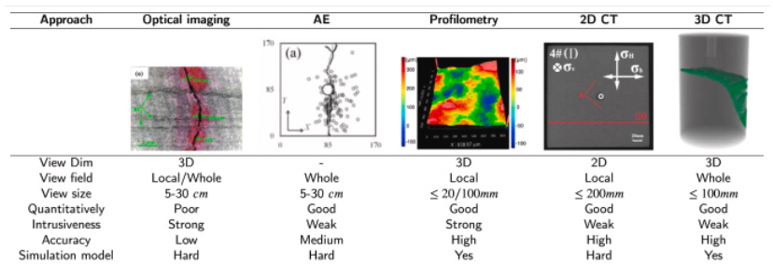
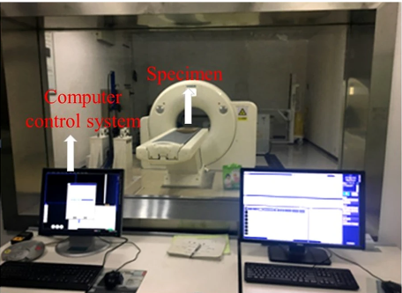
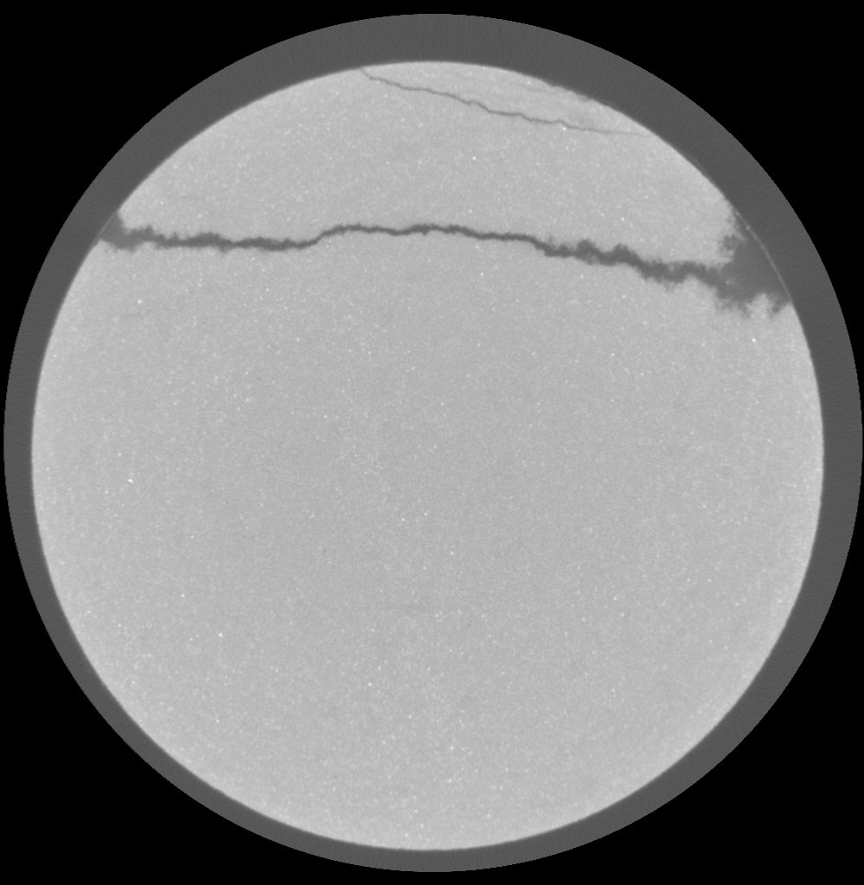

Part 1
Introduction
Image of a rock test
(Shimizu et al., 2000)
（b) Comparison of different fracture analysis methods
(Yang et al. 2021)
How to detect the cracks in hundreds of 2D CT images?
Cracks
（c) Image of X-ray CT equipment (Zhou et al. 2021)
Page 4
Image credit: https://www.soogif.com/materialPage/0zzGcnLOvvg

Slide 5
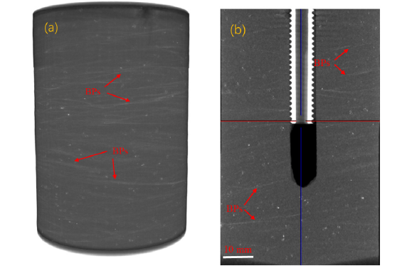


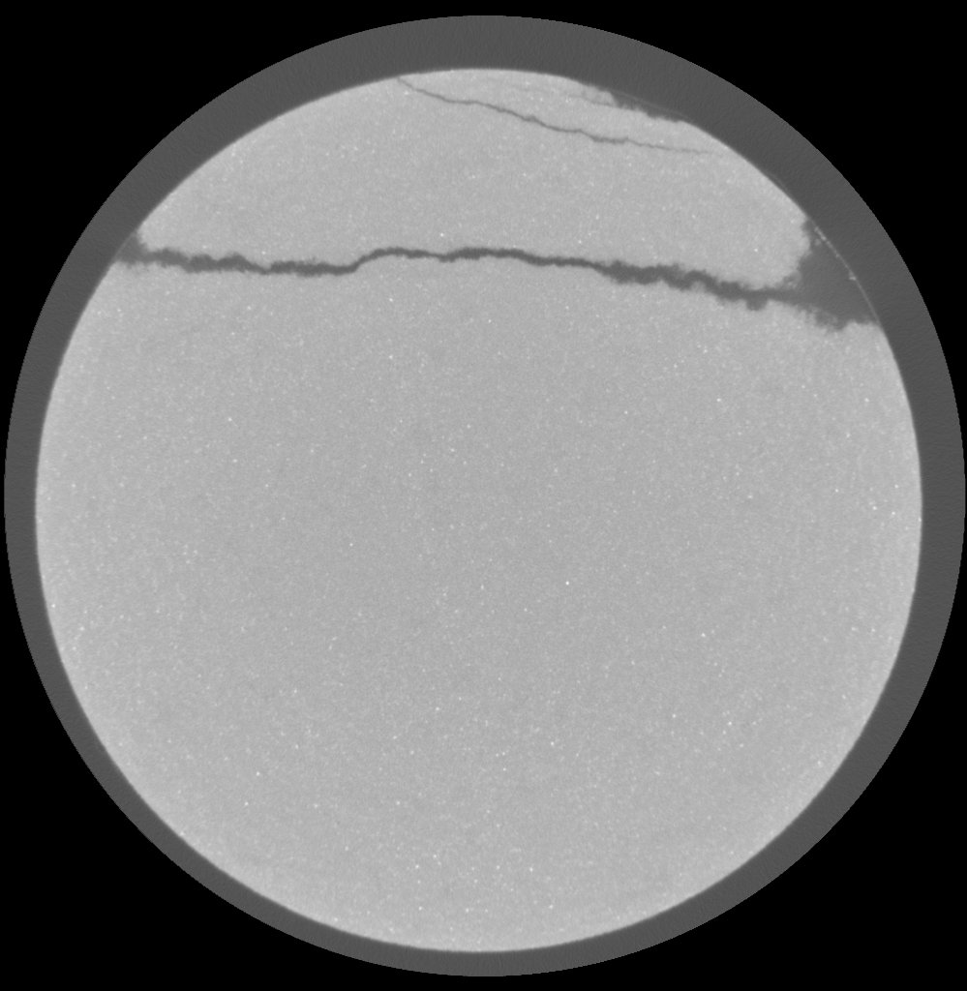
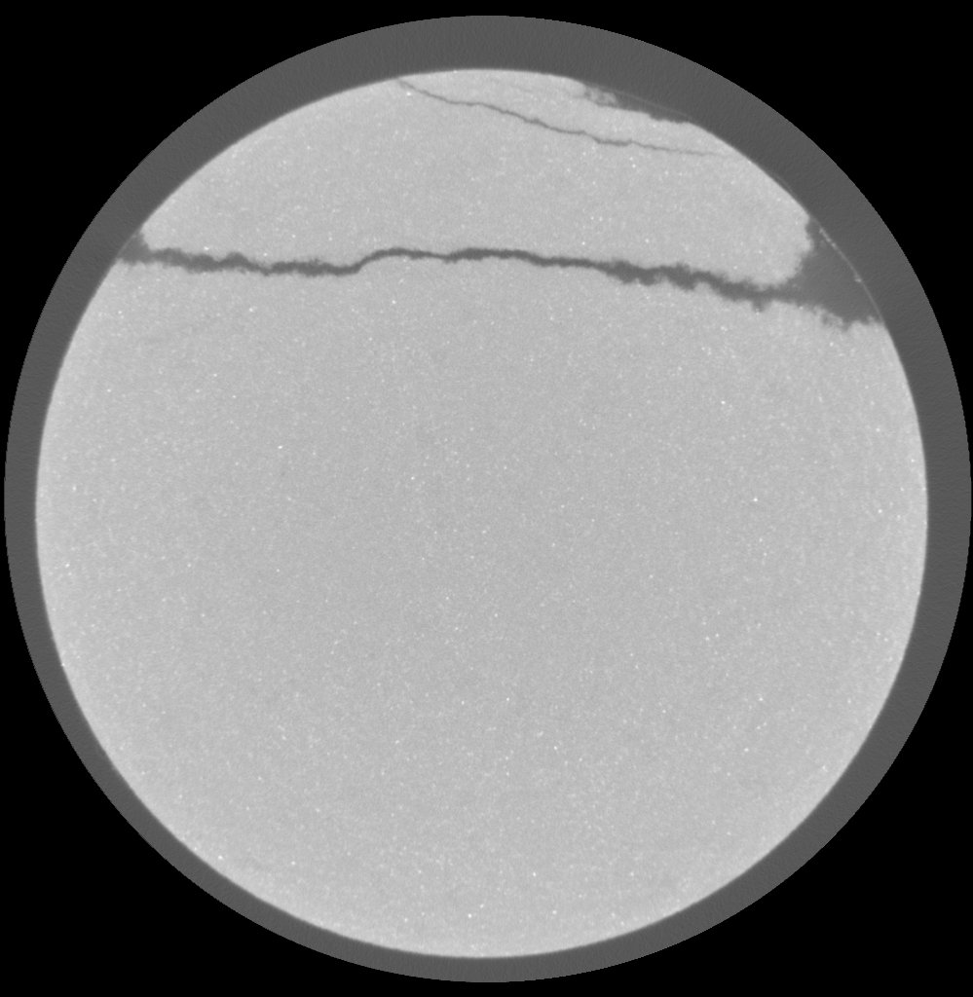
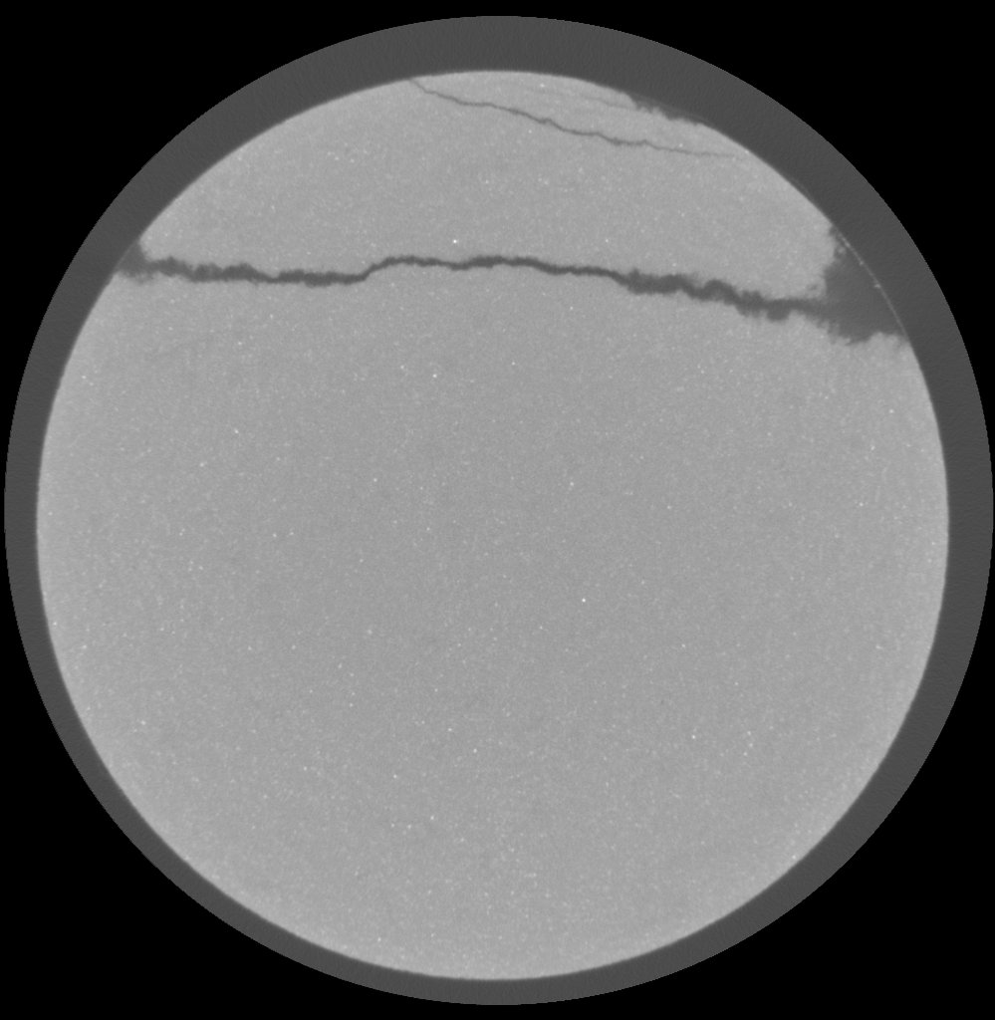
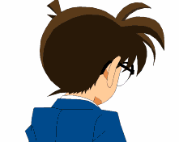
Part 1
Objective
Cracks
Sandstone sample
(Yang et al. 2021)
(b) Selected 2D CT images of sandstone sample
(6 out of 937) (Yang et al. 2021)
How to detect the cracks in hundreds of 2D CT images?
Note: The ResUNet Python code was cited from:
https://github.com/Subham2901/Concrete_Crack_Segmentation/blob/master/Notebooks/Deep_crack.ipynb
Try U-Net!!!
Standard U-Net
Residual U-Net (ResUNet)
Residual U-Net-Transfer Learning
(ResUNet-TL)
Page 5
Image credit: https://cn.phoneky.com/gif-animations/?id=s2s101943

Slide 6
2
Part
Methodology & Procedure

Slide 7
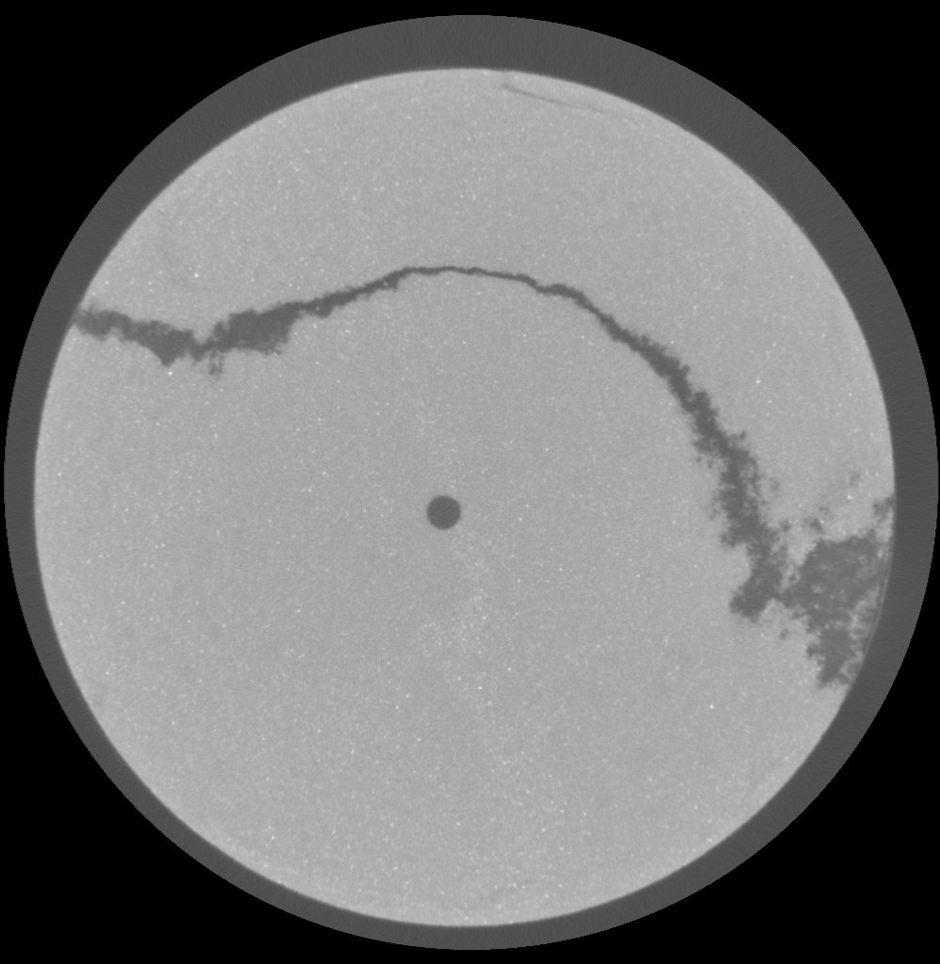

Part 2
Methodology: Standard U-Net – architecture and loss function
1
16
16
16
32
16
64
32
Input
d=0.1
Output
d=0.1
256²
256²
32
32
32
64
64
128
d=0.1
128²
d=0.1
128²
64
64
64
256
128
128
d=0.2
64²
d=0.2
64²
128
128
128
256
256
256
d=0.2
Conv 3×3, ReLu
32²
d=0.5
32²
MaxPooling 2×2
256
256
Up-conv 3×3
16²
16²
d=0.2
Conv 1×1, Sigmoid
Loss function: Binary cross-entropy
Concatenate
$$L\left(y,p\right)=−(y∗\log\left(p\right)+\left(1−y\right)∗\log\left(1−p\right))$$
Dropout rate: d
where:
L(y, p) represents the binary cross-entropy loss
y is the true label (either 0 or 1)
p is the predicted probability for class 1
(i.e., the output of the sigmoid activation function)
Page 7

Slide 8

Part 2
Methodology: ResUNet – architecture and loss function
16
16
32
16
Input
Output
256²
256²
256²
E1
32
32
64
32
128²
128²
E2
64
64
128
64
Conv 3×3, ReLu
MaxPooling 2×2
64²
64²
Up-conv 3×3
E3
128
128
128
128
Conv 1×1, Sigmoid
Concatenate
32²
32²
E4
256
256
256
Residual block
16²
16²
E5
b0
b1
Dice coefficient
Dropout rate: 0.5
Loss function: Dice loss
D$\left(y,p\right)=1−[\frac{\left(2 ∗ \left|y ∩ p\right|\right)}{\left(\left|y\right|+ \left|p\right|\right)}]$
where:
y is the ground truth binary mask;
p is the predicted binary mask;
|y| and |p| represent the sum of all elements in y and p, respectively;
|y ∩ p| represents the sum of the element-wise product of y and p.
Page 8

Slide 9

Part 2
Methodology: Residual U-Net with transfer learning techniques (ResUNet-TL)– architecture and loss function
64
64
128
64
Input
Output
256²
256²
256²
E1
128
128
256
128
128²
Conv 3×3, ReLu
128²
MaxPooling 2×2
E2
256
256
512
256
Up-conv 3×3
Conv 1×1, Sigmoid
64²
64²
Concatenate
E3
512
512
512
512
Residual block
32²
32²
VGG16 block
E4
512
512
512
16²
16²
Dropout rate: 0.5
E5
b0
b1
Loss function: Dice loss
Dice coefficient
D$\left(y,p\right)=1−[\frac{\left(2 ∗ \left|y ∩ p\right|\right)}{\left(\left|y\right|+ \left|p\right|\right)}]$
where:
y is the ground truth binary mask;
p is the predicted binary mask;
|y| and |p| represent the sum of all elements in y and p, respectively;
|y ∩ p| represents the sum of the element-wise product of y and p.
Page 9

Slide 10
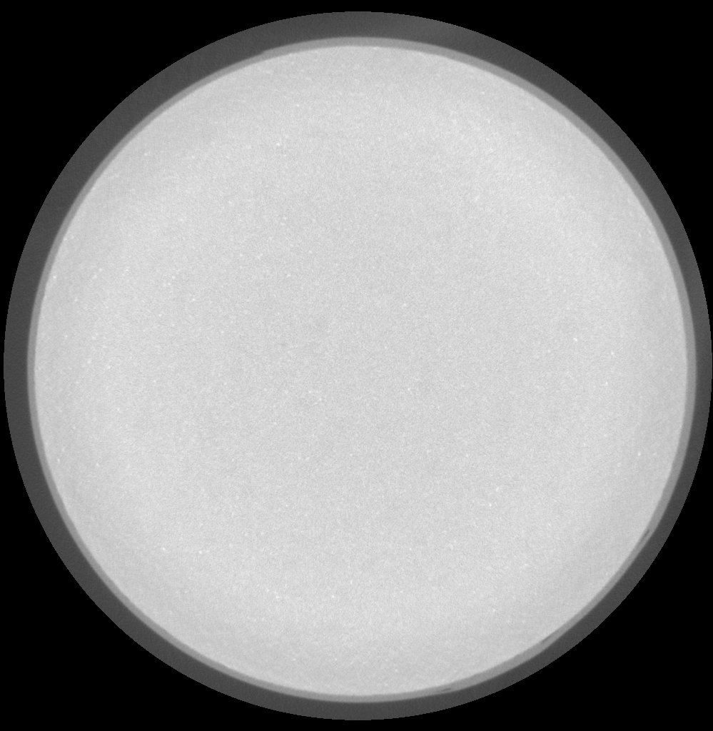
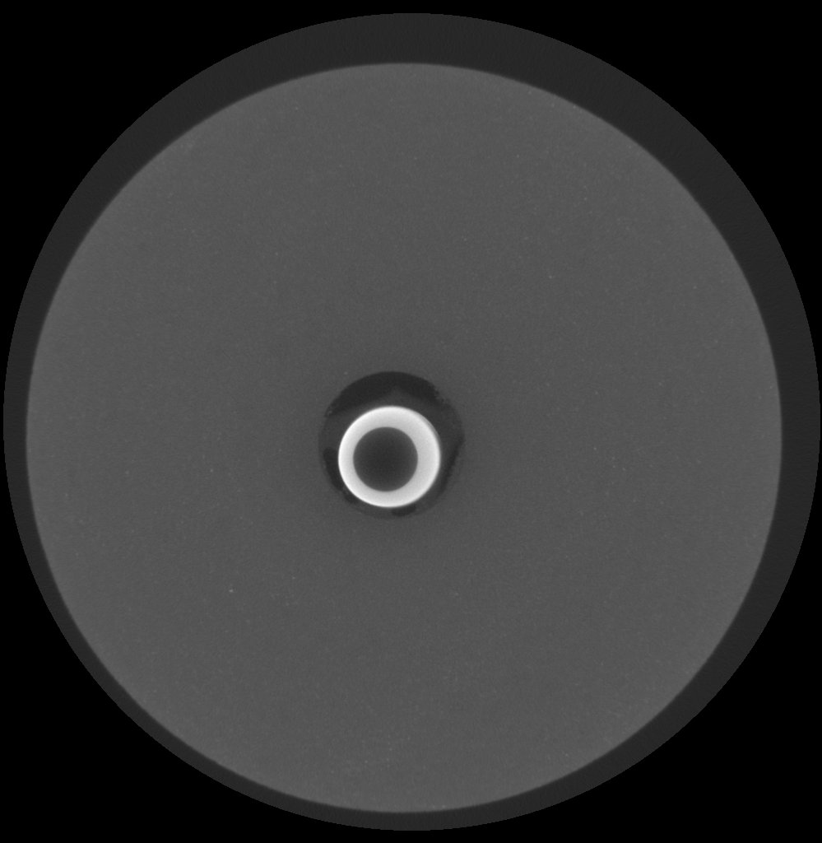
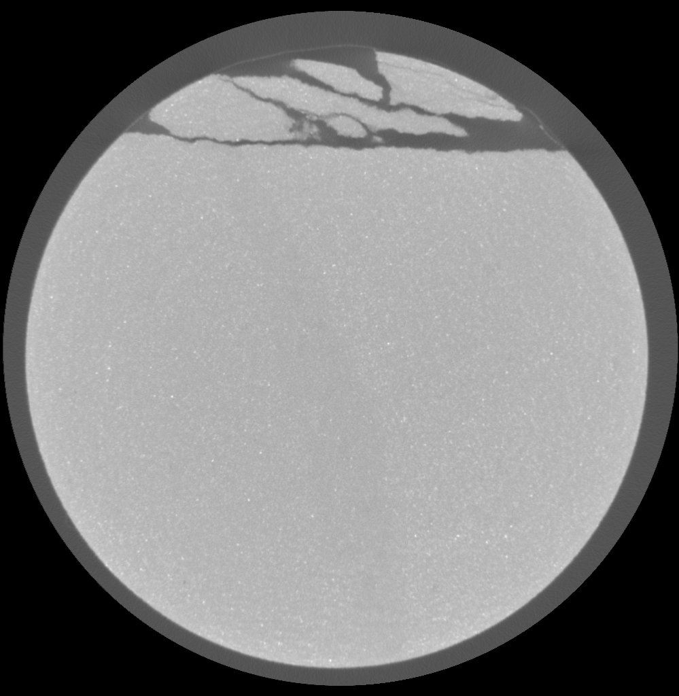
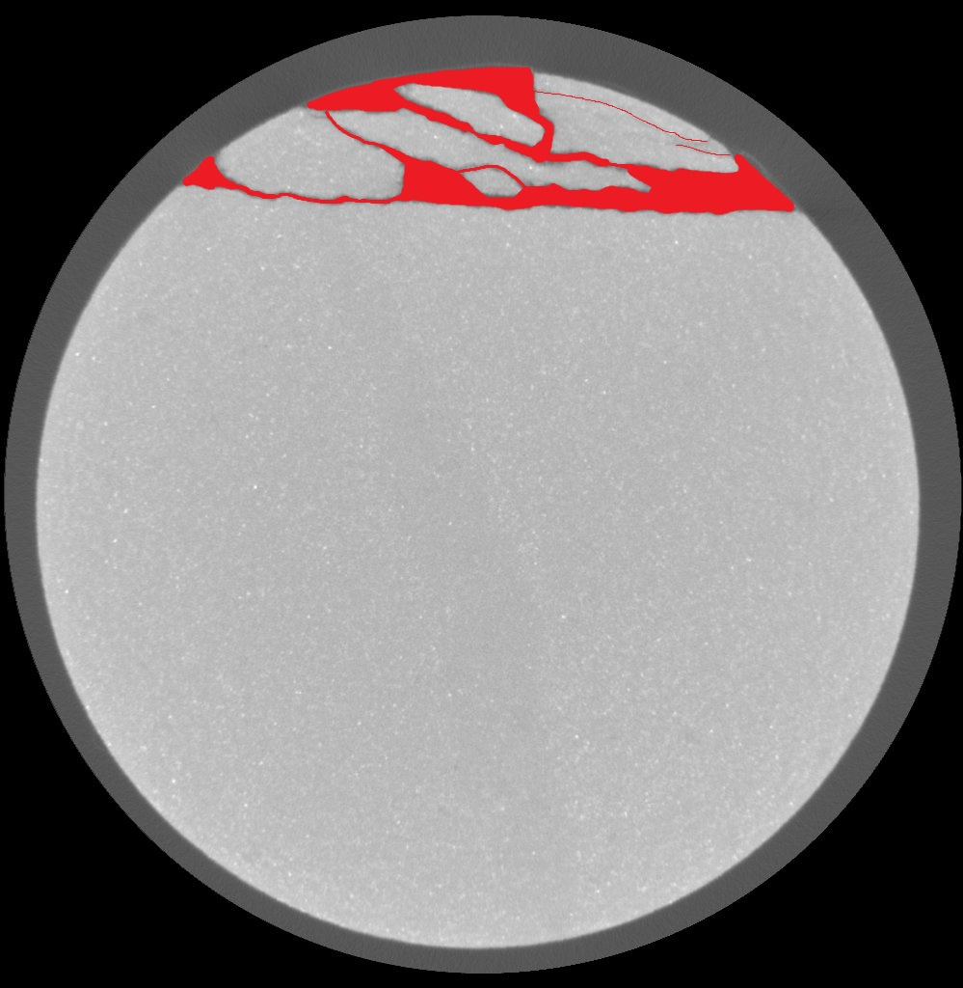


Part 2
Procedure
Label some CT images
Split the dataset (Training, validating and testing)
Design U-Net-based models
Resize, normalize, and augment data
Train, evaluate, and test the UNet
340 images without cracks
= 0.57
597 images with cracks
Without cracks
With cracks
143 images without cracks
= 0.54
265 images with cracks
Labeled image
Binary image
Labeled image
Binary image
Training (70%), Validation (15%), and testing data (15%).
Develop U-Net based models: Standard U-Net, ResNet, ResNet-TL
  Add L2 regulation
  Add dropout technique
Page 10

Slide 11
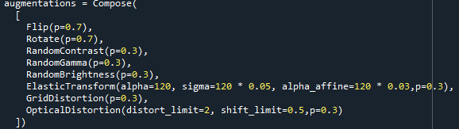
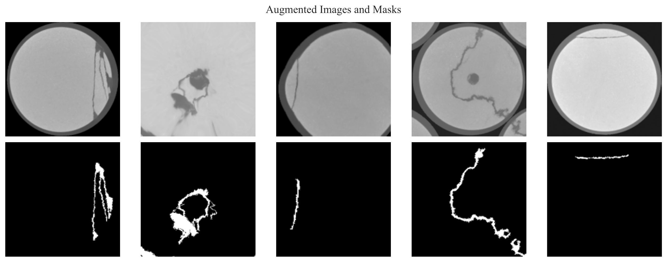
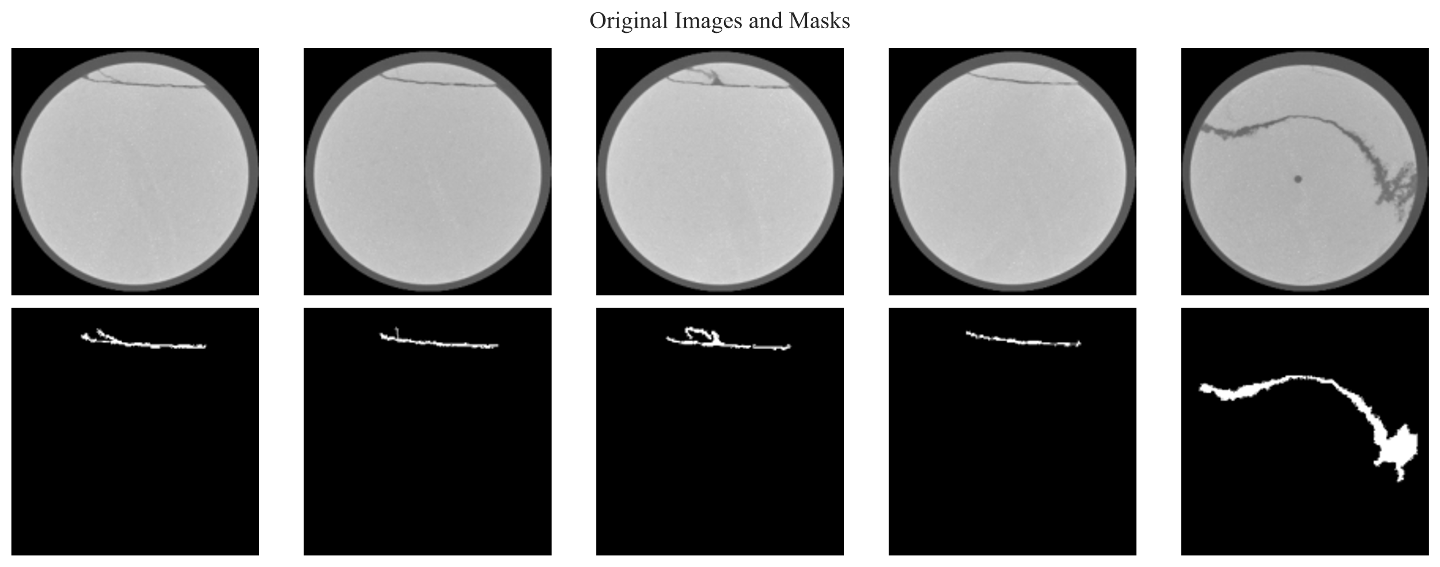
Part 2
Procedure
Label some CT images
Split the dataset (Training, validating and testing)
Design U-Net-based models
Resize, normalize, and augment data
Train, evaluate, and test the models
Resize, normalize, and augment data:
  Resize the input images as 256×256;
  Batch size: 32
  Normalize the input image pixel value to the range of [0,1]
Page 11

Slide 12
3
Part
Results & Discussion

Slide 13
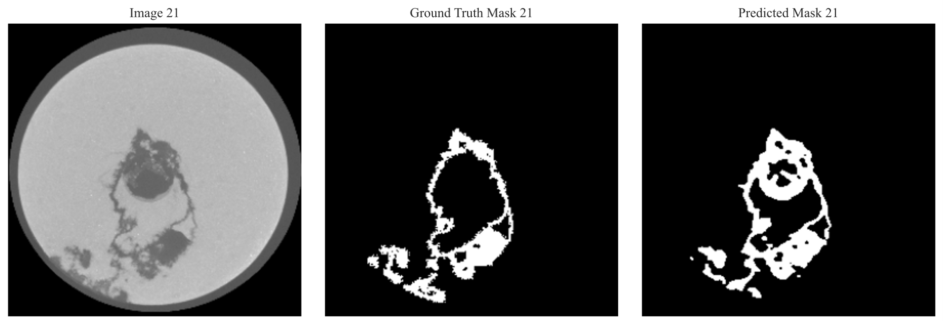
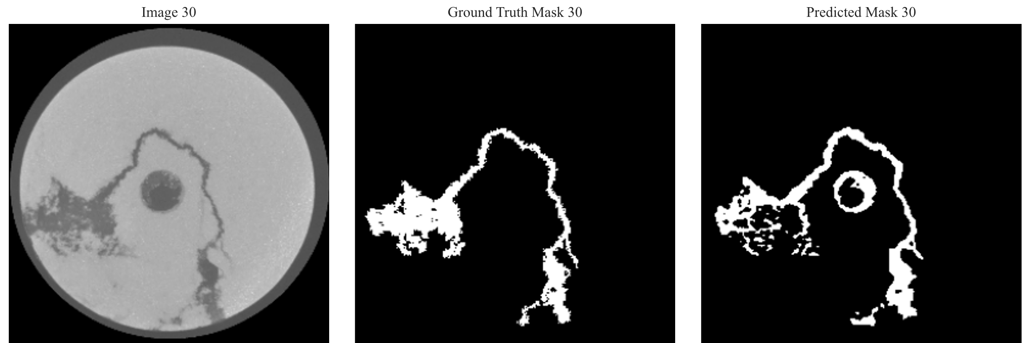
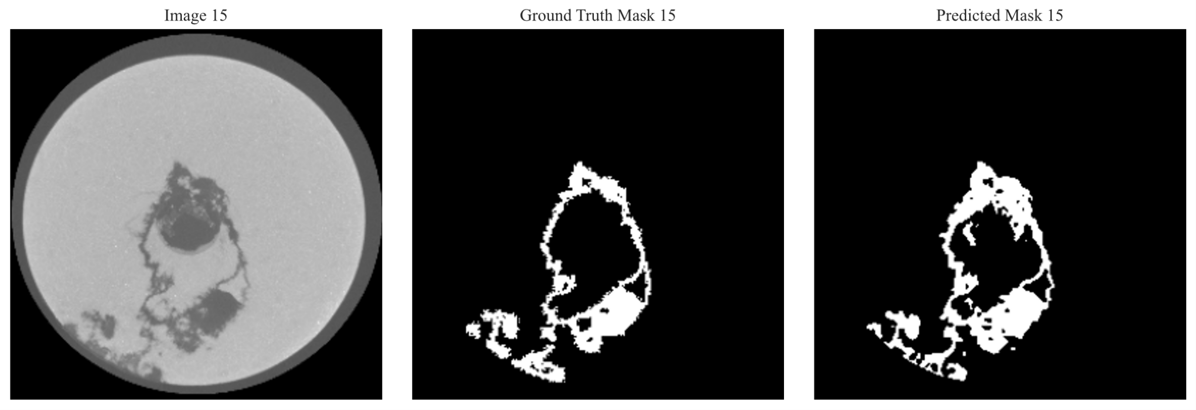
Part 3
Predicted results – U-Net, ResUNet, ResUNet-TL
U-Net
ResUNet
ResUNet-TL
Page 13

Slide 14
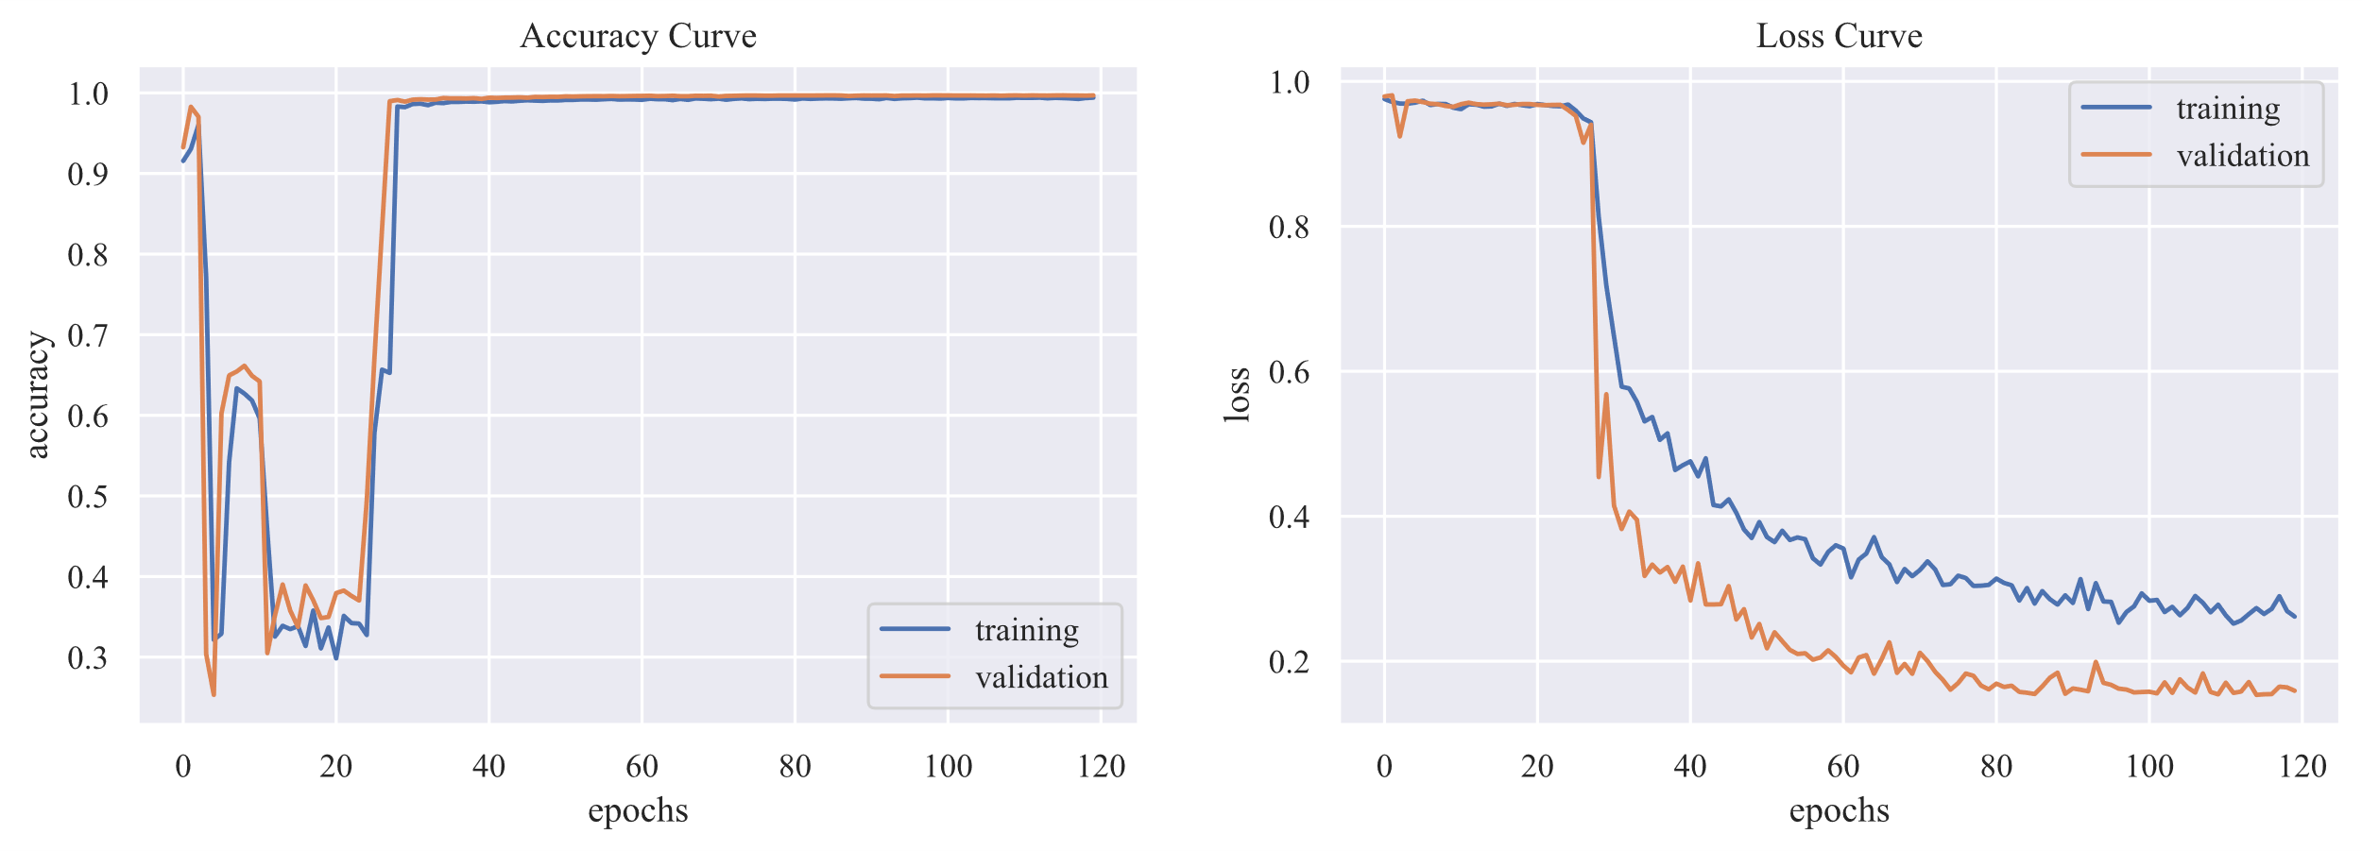
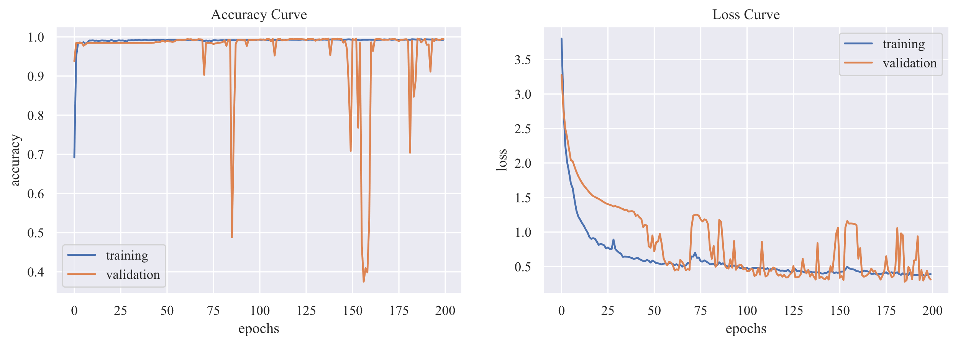
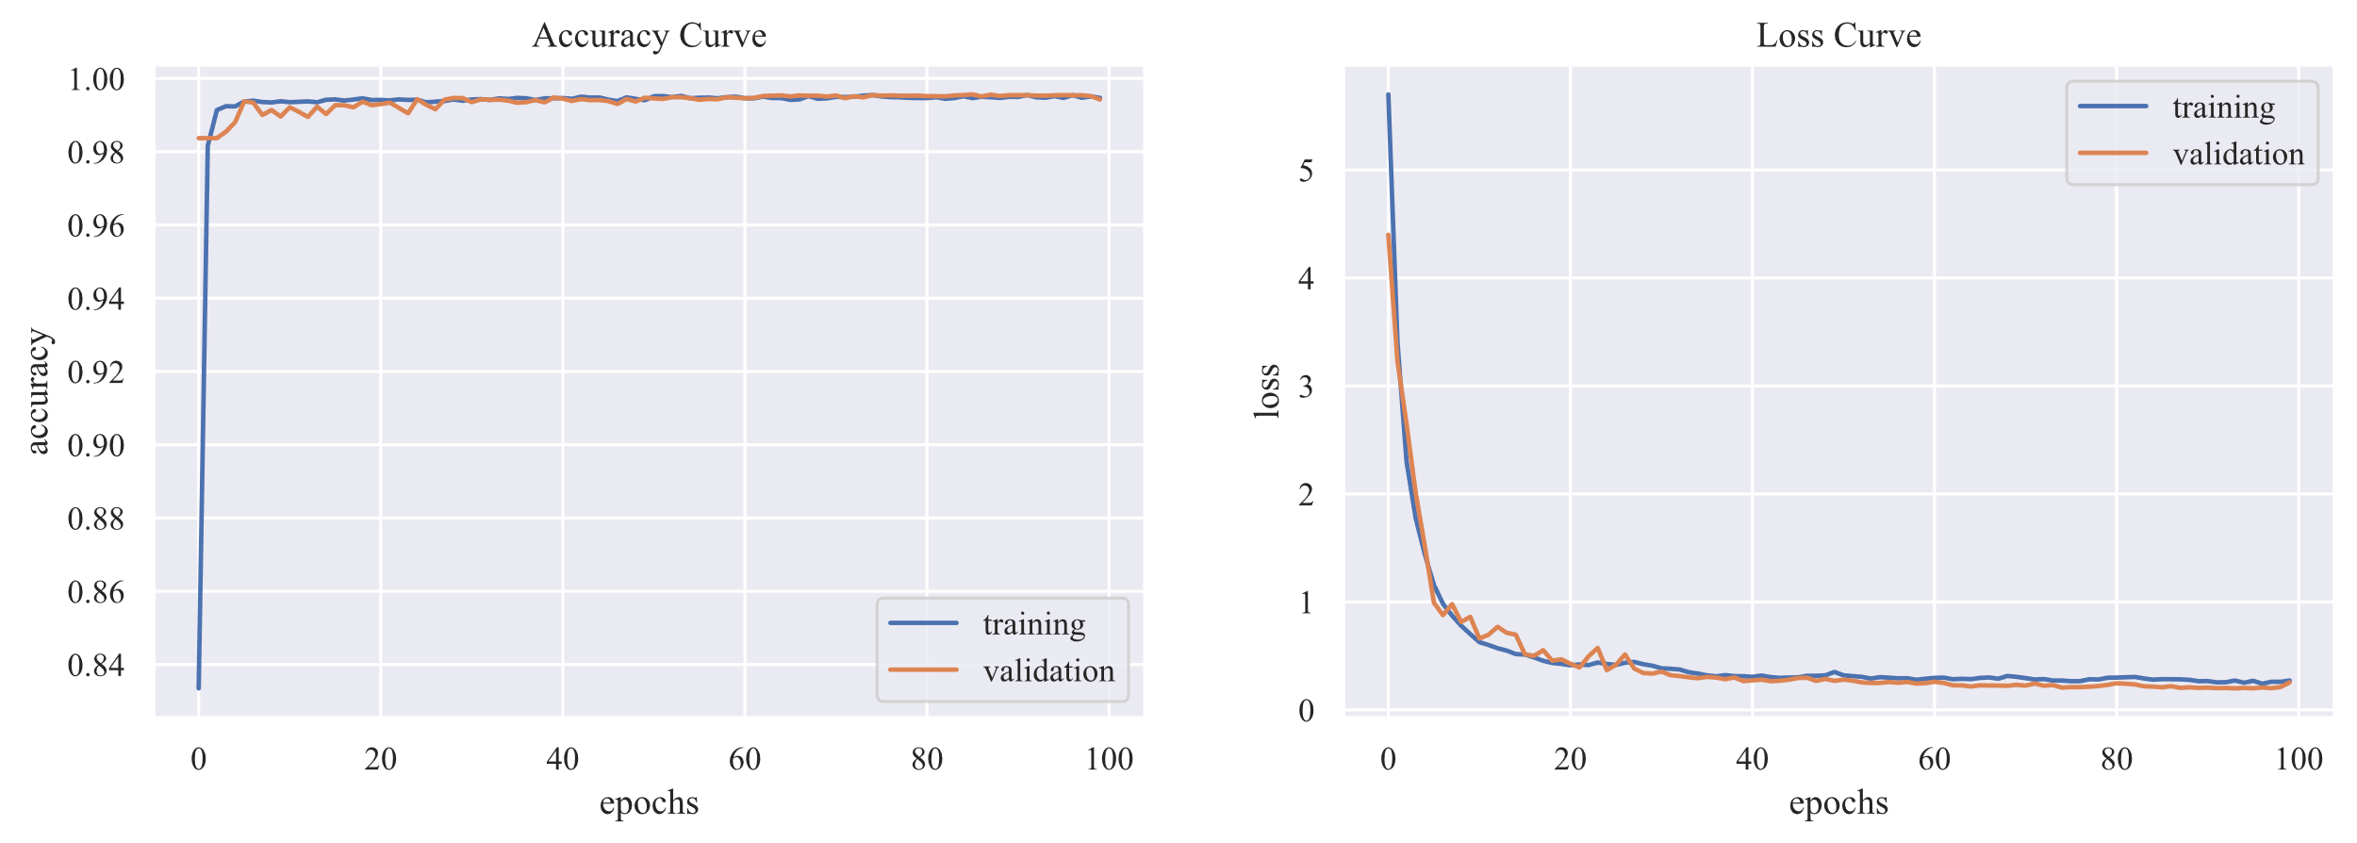
Part 3
Comparison of different accuracy and loss curves
U-Net
Accuracy
Loss
ResUNet
Accuracy
Loss
ResUNet-TL
Loss
Accuracy
Page 14

Slide 15
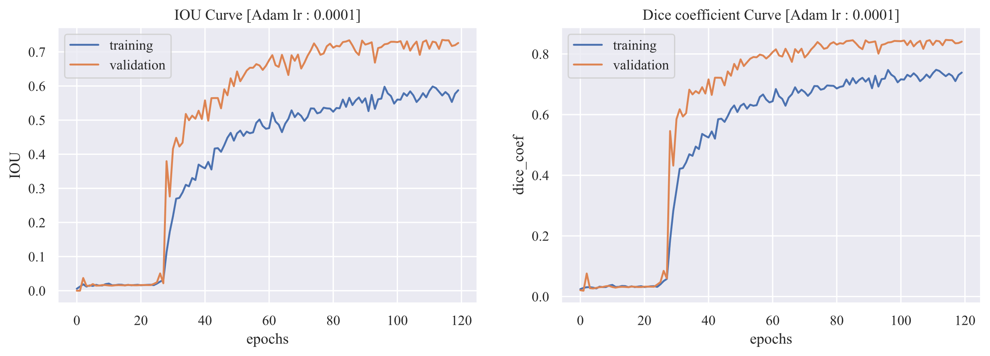
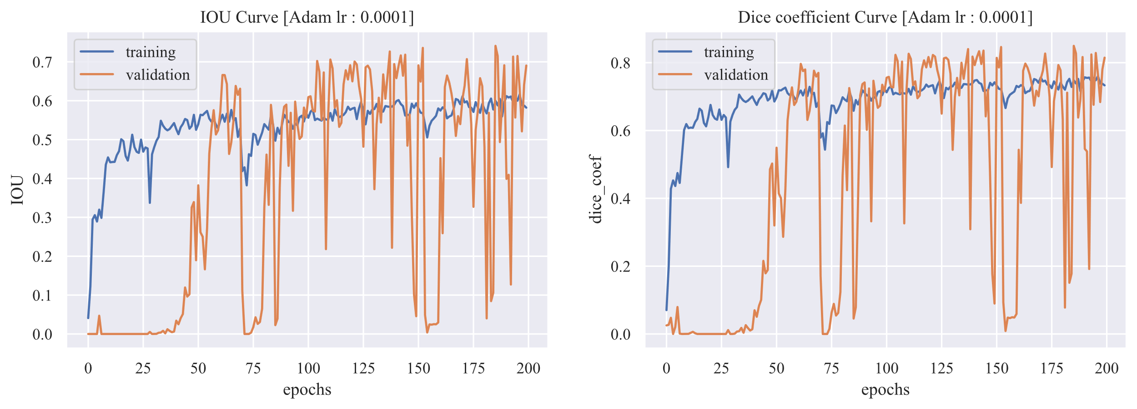
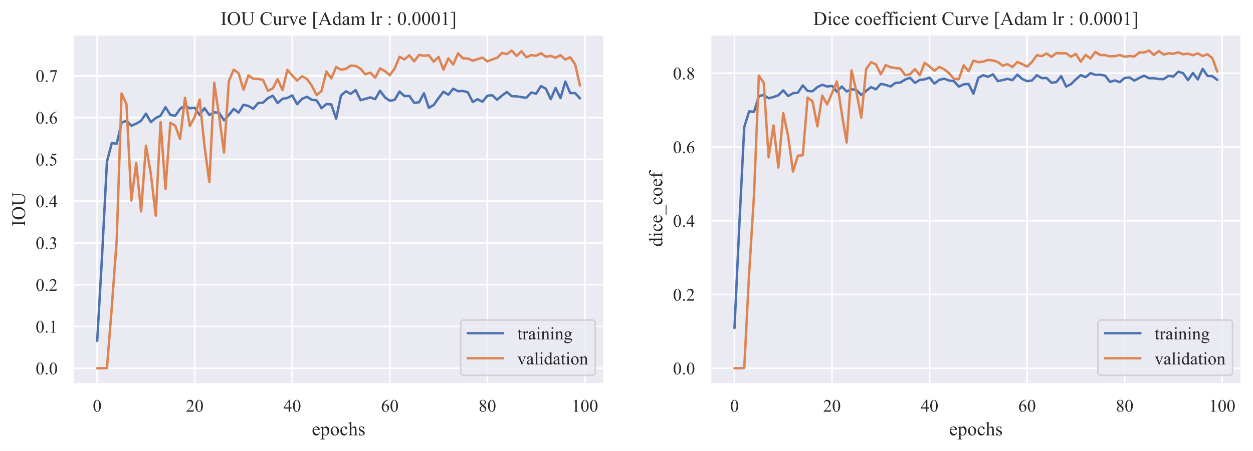
Part 3
Comparison of different IOU and Dice coefficient curves
U-Net
IOU
Dice coefficient
ResUNet
IOU
Dice coefficient
IOU: Intersection over Union
IOU = (Intersection area) / (Union area)
Dice coefficient: Measures the similarity between two sets.
(2 ∗ |𝑦 ∩ 𝑝|))/((|𝑦|+ |𝑝|)
ResUNet-TL
IOU
Dice coefficient
Page 15

Slide 16
Part 3
Confusion Matrix
U-Net |  | True |  | ResUNet |  | True |  | ResUNet-TL |  | True
 |  | + | - |  |  | + | - |  |  | + | -
Predicted | + | 399332 | 8546 | Predicted | + | 4022838 | 6683 | Predicted | + | 4014719 | 3545
 | - | 12663 | 48701 |  | - | 9796 | 23915 |  | - | 12272 | 32696
✔
[[True Negatives (TN) False Positives (FP)]
[False Negatives (FN) True Positives (TP)]]
 | U-Net | ResUNet | ResUNet-TL
Accuray | 0.955 | 0.996 | 0.996
Precision | 0.851 | 0.782 | 0.902
Sensitivity | 0.794 | 0.709 | 0.727
Specificity | 0.979 | 0.998 | 0.999
F1 Score | 0.821 | 0.744 | 0.805
Accuracy: (TP + TN) / (TP + TN + FP + FN)
Precision: TP / (TP + FP)
Recall (Sensitivity): TP / (TP + FN)
Specificity: TN / (TN + FP)
F1 Score:
2 * (Precision * Recall) / (Precision + Recall)
Page 16

Slide 17
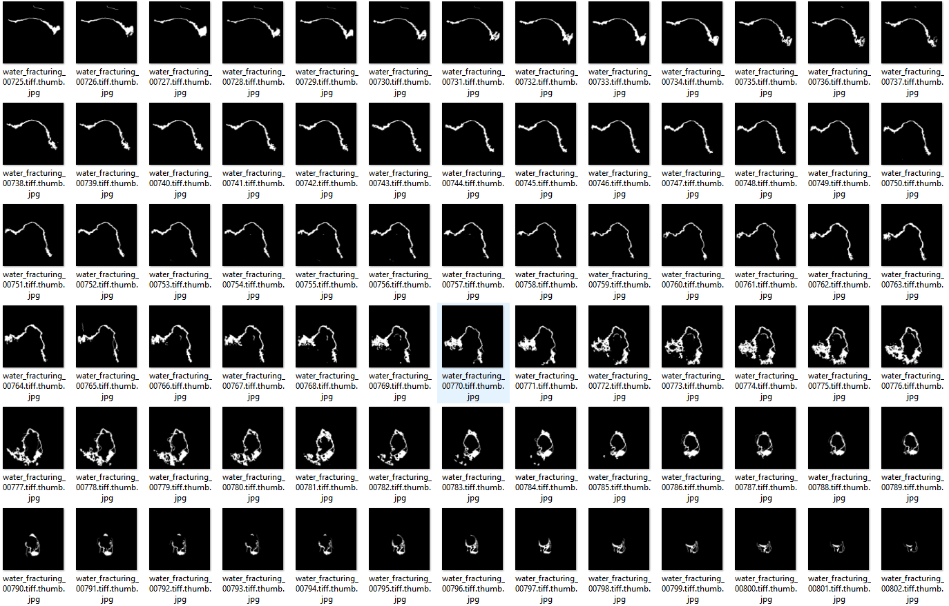
Part 3
Application of the ResUNet-TL model
Labeling rest of the CT images using the ResUNet-TL model
Page 17

Slide 18
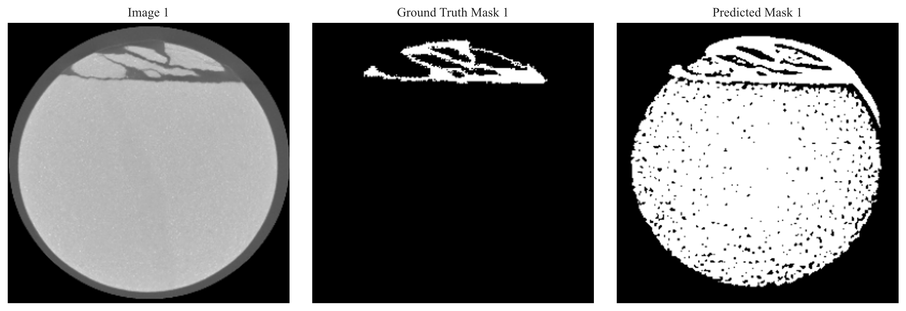
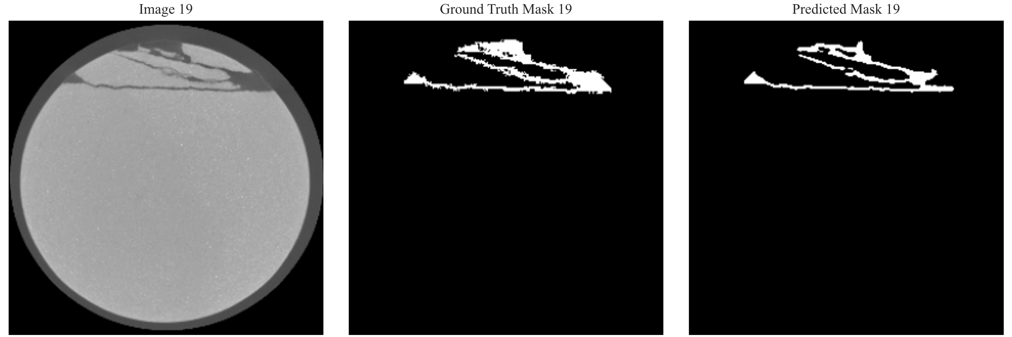
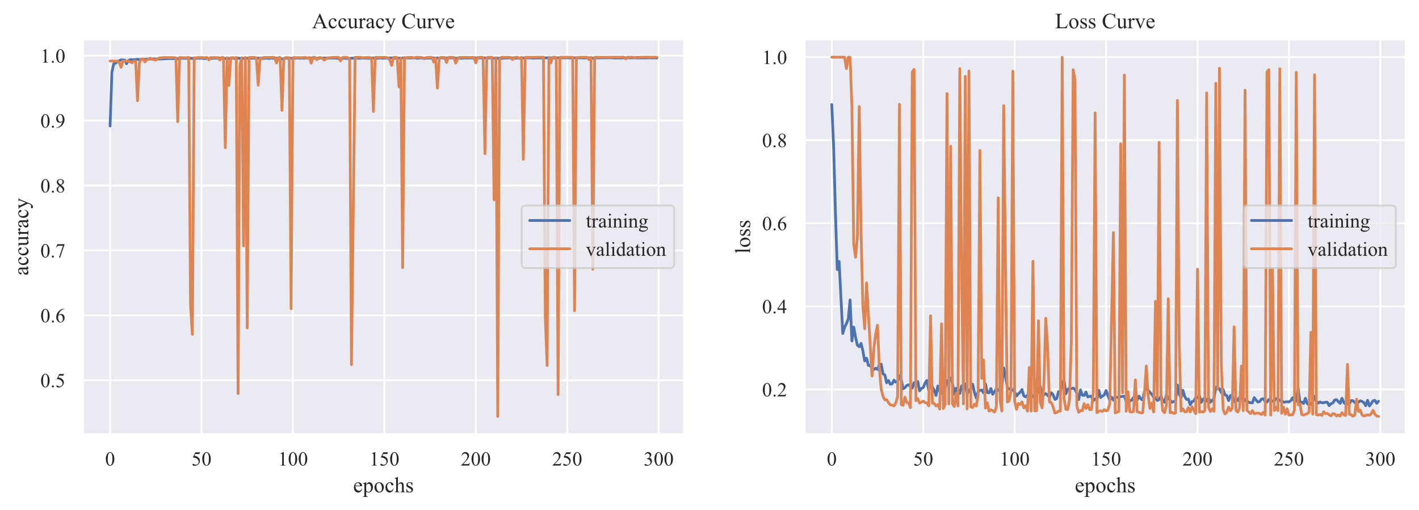


Part 3
Discussion
1. Selecting an appropriate number of epochs is crucial.
(a) Epoch = 100
(b) Epoch = 200
2. Imbalanced data can lead to biased learning, and L2 regulation can prevent overfitting.
(a) Imbalanced data and without L2 regulation
(b) Balanced data and with L2 regulation
3. The number of the feature map can influence the model performance.
(a) Standard UNet
(b) ResUNet
(c) ResUNet-TL
Page 18

Slide 19
4
Part
Conclusions & Future work

Slide 20
Part 4
Conclusions & Future work
Conclusions:
  UNet-based models have demonstrated their applicability in detecting a large number of CT images.
  ResUNet-TL is relatively more suitable for this particular project.
  Appropriate number of epochs is important for optimal model performance.
  Imbalanced data can result in biased learning.
  L2 regularization yields a simpler model that is less prone to overfitting the training data.
  Increasing the number of feature maps allows the model to learn more complex features, but it also results in higher computational costs.
Future work:
  Expand the dataset for further training and refinement of the developed models.
  Conduct segmenting multiple classes within CT images.
  Implementation of 3D reconstruction techniques.
Page 20

Slide 21
References
Detection of Internal Fractures in Sandstone Specimens with CNN and U-Net
Yang, B., Wang, H., Wang, B., Shen, Z., Zheng, Y., Jia, Z., & Yan, W. (2021). Digital quantification of fracture in full-scale rock using micro-CT images: A fracturing experiment with N2 and CO2. Journal of Petroleum Science and Engineering, 196, 107682.
Shimizu, T., & Tachibana, E. A Study On Uniaxial Compressive Strength Of Plain Concrete Under Dynamic Cyclic Loading.
Zhou, X. P., Jiang, D. C., & Zhao, Z. (2021). Digital Evaluation of Micro-Pore Water Effects on Mechanical and Damage Characteristics of Sandstone Subjected to Uniaxial, Cyclic Loading–Unloading Compression by 3D Reconstruction Technique. Rock Mechanics and Rock Engineering, 1-21.
Liu, Y., Yao, J., Lu, X., Xie, R., & Li, L. (2019). Deep Crack: A deep hierarchical feature learning architecture for crack segmentation. Neurocomputing, 338, 139-153.
Page 21

Slide 22
Thank you!
Question?

