Slide 1
Jurassic Navajo Sandstone, SE Utah (Eolian Wind blown sandstone) Goal: 1. Develop MLA to distinguish normal cross bedded sandstone from soft sediment deformation (SSD) where cross bedding was disrupted and disturbed from liquefaction and fluidization (original textures were altered probably due to triggers like equakes. 2. Apply that MLA to map Earth examples as well as in remote imagery from Mars. Rules: 1. Normal cross bedded dune sandstone (angles up to 34 degrees angle of repose), usually shows a pretty strong anisotropy (often weathers as ribs of sandstone). Some major bedding surfaces and interdune deposits can be horizontal. 2. Deformed sandstone; swirly patterns, typically show some angles of internal bedding exceeding 34 degrees. The most deformed is massive where nearly all original bedding is gone. This shows the smoothest weathering pattern. See attached annotated images and all the higher res images

Slide 2
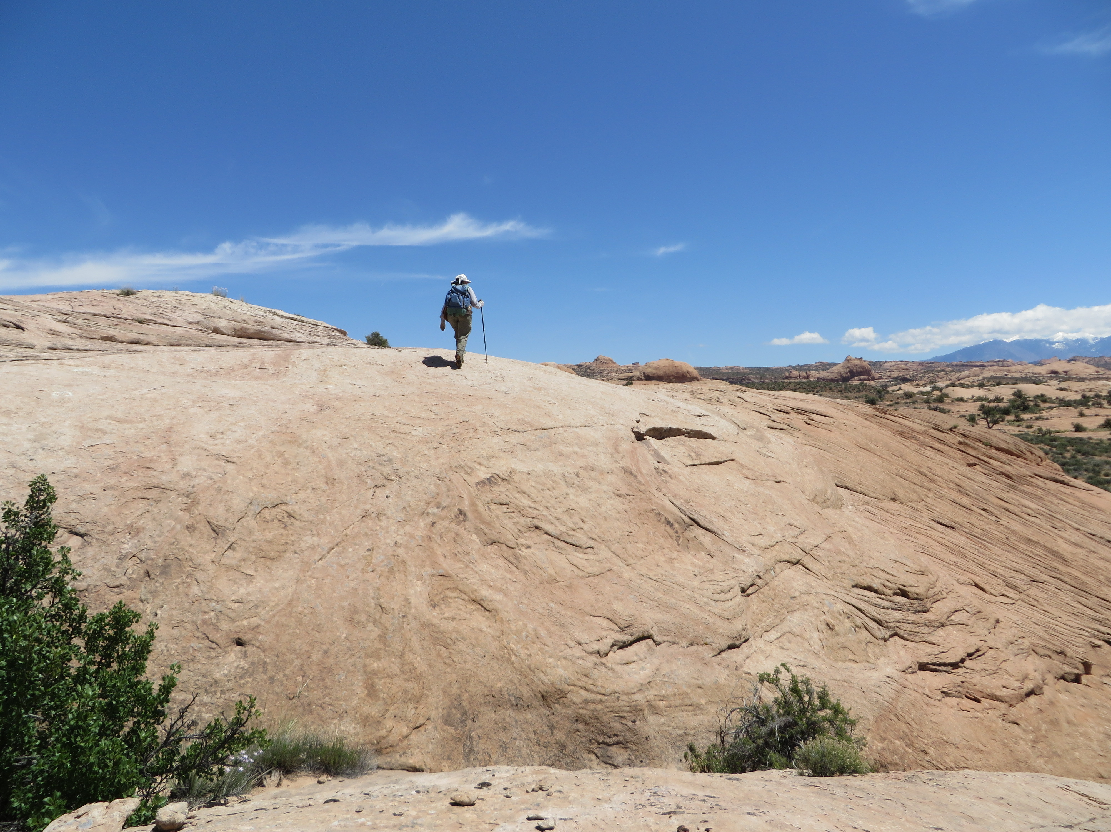
massive
normal
deformed

Slide 3
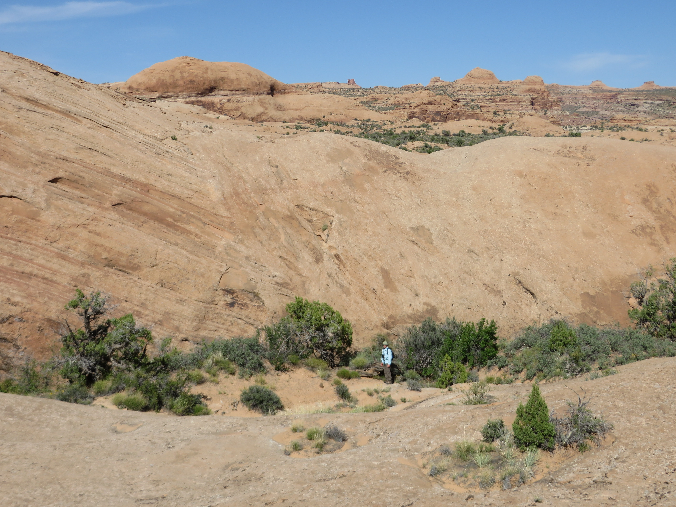
massive
normal
deformed

Slide 4
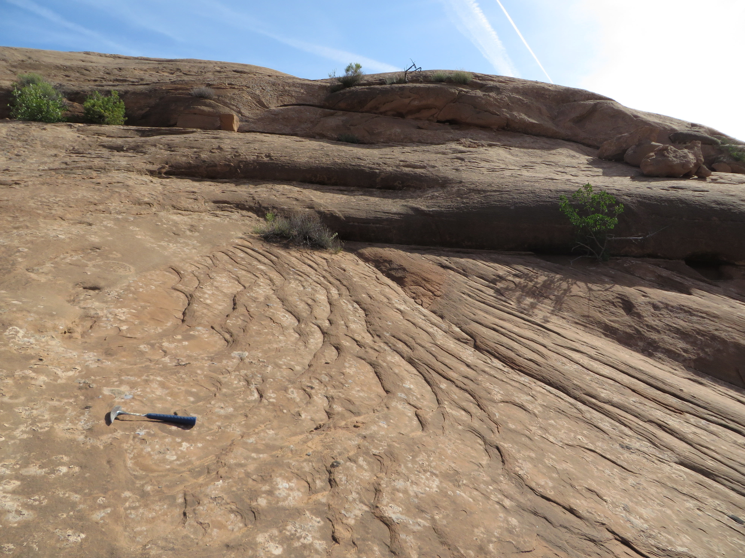
massive
normal
deformed

Slide 5
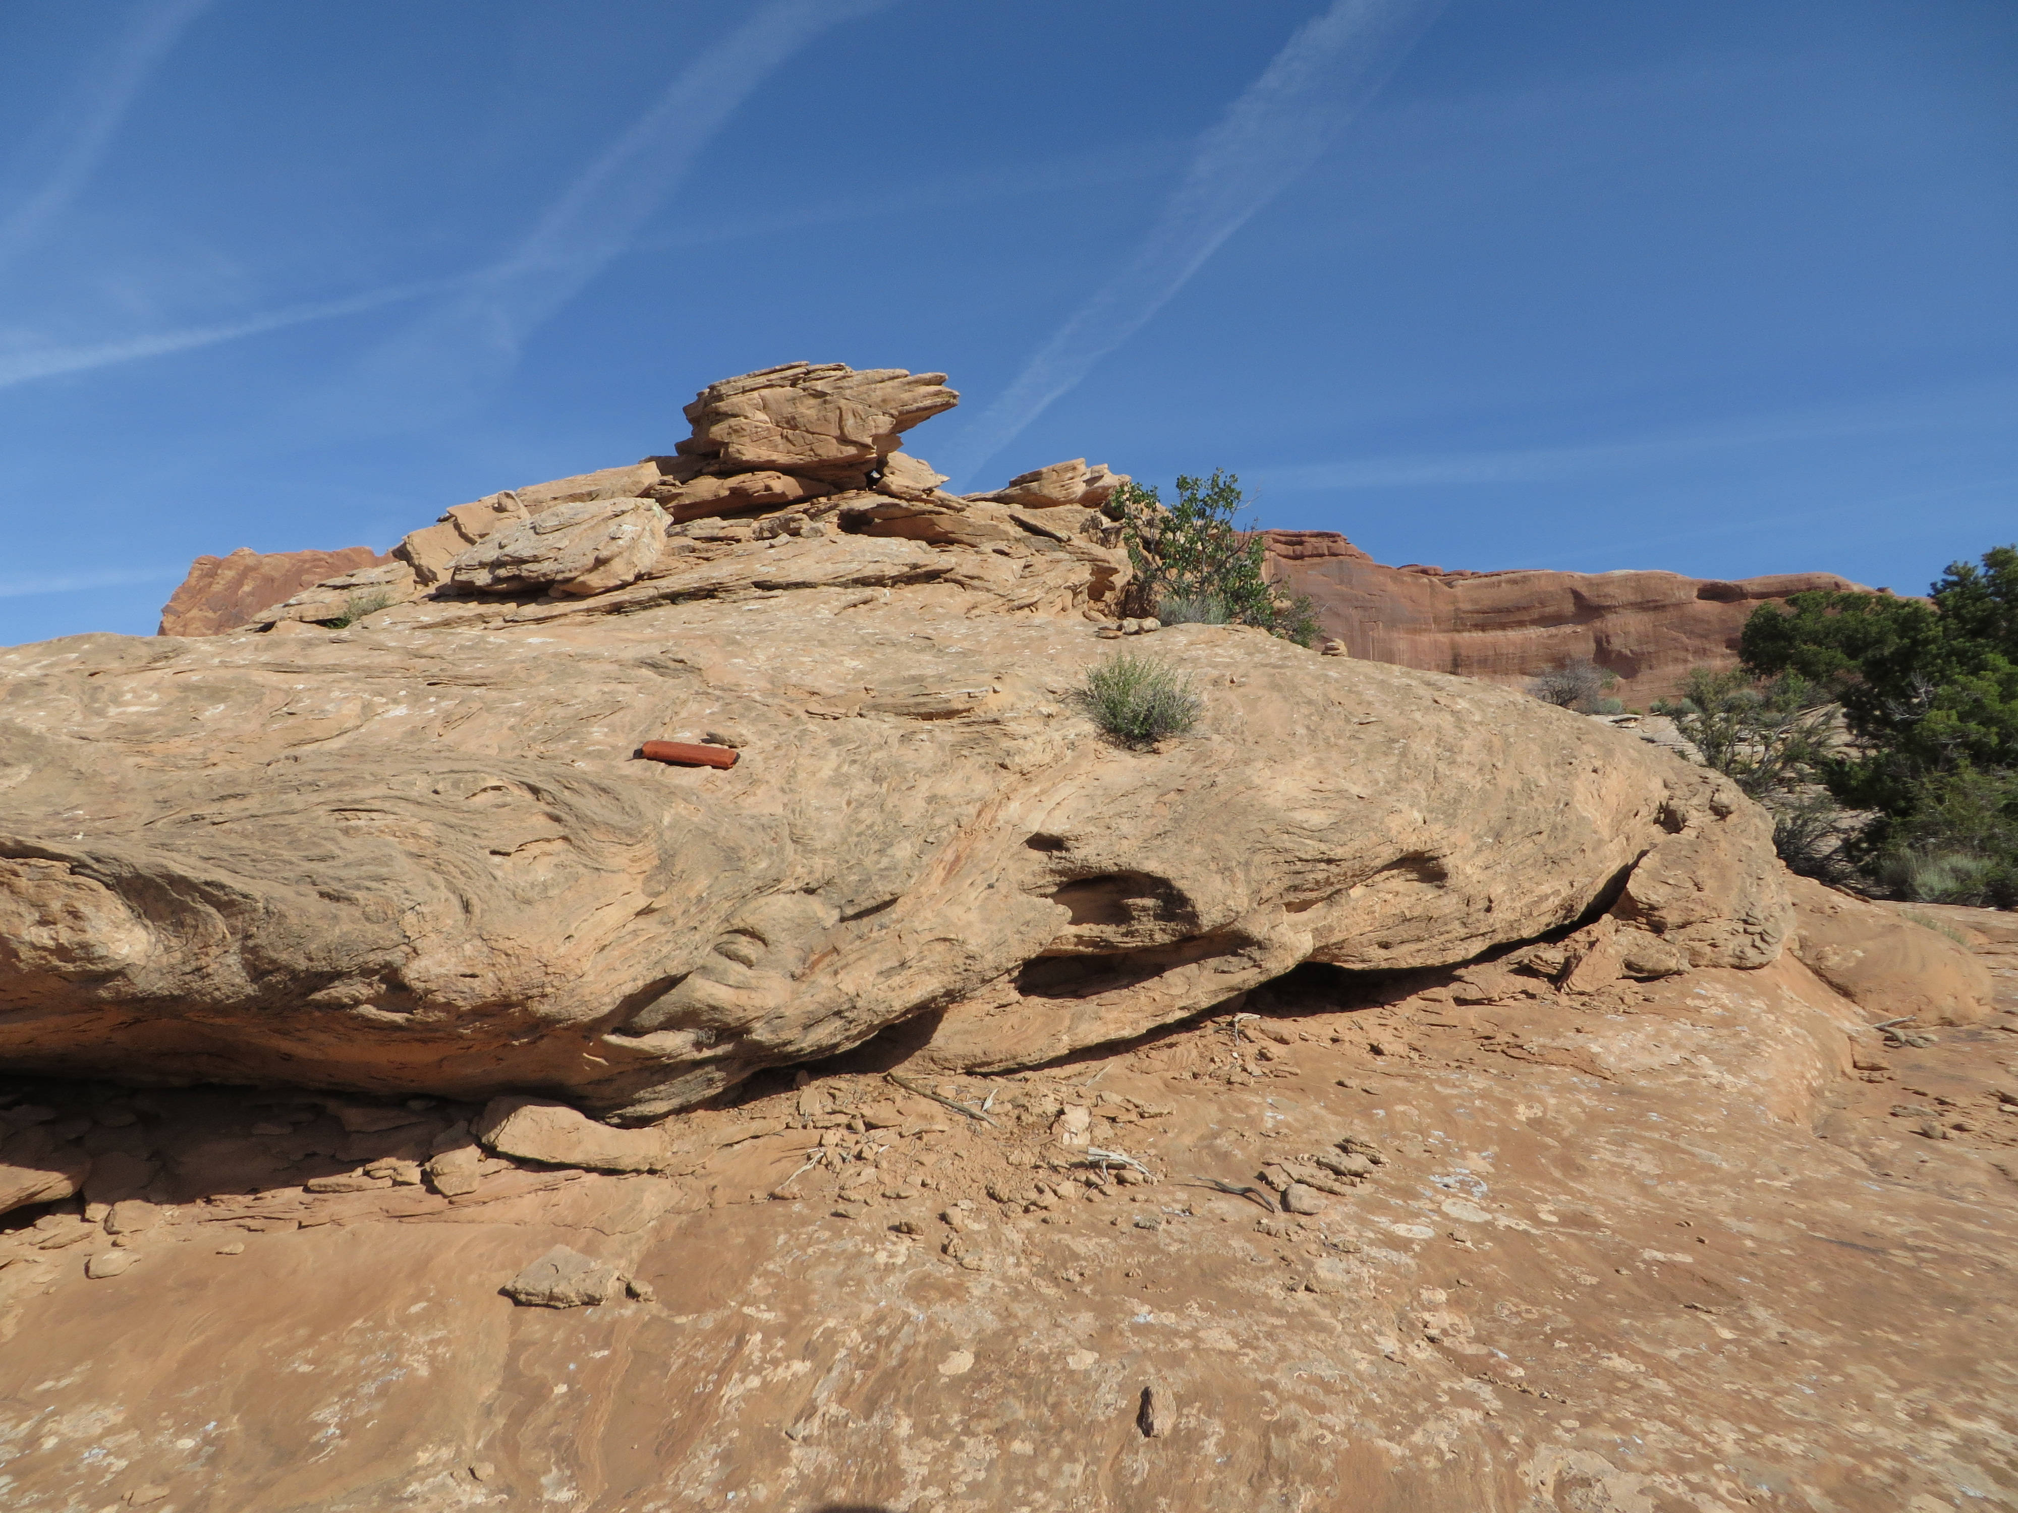
deformed

Slide 6
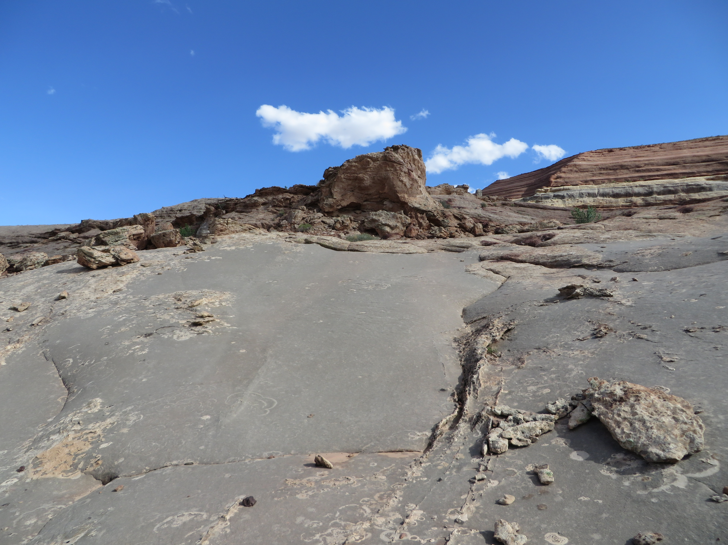
Intrusive sandstone diapir
massive
Remnant deformed bedding

