Slide 1
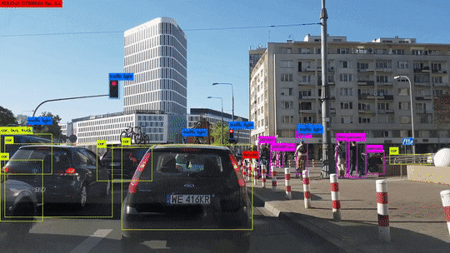
You Only Look Once
YOLO

Slide 2
Outline
Motivation
Key Idea of Yolo
Ugly Details: Anchor Boxes+Target Vector
Intersection-of-Union (IOU)
Loss Function

Slide 3
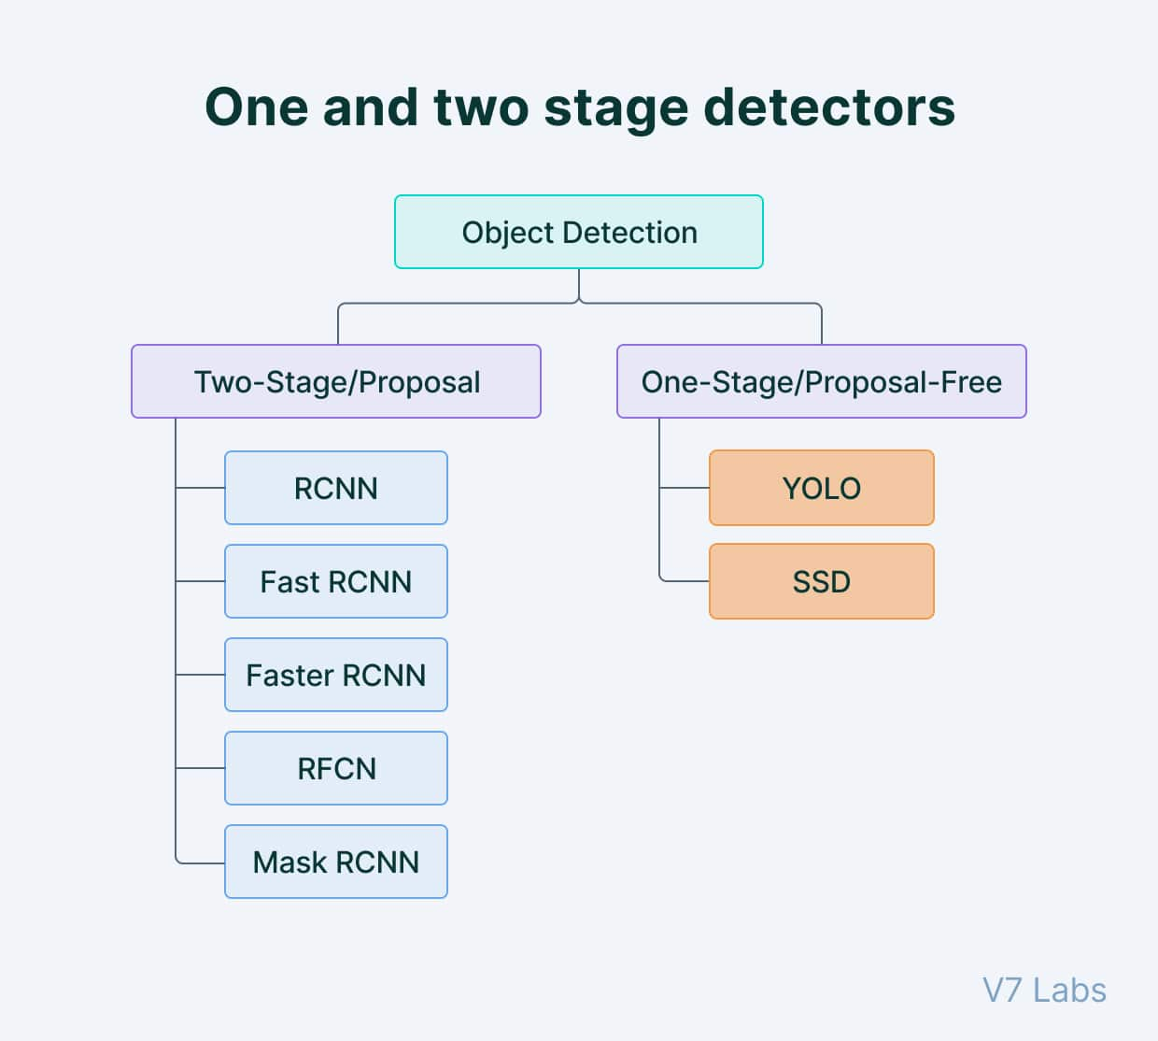
One and Two Stage Detectors
Generally, single-shot object detection is better suited for real-time applications, while two-shot object detection is better for applications where accuracy is more important.
Object detection algorithms are broadly classified into two categories based on how many times the same input image is passed through a network.

Slide 4
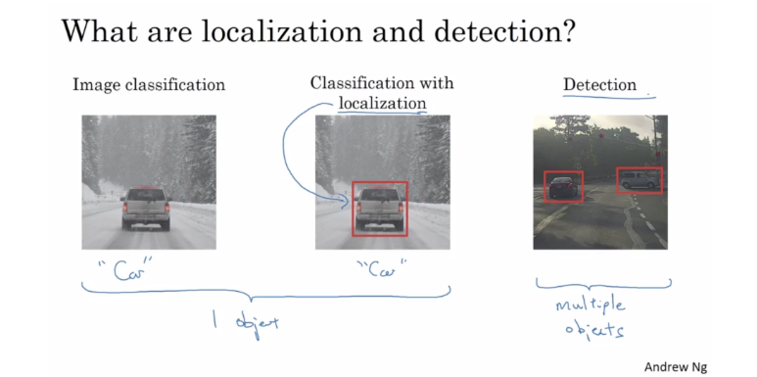
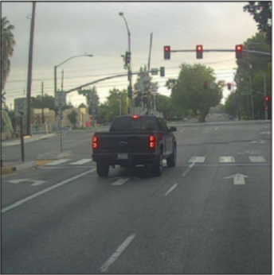
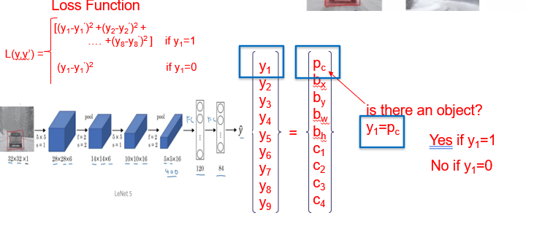
YOLO Motivation
Easy: One Isolated Object
Hard: Overlapping Objects

Slide 5
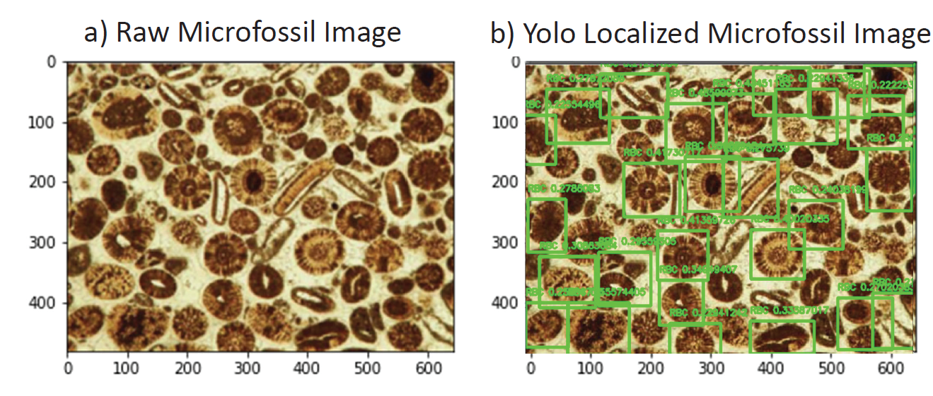
YOLO Motivation

Slide 6
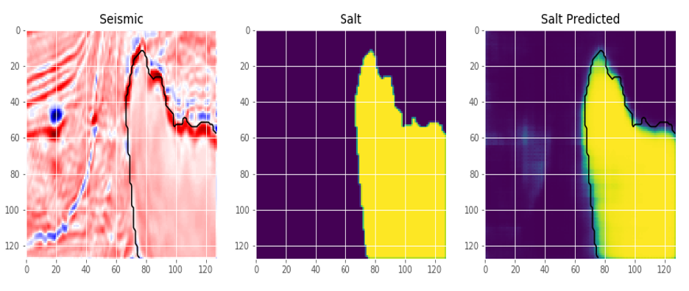
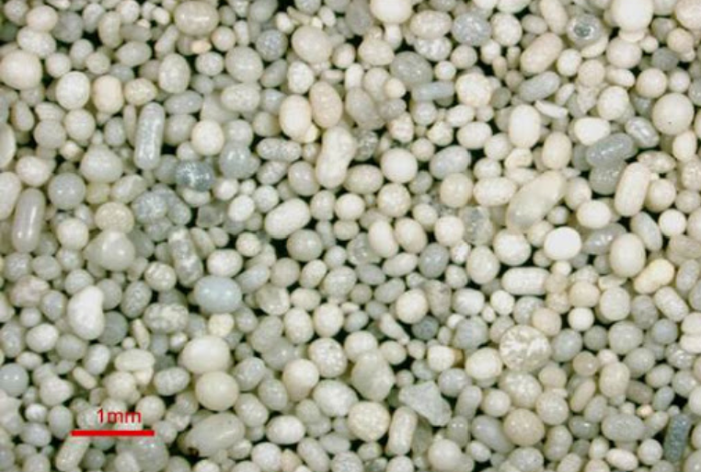
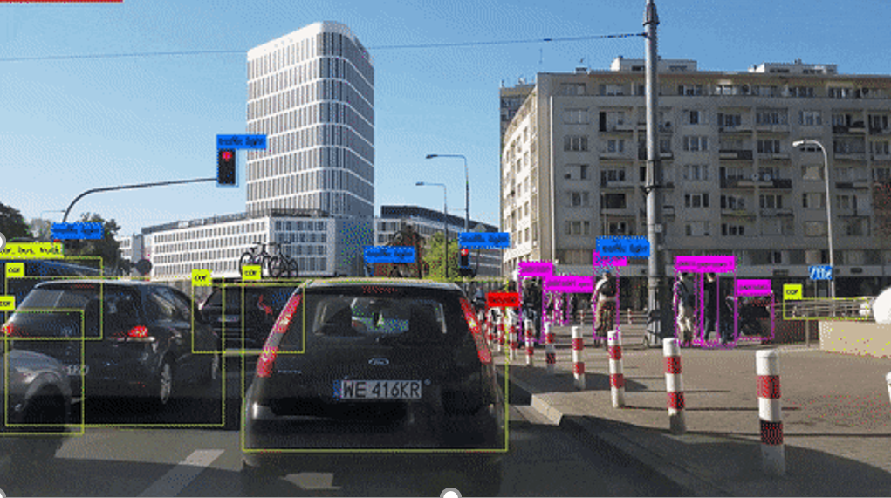

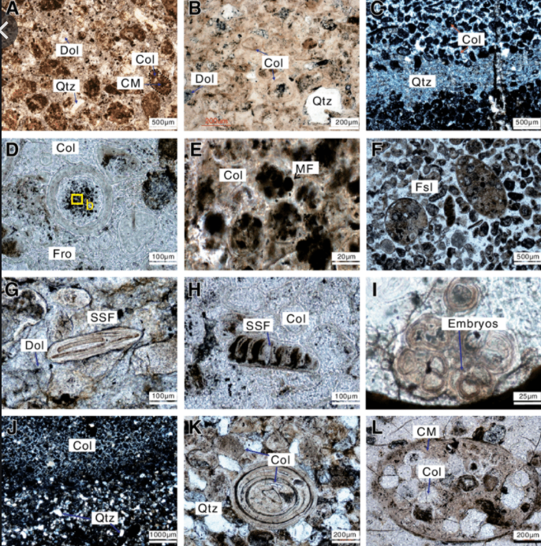
YOLO Motivation
Frame per second

Slide 7
Outline
Motivation
Key Idea of Yolo
Ugly Details: Anchor Boxes+Target Vector
Intersection-of-Union (IOU)
Loss Function

Slide 8
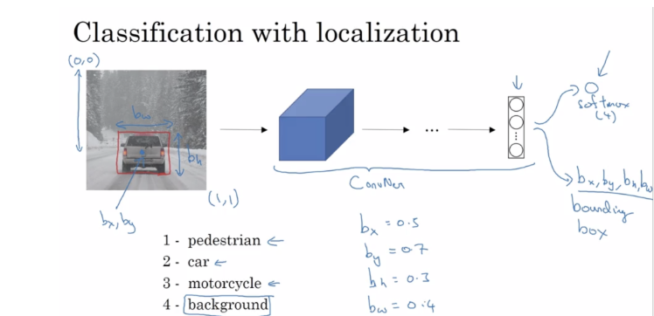
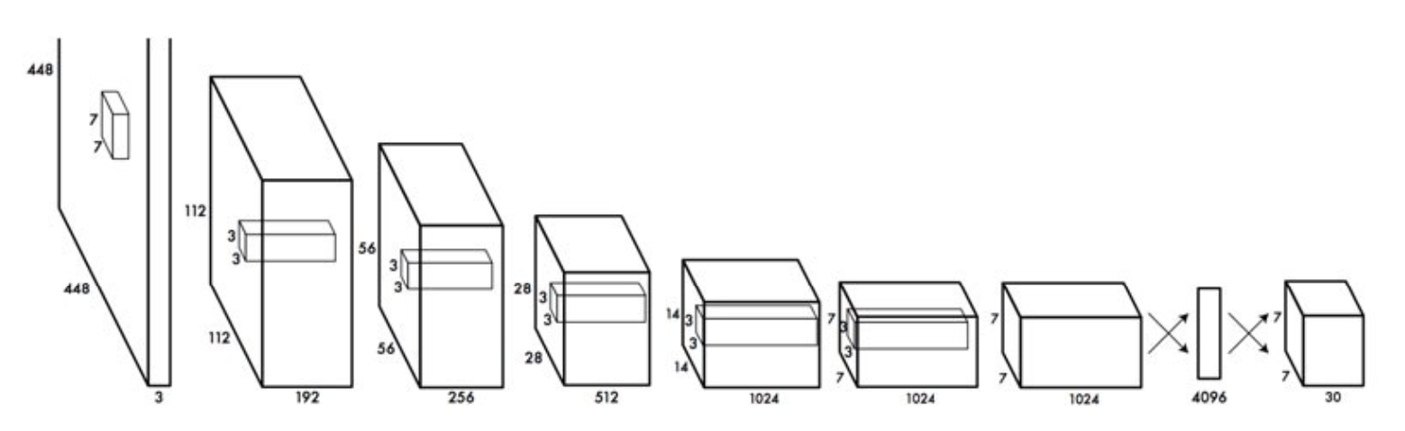
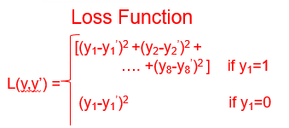
Localization, Classification and Detection
is there an
object?
y₁=p_{c}
Mixed regression
+ classification
Yes if y₁=1
(0,0)
p_{c}
b_{x}
b_{y}
b_{w}
b_{h}
c₁
c₂
c₃
c₄
No if y₁=0
y₁
y₂
y₃
y₄
y₅
y₆
y₇
y₈
y₉
b_{w}
8x1
b_{h}
=
w^{(k+1)} = w^{(k)} - α∂ε/∂w
(1,1)
(b_{x},b_{y})
c₁
c₂
c₃
c₄
b_{x}=0.5
b_{y}=0.7
b_{h}=0.3
b_{w}=0.4
ε(y,y’) =

Slide 9
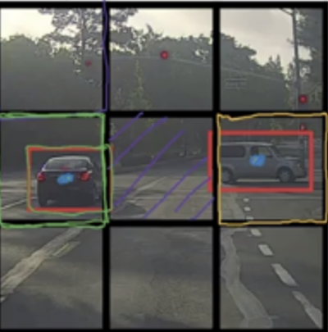

YOLO
Target output
3x3x8
p_{c}
b_{x}
b_{y}
b_{w}
b_{h}
c₁
c₂
c₃
0
?
?
?
?
?
?
?
0
?
?
?
?
?
?
?
0
?
?
?
?
?
?
?
3x3 cells
Y=Target output
3x3x8
1
b_{x}
b_{y}
b_{w}
b_{h}
0
1
0
1
b_{x}
b_{y}
b_{w}
b_{h}
0
1
0
0
?
?
?
?
?
?
?
1
b_{x}
b_{y}
b_{w}
b_{h}
0
1
0
1
b_{x}
b_{y}
b_{w}
b_{h}
1
0
0
What if two
Objects/cell?
0
?
?
?
?
?
?
?
0
?
?
?
?
?
?
?
0
?
?
?
?
?
?
?
You Only Look Once
Then two
Anchor Boxes/cell?
3x3x16

Slide 10
Outline
Motivation
Key Idea of Yolo
Ugly Details: Anchor Boxes+Target Vector
Intersection-of-Union (IOU)
Loss Function

Slide 11
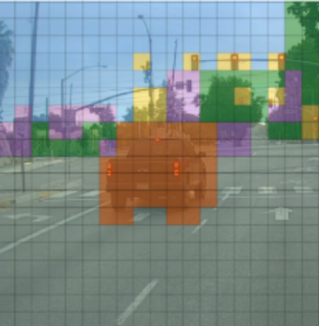
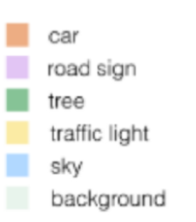
Training YOLO: Anchor Boxes+Target Vector
Step0: Breakup image into 20x20 cells. Mark Center-of-Masses/object
Step1: Detect highest class probability/cell
w^{(k+1)} = w^{(k)} - α∂ε/∂w
Step 2: Each cell has 2 anchor boxes
p_{c}
b_{x}
b_{y}
b_{w}
b_{h}
c₁
c₂
c₃
p_{c}
b_{x}
b_{y}
b_{w}
b_{h}
c₁
c₂
c₃

Slide 12


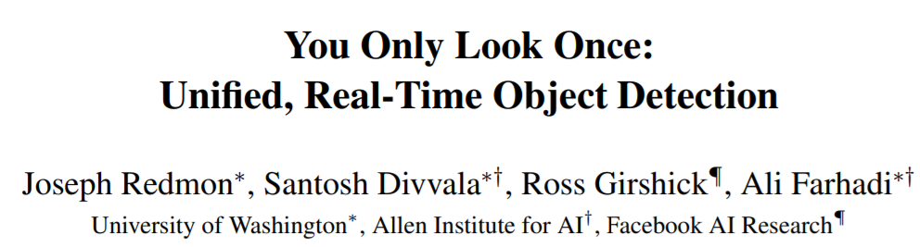
Training YOLO: Anchor Boxes+Target Vector
Step0: Breakup image into 20x20 cells. Mark Center-of-Masses/object
Step1: Detect highest class probability/cell
w^{(k+1)} = w^{(k)} - α∂ε/∂w
Step 2: Each cell has 2 anchor boxes
Step 3: Eliminate anchor boxes unless its cell has Center-of-Mass point
Step 4: Eliminate 1-out-2-anchor box/cell w lowest class prob.
.2
p_{c}=0
Probability confidence
Of an object/cell
Lower probability
bike in anchor box
High probability
Bike in anchor box

Slide 13
Training YOLO: Anchor Boxes+Target Vector
Step0: Breakup image into 20x20 cells. Mark Center-of-Masses/object
Step1: Detect highest class probability/cell
w^{(k+1)} = w^{(k)} - α∂ε/∂w
Step 2: Each cell has 2 anchor boxes
. (But only 1 needed/cell if 1 obj./cell)
Step 3: Eliminate anchor boxes unless its cell has Center-of-Mass point
Step 4: Eliminate 1-out-2-anchor box/cell w lowest class prob.
Step 5: Iterate
.2
0
p_{c}=0
Lower probability
bike in anchor box
High probability
Bike in anchor box

Slide 14
Outline
Motivation
Key Idea of Yolo
Ugly Details: Anchor Boxes+Target Vector
Intersection-of-Union (IOU)
Loss Function

Slide 15
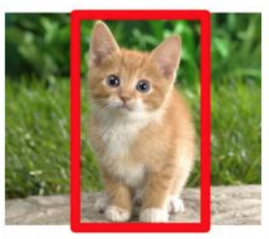
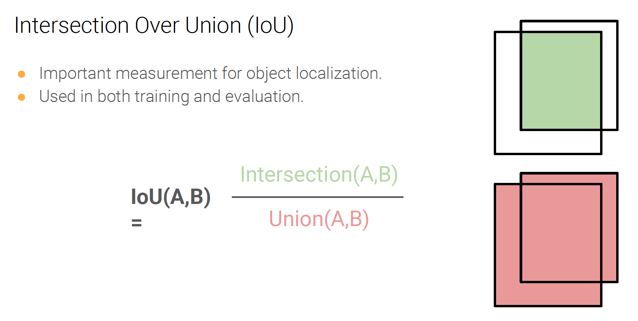
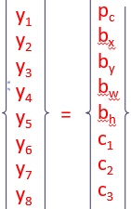
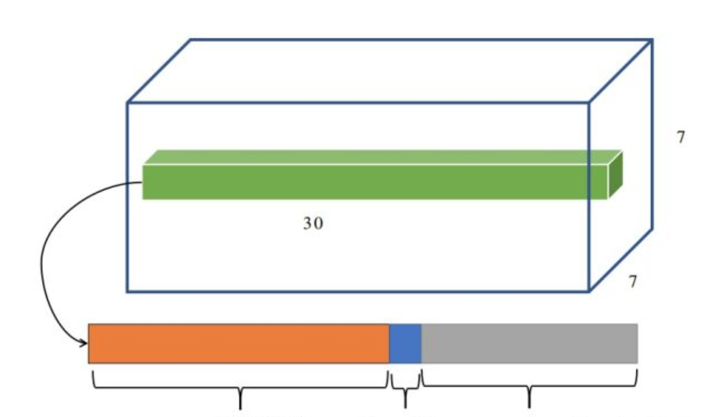
Bounding Box
Classification+Localization: Intersection of Union (IOU)
(x,y)
How close is intersection of truth & proposed overlapping boxes?
h—height
Truth
BB
w—width
IoU>0.7 positive
IoU<0.3 negative
0.3<IoU<0.7
Number used in training
Intersection of Union
P_{c} =Pr(Object)*IOU If cell contains objects
P_{c} =0 If cell doesn’t contain objects

Slide 16
Outline
Motivation
Key Idea of Yolo
Ugly Details: Anchor Boxes+Target Vector
Intersection-of-Union (IOU)
Loss Function & Confidence
Confidence=Pr(Object)*IOU If cell contains objects
Confidence=0 If cell doesn’t contain objects
ε(y,y’) =

Slide 17
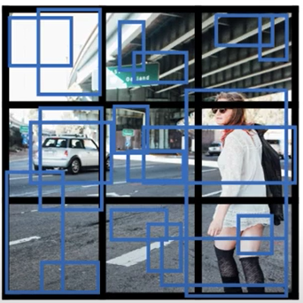
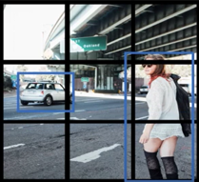
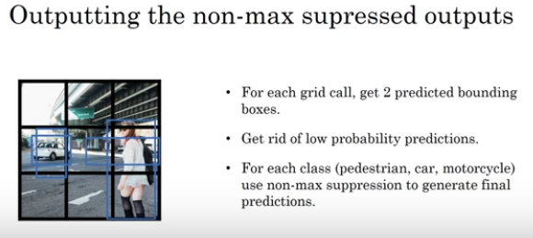
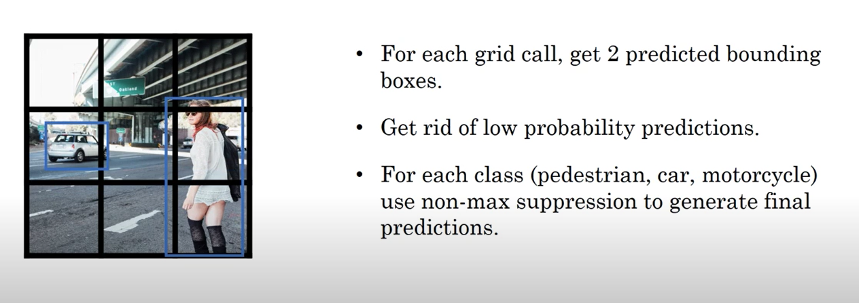
Summary
(x,y)
IOU→eliminates boxes
Intersecting same object
YOLO Training
Truth
BB
Target boxes:
One bounding box/object
w—width
w^{(k+1)} = w^{(k)} - α∂ε/∂w
Two bounding boxes/cell
>24 layers VGG+transfer learning
YOLO Prediction
One key technique used in the YOLO models is non-maximum suppression (NMS). NMS is a post-processing step that is used to improve the accuracy and efficiency of object detection. In object detection, it is common for multiple bounding boxes to be generated for a single object in an image. These bounding boxes may overlap or be located at different positions, but they all represent the same object. NMS is used to identify and remove redundant or incorrect bounding boxes and to output a single bounding box for each object in the image.
YOLO predicts multiple bounding boxes per grid cell. At training time, we only want one bounding box predictor to be responsible for each object. YOLO assigns one predictor to be “responsible” for predicting an object based on which prediction has the highest current IOU with the ground truth. This leads to specialization between the bounding box predictors. Each predictor gets better at forecasting certain sizes, aspect ratios, or classes of objects, improving the overall recall score.

Slide 18
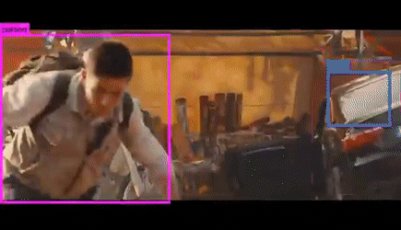
Summary
YOLO=Real-time Detection
https://www.youtube.com/watch?v=9s_FpMpdYW8
Advantage: Fast
Disadvantage: Small Object
Multi objects in same cell

Slide 19
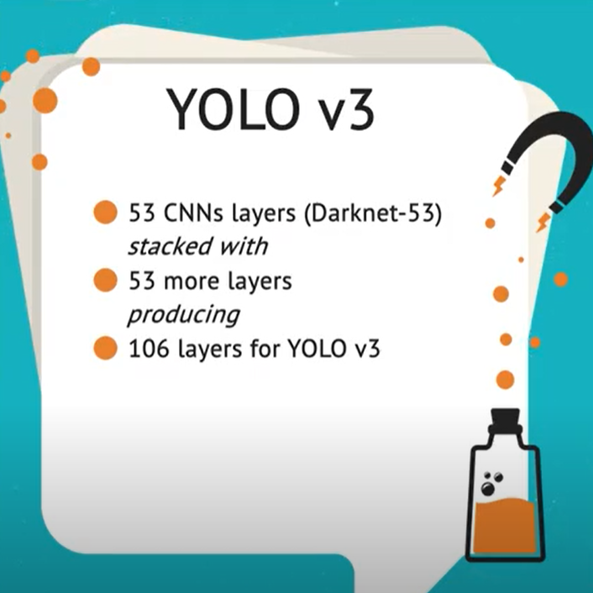
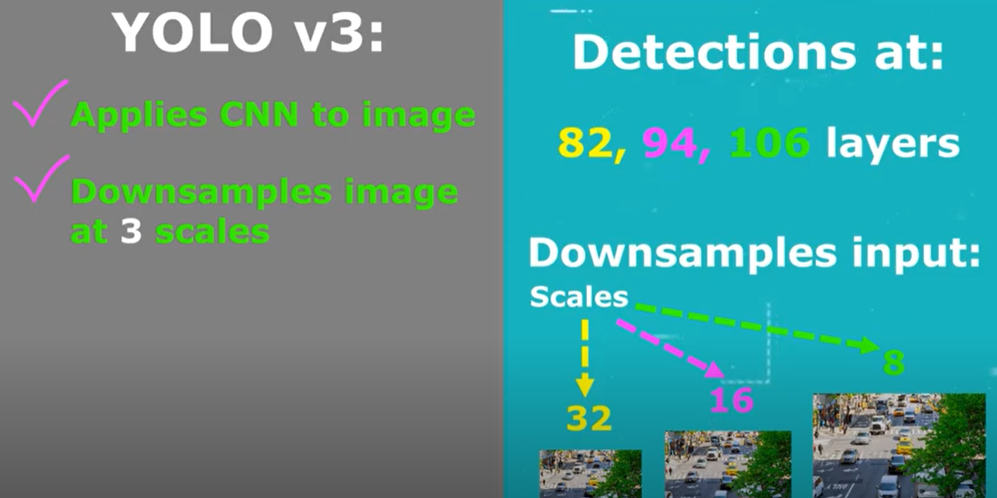
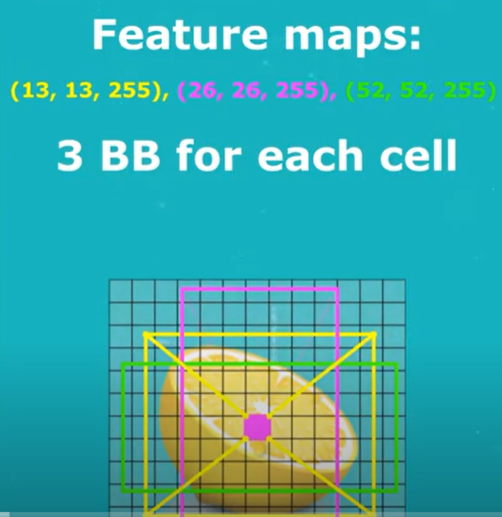
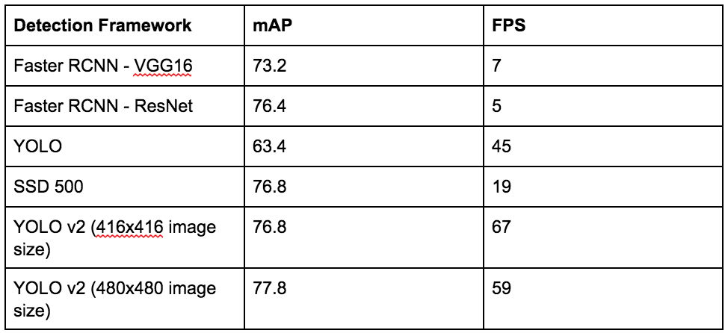
Summary
Mean Average Precision
Frame per second

Slide 20
YOLO v2
YOLO v2, also known as YOLO9000, was introduced in 2016 as an improvement over the original YOLO algorithm. It was designed to be faster and more accurate than YOLO and to be able to detect a wider range of object classes. This updated version also uses a different CNN backbone called Darknet-19, a variant of the VGGNet architecture with simple progressive convolution and pooling layers.
One of the main improvements in YOLO v2 is the use of anchor boxes. Anchor boxes are a set of predefined bounding boxes of different aspect ratios and scales. When predicting bounding boxes, YOLO v2 uses a combination of the anchor boxes and the predicted offsets to determine the final bounding box. This allows the algorithm to handle a wider range of object sizes and aspect ratios.
Another improvement in YOLO v2 is the use of batch normalization, which helps to improve the accuracy and stability of the model. YOLO v2 also uses a multi-scale training strategy, which involves training the model on images at multiple scales and then averaging the predictions. This helps to improve the detection performance of small objects.
YOLO v2 also introduces a new loss function better suited to object detection tasks. The loss
Summary

Slide 21
Summary
YOLO v3
YOLO v3 is the third version of the YOLO object detection algorithm. It was introduced in 2018 as an improvement over YOLO v2, aiming to increase the accuracy and speed of the algorithm.
One of the main improvements in YOLO v3 is the use of a new CNN architecture called Darknet-53. Darknet-53 is a variant of the ResNet architecture and is designed specifically for object detection tasks. It has 53 convolutional layers and is able to achieve state-of-the-art results on various object detection benchmarks.
Another improvement in YOLO v3 are anchor boxes with different scales and aspect ratios. In YOLO v2, the anchor boxes were all the same size, which limited the ability of the algorithm to detect objects of different sizes and shapes. In YOLO v3 the anchor boxes are scaled, and aspect ratios are varied to better match the size and shape of the objects being detected.
YOLO v3 also introduces the concept of "feature pyramid networks" (FPN). FPNs are a CNN architecture used to detect objects at multiple scales. They construct a pyramid of feature maps, with each level of the pyramid being used to detect objects at a different scale. This

Slide 22
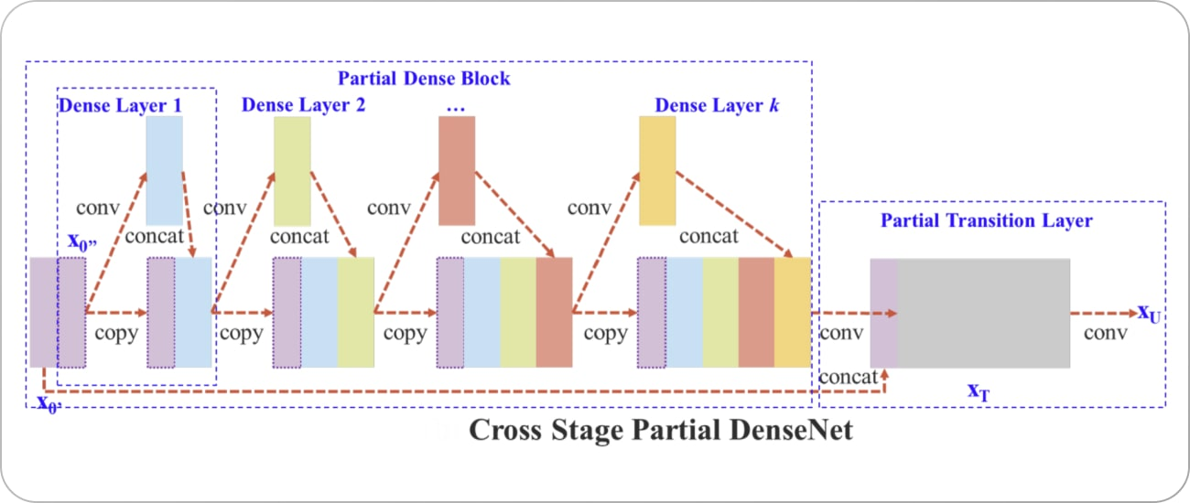
Summary
The primary improvement in YOLO v4 over YOLO v3 is the use of a new CNN architecture called CSPNet (shown below). CSPNet stands for "Cross Stage Partial Network" and is a variant of the ResNet architecture designed specifically for object detection tasks. It has a relatively shallow structure, with only 54 convolutional layers. However, it can achieve state-of-the-art results on various object detection benchmarks.

Slide 23
Summary
The primary improvement in YOLO v4 over YOLO v3 is the use of a new CNN architecture called CSPNet (shown below). CSPNet stands for "Cross Stage Partial Network" and is a variant of the ResNet architecture designed specifically for object detection tasks. It has a relatively shallow structure, with only 54 convolutional layers. However, it can achieve state-of-the-art results on various object detection benchmarks.

Slide 24
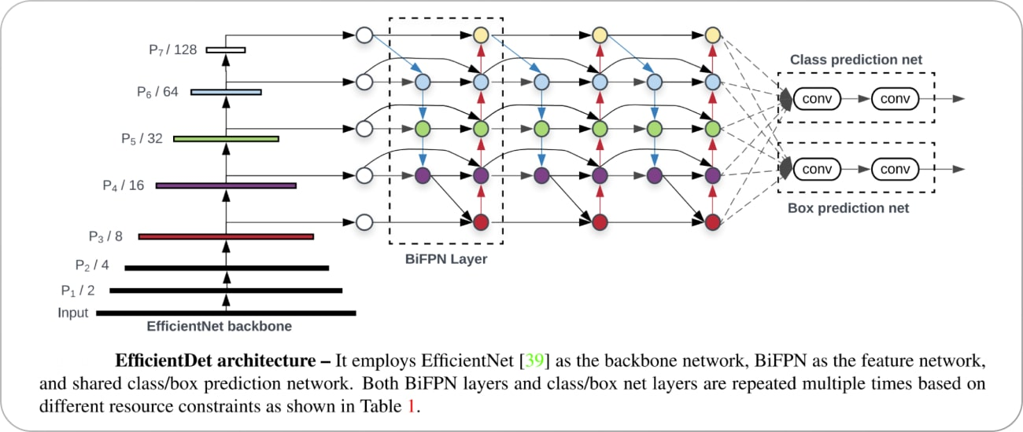
Summary
https://www.v7labs.com/blog/yolo-object-detection
Unlike YOLO, YOLO v5 uses a more complex architecture called EfficientDet (architecture shown below), based on the EfficientNet network architecture. Using a more complex architecture in YOLO v5 allows it to achieve higher accuracy and better generalization to a wider range of object categories.

Slide 25
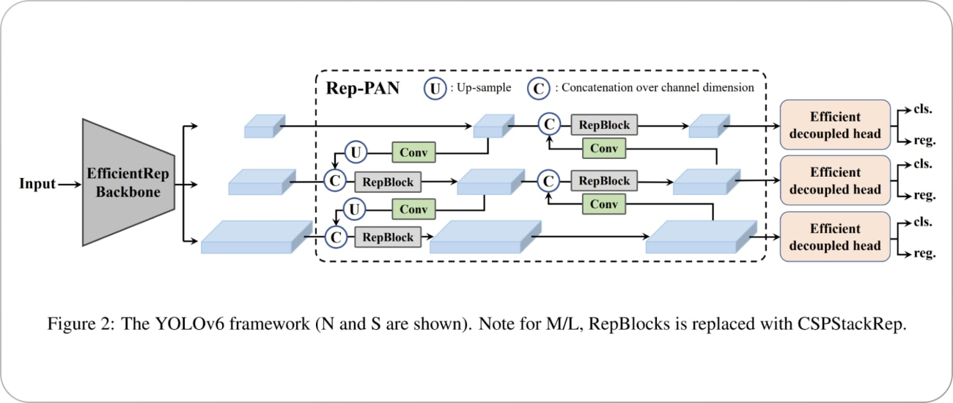
Summary
https://www.v7labs.com/blog/yolo-object-detection
YOLO v6 was proposed in 2022 by Li et al. as an improvement over previous versions. One of the main differences between YOLO v5 and YOLO v6 is the CNN architecture used. YOLO v6 uses a variant of the EfficientNet architecture called EfficientNet-L2. It’s a more efficient architecture than EfficientDet used in YOLO v5, with fewer parameters and a higher computational efficiency. It can achieve state-of-the-art results on various object detection benchmarks. The framework of the YOLO v6 model is shown below.

Slide 26
Summary
https://www.v7labs.com/blog/yolo-object-detection
YOLO v7, latest version of YOLO, has several improvements over the previous versions. One of the main improvements is the use of anchor boxes.
Anchor boxes are a set of predefined boxes with different aspect ratios that are used to detect objects of different shapes. YOLO v7 uses nine anchor boxes, which allows it to detect a wider range of object shapes and sizes compared to previous versions, thus helping to reduce the number of false positives.
A key improvement in YOLO v7 is the use of a new loss function called “focal loss.” Previous versions of YOLO used a standard cross-entropy loss function, which is known to be less effective at detecting small objects. Focal loss battles this issue by down-weighting the loss for well-classified examples and focusing on the hard examples—the objects that are hard to detect.

Slide 27
Summary
https://www.v7labs.com/blog/yolo-object-detection
YOLO v7 is a powerful and effective object detection algorithm, but it does have a few limitations.
YOLO v7, like many object detection algorithms, struggles to detect small objects. It might fail to accurately detecting objects in crowded scenes or when objects are far away from the camera.
YOLO v7 is also not perfect at detecting objects at different scales. This can make it difficult to detect objects that are either very large or very small compared to the other objects in the scene.
YOLO v7 can be sensitive to changes in lighting or other environmental conditions, so it may be inconvenient to use in real-world applications where lighting conditions may vary.
YOLO v7 can be computationally intensive, which can make it difficult to run in real-time on resource-constrained devices like smartphones or other edge devices.

Slide 28
Summary
Generally, single-shot object detection is better suited for real-time applications, while two-shot object detection is better for applications where accuracy is more important.
Object detection algorithms are broadly classified into two categories based on how many times the same input image is passed through a network.

Slide 29
Summary
The End

Slide 30
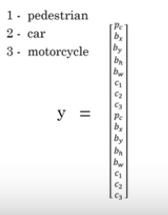
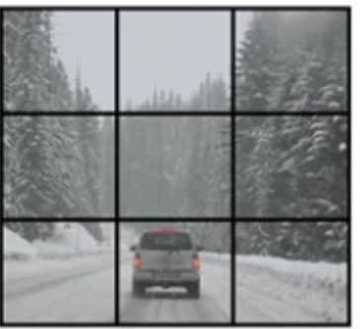
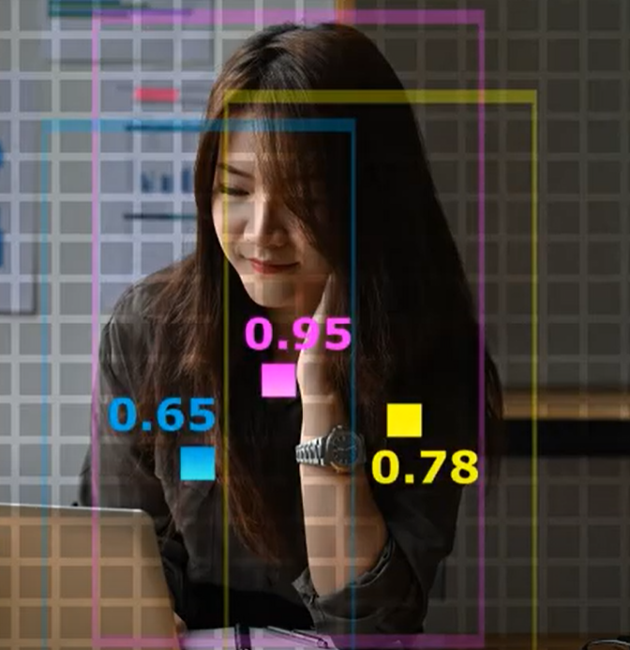
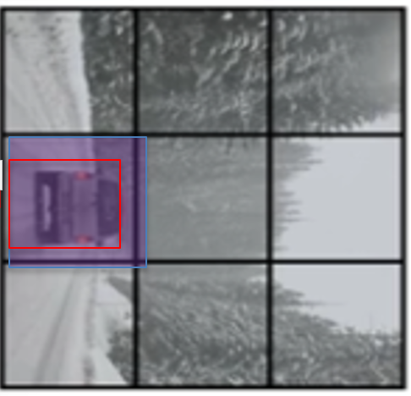
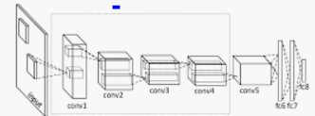
You Only Look Once (YOLO)
Target y
No car
car
3x3 cells (ROIs)
Assign 2 anchor boxes/cell
3x3x16
For one picture y is 3x3x2x8 flattened vector
16
9 cells
(4 coord.+4 classes)/BB
2 anchor boxes
3
3

Slide 31
You Only Look Once (YOLO)
Shihang Feng + GTS

Slide 32
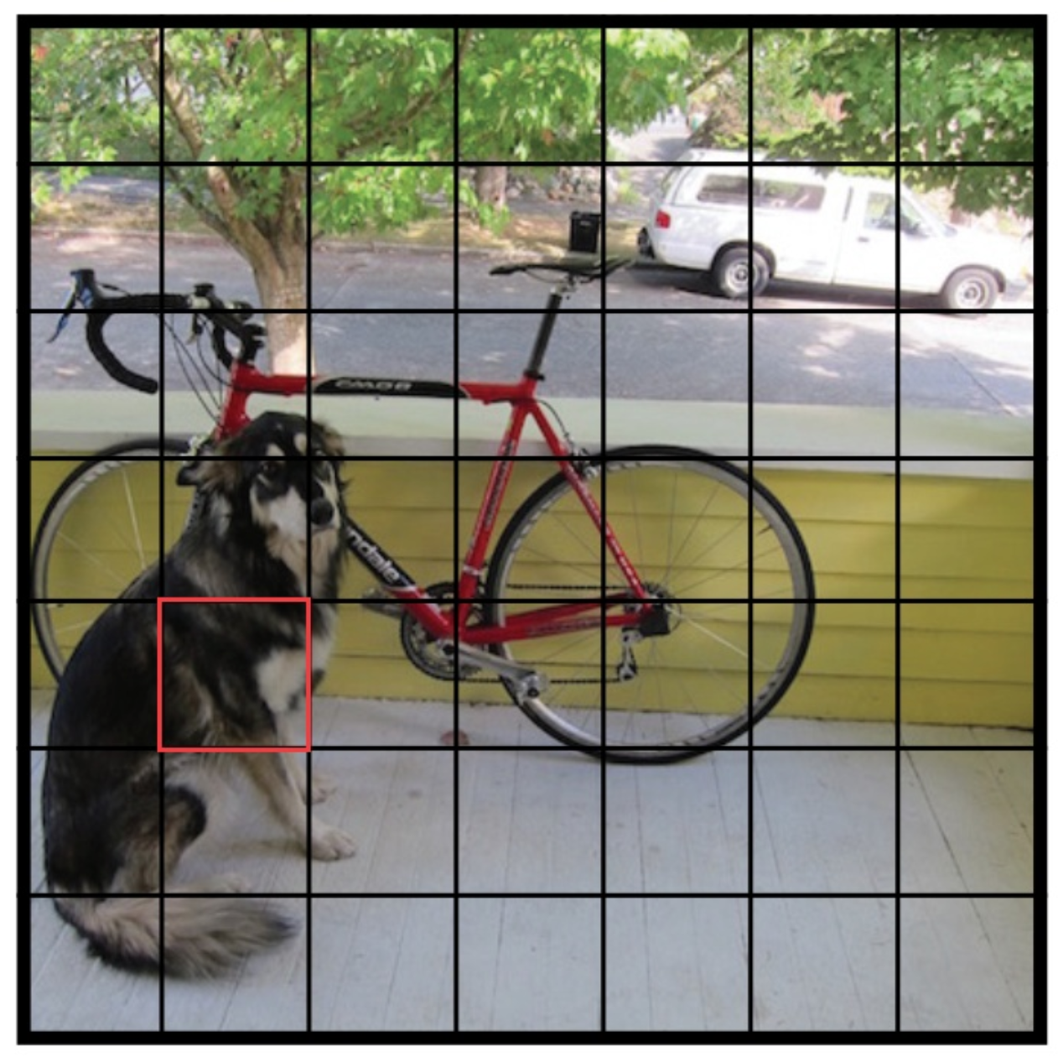
Confidence Metric
Yolo: Propose possible boxes + Classification +Localization
20
Class Probability
2
Confidence
8
2*(x,y,h,w)
Confidence C=Pr(object)*IOU
Pr(Object) is the probability the box contains an object.
In the training, if box contains an object, Pr(object)=1, Confidence=IOU, otherwise Pr(object)=Confidence=0
In the test, only confidence score will be output, the high score means the window contain object and location is correct

Slide 33
Localization, Classification and Detection
Bounding
Box
Multiple Objects
Assume 1 object

Slide 34
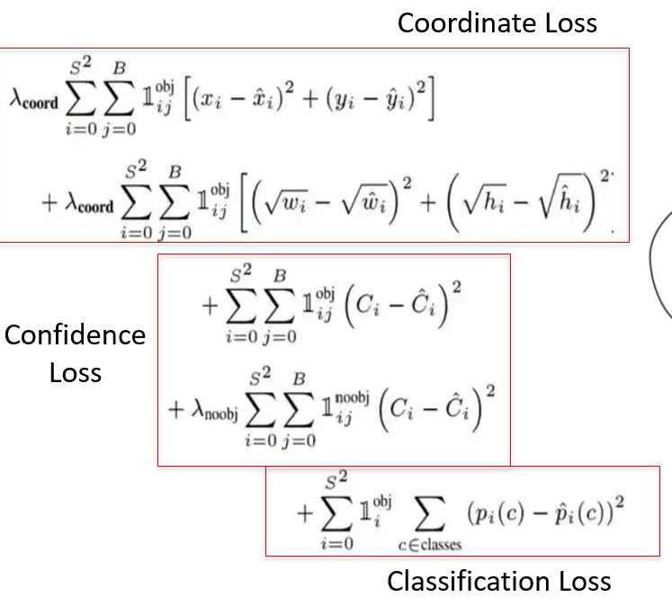


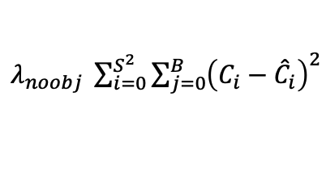

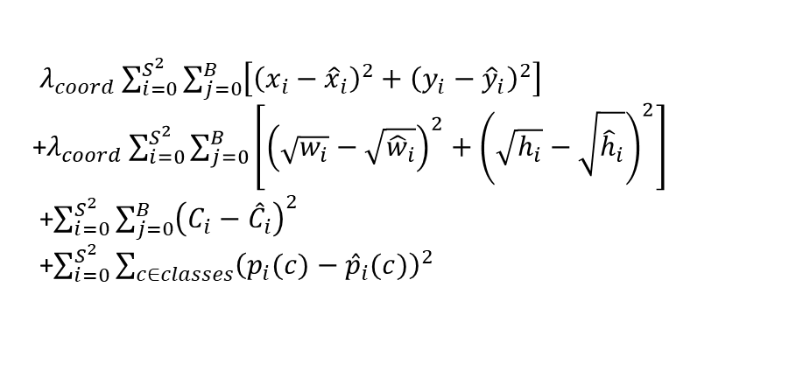
YOLO
i=cell #
j=BB #
$𝕀_{ij}^{obj}$=1, $𝕀_{ij}^{noobj}$=0 if i_{th} cell has a object center in it and the j_{th} bounding box has the
highest IoU among all the B bounding boxes with this cell, otherwise $𝕀_{ij}^{obj}$=0, $𝕀_{ij}^{noobj}$=1
Red box in the left image, $𝕀_{ij}^{obj}$=1, $𝕀_{ij}^{noobj}$=0
j BB index silent
Loss Function
S*S cells
$λ_{coord}\sum_{i=0}^{S^{2}}{\sum_{j=0}^{B}{\left[{\left(x_{i}−{\hat{x}}_{i}\right)}^{2}+{\left(y_{i}−{\hat{y}}_{i}\right)}^{2}\right]}}$
+$λ_{coord}\sum_{i=0}^{S^{2}}{\sum_{j=0}^{B}{\left[{\left(\sqrt{w_{i}}−\sqrt{{\hat{w}}_{i}}\right)}^{2}+{\left(\sqrt{h_{i}}−\sqrt{{\hat{h}}_{i}}\right)}^{2}\right]}}$
+$\sum_{i=0}^{S^{2}}{\sum_{j=0}^{B}{{\left(C_{i}−{\hat{C}}_{i}\right)}^{2}}}$
+$\sum_{i=0}^{S^{2}}{\sum_{c∈classes}{{\left(p_{i}(c)−{\hat{p}}_{i}(c)\right)}^{2}}}$
+
Confidence loss, coordinate loss and classification loss are calculated
Dog Center
Black box in the left image, $𝕀_{ij}^{obj}$=0, $𝕀_{ij}^{noobj}$=1
Loss Function
$λ_{noobj} \sum_{i=0}^{S^{2}}{\sum_{j=0}^{B}{{\left(C_{i}−{\hat{C}}_{i}\right)}^{2}}}$
Confidence=Pr(Object)*IOU If cell contains objects
Confidence=0 If cell doesn’tcontain objects
Only confidence loss are calculated

Slide 35

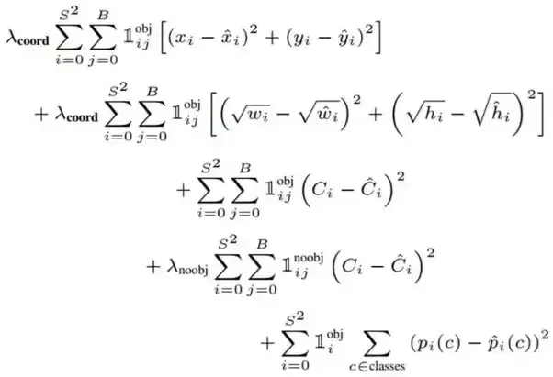
YOLO Loss Function
Confidence=Pr(Object)*IOU If cell contains objects
Confidence=0 If cell doesn’tcontain objects
Loss function
Indicator Functions: either 1 or 0
Sum over
i cells
Sum over
Bounding Boxes
Coordinate Loss
Merge and Purge
Confidence
Loss
20
Class Probability
2
Confidence
8
2*(x,y,h,w)
Confidence C=Pr(object)*IOU
Classification Loss

Slide 36
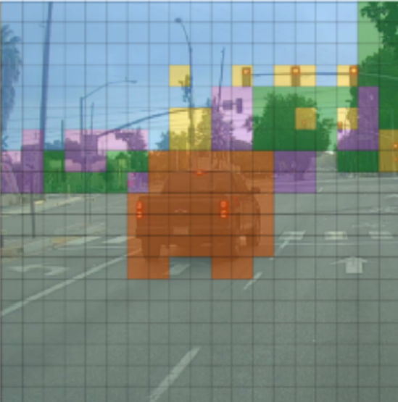
Training YOLO: Anchor Boxes+Target Vector
Step1: Each object has Center-of-mass
Step 2: Each cell has 2 anchor boxes
. (But only 1 needed/cell if 1 obj./cell)
Step 3: Iterate, resize+eliminate anchor boxes
Non-max suppresion
Eliminate anchor
boxes without objects.
Eliminate low p_{c}
Choose best anchor
box/cell
Non-max
Suppression per
Object class
L
Target Cube Y
p_{c}=0
0.2
Lower probability
bike in anchor box
High probability
Bike in anchor box
20
Class Probability
2
Confidence
p_{c} = p(bike)*IoU
8
2*(x,y,h,w)
Confidence=Pr(Object)*IOU If cell contains objects
Confidence=0 If cell doesn’t contain objects
Assign 2 anchor boxes/cell

Slide 37
Training YOLO: Anchor Boxes+Target Vector
Step1: Each object has Center-of-mass
Step 2: Each cell has 2 anchor boxes
. (But only 1 needed/cell if 1 obj./cell)
Step 3: Iterate, resize+eliminate anchor boxes
Assign 2 anchor boxes/cell

Slide 38
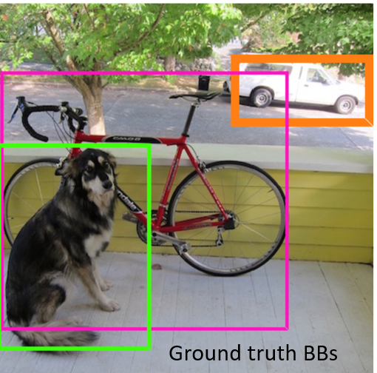
Training YOLO: Anchor Boxes+Target Vector
Step1: Each object has Center-of-mass
Step 2: Each cell has 2 anchor boxes
. (But only 1 needed/cell if 1 obj./cell)
Step 3: Iterate, resize+eliminate anchor boxes
Non-max suppresion
Eliminate anchor
boxes without objects.
Eliminate low p_{c}
Choose best anchor
box/cell
Non-max
Suppression per
Object class
L
Target Cube Y
p_{c}=0
0.2
Lower probability
bike in anchor box
High probability
Bike in anchor box
20
Class Probability
2
Confidence
p_{c} = p(bike)*IoU
8
2*(x,y,h,w)
Confidence=Pr(Object)*IOU If cell contains objects
Confidence=0 If cell doesn’t contain objects
Assign 2 anchor boxes/cell

Slide 39
Training YOLO: Anchor Boxes+Target Vector
Step1: Each object has Center-of-mass
Step 2: Each cell has 2 anchor boxes
. (But only 1 needed/cell if 1 obj./cell)
Step 3: Iterate, resize+eliminate anchor boxes
Non-max suppresion
Eliminate anchor
boxes without objects.
Eliminate low p_{c}
Choose best anchor
box/cell
Non-max
Suppression per
Object class
L
Target Cube Y
p_{c}=0
0.2
Lower probability
bike in anchor box
High probability
Bike in anchor box
20
Class Probability
2
Confidence
p_{c} = p(bike)*IoU
8
2*(x,y,h,w)
Confidence=Pr(Object)*IOU If cell contains objects
Confidence=0 If cell doesn’t contain objects
Assign 2 anchor boxes/cell

