Slide 1
I. Object Detection & Localization
II. Classification and Segmentation of Drone Images Using a Convolutional Neural Network
Shihang Feng and GTS
King Abdullah University of Science and Technology

Slide 2
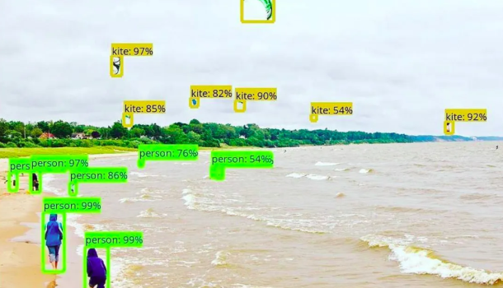
Object Detection & Localiztion
Goal: Detect & Localize Objects, and Classify
Find objects
Find 4 corners &
Center pt of box
Label objects

Slide 3
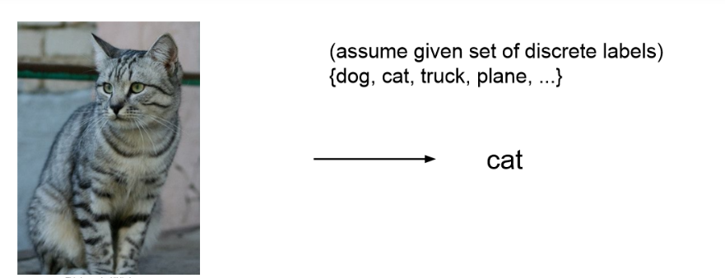
Image Classification
(picture classififcation)
One equation per cat: σ(W^{(N)} σ(W^{(N-1)} (..σ(W⁽¹⁾ x)..))=1

Slide 4
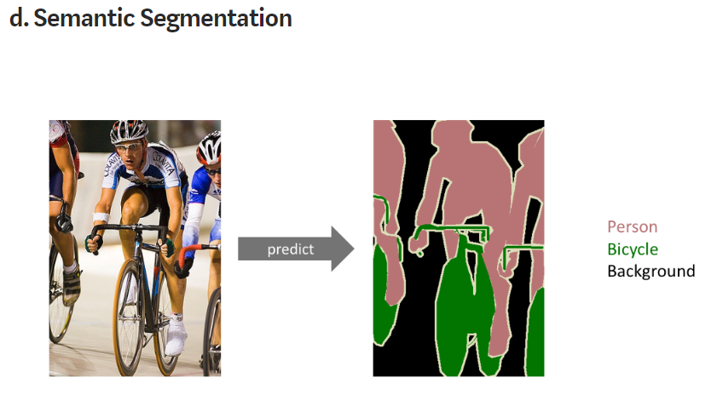
Semantic Segmentation
(pixel classififcation)
Goal: Label each output pixel with class
Receptive field
Three equations per/pixel: σ(W^{(N)} σ(W^{(N-1)} (..σ(W⁽¹⁾ x_{receptive} )..)) = (1,0,0)
σ(W^{(N)} σ(W^{(N-1)} (..σ(W⁽¹⁾ x’_{receptive} )..))=(0,1,0)
σ(W^{(N)} σ(W^{(N-1)} (..σ(W⁽¹⁾ x’_{receptive} )..))=(0,0,1)
σ(W^{(N)} σ(W^{(N-1)} (..σ(W⁽¹⁾ x’_{receptive} )..))=(1,0,0)

Slide 5
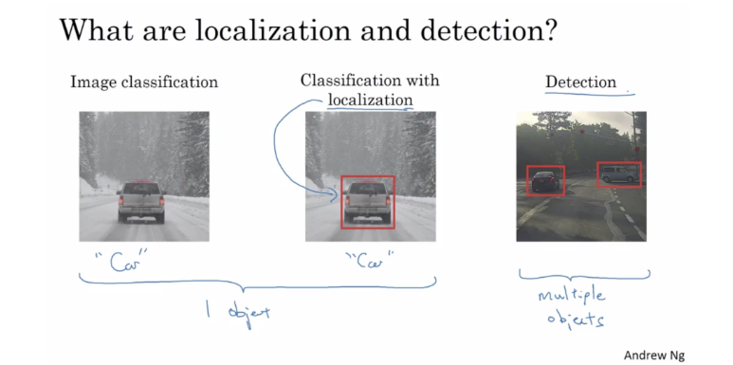
Localization, Classification and Detection
Bounding
Box
Multiple Objects
Assume 1 object

Slide 6
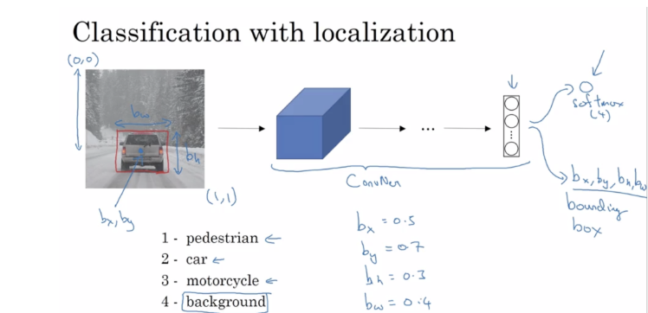
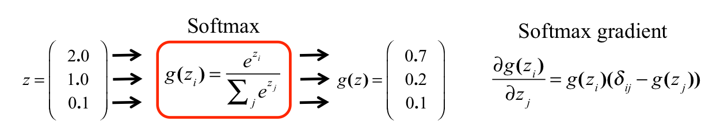
Localization, Classification and Detection
Mixed regression
+ classification
(0,0)
b_{x}
b_{y}
b_{w}
b_{h}
c₁
c₂
c₃
c₄
b_{w}
8x1
softmax
b_{h}
(1,1)
(b_{x},b_{y})
b_{x}=0.5
b_{y}=0.7
b_{h}=0.3
b_{w}=0.4
c₁
c₂
c₃
c₄

Slide 7
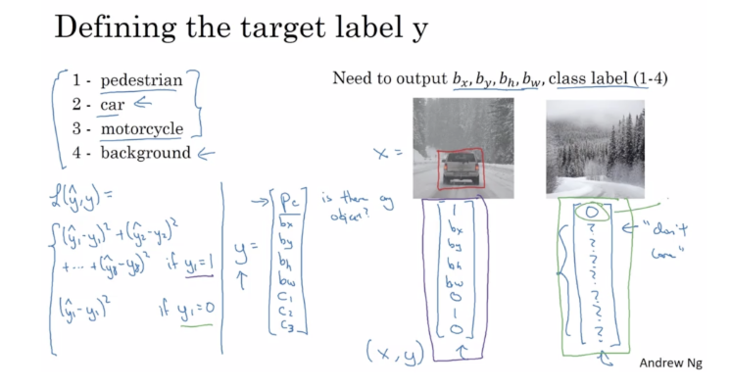
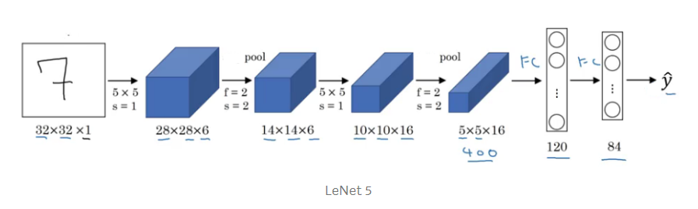
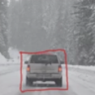
Localization, Classification and Detection
Classes
Goal: Output
X=
Loss Function
[(y₁-y₁’)² +(y₂-y₂’)² +
…. +(y₈-y₈’)² ] if y₁=1
L(y,y’) =
(y₁-y₁’)² if y₁=0
y₁
y₂
y₃
y₄
y₅
y₆
y₇
y₈
y₉
p_{c}
b_{x}
b_{y}
b_{w}
b_{h}
c₁
c₂
c₃
c₄
is there an object?
y₁=p_{c}
=
Yes if y₁=1
No if y₁=0

Slide 8
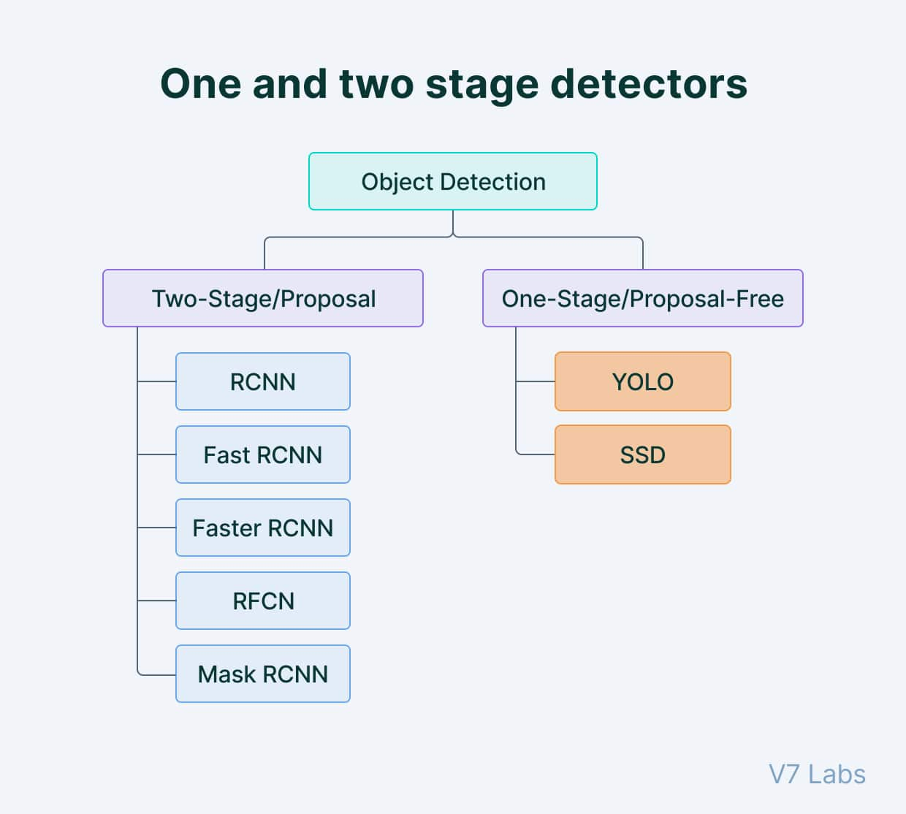
One and Two Stage Detectors
Generally, single-shot object detection is better suited for real-time applications, while two-shot object detection is better for applications where accuracy is more important.
Object detection algorithms are broadly classified into two categories based on how many times the same input image is passed through a network.

Slide 9
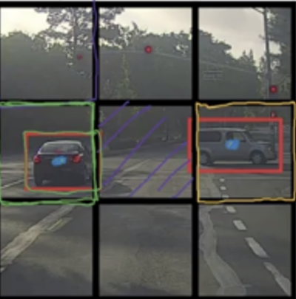
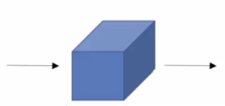
YOLO
Target output
3x3x8
p_{c}
b_{x}
b_{y}
b_{w}
b_{h}
c₁
c₂
c₃
0
?
?
?
?
?
?
?
0
?
?
?
?
?
?
?
0
?
?
?
?
?
?
?
3x3 cells
Y=Target output
3x3x8
1
b_{x}
b_{y}
b_{w}
b_{h}
0
1
0
0
?
?
?
?
?
?
?
1
b_{x}
b_{y}
b_{w}
b_{h}
0
1
0
w^{(k+1)} = w^{(k)} - α∂ε/∂w
0
?
?
?
?
?
?
?
0
?
?
?
?
?
?
?
0
?
?
?
?
?
?
?
You Only Look Once

Slide 10
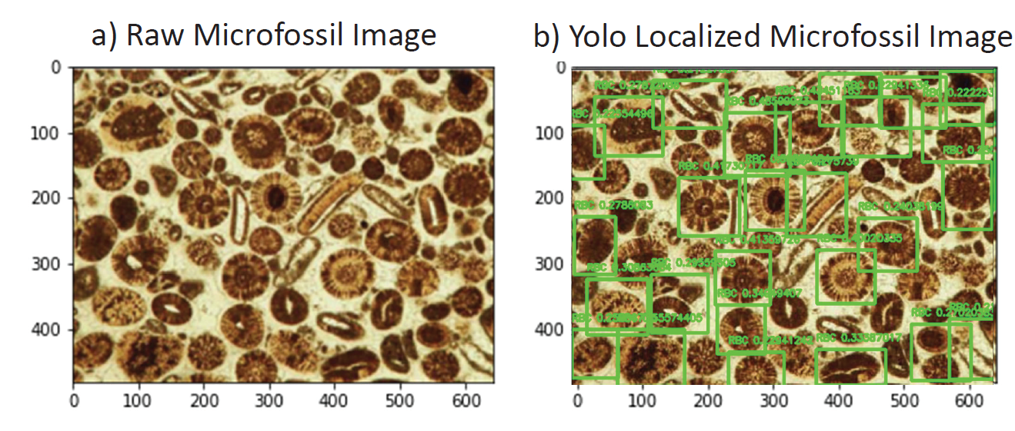

Slide 11
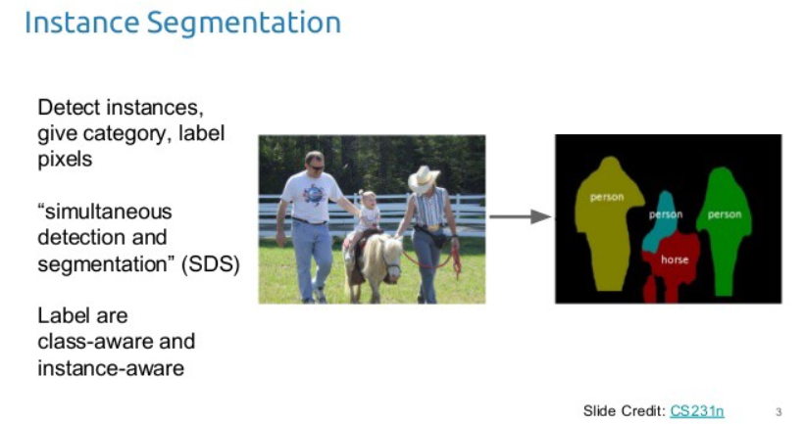
Instance Segmentation
Semantic does not differentiate
one person from another

Slide 12
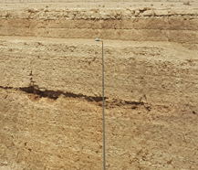
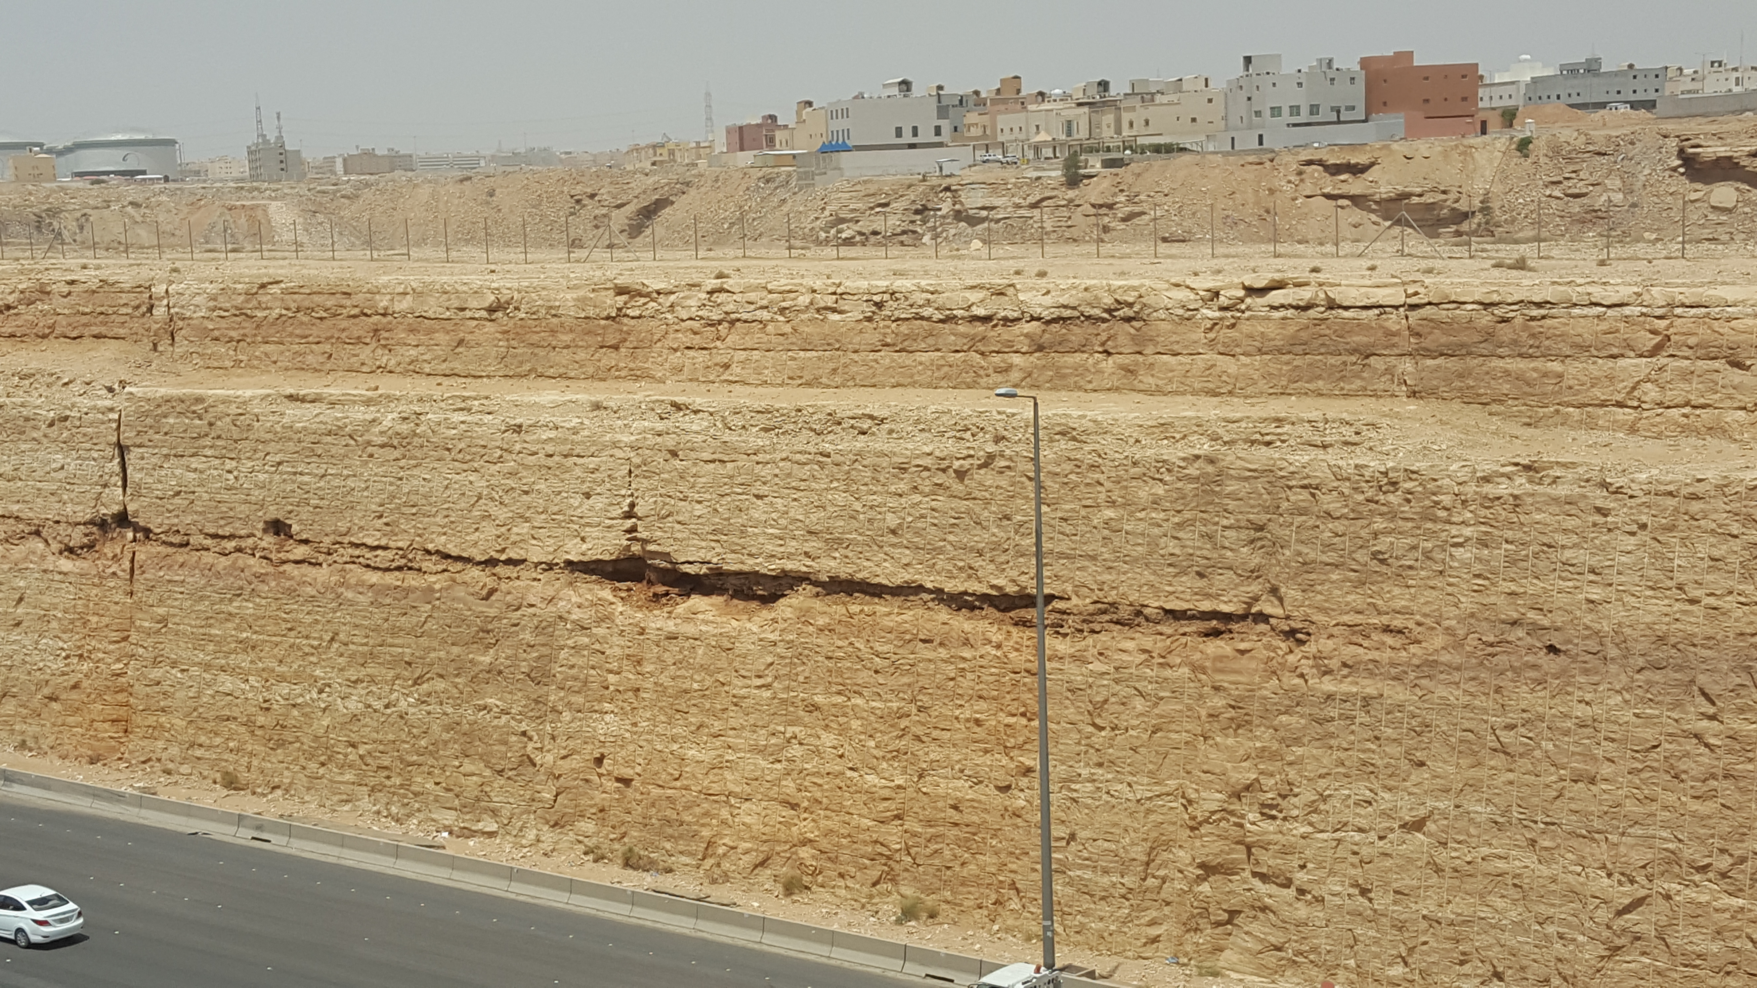
Localization, Classification and Detection
a) Image Classification
c) Detection
Bounding
Box
Multiple Objects
Karst
Karst
Karst
b) Image Classification
with Localization
Bounding
Box
Karst
Multiple Karsts

Slide 13
Computing Box Coordinates & Class
(0,0)
p_{c}
b_{x}
b_{y}
b_{height}
b_{width}
c₁
c₂
c₃
b_{width}
b_{height}
CNN
y =
(b_{x},b_{y})
(1,1)
c₁ = 1
c₂ = 1
c₃ = 1
P_{c} = 1
karst
limestone
shale
none-of-above

Slide 14
Localization, Classification and Detection
Summary
Classes
Goal: Output
X=
Loss Function
[(y₁-y₁’)² +(y₂-y₂’)² +
…. +(y₈-y₈’)² ] if y₁=1
L(y,y’) =
(y₁-y₁’)² if y₁=0
y₁
y₂
y₃
y₄
y₅
y₆
y₇
y₈
y₉
p_{c}
b_{x}
b_{y}
b_{w}
b_{h}
c₁
c₂
c₃
c₄
is there an object?
y₁=p_{c}
=
Yes if y₁=1
No if y₁=0

Slide 15
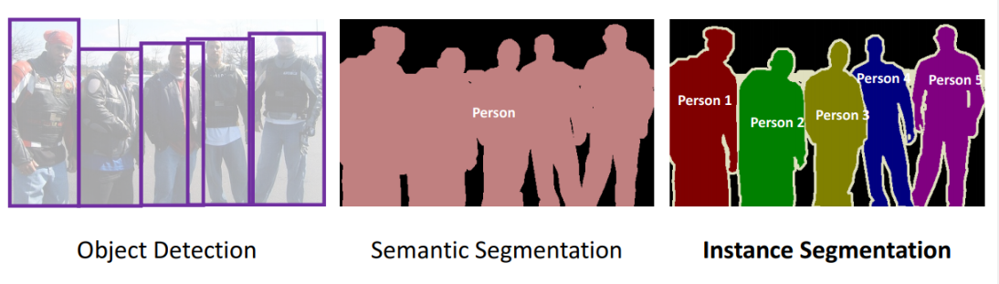
Summary
Object, Semantic, Instance Segmentation

Slide 16
Summary
The End

Slide 17
YOLO v2
YOLO v2, also known as YOLO9000, was introduced in 2016 as an improvement over the original YOLO algorithm. It was designed to be faster and more accurate than YOLO and to be able to detect a wider range of object classes. This updated version also uses a different CNN backbone called Darknet-19, a variant of the VGGNet architecture with simple progressive convolution and pooling layers.
One of the main improvements in YOLO v2 is the use of anchor boxes. Anchor boxes are a set of predefined bounding boxes of different aspect ratios and scales. When predicting bounding boxes, YOLO v2 uses a combination of the anchor boxes and the predicted offsets to determine the final bounding box. This allows the algorithm to handle a wider range of object sizes and aspect ratios.
Another improvement in YOLO v2 is the use of batch normalization, which helps to improve the accuracy and stability of the model. YOLO v2 also uses a multi-scale training strategy, which involves training the model on images at multiple scales and then averaging the predictions. This helps to improve the detection performance of small objects.
YOLO v2 also introduces a new loss function better suited to object detection tasks. The loss
Summary

Slide 18
Summary
YOLO v3
YOLO v3 is the third version of the YOLO object detection algorithm. It was introduced in 2018 as an improvement over YOLO v2, aiming to increase the accuracy and speed of the algorithm.
One of the main improvements in YOLO v3 is the use of a new CNN architecture called Darknet-53. Darknet-53 is a variant of the ResNet architecture and is designed specifically for object detection tasks. It has 53 convolutional layers and is able to achieve state-of-the-art results on various object detection benchmarks.
Another improvement in YOLO v3 are anchor boxes with different scales and aspect ratios. In YOLO v2, the anchor boxes were all the same size, which limited the ability of the algorithm to detect objects of different sizes and shapes. In YOLO v3 the anchor boxes are scaled, and aspect ratios are varied to better match the size and shape of the objects being detected.
YOLO v3 also introduces the concept of "feature pyramid networks" (FPN). FPNs are a CNN architecture used to detect objects at multiple scales. They construct a pyramid of feature maps, with each level of the pyramid being used to detect objects at a different scale. This

Slide 19
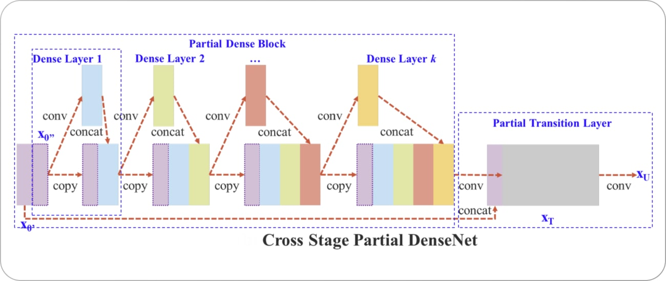
Summary
The primary improvement in YOLO v4 over YOLO v3 is the use of a new CNN architecture called CSPNet (shown below). CSPNet stands for "Cross Stage Partial Network" and is a variant of the ResNet architecture designed specifically for object detection tasks. It has a relatively shallow structure, with only 54 convolutional layers. However, it can achieve state-of-the-art results on various object detection benchmarks.

Slide 20
Summary
The primary improvement in YOLO v4 over YOLO v3 is the use of a new CNN architecture called CSPNet (shown below). CSPNet stands for "Cross Stage Partial Network" and is a variant of the ResNet architecture designed specifically for object detection tasks. It has a relatively shallow structure, with only 54 convolutional layers. However, it can achieve state-of-the-art results on various object detection benchmarks.

Slide 21
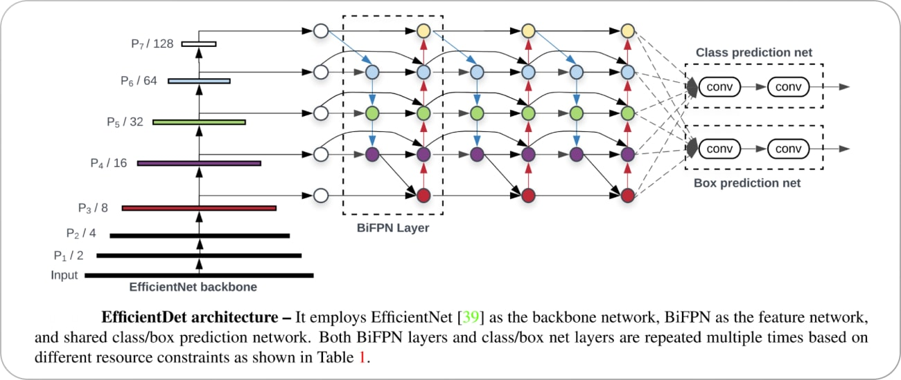
Summary
https://www.v7labs.com/blog/yolo-object-detection
Unlike YOLO, YOLO v5 uses a more complex architecture called EfficientDet (architecture shown below), based on the EfficientNet network architecture. Using a more complex architecture in YOLO v5 allows it to achieve higher accuracy and better generalization to a wider range of object categories.

Slide 22
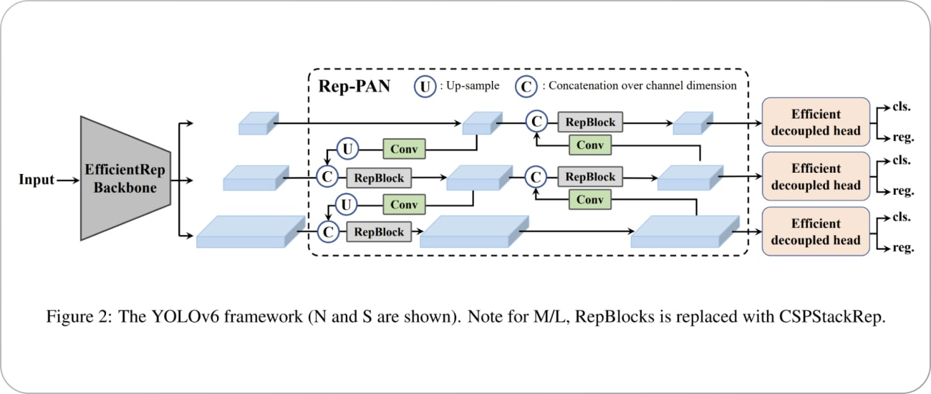
Summary
https://www.v7labs.com/blog/yolo-object-detection
YOLO v6 was proposed in 2022 by Li et al. as an improvement over previous versions. One of the main differences between YOLO v5 and YOLO v6 is the CNN architecture used. YOLO v6 uses a variant of the EfficientNet architecture called EfficientNet-L2. It’s a more efficient architecture than EfficientDet used in YOLO v5, with fewer parameters and a higher computational efficiency. It can achieve state-of-the-art results on various object detection benchmarks. The framework of the YOLO v6 model is shown below.

Slide 23
Summary
https://www.v7labs.com/blog/yolo-object-detection
YOLO v7, latest version of YOLO, has several improvements over the previous versions. One of the main improvements is the use of anchor boxes.
Anchor boxes are a set of predefined boxes with different aspect ratios that are used to detect objects of different shapes. YOLO v7 uses nine anchor boxes, which allows it to detect a wider range of object shapes and sizes compared to previous versions, thus helping to reduce the number of false positives.
A key improvement in YOLO v7 is the use of a new loss function called “focal loss.” Previous versions of YOLO used a standard cross-entropy loss function, which is known to be less effective at detecting small objects. Focal loss battles this issue by down-weighting the loss for well-classified examples and focusing on the hard examples—the objects that are hard to detect.

Slide 24
Summary
https://www.v7labs.com/blog/yolo-object-detection
YOLO v7 is a powerful and effective object detection algorithm, but it does have a few limitations.
YOLO v7, like many object detection algorithms, struggles to detect small objects. It might fail to accurately detecting objects in crowded scenes or when objects are far away from the camera.
YOLO v7 is also not perfect at detecting objects at different scales. This can make it difficult to detect objects that are either very large or very small compared to the other objects in the scene.
YOLO v7 can be sensitive to changes in lighting or other environmental conditions, so it may be inconvenient to use in real-world applications where lighting conditions may vary.
YOLO v7 can be computationally intensive, which can make it difficult to run in real-time on resource-constrained devices like smartphones or other edge devices.

Slide 25
Summary
Generally, single-shot object detection is better suited for real-time applications, while two-shot object detection is better for applications where accuracy is more important.
Object detection algorithms are broadly classified into two categories based on how many times the same input image is passed through a network.

Slide 26
Summary
The End

Slide 27


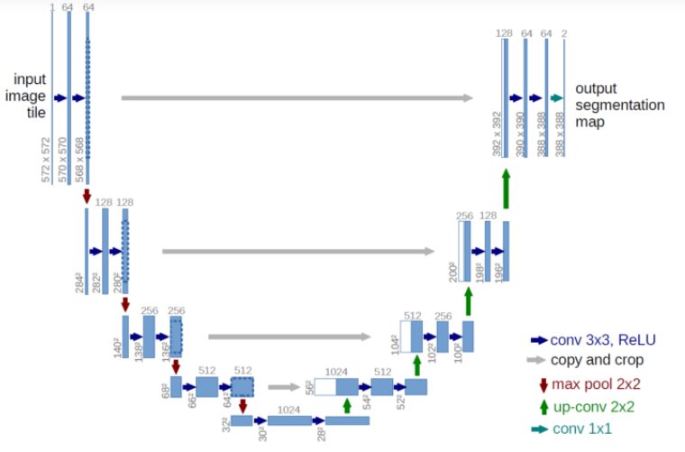
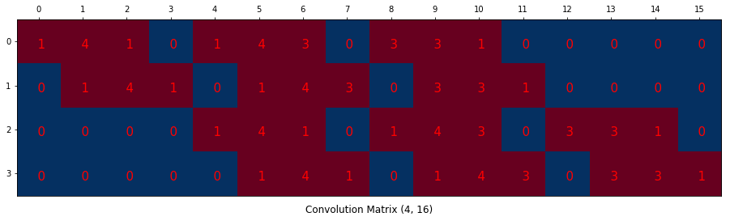
U-Net
Summary
Spatial size decreases
by pooling
z^{(n+1)} =W^{(n+1)} a^{(n)}
# features increase
Spatial size increases
by upsampling
z^{(n+1)} =W^{T(n+1)} a^{(n)}
“~deconvolutions”

Slide 28
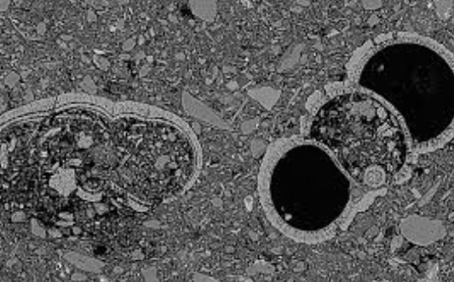
Summary: Object, Semantic, Instance Segmentation
Instance segmentation
Object detection
Karst 1
Karst 2
Semantic segmentation
Karst

Slide 29
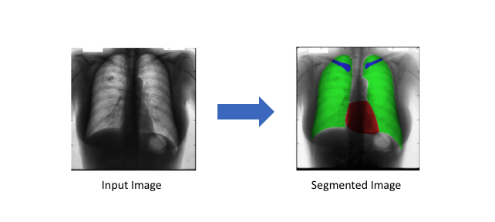
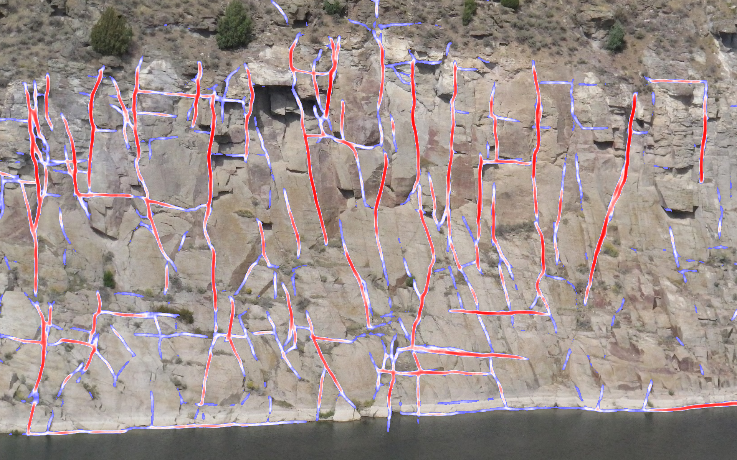
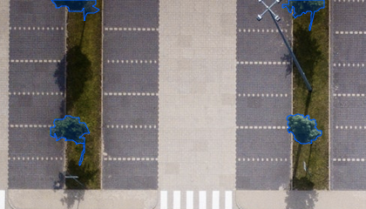
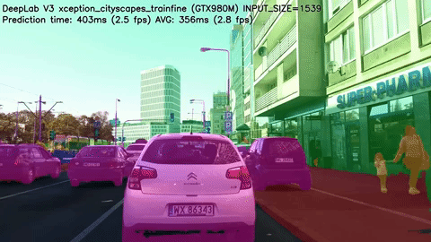
Semantic Segmentation

Slide 30
The End
Summary

Slide 31
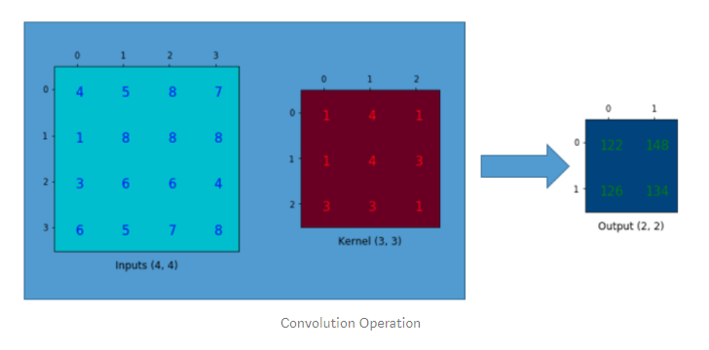
By down sampling, the model better understands “WHAT” is present in the image, but it loses the information of “WHERE” it is present.
The height and width of the image gradually reduces (down sampling, because of pooling) which helps the filters in the deeper layers to focus on a larger receptive field (context).

Slide 32
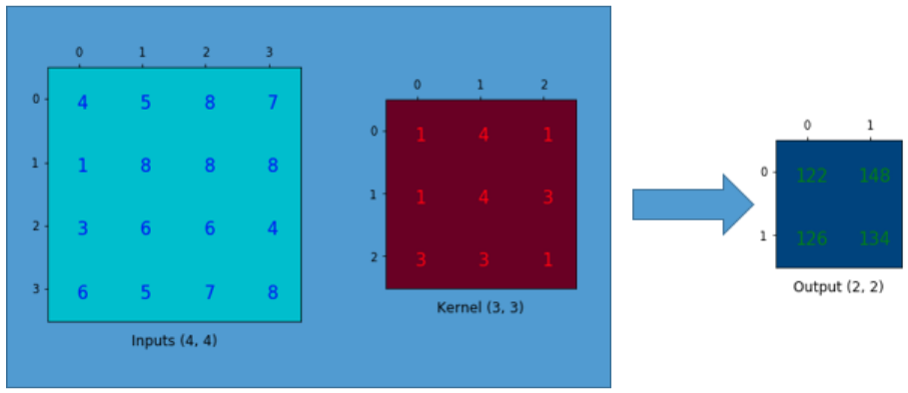
U-Net
Spatial size decreases
by pooling
z^{(n+1)} =W^{(n+1)} a^{(n)}
# features increase
Spatial size increases
by upsampling
z^{(n+1)} =W^{T(n+1)} a^{(n)}
“~deconvolutions”

Slide 33
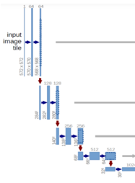
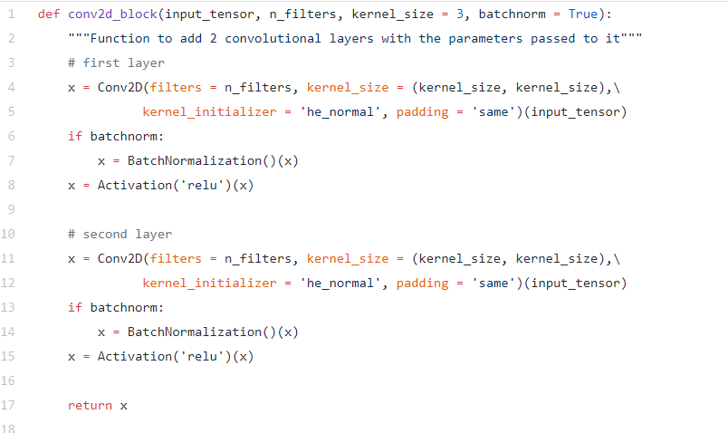
Block

Slide 34
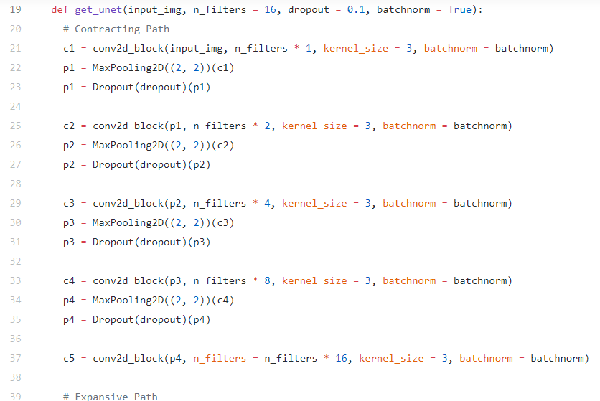

Slide 35
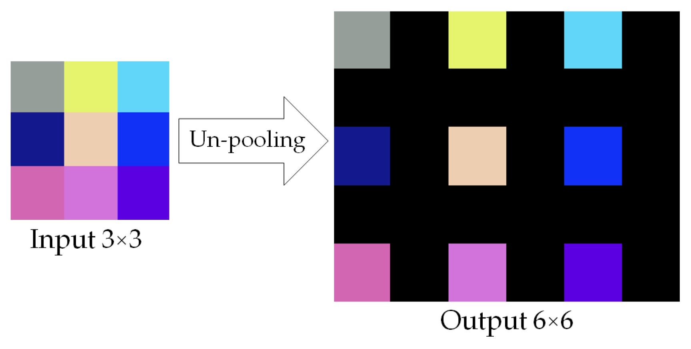
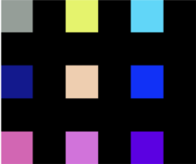
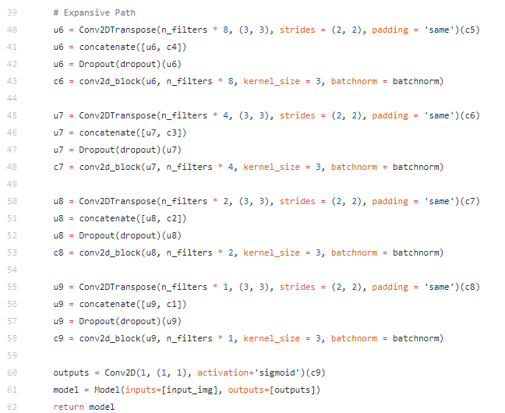
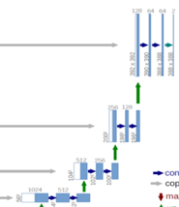
Convolution with
a filter
fills in blanks
unpooling
Bridge or Skip
Bridge or Skip

Slide 36
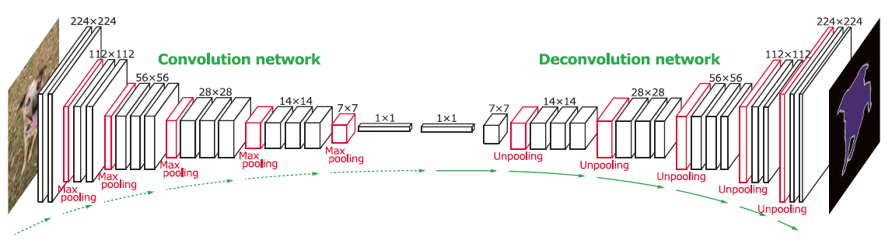
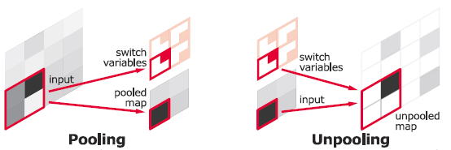
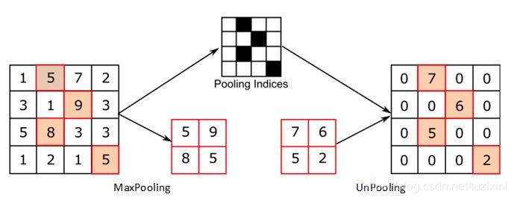
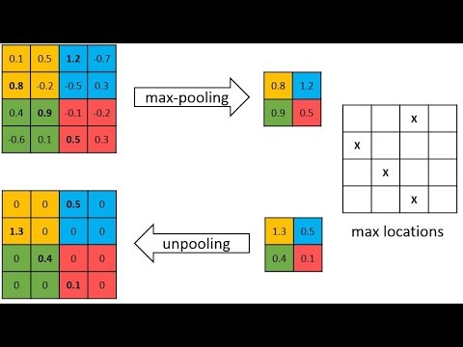
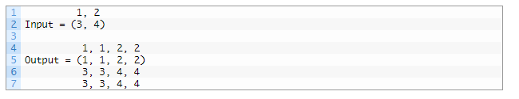
https://towardsdatascience.com/understanding-semantic-segmentation-with-unet-6be4f42d4b47
3 4 | ... https://machinelearningmastery.com/upsampling-and-transpose-convolution-layers-for-generative-adversarial-networks/ # define model model = Sequential() model.add(UpSampling2D())

Slide 37
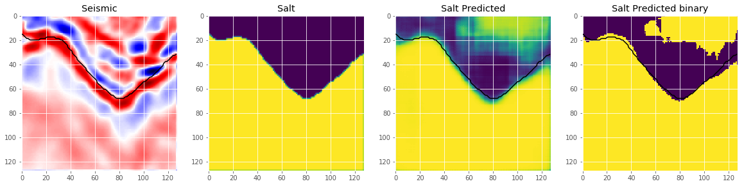
https://towardsdatascience.com/understanding-semantic-segmentation-with-unet-6be4f42d4b47
Salt Prediction
We use Keras callbacks to implement:
Learning rate decay if the validation loss does not improve for 5 continues epochs.
Early stopping if the validation loss does not improve for 10 continuous epochs.
Save the weights only if there is improvement in validation loss.
We use a batch size of 32.
Note that there could be a lot of scope to tune these hyper parameters and further improve the model performance.
The model is trained on P4000 GPU and takes less than 20 mins to train.

Slide 38
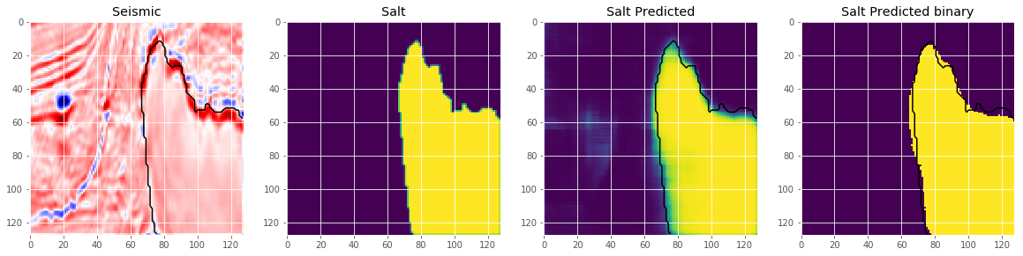
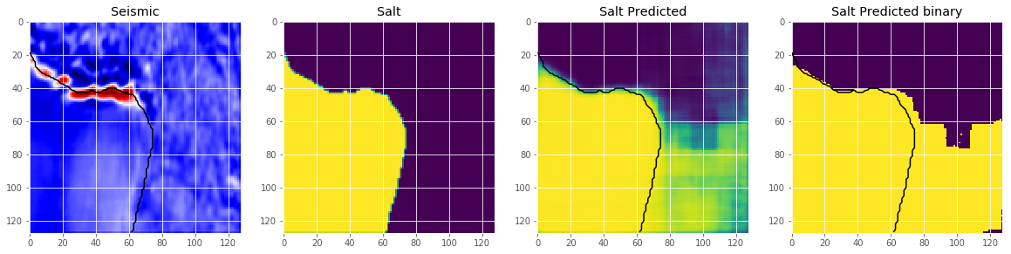
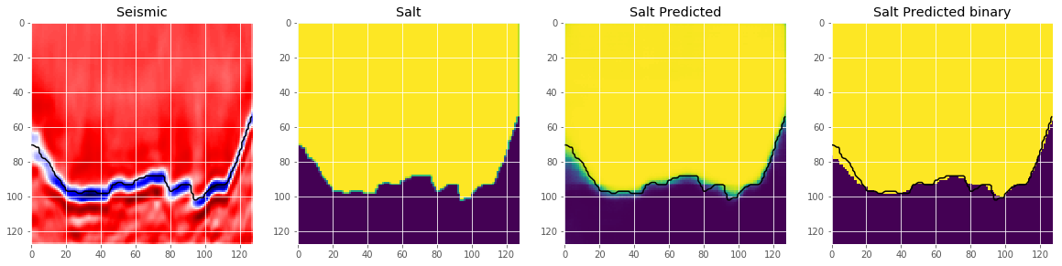
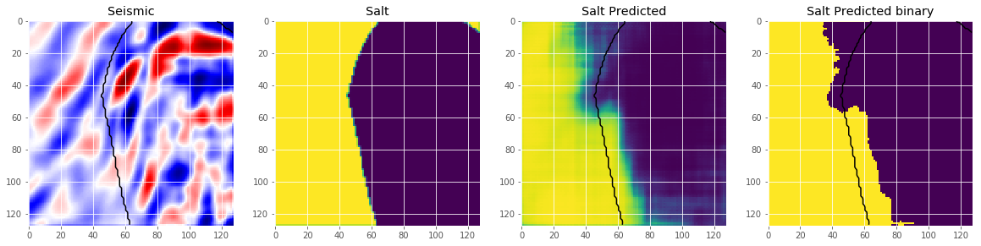
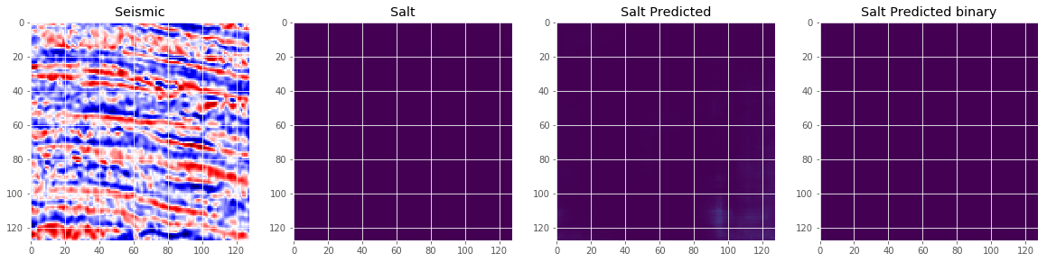
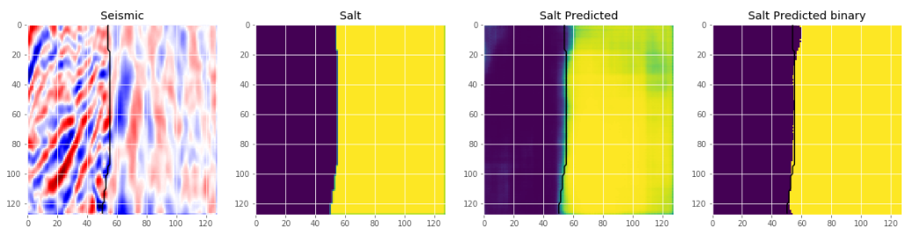
https://towardsdatascience.com/understanding-semantic-segmentation-with-unet-6be4f42d4b47

Slide 39
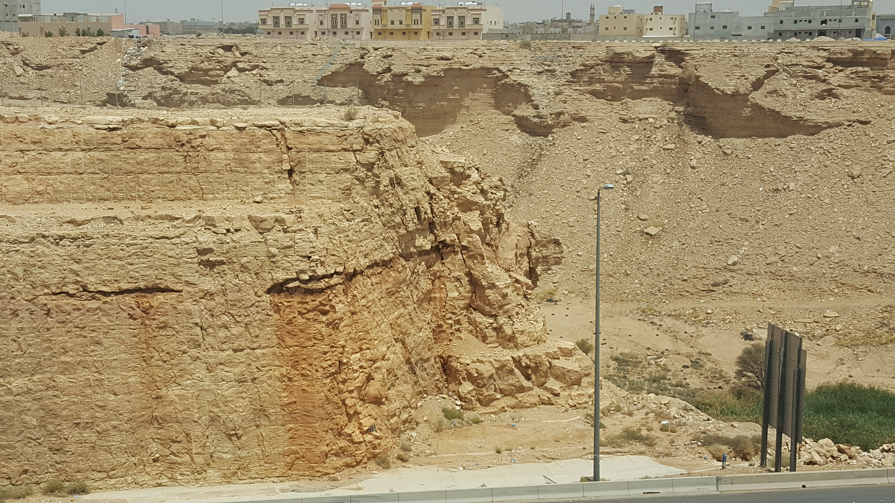
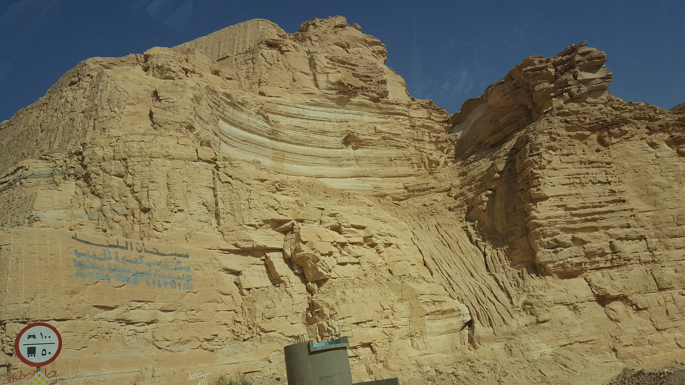

https://mail.google.com/mail/u/0/#inbox/FMfcgxwDrbzMLGlqjkWPrZJwqjbVHQbZ?projector=1

Slide 40


Slide 41


Slide 42


Slide 43

U-Net
Spatial size decreases
by pooling
z^{(n+1)} =W^{(n+1)} a^{(n)}
# features increase
Spatial size increases
by upsampling
z^{(n+1)} =W^{T(n+1)} a^{(n)}
convolutions
“~deconvolutions”

Slide 44


Slide 45


Slide 46



Slide 47






