Slide 1
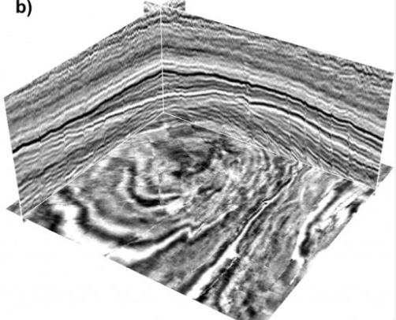
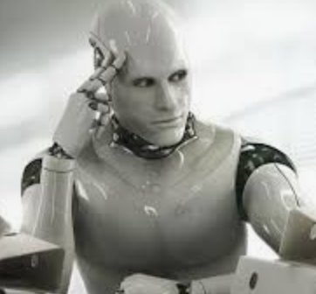
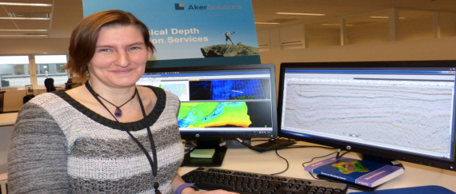
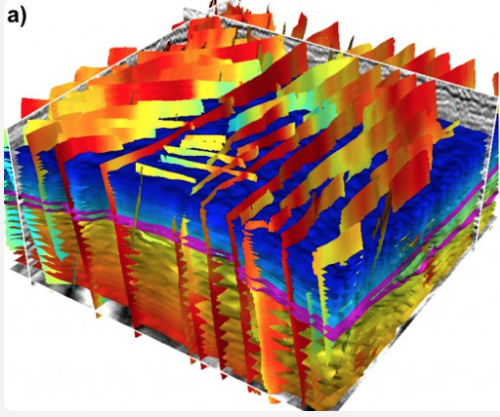

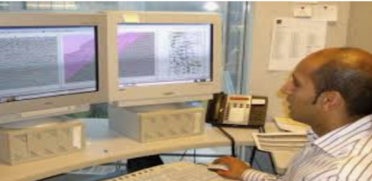
Seismic Interpretation
Seismic Interpretation Workflow
Seismic Record → Geology
3D Seismic Imaging
30 People
Seismic Interpreter
Months
Weeks
3D Geology Structure
3 hours
…

Slide 2
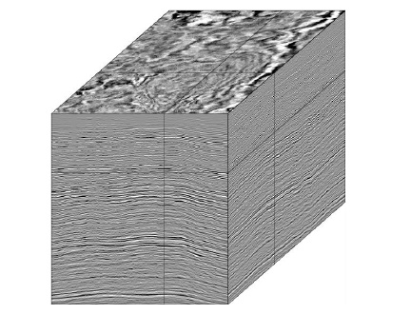
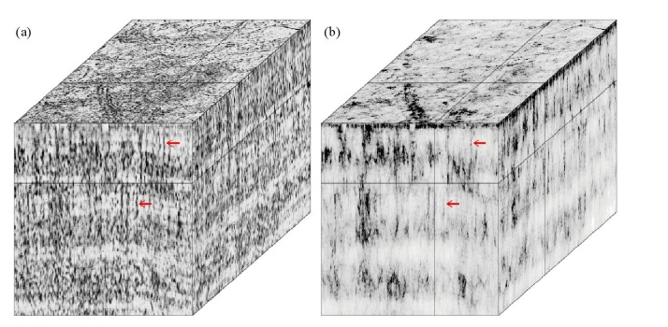
CNN Fault Detection: Field Data+Coherency
Input
Y Coherency
1000x653x1083
2.5 hours with 400 cores

Slide 3
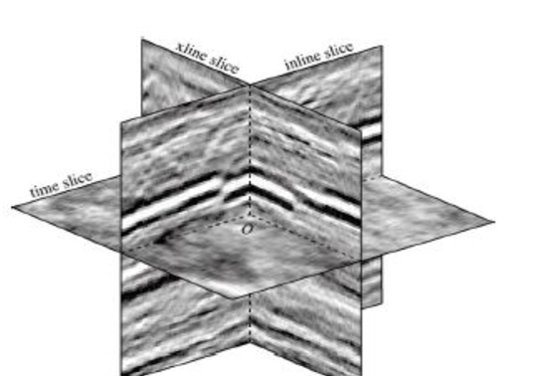
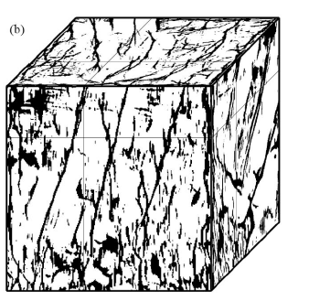
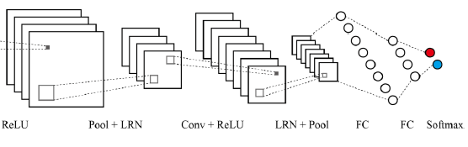
Aramco Fault Interpretation by CNN
(Xiong, Ji, Wang, AlBinHassan, Ali & Luo, 2018, Geophysics)
X
Y
(y=1→fault; y=0→non-fault)
24x24x3
(x, y, t)
73% Accuracy!
5x5x64
384x1
5x5x32
192x1
o
o
o
Conv Pool+LRN
Conv Pool+LRN
FC
FC
Soft
Max
+
ReLU
+
ReLU
2x2
2x2
dx=25 m, dt=2 ms
Training Data: 8 cubes, 50,000 points for faults/cube

Slide 4
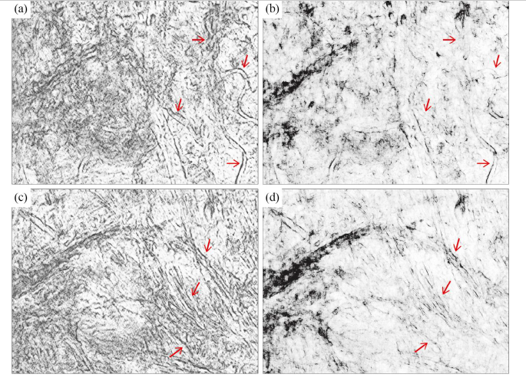
Aramco Fault CNN
Y Coherency
Training (73% accuracy)
Testing (73% accuracy)
Actual (74% accuracy)

Slide 5
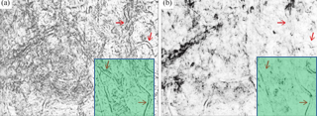
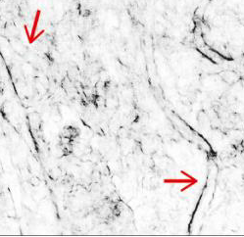
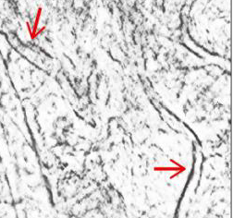
Aramco Fault CNN

Slide 6
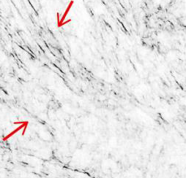
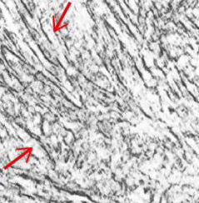
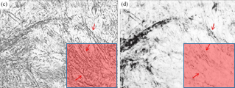
Aramco Fault CNN

Slide 7
Aramco Fault CNN

Slide 8
Labs | Purpose | Link
1 K-means and DBSCAN | Learn how K-means and DBSCAN work and hyper-parameters decide results | https://colab.research.google.com/drive/1WRYzkb0Wd5SYyYO_OkBYnd7h1tab6N9X?usp=sharing
2 Crack Detection on AlUla Photos | Understand Keras and basic idea of U-Net. Learn how to use U-Net to detect cracks. | https://colab.research.google.com/drive/1n7K1esyM_FmWb-6ZwT8eGWxylOk4xoOp
3 Salt Body Identification by Convolutional Neural Network | Learn how to use CNN to detect salt body. Try to label salt by hand | https://drive.google.com/file/d/1RiSgAPd6AUUSM_sfifK0S-yMAQnyD2ae/view?usp=sharing
3.1 Salt Detection with U-net Lab | Learn about setting up U-net training and validation with KERAS Use U-net network to do semantic segmentation of input images, | https://colab.research.google.com/drive/1LT-kOWWqxCzwrrCeSr_-dV6ycxVuQZf9?usp=sharing
4 Identifying Migration Artifacts and Reflectors by Machine Learning Methods | Try to use SAM and simple to detect artifacts and image. Try to label artifacts by hand | https://drive.google.com/file/d/12-UJ1VmyC5cdTUHGQlm08Rww2snqUzz5/view?usp=sharing

Slide 9
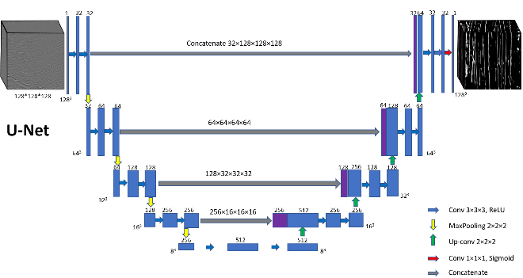
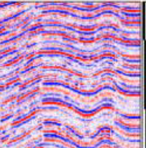
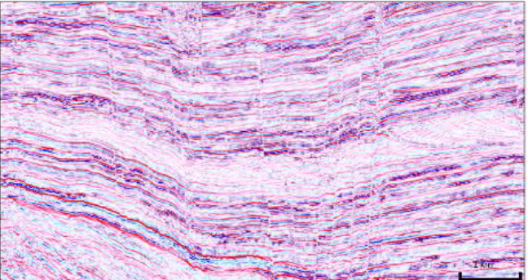
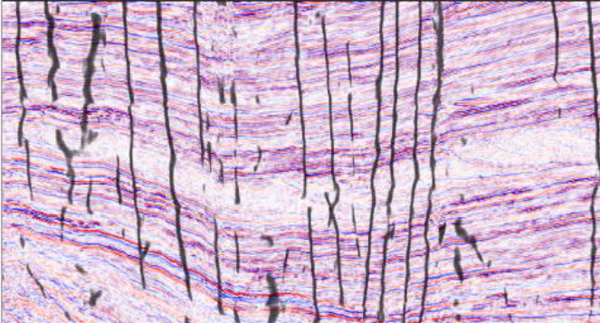
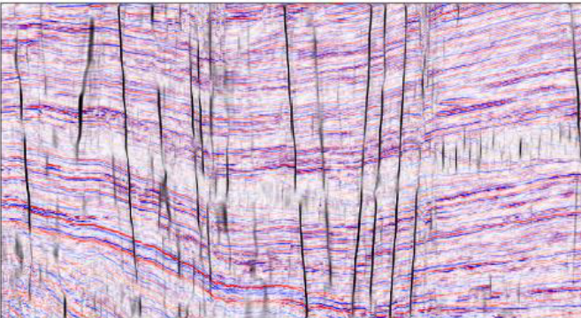
CNN Fault Detection: Synthetic Data
Labeled
Synthetics
Synthetics
Step 1: U-Net Architecture
Step 2: Training
Step 3: Testing
Raw
Image Processing
CNN
Comparing convolutional neural networking and image processing seismic fault detection methods, 2020, Jie Qi*, Bin Lyu, Xinming Wu, and Kurt Marfurt

Slide 10
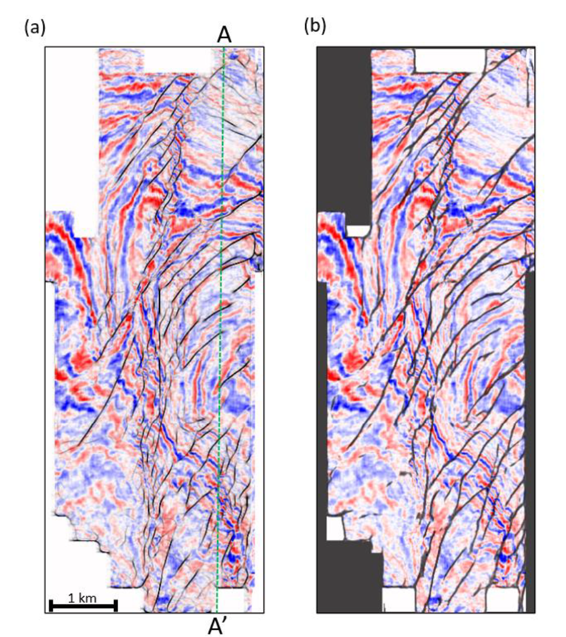
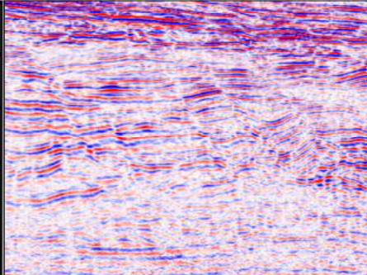
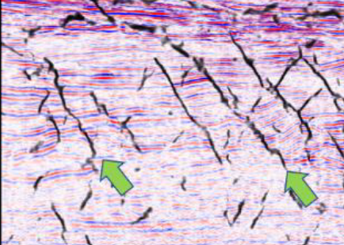
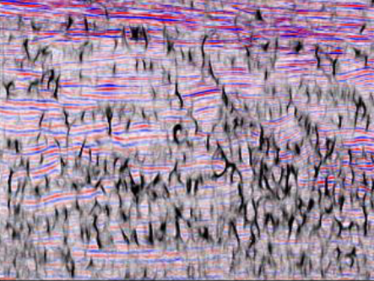
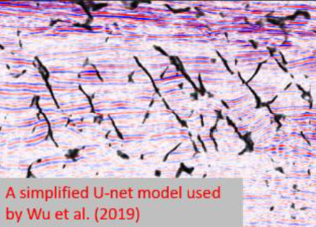
CNN Fault Detection: Synthetic Data
Raw
Image Processing
CNN
Neither algorithm is able to map the soling out parts of the listric faults easily identified by a human interpreter.
Comparing convolutional neural networking and image processing seismic fault detection methods, 2020, Jie Qi*, Bin Lyu, Xinming Wu, and Kurt Marfurt

Slide 11
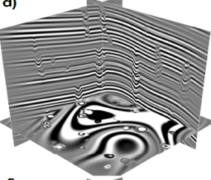
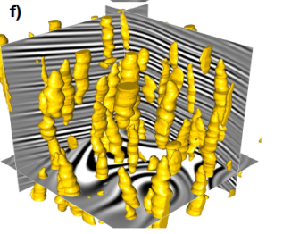
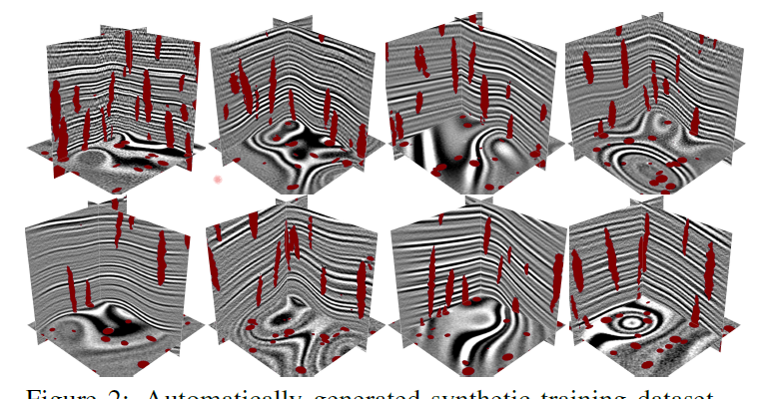
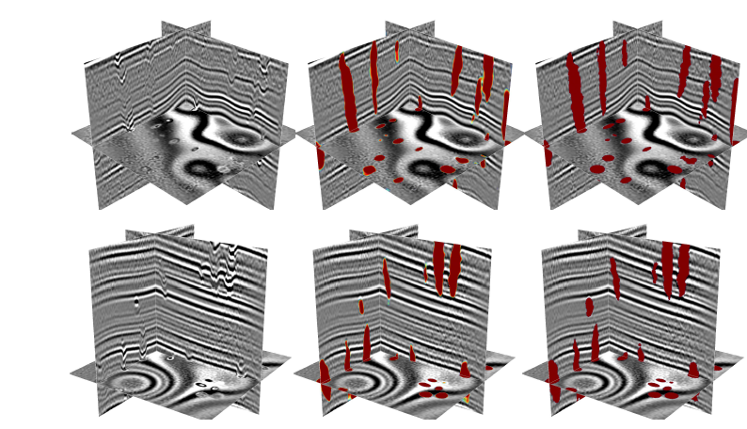
CNN Paleokarst Detection: Synthetic Data
Labeled
Synthetics
Step 1: U-Net Architecture
Synthetics
Step 2: Training
Step 3: Testing
Raw
CNN
Groundtruth
Deep learning for characterizing paleokarst features in 3D seismic images, 2020, Xinming Wu⇤,1, Shangsheng Yan1, Jie Qi2, and Hongliu Zeng3

Slide 12
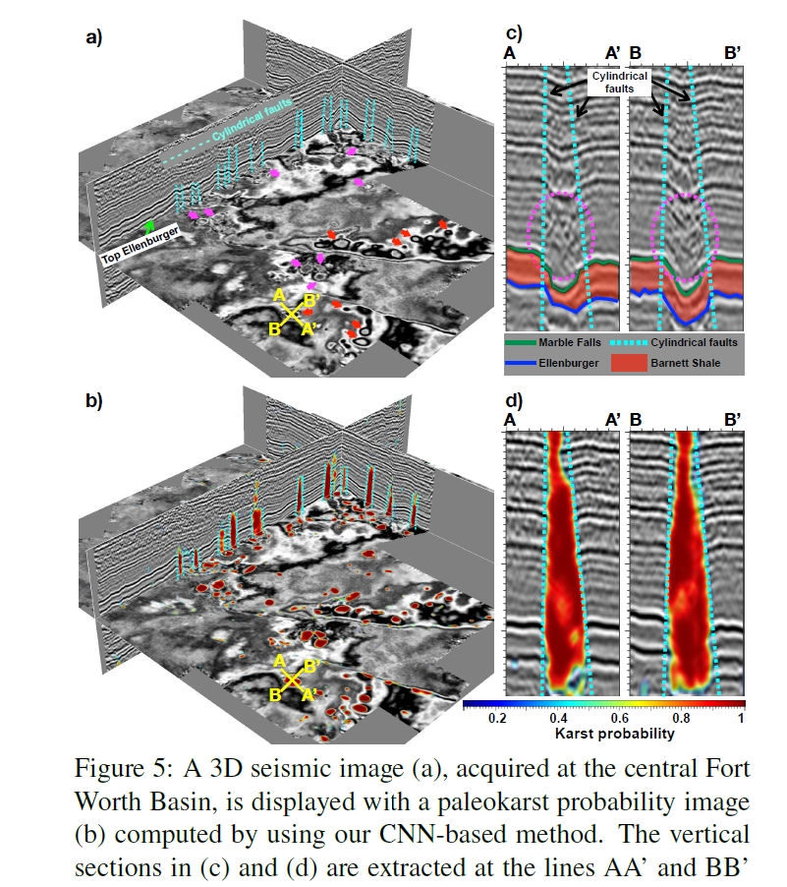
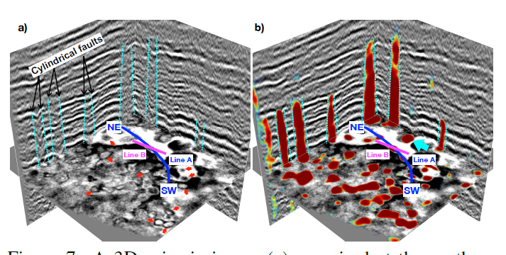
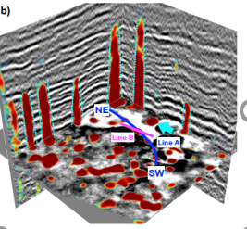
CNN Paleokarst Detection: Field Data

Slide 13
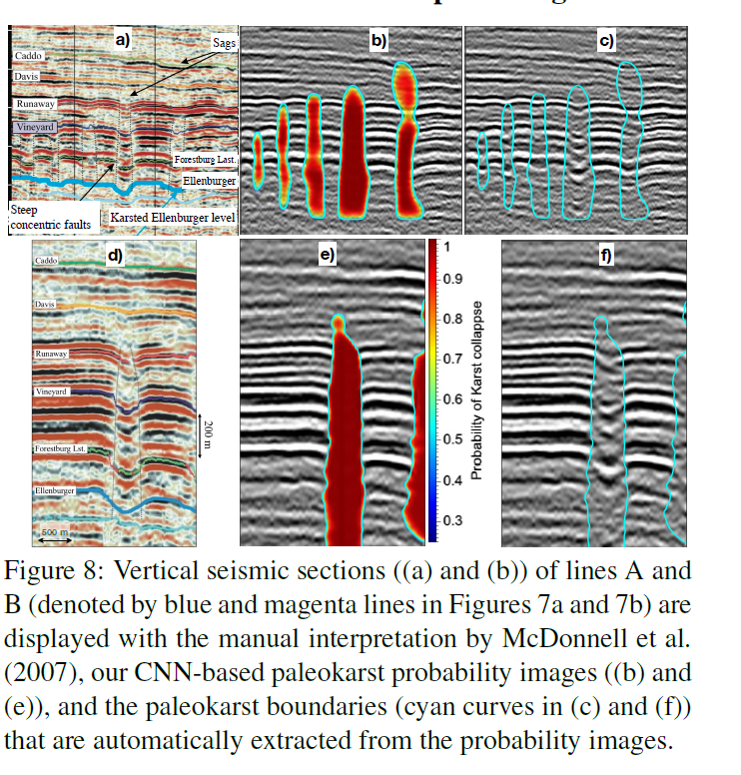
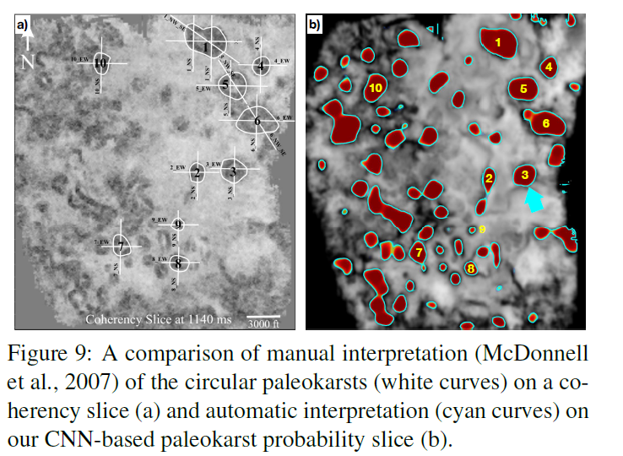
CNN Paleokarst Detection: Field Data

Slide 14
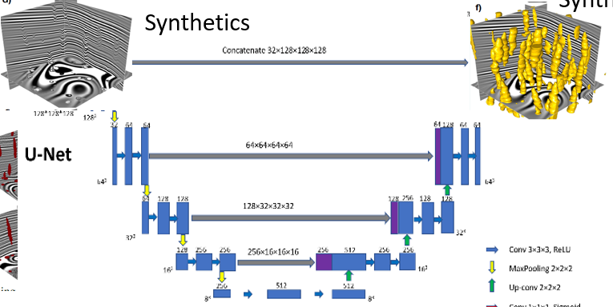
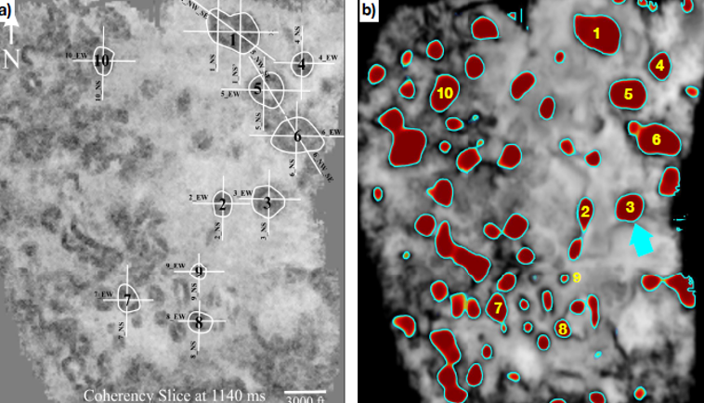

Summary: CNN Paleokarst Detection: Field
U-Net Train Test
ttps://doi.org/10.5281/zenodo.3690252. The CNN, trained with only synthetic datasets, works well in field seismic images to detect paleokarst features from which we can automatically extract the 3D boundary of each paleokarst chimney tube and quantitatively measure its geometric parameters.

Slide 15
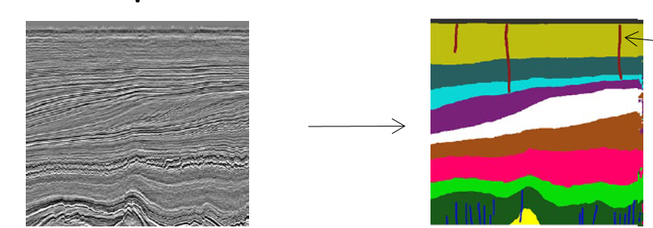
2nd Day: Talks+Labs
Supervised CNN Learning: Theory
Details of Convolutional Neural Network (CNN)
Training
Validation
Testing
Transfer Training, U-Net
Examples: Salt Flank Detection
Fault Detection: : Synthetic Data Approach
Paleokarst Detection, Rock Identification, Hyperspectral Image

Slide 16
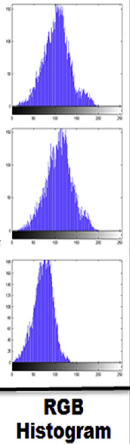
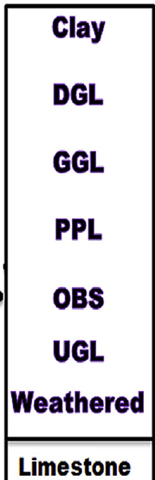
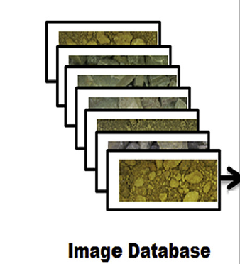
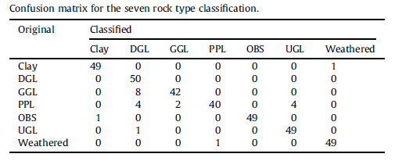
Deep Learning: Classification Limestones
X
W
Y
X
Y
Red Variance = 2.2
Red Skewness = 2.8
Red Kurtosis = 3.4
Blue Variance = 1.3
Blue Skewness = 1.2
Blue Kurtosis = 1.1
Green Variance = 4.5
Green Skewness = 1.1
Green Kurtosis = 1.0
Patel+Chatterjee (2016)

Slide 17
Tuesday Talks+Labs
Supervised CNN Learning: Theory
Details of Convolutional Neural Network (CNN)
Training
Validation
Testing
Transfer Training, U-Net
Examples: Salt Flank Detection
Fault Detection: : Synthetic Data Approach
Paleokarst Detection, Summary

Slide 18
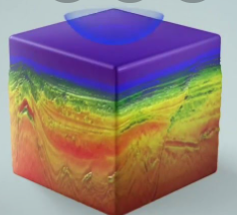
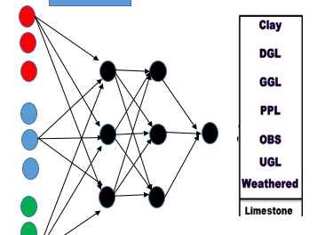

Future Deep Learning Geoscience
Elon Musk (2012): Tesla self-driving car by 2017
ML processed data → QC by Expert
Paradigm Shift
Shell Labs
Shell Labs
Schlumberger
Success
Testing
Fault
Detection
Lithology
Detection
Well-Log+
Seismic+Lithology
Seismic
Inversion

Slide 19
Review: Convolutional Neural Network

Slide 20
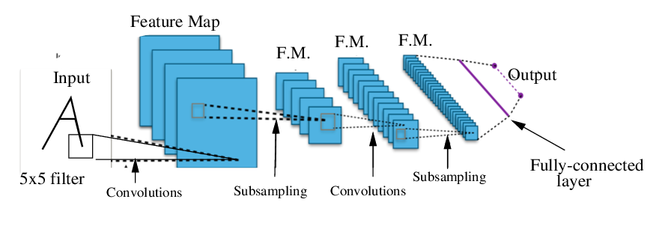




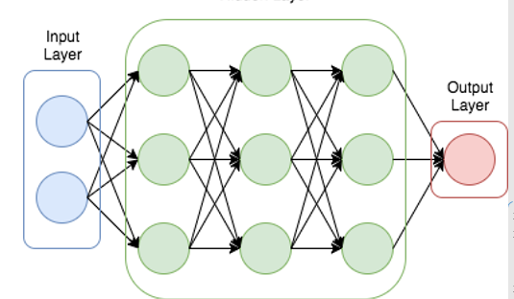
Review: Convolutional Neural Network
σ
σ
z
i^{th} node → row-vector dot product [W·a]_{i} = z_{i}
Each column of nodes → matrix-vector mult. W·a = z
Convolution only has a few filter coeffciients,
So we include a parallel set of nodes (panels)
Filter
coefficients
Unflattened z

Slide 21
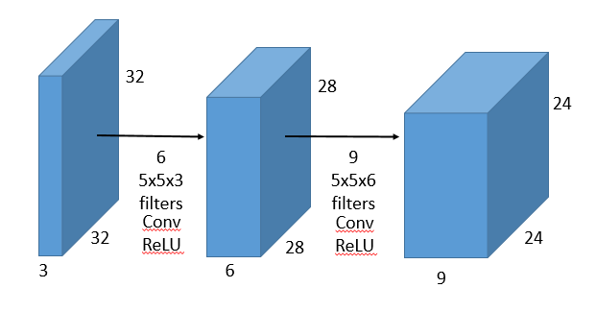
CNN & Max Pooling
Layer 3
Layer 1
Layer 2

Slide 22
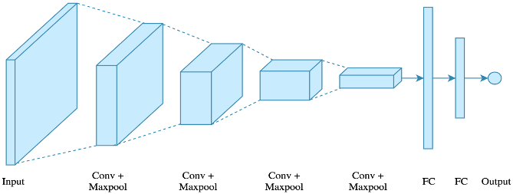
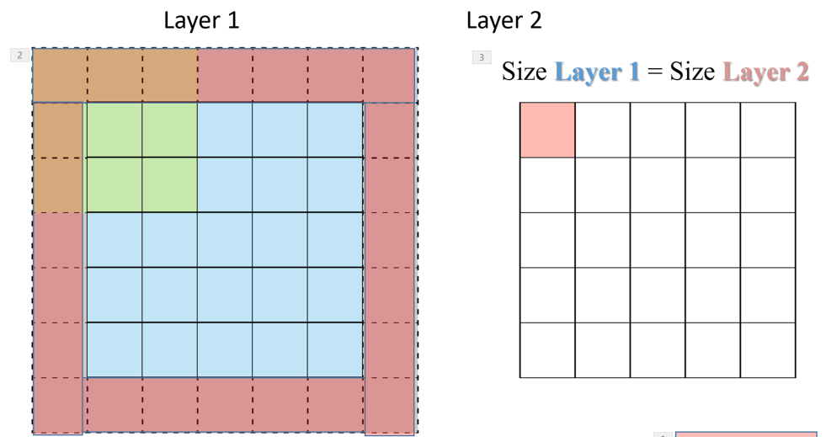




Review: Convolutional Neural Network
Layer 1 Conv. Filter→Layer 2
Padding Layer 1
Feature Maps
Maxpooling
Flattening & Regularization: Dropout & Batch Normalization

Slide 23


Dropout→ Regularize Solution

Slide 24
Convolutional Neural Network
Layer 1 Conv. Filter→Layer 2
Padding Layer 1
Feature Maps
Maxpooling
Flattening & Regularization: Dropout & Batch Normalization

Slide 25




Batch Normalization
Recall
μ=1/M Σ x_{i}
σ² = sqrt[1/M Σ (μ-x_{i} )²]
x_{i}^{norm} = (μ-x_{i})/ sqrt(σ+ε)
Learnable
parameters
Histogram(x₁,x₂)
μ=1/M Σ_{i} a_{i}^{(k)}
x₂
x₂
Normalize Input
a_{i}^{norm} = (μ-a_{i})/ sqrt(σ² +ε)
x₂
x₁
x₁
x₁
a_{i}^{BN} = γa_{i}^{norm} + β
Each a_{i}^{(k)} (or z_{i}^{(k)}) gets normalized
& demeaned in each layer
a₁⁽²⁾
Benefit: Robustness + Speed Convergence
a₂⁽²⁾
Can we do same with
CNN or NN?
a₃⁽²⁾
https://www.youtube.com/watch?v=tNIpEZLv_eg

Slide 26
Convolutional Neural Network
Layer 1 Conv. Filter→Layer 2
Padding Layer 1
Feature Maps
Maxpooling
Flattening & Regularization: Dropout & Batch Normalization
Training

Slide 27


Batch Normalization
Normalization of
each layer’s feature map.
Not just input layer. Speeds
Up convergence.
https://towardsdatascience.com/batch-normalization-in-neural-networks-1ac91516821c
https://www.youtube.com/watch?v=nUUqwaxLnWs

Slide 28


Convolutional Neural Network
Layer 1 Conv. Filter→Layer 2
Padding Layer 1
Feature Maps
Maxpooling
Flattening & Regularization: Dropout & Batch Normalization
Training

Slide 29

Summary
Only one of the 3x1 y vectors below
is allowed with One-out-of-K
0 1 1
Multiclass Objective Function (K>2)
0 0 1
One-out-of-K
P(C₁|x )
softmax
0 1 0
W^{[3]} a^{[2]} = z^{[3]}
e^{z1}
z_{i}^{[3]}
1
e
~
σ(z_{i})^{soft} =
= y
Note: only one of the y_{k}^{(i)} terms in (k) will be
non-zero, the correct class type
=
e^{z1} + e^{z2}
1 + e^{z2- z1}
z₁^{[3]}
z₂^{[3]}
z₃^{[3]}
-z
1 0 0
z₁^{[3]}
σ(z₁ ^{[3]})
y₁
e + e + e
e^{z2}
e^{z3}
For example K=3:
ε=- Σ_{i} y₁^{(i)} lnσ(z₁^{(i)})+y₂^{(i)} lnσ(z₂^{(i)})+y₃^{(i)} lnσ(z₃^{(i)})
Ith element → i^{th} class
e^{z1}
+ + = 1
e^{z1} + e^{z2} + e^{z3}
e^{z1} + e^{z2} + e^{z3}
e^{z1} + e^{z2} + e^{z3}
z₂^{[3]}
σ(z₂ ^{[3]})
y₂
ε=- Σ_{i} Σ_{k} y_{k}^{(i)} lnσ(z_{k}^{(i)})^{soft}
σ(z₃ ^{[3]})
y₃
z₃^{[3]}

Slide 30

1
Cross-Entropy Objective Function
g(z)
Joint, conditional, marginal probability?
0
z
Conditional Probability function binary, i.e. two class, classifier
z
σ(wx) if y=1
1
Given w & RV x, what is
proability of y occuring
σ(z)
P(y|w,x) =
0
z
1-σ (wx) if y=0
1
1-σ (z)
P(x,y)=P(y|x)P(x)
= A_{x,y} A_{x}
A_{x} A
= A_{x,y}/A
0
z
A
Combining above into more compact expression
A_{x}
A_{y}
P(y|w,x) =
σ(wx)^{y} (1-σ (wx))^{1-y} (1)
A_{x,y}
Max. liklihood selects w that maximizes likelihood of P(y|w,x) .
→ If you predicted correctly this will be nearly 1, whether or not y=0 or y=1. Otherwise small
Example: Unfair coin flip P(heads)=1/3
P(tails)=1-1/3=2/3

Slide 31

1
g(z)
Cross-Entropy Error Function
Joint, conditional, marginal probability?
0
z
Conditional Probability function binary, i.e. two class, classifier
σ(wx) if y=1
1
Given w & RV x, what is
proability of y occuring
σ(z)
P(y|w,x) =
0
z
1-σ (wx) if y=0
1
σ(z)
1-σ (z)
P(x,y)=P(y|x)P(x)
= A_{x,y} A_{x}
A_{x} A
= A_{x,y}/A
0
z
A
Combining above into more compact expression
Steeper slopes converge faster
No vanishing gradient
A_{x}
A_{y}
ε(z)
P(y|w,x) =
σ(wx)^{y} (1-σ (wx))^{1-y} (1)
(1-σ(z))²
A_{x,y}
L² misfit
Max. likelihood selects w that maximizes likelihood of P(y|w,x) .
However, we prefer a simpler minimization problem by taking –ln of equation (1)
we get cross-entropy loss function
Example: Unfair coin flip P(heads)=1/3
P(tails)=1-1/3=2/3
Cross-entropy objective function
converges faster than L2 misfit
For binary classification
ε =
-yln(σ(wx)) - (1-y)ln (1-σ (wx)) (2)
For many independent examples with outcomes (y₁ ,y₂,…) have joint CPF as
Ok to replace P with –lnP because P=g(z) monotonic
increasing and so is lnP(z). Hence, w* stationary for both
functions.
Example: what are chances of flipping 3 heads in
A row? P(heads, heads, heads|flip,flip,flip)= .5³
ε = -ln[P(y⁽¹⁾,y⁽²⁾,…y^{(N)} |w,x⁽¹⁾,…x^{(N)})] = -ln Π_{i} P(y^{(i)}|w,x^{(i)})
= -Σ_{k}ln[P(y^{(k)}|w,x^{(k)}]

Slide 32




Code for Logistic Learning Algorithm y=1 or y=0
Stochastic update:
w_{k} =: w_{k} - α (a(w•x)– y) x_{k}
% Stochastic update:
Mini-batch SGD
x_{i}
x=X(:,1);y=T(1,1);
xx=X; yy=TT;
for i=2:nit
for k=1:K
y=yy(k);
x=xx(:,k);
z=w·x + b;
a=1./(1+exp(-z));
w=w-alpha*(a-y)*x;
b = b - alpha*(a-y);
end
err(i)=obj(i)-obj(i-1);b=0;gw=0;gb=0;
end
end
% Loop over iterations
J=384; K=1 SGD
a(z)=1./(1+exp(-z));
Photo #N
Photo #3
Photo #2
Photo #1
for j=1:J
% Loop over Batches
x₁
x₂
x₃
x₁
x₂
x₃
x₁
x₂
x₃
x₁
x₂
x₃
One example input
% Loop over training examples in Batch
J=6; K=64 Minibatch SGD
....
W x b
One Epoch=6 Minibatch Updates
for i=2:nit % Loop over iterations
z=w'*x + b;
a=1./(1+exp(-z));
obj(i)=-[y*log(a)+(1-y)*log(1-a)];
w=w-alpha*(a-y)*x; % Stochastic
b = b - alpha*(a-y); % gradients
err(i)=obj(i)-obj(i-1);
end
a(z)
Note: unknown shift value b
obj(i)=-[y*log(a)+(1-y)*log(1-a)] +obj(i);
gw =gw + (a-y)*x; % Accumulate gw gradients
gb = gb + (a-y); % Accumulate gb gradients
w=w-alpha*gw; % Update model w
b = b – alpha*gb;
% Update model b
end

Slide 33

Softmax Multiclass Classififcation
Cross entropy objective function for
binary classification
Two Classes (K=1): Find w that minimizes
ε = -ln Π_{i} {a(x^{(i)}•w)^{ti} [1-a(x^{(i)}•w)^{(1-ti)}]}
Multiclass Objective Function (K>2)
a^{[1]}
a^{[2]}
One-out-of-K
P(y₁,y₂,y₃ |w,x)
softmax
a^{[0]}
W^{[3]} a^{[2]} = z^{[3]}
e^{z1}
z_{i}^{[3]}
1
e
~
a₁^{[2]}
σ(z_{i})^{soft} =
=
= y_{i}
W^{[2]}
e^{z1} + e^{z2}
1 + e^{z2- z1}
W^{[1]}
z₁^{[3]}
z₂^{[3]}
z₃^{[3]}
-z
z₁^{[3]}
σ(z₁ ^{[3]})
y₁
e + e + e
a₂^{[2]}
W^{[3]}
Note: only one of the terms in (k) will be
non-zero, the correct class type
I(examples ) K(classes)
z₂^{[3]}
σ(z₂ ^{[3]})
y₂
ε=- Σ_{i} Σ_{k} y_{k}^{(i)} lnσ(z_{k}^{(i)})^{soft}
a₃^{[2]}
σ(z₃ ^{[3]})
y₃
z₃^{[3]}

Slide 34



CNN Summary
5x5x64
384x1
5x5x64
192x1
X
Y
(y=1→fault; y=0→non-fault)
Conv Pool+LRN
Conv Pool+LRN
FC
FC
Soft
Max
Pool+B.N.
Pool+B.N.
+
ReLU
2x2
+
ReLU
2x2

Slide 35


2nd Tuesday Talks+Labs
Introduction: Three Classes Machine Learning
Unsupervised Learning Cluster Analysis: K-Means, DBSCAN & SOG
Labs
Supervised Learning: Neural Networks
Theory
Training, Validation, Testing
Iterative Steepest Descent
Activation & Objective Functions
Simple Example: NN
Neural Network Lab

Slide 36



Single-Node Neural Network
W^{(k+1)} = W^{(k)} - α a(w)(1-a(w))X^{(k)T} (a(x^{(k)}w) –t)
for k=2:nit % Looping over gradient iterations
[grad,res]=gradient(M,N,x,t,w,beta,res,k,io);
alpha=.001*sqrt(grad'*grad);
w=w-alpha*grad; % Gradient descent update
end
Neural Network Classification t
x₀
x₁
.
.
x_{N}
t = a( )
w₁
Σx_{i} w_{i}
w₂
∑
t
Unbalanced input..too few examples
with x = [1 1 0 0 0 0] etc. Therefore iterations spend most energy
on classifying the other ones such as [1 1 0 1 1 0 ]
w₃
Label t =1 if there is a single 1
In 6x1 input vector x, and t=0 otherwise
t=w₁x₁ + w₂x₂ +…x₅w₅+x₆b
100 6x1 Input Training Pairs
X(1:6,1) X(1:6,2)
X(1:6,3) X(1:6,4)
X(1:6,5) X(1:6,6)
X(1:6,7) X(1:6,8)
x₆→
X₁→
X₂→
X₃→
X₄→
X₅→
t→
1 0 0 0 0 0 1 1
t(1) t(2) t(3) t(4) t(5) t(6) t(7) t(8)

Slide 37


Single-Node Neural Network
W^{(k+1)} = W^{(k)} - α a(w)(1-a(w))X^{(k)T} (a(x^{(k)}w) –t)
for k=2:nit % Looping over gradient iterations
[grad,res]=gradient(M,N,x,t,w,beta,res,k,io);
alpha=.001*sqrt(grad'*grad);
w=w-alpha*grad; % Gradient descent update
end
Neural Network Classification t
x₀
x₁
.
.
x_{N}
t = a( )
w₁
Σx_{i} w_{i}
w₂
∑
t
w₃
100 6x1 Feature vectors
X(1:6,1) X(1:6,2)
X(1:6,3) X(1:6,4)
X(1:6,5) X(1:6,6)
X(1:6,7) X(1:6,8)
1 0 0 0 0 0 1 1
t(1) t(2) t(3) t(4) t(5) t(6) t(7) t(8)

Slide 38




1-, 2-, 4-Layer Neural Network Results
W^{(k+1)} = W^{(k)} - α a(w)(1-a(w))X^{(k)T} (a(x^{(k)}w) –t)

Slide 39
Labs | Purpose | Link
1 K-means | Learn how K-means works and hyper-parameters decide results | https://colab.research.google.com/drive/1WRYzkb0Wd5SYyYO_OkBYnd7h1tab6N9X?usp=sharing
2 DBSCAN Application on Earthquake Clustering. | Apply DBSCAN on a simple synthetic data and valid effects of parameters. Apply DBSCAN on earthquake clustering | https://colab.research.google.com/drive/1sTaLEn4sHd-qToYeG3duVrJeySzl6syM?usp=sharing
3 Fully Connected Neural Network Lab | Learn how FCN works and use FCN to detect a simple vector | https://drive.google.com/file/d/1oaiWwPRwLO96jeo0o9bhhO3ExI1jcWAV/view?usp=sharing
4 Crack Detection on AlUla Photos | Understand Keras and basic idea of U-Net. Learn how to use U-Net to detect cracks. | https://colab.research.google.com/drive/1n7K1esyM_FmWb-6ZwT8eGWxylOk4xoOp
5 Salt Body Identification by Convolutional Neural Network | Learn how to use CNN to detect salt body. Try to label salt by hand | https://drive.google.com/file/d/1RiSgAPd6AUUSM_sfifK0S-yMAQnyD2ae/view?usp=sharing
5.1 Salt Detection with U-net Lab | Learn about setting up U-net training and validation with KERAS Use U-net network to do semantic segmentation of input images, | https://colab.research.google.com/drive/1LT-kOWWqxCzwrrCeSr_-dV6ycxVuQZf9?usp=sharing
6 Identifying Migration Artifacts By SVM and compare it with other methods | Try to use SVM and simple to detect artifacts and image. Try to label artifacts by hand | https://drive.google.com/file/d/12-UJ1VmyC5cdTUHGQlm08Rww2snqUzz5/view?usp=sharing

Slide 40
2nd Tuesday Talks+Labs
Introduction: Three Classes Machine Learning
Unsupervised Learning Cluster Analysis: K-Means, DBSCAN & SOG
Labs
Supervised Learning: Neural Networks
Theory
Training, Validation, Testing
Iterative Steepest Descent
Activation & Objective Functions
AlUla
Neural Network Lab

Slide 41


Feature maps of the fully convolution network to do fault detection
Input Of FCN
Feature Map of 1st Deconv Layer
Feature Map of 2nd deconv Layer
Feature Map of 3nd deconv Layer
Feature Map of 4th deconv Layer
Output
Notes:
介绍一下想要利用这个特征加深对卷积网络的理解

Slide 42
2nd Day: Talks+Labs
Introduction: Three Classes Machine Learning
Unsupervised Learning Cluster Analysis: K-Means, DBSCAN & SOG
Labs
Supervised Learning: Neural Networks
Theory
Training, Validation, Testing
Iterative Steepest Descent
Sigmoid
Activation & Objective Functions
Simple Example
Neural Network Lab

Slide 43



Sigmoid σ(z) → Binary CPF P(y|w,x)
y
w
x
Probability of transmitting input
signal of strength z
σ(z)
σ(z)
Hubel and Weisel (1959),

Slide 44

Sigmoid Function
x₀
x₁
.
.
x_{N}
t = σ( )
w₁
Σx_{i} w_{i}
σ(z)
w₂
∑
y
a(z) = 1/(1+e^{-z})
a(z) = 1/(1+e^{-z})
dσ(z)/dz = σ (z)(1-σ (z))
dσ(z)/dz = σ (z)(1-σ (z))
w₃
What is ?
σ(z)
a(z)
dσ(z)/dz
z
z
Obs. class
Predicted class
Observed class
y ~ σ(w^{T}x) = 1/(1+e ^{–w}:^{x})

