Slide 1
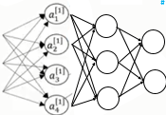


Multi-Node Neural Network
W^{(k+1)} = W^{(k)} - α a(w)(1-a(w))X^{(k)T} (a(x^{(k)}w) –t)
Neural Network Classification t
x₀
x₁
.
.
x_{N}
t = a( )
w₁
Σx_{i} w_{i}
w₂
∑
t
w₃
Class of
motorcycle
Class of
motorcycle
x₀
x₁
…x_{n}
t
Photos
Of
MCs
1 82 123 1
33 33.8 222 0
240 128 44 0
55 180 211 1

Slide 2
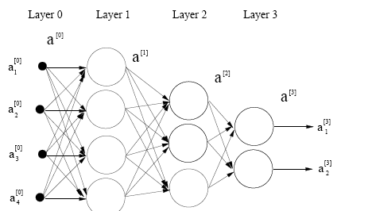
Outline
Neural Network Forward-Propagation
Neural Network Back-Propagation
w_{k} = w_{k} - α Σ_{i} a(w^{T}x^{(i)})(1-a(w^{T}x^{(i)})) x_{ik} r^{(i)}
MATLAB Example
Summary

Slide 3
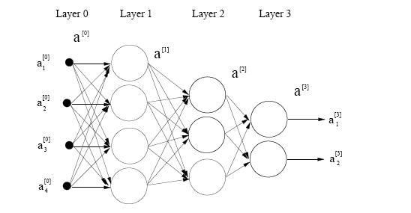
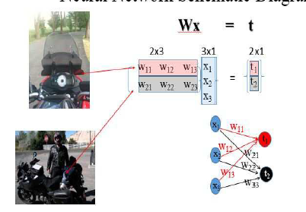
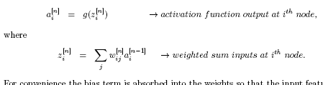
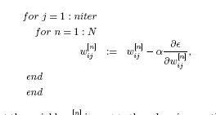
Multiple-Node-Layer NN for Classification
4x3
g( ) g( )
a^{[1]}=g(W^{[1]} a^{[0])})
z^{[1]}
Σ ∫
g( ) g( )
Σ ∫
Σ ∫
Predicted class for ith data @
Nth node
Σ ∫
Misfit function
Observed class for ith data
ε= ½ Σ_{i} Σ_{n}(a_{n}^{(i)[N]}-y_{n}^{(i)})² + regularize

Slide 4
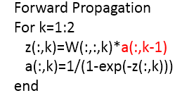
Forward Propagation Multiple-Node-Layer NN
m=[1,2,…M]
Recursion
For convenience here, layer # is denoted as subscript
Given: σ₃(w₃σ₂(w₂σ₁(w₁a₀)))
N
Loop over N Layers
z(m,k) =W(m,k)
Find: Recursion to compute forward modeled field
1+
recursion = method of solving a problem where the solution depends on solution from the previous iteration
Cost=O(N) matrix-vector multiplies where N=# layers

Slide 5
Forward Propagation Multiple-Node-Layer NN
://www.youtube.com/watch?v=-jxrYTq0uNo&list=PLBAGcD3siRDguyYYzhVwZ3tLvOyyG5k6K&index=25
layer 0 layer 1 layer 2
a
^{[0]}
Forward Propagation
For k=1:2
z(:,k)=W(:,:,k)*a(:,k-1)
a(:,k)=1/(1+exp(-z(:,k)))
end
3x1
2x1
1x1
w₁₁
^{[0]}
[1]
a
x₁
x₂
x₃
t₁
z₁
a₁
[2]
1
[1]
[1]
[1]
w₁₁
[1]
w₁₂
w₂₁
_{[2]}
_{[2]}
z₁
a₁
w₁₃
t₁
^{[0]}
[1]
a
2
w₂₂
[2]
[1]
z₂
a₂
w₁₂
t₂
[1]
[1]
[1]
w₂₃
^{[0]}
a(:,2) gives predicted class!
a
3
a
^{[1]}
+ W
b
+ W^{[1]}
a( )
x
W^{[2]}
a^{[0]}
a^{[1]}
= t
= t
a^{[1]}
= a^{[2]}
a
^{[2]}
z₁
w₁₁
[1]
[1]
w₁₂
w₁₃
a₁
a₁
w₁₁
a₁
[1]
x₁
t₁
w₁₂
[1]
[0]
[1]
[2]
[2]
[1]
b₁^{[1]}
[0]
a( )
a( )
a( )
t₁
=a
^{[2]}
+
w₂₁
w₂₂
w₂₃
x₂
=
b₂^{[1]}
[1]
[1]
[1]
a₂
a₂
[0]
[0]
[1]
t₂
z₂
[1]
a₂
t₂
x₃
[1]
[0]
a₃
[0]

Slide 6
Forward Propagation Multiple-Node-Layer NN
a)
c)
layer 0 layer 1 layer 2
Recursion, use
Previously calculated a(:,k-1)
^{[0]}
a
^{[1]}
^{[2]}
a
a
Forward Propagation
For k=1:2
z(:,k)=W(:,:,k)*a(:,k-1)
a(:,k)=1/(1+exp(-z(:,k)))
end
w₁₁
^{[0]}
[1]
a
t₁
z₁
a₁
[2]
1
[1]
[1]
[1]
w₁₁
[1]
w₁₂
w₂₁
_{[2]}
_{[2]}
z₁
a₁
w₁₃
t₁
^{[0]}
[1]
a
2
w₂₂
[2]
[1]
z₂
a₂
w₁₂
t₂
[1]
[1]
[1]
w₂₃
^{[0]}
a
3
+ W
b)
b
+ W^{[1]}
a( )
x
a^{[0]}
a^{[1]}
W^{[2]}
= t
a( )
= t
a^{[1]}
= a^{[2]}
a
^{[2]}
z₁
w₁₁
[1]
[1]
w₁₂
w₁₃
a₁
w₁₁
a₁
[1]
x₁
t₁
w₁₂
[0]
a( )
[1]
[0]
a₁
[2]
[2]
[1]
1
[1]
a( )
b^{[1]} +
a( )
t₁
=a
^{[2]}
w₂₁
w₂₂
w₂₃
x₂
=
1
[1]
[1]
[1]
a₂
[0]
[0]
a₂
[1]
t₂
z₂
[1]
a₂
t₂
x₃
[1]
[0]
a₃
[0]

Slide 7
Outline
Neural Network Forward-Propagation
Neural Network Back-Propagation
w_{k} = w_{k} - α Σ_{i} a(w^{T}x^{(i)})(1-a(w^{T}x^{(i)})) x_{ik} r^{(i)}
MATLAB Example
Summary

Slide 8
Backward Propagation Multiple-Node-Layer NN
For convenience,
layer # = subscript
Implicit function of w₁
Some Rules: 1. dσ_{i}(z_{i})/dz_{i} = dσ_{i}
z₃
z₂
z₁
2. z_{i}=w_{i} σ_{i-1}(z_{i-1})
Recall ε= ½ Σ_{i} [y_{i}-σ(w₃ σ(w₂ σ₁(w₁a₀ )))_{i} ]²
3. dz_{i}/dw_{i} = σ_{i-1}
Given: σ₃(w₃σ₂(w₂σ₁(w₁σ₀( ...)))
∂ε/∂w_{k} =(σ_{n}-y) ∂σ_{n}/∂w_{k}
4. dz_{i}/dσ_{i-1} = w_{i}
Find: Recursive way to compute partial derivatives
Recursive backward error propagation to update model w’s
Soln ∂σ₃ ∂z₃
∂σ₃
dσ₃
σ₂
∂w₃
=
∂z₃
A(3)=dsigma(3)*w(3)
Grad(3)=dsigma(3)*sigma(2)
Used for w₃ gradient
∂w₃
∂σ₃ ∂z₃ ∂σ₂ ∂z₂
∂σ₃
dσ₃
w₃
dσ₂
σ₁
Used for w₂ gradient
∂w₂
=
∂z₃
∂w₂
For k=2:-1:-1
A(k)=A(k+1)*w(k)*dsigma(k)
Grad(k)=A(k+1)*dsigma(k)*sigma(k-1)
end
∂σ₂
∂z₂
∂σ₃ ∂z₃ ∂σ₂ ∂z₂ ∂σ₁
∂σ₃
dσ₃
w₃
dσ₂
w₂
∂z₁
dσ₁
σ₀
Used for w₁ gradient
∂w₁
=
∂z₃
∂σ₂
∂z₂
∂σ₁
∂z₁
∂w₁
∂σ/∂w₁
∂σ/∂w₂
∂σ/∂w₃
a₀
a₁
a₂
∂σ₃ ∂z₃ ∂σ₂ ∂z₂ ∂σ₁
∂σ₀
∂σ₃
dσ₁
∂z₁
∂z₀
dσ₃
w₃
dσ₂
w₂
w₁
dσ₀
σ₋₁
Used for w₀ gradient
∂w₀
=
∂z₃
∂σ₂
∂z₂
∂σ₁
∂σ₀
∂z₀
∂w₀
∂z₁
∂σ₃ ∂z₃ ∂ σ₂ ∂z₂ ∂σ₁
∂σ₃
dσ₂
w₂
dσ₁
∂z₁
∂σ₀
∂z₀ ∂σ₋₁
w₁
w₀
∂z₋₁
dσ₃
w₃
dσ₀
dσ₋₁
σ₋₂
Used for w₋₁ gradient
∂w₋₁
=
∂z₃
∂σ₂
∂z₂
w₃
∂z₋₁
w₁
w₂
∂σ₁
∂z₁
∂σ₀
∂z₀
∂σ₋₁
∂w₋₁

Slide 9
Steepest Descent for an N-Layer Network
N=1
Given: [x,y]
g(z)=1/(1-e^{-z})
g(w^{T}x)
t
Find: y^{pred.} s.t. w minimizes ε = ½ (a^{[1]} -y )²
Mercifully, only one sample.
No summation over samples
z^{[1]} = w^{[1]} •a^{[0]}
1-layer NN:
y^{pred}
a^{[1]}
a^{[0]}
a^{[0]} =(1,a^{[0]} )
Input features
a^{[1]} = g(w^{[1]}•a^{[0]})
Residual field
backpropagated to 1st layer
∂ε
∂ε
∂a^{[1]}
∂z^{[1]}
∂g(z^{[1]})
∂z^{[1]}
Gradient w/r w^{[1]}:
=
=
(a^{[1]}-y )
= (a^{[1]}-y) dg^{[1]}(z^{[1]}) a^{[0]}
(eq. 1)
i
∂w^{[1]}
∂a^{[1]}
∂z^{[1]}
∂w^{[1]}
∂z^{[1]}
∂w^{[1]}
^{i}
^{i}
^{i}
^{i}
Forward field
to 1st layer
Note: if g=1/(1+e^{-z}) then g’=g(1-g) so
∂g(z^{[1]})
= g^{[1]}(1-g^{[1]} )
∂z^{[1]}
Sum i over examples
w_{k} := w_{k} - α Σ_{i} r^{(i)} a(w^{T}x^{(i)})(1-a(w^{T}x^{(i)})) x_{ik}

Slide 10
Steepest Descent for an N-Layer Network
N=2
Given: [x,y]
Find: y^{pred.} s.t. w^{[1]} minimizes ε = ½ (a^{[1]} -y )²
z^{[1]} = w^{[1]} •a^{[0]}
1-layer NN:
y^{pred}
a^{[1]}
a^{[0]}
a^{[0]} =(1,a^{[0]} )
Input features
a^{[1]} = g(w^{[1]}•a^{[0]})
Residual field
backpropagated to 1st layer
Forward field
to 1st layer
∂ε
∂ε
∂a^{[1]}
∂z^{[1]}
∂g(z^{[1]})
∂z^{[1]}
Gradient w/r w^{[1]}:
=
=
(a^{[1]}-y )
= (a^{[1]}-y) dg^{[1]}(z^{[1]}) a^{[0]}
(eq. 1)
∂w^{[1]}
∂a^{[1]}
∂z^{[1]}
∂w^{[1]}
∂z^{[1]}
∂w^{[1]}
^{i}
^{i}
i
^{i}
^{i}
Find: y^{pred.} s.t. w^{[1]}, w^{[2]} minimizes ε = ½ (a^{[2]} -y )²
Mercifully, only one sample.
No summation over samples
.
∂a^{[2]}
∂g(z^{[2]})
∂z(w^{[2]}•a^{[1]})
a^{[2]}
w^{[2]}
a^{[1]}
w₁^{[1]}
=
= dg(z^{[2]}) w^{[2]}
2-layer NN:
y^{pred}
w₂^{[1]}
a^{[0]}
∂a^{[1]}
∂z^{[2]}
∂a^{[1]}
w₃^{[1]}
a^{[2]} = g(z^{[2]})
a^{[1]} = g(z^{[1]})
∂a^{[1]}
∂z^{[1]}
=
dg(z^{[1]});
=
a_{i}^{[0]};
∂z^{[1]}
∂w_{i} ^{[1]}
∂ε
∂ε
∂a^{[2]}
∂z^{[2]}
∂g(z^{[2]})
∂z^{[2]}
Gradient w/r w^{[2]} :
=
= (a^{[2]}-y )
= (a^{[2]} –y)dg(z^{[2]}) a^{[1]}
∂w^{[2]}
∂a^{[2]}
∂z^{[2]}
∂w^{[2]}
∂z^{[2]}
∂w^{[2]}
^{i}
^{i}
^{i}
^{i}
Reuse for recursion
∂ε
∂ε
∂a^{[2]}
∂a^{[1]}
∂z^{[1]}
Residual field backpropagated to 1st layer
Gradient w/r w^{[1]} :
=
= (a^{[2]}-y) dg(z^{[2]}) w^{[2]}
dg(z^{[1]}) a_{i}^{[0]}
Forward field
at 0th layer
∂w^{[1]}
∂a^{[2]}
∂a^{[1]}
∂z^{[1]}
∂w^{[1]}
^{i}
^{i}

Slide 11
Outline
Neural Network Forward-Propagation
w_{k} = w_{k} - α Σ_{i} a(w^{T}x^{(i)})(1-a(w^{T}x^{(i)})) x_{ik} r^{(i)}
Neural Network Back-Propagation
w_{k} = w_{k} - α Σ_{i} a(w^{T}x^{(i)})(1-a(w^{T}x^{(i)})) x_{ik} r^{(i)}
MATLAB Example
Summary

Slide 12
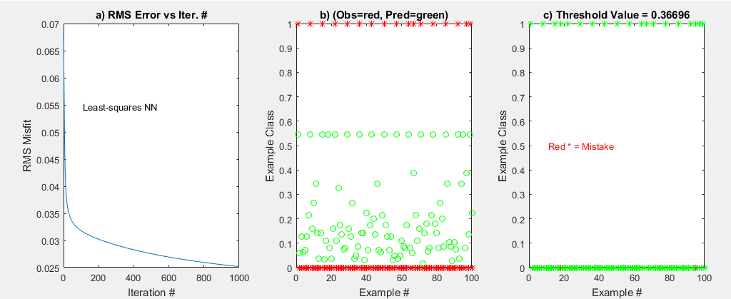
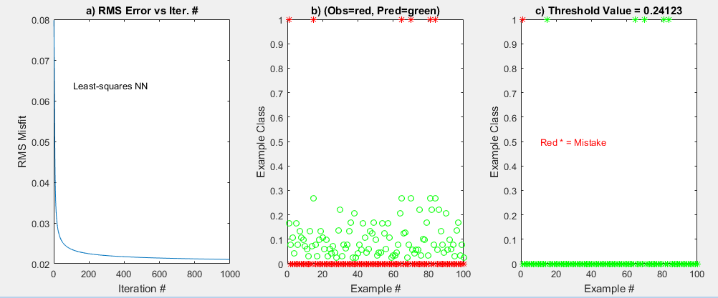
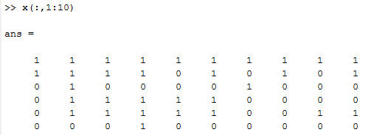
Single-Node Neural Network
W^{(k+1)} = W^{(k)} - α a(w)(1-a(w))X^{(k)T} (a(x^{(k)}w) –t)
for k=2:nit % Looping over gradient iterations
[grad,res]=gradient(M,N,x,t,w,beta,res,k,io);
alpha=.001*sqrt(grad'*grad);
w=w-alpha*grad; % Gradient descent update
end
Neural Network Classification t
x₀
x₁
.
.
x_{N}
t = a( )
w₁
Σx_{i} w_{i}
w₂
∑
t
Unbalanced input..too few examples
with x = [1 1 0 0 0 0] etc. Therefore iterations spend most energy
on classifying the other ones such as [1 1 0 1 1 0 ]
w₃
Label t(i) =1 if there is a single 1
In 5x1 input vector x, and t(i)=0 otherwise
100 6x1 Feature vectors
X(1:6,1) X(1:6,2)
X(1:6,3) X(1:6,4)
X(1:6,5) X(1:6,6)
X(1:6,7) X(1:6,8)
b→
X₁→
X₂→
X₃→
X₄→
X₅→
1 0 0 0 0 0 1 1
t(1) t(2) t(3) t(4) t(5) t(6) t(7) t(8)

Slide 13
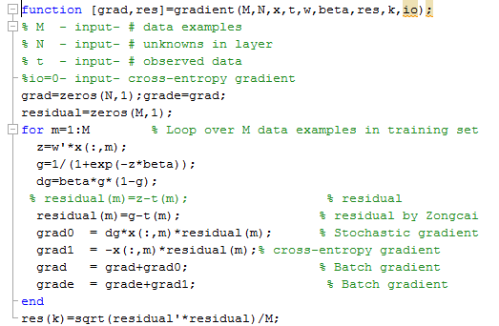
Single-Node Neural Network
W^{(k+1)} = W^{(k)} - α a(w)(1-a(w))X^{(k)T} (a(x^{(k)}w) –t)
for k=2:nit % Looping over gradient iterations
[grad,res]=gradient(M,N,x,t,w,beta,res,k,io);
alpha=.001*sqrt(grad'*grad);
w=w-alpha*grad; % Gradient descent update
end
Neural Network Classification t
x₀
x₁
.
.
x_{N}
t = a( )
w₁
Σx_{i} w_{i}
w₂
∑
t
w₃
100 6x1 Feature vectors
X(1:6,1) X(1:6,2)
X(1:6,3) X(1:6,4)
X(1:6,5) X(1:6,6)
X(1:6,7) X(1:6,8)
1 0 0 0 0 0 1 1
t(1) t(2) t(3) t(4) t(5) t(6) t(7) t(8)

Slide 14
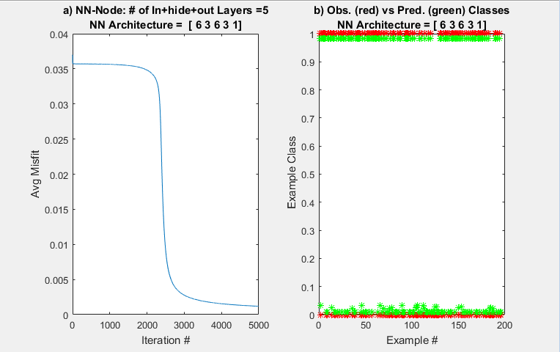
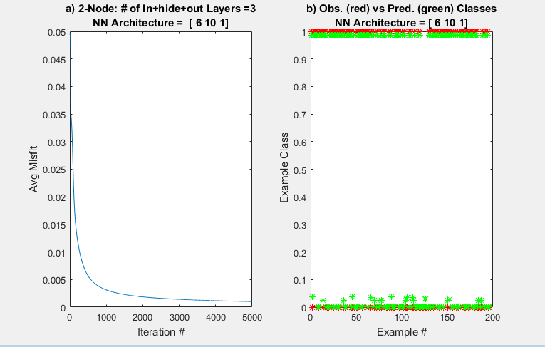
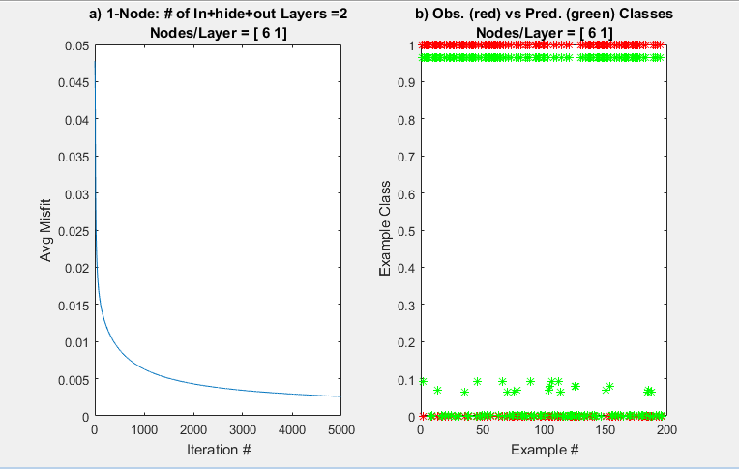
1-, 2-, 4-Layer Neural Network Results
W^{(k+1)} = W^{(k)} - α a(w)(1-a(w))X^{(k)T} (a(x^{(k)}w) –t)

Slide 15
Outline
Neural Network Forward-Propagation
w_{k} = w_{k} - α Σ_{i} a(w^{T}x^{(i)})(1-a(w^{T}x^{(i)})) x_{ik} r^{(i)}
Neural Network Back-Propagation
w_{k} = w_{k} - α Σ_{i} a(w^{T}x^{(i)})(1-a(w^{T}x^{(i)})) x_{ik} r^{(i)}
Cross-entropy Error Function
Summary

Slide 16
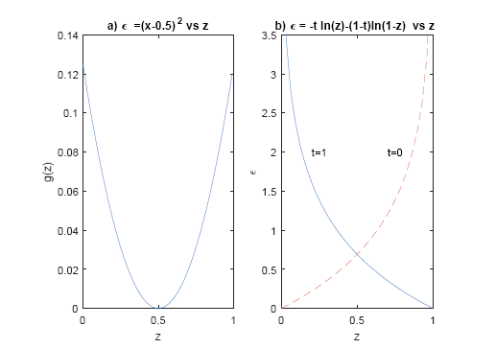



Cross Entropy Objective Function
Find w that maximimizes probability for a given x
PDF for binary outcomes: t=1 or t=0
g(z)=1/(1+e^{-z})
Define ε= –ln(P) and find w that minimizes ε
Gradient of ε
P(t₁,t₂,…t_{M}|w,x) = P(t₁|w,x)P(t₂|w,x)…P(t_{M}|w,x)
ln[P(t₁,t₂,…t_{M}|w,x)] = ln[P(t₁|w,x)]+ln[P(t₂|w,x)]…+ln[P(t_{M}|w,x)]

Slide 17
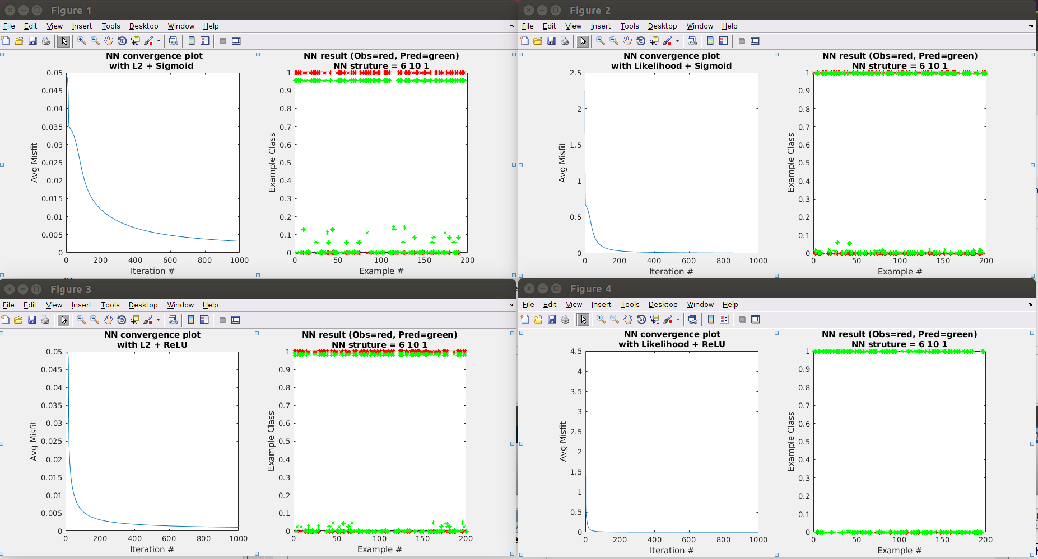
Cross-Entropy Error Function

Slide 18

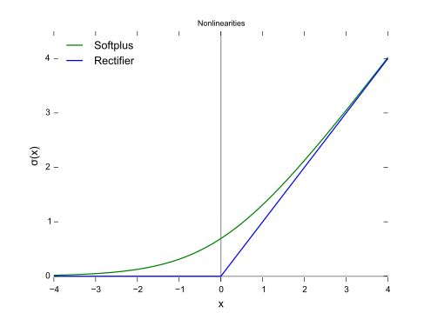
ReLu (Rectified Linear Unit)
The rectifier is, as of 2018, the most popular activation function for deep neural networks.^{[5][6]}

Slide 19
Cross-Entropy+ReLU

Slide 20
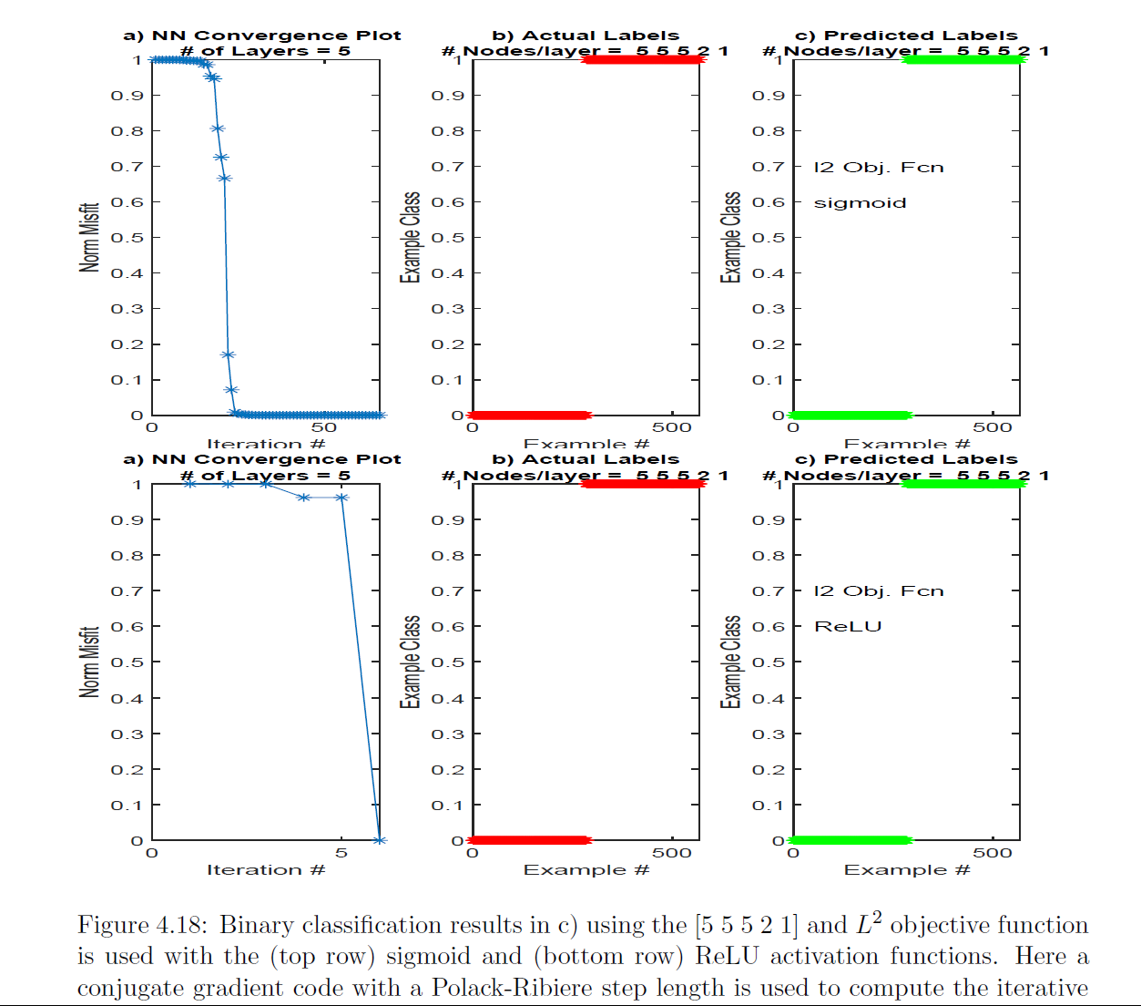
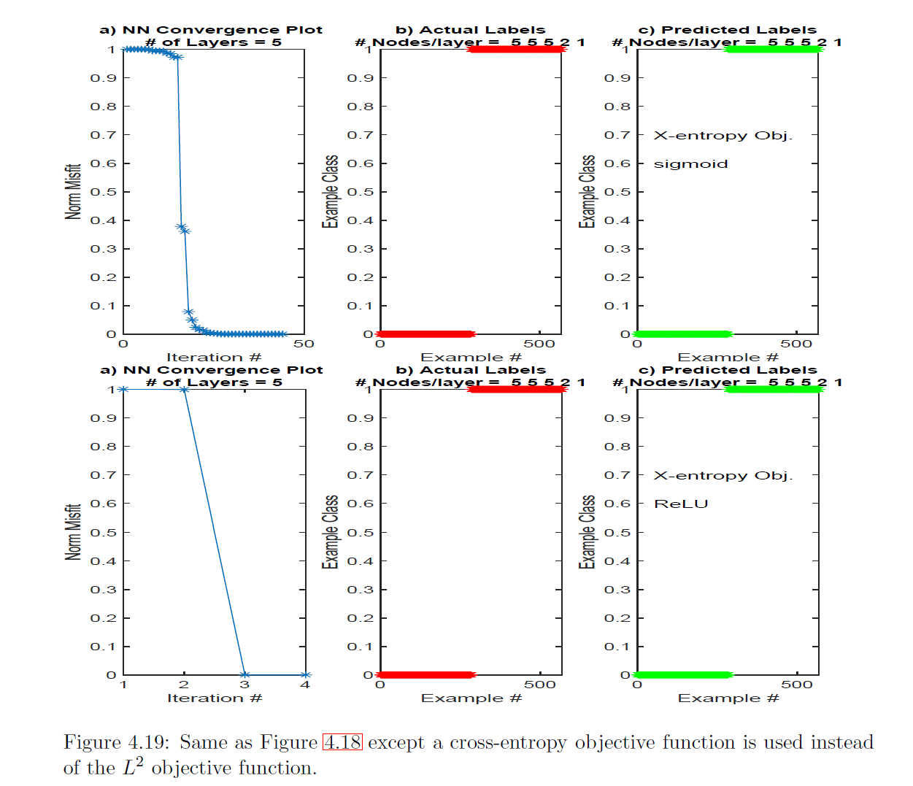
Cross-Entropy+ReLU+CG

Slide 21
Outline
Neural Network Forward-Propagation
w_{k} = w_{k} - α Σ_{i} a(w^{T}x^{(i)})(1-a(w^{T}x^{(i)})) x_{ik} r^{(i)}
Neural Network Back-Propagation
Cross-entropy Error Function, Multinomial Classifiers
Summary

Slide 22
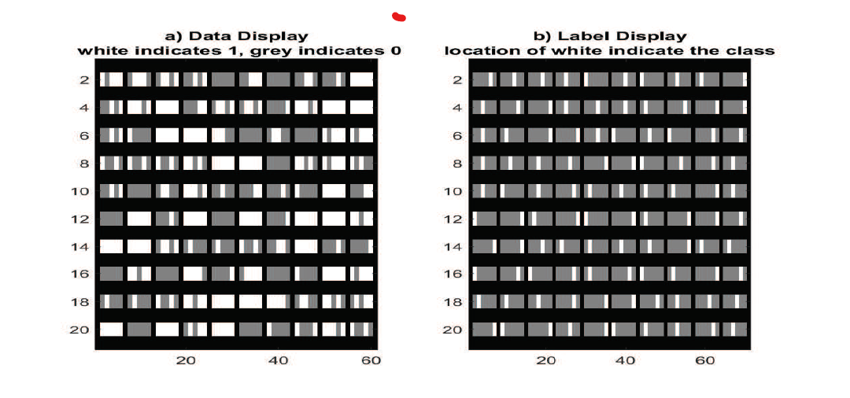
Multinomial Classifier

Slide 23
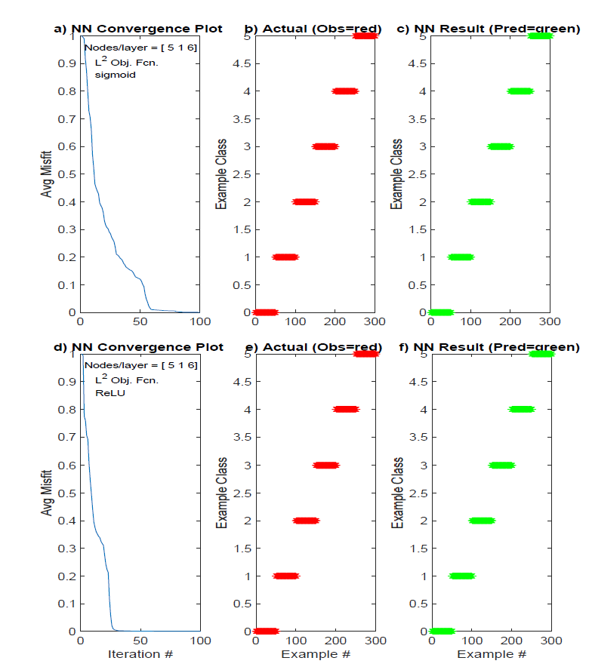
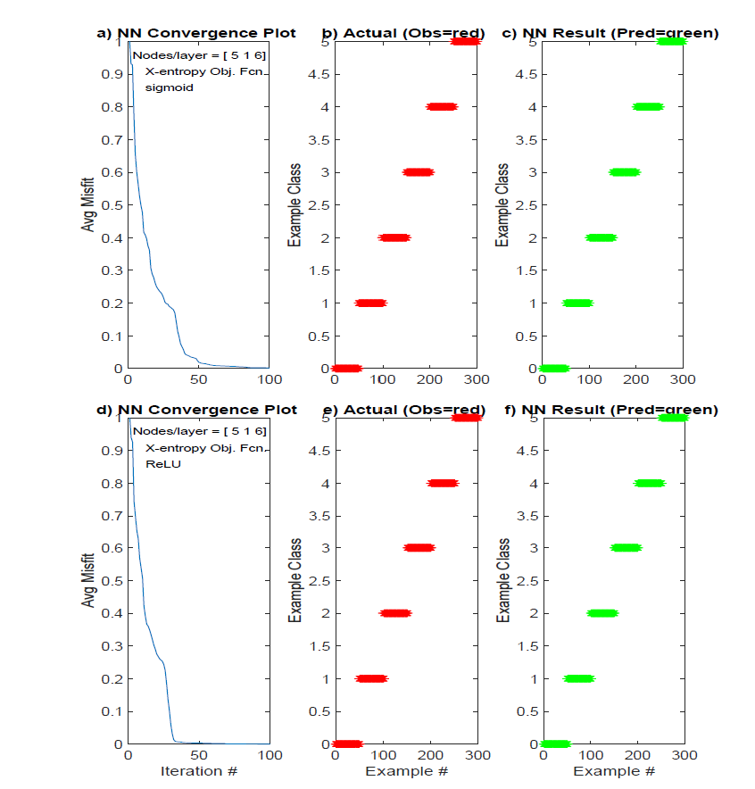
Multinomial Classifier

Slide 24
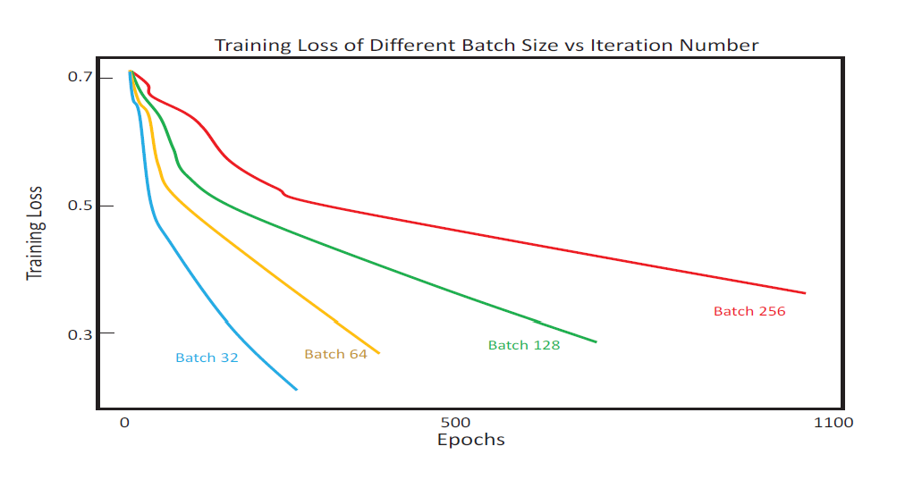
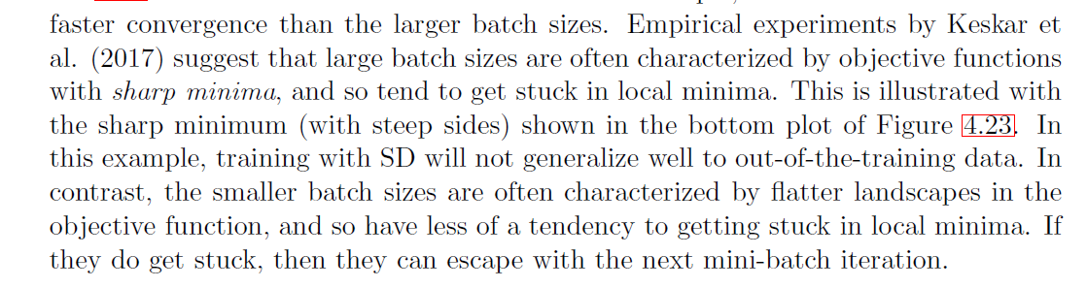
Mini-Batch Results

Slide 25
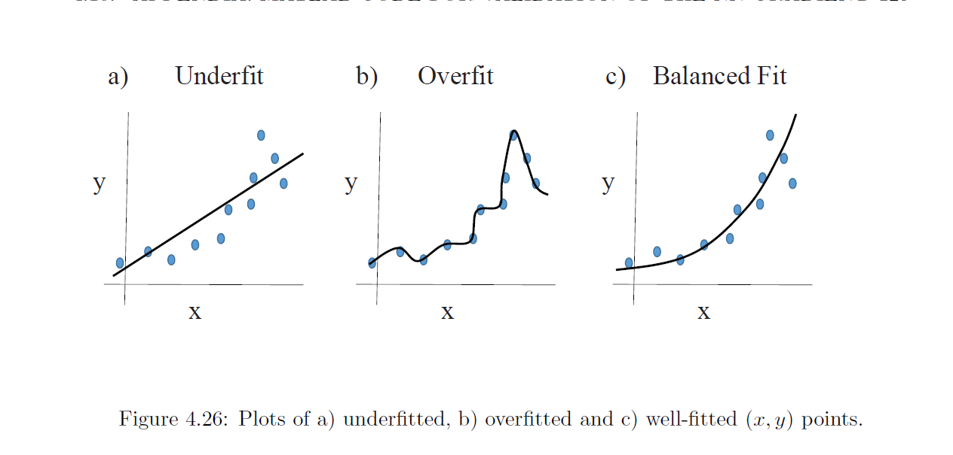
Start Tuesday morning class
Under, Well- and Over-Fitted Data

Slide 26
Outline
Neural Network Forward-Propagation
w_{k} = w_{k} - α Σ_{i} a(w^{T}x^{(i)})(1-a(w^{T}x^{(i)})) x_{ik} r^{(i)}
Neural Network Back-Propagation
Cross-entropy Error Function, Multinomial Classifiers
Summary

Slide 27
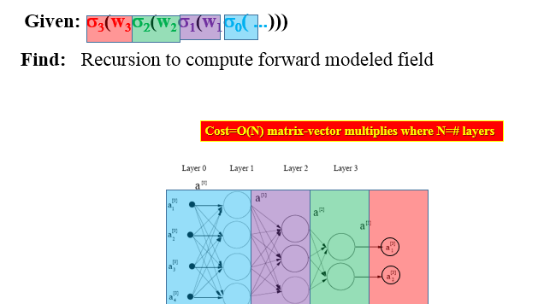
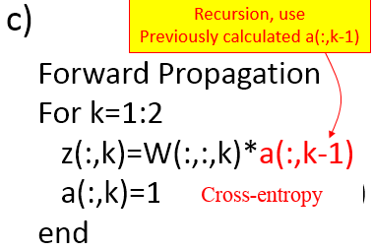
Summary
Neural Network Forward-Propagation
k = Layer #

Slide 28
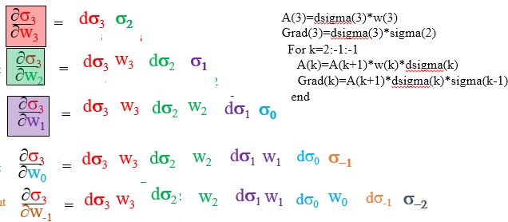
Summary
Neural Network Backward-Propagation
Given: σ₃(w₃σ₂(w₂σ₁(w₁σ₀( ...)))
Find: Gradients

Slide 29
Summary
Cross Entropy Function

Slide 30
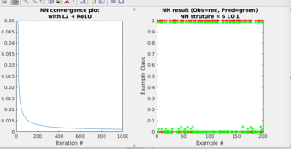
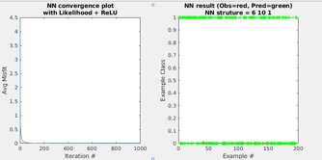
Summary
ReLu (Rectified Linear Unit)
The rectifier is, as of 2018, the most popular activation function for deep neural networks.^{[5][6]}

