Slide 1
Principal Component Analysis
Part 1: Theory
Part 2: Analytical Example, Dinosaurs, MATLAB
Part 3: Hyperspectral Imaging: Limestones, Landsat
Brazil Uranium-K-Thorium

Slide 2
Outline
Intuitive PCA
Mathematics of PCA
Examples of PCA: Migration Images
Summary

Slide 3


Data Covariance Matrix for a Small Window in Migration Image
Experiment 1
(aka Dx1 feature vector 1)
Small 2x2 image of
Prestack Migration image
x⁽¹⁾
x⁽¹⁾
x^{(1)T}
x₁⁽¹⁾x₁⁽¹⁾ x₁⁽¹⁾x₂⁽¹⁾ x₁⁽¹⁾x₃⁽¹⁾ x₁⁽¹⁾x₄⁽¹⁾
x₁⁽¹⁾
x₂⁽¹⁾
x₃⁽¹⁾
x₄⁽¹⁾
x₁⁽¹⁾
x₂⁽¹⁾
x₃⁽¹⁾
x₄⁽¹⁾
x₁⁽¹⁾ x₂⁽¹⁾ x₃⁽¹⁾ x₄⁽¹⁾
Mig1
Outer product
=
x₂⁽¹⁾x₁⁽¹⁾ x₂⁽¹⁾x₂⁽¹⁾ x₂⁽¹⁾x₃⁽¹⁾ x₂⁽¹⁾x₄⁽¹⁾
vectorize
x₃⁽¹⁾x₁⁽¹⁾ x₃⁽¹⁾x₂⁽¹⁾ x₃⁽¹⁾x₃⁽¹⁾ x₃⁽¹⁾x₄⁽¹⁾
x₄⁽¹⁾x₁⁽¹⁾ x₄⁽¹⁾x₂⁽¹⁾ x₄⁽¹⁾x₃⁽¹⁾ x₄⁽¹⁾x₄⁽¹⁾
Average 1/N Σ_{i=1}^{N}
+
DxD Data Covariance matrix
x₁⁽²⁾x₁⁽²⁾ x₁⁽²⁾x₂⁽²⁾ x₁⁽²⁾x₃⁽²⁾ x₁⁽²⁾x₄⁽²⁾
σ₁₁² σ₁₂² σ₁₃² σ₁₄²
x₂⁽²⁾x₁⁽²⁾ x₂⁽²⁾x₂⁽²⁾ x₂⁽²⁾x₃⁽²⁾ x₂⁽²⁾x₄⁽²⁾
σ₂₁² σ₂₂² σ₂₃² σ₂₄²
x₃⁽²⁾x₁⁽²⁾ x₃⁽²⁾x₂⁽²⁾ x₃⁽²⁾x₃⁽²⁾ x₃⁽²⁾x₄⁽²⁾
σ₃₁² σ₃₂² σ₃₃² σ₃₄²
x₄⁽²⁾x₁⁽²⁾ x₄⁽²⁾x₂⁽²⁾ x₄⁽²⁾x₃⁽²⁾ x₄⁽²⁾x₄⁽²⁾
σ₄₁² σ₄₂² σ₄₃² σ₄₄²

Slide 4
Data Covariance Matrix for a Small Window in Migration Image
Experiment 1
(aka Dx1 feature vector 1)
Small 2x2 image of
Prestack Migration image
x⁽¹⁾
x⁽¹⁾
x^{(1)T}
x₁⁽¹⁾x₁⁽¹⁾ x₁⁽¹⁾x₂⁽¹⁾ x₁⁽¹⁾x₃⁽¹⁾ x₁⁽¹⁾x₄⁽¹⁾
x₁⁽¹⁾
x₂⁽¹⁾
x₃⁽¹⁾
x₄⁽¹⁾
x₁⁽¹⁾
x₂⁽¹⁾
x₃⁽¹⁾
x₄⁽¹⁾
x₁⁽¹⁾ x₂⁽¹⁾ x₃⁽¹⁾ x₄⁽¹⁾
Mig1
Outer product
=
x₂⁽¹⁾x₁⁽¹⁾ x₂⁽¹⁾x₂⁽¹⁾ x₂⁽¹⁾x₃⁽¹⁾ x₂⁽¹⁾x₄⁽¹⁾
vectorize
x₃⁽¹⁾x₁⁽¹⁾ x₃⁽¹⁾x₂⁽¹⁾ x₃⁽¹⁾x₃⁽¹⁾ x₃⁽¹⁾x₄⁽¹⁾
x₄⁽¹⁾x₁⁽¹⁾ x₄⁽¹⁾x₂⁽¹⁾ x₄⁽¹⁾x₃⁽¹⁾ x₄⁽¹⁾x₄⁽¹⁾
+
x⁽²⁾
x^{(2)T}
DxD Data Covariance matrix
x₁⁽²⁾x₁⁽²⁾ x₁⁽²⁾x₂⁽²⁾ x₁⁽²⁾x₃⁽²⁾ x₁⁽²⁾x₄⁽²⁾
x₁⁽²⁾
x₂⁽²⁾
x₃⁽²⁾
x₄⁽²⁾
x₁⁽²⁾ x₂⁽²⁾ x₃⁽²⁾ x₄⁽²⁾
σ₁₁² σ₁₂² σ₁₃² σ₁₄²
=
x₂⁽²⁾x₁⁽²⁾ x₂⁽²⁾x₂⁽²⁾ x₂⁽²⁾x₃⁽²⁾ x₂⁽²⁾x₄⁽²⁾
σ₂₁² σ₂₂² σ₂₃² σ₂₄²
x₃⁽²⁾x₁⁽²⁾ x₃⁽²⁾x₂⁽²⁾ x₃⁽²⁾x₃⁽²⁾ x₃⁽²⁾x₄⁽²⁾
σ₃₁² σ₃₂² σ₃₃² σ₃₄²
x₄⁽²⁾x₁⁽²⁾ x₄⁽²⁾x₂⁽²⁾ x₄⁽²⁾x₃⁽²⁾ x₄⁽²⁾x₄⁽²⁾
σ₄₁² σ₄₂² σ₄₃² σ₄₄²

Slide 5
Data Covariance Matrix for a Small Window in Migration Image
Experiment 1
(aka Dx1 feature vector 1)
Small 2x2 image of
Prestack Migration image
x⁽¹⁾
x⁽¹⁾
x^{(1)T}
x₁⁽¹⁾x₁⁽¹⁾ x₁⁽¹⁾x₂⁽¹⁾ x₁⁽¹⁾x₃⁽¹⁾ x₁⁽¹⁾x₄⁽¹⁾
x₁⁽¹⁾
x₂⁽¹⁾
x₃⁽¹⁾
x₄⁽¹⁾
x₁⁽¹⁾
x₂⁽¹⁾
x₃⁽¹⁾
x₄⁽¹⁾
x₁⁽¹⁾ x₂⁽¹⁾ x₃⁽¹⁾ x₄⁽¹⁾
Mig1
Outer product
=
x₂⁽¹⁾x₁⁽¹⁾ x₂⁽¹⁾x₂⁽¹⁾ x₂⁽¹⁾x₃⁽¹⁾ x₂⁽¹⁾x₄⁽¹⁾
vectorize
x₃⁽¹⁾x₁⁽¹⁾ x₃⁽¹⁾x₂⁽¹⁾ x₃⁽¹⁾x₃⁽¹⁾ x₃⁽¹⁾x₄⁽¹⁾
x₄⁽¹⁾x₁⁽¹⁾ x₄⁽¹⁾x₂⁽¹⁾ x₄⁽¹⁾x₃⁽¹⁾ x₄⁽¹⁾x₄⁽¹⁾
+
x⁽²⁾
x^{(2)T}
DxD Data Covariance matrix
x₁⁽²⁾x₁⁽²⁾ x₁⁽²⁾x₂⁽²⁾ x₁⁽²⁾x₃⁽²⁾ x₁⁽²⁾x₄⁽²⁾
x₁⁽²⁾
x₂⁽²⁾
x₃⁽²⁾
x₄⁽²⁾
x₁⁽²⁾ x₂⁽²⁾ x₃⁽²⁾ x₄⁽²⁾
σ₁₁² σ₁₂² σ₁₃² σ₁₄²
x₂⁽²⁾x₁⁽²⁾ x₂⁽²⁾x₂⁽²⁾ x₂⁽²⁾x₃⁽²⁾ x₂⁽²⁾x₄⁽²⁾
=
σ₂₁² σ₂₂² σ₂₃² σ₂₄²
x₃⁽²⁾x₁⁽²⁾ x₃⁽²⁾x₂⁽²⁾ x₃⁽²⁾x₃⁽²⁾ x₃⁽²⁾x₄⁽²⁾
σ₃₁² σ₃₂² σ₃₃² σ₃₄²
x₄⁽²⁾x₁⁽²⁾ x₄⁽²⁾x₂⁽²⁾ x₄⁽²⁾x₃⁽²⁾ x₄⁽²⁾x₄⁽²⁾
σ₄₁² σ₄₂² σ₄₃² σ₄₄²

Slide 6
Data Covariance Matrix for a Small Window in Migration Image
Experiment 1
(aka Dx1 feature vector 1)
Small 2x2 image of
Prestack Migration image
x⁽¹⁾
x⁽¹⁾
x^{(1)T}
x₁⁽¹⁾
x₂⁽¹⁾
x₃⁽¹⁾
x₄⁽¹⁾
x₁⁽¹⁾
x₂⁽¹⁾
x₃⁽¹⁾
x₄⁽¹⁾
x₁⁽¹⁾ x₂⁽¹⁾ x₃⁽¹⁾ x₄⁽¹⁾
X X^{T}
Mig1
Outer product
vectorize
x₁⁽¹⁾
x₂⁽¹⁾
x₃⁽¹⁾
x₄⁽¹⁾
x₁⁽²⁾
x₂⁽²⁾
x₃⁽²⁾
x₄⁽²⁾
x₁⁽¹⁾ x₂⁽¹⁾ x₃⁽¹⁾ x₄⁽¹⁾
x₁⁽²⁾ x₂⁽²⁾ x₃⁽²⁾ x₄⁽²⁾
x⁽²⁾
x^{(2)T}
DxD Data Covariance matrix
x₁⁽²⁾
x₂⁽²⁾
x₃⁽²⁾
x₄⁽²⁾
x₁⁽²⁾ x₂⁽²⁾ x₃⁽²⁾ x₄⁽²⁾
σ₁₁² σ₁₂² σ₁₃² σ₁₄²
σ₂₁² σ₂₂² σ₂₃² σ₂₄²
Data matrix X = Each row is a migration image
or feature vector
σ₃₁² σ₃₂² σ₃₃² σ₃₄²
σ₄₁² σ₄₂² σ₄₃² σ₄₄²

Slide 7
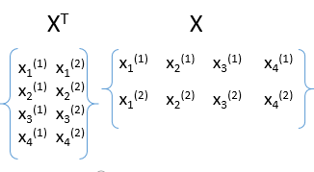
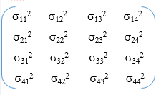

Prestack small sub-images of
Migration images for three shots
Principal Component Analysis Applied to Migration images
x₁
Mig1
1
0
0
0.5
https://video.search.yahoo.com/yhs/search;_ylt=A0LEVvy0.yZaIVEAKL8PxQt.;_ylu=X3oDMTEybGpyazhvBGNvbG8DYmYxBHBvcwMxBHZ0aWQDQjQ5ODFfMQRzZWMDc2M-?p=youtube+video+principal+component&fr=yhs-adk-adk_sbyhp&hspart=adk&hsimp=yhs-adk_sbyhp#id=12&vid=bd48bd866821153171cff6d66200ac14&action=view
1
What are 2 dominant eigenvectors of Mig1?
0
0
0
1
vectorize
1
0
0
0
0.5
Mig1 = Σ_{i=1,2} a_{i} v_{i} =
1 +0.5
x₂
T
.9
1.5
2.1
1.3
X₁ X₁
X₁ X₂
X₁ X₃
Get eigenvectors v_{i}
& eigenvalues λ_{ι}
λ
Mig2
ε=threshold
vectorize
Demean, normalize
& get 2nd moment matrix
X₂ X₁
X₂ X₂
X₂ X₃
Index #
X₃ X₁
X₃ X₂
X₃ X₃
Keep eigenvectors v_{i} for i=1,2
above threshold λ>ε
Replace migration
Images mig1, mig2, mig3 as sum of
2 weighted basis functions
x₃
Mig3
1.1
1.5
2.3
1.1
vectorize
^
Mig₁
Stack filtered
Migration images
Mig1, Mig2, Mig3
To get M
Mig1 = Σ_{i=1,2} a_{i} v_{i}
where a_{i} = v_{i}
^
Mig₂
^
^
^
Mig2 = Σ_{i=1,2} b_{i} v_{i}
where b_{i} = v_{i}
4x1 feature vectors
^
Mig₃
Mig2 = Σ_{i=1,2} c_{i} v_{i}
where c_{i} = v_{i}
https://www.youtube.com/watch?v=FgakZw6K1QQ

Slide 8
Outline
Intuitive PCA
Mathematics of PCA
Examples of PCA: Simple Two Points
Summary

Slide 9
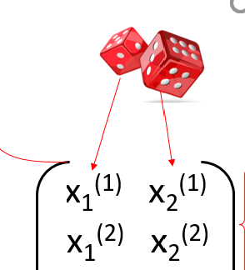

Example: Principal Component Analysis
½ $√$(1²+(-1)²)
-1
1 -1
X =
1
-1 -1
X^{T}=
1/√2
1/√2
Average x⁽¹⁾ and x⁽²⁾ is zero
( 1 1) = x⁽¹⁾
Covariance matrix
1
1 1
X^{T}X =
x⁽²⁾= ( -1 -1)

Slide 10
Example: Principal Component Analysis
Σ =
1
1 1
-λ 1
1 1-λ
(1-λ)² -1=0 → λ=2 or=0
( 1 1)
-2 1
1 1-2
1
1
λ=2
-1
x=y or a₁ =
1/√2
-1
( -1 -1)
λ=0
1
1 1
1
−1
x=-y or a₂ =
PCA finds direction that maximizes variance
of data projected to PC1 axis
1/√2

Slide 11
Outline
Intuitive PCA
Mathematics of PCA
Examples of PCA: PCA & MATLAB
Summary

Slide 12
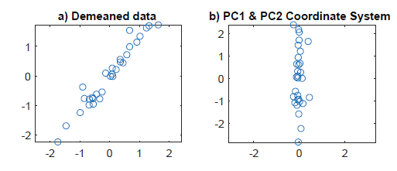
Example: MATLAB
clear all
data=zeros(30,2);data1=data;
data(:,1) = randn(30,1);
data(:,2) = 3.4 + 1.2 * data(:,1) + 0.2*randn(size(data(:,1)));
% data=data2;
subplot(121);plot(data(:,1),data(:,2),'o');
title('a) Raw data');axis('equal');pause(1)
data(:,1) = data(:,1)-mean(data(:,1));
data(:,2) = data(:,2)-mean(data(:,2));
subplot(121);plot(data(:,1),data(:,2),'o');
title('a) Demeaned data');axis('equal')
C = cov(data);
[V,D] = eig(C);
x=V(1,1)*data(:,1)+V(2,1)*data(:,2);
y=V(1,2)*data(:,1)+V(2,2)*data(:,2);
subplot(122);plot(x,y,'o');axis('equal');
title('b) PC1 & PC2 Coordinate System')
xlabel('PC2');ylabel('PC1')

Slide 13
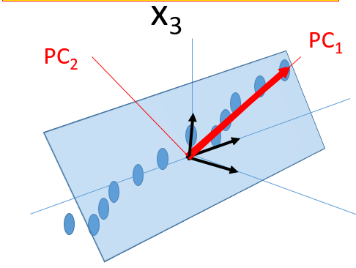
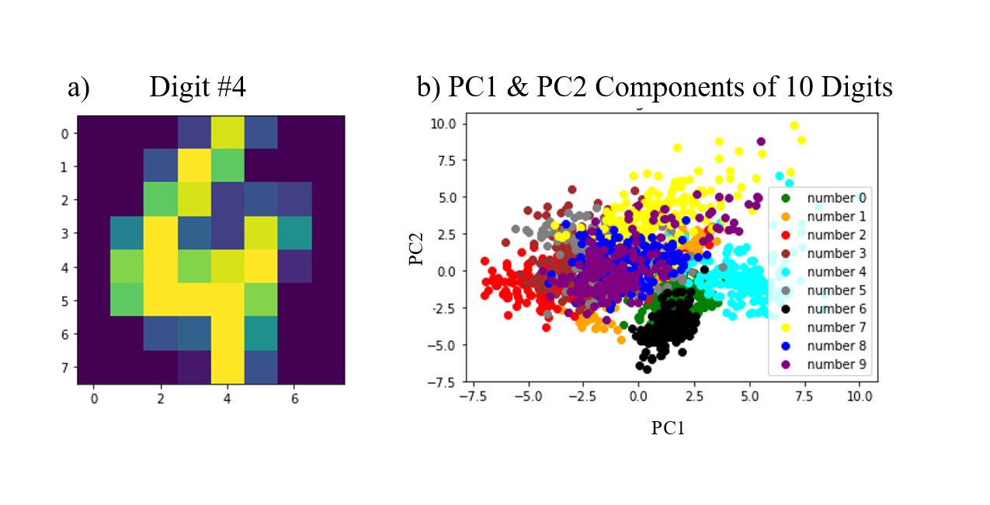
^
^
Pts exist in 64x1 space e_{i}
Pts in PC1 x PC2 Space
PC2
PC1

Slide 14
Outline
Intuitive PCA
Mathematics of PCA
Examples of PCA: PCA & Dinosaurs
Summary

Slide 15

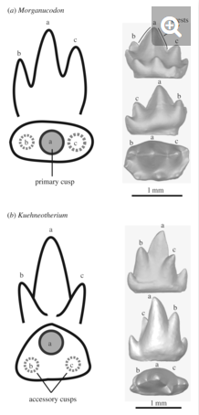
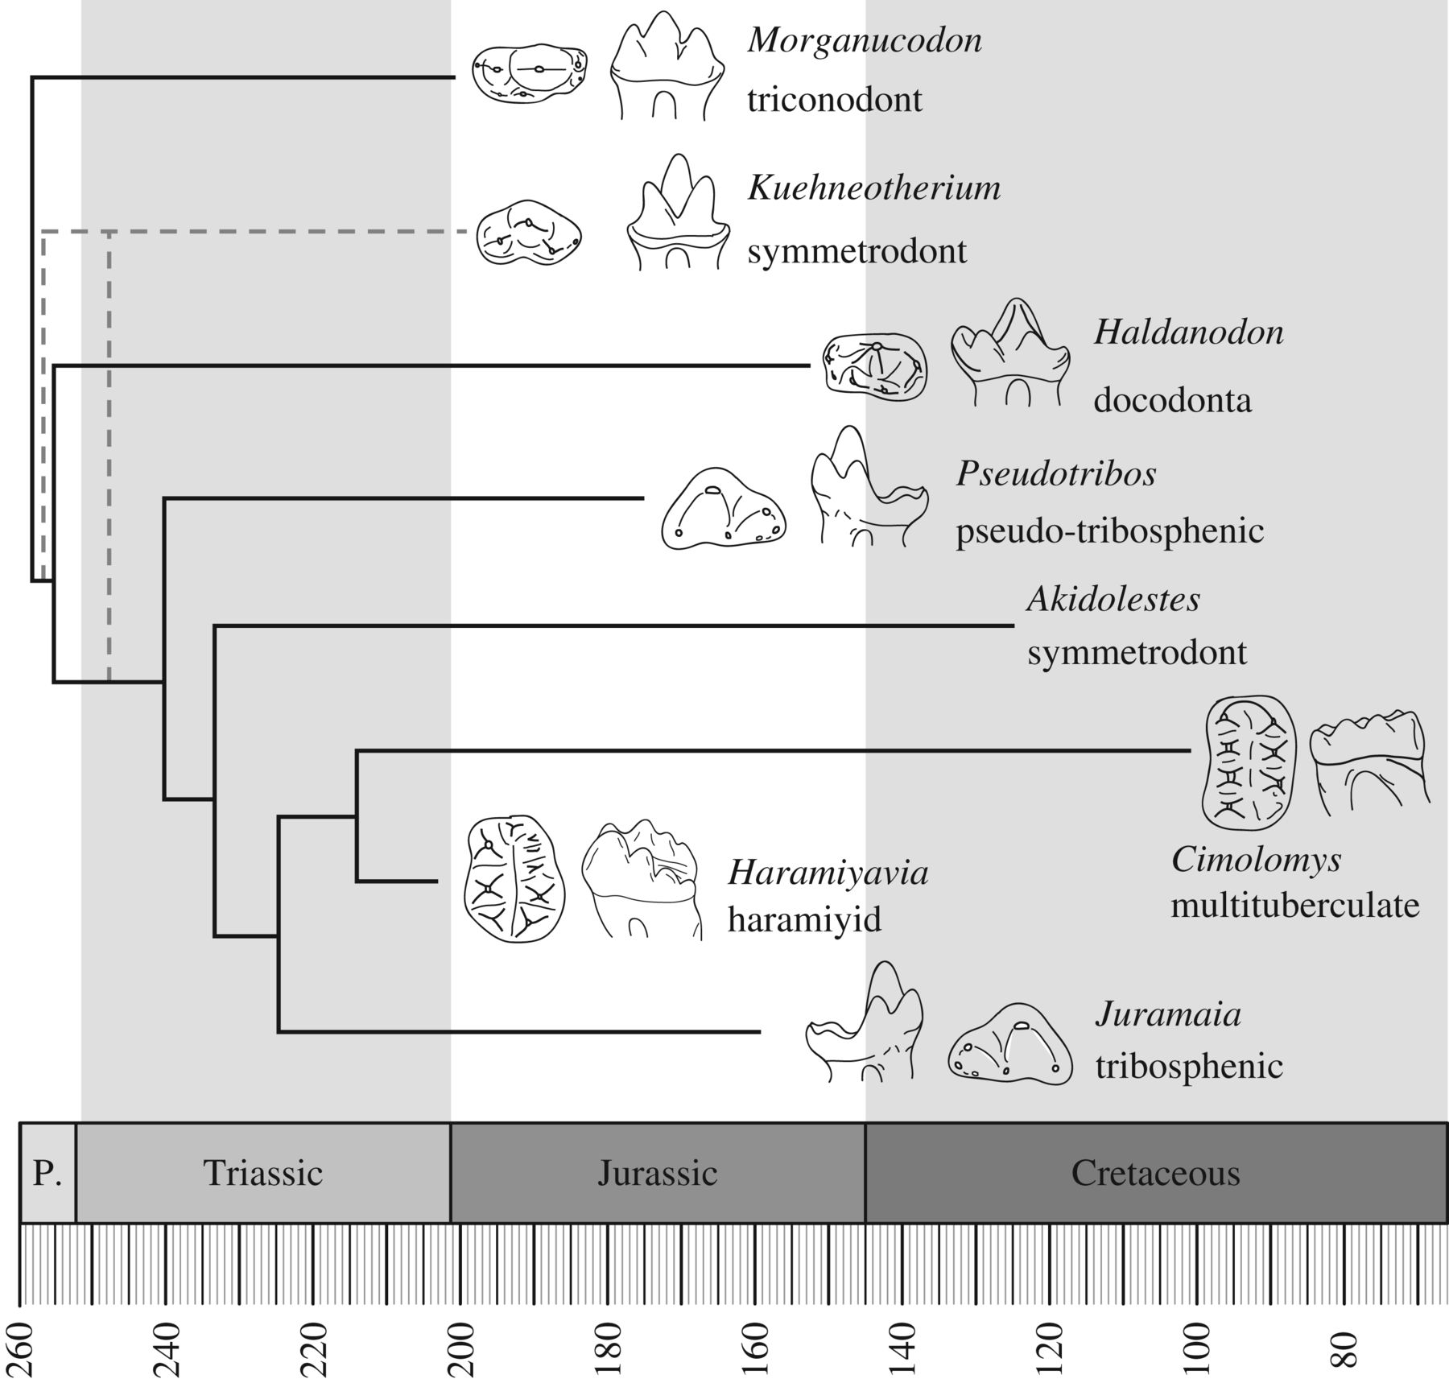
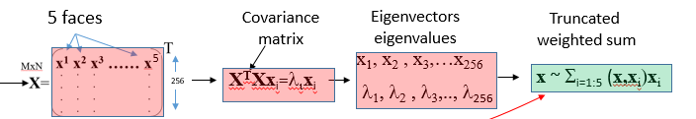
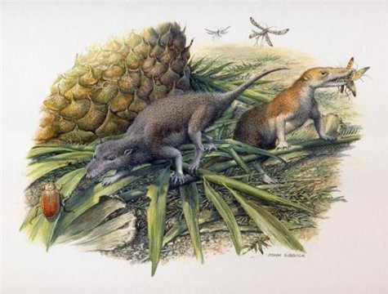
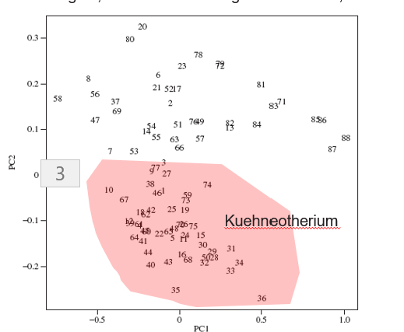
Example: 9-Dimensional Teeth Freatures
88 samples
Input: 9x1 x^{(n)} teeth Features (h/w, h, w,…
88 samples
88 fossil teeth from the early mammalian
insectivore Kuehneotherium
88
9
9
9
X₉⁽¹⁾
PC2
Goal: Distinguish Kuehneotherium teeth from Morganucodun teeth
PC1

Slide 16
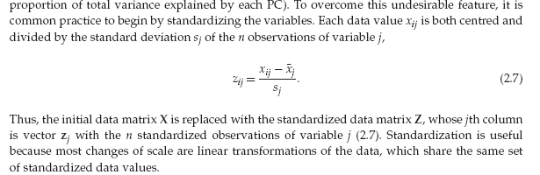
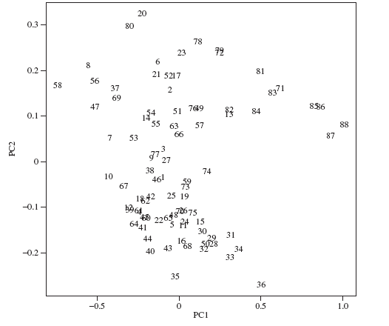
Example: 9-Dimenional Teeth Freatures
Fossils near the top of figure have smaller
lengths, relative to their heights and widths,
Input: 9x1 x^{(n)} teeth Features (h/w, h, w,…
88 fossil teeth from the early mammalian
insectivore Kuehneotherium
large teeth are on
the left and small
teeth on the right.
Q: PC2 & PC1 are important,
But how do you know
If height, h/w, weight,
roundness, etc are most
Important??
Kuehneotherium
A: If (height,PC1) is large
Then height important, if
(h/w,PC1) is large then important,
Etc. Make sure PC1 & height are unit vectors so (height,PC1)=cos(φ)
Goal: Distinguish Kuehneotherium teeth from Morgan teeth

Slide 17
Example: 9-Dimensional Teeth Freatures
Goal: Distinguish Kuehneotherium teeth from Morgan teeth
Fossils near the top of figure have smaller
lengths, relative to their heights and widths,
Q: PC2 & PC1 are important,
But how do you know
If height, h/w, weight,
roundness, etc are most
Important??
A: If (height,PC1)=cosΦ∼1 is large
Then height important, if
(h/w,PC1) is large then important,
Etc. Make sure PC1 & height are unit vectors
so (height,PC1)=cos(φ)
Kuehneotherium
(Teeth length,PC1)
PC1
Φ
Teeth length

Slide 18
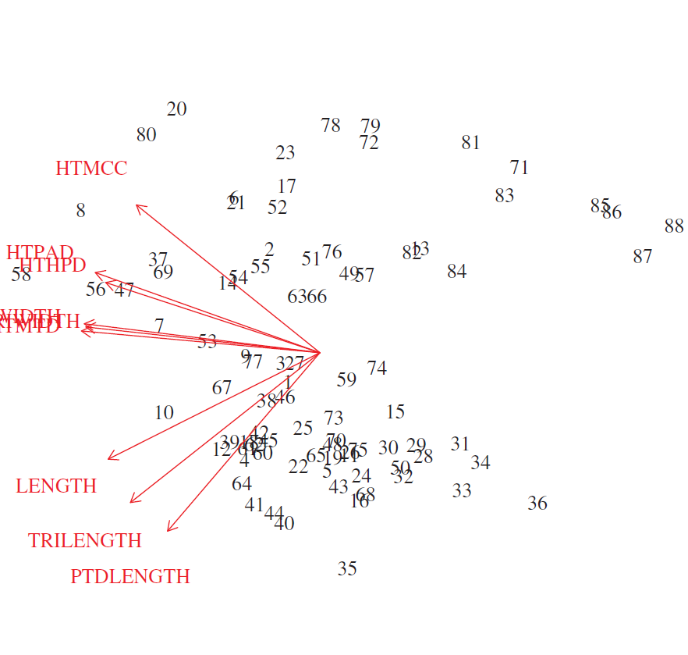
What is Meaning of PC1?
Input: 9x1 x^{(n)} teeth Features (h/w, h, w,…
Biplots
Test each x_{i} to see how much it contributes to PC₁
Most of data are in x₁ –x₃ plane
x₃
(PC_{1,} x₁ ) ~ .7
PC₁
Width & Height highly
correlated along PC1
PC₂
(PC_{1,} x₂ ) ~ 0
x₁
(PC_{1,} x₃ ) ~ .69
(Teeth length vector on Pc1xPC2)
This means points with large PC2
Comp. influenced by teeth width
Biplots
Test each x_{i} to see how much it contributes to PC₂
Teeth width
Teeth length
x₂
Fossils near the top of figure have smaller
lengths, relative to their heights and widths,

Slide 19
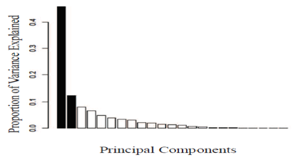

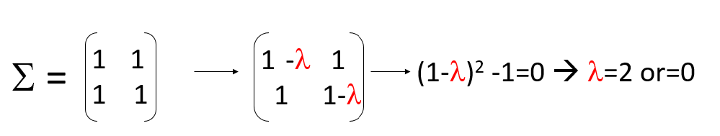
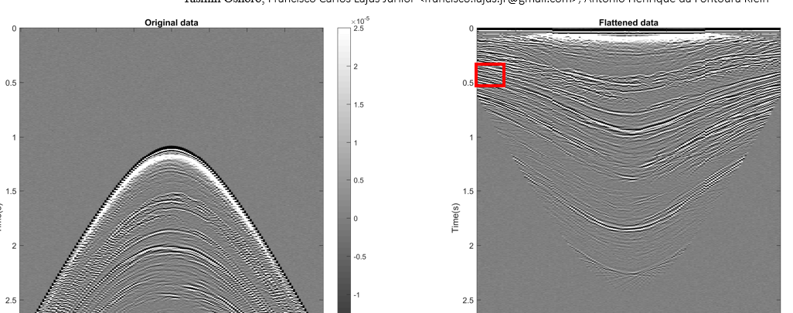

What did we Learn?
How to select # of PC vectors (scree plot/elbow)
Physical Meaning of PC components: (e₁,PC1)
Biplot: v = (e₁,PC1)PC1 + (e₁,PC2)PC2
PCA Analytical Example
Select Data Features so fewest
PC’s are needed
h/w

Slide 20
Principal Component Analysis
Part 1: Theory
Part 2: Analytical Example, Dinosaurs, MATLAB
Part 3: Hyperspectral Imaging: Limestones, Landsat
Brazil Uranium-K-Thorium

Slide 21
Outline
Intuitive PCA
Mathematics of PCA
Examples of PCA: Limestone & PC1/PC2 Geochem
Dolomite
Summary

Slide 22
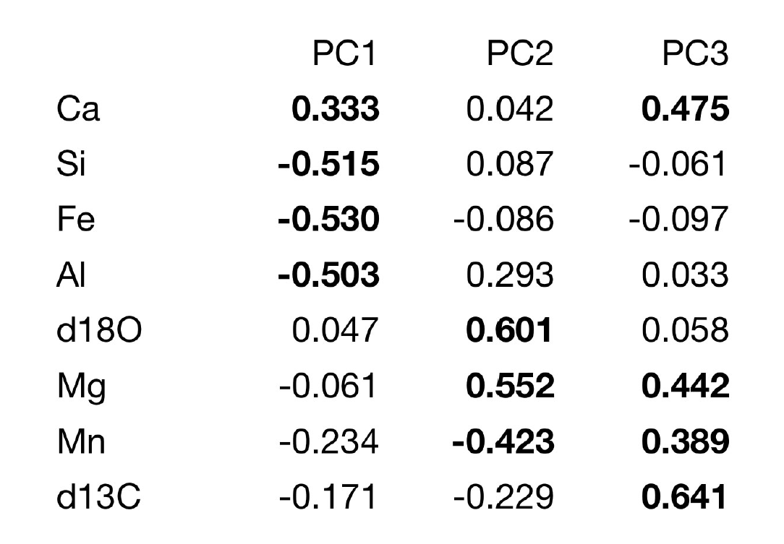
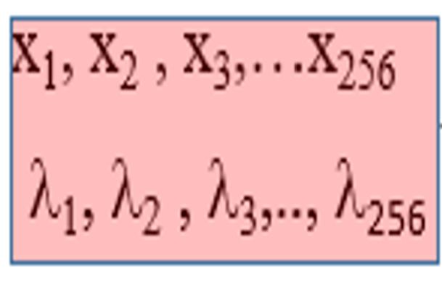
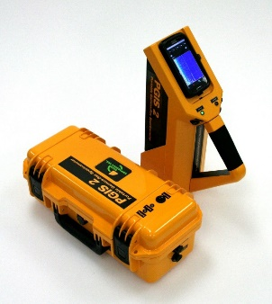
Carbonate Samples in Tennessee
Convert Sample 9x1 Vectors to PC Components
Geochem
Contribution
(80)
PC1 PC2 PC3……..PC9
(80)
8
……..
(80)
8
X₉⁽¹⁾
X₉⁽¹⁾
(80)
8
8

Slide 23
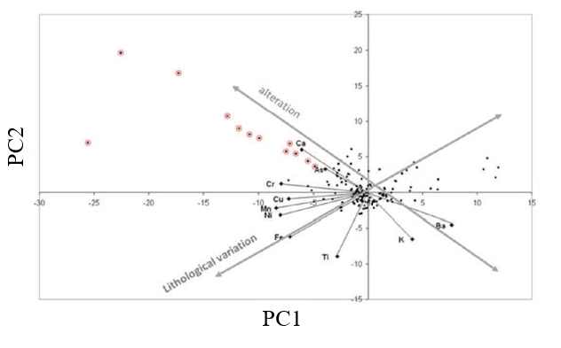
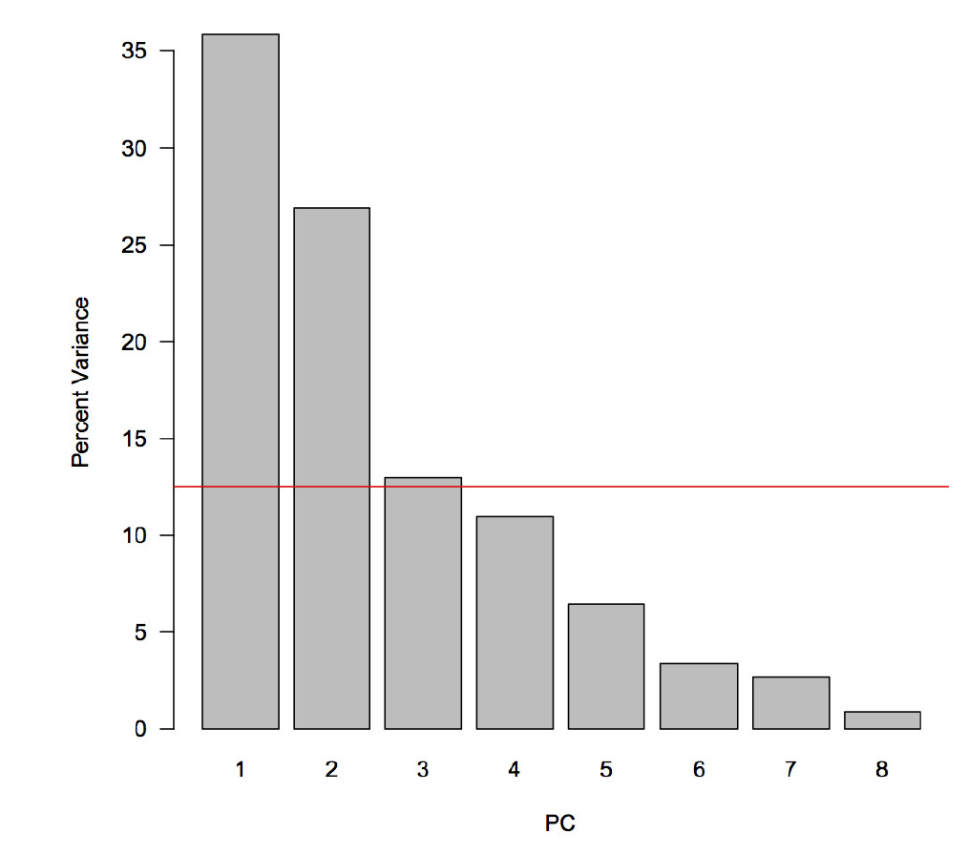
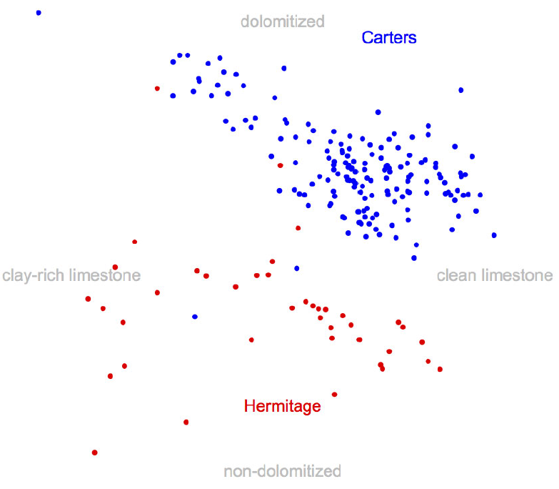
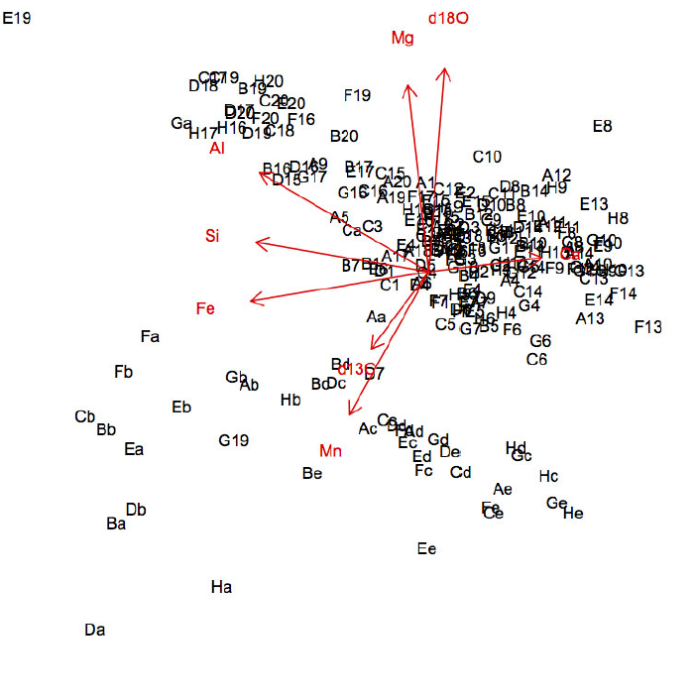
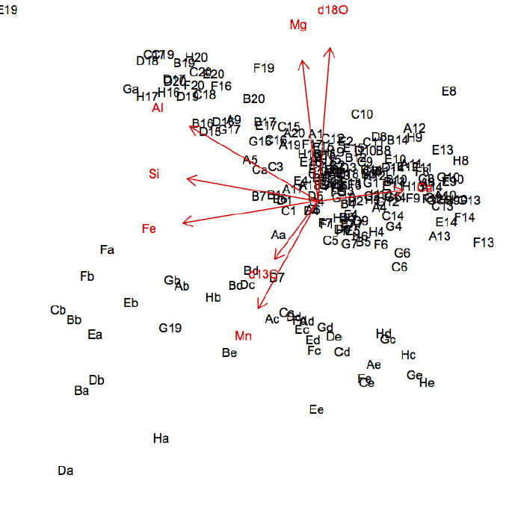
Positive PC1 → Ca (limestone CaCO³)
Negative PC1 → Si, Fe, Al. (clay!)
Borehole Samples of Rock Face
PC1 is a unit vector so ||PC1||² =1
Cleaner limestone CaCO³ more right quads
Biplots
More clay → more left quads
Geochem
Contribution
Q: Wait a minute! What does silica PC1:
Negative -0.515 Si mean? It means
Si is negative percentage of sample???
A: Since we demeaned our input
Data, -0.515 means that the Silica
% different from the mean. Also, larger
Components α>0 of Silica α(0,1,0,..) lead
to points plotted more to left of
origin, that is α(0,1,0,..) → -αPC1
Q: What constitutes a large loading?
PC1 PC2 PC3
PC2
A: ----------------------
e₁= (1,0,0,…)
PC3 explains variance in more than 1 variable
So we should include it in plots
e₂= (0,1,0,…)
---- Projections of FE=e₃ onto
PC1xPC2 plane
e₃= (0,0,1,…)
PC1·e₃
PC1
Ca
1/8=.12
PC2·e₃
D
Plot of FE unit vector e₃
Onto PC1xPC2 plane
Positve PC2 → strong + weights for Mg & d180
→ dolomite (limestone MgCO³)
PCA Scores show Groups of Elements, not Single Elements
PC1

Slide 24
Outline
Intuitive PCA
Mathematics of PCA
Examples of PCA: Hyperspectral + Geology
Summary

Slide 25
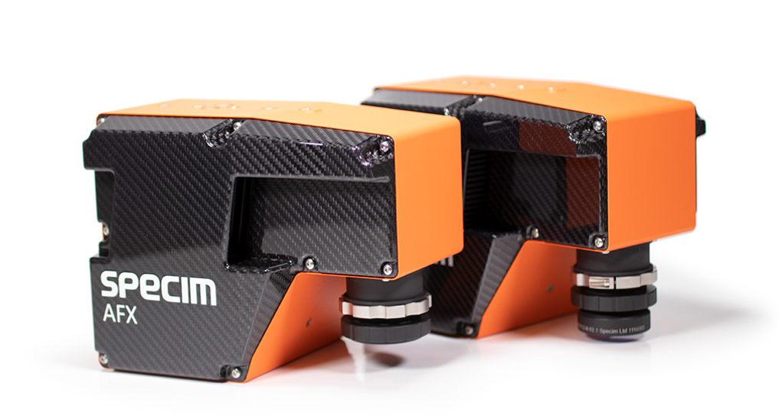
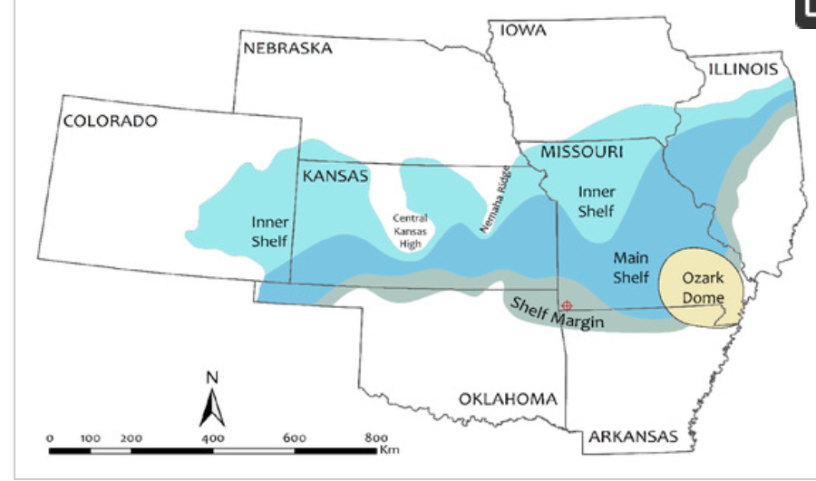
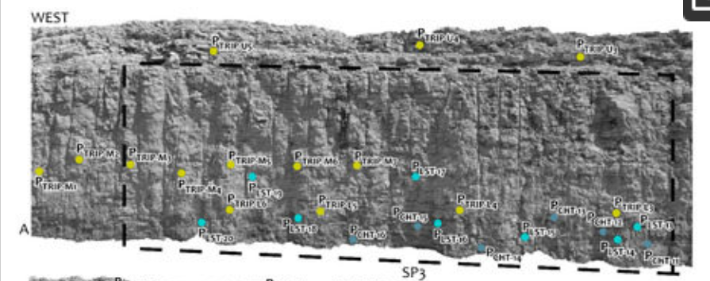
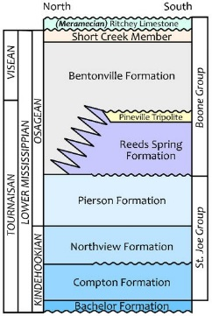
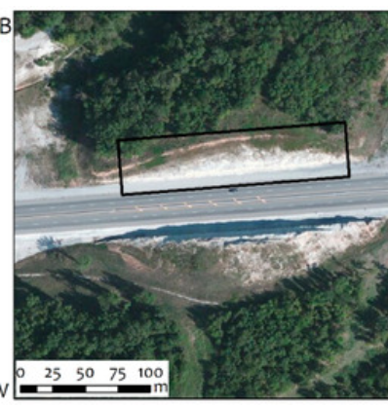
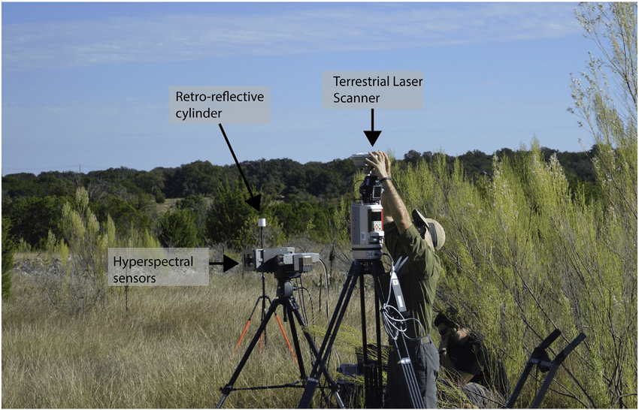
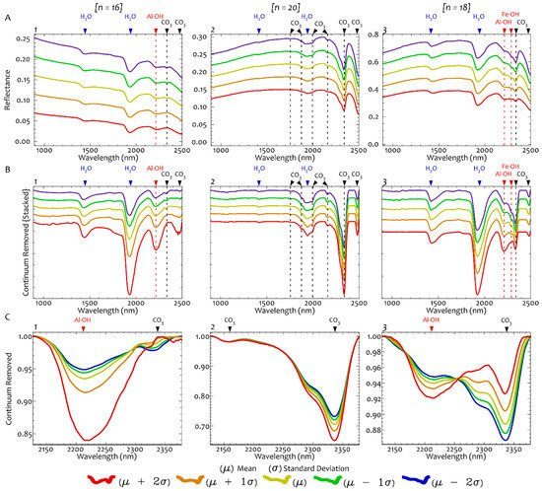
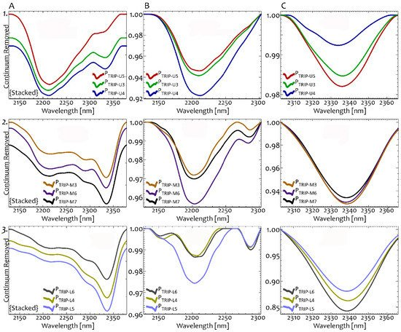
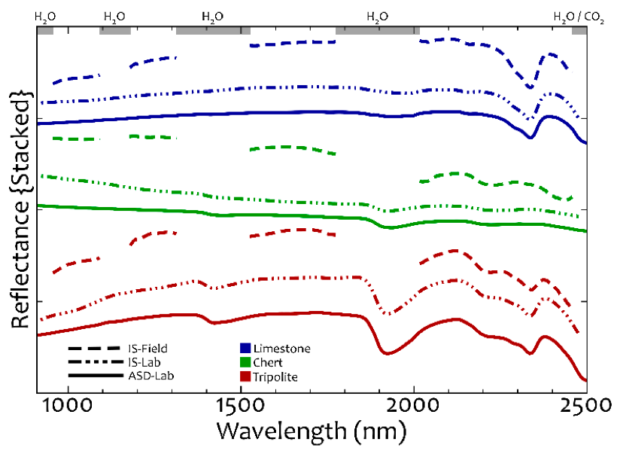
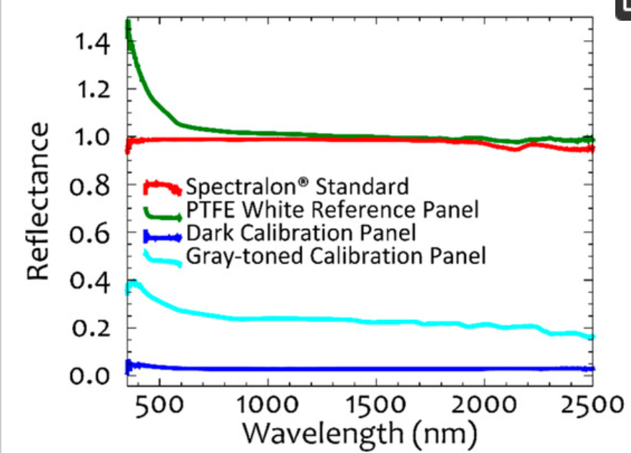
Hyperspectral Imaging & Geology Identification (Central USA)
Tripolite at three different levels
At three different Road Cuts
Level 1
Level 2
Level 3
Maximum Noise Fraction (MNF) transformation [52] was applied to filtered reflectance images so as to enhance the inherent variability between spectral bands and remove random noise. The spatially coherent, noise-free components with high eigenvalues (roughly > 3.0 representing > 0.6 spatial coherence) representing most of the variance in the image were segregated from the noisy data. The first 12–17 MNF components were found to be spatially coherent for both ground- and laboratory-based hyperspectral images. Subsequently, an inverse MNF transformation was applied, using only the spatially coherent components to convert the data back to its spectral domain providing noise-free reflectance images.
Representative reflectance spectra of chert (A1), limestone (A2), and tripolite (A3) calculated using standard deviation (σ) around the mean (µ). (B) Continuum removed spectra of chert (B1), limestone (B2), and tripolite (B3). The spectra are offset by 0.1 for clarity. (C) Spectra of chert (C1), limestone (C2), and tripolite (C3) with continuum removed over 2128–2378 nm range. The number of samples analyzed is indicated by [n].
https://www.mdpi.com/2072-4292/8/12/1018/htm
Continuum removed spectra of selected tripolite samples collected from (1) higher levels, (2) middle levels, and (3) lower levels of the roadcut, where accessible. Continuum removal was applied over the wavelength ranges of (A) 2128–2378 nm, (B) 2128–2302 nm, and (C) 2303–2373 nm.

Slide 26
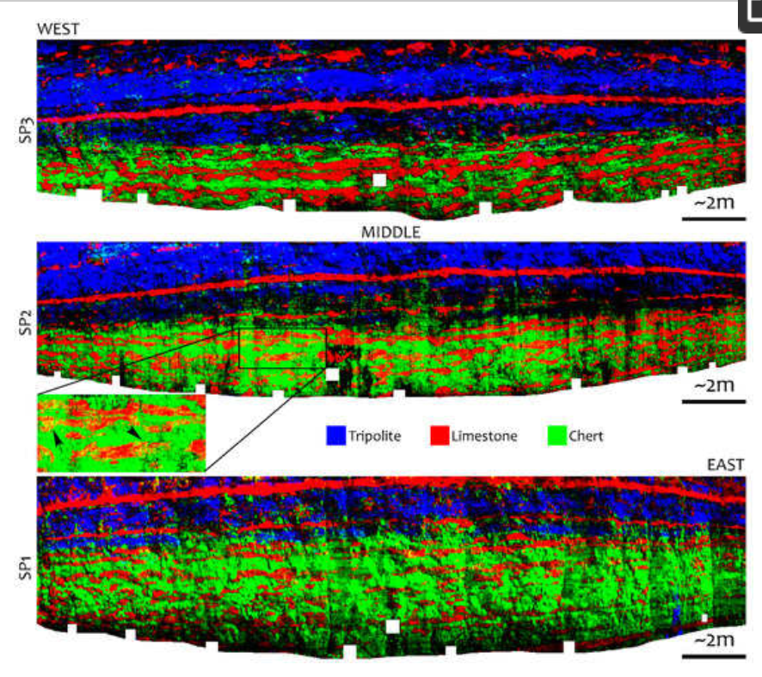
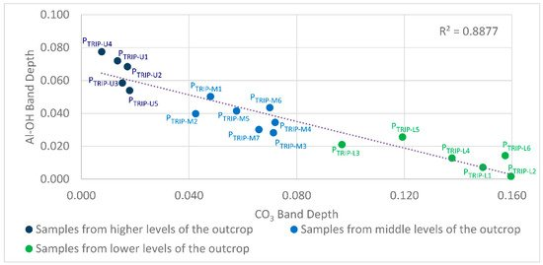
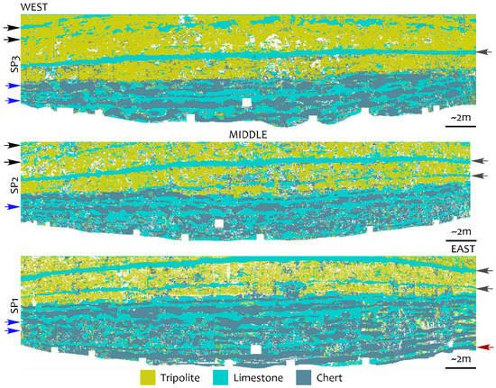
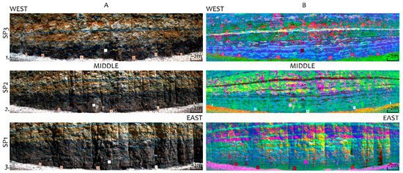
Layer 1
Spectral Feature Fitting [55,56] using the laboratory spectra and Mixture-tuned Match Filtering [57,58,59] using the field image spectra and laboratory image spectra for ground- and laboratory-based images, respectively. Spectral Feature Fitting (SFF), as a whole-pixel approach, has been commonly used for hyperspectral image classification [60,61]. As an absorption feature-based algorithm, SFF compares the spectral features between an image pixel and a reference spectrum. The algorithm takes continuum-removed image and reference spectra and evaluates their fit using a least-squares technique.
Layer 2
Layer 3
Figure 12. (A) False color hyperspectral images of the roadcut along US-71 Hwy near Pineville from scan positions 3 to the West to 1 to the East (SP3-SP1), spectral bands 1086, 1554, and 2033 nm are displayed in red, green, and blue (RGB). (B) False color Maximum Noise Fraction (MNF) images based on (A) with bands (5, 1, and 2), (6, 5, and 2), and (5, 2, and 6) displayed in RGB for SP3 to SP1, respectively
Representative reflectance spectra of chert (A1), limestone (A2), and tripolite (A3) calculated using standard deviation (σ) around the mean (µ). (B) Continuum removed spectra of chert (B1), limestone (B2), and tripolite (B3). The spectra are offset by 0.1 for clarity. (C) Spectra of chert (C1), limestone (C2), and tripolite (C3) with continuum removed over 2128–2378 nm range. The number of samples analyzed is indicated by [n].
Continuum removed spectra of selected tripolite samples collected from (1) higher levels, (2) middle levels, and (3) lower levels of the roadcut, where accessible. Continuum removal was applied over the wavelength ranges of (A) 2128–2378 nm, (B) 2128–2302 nm, and (C) 2303–2373 nm.

Slide 27
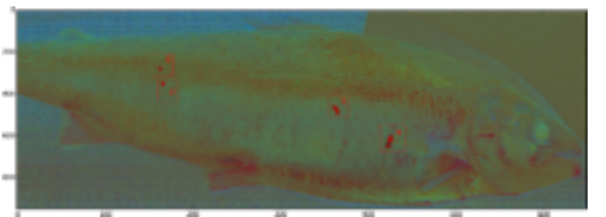
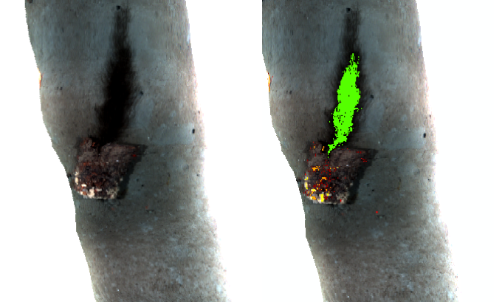
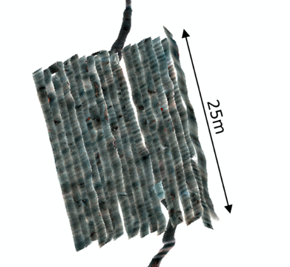
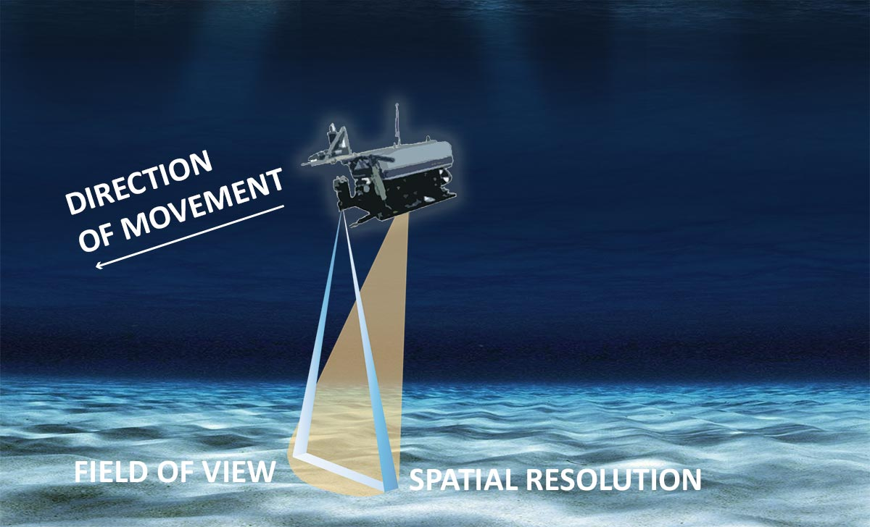
Representative reflectance spectra of chert (A1), limestone (A2), and tripolite (A3) calculated using standard deviation (σ) around the mean (µ). (B) Continuum removed spectra of chert (B1), limestone (B2), and tripolite (B3). The spectra are offset by 0.1 for clarity. (C) Spectra of chert (C1), limestone (C2), and tripolite (C3) with continuum removed over 2128–2378 nm range. The number of samples analyzed is indicated by [n].
Continuum removed spectra of selected tripolite samples collected from (1) higher levels, (2) middle levels, and (3) lower levels of the roadcut, where accessible. Continuum removal was applied over the wavelength ranges of (A) 2128–2378 nm, (B) 2128–2302 nm, and (C) 2303–2373 nm.

Slide 28
Outline
Intuitive PCA
Mathematics of PCA
Examples of PCA: Landsat + Agriculture
Summary

Slide 29
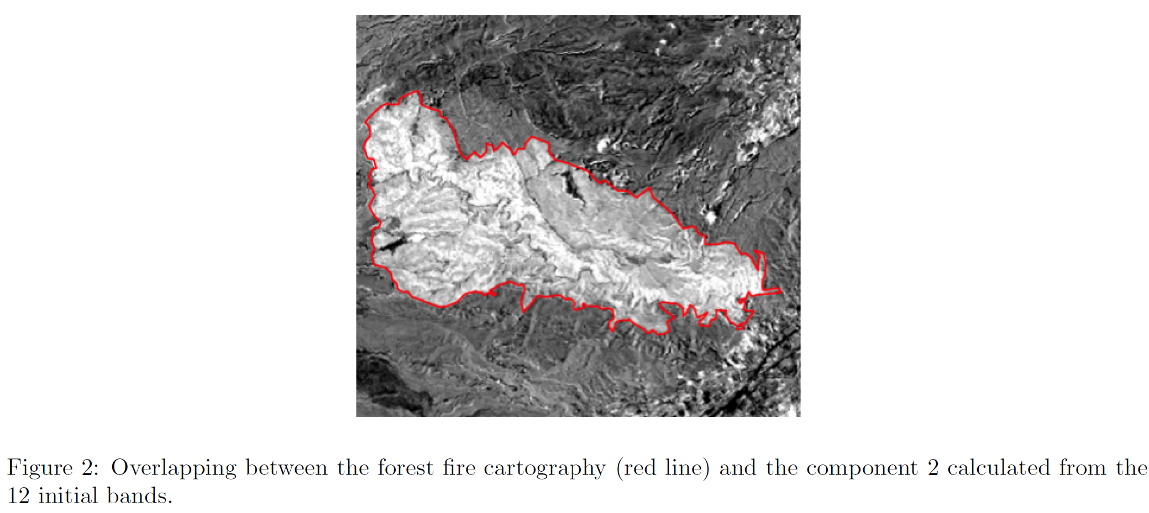
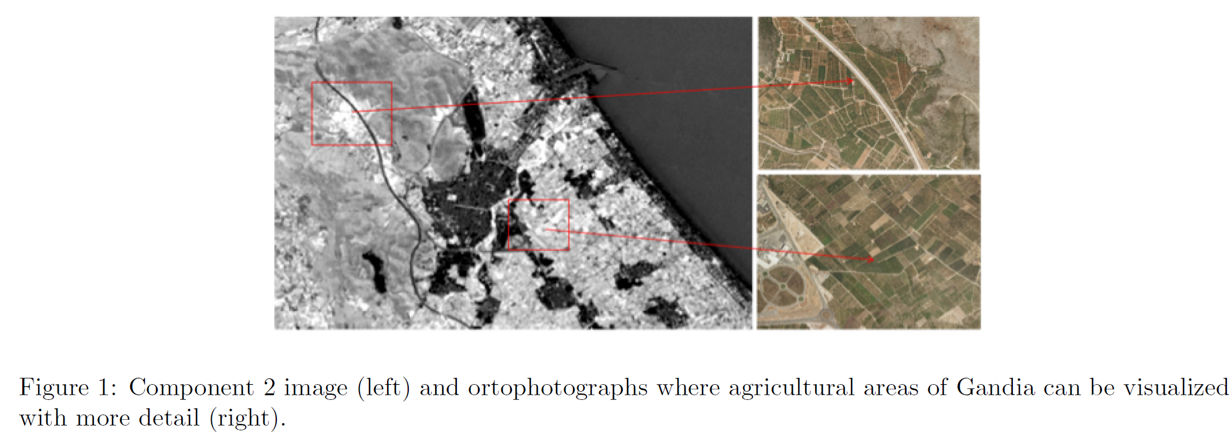
Landsat Calif. PC Images
PC2
PC1
Principal component analysis applied to
remote sensing
Javier Estornell, Jesus M. Mart-Gavila, M. Teresa Sebastia, Jesus Mengual
Universitat Politecnica de Valencia
jaescre@cgf.upv.es, jemarga@cgf.upv.es, mtsebastia@hma.upv.es, jemencu@hma.upv.es
Abstract

Slide 30
Outline
Intuitive PCA
Mathematics of PCA
Examples of PCA: Medical Imaging
Summary

Slide 31
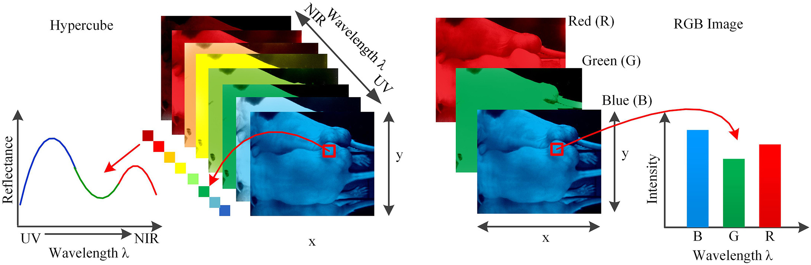
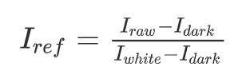
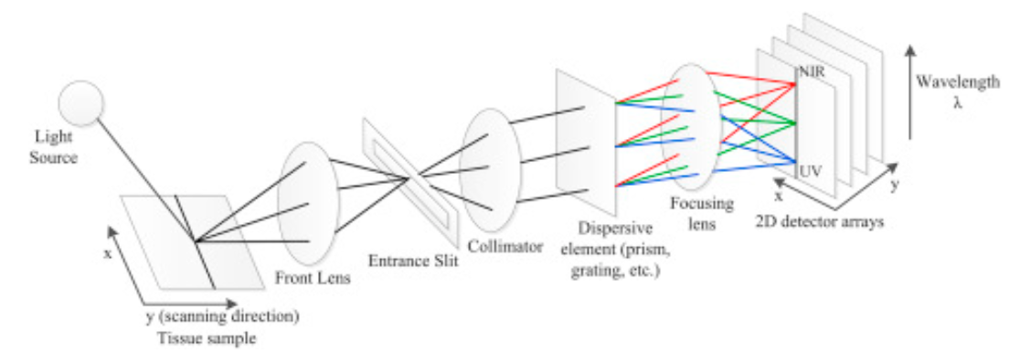
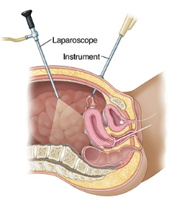
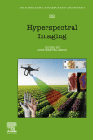
Hyperspectral imaging (HSI) for Important Disease Diagnosis and Image-guided Surgery.
Hyperspectal Reflectance Image of an Organ
RGB Reflectance Image of an Organ
Data Handling in Science and Technology
Volume 32, 2020, Pages 523-565, Fei
Chapter 3.6 - Hyperspectral imaging in medical applications

Slide 32



Hyperspectral imaging (HSI) for Important Disease Diagnosis and Image-guided Surgery.
Hyperspectal Reflectance Image of an Organ
RGB Reflectance Image of an Organ
Kernel-SVMs were much more effective than radial-basis function (RBF) neural networks and the KNN classifier. PCA 86% vs Raw 83% tumor identification improved.
X₁⁽¹⁾
X₂⁽¹⁾
X₃⁽¹⁾
.
.
.
Instrument Response Correction
CMOS Chip Correction
Corrects for uneven dark pixels
Reference
Sample
Corrects for uneven light pixels

Slide 33
Outline
Intuitive PCA
Mathematics of PCA
Examples of PCA: Cluster+PCA with
Brazil Airborne Survey
Summary

Slide 34



Principal Component Analysis
Principal Component Analysis and K-means analysis of airborne gamma ray spectrometry surveys
Rafael Pires de Lima1,2 and Kurt J. Marfurt1
1The University of Oklahoma, 2CPRM – Geological Survey of Brazil

Slide 35



Principal Component Analysis
Principal Component Analysis and K-means analysis of airborne gamma ray spectrometry surveys
Rafael Pires de Lima1,2 and Kurt J. Marfurt1
1The University of Oklahoma, 2CPRM – Geological Survey of Brazil
Gamma rays can travel for up to 300 m through air, but are stopped by water and other molecules (eg in soil, rock). The energy of each gamma ray is characteristic of the radioactive element it came from.
Potassium
Counts/s
Thorium
Uranium
measuring the energy of gamma rays being emitted in an area, we can infer the presence of particular minerals in the earth’s surface.
Higher energy
Potassium
Uranium
Thorium

Slide 36

Principal Component Analysis
Principal Component Analysis and K-means analysis of airborne gamma ray spectrometry surveys
Rafael Pires de Lima1,2 and Kurt J. Marfurt1
1The University of Oklahoma, 2CPRM – Geological Survey of Brazil
Gamma rays can travel for up to 300 m through air, but are stopped by water and other molecules (eg in soil, rock). The energy of each gamma ray is characteristic of the radioactive element it came from.
Potassium
Counts/s
Thorium
Uranium
measuring the energy of gamma rays being emitted in an area, we can infer the presence of particular minerals in the earth’s surface.
Higher energy
Potassium
Uranium
Thorium

Slide 37
Principal Component Analysis
Principal Component Analysis and K-means analysis of airborne gamma ray spectrometry surveys
Rafael Pires de Lima1,2 and Kurt J. Marfurt1
1The University of Oklahoma, 2CPRM – Geological Survey of Brazil
Counts/s
K
Ur
Th
Typical values are
:
Potassium | 0-450 cps | 0-5% potassium | percent
Thorium | 0-230 cps | 0-58 ppm equivalent thorium | parts per million
Uranium | 0-120 cps | 0-20 ppm equivalent uranium | parts per million
Total count | 0-4600 cps | 0-150 nGy/h air absorbed dose rate | nanoGray per hour

Slide 38


Ternary, PC1 & PC2 Maps
x=(TC, Th, Ur, K)
Total Count
Potassium
Potassium count
Th count
Ur count
30 km
Total count
Th count
Thorium
Uranium
Potassium count
Ur count
(x₁,x₂, x₃, x₄)
……
(x₁,x₂, x₃, x₄)
(x₁,x₂, x₃, x₄)
(x₁,x₂, x₃, x₄)
.
.
.

Slide 39




Ternary, PC1 & PC2 Maps
x=(TC, Th, Ur, K)
Geology
Total Count
Potassium
Ternary
Potassium
Potassium count
Th count
Ur count
Uranium
Thorium
30 km
Total count
Th count
Thorium
Uranium
Potassium count
PC1
PC2
Ur count
(x₁,x₂, x₃, x₄)
(x₁,x₂, x₃, x₄)
(x₁,x₂, x₃, x₄)
(x₁,x₂, x₃, x₄)
.
.
.

Slide 40



K-Means Clustering
Geology
Total Count
Potassium
Ternary
Potassium
Uranium
Thorium
30 km
(TC, Ur, Th, K) K means
(PC1, PC2) K means
Thorium
Uranium
PC1
PC2

Slide 41
Leznik, M; Tofallis, C. 2005 [uhra.herts.ac.uk/bitstream/handle/2299/715/S56.pdf Estimating Invariant Principal Components Using Diagonal Regression.]
Summary
PCA → Find a maximizes σ², i.e. ε = <a^{T}X^{T}Xa> -λ(a^{T}a-1)
PCA finds direction that maximizes variance of data projected to PC1 axis
Results of PCA → Depend on the scaling of the variables. A scale-invariant form of PCA has been developed.^{[13]}
x₂
X₁ = Mg and
X₂ CO3
Skeletonized data!
Workflow:
x₁
Demean data and scale data with different units
Form Covariance matrix X^{T}X and find λ_{i} and v_{i} . Assess Scree Plots.
Plot z^{(n)} ~ v₁ •x^{(n)}v⁽¹⁾ + v₂ •x^{(n)}v⁽²⁾ where threshold keeps 70% energy of largest eigenvalue contributions. That is, don’t use v_{n} if λ_{n}/ λ_{max} < 0.3
4. Test (x_{i},PC₁) for meaning of PC₁

Slide 42
Summary
How to select # of PC vectors (scree plot/elbow)
Physical Meaning of PC components: (e₁,PC1)
Biplot: v = (e₁,PC1)PC1 + (e₁,PC2)PC2
PCA Analytical Example
Select Data Features so fewest
PC’s are needed
h/w

Slide 43
Advanced ML
(Spring Semester)
    Variational and Regularized Autoencoders
Generative Adversarial Networks
Automatic Differentiation
Neural Network PDEs
Recurrent Neural Networks
Reinforcement Learning

Slide 44

Summary
Stop p
are correlated
Because dolomite is MgCO3
PCA key points
1. The first selected component by PCA is the component that has the highest variance followed by second, third and so on.
2. Assumes data are linearly correlated
3. Normalizing data becomes extremely important when the predictors are measured in different units.
4. PCA is a tool which helps to produce better visualizations of high dimensional data.

Slide 45
Summary
Principal Component Analysis (PCA)
What happens when a data set has too many variables ? remove correlated variables using PCA
Q: What is PCA ?
A: Method of extracting important variables from a large set of variables available in a data set.
the variables shoud be numeric and have standardized data.
categorical variables must be converted to numerical. Find the components which explain the maximum variance. This is because, we want to retain as much information as possible using these components. So, higher is the explained variance, higher will be the information contained in those components.
Leznik, M; Tofallis, C. 2005 [uhra.herts.ac.uk/bitstream/handle/2299/715/S56.pdf Estimating Invariant Principal Components Using Diagonal Regression.]
https://developer.ibm.com/recipes/tutorials/machine-learning-and-ibm-watson-studio/

Slide 46

PCA consists of a number of steps:
- Loading the data
- Subtracting the mean of the data from the original dataset
- Finding the covariance matrix of the dataset
- Finding the eigenvector(s) associated with the greatest eigenvalue(s)
- Projecting the original dataset on the eigenvector(s
%Uncomment to see the data after the deduction of the mean
%subplot(4,1,2);
%plot(xnew,ynew, 'o');
%title('mean is deducted')
%step 3, covariance matrix
covariancematrix=cov(xnew,ynew);
%step 4, Finding Eigenvectors
[V,D] = eig(covariancematrix);
D=diag(D);
maxeigval=V(:,find(D==max(D)));
%step 5, Deriving the new data set
%finding the projection onto the eigenvectors
finaldata=maxeigval'*[xnew,ynew]';
subplot(3,1,2);
stem(finaldata, 'DisplayName', 'finaldata', 'YDataSource', 'finaldata');
title('PCA 1D output ')
%we do a classification now
subplot(3,1,3);
title('Final Classification')
hold on
for i=1:size(finaldata,2)
if finaldata(i)>=0
plot(x(i),y(i),'o')
plot(x(i),y(i),'r*')
else
plot(x(i),y(i),'o')
plot(x(i),y(i),'g*')
end
end
% PCA
% Written by SIAMAK FARIDANI
% I used this tutotial
% www.cs.otago.ac.nz/cosc453/student_tutorials/principal_components.pdf
clc;
close all;
clear all;
numdata=20; %should be even
%step 1, generating a dataset
x1=rand(numdata/2,1);
y1=rand(numdata/2,1);
x2=3*rand(numdata/2,1)+3;
y2=3*rand(numdata/2,1)+3;
x=[x1;x2];
y=[y1;y2];
%step 2, finding a mean and subtracting
xmean=mean(x);
ymean=mean(y);
xnew=x-xmean*ones(numdata,1);
ynew=y-ymean*ones(numdata,1);
subplot(3,1,1);
plot(x,y, 'o');
title('Original Data');

Slide 47

PCA consists of a number of steps:
- Loading the data
- Subtracting the mean of the data from the original dataset
- Finding the covariance matrix of the dataset
- Finding the eigenvector(s) associated with the greatest eigenvalue(s)
- Projecting the original dataset on the eigenvector(s

Slide 48

Principal Component Analysis
Reduce Dimensionality of Data
D = diagonal matrix
R D m’
Example:
Lm=d
→ R R^{T}LR R^{T}m = d (Householder transform R
assumes NxN SPD L & R^{T}R=I)
Multiply both sides by R^{T} gives
Dm’ = R^{T} d
Multiply by D⁻¹ gives
.
.
.
.
.
λ₁
r₁₁
r₁₂
.
.
0
r₁
.
r_{1N}
d₁
.
.
.
0
λ₂
r₂₁
r₂₂
.
.
0
r₂
r_{2N}
d₂
m’ = D⁻¹ R^{T} d
.
.
.
.
.
.
.
=
.
.
.
.
.
.
.
.
.
.
.
.
.
.
.
.
.
.
.
.
0
0
.
r_{D1}
r_{D2}
.
λ_{N}
r_{D}
r_{DN}
d_{N}
Threshold eigenvalues ε & only keep the M eigencomponents s.t. |λ_{i} |>ε
m ’ = Σ_{i=1…M} (r_{i} ,d)/λ_{i}
Reduced number of components of m’
Finite number of CG iterations only reconstructs most significant components of model

Slide 49
Random Noise is Uncorrelated
d=n+s
=
s
n
+
x₂
-1*1=-1
1*1=1
1*1=+1
x₁
=
+
-1*-1=1
x₁= x₁ + x₁
Coherent sum
Incoherent sum
<x₁ ,x₂> = < x₁ ,x₂ >+< x₁ ,x₂ >
< x₁ ,x₂ > =huge
< x₁ ,x₂ > ~ 0
0 0 0
0
0 0
0 0
0
0 0 0

Slide 50
Summary
Total Count
Potassium
Despite the high correlation between the primary aerogeophysical gamma ray products, PCA was able to condense the information into a smaller set of dimensions
(two instead of four). The results obtained using K-means clustering of PC 1 and PC 2 are also better (presenting a better correlation with the traditional geological map) when
compared with the clustering of TC, K, eTh and eU maps.
At present, we present only visual comparisons of the traditional geologic maps based on outcrops to the geophysical maps. We anticipate that areas that have a high
spatial correlation can be used as training to identify similar features that were either overlooked or buried. For future work, we intend to test different image processing
methodologies, such as ICA. We also intend to test different clustering techniques, such as Self Organizing Maps (SOM), as used by Carneiro et al, (2012) over the Brazilian Amazon.
Thorium
Uranium

Slide 51
Outline
Intuitive PCA
Mathematics of PCA
Examples of PCA: Stratigraphy
Summary

Slide 52









Principal Component Analysis
Raw Data
Flattened+Filtered Data
Instantaneous Frequency
Porous
Hi-freq=porous
Porous vs non-porous ~split-up of the single low-frequency
cycle into two high-frequency cycles.
In general, a frequency high indicates porosity and a low is related to a lack of porosity. The high and low frequency anomalies can be detected by differences in shading patterns.
X^{(n)} =(t₁, t₂, ……t₁₅₀)^{(n)}
2-Components
correlation coefficient
of m eigenvector & trace A,B
v₁( X^{(n)}•v₁) + v₂(X^{(n)}•v₂)
(t₁, t₂, ……t₁₅₀)⁽¹⁾
(t₁, t₂, ……t₁₅₀)⁽²⁾
(t₁, t₂, ……t₁₅₀)⁽³⁾
A B
(t₁, t₂, ……t₁₅₀)⁽⁴⁾
.
.
.
3-Components
X=
v₁( X^{(n)}•v₁) + v₂(X^{(n)}•v₂) + v₂(X^{(n)}•v₃)
(t₁, t₂, ……t₁₅₀)⁽²⁰⁰⁾
Correlation coefficients

Slide 53
Principal Component Analysis
Raw Data
Flattened+Filtered Data
Instantaneous Frequency
Porous
Hi-freq=porous
Dry Hole
correlation coefficient
of m eigenvector & trace A,B
Each trace has
a coeff. α for
PC1 and PC2
α₂
A B
Hi-freq=porous
α₁
If it could be assigned to a class,
the probability it was in the correct class was computed as the ratio of its
reciprocal distance to that class and the sum of the reciprocal distance to all classes :

Slide 54



Principal Component Analysis
X^{(n)} =(t₁, t₂, ……t₁₅₀)^{(n)}
2-Components
v₁( X^{(n)}•v₁) + v₂(X^{(n)}•v₂)
A B
3-Components
v₁( X^{(n)}•v₁) + v₂(X^{(n)}•v₂) + v₂(X^{(n)}•v₃)
Correlation coefficients

Slide 55
Outline
Intuitive PCA
Mathematics of PCA
Examples of PCA: PCA & Genomics
Summary

Slide 56


Example: Genomics and PCA
Input: 37x1 x^{(n)}
Goal: Enhance clustering & reduce dim.
Plotting points z^{(n)} ~ v₁ •x^{(n)}v⁽¹⁾ + v₂ •x^{(n)}v⁽²⁾
A principal components analysis scatterplot of Y-STR haplotypes calculated from repeat-count values for
37 Y-chromosomal STR markers from 354 individuals.
PCA has successfully found linear combinations of the different markers, that separate out different clusters corresponding to different lines of individuals' Y-chromosomal genetic descent
https://en.wikipedia.org/wiki/Principal_component_analysis

Slide 57
Outline
Intuitive PCA
Mathematics of PCA
Examples of PCA: Food & PC1/PC2 Plot
Summary

Slide 58


