Slide 1
Principal Component Analysis
Part 1: PCA Theory
Part 2: Analytical Example, Dinosaurs, MATLAB
Part 3: Hyperspectral Imaging: Limestones, Landsat
Brazil Uranium-K-Thorium

Slide 2
Outline
Intuitive PCA: Facial Recognition
Mathematics of PCA
Examples of PCA
Summary

Slide 3



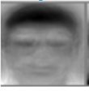
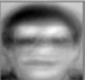

Facial Recognition
Picture is a sum of weighted basis vectors
Principal component analysis (PCA) can approximate the vector image by using a much lower-dimensional space, often with very little error.
basis vectors
x = α₁x₁ + α₂x₂ + α₃x₃ + α₄x₄ + . = Σ_{i=1}α_{i} x_{i}
x
16x16=256
55
88
89
.
.
155
155
210
1
0
0
0
.
.
.
0
0
1
0
0
.
.
.
0
0
0
1
0
.
.
.
0
0
0
0
.
0
1
.
0
.
55
+
88
+
89
+…+
155
+ . . . .
=
.
=
16x16=256 dimensional space
256x1
Perturb eye
pixels to 255
X₃ =
(0,0,1,…)
55
88
89
155
Inefficient basis functions that don’t resemble main features of person!
Much more EFFICIENT basis function,
Only need a few to recognize person
X₁=(1,0,0…)
10
8
.05
.01
X₂=(0,1,0,…)
PCA is an algorithm that transforms a set of possibly-correlated variables into a set of uncorrelated linear combinations of those variables; these combinations are called principal components. PCA finds these new features in such a way that most of the variance of the data is retained in the generated low-dimensional representation.

Slide 4
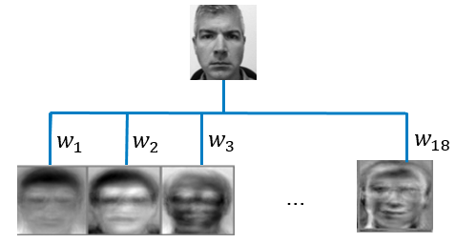

Facial Recognition
High Dimensionality of Input Vectors
Problem: Dimension of feature Dx1 vectors x^{(n)} is too big →
Noise in data. Too hard to plot 10⁶ dimensional data to compare to other faces
Eigenfaces method for facial recognition
16x16=256 dimensional space
16x16
55
88
89
.
.
155
155
155
155
155
155
200
210
.
.
.
155 155 155
155 155 155
x₃
Many features are redundant.
Portions of row vector correlated
x₁
x₂
Principal component analysis (PCA) and autoencoder networks enable you to approximate the vector image by using a much lower-dimensional space, often with very little error.
PCA is an algorithm that transforms a set of possibly-correlated variables into a set of uncorrelated linear combinations of those variables; these combinations are called principal components. PCA finds these new features in such a way that most of the variance of the data is retained in the generated low-dimensional representation.

Slide 5

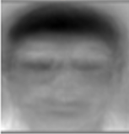

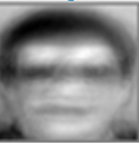
Reducing Dimensionality of Input Vectors
High Dimensionality of Input Vectors
Problem: Dimension of feature Dx1 vectors x^{(n)} is too big → high comp. cost.
Noise in data. Too hard to plot 10⁶ dimensional data
Eigenfaces method for facial recognition
Old 256x1 Basis Vectors
16x16=256 dimensional space
16x16
55
88
89
.
.
155
155
155
155
155
155
200
210
.
.
.
(0,0,1,0,……0)
155 155 155
155 155 155
x₃
Many features are redundant.
Portions of row vector correlated
New 256x1 Basis Vectors
Dimension reduction
(1,0,0,0,……..…0)
~10
~.05
x₁
~9
~.1
(0,1,0,0,……..…0)
x₂
44,255,66,..,……,211)
y₂
(13,33,66,99,……..…,11)
y₁

Slide 6


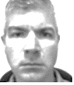
Summary
Reducing Dimensionality of Input Vectors
High Dimensionality of Input Vectors
Step 1: Find Transform where redundancy, noise, dimension reduced.
That is find new basis functions x_{i} such that x=Σ_{i=1,2,…256} α_{ι} x_{i}
x x₁ x₂ x₂₅₆
= 10 + 9 + …. .01
Step 2: Truncate the sum of new basis functions x_{i} such that x~Σ_{i=1,2} α_{ι} x_{i}
If you truncated noise then
x₁ x₂
~ 10 + 9

Slide 7
Intuitive Principal Component Analysis
can you send me the PPT of the data before after PCA filtering? I want to show it to my class.
As I understand it, you
1). flattened events in, for example, 32 traces in the CSG,
2). then fixed the time sample at T1 and form a 32x1 vector denoted as X1 consisting of the amplitudes for each trace at time T1,
3) You repeated this for time sample T2 to get the 32x1 vector X2. You did this for all time samples to get N 32x1 vectors Xi, where N is the number of time samples.
4) This allowed you to compute the 32x32 matrix XXT for each vector. Adding these XXT's up for all the time samples (after demeaning+normalization) gives the covariance matrix.
5) The covariance matrix is used to get the PC vectors, which uses just a few strong ones to reconstruct the original data
Please verify if above procedure is correct..or provide the correct procedure with pictures. I need this today if you dont mind...
Thanks

Slide 8
Outline
Intuitive PCA: Mathematics
Mathematics of PCA
Examples of PCA
Summary

Slide 9
Intuitive Principal Component Analysis
Problem: Dimension of feature Dx1 vectors x^{(n)} is too big → high comp. cost.
Noise in data.
Goal: PCA reduces dimensionality of x^{(n)} by finding coordinate system that
maximizes of variance of x^{(n)} . Side benefit is it can separate noise & signal.
Step 1: Find rotated coordinate system that maximizes variance of x^{(n)} along a coordinate
(or, equivalently, minimizes variance along orthogonal coordinate)
x₂
y₁
Φ σ_{y1} σ_{y2}
This means that the components X₁ ₊ and X₂ are highly correlated.
Knowing value of X₁ means you know value of X₂, ratio of X₁ / X₂
is ~ constant for all samples
y₁
y₁
7º 0.1 0.09
20º 0.7 0.07
45º 2.2 0.01
y₂
Project features onto x₁ → variance = 1/NΣi (x₁^{(i)}-x₁ )² < 1/NΣ_{i}(y₁^{(i)}-y₁ )²
y₂
y₂
Skeletonized data!
x₁
x₂ →variance = 1/NΣi (x₂^{(i)}-x₂ )² < 1/NΣ_{i}( y₂^{(i)}-y₂ )²
x = Σ_{i=1,2} a_{i} y_{i} ~ a₁y₁ dimension reduction
x = Σ_{i=1,2} b_{i} x_{i} full dimension

Slide 10


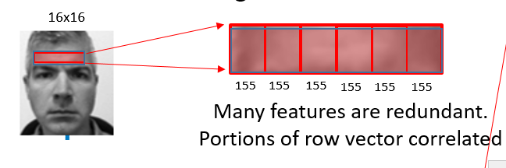
Intuitive Principal Component Analysis
Two pixel picture
Assume demeaned+normalized R.V. data
Y
Y =(y₁ ,y₂)
Projection of
x⁽¹⁾ onto y
(x₁⁽¹⁾ x₂⁽¹⁾ )
y₁
y₂
z⁽¹⁾
=
(x₁⁽²⁾ x₂⁽²⁾ ) z⁽²⁾
Projection of
x⁽²⁾ onto y
x₂
Φ σ_{x1} σ_{x2}
Y
(x₁⁽³⁾ x₂⁽³⁾ ) z⁽³⁾
20º 0.7 0.07
(x₁⁽⁴⁾ x₂⁽⁴⁾ ) z⁽⁴⁾
Y⊥
Project features onto x₁ → variance = 1/NΣ_{i} ||x^{(i)}-x ||² < 1/Nσ_{i}||y ^{(i)}-y ||²
Training data
.
.
.
.
.
.
x₁
(x₁^{(N)} x₂^{(N)} ) z^{(N)}

Slide 11
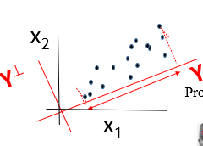
Intuitive Principal Component Analysis
PC1=y=Argmax_{y} z^{T}z
<x₁x₂ > ~ Σ_{i=1..N} x₁^{(i)} x₂^{(i)}
<x₁²> <x₁x₂>
X^{T}X = Covariance Matrix
=
<x₁ x₂> <x₂² >
y^{T} X^{T}
X y
z^{T}
z
Projection of
x⁽¹⁾ onto y
(x₁⁽¹⁾ x₂⁽¹⁾ )
y₁
y₂
z⁽¹⁾
y₁ y₂
x₁⁽¹⁾ x₁⁽²⁾ x₁⁽³⁾ x₁⁽⁴⁾ …..x₁^{(N)}
=
(x₁⁽²⁾ x₂⁽²⁾ )
z⁽²⁾
Projection of
x⁽²⁾ onto y
x₂⁽¹⁾ x₂⁽²⁾ x₂⁽³⁾ x₂⁽⁴⁾ …..x₂^{(N)}
(x₁⁽³⁾ x₂⁽³⁾ )
z^{T}·
z⁽³⁾
= z⁽¹⁾² + z⁽²⁾² +….
(x₁⁽⁴⁾ x₂⁽⁴⁾
z₄
.
.
.
.
.
.
Sum of
squared projections or
Variances (assumes
Zero mean)
(x₁^{(N)} x₂^{(N)}
z^{N)}

Slide 12
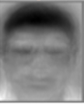
Intuitive Principal Component Analysis
PC1=y=Argmax_{y} z^{T}z
<x₁x₂ > ~ Σ_{i=1..N} x₁^{(i)} x₂^{(i)}
<x₁²> <x₁x₂>
X^{T}X = Covariance Matrix
Two pixel picture
=
<x₁ x₂> <x₂² >
In general, each row consist of 10⁶ pixels/picture
y^{T} X^{T}
X y
z^{T}
z
Projection of
x⁽¹⁾ onto y
(x₁⁽¹⁾ x₂⁽¹⁾ )
y₁
y₂
z⁽¹⁾
y₁ y₂
x₁⁽¹⁾ x₁⁽²⁾ x₁⁽³⁾ x₁⁽⁴⁾ …..x₁^{(N)}
=
(x₁⁽²⁾ x₂⁽²⁾ )
z⁽²⁾
Projection of
x⁽²⁾ onto y
x₂⁽¹⁾ x₂⁽²⁾ x₂⁽³⁾ x₂⁽⁴⁾ …..x₂^{(N)}
(x₁⁽³⁾ x₂⁽³⁾ )
z^{T}·
z⁽³⁾
= z⁽¹⁾² + z⁽²⁾² +….
(x₁⁽⁴⁾ x₂⁽⁴⁾
.
.
.
.
.
.
Sum of
Squared projections or
variances
(x₁^{(N)} x₂^{(N)}
z^{N)}

Slide 13
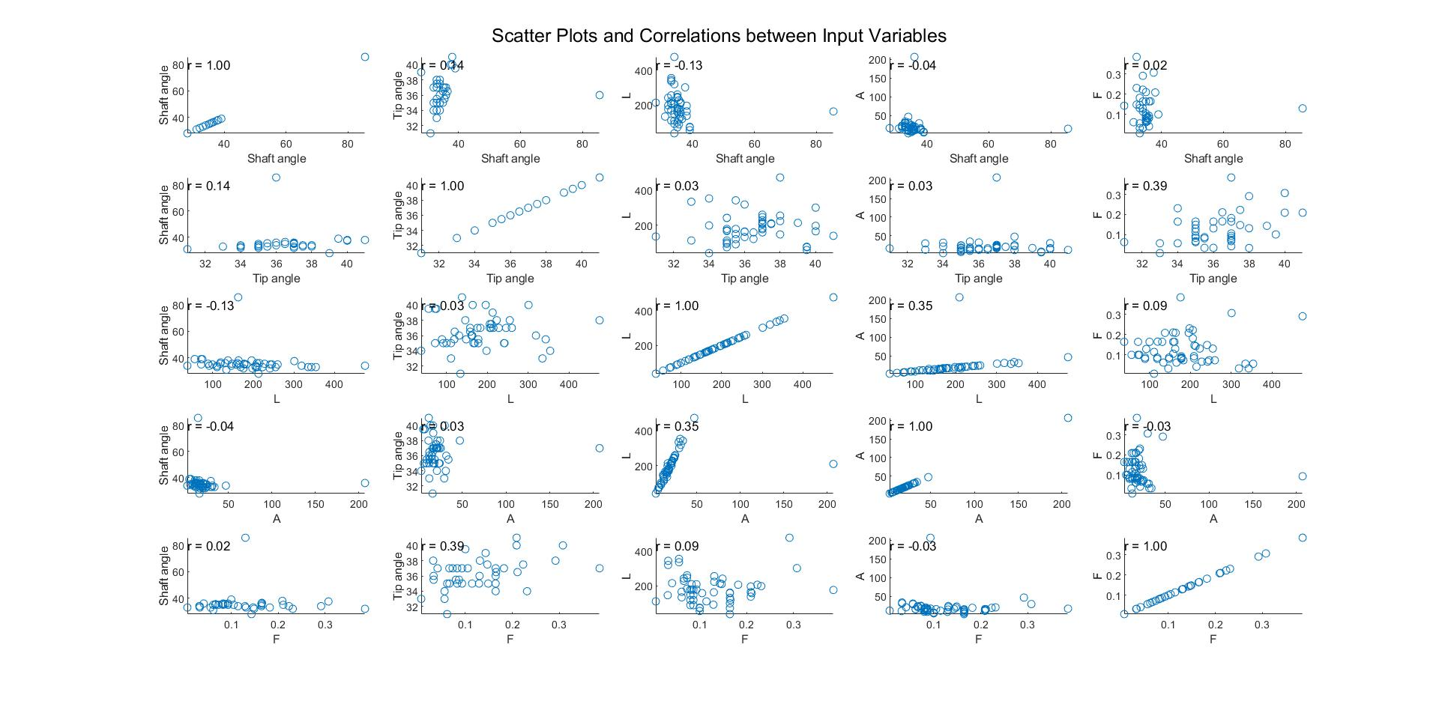
X^{T}X

Slide 14
Outline
Intuitive PCA
Mathematics of PCA
Examples of PCA
Summary

Slide 15
Linear Algebra Background
x₂
a=b
a² x₁² + b² x₂² = ε
a = 0.5 b
σ_{x1}
x₁
Easy to find mean (μ_{x1},μ_{x2}) and
σ_{x1} and σ_{x2} if major/minor axis
along coordinate axes
σ_{x1}
x₁ x₂ a² 0 x₁
0 b² x₂
= ε
x₂
a = 0.5 b
c ≠ 0
Not easy to find mean (μ_{x1},μ_{x2}) and
σ_{x1} and σ_{x2} if major/minor axis
not along coordinate axes
a² x₁² + b² x₂² + 2cxy = ε
x₁
x₁ x₂ a² c x₁
c b² x₂
Find rotation matrix that rotates x by angle α
= ε
x
R^{T} R = I
R
x
R^{T} R I
α
cos(α) sin(α) x₁ y₁
−sin(α) cos(α) x₂ y₂
1 0
0 1
=
cos(α) −sin(α)
sin(α) cos(α)
cos(α) sin(α)
−sin(α) cos(α)
=

Slide 16

Linear Algebra Background
The coordinates here are (y₁, y₂)
y₂
a² y₁² + b² y₂² = ε
y₁
y₁ y₂ a² 0 y₁
0 b² y₂
= ε
x₂
y₁
y₂
y₂
We say that the orthonormal rotation R
matrix diagonalizes the matrix and
zeros its off-diagonal terms. If
the matrix was X^{T}X covariance matrix then
diagonalizing the matrix decorreleates
the random variables. That is, <x_{i}x_{j}>=0 for
i ≠ j
x₁
a² x₁² + b² x₂² + 2cx₁x₂ = ε
y₁
x₁ x₂ a² c x₁
c b² x₂
= ε
COS(45^{O})
-SIN(45^{O})
0
1
COS(45^{O})
SIN(45^{O})
1
0
R^{T} R
R^{T} R
Rotates axes by 45º
Coordinate axes are || to minor/major axes so diagonal matrix
y₁
y₂
y₁
y₂
a² c x₁
c b² x₂
y₁
y₂
a² c x₁
c b² x₂
a² c x₁
c b² x₂
y₁
y₂
a² c x₁
c b² x₂
a² c x₁
c b² x₂
y₁ y₂
α² 0
0 β²
= ε
= ε
α² 0
0 β²
= ε
a² c x₁
c b² x₂
cos(α) −sin(α)
sin(α) cos(α)
cos(α) sin(α)
−sin(α) cos(α)
= ε
cos(α) −sin(α)
sin(α) cos(α)
cos(α) sin(α)
−sin(α) cos(α)
= ε
y₁ y₂
cos(α) −sin(α)
sin(α) cos(α)
cos(α) sin(α)
−sin(α) cos(α)
= ε
cos(α) −sin(α)
sin(α) cos(α)
cos(α) sin(α)
−sin(α) cos(α)
y₁ y₂
cos(α) −sin(α)
sin(α) cos(α)
cos(α) sin(α)
−sin(α) cos(α)
cos(α) sin(α)
−sin(α) cos(α)
cos(α) −sin(α)
sin(α) cos(α)
cos(α) sin(α)
−sin(α) cos(α)
x₁ x₂
cos(α) −sin(α)
sin(α) cos(α)
cos(α) sin(α)
−sin(α) cos(α)
x₁ x₂
cos(α) −sin(α)
sin(α) cos(α)
cos(α) sin(α)
−sin(α) cos(α)
x₁ x₂
cos(α) −sin(α)
sin(α) cos(α)
y₁ y₂
cos(α) sin(α)
−sin(α) cos(α)
x₁ x₂
cos(α) −sin(α)
sin(α) cos(α)
cos(α) sin(α)
−sin(α) cos(α)
x₁ x₂
cos(α) −sin(α)
sin(α) cos(α)
cos(α) sin(α)
−sin(α) cos(α)

Slide 17
Linear Algebra Background
The coordinates here are (y₁, y₂)
y₂
y₂
a² y₁² + b² y₂² = ε
y₁
y₁
y₁ y₂ a² 0 y₁
0 b² y₂
= ε
x₂
We say that the orthonormal rotation R
matrix diagonalizes the matrix and
zeros its off-diagonal terms. If
the matrix was X^{T}X covariance matrix then
diagonalizing the matrix decorreleates
the random variables. That is, <x_{i}x_{j}>=0 for
i ≠ j
x₁
a² x₁² + b² x₂² + 2cx₁x₂ = ε
x₁ x₂ a² c x₁
c b² x₂
= ε
COS(45^{O})
-SIN(45^{O})
0
1
COS(45^{O})
SIN(45^{O})
1
0
R^{T} R
Rotates axes by 45º
R^{T} R
a² c x₁
c b² x₂
y₁ y₂
y₁
y₂
y₁
y₂
x₁ x₂
cos(α) −sin(α)
sin(α) cos(α)
cos(α) sin(α)
−sin(α) cos(α)
cos(α) −sin(α)
sin(α) cos(α)
cos(α) sin(α)
−sin(α) cos(α)
= ε
y₁ y₂
α² 0
0 β²

Slide 18
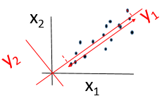
Theory of Principal Component Analysis
Transpose of Data matrix
Demean and normalize all x^{i)}
x⁽¹⁾ x⁽²⁾ …… x^{(N)}
Dx1
DxN
.
.
.
.
.
.
.
.
.
.
.
.
.
.
.
.
and elements of x^{n} = random variables
Given: x^{n} s.t. X^{T} =
z^{(i)} = (Xa)^{(i)} = projection of ith row vector onto a
Find: Linear projection of rows of X on a s.t. z = Xa that maximizes σ_{z}
Sum of variances (SOV): z₁²
……+z_{N}²
+z₂²
= Sum of squared distances (SOD) z
Step 1: Demean x so that σ² = <z^{T} z> = <a^{T}X^{T}Xa>
x^{(i)}
z_{i}
Unit vector condition
Step 2: Find a maximizes σ², i.e. ε = ½ <a^{T}X^{T}Xa> -λ² (a^{T}a-1)
Stationarity: ∂ε/∂a_{i} = 0 → X^{T}Xa –λ² a = 0 → X^{T}Xa = λ² a
Largest λ maximizes
SOD along a
Step 3: Thus a is an eigenvector of covariance matrix X^{T}X and λ² = eigenvalue
Hence σ² = <a^{T}X^{T}Xa> = λ²
Householder transform
a^{T}X^{T}Xa = sum of squared distances
from origin to each point along an eigen-axis
Σ
Find A that diagonalizes Σ if DxD Σ is SPD

Slide 19
Theory of Principal Component Analysis
T
x¹ x² x³ …… x^{N}
Mx1
MxN
.
.
.
.
.
.
.
.
.
.
.
.
.
.
.
.
and x^{n} a random variable
Given: x^{n} s.t. X=
Step 3: Thus a is an eigenvalue of covariance matrix X^{T}X and λ = eigenvalue
Hence σ = <a^{T}X^{T}Xa> = λ²
Householder transform
Σ
Find A that diagonalizes Σ if NxN Σ is SPD

Slide 20
Theory of Principal Component Analysis
T
x¹ x² x³ …… x^{N}
Mx1
MxN
.
.
.
.
.
.
.
.
.
.
.
.
.
.
.
.
and x^{n} a random variable
Given: x^{n} s.t. X=
Step 3: Thus a is an eigenvector of covariance matrix X^{T}X and λ² = eigenvalue
Hence σ² = <a^{T}X^{T}Xa> = λ²
Householder transform
Σ
Find A that diagonalizes Σ if NxN Σ is SPD
a_{i} = ith principal component of data set
PCA=Discrete Karhunen–Loève transform (KLT)
Since the covariance matrix of a standardized dataset (divide each comp by σ_{i} is merely the correlation matrix R of
the original dataset, a PCA on the standardized data is also known as a correlation matrix PCA.
PCA is mathematically defined as an orthogonal linear transformation that transforms the data to a new coordinate system such that the greatest variance by some projection of the data comes to lie on the first coordinate (called the first principal component), the second greatest variance on the second coordinate, and so on.

Slide 21
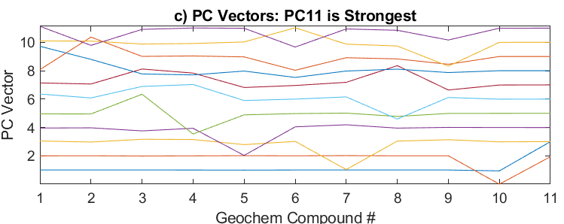
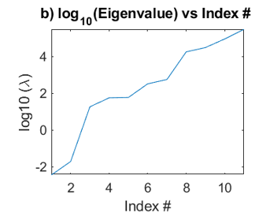
Theory of Principal Component Analysis
T
x¹ x² x³ …… x^{N}
Mx1
MxN
.
.
.
.
.
.
.
.
.
.
.
.
.
.
.
.
and x^{n} a random variable
Given: x^{n} s.t. X=
Step 3: Thus a is an eigenvector of covariance matrix X^{T}X and λ² = eigenvalue
Hence σ² = <a^{T}X^{T}Xa> = λ²
Householder transform
Σ
Find A that diagonalizes Σ if NxN Σ is SPD
v v
MATLAB Code
[V D] = Eig(X^{T}X)
(α₁,α₂) = (v∙x⁽¹⁾, v∙x⁽¹⁾)
D
V
Eigenvectors of SPD X^{T}X
are orthonormal
row
v
v
column

Slide 22
Outline
Intuitive PCA
Mathematics of PCA
Examples of PCA: Turkana Geochem Data
Summary

Slide 23
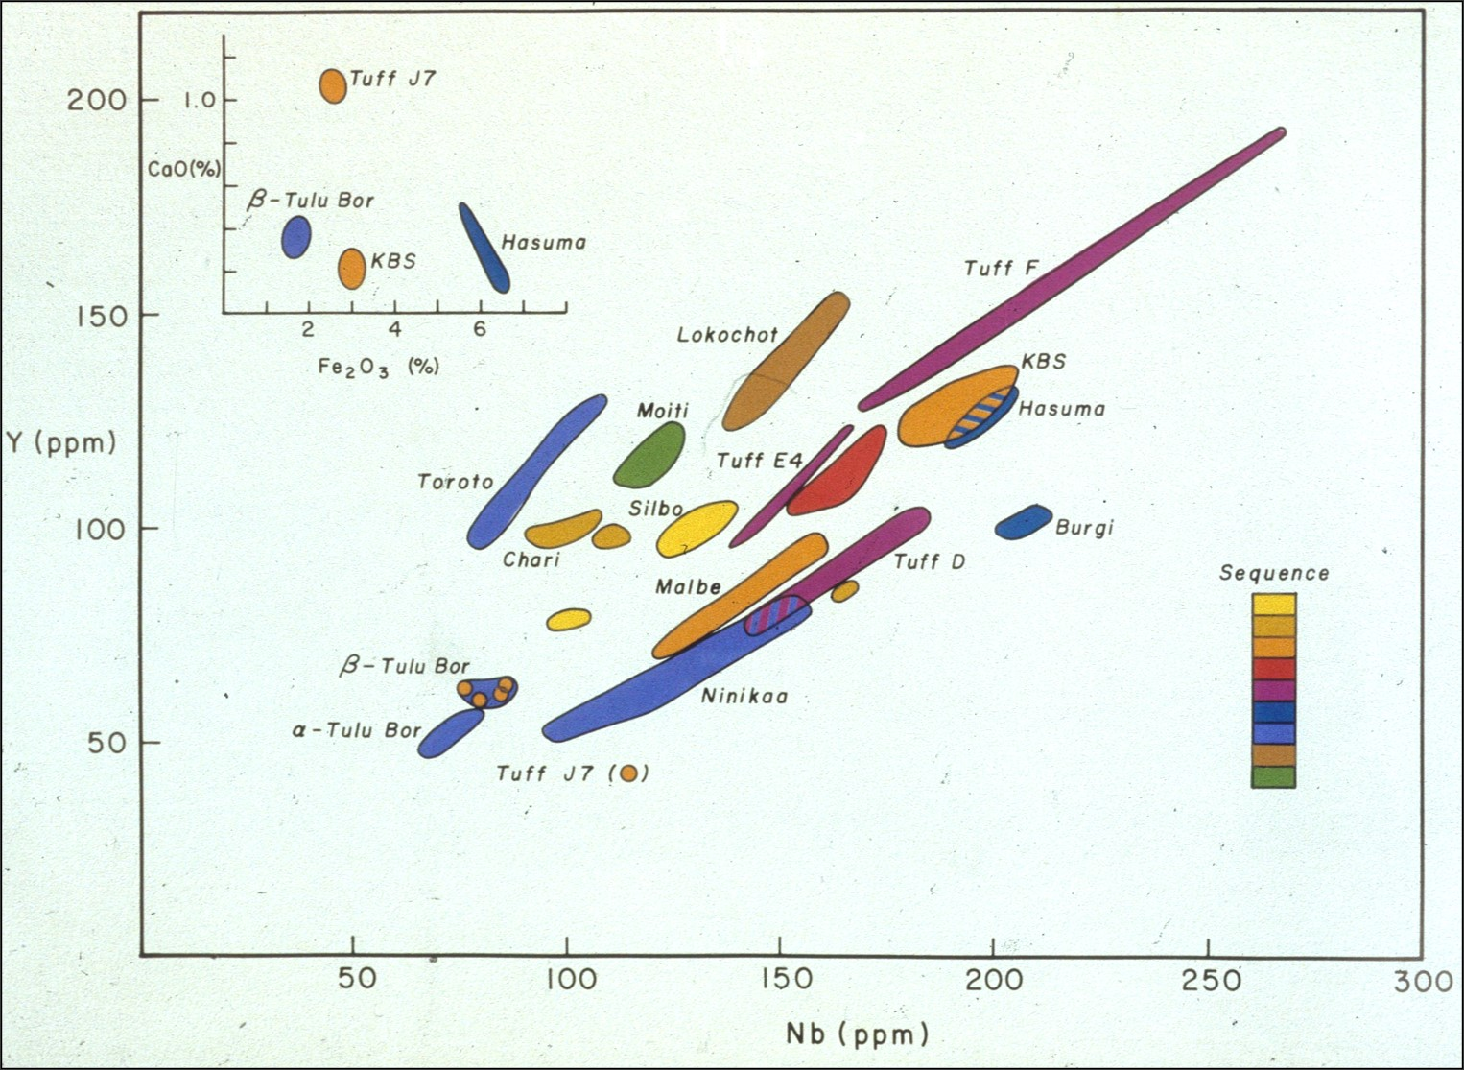
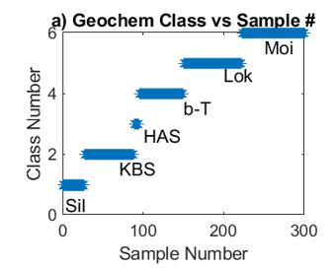
Dating Homin Layers by Geochem
Problem: Different Turkana beds

Slide 24
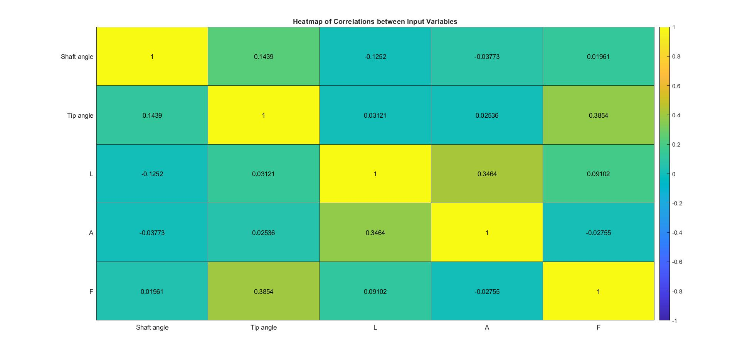
Random Variables
Each % measurement
is a RV because of random
error
% concentration level
C
O₂ CaCO₃ Fe NaCl K
C
O₂
CaCO₃
Fe
NaCl
K
x₁⁽¹⁾
x₂⁽¹⁾
x₃⁽¹⁾
x₄⁽¹⁾
x₅⁽¹⁾
x⁽¹⁾
x⁽¹⁾
Bed 1
x⁽²⁾
Bed 2
X^{T}X
x⁽³⁾
Bed 3
x⁽⁴⁾
Bed 4
x⁽⁵⁾

Slide 25
Random Variables
C
O₂ CaCO₃ Fe NaCl
C
O₂
CaCO₃
Fe
NaCl
K
X^{T}X

Slide 26
Random Variables
C
CaCO₃ CaCO₂ Fe NaCl K
Rotate 45º along O₂ axis
View along c+Ca & O₂ Plane
View Ca-O₂ Plane
View C-O₂ Plane
% O₂
% O₂
% O₂
% O₂
% O₂
% C
% C
% Ca
% Ca
% C+Ca
% C+Ca
% C+Ca
% C+Ca

Slide 27
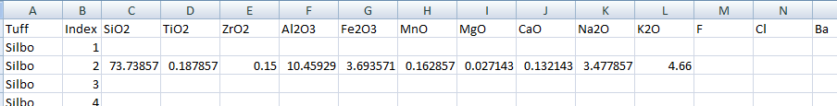
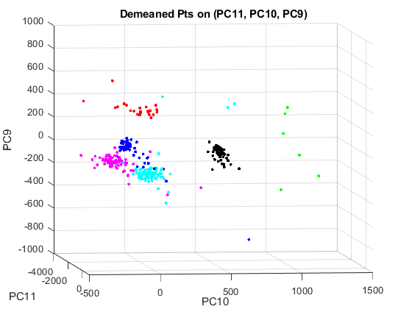
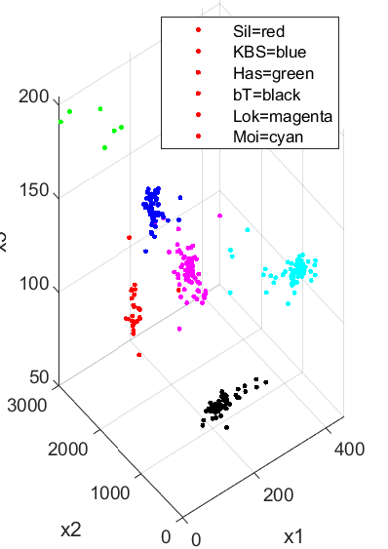
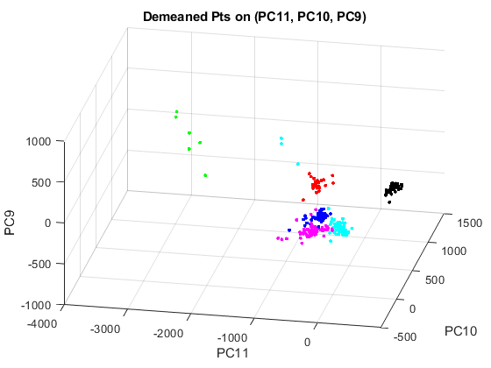
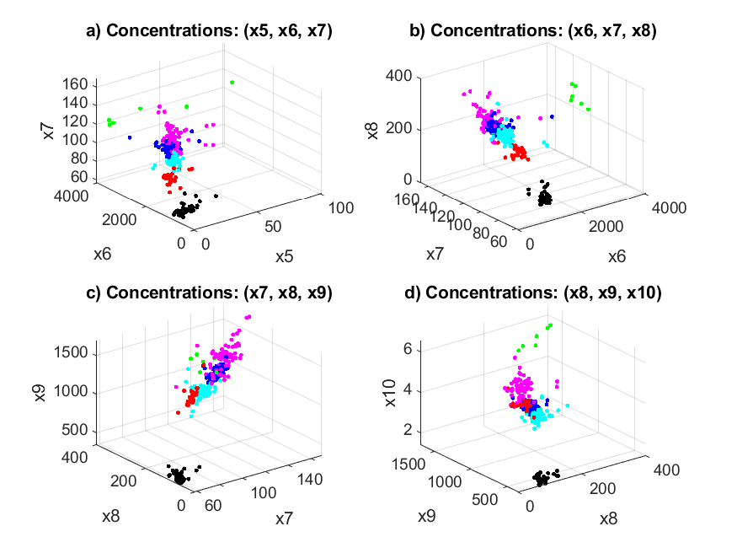
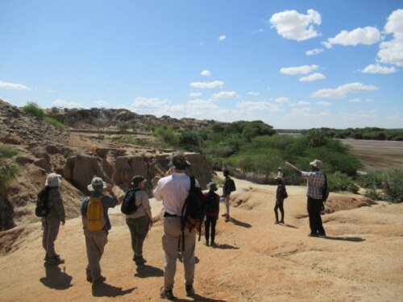
Dating Homin Layers by Geochem
Get best fit ellipse to each cloud of points → σ² and μ
Compute centers+variance of
classes. Now probability table
P(class|x_{i}) =
N exp(-||x_{i}-μ_{class}||² /σ²_{class})
Gathogo-Brown
PCA Test #1
Problem: Different Turkana beds
x_{Has}
11x(11-1)x(11-2)
> 1000 Combinations
Bed P(c)
.01
.02
.13
.85
.01
.08
x_{KBS}
Moi
b-T
Lok
KBS
Sil
Has
.84
x₃
x_{Moi}
x_{Lok}
.85
x_{Sil}
X_{b-T}
You do this for all possible triplet trios (PC₁,PC₂,PC₃). This finds the cluster x_{i} belongs to with highest probability if all but one bed should have low probabilities.
x₂
x₁

Slide 28
Dating Homin Layers by Geochem
Compute centers+variance of
classes. Now probability table
P(class|x_{i}) =
N exp(-||x_{i}-x_{class}||² /σ²_{class})
Gathogo-Brown
non-PCA Test #2
Problem: Different Turkana beds
11x(11-1)x(11-2)
> 1000 Combinations
x_{Has}
Loki Bed
μ σ² P
x_{KBS}
SiO₂
TiO₂
ZrO₂
AlO₃
MnO₃
CaO
1
.6
.01
(.6,.9)
.85
(.1,4)
.6
.85
.31
x₃
x_{Moi}
x_{Lok}
x_{Sil}
X_{b-T}
MgO
TiO₂
ZrO₂
AlO₃
MnH₂
CaO
x₂
x₁
MgO
TiO₂
ZrO₂
AlO₃
MnO+3
CaO

Slide 29
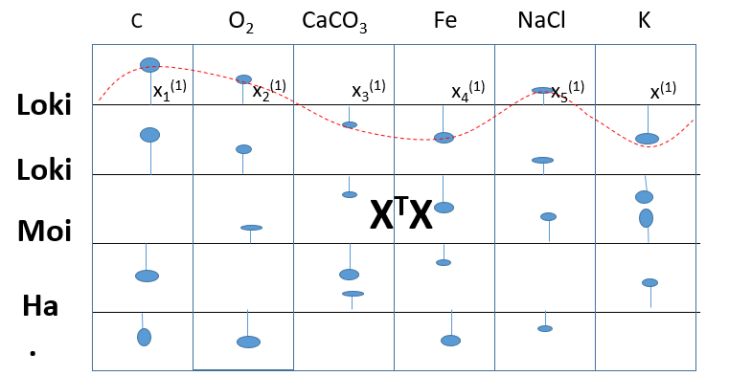
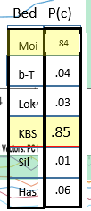
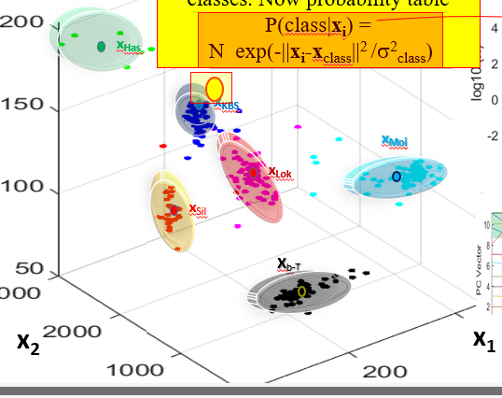
Summary: Pathago-Brown PCA
1. Create X & X^{T}X from Geochem Data
V_{Moi}
2. [V D] = eig(X^{T}X)
V_{Loki}
V_{Moi}
V_{Has}
V_{b-T}
V_{KBS}
V_{Silo}
3. Project x_{i} onto PCs
y₃
(y₁,y₂,y₃) = (PC1∙x_{i}, PC2∙x_{i}, PC3∙x_{i} )
4. Test new point x_{i}^{new}
y₂
y₁

Slide 30
Outline
Intuitive PCA
Mathematics of PCA
Examples of PCA: Denoising Seismic Traces
Summary

Slide 31
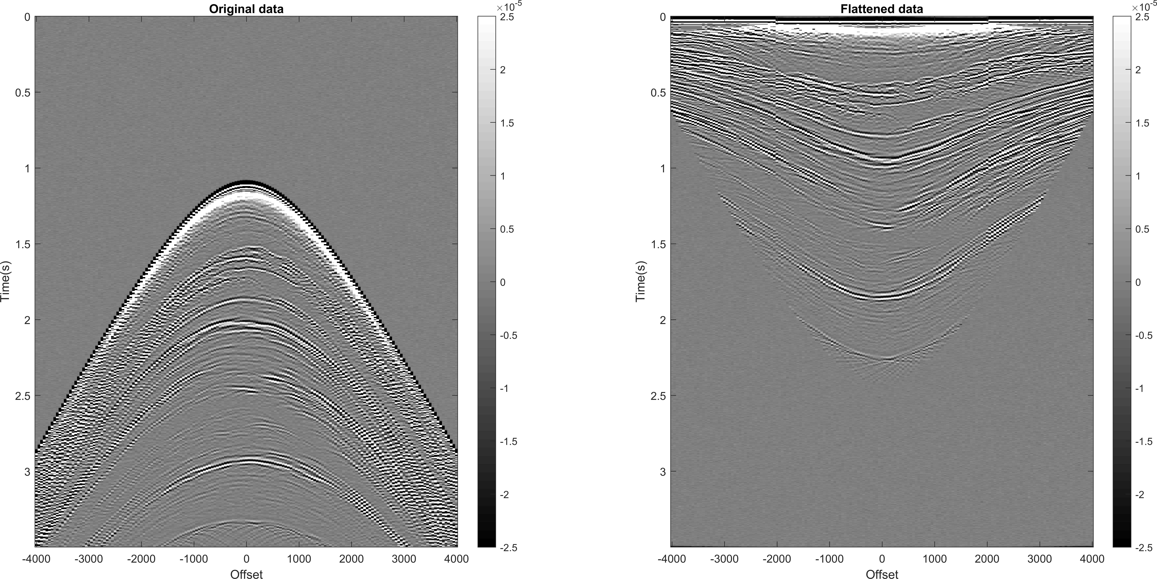
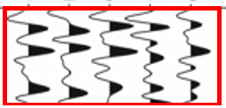
Flattening the CSG
Yasmin Oshoro, Francisco Carlos Lajús Junior <francisco.lajus.jr@gmail.com>, Antonio Henrique da Fontoura Klein

Slide 32

Denoising Seismic Traces
a) Seismograms
b) Noisy Seismograms in (offset, time, amplitude)
Offset
Amp
window in (offset, time) at t=1 s
A = 1
Time
Offset
Time
c) Amp - <A> vs Offset
d) Amp in (PC1, amplitude)
d) Amp - <A> in (PC1, PC2)
PC2
Amp
Amp
Amplitudes
projected
onto PC2
window in (offset, time) at t=1 s
A = 0
Small
Variance
A = 0
Offset
PC1
PC1
Amplitudes projected
onto PC1
Large Variance

Slide 33
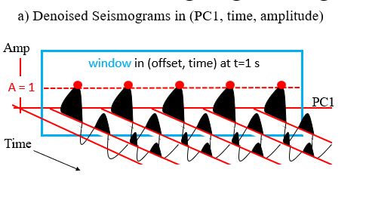
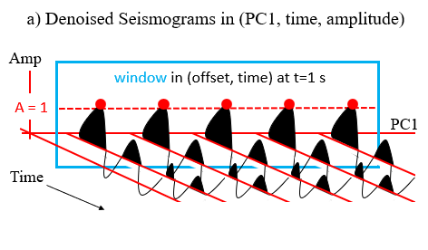
Denoising Seismic Traces
a) Seismograms
b) Noisy Seismograms in (offset, time, amplitude)
Offset
Amp
window in (offset, time) at t=1 s
A = 1
Time
Offset
Time
c) Amp - <A> vs Offset
d) Amp in (PC1, amplitude)
Amp
Amp
window in (offset, time) at t=1 s
A = 0
Offset
PC1

Slide 34
Denoising Seismic Traces (cont.)
Aligning Misaligned Seismograms
a) Denoised Seismograms in (PC1, time, amplitude)
b) Misaligned Seismograms in (offset, time, amplitude)
Amp
window in (offset, time) at t=1 s
Amp
A = 1
PC1
Offset
PC2
Time
Time
PC1
c) Aligned Seismograms in (PC1, PC2, amplitude)
Amp
PC1
PC2

Slide 35
Principal Component Analysis
Reduce Dimensionality of Data
Noisy Traces
Denoised Traces
x⁽¹⁾ x⁽²⁾
y⁽¹⁾ y⁽²⁾
n₁ n₂
Given: x^{(k)} , λ_{i} , and y_{i} where X^{T}X y_{i}=λ_{i} y_{i}
=
+
Find: α_{i} s.t. x^{(k)} =Σ_{m=1…M} α_{m}y_{m} (1)
Soln:
Multiply eq 1 by y_{i} to give
(x^{(k)} ,y_{i}) = α_{i}
Threshold eigenvalues ε & only keep the M eigen-components s.t. |λ_{i} |>ε
x^{(k)} ~ Σ_{m=1,2}(y_{m} , x^{(k)} ) y_{m}
Reduced number of components of m’
y₂ = 0
Note: All PCs are uncorrelated with one another. That is, y₁ $•$

Slide 36
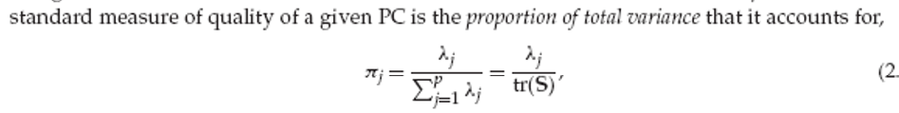
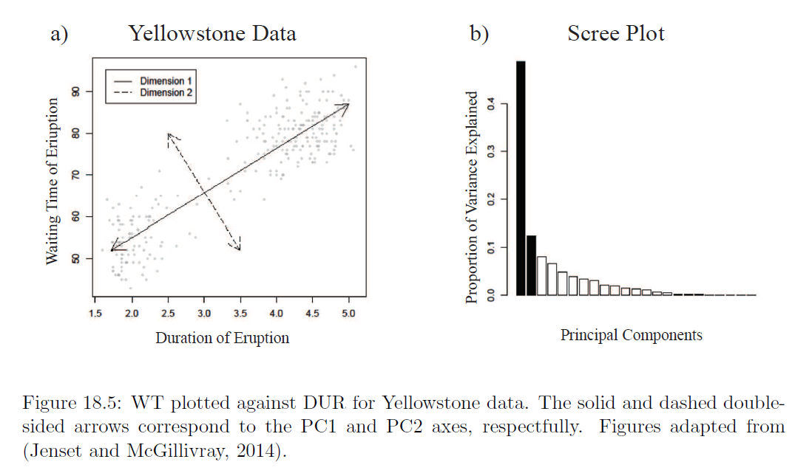
Principal Component Analysis
Reduce Dimensionality of Data
Threshold eigenvalues ε & only keep the M eigencomponents s.t. |λ_{i} |>ε
x= Σ_{i=1…M} y_{i} (y_{i} ,x)/λ_{i}
Reduced number of components of m’
Finite number of CG iterations only reconstructs most significant components of model

Slide 37
Outline
Intuitive PCA
Mathematics of PCA
Examples of PCA: Denoising Seismic Traces
Summary

Slide 38




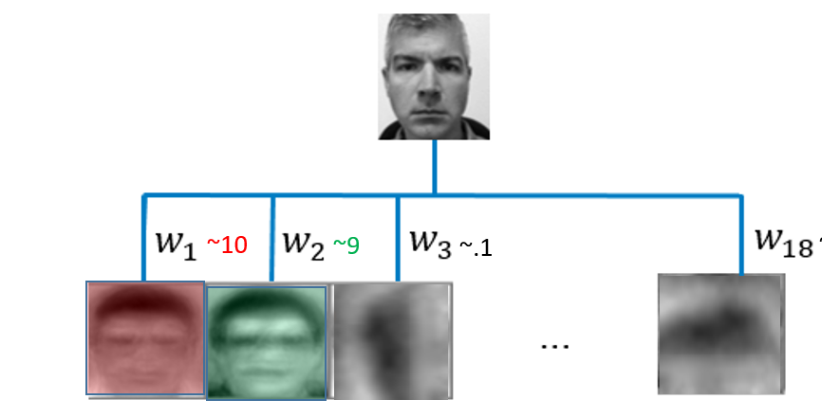
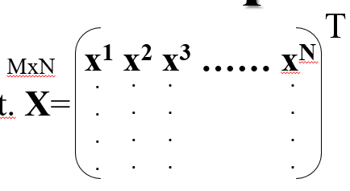
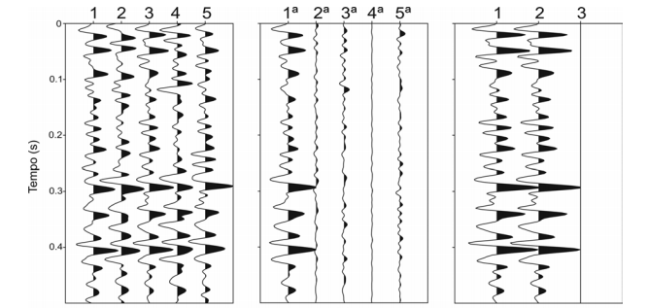
16x16=256
5 faces
Covariance
matrix
Eigenvectors
eigenvalues
Truncated
weighted sum
5
x₁, x₂ , x₃,…x₂₅₆
X^{T}Xx_{i}=λ_{ι}x_{i}
x ~ Σ_{i=1:5} (x,x_{i})x_{i}
2
2
256
λ₁, λ₂ , λ₃,.., λ₂₅₆
2
Sum of 5 singular values
Why did we flatten? What would happen
If we didn’t flatten?
Stacked trace
(a)
(b)
(c)
SVD filtering applied in the central trace (3rd)
Notice that the first trace in (b), which is associated with 1st singular value, retain most similarity with central trace
DD
DD
D
D
Fig1: SVD filtering. (a) 5 traces extracted from a given data, M = 5; (b) Traces obtain for 5 singular values; (c) The original trace is show in 1, the second trace is obtain by stacking the 5 traces in (b), and the residual its showing in 3

Slide 39
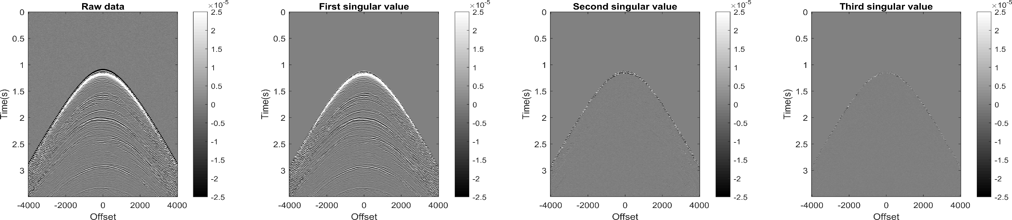

Raw Data vs Singular Value Vectors vs Window Sizes
Window=[3,3]
Window=[5,3]

Slide 40
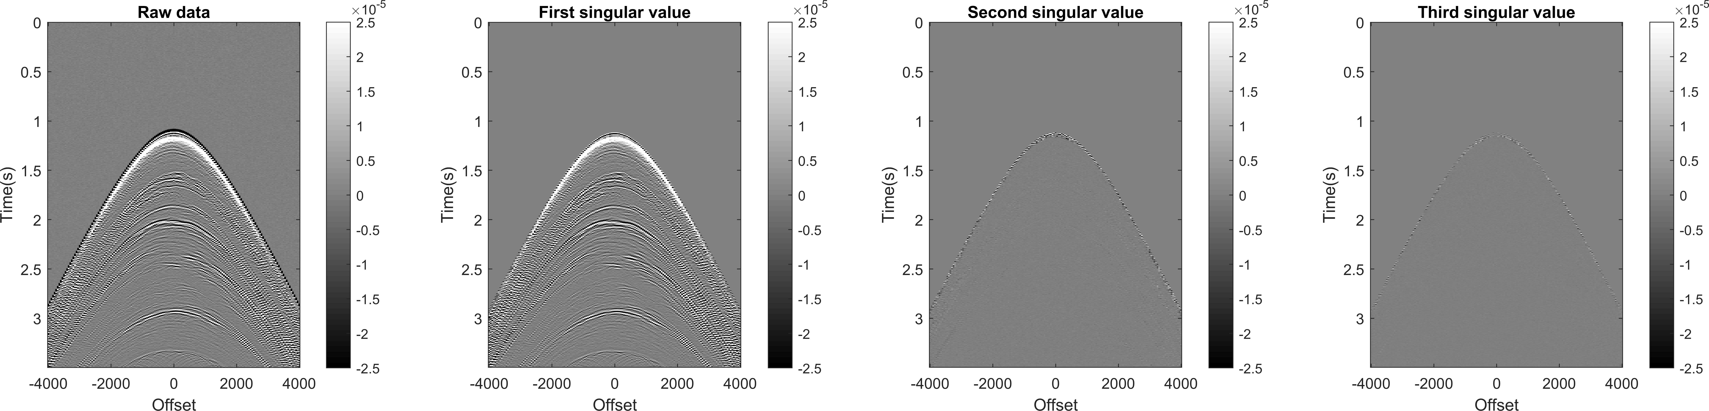
Denoised CSG
Window=[3,3]

Slide 41
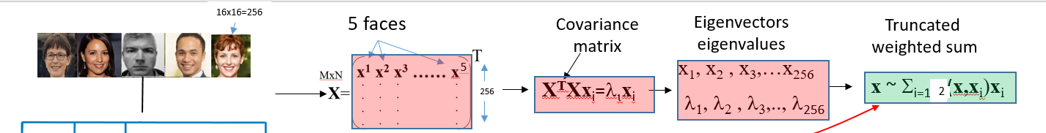
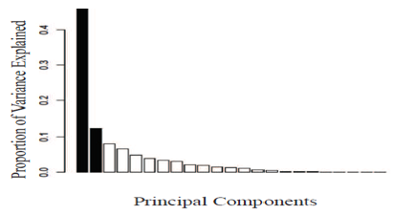
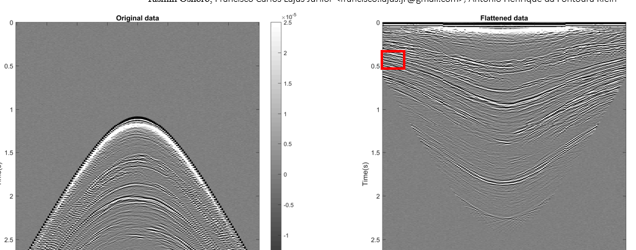
What did we Learn?
How to select # of PC vectors (scree plot/elbow)
Denoising Seismic Data: x~ (x,PC1)PC1 + (x,PC2)PC2
Choose similar training data
Select Data Features so fewest
PC’s are needed

Slide 42
Denoising Seismic Traces
a) Seismograms
b) Noisy Seismograms in (offset, time, amplitude)
Offset
Amp
window in (offset, time) at t=1 s
A = 1
Time
Offset
Time
Offset
c) Amp - <A> vs Offset
d) Demeaned Amplitudes
Amp
PC2
window in (offset, time) at t=1 s
Amplitudes
projected
onto PC2
A = 0
A = 0
Offset
PC1
Amplitudes projected
onto PC1

