Slide 1
Probability Theory for Machine Learning
Chris Cremer
(with additions by GTS)

Slide 2
Material
Machine Learning in Geosciences - GT Schuster
Pattern Recognition and Machine Learning - Christopher M. Bishop
All of Statistics – Larry Wasserman
Wolfram MathWorld
Wikipedia

Slide 3
Outline
Motivation
Probability Definitions and Rules
Conditional, Joint, Marginal Distributions
Law of Total Probability
Bayes’ Theorem (Rule)
Discrete vs Continuous RVs
Gaussian Distributions
Maximum Likelihood Estimation (MLE) for Gaussian Parameters
MLE and Least Squares
: Bernouli & Binomial Distributions
: Univariate

Slide 4
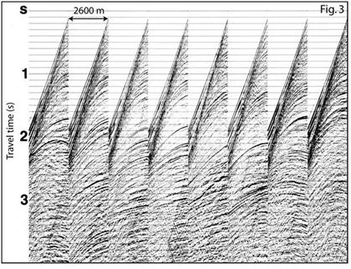
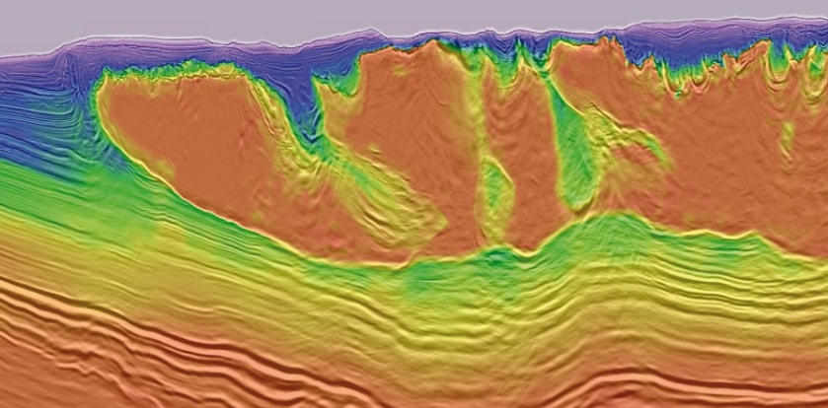
Motivation
Given: d = data & model L, where Lm=d
Find: m
Uncertainty arises through:
  Noisy measurements
  Finite size of data sets
  Ambiguity: The word bank can mean (1) a financial institution, (2) the side of a river, or (3) tilting an airplane. Which meaning was intended, based on the words that appear nearby?
  Limited Model Complexity
Probability theory provides a consistent framework for the quantification and manipulation of uncertainty
Allows us to make optimal predictions given all the information available to us, even though that information may be incomplete or ambiguous
Also Find: Δm
Science says we not only need m, but also
uncertainty Δm

Slide 5
Outline
Motivation
Probability Definitions and Rules
Conditional, Joint, Marginal Distributions
Law of Total Probability
Bayes’ Theorem (Rule)
Discrete vs Continuous RVs
Gaussian Distributions
Maximum Likelihood Estimation (MLE) for Gaussian Parameters
MLE and Least Squares
: Bernouli & Binomial Distributions
: Univariate

Slide 6
Sample Space
The sample space Ω is the set of possible outcomes of an experiment. Points ω in Ω are called sample outcomes, realizations, or elements. Subsets of Ω are called Events.
Example. If we toss a coin twice then Ω = {HH,HT, TH, TT}. The event that the first toss is heads is A = {HH,HT}
We say that events A1 and A2 are disjoint (mutually exclusive) if Ai ∩ Aj = {}
  Example: first flip being heads and first flip being tails

Slide 7
Some Probability Terminology
Total Universe: N=100 samples
Random Variable (RV) = value that represents the
numerical outcome of a random phenomenon
Discrete RV = x
RV can only take on a countable number of values
Examples: happy, sad, working x ∈ {1,2,3}
coin flip outcome x ∈ {0,1}
Continuous RV = x
RV can only take on a uncountable number of values
Examples: temperature x ∈ {76.12,76.13, 76.14, …..}
seismic amplitudes x ∈ {0, 0.001, 0.002,..}
Probability Mass Function: Frequency occurrence of x
1≥P(x) = N_{heads}/N = 70/100 ≥0
1≥ P(x) = N_{tails}/N = 30/100 ≥0
Coin Flip PMF (Unfair Coin)
Histogram ~
P(x)
0 1
x

Slide 8

Probability
We will assign a real number P(A) to every event A, called the probability of A.
To qualify as a probability, P must satisfy three axioms:
  Axiom 1: P(A) ≥ 0 for every A
  Axiom 2: P(Ω) = 1
  Axiom 3: If A1,A2, . . . are disjoint then

Slide 9
Outline
Motivation
Probability Definitions and Rules
Conditional, Joint, Marginal Distributions
Law of Total Probability
Bayes’ Theorem (Rule)
Discrete vs Continuous RVs
Gaussian Distributions
Maximum Likelihood Estimation (MLE) for Gaussian Parameters
MLE and Least Squares
: Bernouli & Binomial Distributions
: Univariate

Slide 10
Joint and Conditional Probabilities
Intersection normalized by
total universe area
Joint Probability
  P(X,Y)=A_{X∩Y} /A
  Probability of X and Y
Conditional Probability
  P(X|Y) = P(X,Y)/P(Y)
  Probability of X given Y
Happy
Intersection Normalized
by sub-universe area
Sad

Slide 11
Independent and Conditional Probabilities
Assuming that P(B) > 0, the conditional probability of A given B:
P(A|B)=P(AB)/P(B)
P(AB) = P(A|B)P(B) = P(B|A)P(A)
  Product Rule
Two events A and B are independent if
P(AB) = P(A)P(B)
  Joint = Product of Marginals
Two events A and B are conditionally independent given C if they are independent after conditioning on C
P(AB|C) = P(B|AC)P(A|C) = P(B|C)P(A|C)
Note: P(AB) = P(A,B) = P(A∩ B)
No intersection of red and blue circles
  Product Rule
  A not dependent on B

Slide 12
Example
60% of ML students pass the final and 45% of ML students pass both the final and the midterm *
What percent of students who passed the final also passed the midterm?
* These are made up values.

Slide 13
Example
60% of ML students pass the final and 45% of ML students pass both the final and the midterm *
What percent of students who passed the final also passed the midterm?
Reworded: What percent of students passed the midterm given they passed the final?
P(M|F) = P(M,F) / P(F)
• = .45 / .60
• = .75
(Purple Area)/(Red Area)
* These are made up values.

Slide 14
Outline
Motivation
Probability Definitions and Rules
Conditional, Joint, Marginal Distributions
Law of Total Probability
Bayes’ Theorem (Rule)
Discrete vs Continuous RVs
Gaussian Distributions
Maximum Likelihood Estimation (MLE) for Gaussian Parameters
MLE and Least Squares
: Bernouli & Binomial Distributions
: Univariate

Slide 15
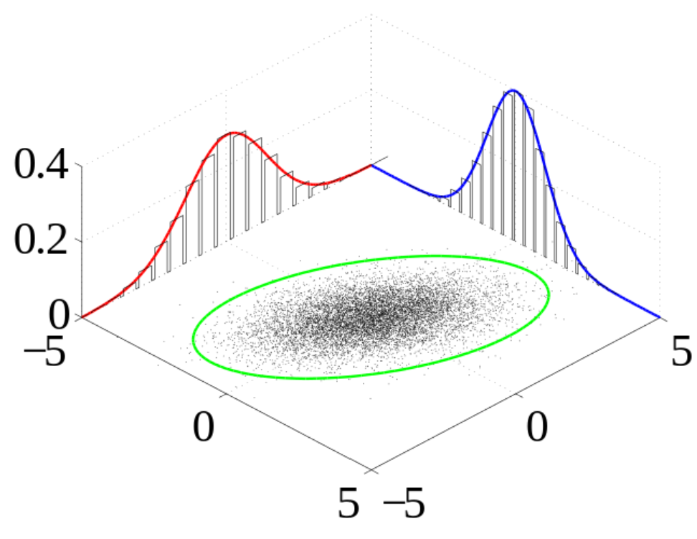

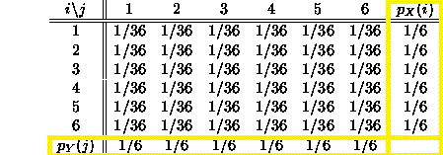

Marginalization and Law of Total Probability
p(x)
Marginalization (Sum Rule)
p(x,y)
p(y)
Roll two dice (36 events (1,1),(1,2),(2,3)…)
y
Law of Total Probability
Px(x)
x
x/y
DD
Sum along y
DD
Note: Σ_{x=1}⁶ p_{x}(x) = 1 like any probability fcn.
DD
DD
Σ_{y=1}⁶ p_{y}(y) = 1
DD
DD
Place p_{x}(x) & p_{y}(y) along margins of table,
hence marginal probability
Py(y)

Slide 16
Marginalization and Law of Total Probability
p(x)
Marginalization (Sum Rule)
p(x,y)
p(y)
p(x,y₆)
p(x,y₅)
p(x.y₄)
p(x,y₃)
p(x,y₂)
p(x,y₁)
y
Law of Total Probability
x
p(x) = Σ_{i}
Σ_{i}
p(x,y_{i} ) = p(x|y_{i})p(y_{i})

Slide 17
Outline
Motivation
Probability Definitions and Rules
Conditional, Joint, Marginal Distributions
Law of Total Probability
Bayes’ Theorem (Rule)
Discrete vs Continuous RVs
Gaussian Distributions
Maximum Likelihood Estimation (MLE) for Gaussian Parameters
MLE and Least Squares
: Bernouli & Binomial Distributions
: Univariate

Slide 18


Bayes’ Rule
P(A|B) = P(AB) /P(B)
P(A|B) = P(B|A)P(A) /P(B)
P(A|B) = P(B|A)P(A) / Σ P(B|A)P(A)
(Conditional Probability) (Product Rule)
(Law of Total Probability)

Slide 19


Bayes’ Rule
Huh? We just plugged numbers
To get p(x|Φ), we never had any
Analytical formula?
p(x|Φ) p(Φ)
|Φ)
(Φ)
p(Φ|
Don’t worry, we will use Gaussian
formula N(μ,Σ) to fit to data x, and
find optimal fitting parameters μ & Σ
dL/dΦ = 0 & solve for Φ.
Ignore evidence E
because not a function of Φ
p(x) not a function of Φ, so not
Used for taking derivative of
L w/r to Φ
L = ln P(x|Φ);
Log-likelihood
-------------
?

Slide 20


Example
Suppose you have tested positive for a disease; what is the probability that you actually have the disease?
It depends on the accuracy and sensitivity of the test, and on the background (prior) probability of the disease.
P(T=1|D=1) = .95
P(T=1|D=0) = .10
P(D=1) = .01
(true positive) (false positive) (prior)
P(D=1|T=1) = ?
The probability that you have the disease
given you tested positive is 8.7%
= .95x.01/P(T)
.0095
(P(T|D)P(D) + P(T|-D)P(-D)]
=
= .0095 / .1085 = .087

Slide 21
Example
P(T=1|D=1) = .95
P(T=1|D=0) = .10
P(D=1) = .01
(true positive) (false positive) (prior)
Bayes’ Rule
P(D|T) = P(T|D)P(D) / P(T)
= .95 * .01 / .1085 = .087
Law of Total Probability
P(T) = Σ P(T|D)P(D)
= P(T|D=1)P(D=1) + P(T|D=0)P(D=0)
= .95*.01 + .1*.99
= .1085
The probability that you have the disease given you tested positive is 8.7%

Slide 22
Outline
Motivation
Probability Definitions and Rules
Conditional, Joint, Marginal Distributions
Law of Total Probability
Bayes’ Theorem (Rule)
Discrete vs Continuous RVs
Gaussian Distributions
Maximum Likelihood Estimation (MLE) for Gaussian Parameters
MLE and Least Squares
: Bernouli & Binomial Distributions
: Univariate

Slide 23
Random Variable
How do we link sample spaces and events to data?
A random variable is a mapping that assigns a real number X(ω) to each outcome ω
Example: Flip a coin ten times. Let X(ω) be the number of heads in the sequence ω. If ω = HHTHHTHHTT, then X(ω) = 6.

Slide 24


Discrete vs Continuous Random Variables
Discrete: can only take a countable number of values
Example: number of heads
Distribution defined by probability mass function (pmf)
Marginalization:
Continuous: can take infinitely many values (real numbers)
Example: time taken to accomplish task
Distribution defined by probability density function (pdf)
Marginalization:

Slide 25


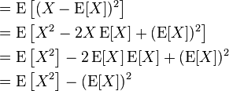

Probability Distribution Statistics
Mean: E[x] = μ = first moment =
Univariate continuous random variable
=
Univariate discrete random variable
Variance: Var(X) =
Nth moment =

Slide 26
Outline
Motivation
Probability Definitions and Rules
Conditional, Joint, Marginal Distributions
Law of Total Probability
Bayes’ Theorem (Rule)
Discrete vs Continuous RVs
Gaussian Distributions
Maximum Likelihood Estimation (MLE) for Gaussian Parameters
MLE and Least Squares
: Bernouli & Binomial Distributions
: Univariate

Slide 27
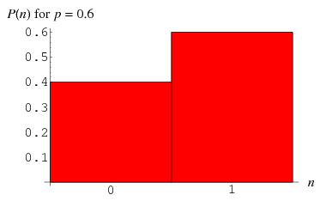
Bernoulli Distribution
Discrete Distribution
Input: x ∈ {0, 1}
Parameter: μ
Example: Probability of flipping heads with unfair coin (x=1)
= Frequency get a heads (x=1)
= ½ for a fair coin
Mean = E[x] = μ
Variance = μ(1 − μ)

Slide 28
Outline
Motivation
Probability Definitions and Rules
Conditional, Joint, Marginal Distributions
Law of Total Probability
Bayes’ Theorem (Rule)
Discrete vs Continuous RVs
Gaussian Distributions
Maximum Likelihood Estimation (MLE) for Gaussian Parameters
MLE and Least Squares
: Bernouli & Binomial Distributions
: Univariate

Slide 29
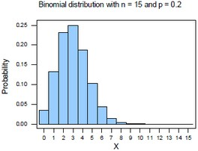

Binomial Distribution
Discrete Distribution
Input: m = number of successes
Parameters: N = number of trials
μ = probability of success
Example: Probability of flipping heads m times out of N independent flips with success probability μ
Mean = E[x] = Nμ
Variance = Nμ(1 − μ)
m

Slide 30
Multinomial Distribution
Discrete Distribution
The multinomial distribution is a generalization of the binomial distribution to k categories instead of just binary (success/fail)
For n independent trials each of which leads to a success for exactly one of k categories, the multinomial distribution gives the probability of any particular combination of numbers of successes for the various categories
Example: Rolling a die N times
k ∈ {0,1,2,3,…K}
0 heads, 1 head, 2 heads,….in K flips of the coin

Slide 31

Multinomial Distribution
Discrete Distribution
Input: m₁ … m_{K} (counts)
Parameters: N = number of trials
μ = μ₁ … μ_{K} probability of success for each category, Σμ=1
Mean of m_{k}: Nµ_{k}
Variance of m_{k}: Nµ_{k}(1-µ_{k})

Slide 32
Outline
Motivation
Probability Definitions and Rules
Conditional, Joint, Marginal Distributions
Law of Total Probability
Bayes’ Theorem (Rule)
Discrete vs Continuous RVs
Gaussian Distributions
Maximum Likelihood Estimation (MLE) for Gaussian Parameters
MLE and Least Squares
: Bernouli & Binomial Distributions
: Univariate

Slide 33
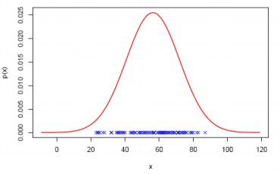

Gaussian Distribution
Continuous Distribution
Aka the normal distribution
Widely used model for the distribution of continuous variables
In the case of a single variable x, the Gaussian distribution can be written in the form
D
D
where μ is the mean and σ² is the variance

Slide 34
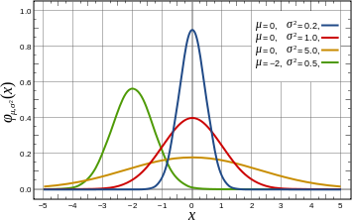
Gaussian Distribution
Gaussians with different means and variances

Slide 35
Outline
Motivation
Probability Definitions and Rules
Conditional, Joint, Marginal Distributions
Law of Total Probability
Bayes’ Theorem (Rule)
Discrete vs Continuous RVs
Gaussian Distributions
Maximum Likelihood Estimation (MLE) for Gaussian Parameters
MLE and Least Squares
: Bernouli & Binomial Distributions
: Multivariate

Slide 36
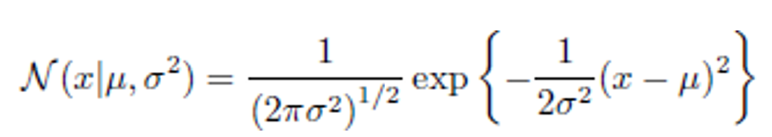
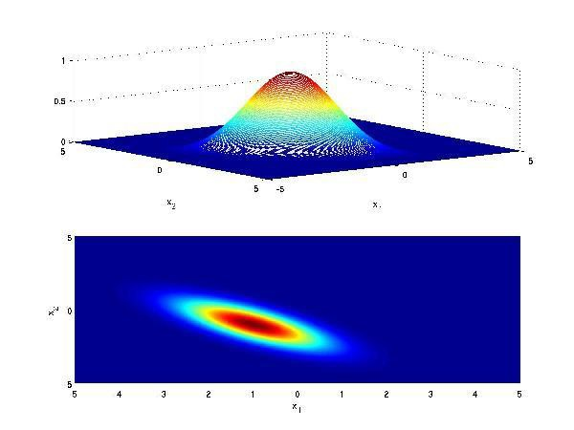
Multivariate Gaussian Distribution
For a D-dimensional vector x, the multivariate Gaussian distribution takes the form
where μ is a D-dimensional mean vector
Σ is a D × D covariance matrix
|Σ| denotes the determinant of Σ
Ellipticity determined by
Covariance σ_{xy}

Slide 37
Outline
Motivation
Probability Definitions and Rules
Conditional, Joint, Marginal Distributions
Law of Total Probability
Bayes’ Theorem (Rule)
Discrete vs Continuous RVs
Gaussian Distributions
Maximum Likelihood Estimation (MLE) for Gaussian Parameters
MLE and Least Squares
: Bernouli & Binomial Distributions
: Multivariate & Null Hypothesis

Slide 38
Null Hypothesis
What Is a Null Hypothesis?
A null hypothesis is a type of hypothesis used in statistics that
proposes that there is no difference between certain characteristics
of a population (or data-generating process).
# Days
1 2 3 4 5 6
Biking Hours/week
For example, A friend claims that YY in her school
Rides an average of 6 hours/week. The null hypothesis is that YY
weekly ride time mean is 6.0. ... (The null hypothesis here—that the ride time/week
mean is 6.0—can not be proven using the sample data; it can only be rejected.)
If the calculated mean is 4.0, then the null hypothesis is false & is rejected.
If the calculated mean is 6.0 then this does not prove your null hypothesis is correct or verified.
or science
Curse of statistics is that you never prove things are correct, only disprove them.

Slide 39
Outline
Motivation
Probability Definitions and Rules
Conditional, Joint, Marginal Distributions
Law of Total Probability
Bayes’ Theorem (Rule)
Discrete vs Continuous RVs
Gaussian Distributions
Maximum Likelihood Estimation (MLE) for Gaussian Parameters
MLE and Least Squares: VSP
: Bernouli & Binomial Distributions
: Multivariate, Null Hypothesis
& Frequentists vs Bayes’

Slide 40

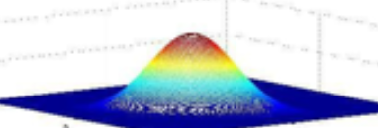

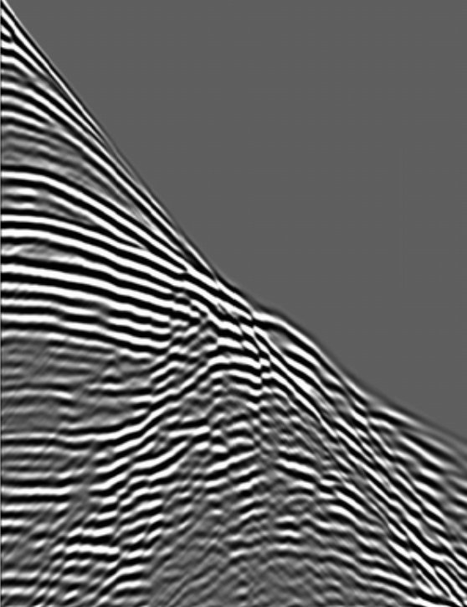
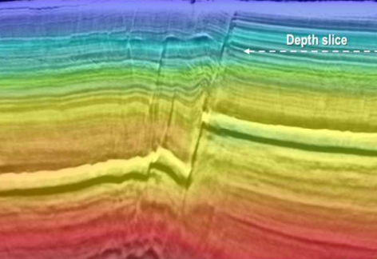
Many scientists only invert for the model parameter m, and do not give the uncertainty Δm.
They deem an acceptable fit if a graph of predicted data and model “looks good”, a chi-by-eye”
assessment. Luckily, its practioners get what thy deserve.” Press et al. (2007)
P(d|m)
d₁
m₀
P(m|d)
m₁
d₀
m₃
m₂
d₃
d₂
flattened model point
m₁
m₂
m₃
.
.
d₁
m₁
C₂₁ . . . . .
C₂₂ . . . . .
C₃₂ . . . . .
.
.
μ₁
μ₂
μ₃
.
.
C₁₁
C₂₁
C₃₁
.
.
model mean
Data covariance matrix
N(d|m,μ,Σ) = exp(-.5(d-μ(m))Σ⁻¹(d-μ(m))^{T} )

Slide 41
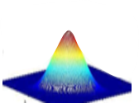

Frequentists vs Bayesians
m
d
Lm=d
P(d|m)
Science says we not only need m, but also
uncertainty Δm
p(d|m) p(m)
<Δm Δm^{T} > = [L^{T}L]⁻¹σ²
◊ <Δm Δm^{T}> = [L^{T}L]⁻¹σ²
N(μ,σ) =
p(m|d) =
p(d)
model
covariance
Variance
data
Bayesian Viewpoint: Only a single data set is observed, and uncertainty in m
Is expressed by probability distribution over m”. (Bishop, 2006)
Probability p(d|m) data given m
→ likelihood of model given data
Frequentists: No PDF associated
with m (no statistic universe model).
Frequentists: Model m consists of “fixed parameters determined by MLE. Model error bars determined
by assessing influences from different noise data sets according to data PDF .” (Bishop, 2006)
Frequentists: d = Lm predicts relation between measured RV data and model parameters
Find: min_{m} ε= min_{m} ||L(m+Δm)-(d-Δd)||²
Solution:
Δm = [L^{T}L]⁻¹L^{T}Δd
Q: What does it mean to know pdf d from m?
A: p(d|m)= Π_{n=1}^{N} exp(-0.5{[L(m)]_{n} -d_{n} }²/σ² )
p(d|m) p(m)
Bayes Find : p(m|d) =
where likelihood p(d|m) = probability d given model m
p(d)
Assume
Gaussian:
Likelihood: p(d|m) =p(d₁,d_{2,}..|m) α Π_{n=1}^{N} exp(-0.5{[L(m)]_{n} -d_{n} }²/σ² } Independent RVs
Max_{μ,σ} L(d|L(m),σ)= Max_{μ,σ} log p(d|m) = -0.5 Σ_{n=1}^{N} {[L(m)]_{n} -d_{n} }²/σ²}

Slide 42
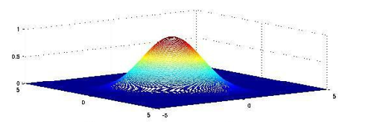
Max_{μ,σ} log p(d|m) = -0.5 Σ_{n=1}^{N} {d_{n} - [L(m)]_{n} }²/σ²}
Solution m*: Maximum Likelihood Estimate (MLE)
(d₁-μ₁)² + (d₂-μ₂)²
N(d|μ,σ) =
Data
recorded
Model
Explains data
d₁
d₂
data
For example: if red pts are given, is above Gaussian a good fit?
Question: What is optimal model (μ,σ) in N (d|μ,σ²) that best explains data?
Answer: Least Squares = model minimizes sum squared residuals
Bayesian Analysis → model m that maximizes –sum squared residuals
Lm → μ & σ will be function of Lm
See ‘Gibbs Sampling for the Uninitiated’ for a straightforward introduction to parameter
estimation: http://www.umiacs.umd.edu/~resnik/pubs/LAMP-TR-153.pdf

Slide 43
Outline
Motivation
Probability Definitions and Rules
Conditional, Joint, Marginal Distributions
Law of Total Probability
Bayes’ Theorem (Rule)
Discrete vs Continuous RVs
Gaussian Distributions
Maximum Likelihood Estimation (MLE) for Gaussian Parameters
MLE and Least Squares
: Bernouli & Binomial Distributions
: Multivariate, Null Hypothesis
& Frequentists vs Bayes’

Slide 44
I.I.D.
IID: Random variables are independent and identically distributed (i.i.d.) if they have the same probability distribution as the others and are all mutually independent.
Example: Coin flips are assumed to be IID

Slide 45


MLE for Gaussian Parameters
Likelihood =
Now we want to maximize this function wrt µ
Instead of maximizing the product, we take the log of the likelihood so the product becomes a sum
Log
Log Likelihood = log
We can do this because log is monotonically increasing
Meaning

Slide 46

MLE for Gaussian Parameters
Log Likelihood simplifies to:
Now we want to maximize this function wrt μ
How?
To see proofs for these derivations: http://www.statlect.com/normal_distribution_maximum_likelihood.htm

Slide 47


MLE for Gaussian Parameters
Log Likelihood simplifies to:
Now we want to maximize this function wrt μ
Take the derivative, set to 0, solve for μ
Homework: Due Sunday
To see proofs for these derivations: http://www.statlect.com/normal_distribution_maximum_likelihood.htm

Slide 48
Outline
Motivation
Probability Definitions and Rules
Conditional, Joint, Marginal Distributions
Law of Total Probability
Bayes’ Theorem (Rule)
Discrete vs Continuous RVs
Gaussian Distributions
Maximum Likelihood Estimation (MLE) for Gaussian Parameters
Line Fit: MLE and Least Squares
: Bernouli & Binomial Distributions
: Multivariate

Slide 49
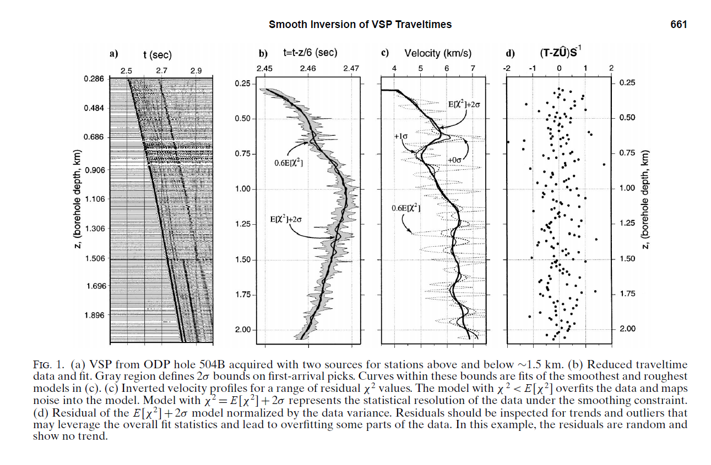

VSP Modeling & Traveltime Inversion
t=Ls; s = [L^{T}L]⁻¹L^{T}t
ε=||t-Ls||² ➔
d = t(z)
t
z
1st arrival
traveltimes
t_{i} = Σ_{j=1}^{i} z_{j}/v_{j} t=Ls s = [L^{T}L]⁻¹L^{T}t

Slide 50
VSP Modeling & Least Squares Traveltime Inversion
t=Ls; s = [L^{T}L]⁻¹L^{T}t
VSP Modeling & Least Squares Traveltime Inversion
d=Lm; m = [L^{T}L]⁻¹L^{T}d
ε=||t-Ls||² ➔
Data misfit model penalty
d = t(z)
Step 1:Define Objective ε=||d-Lm||² + λ||m||²
t
Step 2: New Objective ε =exp(-1/2 ||d-Lm||² - λ||m||²)
z
1st arrival
traveltimes
Step 3: argmax_{m} ε = m∗ = [L^{T}L + λI ]⁻¹L^{T}d (eq.1)
λ = σ_{d|m} /σ_{m}
Optimal solution is one which is compromise between
Best data fit and model closest to origin
2
2
Data misfit Model penalty
P(m|d)
We will next show eq. 1 damped
LS soln = MAP solution
P(d|m)
P(m)
m*
m*
^{μ}
= 0
m
MLE: m* =[L^{T}L]⁻¹L^{T}d
m
Damped LS Solution

Slide 51
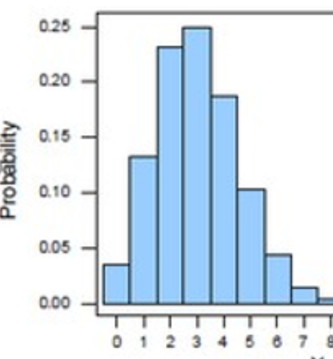
Bayes’ Formula, Earth Model m and Data d
Choose well logs or Bootstrap:
Breakup data into sets t^{(n)}
Invert t^{(n)} → v^{(n)}(z)
Compute σ_{m} and μ_{m}
Given: Recorded VSP traveltimes d=t(z)
Find: Optimal m*= v(z)* and uncertainty P(m|d)
v(z)
d = t(z)
m
v(z)
t
2
e^{-0.5 ||m} ^{– μ ||} ^{/σ}
2
P(m)
P(m)
m
m
m
P(m|d) =
P(d|m)
P(d)
P(d)
z
z
2
^{σ}
2
-
e^{-0.5 ||d} ^{– μ ||} ^{/σ}
2
2
d
e^{-0.5 ||d} ^{- d(m)||} ^{/σ}
d
1st arrival
traveltimes
d|m
^{m*}
observed - predicted
traveltimes traveltimes
1. Estimate picking error μ_{d} & σ_{d} from data
2. Different people pick data→σ_{m} and μ_{m}
3. Generate traveltimes from bootstrap v^{(n)}(z)
from models. Compute σ_{m} and μ_{m}
b) Probability Density Distributions
P(m|d)
Note: P(d) not fcn of m
PDF
P(d|m)
P(m)
Note: MAP=regularized LS
2
2
If μ_{m}=0 then P(d|m)=e^{-.5||d-d(m)|| -0.5} ^{||m-μ}_{m} ||
m*
m*
^{μ}
MLE: m* =[L^{T}L]⁻¹L^{T}t
m
m
MAP: m* =[L^{T}L+I]⁻¹L^{T}t

Slide 52
MAP & MLE
Given: d
If red pts are given
Is above Gaussian a good fit?
What is optimal N(x|μ,σ²) that explains
data?
Find: m such that
Maximum Likelihood Estimation
MLE: m* = argmax_{m} P(d|m) = [L^{T}L]⁻¹L^{T}d where P(d|m) α exp(-0.5 ||d-d(m)||²)
Reverse conditional by Bayes’ Thm.
Maximum a Posterior Estimation
MAP: m* = argmax_{m} P(m|d) = [L^{T}L+I]⁻¹L^{T}d where P(m|d) α exp(-0.5 ||d-d(m)||² - 0.5||m||² )
P(m|d)
PDF
P(d|m)
P(m)
^{μ}
m*
^{μ}
d|m
m

Slide 53
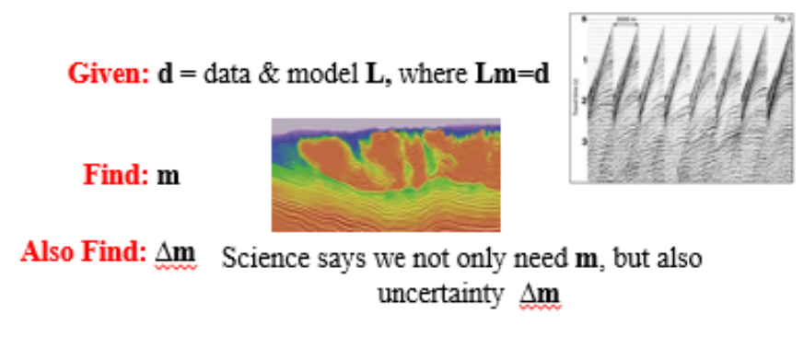
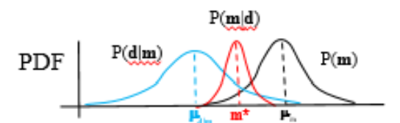
Summary
Motivation
Probability Definitions and Rules
Conditional, Joint, Marginal Distributions
Law of Total Probability
Bayes’ Theorem (Rule)
Discrete vs Continuous RVs
Gaussian Distributions
Maximum Likelihood Estimation (MLE) for Gaussian Parameters
MLE and Least Squares
MAP and Regularized Least Squares
Frequentists: Δm = [L^{T}L]⁻¹L^{T}Δd
Bayesian: p(m|d) =
p(d|m) p(m)
p(d)
: Bernouli & Binomial Distributions
: Multivariate

Slide 54
Null Hypothesis
What Is a Null Hypothesis?
A null hypothesis is a type of hypothesis used in statistics that
proposes that there is no difference between certain characteristics
of a population (or data-generating process).
# Days
1 2 3 4 5 6
Biking Hours/week
For example, A friend claims that YY in her school
Rides an average of 6 hours/week. The null hypothesis is that YY
Weekly ride time mean is 6.0. ... (The null hypothesis here—that the ride time/week
mean is 6.0—can not be proven using the sample data; it can only be rejected.)
If the calculated mean is 4.0, then the null hypothesis is false & is rejected.
If the calculated mean is 6.0 then this does not prove your null hypothesis is correct or verified.
or science
Curse of statistics is that you never prove things are correct, only disprove them.

Slide 55
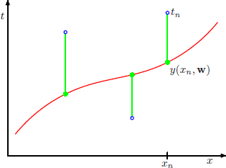

Line Fit: Maximum Likelihood and Least Squares
Vertical Seismic Profile (VSP)
t_{n} = Recorded data
Suppose that you are presented with a sequence of data points (x₁, t₁), ..., (x_{n}, t_{n}), and you are asked to find the “best fit” line passing through those points.
In order to answer this you need to know precisely how to tell whether one line is “fitter” than another
A common measure of fitness is the squared- error
T= traveltime
y(x_{n} ,w)=Predicted data
X=depth
[t_{n} – y_{n}]²
For a good discussion of Maximum likelihood estimators and least squares see
http://people.math.gatech.edu/~ecroot/3225/maximum_likelihood.pdf

Slide 56



Line Fit: Maximum Likelihood and Least Squares
y(x,w) is estimating the recorded traveltime t
Blue Line
t_{n} = Recorded data
y(x,s) = s₁x₁ + s₂x₂ +…
T= traveltime
y(x_{n} ,w)=Predicted data
Modeling or prediction operator
Error/Loss/Cost/Objective = sum squared errors
Least Square Solution
  Minimize L(w) wrt w → w=[L^{T} L]⁻¹ Lt
prediction
X=depth
[t_{n} – y_{n}]²
data
n^{h} data sample index

Slide 57
Maximum Likelihood and Least Squares
Now we approach curve fitting from a probabilistic perspective
We can express our uncertainty over the value of the target variable using a probability distribution
We assume, given the value of x, the corresponding value of t has a Gaussian distribution with a mean equal to the value y(x,w)
β is the precision parameter (inverse variance)

Slide 58
Maximum Likelihood and Least Squares
β is the precision parameter (inverse variance)

Slide 59
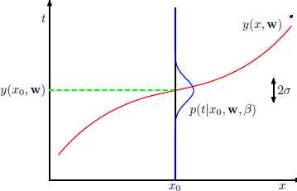
Maximum Likelihood and Least Squares
Optimal mean in
data prediction
Uncertainty in
data prediction
Data prediction

Slide 60


Maximum Likelihood and Least Squares
We now use the training data {x, t} to determine the values of the unknown parameters w and β by maximum likelihood
Log Likelihood

Slide 61

Summary: Maximum Likelihood and Least Squares
Log Likelihood
Maximize Log Likelihood wrt to w
Since last two terms, don’t depend on w,
they can be omitted.
Also, scaling the log likelihood by a positive constant β/2 does not alter the location of the maximum with respect to w, so it can be ignored
Result: Maximize

Slide 62
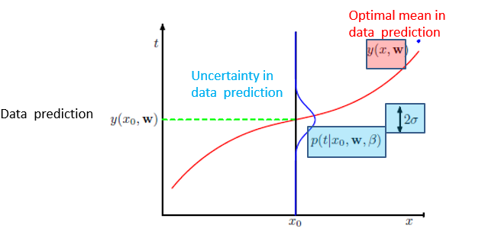

Summary: Maximum Likelihood and Least Squares
MLE
  Maximize
Least Squares
  Minimize
Therefore, maximizing likelihood is equivalent, so far as determining w is concerned, to minimizing the sum-of-squares error function
Significance: sum-of-squares error function arises as a consequence of maximizing likelihood under the assumption of a Gaussian data noise distribution
What you really want is uncertainty p(m|d) in
model parameters from p(d|m)? How?

Slide 63
Discriminant Functions
P(y|x) Neural networks, supervised
Generative Functions
P(x|y) Gaussian Mixture Models

Slide 64
Inferring Parameters
We have data X and we assume it comes from some distribution
How do we figure out the parameters that ‘best’ fit that distribution?
  Maximum Likelihood Estimation (MLE)
  Maximum a Posteriori (MAP)
Reverse conditional by Bayes’ Thm.
For example, if red pts are given
Is above Gaussian a good fit?
What is optimal N(x|μ,σ²) that explains
data?
See ‘Gibbs Sampling for the Uninitiated’ for a straightforward introduction to parameter
estimation: http://www.umiacs.umd.edu/~resnik/pubs/LAMP-TR-153.pdf

