Slide 1


Classification Problem by Single-Node Neural Network
Least Squares Prediction
of Traveltimes t
Neural Network Classification t
ε=1/2 (Xw-t)^{T}(Xw-t)
gradient
x₀
x₁
.
.
x_{N}
t = σ( )
x₀
x₁
.
.
x_{N}
t = Σx_{i} w_{i}
w₁
Σx_{i} w_{i}
w₁
∂ε/∂w_{i} = [X^{T} (Xw-t)]_{i}
∑
t
w₂
∑
t
w₂
adjoint
residual
w₃
w₃
w^{(k+1)} = w^{(k)} - α X^{(k)T} (X^{(k)}w^{(k)} -t)
w^{(k+1)} = w^{(k)} - α σ(w)(1-σ(w))X^{(k)T} (σ(x^{(k)}w) –t)
Linear Regression when t is
Any # along real line
Color of
motorcycle
Non-linear
classification
problem when
Class of
motorcycle
times
x₀
x₁
x₂
t
x₀
x₁
…x_{n}
t
t = #’s are
sparse,
either 0 or 1
#1
1 2 3 0.5
Flattened
Photos
Of
MCs
1 82 123 1
#2
.4 .6 .8 0.15
33 33.8 222 0
σ( )
Σx_{i} w_{i}
#3
2.4 4 .6 6.8 1.3
240 128 44 0
threshold
function
#4
2.2 4 .0 6.0 1.1
55 180 211 1

Slide 2
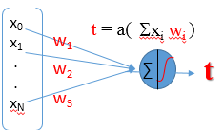
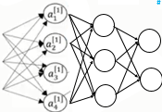
Outline
Threshold Function: Sigmoid
Single-node Neural Network
Cross Entropy Neural Network
Why Multiple-Layer Neural
Network

Slide 3
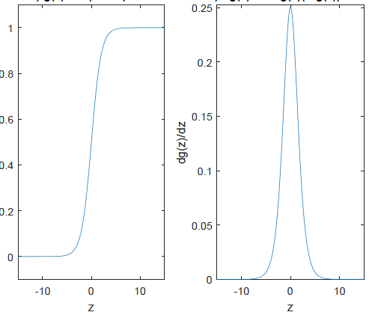

dσ(z)/dz = σ (z)(1-σ (z))
Sigmoid Function
a(z) = 1/(1+e^{-z})
$\frac{d}{dz}$(1-e^{-z})⁻¹= e^{-z} (1+e^{-z})⁻¹ (1+e^{-z})⁻¹
σ(z)
dσ(z)/dz = σ (z)(1-σ (z))
= e^{-z} (1+e^{-z})⁻¹ σ(z)
=
(1+e^{-z})
1
σ(z)
-
(1+e^{-z})
(1+e^{-z})
a(z)
σ(z)
dσ(z)/dz
=
1
-
1
σ(z)
(1+e^{-z})
= (1-σ(z)) σ(z)
z
z

Slide 4
Sigmoid Function
x₀
x₁
.
.
x_{N}
t = σ( )
w₁
Σx_{i} w_{i}
σ(z)
w₂
∑
t
a(z) = 1/(1+e^{-z})
a(z) = 1/(1+e^{-z})
dσ(z)/dz = σ (z)(1-σ (z))
dσ(z)/dz = σ (z)(1-σ (z))
w₃
What is ?
σ(z)
a(z)
dσ(z)/dz
z
z
Obs. class
Predicted class
Is σ(z) Linear?
Observed class
t ~ σ(w^{T}x) = 1/(1+e ^{–w}’ ^{x})
Prop1. F(0)=0
σ(z) ≠ Linear
Prop2. F(x+z)=F(x)+F(z)
Prop3. F(αz)=αF(z)

Slide 5
Chain Rule
dσ(z)/dz = σ (z)(1-σ (z))
∂σ(w^{T}x )
∂w_{k}
= σ(1-σ) x_{k}
i^{th} sample
ε = Σ_{i} [t – σ(w^{T}x )]²
(i) (i)
∂
∂ε = Σ_{i} [t^{(i)} -σ(w^{T}x^{(i)})]²
∂w_{κ}
∂w_{κ}
= Σ_{i} [t^{(i)} -σ(w^{T}x^{(i)} )]
∂
σ(w^{T}x)
∂w_{κ}
t ~ σ(w^{T}x) = 1/(1+e ^{–w}’ ^{x})

Slide 6
dσ(z)/dz = σ (z)(1-σ (z))
Chain Rule
∂σ(w^{T}x )
∂w_{k}
= σ(1-σ) x_{k}
σ(z(w)) is a function of a function
Δσ(z(w))
∂
∂
∂
Δσ(z(w))
Δz(w)
lim
=
Δw
Δz(w)
Δw
∂
∂
∂
Δw→0
z=w^{T}x
∂w^{T}x
w₁x₁+w₂x₂+…w_{N}x_{N}
∂σ(w^{T}x ) = ∂σ(z ) ∂ z
σ(z+Δz)
z(w+Δw)
∂w_{k}
∂z
∂ w_{k}
σ(z)
z(w)
= σ(1-σ) x_{k}
z
z+Δz
w
w+Δw

Slide 7
dσ(z)/dz = σ (z)(1-σ (z))
Outline
∂σ(w^{T}x )
∂w_{k}
= σ(1-σ) x_{k}
Threshold Function: Sigmoid
Threshold Function: Activaton Fcn.
Single-node Neural Network
Cross Entropy Neural Network
Why Multiple-Layer Neural
Network

Slide 8
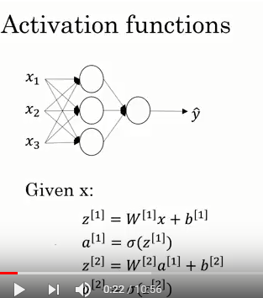
dσ(z)/dz = σ (z)(1-σ (z))
Activation Functions
∂σ(w^{T}x )
1/(1+e^{-z} )
∂w_{k}
= σ(1-σ) x_{k}
1
2-Layer Network
g(az) = σ(az ) = 1/(1+e^{-az} )
where a>0 is a scalar that
→ Heavyside as a→large
g(z) = σ(z ) = 1/(1+e^{-z} )
Sigmoid function
Layer 0
b^{[1]}
Layer 1
Layer 2
z^{[1]}
a^{[1]}
Σ| ∫
Andrew Ng always uses tanh
because it tends to demean the
Data…eliminates bias. Sigmoid is
ok in last layer if binary output 0 or 1
is wanted.
0
a^{[1]}
z
¹
¹
-5 z +5
Σ| ∫
a^{[1]}
Σ| ∫
a^{[2]}
(e^{-z -}e^{-z} )/(e^{z} +e^{-z} )
²
z^{[2]}
Σ| ∫
z^{[2]}
1
a^{[1]}
³
What are dimensions of W if
We add another node?
Σ| ∫
g(z) =(e^{-z -}e^{-z} )/(e^{z} +e^{-z} )
Tanh(z) function
3x1 vector
z₁^{[1]} w₁₁^{[1]} w₁₂^{[1]} w₁₃^{[1]} x₁ b₁^{[1]}
Given: x
Find: y
3x3 matrix for layer 1
σ( )
σ( )
a^{[1]} =
z₂^{[1]} = w₂₁^{[1]} w₂₂^{[1]} w₂₃^{[1]} x₂ + b₂^{[1]}
z₃^{[1]} w₃₁^{[1]} w₃₂^{[1]} w₃₃^{[1]} x₃ b₃^{[1]}
-1
Soln: z^{[1]} = W^{[1] •} x + b^{[1]}
z
-5 z +5
3x1 vector
a^{[1]} = σ(z^{[1]} )
BEST!!!!
1x3 matrix for layer 2
max(0,z)
activation
function
Andrew Ng says most people use ReLU cause
z
z^{[2]} = W^{[2] •} a^{[1]} + b^{[2]}
ReLU much faster than tanh or sigmoid because
slope is no-zero for large z
ReLU
scalar
a^{[2]} = σ(z^{[2]})
g(z) = max(0,z)
Rectified
Linear unit
g(z) = max(0,z)
Leaky ReLU
0
z
-5 z +5
z

Slide 9
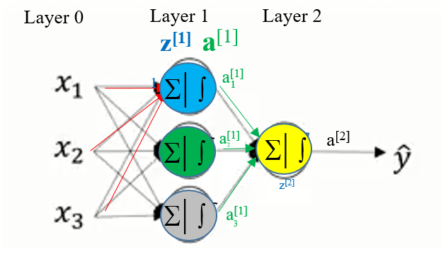
dσ(z)/dz = σ (z)(1-σ (z))
Why Activation Functions
∂σ(w^{T}x )
∂w_{k}
= σ(1-σ) x_{k}
2-Layer Network
Answer: Assume σ(z)=z
Layer 0
Layer 1
Layer 2
Linearity ~ Low Complexity
z^{[1]}
a^{[1]}
¹
¹
a^{[i]} = W^{[i]} z^{[i]}
a^{[1]}
z^{[2]}
a^{[2]}
²
= W^{[i]} W^{[i-1]} z^{[i-1]}
a^{[1]}
³
3x1 vector
Given: x
Find: y
3x3 matrix for layer 1
= W^{[i]} …W^{[1]} x
Soln: z^{[1]} = W^{[1] •} x + b^{[1]}
a^{[1]} = σ(z^{[1]} )
= Wx
1x3 matrix for layer 2
Now NN is just linear regression!
z^{[2]} = W^{[2] •} a^{[1]} + b^{[2]}
Hence, a^{[i]} =y explained by a single matrix W and linear
combination of input vector (x₁ x₂ …x_{n} ) . This is not
very powerful compared to non-linear activation functions.
a^{[2]} = σ(z^{[2]})

Slide 10
dσ(z)/dz = σ (z)(1-σ (z))
Why Activation Functions
2-Layer Network
In the mathematical theory of artificial neural networks, the universal approximation theorem states^{[1]} that a feed-forward network with a single hidden layer containing a finite number of neurons (i.e., a multilayer perceptron), can approximate continuous functions on compact subsets of R^{n}, under mild assumptions on the activation function. The theorem thus states that simple neural networks can represent a wide variety of interesting functions when given appropriate parameters; however, it does not touch upon the algorithmic learnability of those parameters.
One of the first versions of the theorem was proved by George Cybenko in 1989 for sigmoid activation functions.^{[2]}
Kurt Hornik showed in 1991^{[3]} that it is not the specific choice of the activation function, but rather the multilayer feedforward architecture itself which gives neural networks the potential of being universal approximators. The output units are always assumed to be linear. This assumes non-linear activation fcns.
Layer 0
Layer 1
Layer 2
z^{[1]}
a^{[1]}
¹
¹
a^{[1]}
z^{[2]}
a^{[2]}
²
a^{[1]}
³
3x1 vector
Given: x
Find: y
3x3 matrix for layer 1
Soln: z^{[1]} = W^{[1] •} x + b^{[1]}
a^{[1]} = σ(z^{[1]} )
1x3 matrix for layer 2
z^{[2]} = W^{[2] •} a^{[1]} + b^{[2]}
a^{[2]} = σ(z^{[2]})

Slide 11
Derivatives of Activation Functions
dσ(z)/dz = σ (z)(1-σ (z))
∂σ(w^{T}x )
1/(1+e^{-z} )
∂w_{k}
= σ(1-σ) x_{k}
1
dg(z)/dz = g(z)[1-g(z)]
g(z) = σ(z ) = 1/(1+e^{-z} )
Sigmoid function
0.25
0
z
-5 z +5
(e^{-z -}e^{-z} )/(e^{z} +e^{-z} )
1
dg(z)/dz = [1-tanh(z)]²
g(z) =(e^{-z -}e^{-z} )/(e^{z} +e^{-z} )
0.0
Tanh(z) function
-1
z
-5 +5
BEST EVER!!!!
max(0,z)
0 if z<0
1 if z>0
z
dg(z)/dz =
ReLU
1.0
g(z) = max(0,z)
g(z) = max(0,z)
0
z
-5 z +5
z

Slide 12
dσ(z)/dz = σ (z)(1-σ (z))
Outline
Threshold Function
Single-node Neural Network
Cross Entropy Neural Network
Why Multiple-Layer Neural
Network

Slide 13
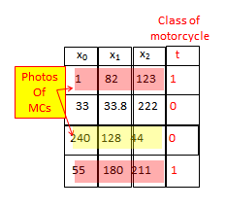
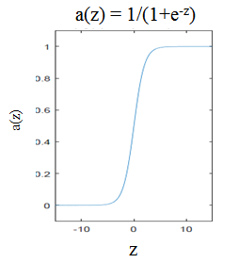

Single Node Neural Network
dσ(z)/dz = σ (z)(1-σ (z))
∂a(w^{T}x )
∂w_{k}
= a(1-a) x_{k}
Obs. class
Predicted class
Given: t = a(w^{T}x) = 1/(1+e ^{-w·x})
Sum over i photos
Find: w s.t. minimizes ε = ½ Σ_{i} (a(w^{T}x^{(i)} ) - t^{(i)} )²
= ½ Σ_{i} ( r^{(i)} )²
w^{T}x = z
Step 1: Gradient: ∂ε/∂w_{k} = Σ_{i} r^{(i)} ∂(a(w^{T}x^{(i)})- t^{(i)} )/∂w_{k}
= Σ_{i} r^{(i)} ∂( a(w^{T}x^{(i)}))/∂w_{k}
= Σ_{i} r^{(i)} a(w^{T}x^{(i)})(1-a(w^{T}x^{(i)}))x_{k}^{(i)}
= Σ_{i} a(w^{T}x^{(i)})(1-a(w^{T}x^{(i)})) x_{k}^{(i)} r^{(i)}
Compare to linear MC problem: ∂ε/∂w_{k} = Σ_{i} x_{ik} r^{(i)}
Note: Normally x_{k}^{(i)} → x_{ik}

Slide 14
Single Node Neural Network
Obs. class
Predicted class
Given: t = a(w^{T}x) = 1/(1+e ^{-w’} ^{x})
Find: w s.t. minimizes ε = ½ Σ_{i} (a(w^{T}x^{(i)} ) - t^{(i)} )²
= ½ Σ_{i} ( r^{(i)} )²
Step 1: Gradient
Step 2: Steepest Descent
For it=1:nit
For k=1:K
w_{k} := w_{k} – α ∂ε/∂w_{k}
= w_{k} - α Σ_{i} a(w^{T}x^{(i)})(1-a(w^{T}x^{(i)})) x_{ik} r^{(i)}
∂ε/∂w_{k} = Σ_{i} a(w^{T}x^{(i)})((1-a(w^{T}x^{(i)})) x_{ik} r^{(i)}
end
Update r^{(i)}
Often just sum over mini-batches
64-128 examples/mini-iteration
end
Sum over i^{th} examples

Slide 15
Derivatives of Activation Functions
dσ(z)/dz = σ (z)(1-σ (z))
∂σ(w^{T}x )
1/(1+e^{-z} )
∂w_{k}
= σ(1-σ) x_{k}
1
dg(z)/dz = g(z)[1-g(z)]
g(z) = σ(z ) = 1/(1+e^{-z} )
Sigmoid function
0.25
0
z
-5 z +5
(e^{-z -}e^{-z} )/(e^{z} +e^{-z} )
1
dg(z)/dz = [1-tanh(z)]²
g(z) =(e^{-z -}e^{-z} )/(e^{z} +e^{-z} )
0.0
Tanh(z) function
-1
z
-5 +5
BEST EVER!!!!
max(0,z)
0 if z<0
1 if z>0
z
dg(z)/dz =
ReLU
1.0
g(z) = max(0,z)
g(z) = max(0,z)
0
z
-5 z +5
z

Slide 16
MATLAB: Single Node Neural Network
Obs. class
Predicted class
Given: t = a(w^{T}x) = 1/(1+e ^{-w’} ^{x})
Find: w s.t. minimizes ε = ½ Σ_{i} (a(w^{T}x^{(i)} ) - t^{(i)} )²
Extract ith row
of XX
Stochastic Gradient: Iterating over one
Photo at a time to update w
Batch Gradient: Iterating over batches
of photos to update w
x=XX(i , : ); step=.01;w=rand(N,1);
For it=2:nit
tpred=w*x
a=1/(1-exp(-tpred))
r = a-t
for k=1:K
grad(k) = a*(1-a)x(k)*r;
w(k)=w(k)-step*grad(k);
end
% test residual, quit if r<threshold
end
Stochastic Gradient: Iterating over one
Photo at a time to update w
Batch Gradient: Iterating over batches
of photos to update w
w_{k} := w_{k} - α Σ_{i} a(w^{T}x^{(i)})(1-a(w^{T}x^{(i)})) x_{ik} r^{(i)}
I only did this for one example pair
(x,t) in the training set. What about many
training pairs (x^{(i)} , t^{(i)})? Write MATLAB code

Slide 17
Outline
Ended here Tuesday morning sept 22
Threshold Function
x₀
x₁
.
.
x_{N}
Σw_{i}
y^{pred}
Single-node Neural Network
Cross Entropy Neural Network (Odds)
Why Multiple-Layer Neural
Network

Slide 18
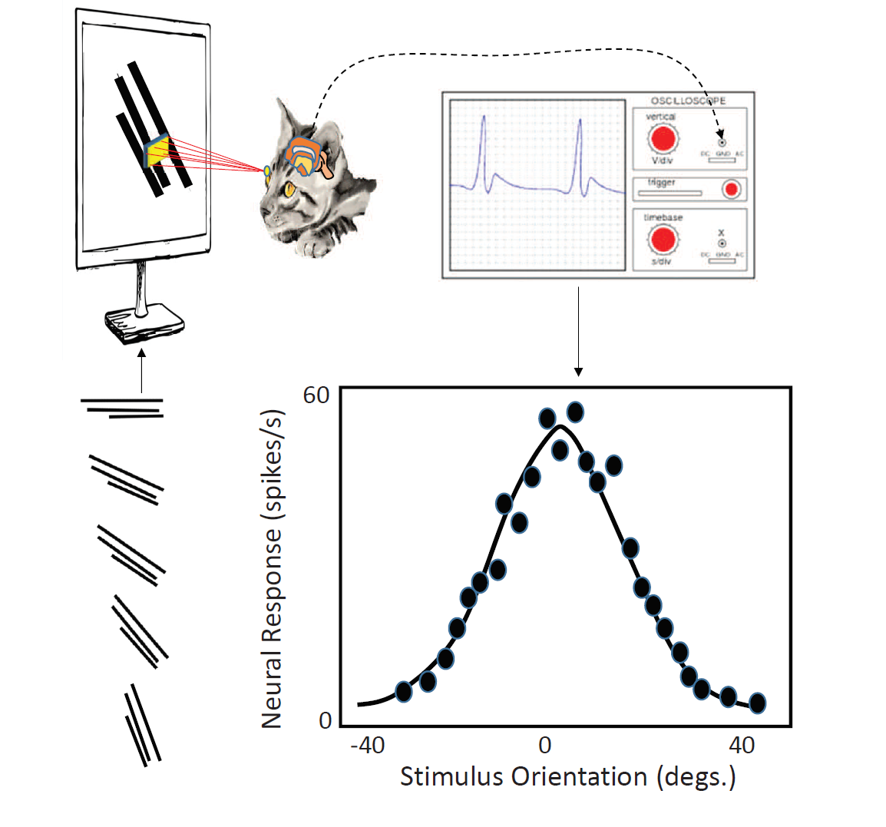
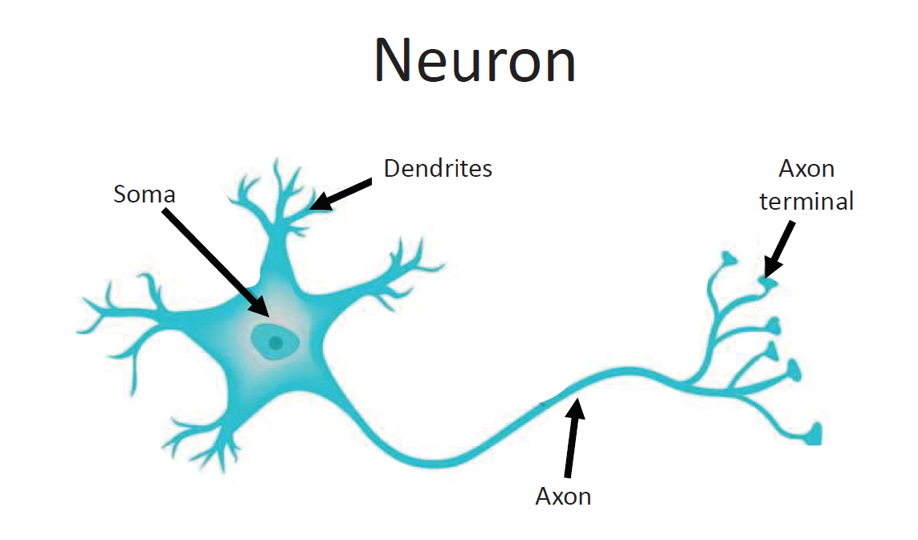
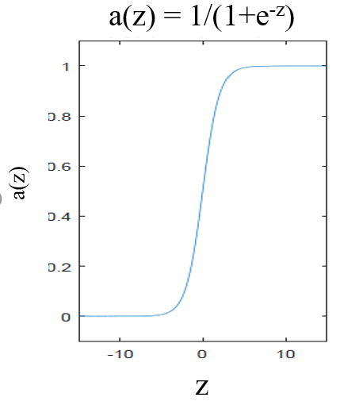
Sigmoid σ(z) → Binary CPF P(y|w,x)
y
w
x
σ(z)
σ(z)
Hubel and Weisel (1959),

Slide 19
Binary PMF P(y|w∙x) and Derivation with Odds
P(y=1|w∙x)=σ(z) has 2 properties of a binary probability mass distribution:
1). 0<σ(z)<1
Note: Increased prob. Of heads
If w₁=+1 and w₂=-1 for z=w₁x₁ + w₂x₂
As an example, assume 1≥P(y|w∙x) ≥0 is a binary conditional
probability of heads (y=1) or tails (y=0)
P(y=1|w∙x)
z)
σ(z)
P(z) =
e^{w·x} - p e^{w·x} = p Multiply by (1-p)
Define a binary probability 0<p<1
Disc. Cont.
Add weight to heads -5< x₁ <5 mg and
add weight to tails -5< x₂ <5 mg.
e^{w·x} = p e^{w·x} + p Rearrange
Probability heads y=1: P^{heads} = p
= σ(z) = P(y=1|z)
σ(z)
e^{w·x} p Divide by 1+e^{w·x}
=
Probability tails y=0: P^{tails} = (1-p)
= 1-σ(z) = P(y=0|z)
1+e^{w·x}
1 p Divide by e^{w·x}
2). Sum of Probability of 2 disjoint outcomes =1:
P^{heads} + P^{tails} = p +(1-p) =1
1+e^{-w·x}
=
x₁ =add weight
To heads
Add weight
to tails
W₁=1 & w₂=-1
According to our experience
Huge range of numbers
^{heads}
^{tails}
w₁x₁ + w₂x₂
B. Odds = [p/(1-p)]
→ ln-odds=ln[p/(1-p)]
ln-odds= w^{T}x
= ln[p/(1-p)]
^{T}
→p=1/(1+e^{-w·x})
P(y=1|w,x)=
1/(1+e^{-wx})
Exponentiate: e^{w x} = p/(1-p)
e^{w·x} = p/(1-p)
P(y=0|w,x)= [1-
- 1/(1+e^{-wx})]
= 1/(1+e^{+wx})

Slide 20
Outline
Threshold Function
x₀
x₁
.
.
x_{N}
Σw_{i}
y^{pred}
Single-node Neural Network
Cross Entropy Neural Network: Odds
Cross Entropy Neural Network: Cross-Entropy
Why Multiple-Layer Neural
Network

Slide 21
1
g(z)
Cross-Entropy Objective Function
Joint, conditional, marginal probability?
0
z
Conditional Probability function binary, i.e. two class, classifier
z
σ(w∙x) if y=1
1
Given w & RV x, what is
proability of y occuring
σ(z)
P(y|w∙x) =
0
z
1-σ(w∙x) if y=0
1
1-σ (z)
P(x,y)=P(y|x)P(x)
= A_{x,y} A_{x}
A_{x} A
= A_{x,y}/A
0
z
A
Combining above into more compact expression
A_{x}
A_{y}
P(y|w,x) =
σ(w∙x)^{y} (1-σ (w∙x))^{1-y} (1)
A_{x,y}
Max. liklihood selects w that maximizes likelihood of P(y|w,x) .
→ If you predicted correctly this will be nearly 1, whether or not y=0 or y=1. Otherwise small
Example: Unfair coin flip P(heads)=1/3
P(tails)=1-1/3=2/3

Slide 22
y = mx + b
x₂ = mx₁ + b
w₂ x₂ = -w₁ x₁ + b
X₂
^
(w₁,w₂)∙ (x₁,x₂) = b
W
w∙x = b
w∙x = 0
X₁

Slide 23
P(Y|w,x))=Yeelow Area/Pink Area
Guess @ Separation Line s.t.
w^{T}x = w₁x₁ + w₂x₂ = 0
P(y|w,x) =
z=w·x
σ(w·x)^{y} (1-σ (w·x))^{1-y}
1
1
x₂ =add weight
to tails
y=1
y=0
x₁ =add
Weight heads
σ(z)
1−σ(z)
w₁x₁ + w₂x₂
0
z
0
z
Heads
Or Tails
Prediction Criterion:
If w· x>0 then H y=1
If w· x<0 then T y=0
P(y|w·x) gets rewarded with a high
score P~1 If correct prediction either
y=1 or y=0
Wt H Wt Tails
X₂
X₁
X₂
y
P(y|w·x)
P(y|w· x)
^
W
1 1 1
.9
w·x>0 so
I predict y=1
.9
^
W
1 -2 0
.8
w·x<0 so
I predict y=0
.8
3 -3 0
.01
.99
z=w·x>0
Mis-predict
w·x>0 so
I mispredict y=1
-1 0 0
.7
.7
X₁
-2 0 0
Maximim Likelihood Optimization
Find w maximizes P⁽¹⁾…P^{(N)} → w & Separable Line
.6
.6
2 3 1
z=w·x>0
.8
.8
z=w·x<0
P(y⁽¹⁾ |w x⁽¹⁾ )
P(y⁽²⁾ |w x⁽²⁾ )…….
P(y⁽⁶⁾ |w x⁽⁶⁾ ) = .9*.8*.01*.7*.6*.8 = .0024
P(y⁽¹⁾ |w x⁽¹⁾ )
P(y⁽²⁾ |w x⁽²⁾ )…….
P(y⁽⁶⁾ |w x⁽⁶⁾ ) = .9*.8*.99*.7*.6*.8 = .241

Slide 24
Joint, Conditional & Marginal Probabilities
Universe of events, two of which are labeled x and y.
The number of times an event occurs is proportional to colored area.
Probability of x event is A_{x}/A. For example, y=test days & x=sick days
A
A_{x,y}
Given w & RV x, what is
probability of y occuring
P(x) = A_{x}/A
Marginal Probability
A_{x}
A_{y}
P(y) = A_{y}/A
Marginal Probability
P(x,y) = A_{x,y}/A
= A_{x,y} A_{x}
A_{x} A
= P(y|x)P(x)
A_{x,y}/A=P(x,y)
Joint Probability
A_{x,y}/A_{x}=P(y|x)
Conditional Probability
If x_{i} and y_{i} are independent then P(y₁,y₂…y_{N}|x₁,x₂,…x_{N})=P(y₁|x₁)P(y₂|x₂)…P(y_{N}|x_{N})
What is probability of Mary, Xin, Bill,…
being sick and then taking a test?
If they all study together and one has covid
Then they all will be sick..their sickness is correlated.

Slide 25
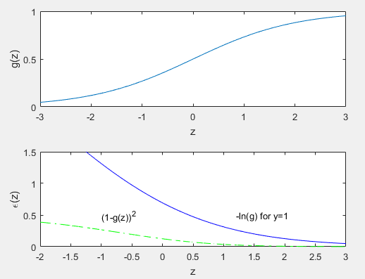
1
g(z)
Cross-Entropy Error Function
Joint, conditional, marginal probability?
0
z
Given w & RV x, what is
proability of y occuring
Conditional Probability function binary, i.e. two class, classifier
σ(wx) if y=1
1
σ(z)
P(y|w,x) =
0
z
P(x,y)=P(y|x)P(x)
= A_{x,y} A_{x}
A_{x} A
= A_{x,y}/A
1-σ (wx) if y=0
σ(z)
A
1
L2: If residual r_{i} is always between
0~10⁻²² & 1, then 0<ε=r_{i}²<1
A_{y}
1-σ (z)
Cross-entropy: If residual r_{i} is always between
0~10⁻²² & 1~10⁰ , then -22<log₁₀ r_{i} <0
A_{x}
0
z
A_{x,y}
Combining above into more compact expression
Steeper slopes of ln(1-σ(z)) converge faster
No vanishing gradient
P(y|w,x) =
σ(wx)^{y} (1-σ (wx))^{1-y} (1)
ε(z)
ε=(1-σ(z))²
A_{x,y}/A_{x}=P(y|x)
ε=-ln(σ(z)) for y=1
L² misfit
Max. likelihood selects w that maximizes likelihood of P(y|w,x) .
P(x) = A_{x}/A
However, we prefer a simpler minimization problem by taking –ln of equation (1)
we get cross-entropy loss function
Cross-entropy objective function
converges faster than L2 misfit
For binary classification
Example: Unfair coin flip P(heads)=1/3
P(tails)=1-1/3=2/3
ε =
-yln(σ(wx)) - (1-y)ln (1-σ (wx)) (2)
For many independent examples with outcomes (y₁ ,y₂,…) have joint CPF as
Ok to replace P with –lnP because P=g(z) monotonic
increasing and so is lnP(z). Hence, w* stationary for both
functions.
Example: what are chances of flipping 3 heads in
A row? P(heads, heads, heads|flip,flip,flip)=
P(head|flip)xP(head|flip)xP(head|flip)=.5³
ε = -ln[P(y⁽¹⁾,y⁽²⁾,…y^{(N)} |w,x⁽¹⁾,…x^{(N)})] = -ln Π_{i} P(y^{(i)}|w,x^{(i)})
= -Σ_{k}ln[P(y^{(k)}|w,x^{(k)}]

Slide 26
Outline
Threshold Function
x₀
x₁
.
.
x_{N}
Σw_{i}
y^{pred}
Single-node Neural Network
Cross Entropy Neural Network: Odds
Cross Entropy Neural Network: Cross-Entropy
Cross Entropy Neural Network: SGD
Why Multiple-Layer Neural
Network

Slide 27
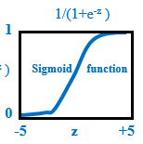
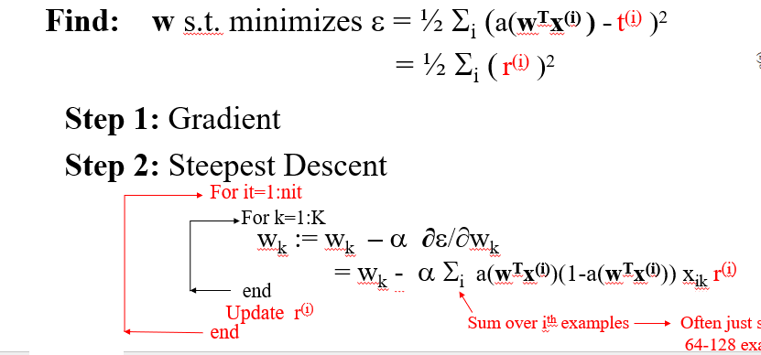

Start here for
ME+Asia Class
Classification Problem by Cross Entropy
y=1 or y=0
Previous derivation
was for y=+1 or -1
a(z) =
Find: w* that minimizes liklihood ε = -ln{σ(x•w)^{y} [1-σ(x•w)]^{(1-y)}}
a(z)
More generally z=wx+b
dz/db = 1
∂ε
∂ε
∂σ
∂z
=
= r^{(i)}
∂[ylnσ +(1-y)ln(1-σ)] y (1-y) y(1- σ) σ(1−y) σ −y
∂b
∂σ
∂z
∂b
= - = - =
z
∂σ σ (1− σ) σ(1− σ) σ(1− σ) σ(1− σ)
∂ε
∂ε
∂σ
∂z
(σ-y)
σ(1-σ) x_{k}
Step 1: Gradient:
=
=
∂w_{k}
∂σ
∂z
∂w_{k}
σ(1-σ)
=
(σ(w•x) – y)
x_{k}
r^{(i)}
No σ, no vanishing gradient!
w_{k} =: w_{k} - α (σ(w•x)– y) x_{k}
Step 2: Stochastic update:
= w_{k} - α (σ(w•x^{(i)}) – y^{i)}) x_{k}
r^{(i)}
Same as Least squares gradient!
^{(i)}
(ith training set)
~X^{T} residual
Batch update:
w_{k} =: w_{k} - α Σ (σ(w•x^{(i)}) – y^{(i)} ) x_{k}
(batch training set with M examples)
^{M}
^{i=0}
^{(i)}
---
x_{k}^{(i)} r^{(i)}
M+1

Slide 28
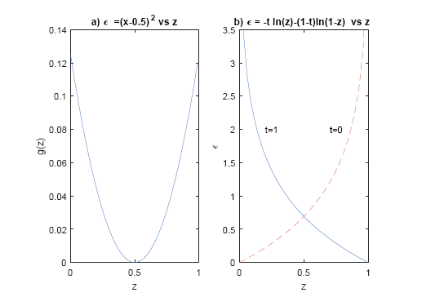
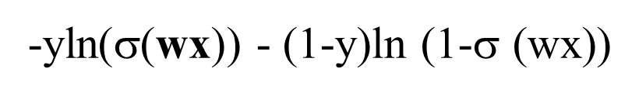

Classification: L² vs Cross-entropy Objective Functions
Cross-entropy
ε =
-yln(σ(wx)) - (1-y)ln (1-σ (wx))
w_{k} := w_{k} - α Σ_{i} x_{ik} r^{(i)}
Adv. Of X-entropy = Steeper Slopes
No vanishing gradient
L²
Adv. 1: No vanishing gradient
y=1
y=0
ε
ε
ε =
½ Σ_{i} (σ (wx)-t^{(i)})²
w_{k} := w_{k} - α Σ_{i} σ(w^{T}x^{(i)})(1-σ(w^{T}x^{(i)})) x_{ik} r^{(i)}
Z
10⁻⁶
10⁻²
10⁻¹
0.9
0.99
Z²
10⁻¹²
10⁻⁴
10⁻²
0.81
0.98
-logZ
6
2
1
.04
0.0044
z=wx
-logZ expands small range of numbers between
0<Z<1 to a large range

Slide 29
Outline
Threshold Function
x₀
x₁
.
.
x_{N}
Σw_{i}
y^{pred}
Single-node Neural Network
Cross Entropy Neural Network: MATLAB SGD
Cross Entropy Neural Network: Odds
Cross Entropy Neural Network: Cross-Entropy
Why Multiple-Layer Neural
Network

Slide 30

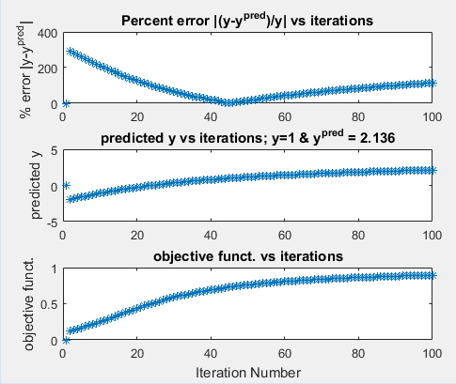
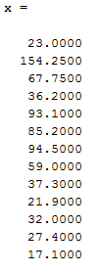
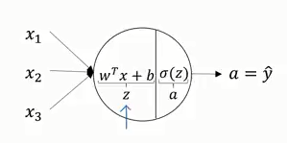
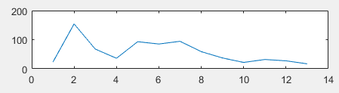
Code for Logistic Learning Algorithm y=1 or y=0
Stochastic update:
w_{k} =: w_{k} - α (a(w•x)– y) x_{k}
% Stochastic update:
%
% w -output- weights
% x - input- training example
%
[X,T] = bodyfat_dataset;
x=X(:,1);y=T(1,1);
N=length(x);
w=(rand(N,1)-.5)*.003;b=(rand(1,1)-.5)*.001;
nit=1000;alpha=.2;obj=zeros(nit,1);err=obj;
X Y=1
a(z)=1./(1+exp(-z));
W x b
One example input
a(z)
for i=2:nit % Loop over iterations
z=w'*x + b;
a=1./(1+exp(-z));
obj(i)=-[y*log(a)+(1-y)*log(1-a)];
w=w-alpha*(a-y)*x; % Stochastic
b = b - alpha*(a-y); % gradients
err(i)=obj(i)-obj(i-1);
end

Slide 31
Outline
Threshold Function
x₀
x₁
.
.
x_{N}
Σw_{i}
y^{pred}
Single-node Neural Network
Cross Entropy Neural Network: Odds
Cross Entropy Neural Network: Cross-Entropy
Cross Entropy Neural Network: Batch SGD
Why Multiple-Layer Neural
Network

Slide 32
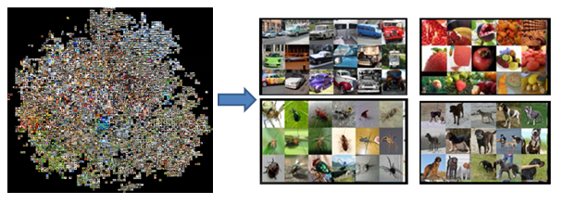
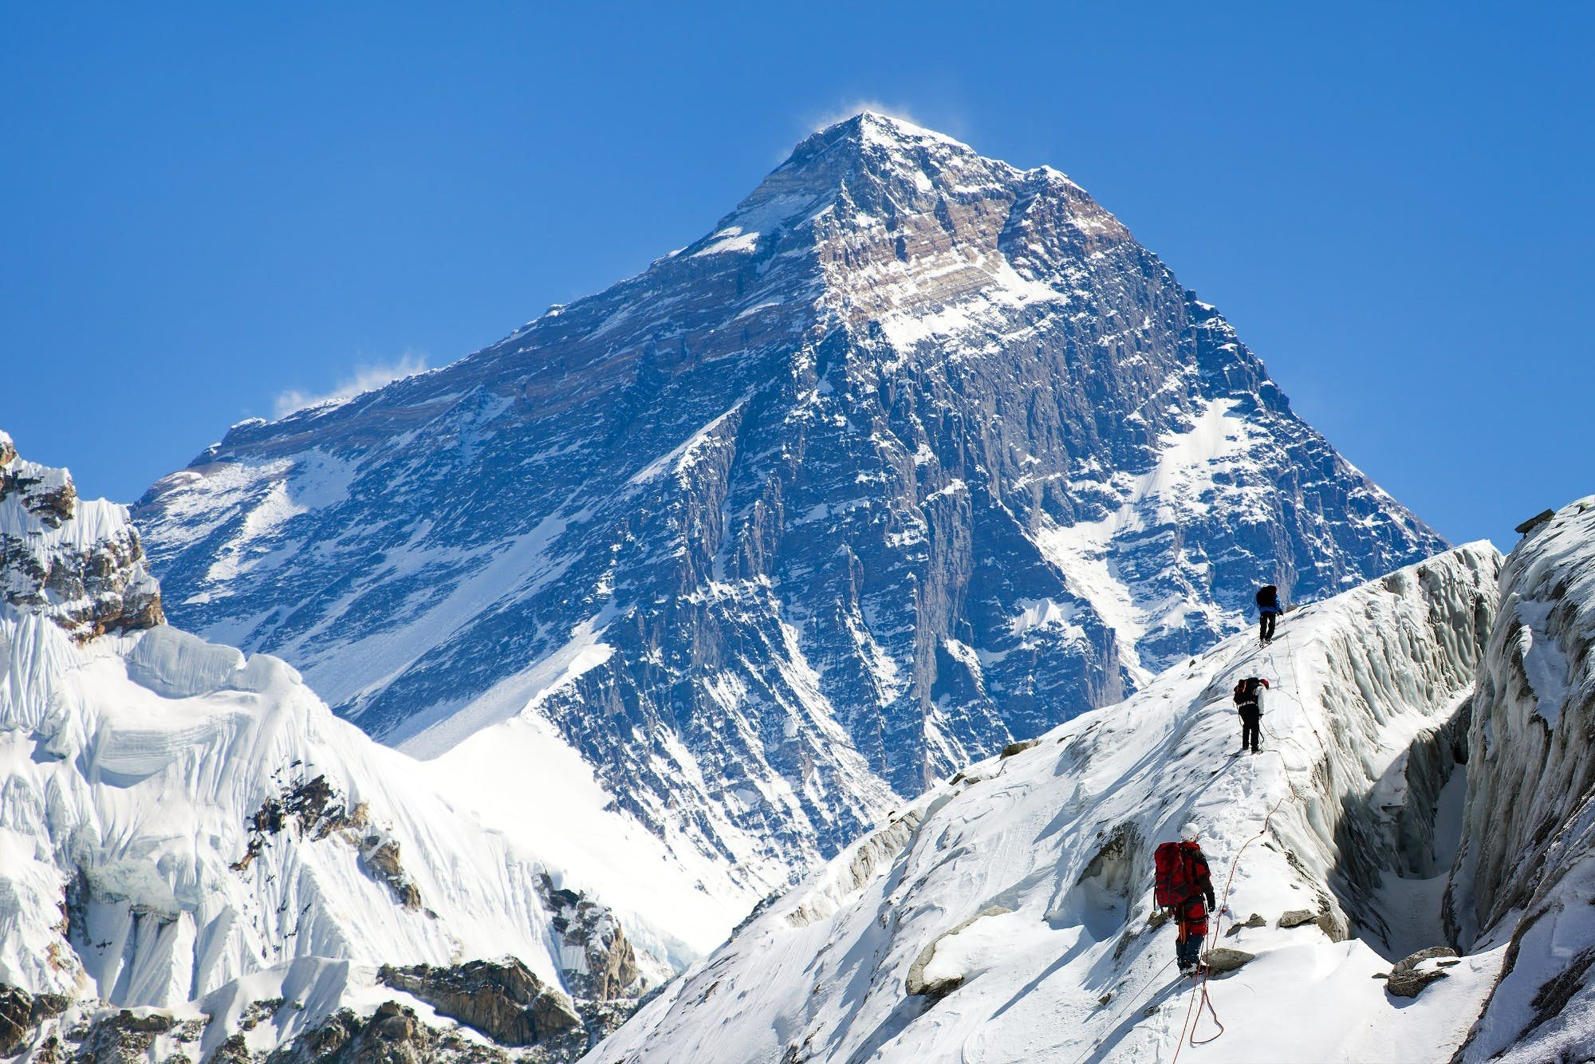
Code for Logistic Learning Algorithm y=1 or y=0
Stochastic update:
w_{k} =: w_{k} - α (a(w•x)– y) x_{k}
% Stochastic update:
Mini-batch SGD
x=X(:,1);y=T(1,1);
xx=X; yy=TT;
for i=2:nit
for k=1:K
y=yy(k);
x=xx(:,k);
z=w·x + b;
a=1./(1+exp(-z));
w=w-alpha*(a-y)*x;
b = b - alpha*(a-y);
end
err(i)=obj(i)-obj(i-1);b=0;gw=0;gb=0;
end
end
% Loop over iterations
J=384; K=1 SGD
a(z)=1./(1+exp(-z));
Photo #N
Photo #3
Photo #2
Photo #1
for j=1:J
% Loop over Batches
x₁
x₂
x₃
x₁
x₂
x₃
x₁
x₂
x₃
x₁
x₂
x₃
One example input
% Loop over training examples in Batch
J=6; K=64 Minibatch SGD
....
W x b
One Epoch=6 Minibatch Updates
for i=2:nit % Loop over iterations
z=w'*x + b;
a=1./(1+exp(-z));
obj(i)=-[y*log(a)+(1-y)*log(1-a)];
w=w-alpha*(a-y)*x; % Stochastic
b = b - alpha*(a-y); % gradients
err(i)=obj(i)-obj(i-1);
end
a(z)
obj(i)=-[y*log(a)+(1-y)*log(1-a)] +obj(i);
gw =gw + (a-y)*x; % Accumulate gw gradients
gb = gb + (a-y); % Accumulate gb gradients
w=w-alpha*gw; % Update model w
b = b – alpha*gb;
% Update model b
end

Slide 33
Outline
Threshold Function
x₀
x₁
.
.
x_{N}
Σw_{i}
y^{pred}
Single-node Neural Network
Cross Entropy Neural Network: Odds
: Matlab Example
Cross Entropy Neural Network: Cross-Entropy
Cross Entropy Neural Network: Batch SGD
Softmax for Multiple-Layer Neural Network

Slide 34
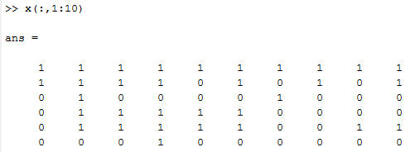
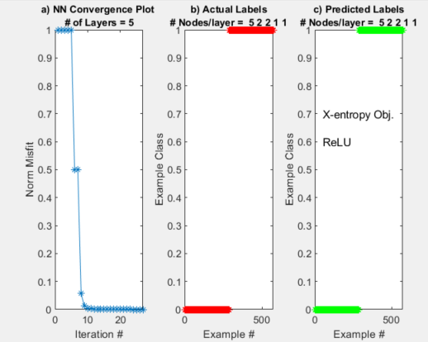
Single-Node Neural Network
W^{(k+1)} = W^{(k)} - α a(w)(1-a(w))X^{(k)T} (a(x^{(k)}w) –t)
for k=2:nit % Looping over gradient iterations
[grad,res]=gradient(M,N,x,t,w,beta,res,k,io);
alpha=.001*sqrt(grad'*grad);
w=w-alpha*grad; % Gradient descent update
end
Neural Network Classification t
x₀
x₁
.
.
x_{N}
t = a( )
w₁
Σx_{i} w_{i}
w₂
∑
t
Unbalanced input..too few examples
with x = [1 1 0 0 0 0] etc. Therefore iterations spend most energy
on classifying the other ones such as [1 1 0 1 1 0 ]
w₃
Label t(i) =1 if there is a single 1
In 5x1 input vector x, and t(i)=0 otherwise
100 6x1 Feature vectors
X(1:6,1) X(1:6,2)
X(1:6,3) X(1:6,4)
X(1:6,5) X(1:6,6)
X(1:6,7) X(1:6,8)
b→
X₁→
X₂→
X₃→
X₄→
X₅→
1 0 0 0 0 0 1 1
t(1) t(2) t(3) t(4) t(5) t(6) t(7) t(8)

Slide 35
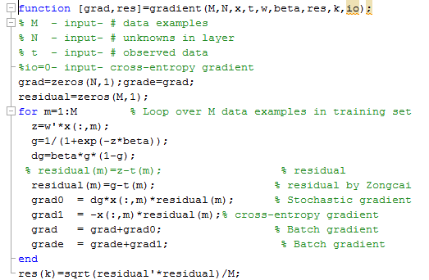
Single-Node Neural Network
W^{(k+1)} = W^{(k)} - α a(w)(1-a(w))X^{(k)T} (a(x^{(k)}w) –t)
for k=2:nit % Looping over gradient iterations
[grad,res]=gradient(M,N,x,t,w,beta,res,k,io);
alpha=.001*sqrt(grad'*grad);
w=w-alpha*grad; % Gradient descent update
end
Neural Network Classification t
x₀
x₁
.
.
x_{N}
t = a( )
w₁
Σx_{i} w_{i}
w₂
∑
t
w₃
100 6x1 Feature vectors
X(1:6,1) X(1:6,2)
X(1:6,3) X(1:6,4)
X(1:6,5) X(1:6,6)
X(1:6,7) X(1:6,8)
1 0 0 0 0 0 1 1
t(1) t(2) t(3) t(4) t(5) t(6) t(7) t(8)

Slide 36
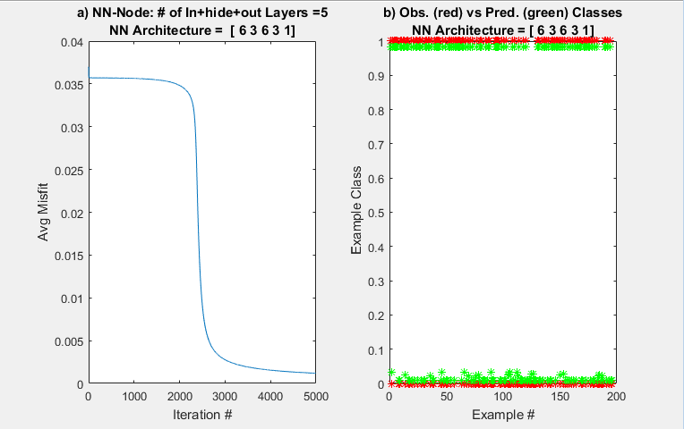
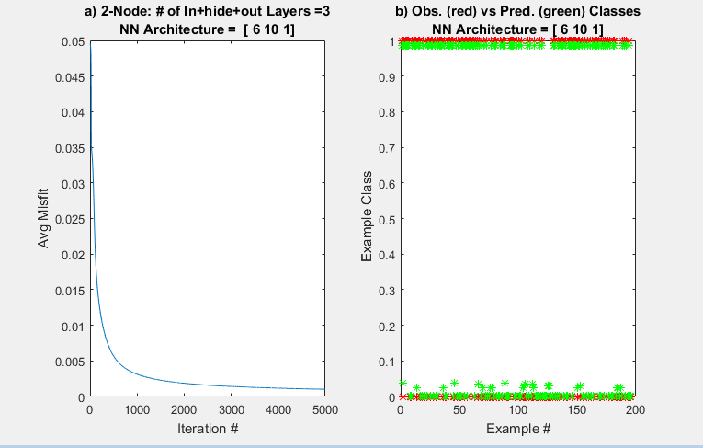
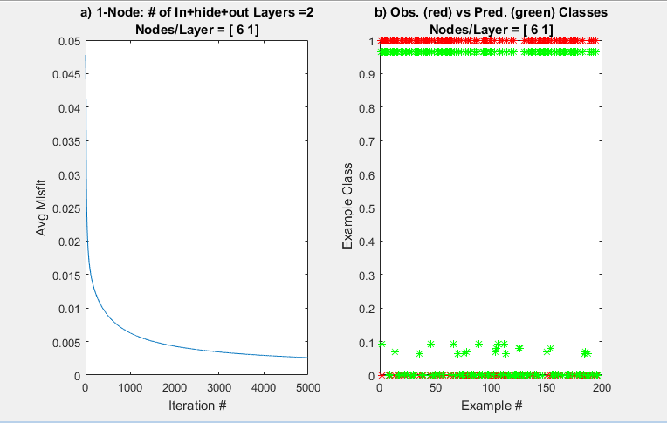
1-, 2-, 4-Layer Neural Network Results
W^{(k+1)} = W^{(k)} - α a(w)(1-a(w))X^{(k)T} (a(x^{(k)}w) –t)

Slide 37
Outline
Threshold Function
x₀
x₁
.
.
x_{N}
Σw_{i}
y^{pred}
Single-node Neural Network
Cross Entropy Neural Network: Odds
Cross Entropy Neural Network: Cross-Entropy
Cross Entropy Neural Network: Batch SGD
Softmax for Multiple-Layer Neural Network

Slide 38
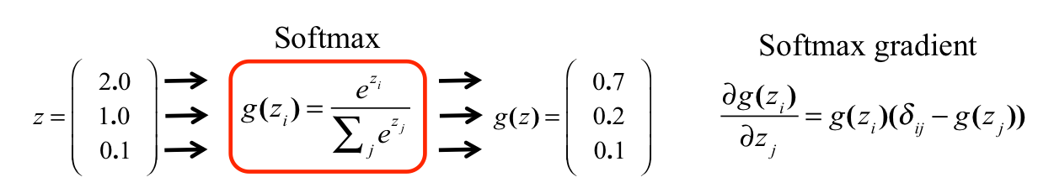


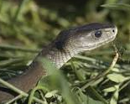
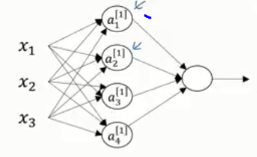
Softmax Multiclass Classififcation
Cross entropy objective function for
binary classification
These #s are probability estimates.
Pick the highest probability as winner.
These are
Probabilities!!!
Two Classes (K=1): Find w that minimizes
ε = -ln Π_{i} {a(x^{(i)}•w)^{yi} [1-a(x^{(i)}•w)^{(1-yi)}]}
Multiclass Objective Function (K>2)
0
0
1
0
1
0
1
0
0
a^{[1]}
a^{[2]}
One-out-of-K
Stack of cards
With pictures of snakes,
Alligators & dogs
P(y₁,y₂,y₃ |W,a)
softmax
a^{[0]}
W^{[3]} a^{[2]} = z^{[3]}
z_{i}^{[3]}
e
a₁^{[2]}
g(z_{i})^{soft} =
≈ y_{i}
W^{[2]}
Vector labels
W^{[1]}
g(z₁ ^{[3]})
y₁
z₁^{[3]}
z₂^{[3]}
z₃^{[3]}
z₁^{[3]}
e + e + e
ε = -ln[ P(1,0,0|z₁)^{y1}
P(0,1,0|z₂ )^{y2}
P(0,0,1|z₃ )^{y3} ]
a₂^{[2]}
W^{[3]}
Note: only one of the terms in (k) will be
non-zero, the correct class type
g(z_{i} )^{soft} is a PMF because 1) 0≤g(z_{i} )^{soft} ≤1
2) Σ_{ι=1}³ g(z_{i}) = 1
y₂
I(examples ) K(classes)
z₂^{[3]}
g(z₂ ^{[3]})
ε=- Σ_{i} Σ_{k} y_{k}^{(i)} ln g(z_{k}^{(i)})^{soft}
ε = -y₁ ln[P(1,0,0|z₁) – y₂ ln[P(1,0,0|z₁) – y₃ ln[P(0,0,1|z₁)
a₃^{[2]}
ε = - y₁ ln[g(z₁)] – y₂ ln[g(z₂)] – y₃ ln ln[g(z₃)]
g(z₃ ^{[3]})
y₃
z₃^{[3]}

Slide 39
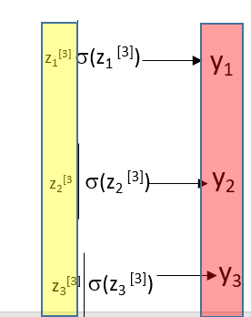
Summary
Only one of the 3x1 y vectors below
is allowed with One-out-of-K
0 1 1
Multiclass Objective Function (K>2)
0 0 1
One-out-of-K
P(C₁|x )
softmax
0 1 0
W^{[3]} a^{[2]} = z^{[3]}
e^{z1}
z_{i}^{[3]}
1
e
~
σ(z_{i})^{soft} =
= y
Note: only one of the y_{k}^{(i)} terms in (k) will be
non-zero, the correct class type
=
e^{z1} + e^{z2}
1 + e^{z2- z1}
z₁^{[3]}
z₂^{[3]}
z₃^{[3]}
-z
1 0 0
z₁^{[3]}
σ(z₁ ^{[3]})
y₁
e + e + e
e^{z2}
e^{z3}
For example K=3:
ε=- Σ_{i} y₁^{(i)} lnσ(z₁^{(i)})+y₂^{(i)} lnσ(z₂^{(i)})+y₃^{(i)} lnσ(z₃^{(i)})
Ith element → i^{th} class
e^{z1}
+ + = 1
e^{z1} + e^{z2} + e^{z3}
e^{z1} + e^{z2} + e^{z3}
e^{z1} + e^{z2} + e^{z3}
z₂^{[3]}
σ(z₂ ^{[3]})
y₂
ε=- Σ_{i} Σ_{k} y_{k}^{(i)} lnσ(z_{k}^{(i)})^{soft}
σ(z₃ ^{[3]})
y₃
z₃^{[3]}

Slide 40
Outline
Threshold Function
x₀
x₁
.
.
x_{N}
Σw_{i}
y^{pred}
Single-node Neural Network
Cross Entropy Neural Network: Odds
Cross Entropy Neural Network: Cross-Entropy
Cross Entropy Neural Network: Batch SGD
Why Multiple-Layer Neural
Network

Slide 41
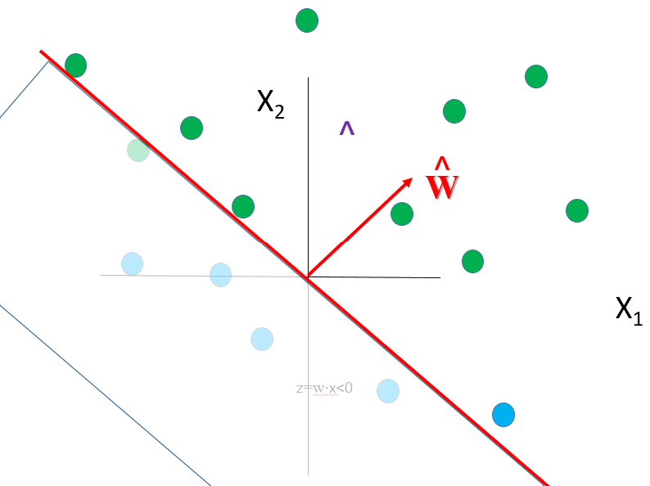
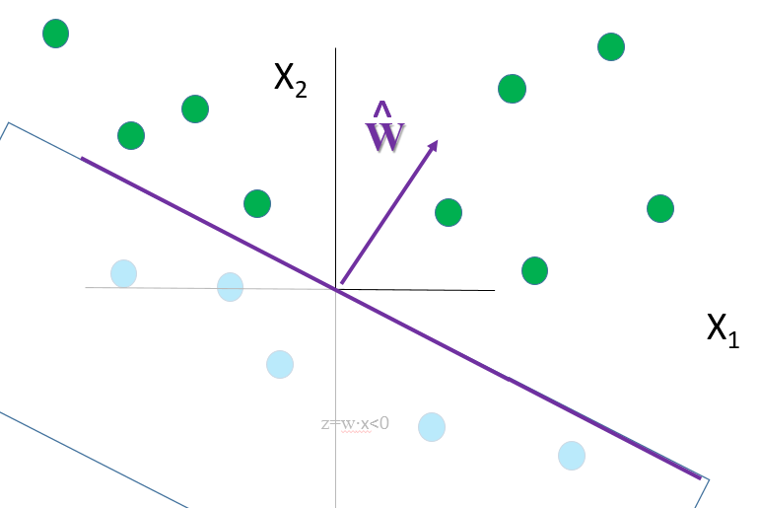
P(Y|w,x))=Yeelow Area/Pink Area
One Sigmoid Acts as a Line Threshold Filter
x₁
x₂
Σ
∫
X₂
^
W
^
W
Guess @ Separation Line s.t.
w^{T}x = w₁x₁ + w₂x₂ = 0
z=w·x>0
X₁
1−σ(w·x) vs w·x
σ(w·x) vs w·x
z=w·x>0
1
σ(w·x)
z=w·x<0
0
-1 0 1
w·x

Slide 42
Two Sigmoid Act as a 2-Line Threshold Filter
Only green+red pts survive
W
σ(w·x)
Only green pts survive
If we only keep σ(z)>0.5
Wait, a single node can’t
separate three colors.
Can we find an irregular
separator to isolate Green?
σ( )
σ(w·x)
+ σ(w·x)
w₁₁ w₁₂ x₁
w₂₁ w₂₂ x₂
Σ
∫
W
x₁
x₂
Σ
∫
Σ
∫
Only green+few blue pts survive
σ(w·x)
Only green pts survive
If we only keep σ(z)>0.5
W
Bingo!

Slide 43

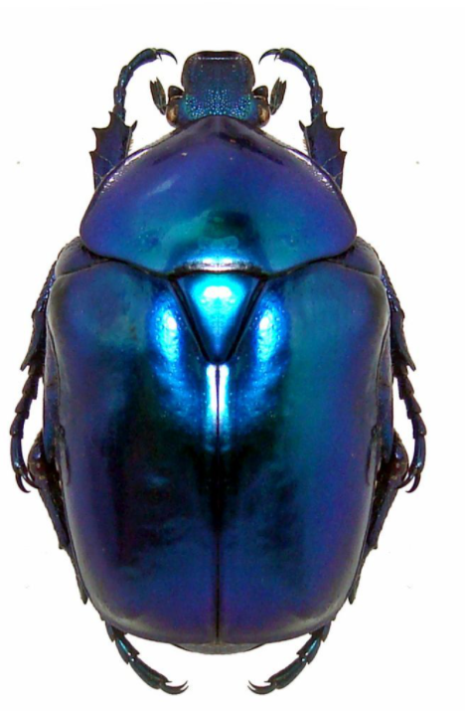
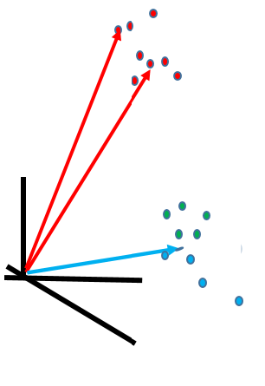



High-Dimensional Classification
σ(w·x)
Manifold=wiggly hyper-surface
W
σ(w·x)
W
Σ
∫
W
x₁
x₂
Σ
∫
Σ
∫
σ(w·x)
Bingo!
W

Slide 44
Outline
Threshold Function
x₀
x₁
.
.
x_{N}
Σw_{i}
y^{pred}
Single-node Neural Network
Cross Entropy Neural Network: Odds
Cross Entropy Neural Network: Cross-Entropy
Cross Entropy Neural Network: Batch SGD
Why Multiple-Layer Neural
Network
Summary

Slide 45
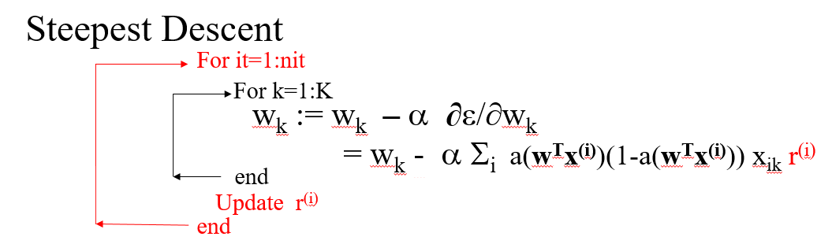
Summary
Single Node LS Neural Network
w^{(k+1)} = w^{(k)} - α Σ_{ι} a(w^{T}x^{(i)})(1-a(w^{T}x^{(i)})) x_{k} r^{(i)}
w=rand(N,1)
For k=2:nit
tpred=w*x
a=1/(1-exp(-tpred))
r=a-t
w = w - α Σ_{ι} a*(1-a) *x *r
end
Use all examples at once
or in B mini-batches. One iteration
Over all examples is one epoch

Slide 46
Summary
Batch Stochastic Gradient
Photo #N
Photo #3
Photo #2
a(z)=1./(1+exp(-z));
Photo #1
J=640; K=1 SGD
x₁
x₂
x₃
x₁
x₂
x₃
x₁
x₂
x₃
x₁
x₂
x₃
J=10; K=64 Minibatch SGD
W x b
....
a(z)
One Epoch=10 Minibatch Updates

Slide 47
Summary
Red
MC
x₂
Not red
MC
Cross entropy objective function for
binary classification
x₁
Two Classes (K=1): Find w that minimizes
ε = -ln Π_{i} {a(x^{(i)}•w)^{ti} [1-a(x^{(i)}•w)^{(1-ti)}]}
Multiclass Objective Function (K>2)
a^{[1]}
a^{[2]}
One-out-of-K
P(y₁,y₂,…y_{K} |w,x)
softmax
a^{[0]}
W^{[3]} a^{[2]} = z^{[3]}
e^{z1}
z_{i}^{[3]}
1
e
~
a₁^{[2]}
σ(z_{i})^{soft} =
=
= y_{i}
W^{[2]}
e^{z1} + e^{z2}
1 + e^{z2- z1}
W^{[1]}
z₁^{[3]}
z₂^{[3]}
z₃^{[3]}
-z
z₁^{[3]}
σ(z₁ ^{[3]})
y₁
e + e + e
a₂^{[2]}
W^{[3]}
Note: only one of the terms in (k) will be
non-zero, the correct class type
I(examples ) K(classes)
z₂^{[3]}
σ(z₂ ^{[3]})
y₂
ε=- Σ_{i} Σ_{k} y_{k}^{(i)} lnσ(z_{k}^{(i)})
a₃^{[2]}
σ(z₃ ^{[3]})
y₃
z₃^{[3]}

Slide 48
Summary
If binary output: Cross-Entropy Objective Function
Define: likelihood function
P(y^{(i)}|x^{(i)},w) = a(x^{(i)}•w)^{yi} [1-a(x^{(i)}•w)]^{(1-yi )}
Find: w* that minimizes liklihood
ε = -Π_{i} ln(a(x^{(i)}•w)^{yi} [1-a(x^{(i)}•w)^{(1-yi )}])
Otherwise, use L₂ misfit function & steepest descent
Find: w* that minimizes L² misfit
ε = ½ Σ_{i} ||Y^{(i)} –Y_{pred} ^{(i)} ||²

Slide 49
Summary
NN finds w→ separation line
Red
MC
x₂
Not red
MC
We needed a bias b s.t w=(w₀ , w₁, w₂ ) so we could
shift the line so we could solve the problem (i.e.
separate green from red).
x₁

Slide 50
P(Y|w,x))=Yeelow Area/Pink Area
Summary
We needed a bias b s.t w=(w₀ , w₁, w₂ ) so we could
shift the line so we could solve the problem (i.e.
separate green from blue).
^
W
w^{* =} Separation Line
w^{T}x = w₁x₁ + w₂x₂ = 0
w^{* =} Separation Line
w^{T}x = w₁x₁ + w₂x₂ + w₀ = 0
Maximim Likelihood Optimization
Find w maximizes P⁽¹⁾…P^{(N)} → w & Separable Line

Slide 51
Summary
Classification: L² vs Cross-entropy Objective Functions
Cross-entropy
ε =
-Π_{i} y^{(i)} ln(σ(w x^{(i)} )) - (1-y^{(i)} )ln (1-σ (wx^{(i)} ))
w_{k} := w_{k} - α Σ_{i} x_{ik} r^{(i)}
No vanishing gradient
L²
ε
ε
ε =
½ Σ_{i} (σ (wx)-t^{(i)})²
w_{k} := w_{k} - α Σ_{i} σ(w^{T}x^{(i)})(1-σ(w^{T}x^{(i)})) x_{ik} r^{(i)}
vanishing gradient

Slide 52
P(Y|w,x))=Yeelow Area/Pink Area
One Sigmoid Acts as a Line Threshold Filter
x₁
x₂
Σ
∫
X₂
^
W
^
W
Guess @ Separation Line s.t.
w^{T}x = w₁x₁ + w₂x₂ = 0
z=w·x>0
X₁
σ(w·x) vs w·x
z=w·x>0
1
σ(w·x)
z=w·x<0
0
-1 0 1
w·x

Slide 53
Two Sigmoid Act as a 2-Line Threshold Filter
W
σ(w·x)
σ( )
σ(w·x) +σ(w·x)
Σ
∫
W
x₁
x₂
Σ
∫
Σ
∫
σ(w·x)
Bingo!
W

Slide 54
The End

Slide 55
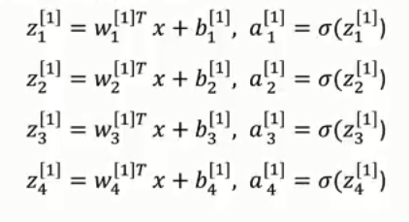
Vectorization of Multiple-Node Neural Network https://www.youtube.com/watch?v=-jxrYTq0uNo&list=PLBAGcD3siRDguyYYzhVwZ3tLvOyyG5k6K&index=25
4x1
4x3
3x1 4x1
4x1
layer 0 layer 1 layer 2
z^{[1]} =
W^{[1]}
z^{[1]}
a^{[0]}
+ b^{[1]} ;
a^{[1]} = σ(
z^{[1]} )
^{[0]}
a^{[1]}
a^{[2]}
a
4x1 vector Output of l node
3x1
1x3
z σ
w₁₁
a^{[1]}
Layer #
Node #
[1]
1
w^{[1]T}
a^{[0]} +
w₁₂
^{[0]}
[1]
w₁₃
¹
a
[1]
1
a^{[1]}
a(z)=1./(1+exp(-z));
z σ
2
w^{[1]T}
a^{[0]} +
x₁
x₂
x₃
²
^{[0]}
a
2
a^{[1]}
W x b
z σ
w^{[1]T}
3
a^{[0]} +
a(z)
^{[0]}
³
a
3
4x3
z σ
a^{[1]}
W^{[1]}
w^{[1]T}
4
a^{[0]} +
⁴
w^{[1]T}
w₁₁
[1]
w₁₂
w₁₃
•
•
•
¹
•
•
•
[1]
[1]
w^{[1]T}
w₂₁
w₂₂
w₂₃
•
•
•
•
•
•
[1]
[1]
[1]
²
w₃₁
w₃₂
w₃₃
•
•
•
w^{[1]T}
•
•
•
[1]
[1]
[1]
³
w₄₁
w₄₂
w₄₃
w^{[1]T}
[1]
[1]
[1]
•
•
•
⁴
•
•
•

Slide 56
Forward & BackPropagation Neural Network Matlab
Feedforward
for i=1:Nlayer
z^{[i]} =W^{[i]}'*a^{[i-1]} + b^{[i]};
a^{[i]} =1./(1+exp(- z^{[i]} ));
end
y^{pred} = z^{[Nlayer]}

Slide 57
Outline
Single-node Perceptron (binary)
Matlab Single-node Perceptron
: Vectorization
Matlab Multiple-Layer Neural Network
Matlab Multiple-Layer+Training
Set Neural Network

Slide 58

Vectorization of N.N. with Multiple Nodes & Layers https://www.youtube.com/watch?v=-jxrYTq0uNo&list=PLBAGcD3siRDguyYYzhVwZ3tLvOyyG5k6K&index=25
# nodes in layer 0
N(0)=3
N(1)=3
N(2)=3
N(3)=2
4x3
layer 2 layer 3
W^{[1]}
layer 0 layer 1 layer 2
z^{[1]} =
a^{[0]}
+ b^{[1]} ;
a^{[1]} = σ(
z^{[1]} )
^{[0]}
a^{[1]}
a^{[2]}
a
a^{[2]}
a^{[3]}
3x1
# nodes in layer 3
Given input x=a^{[0]}
Note: superscript input
one less than node value
^{[0]}
a
1
z^{[1]} = W^{[1]} a^{[0]} + b^{[1]}
^{[0]}
a
a^{[1]} = σ(
2
z^{[1]} )
^{[0]}
a
z^{[2]} = W^{[2]} a^{[1]} + b^{[2]}
3
N(2)xN(1)
Feedforward
for i=1:Nlayer
z^{[i]} =W^{[i]}'*a^{[i-1]} + b^{[i]};
a^{[i]} =1./(1+exp(- z^{[i]} ));
end
y^{pred} = z^{[Nlayer]}
a^{[2]} = σ(
z^{[2]} )
.
.
.
N(i)x1
N(i)x1
z^{[N]} = W^{[N]} a^{[Ν−1]} + b^{[Ν]}
N(N)xN(N-1)
a^{[Ν]} = σ(
a^{[Ν]} =
z^{[N]} )
N(Nlayer)x1
z^{[N]} (often)

Slide 59
Vectorization of N.N. with Multiple Nodes & Layers https://www.youtube.com/watch?v=-jxrYTq0uNo&list=PLBAGcD3siRDguyYYzhVwZ3tLvOyyG5k6K&index=25
# nodes in layer 0
μ₀ = 3
μ₁ =3
μ₂ = 3
μ₃ = 2
4x3
layer 2 layer 3
W^{[1]}
layer 0 layer 1 layer 2
z^{[1]} =
a^{[0]}
+ b^{[1]} ;
a^{[1]} = σ(
z^{[1]} )
^{[0]}
a^{[1]}
a^{[2]}
a
a^{[2]}
a^{[3]}
3x1
# nodes in layer 3
Given input x=a^{[0]}
Note: superscript input
one less than node value
^{[0]}
a
1
z^{[1]} = W^{[1]} a^{[0]} + b^{[1]}
^{[0]}
a
a^{[1]} = σ(
2
z^{[1]} )
^{[0]}
a
z^{[2]} = W^{[2]} a^{[1]} + b^{[2]}
3
N(2)xN(1)
Feedforward
for i=1:Nlayer
z^{[i]} =W^{[i]}'*a^{[i-1]} + b^{[i]};
a^{[i]} =1./(1+exp(- z^{[i]} ));
end
y^{pred} = z^{[Nlayer]}
a^{[2]} = σ(
z^{[2]} )
.
.
.
N(i)x1
N(i)x1
z^{[N]} = W^{[N]} a^{[Ν−1]} + b^{[Ν]}
N(N)xN(N-1)
a^{[Ν]} = σ(
a^{[Ν]} =
z^{[N]} )
N(Nlayer)x1
z^{[N]} (often)

Slide 60
Outline
x₀
x₁
.
.
x_{N}
Single-node Perceptron (binary)
y^{pred}
Matlab Single-node Perceptron
: Vectorization
Matlab Multiple-Layer Neural Network
Matlab Multiple-Layer+Training
Set Neural Network

Slide 61
Vectorization of N.N. with N Layers+ M Training Examples
training
N(0)=3
N(1)=3
N(2)=3
N(3)=2
example #M
layer 0 layer 1 layer 2
layer 2 layer 3
Activation function can be sigmoid,
tanh, ReLU, etc..so we now call it g(z)
^{[0](M)}
….
^{[0](2)}
^{[0](1)}
a^{[2]}
a
a
a
a^{[1]}
a^{[2]}
a^{[3]}
training
layer [#]
example (#)
3x1
A^{[1]} = g(Z^{[1]})
a
M = # examples
^{[0](1)}
^{[0](M)}
^{[0](2)}
^{[0](1)}
Feedforward w/1 Example
for i=1:Nlayer
z^{[i]} =W^{[i]}'*a^{[i-1]} + b^{[i]};
a^{[i]} =1./(1+exp(- z^{[i]} ));
end
y^{pred} = z^{[Nlayer]}
a
a
a
N(1)xM
1
1
1
N(1)xM
^{[0](M)}
……
^{[0](2)}
^{[0](1)}
a
a
a
3=# features
2
2
2
^{[0](M)}
^{[0](2)}
^{[0](1)}
a
a
a
3
3
3
^{[1]}
b
w/Training
Set
Feedforward
for i=1:Nlayer
z^{[i]} =W^{[i]}'*a^{[i-1]} + b^{[i]};
a^{[i]} =1./(1+exp(- z^{[i]} ));
end
y^{pred} = z^{[Nlayer]}
layer 0
^{[1]}
N(i)xN(i-1)
b
W^{[1]}
A^{[0]}
1
= Z^{[1]}
+
^{[1]}
N(i)xM
Matlab
“broadcasting”
b
Z^{[i]} =W^{[i]}'*A^{[i-1]} + b^{[i]};
2
^{[1]}
N(i)xM
A^{[i]} =1./(1+exp(- Z^{[i]} ))
b
N(1)xN(0)
3xM
3
N(1)xM
N(1)x3
N(0)xM
N(Nlayer)xM
Last layer might
Not have activation
Y^{pred} = A^{[Nlayer]}

Slide 62
Summary
N.N. Feed-forward with N Layers+ M Training Examples
N(i)xN(i-1)
N(0)=3
N(1)=3
N(2)=3
N(3)=2
N(i)x1
layer 2 layer 3
layer 0 layer 1 layer 2
For i=1:Nlayer
N(i-1)xM
M = # examples
Z^{[i]} =
W^{[i]}
A^{[i-1]} + b^{[i]}
^{[0](M)}
^{[0](2)}
^{[0](1)}
a
a
a
1
1
1
……
A^{[i]} = g(Z^{[i]})
^{[0](M)}
^{[0](2)}
^{[0](1)}
a
a
a
3=# features
2
2
2
end
^{[0](M)}
^{[0](2)}
^{[0](1)}
a
a
a
3
3
3
Y^{pred} = A^{[Nlayer]}
A^{[0]}
A^{[1]}
A^{[2]}
A^{[3]}
N(Nlayer)xM
M = # examples
If y is scalar then Y=[y⁽¹⁾ y⁽²⁾ …….y^{(M)} ]

Slide 63
Outline
x₀
x₁
.
.
x_{N}
Single-node Perceptron (binary)
y^{pred}
Matlab Single-node Perceptron
: Vectorization
Matlab Multiple-Layer Neural Network
Matlab Multiple-Layer+Training
Set Neural Network
N.N. Backpropagation

Slide 64
Steepest Descent for an N-Layer Network
Given: [x,y]
Find: y^{pred.} s.t. w minimizes ε = ½ (a^{[1]} -y )²
z^{[1]} = w^{[1]} •a^{[0]}
1-layer NN:
y^{pred}
a^{[1]}
a^{[0]}
a^{[0]} =(1,a^{[0]} )
Input features
a^{[1]} = g(w^{[1]}•a^{[0]})
Residual field
backpropagated to 1st layer
∂ε
∂ε
∂a^{[1]}
∂z^{[1]}
∂g(z^{[1]})
∂z^{[1]}
Gradient w/r w^{[1]}:
=
=
(a^{[1]}-y )
= (a^{[1]}-y) dg^{[1]}(z^{[1]}) a^{[0]}
(eq. 1)
i
∂w^{[1]}
∂a^{[1]}
∂z^{[1]}
∂w^{[1]}
∂z^{[1]}
∂w^{[1]}
^{i}
^{i}
^{i}
^{i}
^{i}
Forward field
to 1st layer
Note: if g=1/(1+e^{-z}) then g’=g(1-g) so
∂g(z^{[1]})
= g^{[1]}(1-g^{[1]} )
∂z^{[1]}

Slide 65
Steepest Descent for an N-Layer Network
Given: [x,y]
Find: y^{pred.} s.t. w^{[1]} minimizes ε = ½ (a^{[1]} -y )²
z^{[1]} = w^{[1]} •a^{[0]}
1-layer NN:
y^{pred}
a^{[1]}
a^{[0]}
a^{[0]} =(1,a^{[0]} )
Input features
a^{[1]} = g(w^{[1]}•a^{[0]})
Residual field
backpropagated to 1st layer
Forward field
to 1st layer
∂ε
∂ε
∂a^{[1]}
∂z^{[1]}
∂g(z^{[1]})
∂z^{[1]}
Gradient w/r w^{[1]}:
=
=
(a^{[1]}-y )
= (a^{[1]}-y) dg^{[1]}(z^{[1]}) a^{[0]}
(eq. 1)
∂w^{[1]}
∂a^{[1]}
∂z^{[1]}
∂w^{[1]}
∂z^{[1]}
∂w^{[1]}
^{i}
^{i}
^{i}
^{i}
Find: y^{pred.} s.t. w^{[1]}, w^{[2]} minimizes ε = ½ (a^{[2]} -y )²
.
∂a^{[2]}
∂g(z^{[2]})
∂z(w^{[2]}•a^{[1]})
a^{[2]}
a^{[1]}
=
= dg(z^{[2]}) w^{[2]}
2-layer NN:
y^{pred}
a^{[0]}
∂a^{[1]}
∂z^{[2]}
∂a^{[1]}
a^{[2]} = g(z^{[2]})
a^{[1]} = g(z^{[1]})
∂a^{[1]}
∂z^{[1]}
=
dg(z^{[1]});
=
a^{[0]};
∂z^{[1]}
∂w^{[1]}
∂ε
∂ε
∂a^{[2]}
∂z^{[2]}
∂g(z^{[2]})
∂z^{[2]}
Gradient w/r w^{[2]} :
=
= (a^{[2]}-y )
= (a^{[2]} –y)dg(z^{[2]}) a^{[1]}
∂w^{[2]}
∂a^{[2]}
∂z^{[2]}
∂w^{[2]}
∂z^{[2]}
∂w^{[2]}
^{i}
^{i}
^{i}
^{i}
∂ε
∂ε
∂a^{[2]}
∂a^{[1]}
∂z^{[1]}
Residual field backpropagated to 1st layer
Gradient w/r w^{[1]} :
=
= (a^{[2]}-y) dg(z^{[2]}) w^{[2]}
dg(z^{[1]}) a^{[0]}
Forward field
at 0th layer
∂w^{[1]}
∂a^{[2]}
∂a^{[1]}
∂z^{[1]}
∂w^{[1]}
^{i}
^{i}

Slide 66
Steepest Descent for an N-Layer Network
Given: [x,y]
Find: y^{pred.} s.t. w minimizes ε = -yln a^{[1]} - (1-y)ln a^{[1]}
.
z^{[1]} = w^{[1]} •a^{[0]}
1-layer NN:
y^{pred}
a^{[1]}
a^{[0]}
a^{[0]} =(1,a^{[0]} )
Input features
a^{[1]} = g(z^{[1]})
∂a^{[1]}
∂z^{[1]}
y-a^{[1]}
g^{[1]}(1-g^{[1]})
∂z^{[1]}
∂ε
∂ε
∂g(z^{[1]})
Gradient w/r w^{[1]}:
=
=
a^{[0]}
= (y-a^{[1]}) a^{[0]}
(eq. 1)
∂w^{[1]}
∂a^{[1]}
∂w^{[1]}
a^{[1]}(1-a^{[1]})
∂z^{[1]}
∂w^{[1]}
i
∂z^{[1]}
^{i}
^{i}
^{i}
^{i}
^{i}
Find: y^{pred.} s.t. w minimizes ε = -yln a^{[2]} - (1-y)ln a^{[2]}
.
2-layer NN:
y^{pred}
a^{[2]}
a^{[1]}
a^{[0]}
∂a^{[2]}
∂g(z^{[2]})
∂z(w^{[2]}•a^{[1]})
=
a^{[2]} = g(z^{[2]})
a^{[1]} = g(z^{[1]})
∂a^{[1]}
∂z^{[2]}
∂a^{[1]}
∂ε
∂ε
∂a^{[2]}
∂z^{[2]}
y-a^{[2]}
g^{[2]}(1-g^{[2]})
Gradient w/r w^{[2]} :
=
=
a^{[1]}
= (y-a^{[2]}) a^{[1]}
(eq. 2)
^{i}
∂w^{[2]}
∂a^{[2]}
∂z^{[2]}
∂w^{[2]}
a^{[2]}(1-a^{[2]})
^{i}
^{i}
^{i}
^{i}
∂ε
∂ε
∂a^{[2]}
∂a^{[1]}
∂z^{[1]}
∂ε
∂a^{[2]}
∂a^{[1]}
∂z^{[1]}
Gradient w/r w^{[1]} :
=
Gradient w/r w^{[1]} :
=
(a^{[2]} –y)
^{i}
∂w^{[1]}
∂a^{[2]}
∂a^{[1]}
∂z^{[1]}
∂w^{[1]}
^{i}
∂w^{[1]}
∂a^{[1]}
∂z^{[1]}
∂w^{[1]}
^{i}
^{i}
^{i}
^{i}

Slide 67
Steepest Descent for a Series of Nodes
a^{[1]} =(1, a )
w^{[1]} = (w₀ ,w₁ )
w^{[1]}•a^{[0]} = w₀ + a^{[0]} w₁
w =: w – α(y^{pred} -y)∂y^{pred}/∂w
^{[1]}
^{[1]}
^{[1]}
z^{[3]}
z^{[2]}
z^{[1]}
^{[1]}
^{[1]}
a^{[3]} = g(w^{[3]}•a^{[2]})
a^{[2]} = g(w^{[2]}•a^{[1]})
a^{[1]} = g(w^{[1]}•a^{[0]})
a^{[0]}
4-layer NN:
y^{pred}
a^{[3]}
a^{[2]}
a^{[1]}
a^{[0]}
a^{[0]} =(1,a^{[0]} )
Input features
∂f(g(h(i(x))))
∂f(g(h))
∂h(i)
∂i(x)
Hence a^{[3]} = a^{[3]}(a^{[2]}(a^{[1]}(w^{[1]}•a^{[0]})))
Chain rule:
=
∂x
∂h
∂i
∂x
Chain rule:
Frechet derivative
∂y^{pred}
∂a^{[3]}
∂a^{[2]}
∂a^{[1]}
=
(eq. 1)
∂w^{[1]}
∂a^{[2]}
∂a^{[1]}
∂w^{[1]}
¹
¹
∂a^{[k]}
∂g(z^{[k]})
∂a^{[1]}
=
Since and if g(z)=σ(z), and then dg/dz=g(z)(1-g(z)). Thus eq. 1 becomes
∂a^{[k-1]}
∂a^{[k-1]}
∂w^{[1]}
= a^{[0]}
¹
¹
∂y^{pred}
g(z^{[1]})(1-g(z^{[1]}))a^{[0]}
(eq. 2)
= g(z^{[3]})(1-g(z^{[3]}))
g(z^{[2]})(1-g(z^{[2]}))
∂w^{[1]}
¹
∂y^{pred}
Back-propagation operator that Back-propagates residual (y^{pred} –y) to kth node
= g(z^{[N]})(1-g(z^{[N]}))
g(z^{[N-1]})(1-g(z^{[N-1]}))…..
g(a^{[k]})(1-g(a^{[k]}))a^{[k-1]}
(eq. 3)
∂w^{[k]}
¹
¹
Forward field
propagated to k node

Slide 68

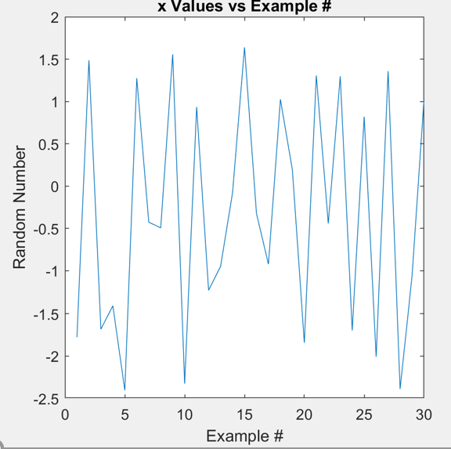


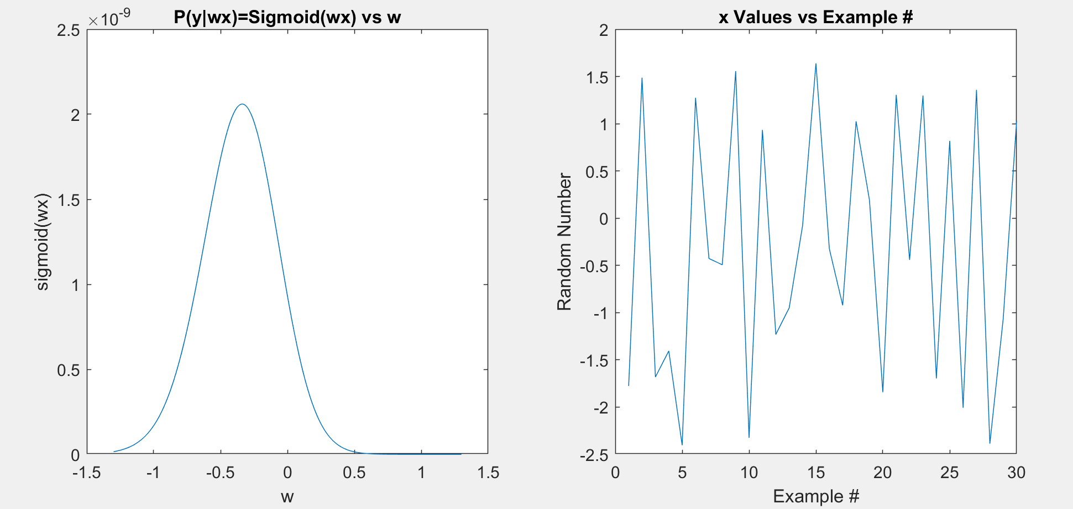
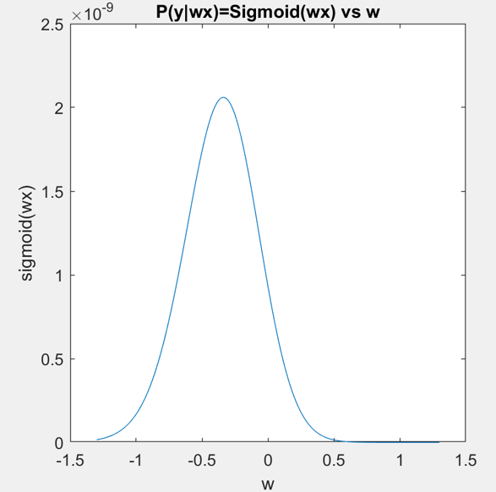
Probability of making basket when x~ 2 close basket P^{pred} =0.75
→ w=1 →ε=min-(P(y=1|x=2,w)-0.75)²
Probability of making basket when x~ 5 near basket P^{pred} =0.98
→ w=3
Cross Entropy: Bball
Binary variable
Random
Variable=distance to pole
Bucket: P(y=1|w,x)= σ(wx)^{y}
Missed:P(y=0|w,x)=(1- σ(wx))^{(1-y)}
I want P(y|w,x) to be my probability predictor
1
0.9
P(x)=σ(x)
Probability I make a basket ~ x distance from pole
0
-5 0 5
x
+5
0
-5
x
Wait, what is best w that makes best predictions P(y|x,w) that agree with observed data?
Data
Goal: Find w that maximizes ε
i
x_{i}
y_{i}
1-y_{i}
(1-σ(w1)) ^{1-y5}
#1
2
1
0
ε =+ P(1|2,w)^{y1} P(1|4,w)^{y2}P(1|9,w)^{y3} P(1|4,w)^{y4} P(0|1,w)^{y5}
#2
4
1
0
= +σ(2w)σ(4w)σ(9w) σ(4w) (1−σ(1w))
#3
9
1
0
#4
4
1
0
1
0
1
1
0.9
#5
ε(w)
0
w*
-5 0 5
P(y=1|w,x) =
1/(1+e^{-wx}) = σ(wx)
w

Slide 69
Cross Entropy: Objective function
ε= Π_{i} P(y^{(i)} |w,x^{(i)} )^{yi} (1-P(y^{(i)} |w,x^{(i)} )^{(1-yi)}
We seek a predictor, i.e. w, that makes a correct prediction all the time (if possible). The best we can predict to be right all the time, which maximizes this product. A product value
less than this maximum means we mispredicted at least one of the predictions. So, find w that maximizes ε

Slide 70
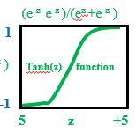
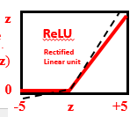
Classification Problem by Sigmoid Perceptron Learning Algorithm
dg(z)/dz = g(z)[1-g(z)]
Given: (x^{(i)} ,t^{(i)}) for i=1,2...N and t=1,0
s.t. sign(w•x^{(i)}) = t^{pred(i)}
g
Sigmoid
function
Find: w* that minimizes ε = 2 Σ_{ι} (t^{pred(i)} – t^{(i)})²
dg(z)/dz = [1-tanh(z)]²
Step 1: Gradient: ∂ε/∂w_{k} = ½ Σ_{ι} (t^{pred(i)} – t^{(i)}) ∂t^{pred(i)}/∂w_{k} (1)
∂w•x^{(i)}
∂g(z^{(i)}) ∂z^{(i)}
=
Step 2: Frechet: ∂t^{pred(i)}/∂w_{k} =
∂z^{(i)} ∂w_{k}
= g(z^{i})(1-g(z^{i} ))x_{k}
Step 3: Stochastic update:
w_{k} =: w_{k} - α (t^{pred(i)} – t^{(i)}) ∂t^{pred(i)}/∂w_{k}
If we chose g=1/(1+e^{-kz} ) where k>>0 then
gradient ~w_{k} + α x_{k} for a misprediction (show this)
= w_{k} - α (t^{pred(i)} – t^{(i)}) g(z^{i})(1-g(z^{i} ))x_{k}

Slide 71
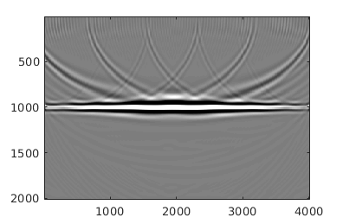

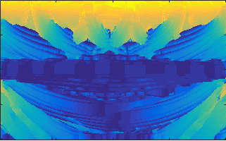
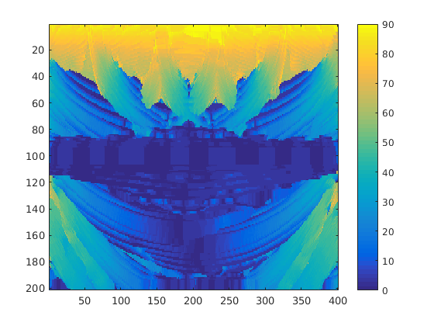
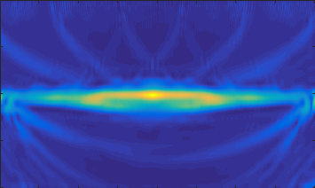
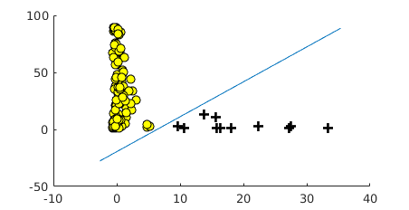
Numerical Result
Migration Image
Dipping Feature
Cleaned Migration Image
90
500
1000
1500
2000
0
Coherency Feature
Feature Map and Decision Boundary
35
500
1000
Dip
1500
2000
0
0 1000 2000 3000
X (m)
Coherency

