Slide 1
https://github.com/jakobbossek/smoof
Linear systems: y=ax →ε=(ax)²
Non-Linear: y=f(x) →ε=x+bx³+ ax⁴
a=1
ε(x)= x²
ε(x)=x+bx³+ ax⁴
ε(x)
ε(x)
∂ε/∂x = 2x
∂²ε/∂x² = 2
x
x
∂ε/∂x = function(x)
No Local Minima!
∂²ε/∂x² = function’(x)
Many Local Minima!

Slide 2
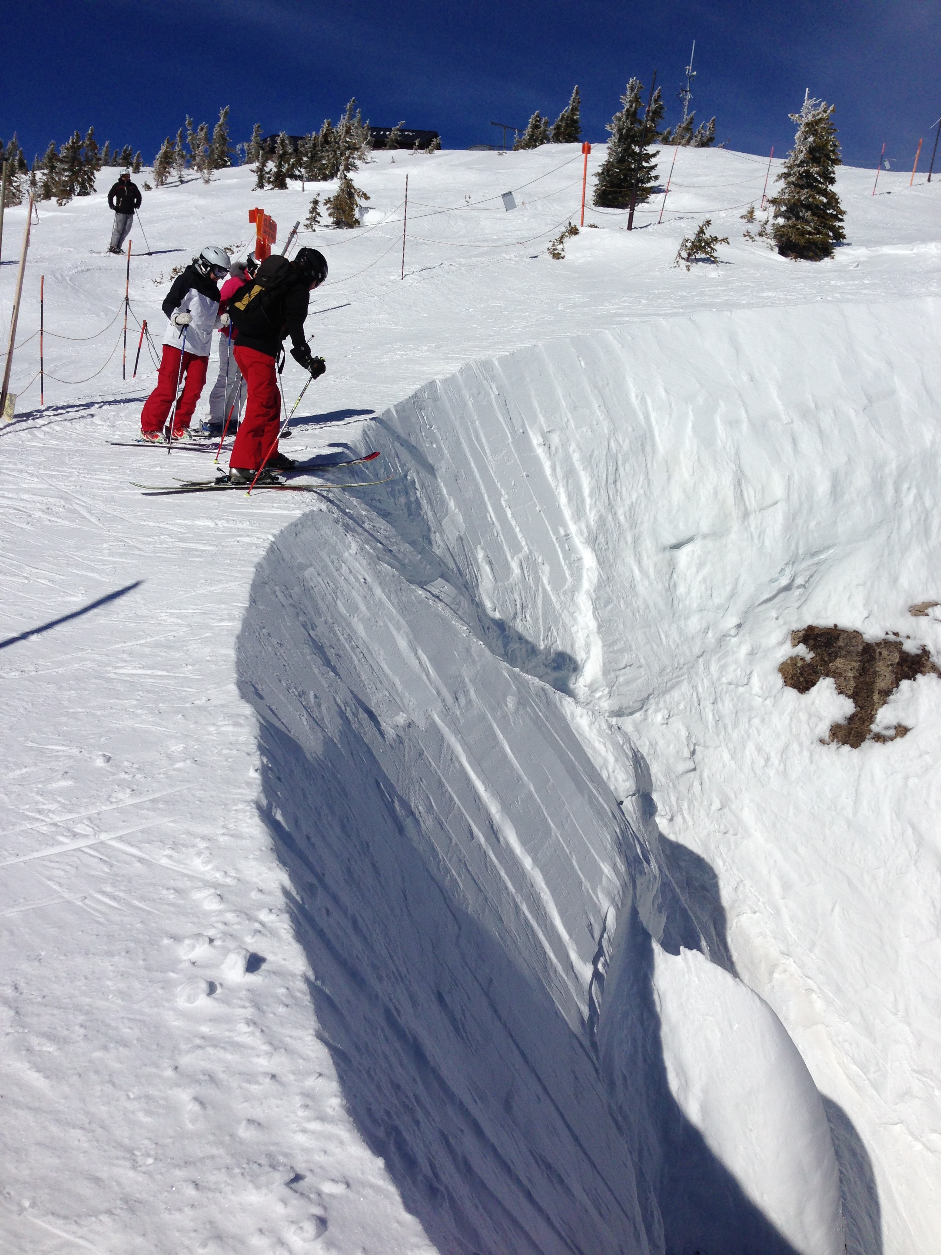
https://github.com/jakobbossek/smoof
^
∇h·r =
∂h/∂r
Projection of
gradient on r
∂²h =
∂h⁺⁺/∂r- ∂h⁺/∂r
Δr
∂r²
^
^
2nd deriv. along r = Curvature along r
∂h⁺/∂r=-2
∂h/∂r=-2.5
∂h⁺⁺/∂r=-21
∂h/∂r=-2.5
Cliff!!!

Slide 3
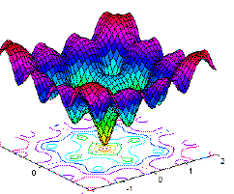
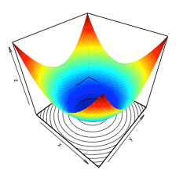
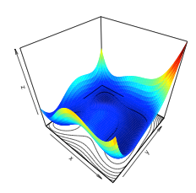
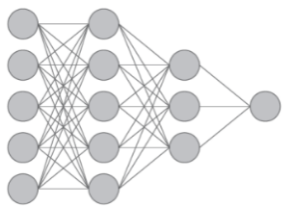
Least Squares Non-Linear Inversion
https://github.com/jakobbossek/smoof
obs - predicted
x
y
ε=Σ_{i} (y_{i}-w₁x_{i}-w₂ )²
x₁
y₁
ε=Σ_{i} (y_{i}-X(w) )²
x₂
y₂
x₃
y₃
x₄
y₄
y
ε
Local minima
ε
x
Modeling eqn: mx + b = y
Modeling eqn: X(w) = y
W₁
W₂

Slide 4
Outline
Non-Linear Problem & Partial Solution
Examples: Rosenbrock Function
Geometrical Meaning of Hessian
Multi-Scale and Pooling
½ Neural Network Diagram
Step Length
Summary

Slide 5
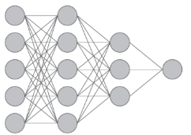

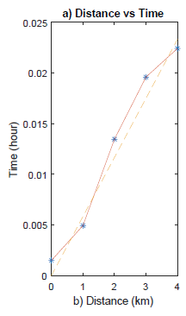
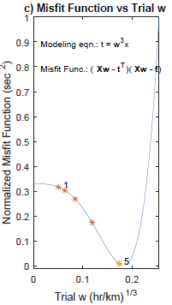
Non-Linear Problem and Partial Solution
Problem: X(w) = t
x₁w²
x₂w²
x₃w²
x₄w²
t₁
t₂
t₃
t₄
xw³ = t
w =
→ X(w)w = t → ε= ½ Σ_{i}(Xw-t)²
Time
Misfit
Local maxima
Bad start
x
w

Slide 6
Preconditioned Steepest Descent Methods
X^{(k)} updated
Problem: X(w) = t
w_{i}^{(k+1)} = w_{i} ^{(k)} – α 1/[X^{(k)T} X^{(k)}]_{ii}² (X^{(k)T}(t^{(k)}-t ))_{i}
~Solution: Precond. S.D.
Step 1. Given data t, provide starting model w⁽⁰⁾. Set k=0. Compute
t⁽⁰⁾ = X^{(k)}w⁽⁰⁾ and residue r = t⁽⁰⁾-t
ε=Σ_{i} (y_{i}-X(w) )²
Step 2. Compute updated solution w^{(k+1)}
w_{i}^{(k+1)} = w_{i} ^{(k)} – α 1/[X^{(k)T}X^{(k)}]_{ii}² (X^{(k)T} (t^{(k)}-t ))_{i}
ε
Step 3. Compute new prediction: t^{(k+1)}=X^{(k)} w^{(k+1)}
Step 4. Compute new residual: r=t^{(k+1)}-t. If r small enough, stop.
Otherwise, set k:=k+1 and repeat steps 2-4 until convergence
ε
Get stuck at local minima
W₁
W₂

Slide 7
Preconditioned Steepest Descent Methods
X^{(k)} updated
Problem: X(w) = t
w_{i}^{(k+1)} = w_{i} ^{(k)} – α 1/[X^{(k)T} X^{(k)}]_{ii}² (X^{(k)T}(t^{(k)}-t ))_{i}
~Solution: Precond. S.D.
Step 1. Given data t, provide starting model w⁽⁰⁾. Set k=0. Compute
t⁽⁰⁾ = X^{(k)}w⁽⁰⁾ and residue r = t⁽⁰⁾-t
Step 2. Compute updated solution w^{(k+1)}
w_{i}^{(k+1)} = w_{i} ^{(k)} – α 1/[X^{(k)T}X^{(k)}]_{ii}² (X^{(k)T} (t^{(k)}-t ))_{i}
X^{T}
X
=
X^{T}
X
1 2 3 4 5 6 7 8
1
2
3
4
5
6
7
8
a
b
c
d
e
f
g
h
α
β
χ
δ
ε
φ
γ
η
X^{T}
X
. . . . .
11
a b c d e f g h
. . . . .
. . . . .
=
X^{T}
X
O(N²)
α β χ δ ε φ γ η
22
.
.
.
.
.
.
.
.
.
. . . . .
. . . . .
X^{T}
X
33
.
.
.

Slide 8
Outline
Non-Linear Problem & Partial Solution
Examples: Rosenbrock Function
Geometrical Meaning of Hessian
Multi-Scale and Pooling
½ Neural Network Diagram
Step Length
Summary

Slide 9
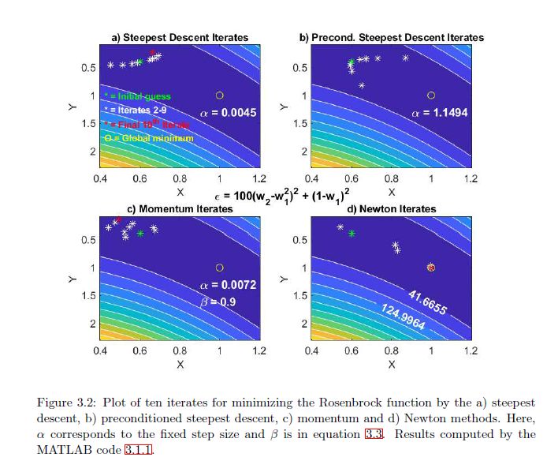
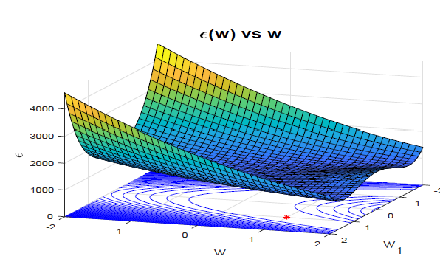
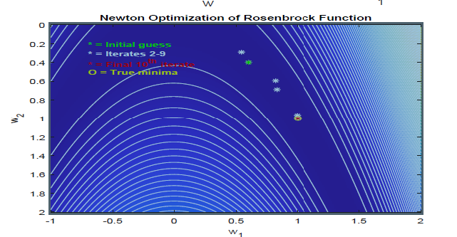
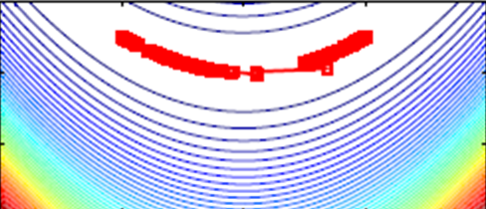
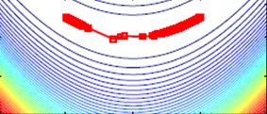
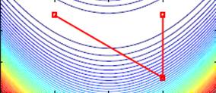
Rosenbrock Function
Ending N/S America
Sept 9
w_{i}^{(k+1)} = w_{i} ^{(k)} – α [X^{(k)T} X^{(k)}]⁻¹ (X^{(k)T}(t^{(k)}-t ))_{i}
ε(w) = 100(w₂ –w₁² )² + (1-w₁)²
Steepest Descent
Newton Optimization
Precond. Steepest Descent
Starting Point
W₂
W₂
W₂
Global Minimum
Global Minimum
W₁
W₁
W₁
Newton Method
W₂
W₁

Slide 10
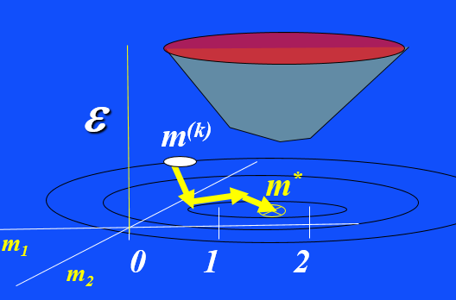
Rosenbrock Function
Sunday ended Sept 13
w_{i}^{(k+1)} = w_{i} ^{(k)} – α 1/[X^{(k)T} X^{(k)}]_{ii}² (X^{(k)T}(t^{(k)}-t ))_{i}
ε(w) = 100(w₂ –w₁² )² + (1-w₁)²
Question: Wait a minute, how did we find w*? Previously we started with Xw=t,
then formed system of equations and measurements, then we used S.D to find w
that minimizes ε=||Xw-t||².
Why not dε/dw=0→ Solve linear system to get w*?
Answer:
Step 1: Expand ε(w) in Taylor series about w₀
Assume O(Δw_{j}³) small
ε(w) = ε(w_{o} ) + Σ_{i} ∂ε/∂w_{i} Δw_{i} + ½ Σ_{i} Σ_{j} ∂²ε/ ∂w_{i}∂w_{j} Δw_{j} Δw_{i}
+…..
w=w₀+dw
Now we use 2nd-order derivatives
w₀
w*
w₂
w₁

Slide 11
Rosenbrock Function
ε(w) = 100(w₂ –w₁² )² + (1-w₁)²
Answer:
Step 1: Expand ε(w) in Taylor series about w₀
Assume O(Δx³) small
ε(w) = ε(w_{o} ) + Σ_{i} ∂ε/∂w_{i} Δw_{i} + ½ Σ_{i} Σ_{j} ∂²ε/∂w_{j}∂w_{i} Δw_{j} Δw_{i}

Slide 12
Rosenbrock Function
w₀
ε(w) = 100(w₂ –w₁² )² + (1-w₁)²
w*
w₂
w₁
Answer:
Step 1: Expand ε(w) in Taylor series about w₀
ε(w) = ε(w_{o} ) + Σ_{i} ∂ε/∂w_{i} Δw_{i} + ½ Σ_{i} Σ_{j} ∂²ε/∂w_{j}∂w_{i} Δw_{j} Δw_{i}
Step 2: Matrix-vector notation
Nx1 γ =gradient
NxN Η = Hessian
Δw^{T}
∂ε/∂w₁
∂²ε/∂w₁²
∂²ε/∂w₁∂w₂
. . .
∂²ε/∂w₁∂w_{N}
Δw₁ Δw₁ ….. Δw_{N}
∂ε/∂w₂
∂²ε/∂w₂∂w₁
. . .
∂²ε/∂w₂∂w_{N}
.
.
.
.
.
.
∂²ε/∂w₂²
.
.
.
Δw^{T}
Δw
. . . .
.
. .
∂ε/∂w_{N}
∂²ε/∂w_{N}∂w₁
∂²ε/∂w_{N}∂w₂
. . .
∂²ε/∂w_{N}²

Slide 13

∂ε(w)/∂w_{i} =
Δw^{T} γ + Δw^{T} H Δw
Rosenbrock Function
w₀
ε(w) = 100(w₂ –w₁² )² + (1-w₁)²
w*
w₂
w₁
Answer:
Step 1: Expand ε(w) in Taylor series about w₀
Δw^{T} γ + 1/2 Δw^{T} H Δw
ε(w) = ε(w_{o} ) + Σ_{i} ∂ε/∂w_{i} Δw_{i} + ½ Σ_{i} Σ_{j} ∂²ε/∂w_{j}∂w_{i} Δw_{j} Δw_{i}
ε(w) = ε(w₀ ) +
Step 2: Matrix-vector notation
Nx1 γ =gradient
NxN Η = Hessian
Δw^{T}
∂ε/∂w₁
∂²ε/∂w₁²
∂²ε/∂w₁∂w₂
. . .
∂²ε/∂w₁∂w_{N}
Δw₁ Δw₁ ….. Δw_{N}
∂ε/∂w₂
∂²ε/∂w₂∂w₁
. . .
∂²ε/∂w₂∂w_{N}
.
.
.
.
.
.
∂²ε/∂w₂²
.
.
.
Δw^{T}
Δw
. . . .
.
. .
∂ε/∂w_{N}
∂²ε/∂w_{N}∂w₁
∂²ε/∂w_{N}∂w₂
. . .
∂²ε/∂w_{N}²

Slide 14
Rosenbrock Function
w₀
ε(w) = 100(w₂ –w₁² )² + (1-w₁)²
w*
w₂
w₁
Answer:
Step 1: Expand ε(w) in Taylor series about w₀
ε(w*) = ε(w₀ ) +
ε(w) = ε(w_{o} ) + Σ_{i} ∂ε/∂w_{i} Δw_{i} + ½ Σ_{i} Σ_{j} ∂²ε/∂w_{j}∂w_{i} Δw_{j} Δw_{i}
Δw^{T} γ + 1/2 Δw^{T} H Δw
Step 2: Take derivative → 0 at w*
γ_{i} + ( H Δw )_{i} = 0 for all i
∂ε(w)/∂w_{i} =
H Δw = - γ (Normal Eqns)
[L^{T}L]⁻¹
L^{T}(d^{(k)}-d)
Δw = -H⁻¹ γ (Newton Formula)
w^{(k+1)} = w^{(k)} - α H_{k}⁻¹ γ_{k} (Iterative Newton Formula)

Slide 15
Rosenbrock Function
ε(w) = 100(w₂ –w₁² )² + (1-w₁)²
w^{(k+1)} = w^{(k)} - α H_{k}⁻¹ γ (Iterative Newton Formula)

Slide 16
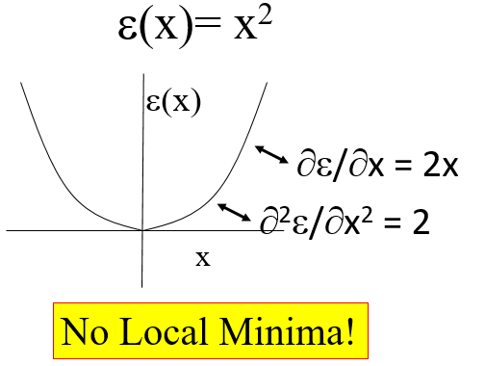
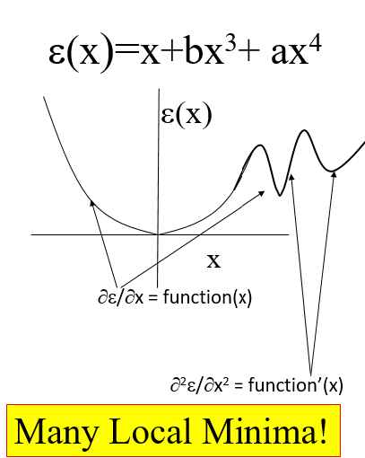
Rosenbrock Function
ε(w) = 100(w₂ –w₁² )² + (1-w₁)²
Step length (not needed if ε quadratic, converges in one iteration)
w^{(k+1)} = w^{(k)} - α H_{k}⁻¹ γ (Iterative Newton Formula)
∂ε/∂w₁
-400w₁(w₂-w₁²) -2(1-w₁)
γ =
=
∂ε/∂w₂
200w₁(w₂-w₁²)
If ε quadratic does
slope change? Does
Hessian change?
If ε is quartic, does slope change with
position? Does
Hessian change?
∂²ε/∂w₁²
∂²ε/ ∂w₁∂w₂
1200w₁²-400w₂+2
-400w₁
Curvature changes
Η =
=
∂²ε/ ∂w₁∂w₂
∂²ε/∂w₂²
400w₁
200
Note: In a linear system H=L^{T}L, which is not a function w

Slide 17
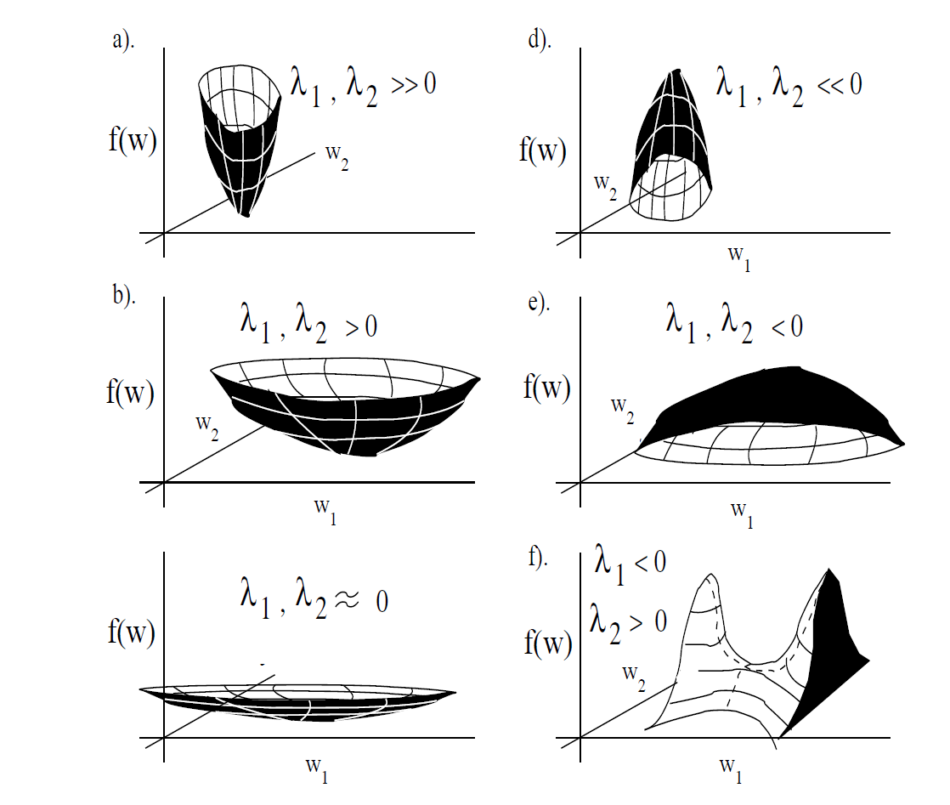
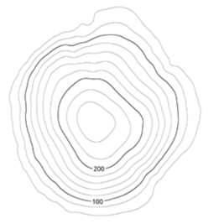

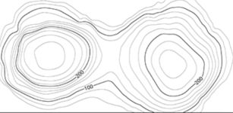

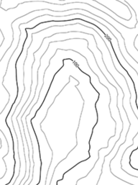

Rosenbrock Function
ε(w) = 100(w₂ –w₁² )² + (1-w₁)²
Step length (not needed if ε quadratic, converges in one iteration)
w^{(k+1)} = w^{(k)} - α H_{k}⁻¹ γ (Iterative Newton Formula)
∂ε/∂w₁
-400w₁(w₂-w₁²) -2(1-w₁)
λ₁,λ₂<0
γ =
=
∂ε/∂w₂
200w₁(w₂-w₁²)
If ε quadratic does
slope change? Does
Hessian change?
λ₁<0, λ₂>0
λ₁,λ₂>0
∂²ε/∂w₁²
∂²ε/ ∂w₁∂w₂
1200w₁²-400w₂+2
-400w₁
Η =
=
∂²ε/ ∂w₁∂w₂
∂²ε/∂w₂²
400w₁
200
Note: In a linear system H=L^{T}L, which is not a function w

Slide 18
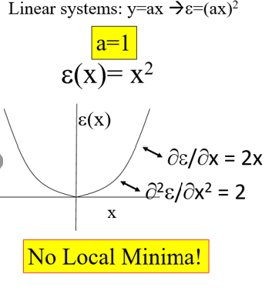
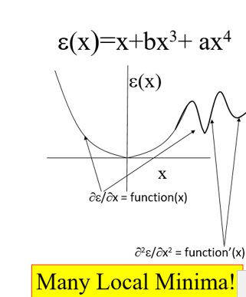
Rosenbrock Function
ε(w) = 100(w₂ –w₁² )² + (1-w₁)²
Step length (not needed if ε quadratic, converges in one iteration)
w^{(k+1)} = w^{(k)} - α H_{k}⁻¹ γ (Iterative Newton Formula)
Why didn’t we see same eq. with the Gauss-Newton : L^{T} LΔm=L^{T}Δd ?
∂ε/∂w₁
-400w₁(w₂-w₁²) -2(1-w₁)
γ =
=
ε= ½ w^{T}L^{T} Lw-w^{T}L^{T}w+ ½d^{T}d
∂ε/∂w₂
200w₁(w₂-w₁²)
= 0
dε/dw= L^{T}(Lw-d)+w^{T}{d(L^{T}L)/dw}w – ½ w^{T}{dL^{T}/dw}w
∂²ε/∂w₁²
∂²ε/ ∂w₁∂w₂
1200w₁²-400w₂+2
-400w₁
Η =
=
∂²ε/ ∂w₁∂w₂
∂²ε/∂w₂²
400w₁
200
Note: In a linear system H=L^{T}L, which is not a function w

Slide 19
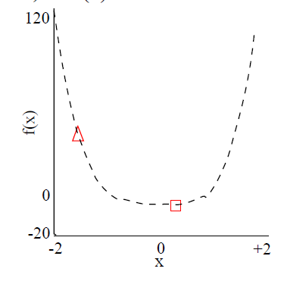
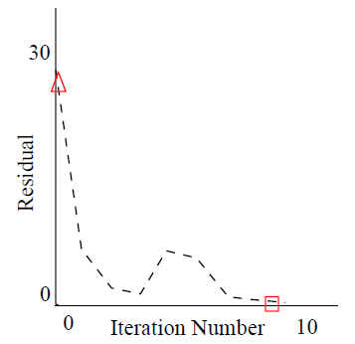
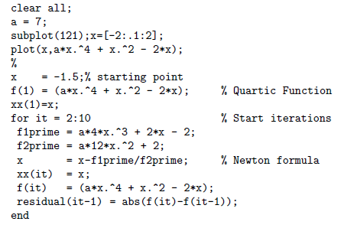
Simple 1D Example:
ε(x) = ax⁴ + x² – 2x
∂ε/∂x = 4ax³ + 2x -2 ;
∂²ε/∂x² = 12ax² + 2
x^{(k+1)} = x^{(k) -} ∂ε/∂x/ ∂²ε/∂x²
= x^{(k) –} (4ax³ + 2x -2 )/ (12ax² + 2)
Write Matlab code to solve ε=ax³
ε(x)

Slide 20
Outline
Non-Linear Problem & Partial Solution
Examples: Rosenbrock Function
Geometrical Meaning of Hessian
Multi-Scale and Pooling
½ Neural Network Diagram
Step Length
Summary

Slide 21
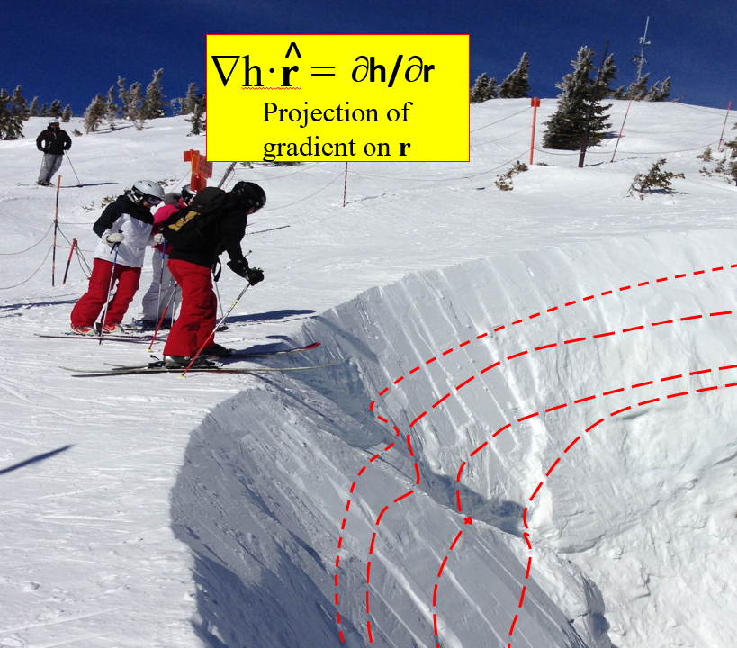
What is Geometrical Meaning of s^{T}Ηs?
w₀
Answer: s^{T}Hs is Curvature along s
s=Unit vector
αs
ε(w) = 100(w₂ –w₁² )² + (1-w₁)²
Component of gradient
along s
w=w₀+αs
w=w₀+αs
◊ε(w₀+αs)-ε(w₀)
Taylor series
→ ∂ε(w)/∂α = ∇ε◦s =∇^{T}ε s
= s^{T} ∇ ε
Change in ε along s
s₁
s₂
∂ε/∂w₁
∂ε/∂w₂
∂²ε(w)/∂α² = ∂ (∂ε(w)/∂ α) /∂α
= ∂ (s^{T} ∇ε ) /∂α
= s^{T} ∇ ∂ ε/∂α
Curvature = Change in ∂ε /∂α along s
= s^{T} ∇∇ ^{T} ε s
∂²ε/∂w₁²
∂²ε/∂w₁∂w₂
∂/∂w₁
∂ε/∂w₁
∂ε/∂w₂
Η =
=
∂/∂w₂
∂²ε/ ∂w₁∂w₂
∂²ε/∂w₂²

Slide 22
Outline
Non-Linear Problem & Partial Solution
Examples: Rosenbrock Function
Geometrical Meaning of Hessian
Multi-Scale and Pooling
½ Neural Network Diagram
Step Length
Summary

Slide 23
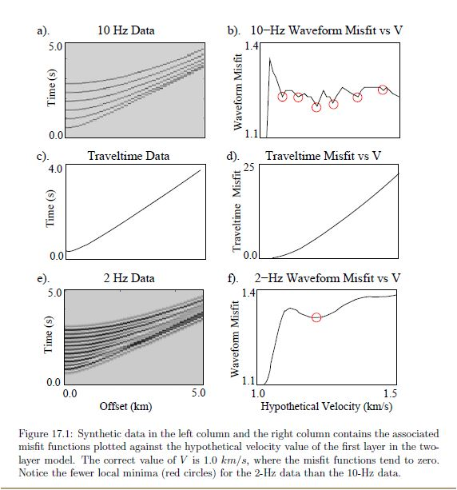


Local Minima
Cycle Skipping
ε = ½ Σ_{i} (d_{i}^{pred} – d_{i}^{obs})²
d^{obs}
d^{pred}
misfit
X
V
skeletalize data
-
=
Low-pass data

Slide 24
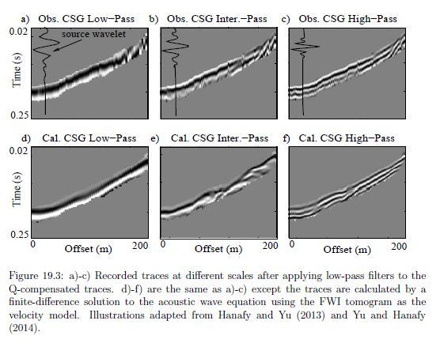
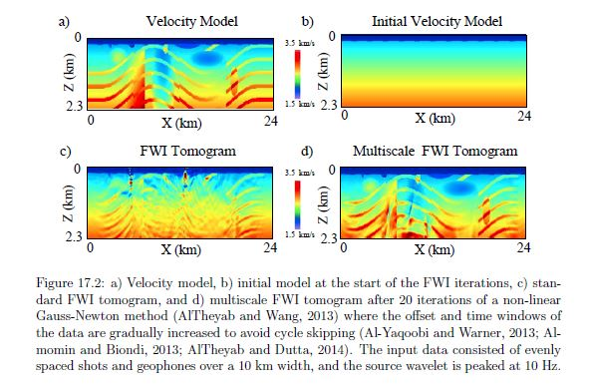
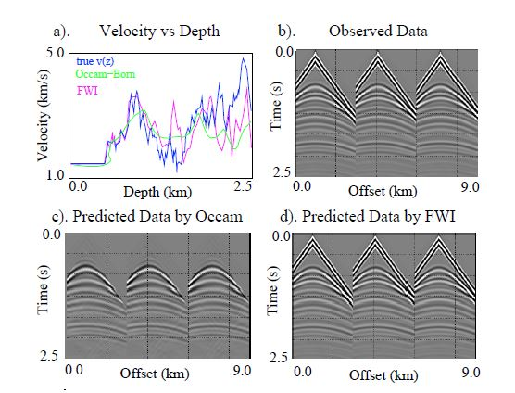
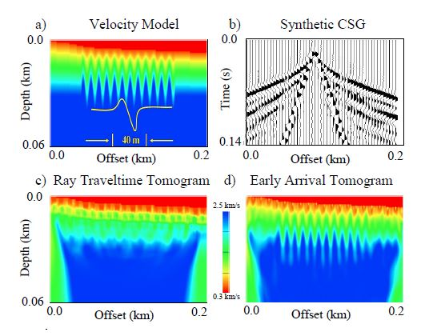
Soln: Multiscale X & T.
obs
pred
misfit
pred
-
=

Slide 25
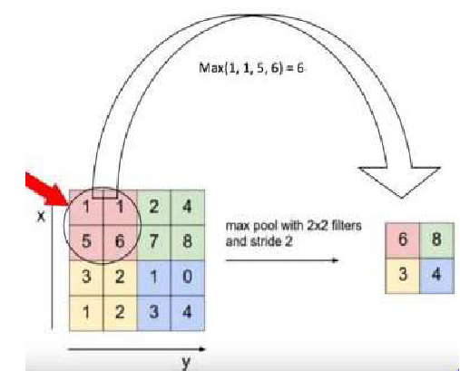

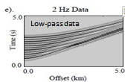
Max Pooling = Multiscaling?
pred
misfit
pred
-
1 km
1 km

Slide 26
Outline
Non-Linear Problem & Partial Solution
Examples: Rosenbrock Function
Geometrical Meaning of Hessian
Multi-Scale and Pooling
½ Neural Network Diagram
Step Length
Summary

Slide 27


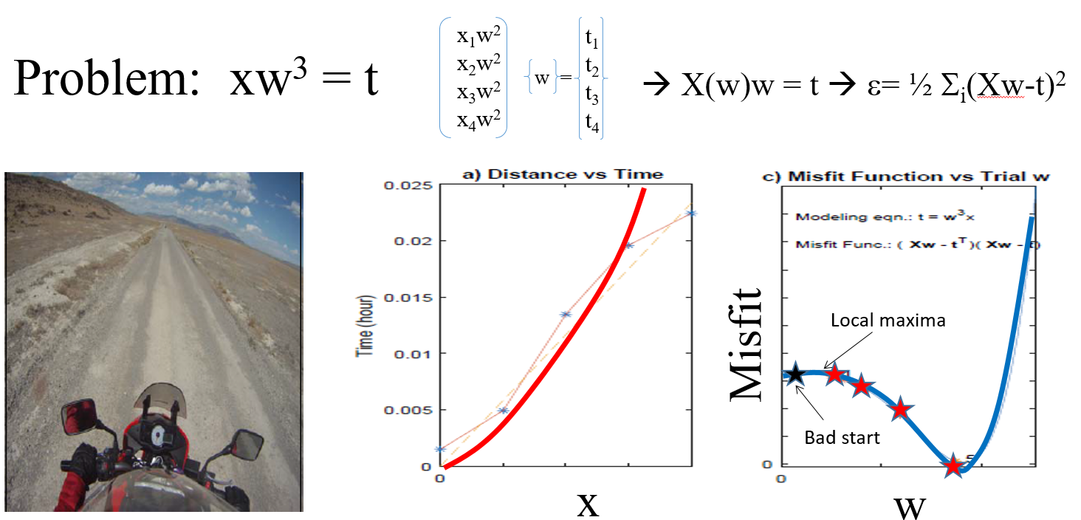
Neural Network Schematic Diagram
Wx = t
σ(t)
2x3 3x1 2x1
t(x,w)
w₁₁ w₁₂ w₁₃
x₁
x₂
x₃
t₁
t₂
y₁
σ( ) =σ( ) = ( )
=
w₂₁ w₂₂ w₂₃
y₂
Non-linear relationship between input, w
and output y
This is ½ the neural
network story
This is the complete neural
network story
x₁
w₁₁
w₁₂
t₁
y₁
x₂
w₂₁
w₃₃
w₂₂
w₁₃
t₂
y₂
x₃

Slide 28
Outline
Ended Monday night Sept 14 class
Ended Tuesday morning Sept 15 class
Non-Linear Problem & Partial Solution
Examples: Rosenbrock Function
Geometrical Meaning of Hessian
Multi-Scale and Pooling
½ Neural Network Diagram
Step Length
Summary

Slide 29

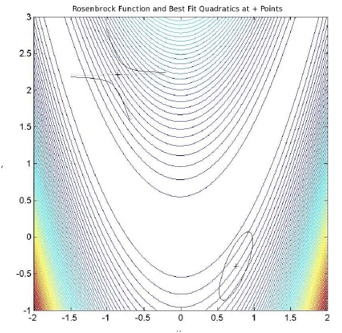
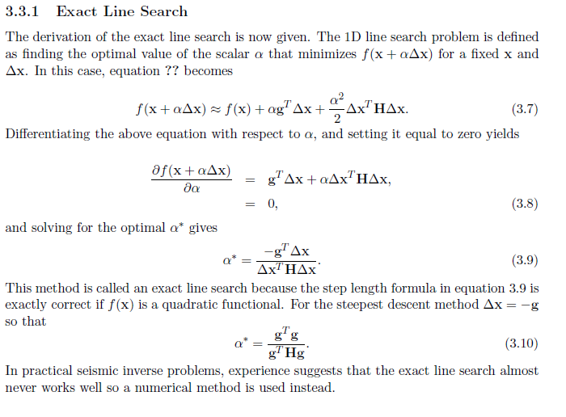
Exact Line Search α
df/dα|_{α=α∗} =0
^
^
^
^
^
f(α)
α∗
α
^
x
Δx
Q: How far should we move?
A: Step length α

Slide 30
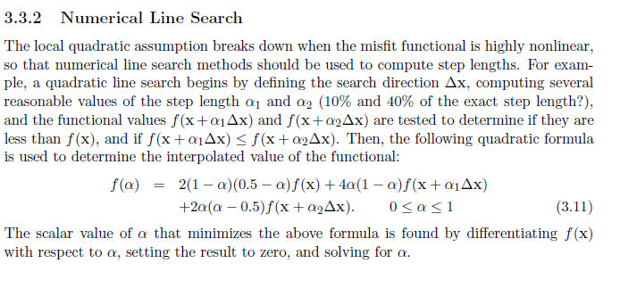
Numerical Line Search α
f(x+α₂Δx)
f(x)
x+α₂Δx
f(α)
f(x+α₁Δx)
α∗
α
x+α₁Δx
x
^
x
Δx
1. Find -gradient direction Δx
2. Evaluate f(α) at 3 points
3. Find α that minimizes f(α)

Slide 31
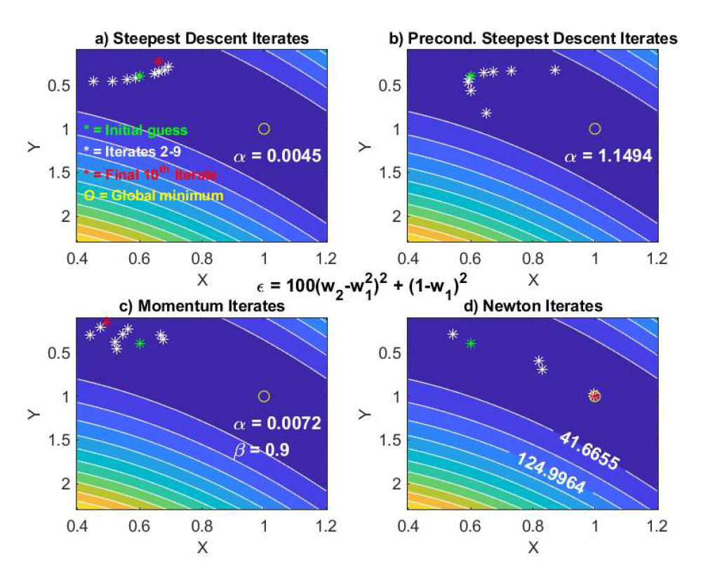
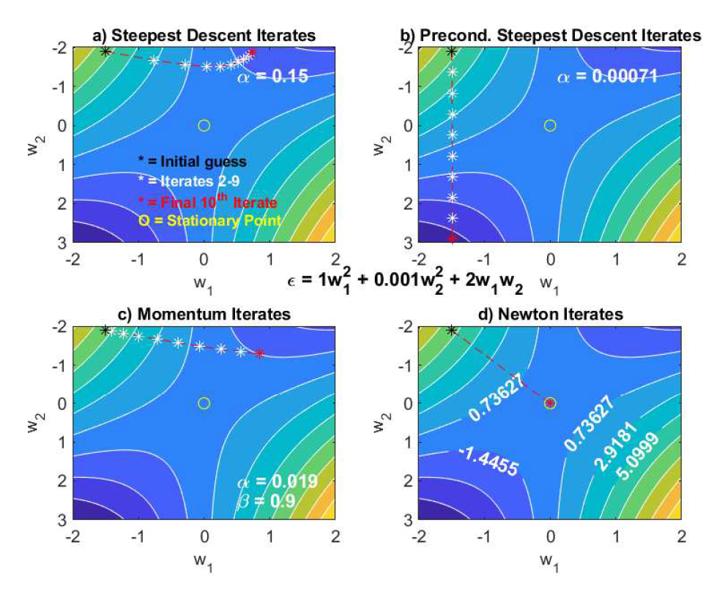
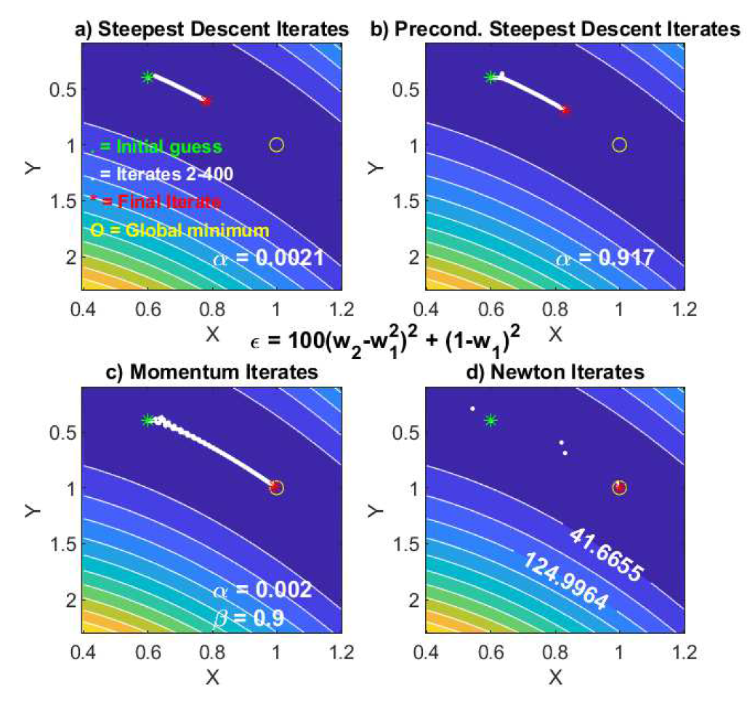
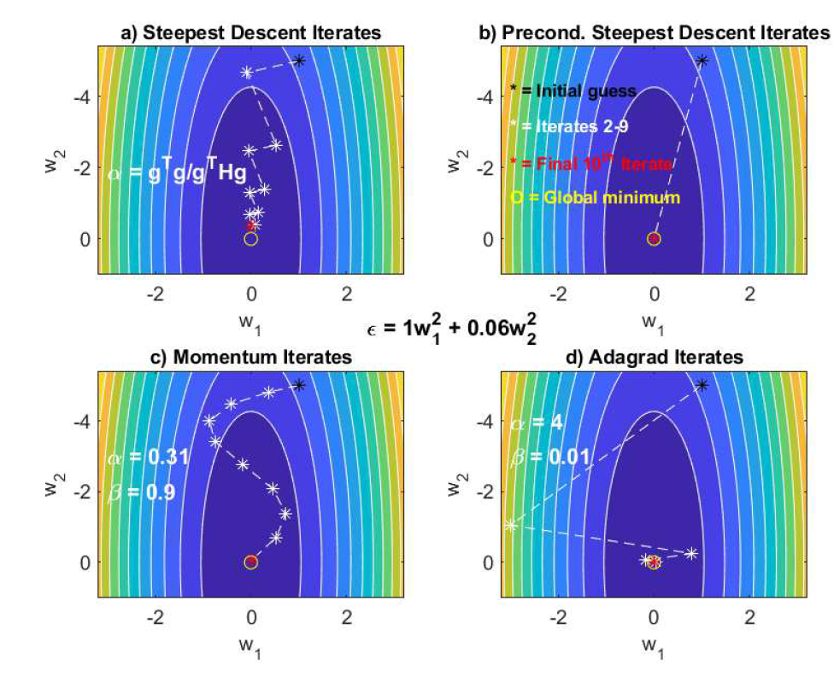
Momentum 1st-order Gradient Descent
http://cs231n.github.io/neural-networks-3/#ada
w₂
cancellation
+ αv^{(k)}
w^{(k+1)}=w^{(k)} + ( βv^{(k+1)} )
w₁
v^{(k)}
v^{(k)}
add
cancel
v^{(k+1)}
v^{(k+1)}
add

Slide 32
Adam Optimizer
Shi
2020/09/20

Slide 33
Adam
adaptive moment estimation method(Adam)
Magnitudes of updates are invariant to the scale of the gradient
Real step sizes are approximately bounded by alpha
naturally performs a form of step size annealing.

Slide 34
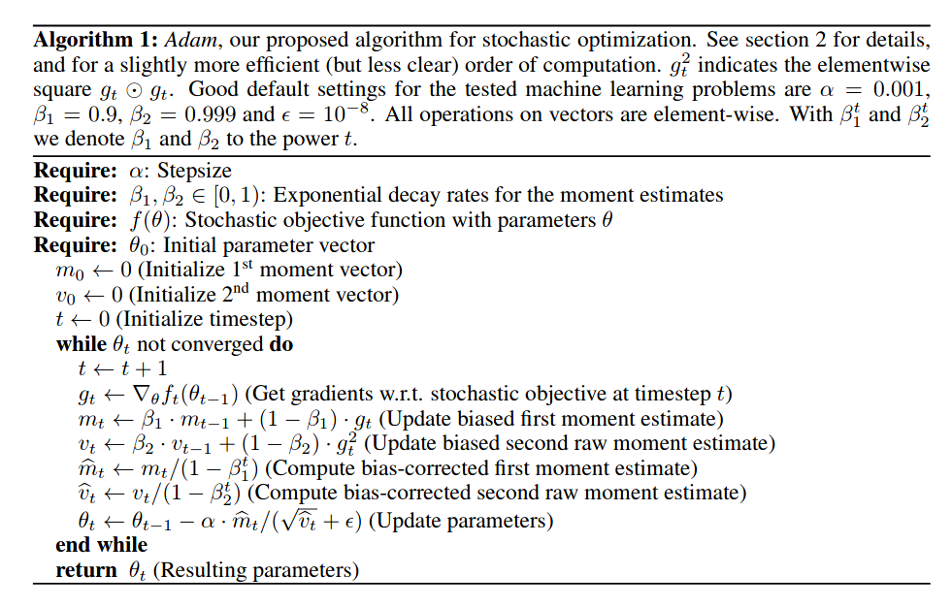




Algrithm Details
Initialization
gradient
moments
Update direction

Slide 35
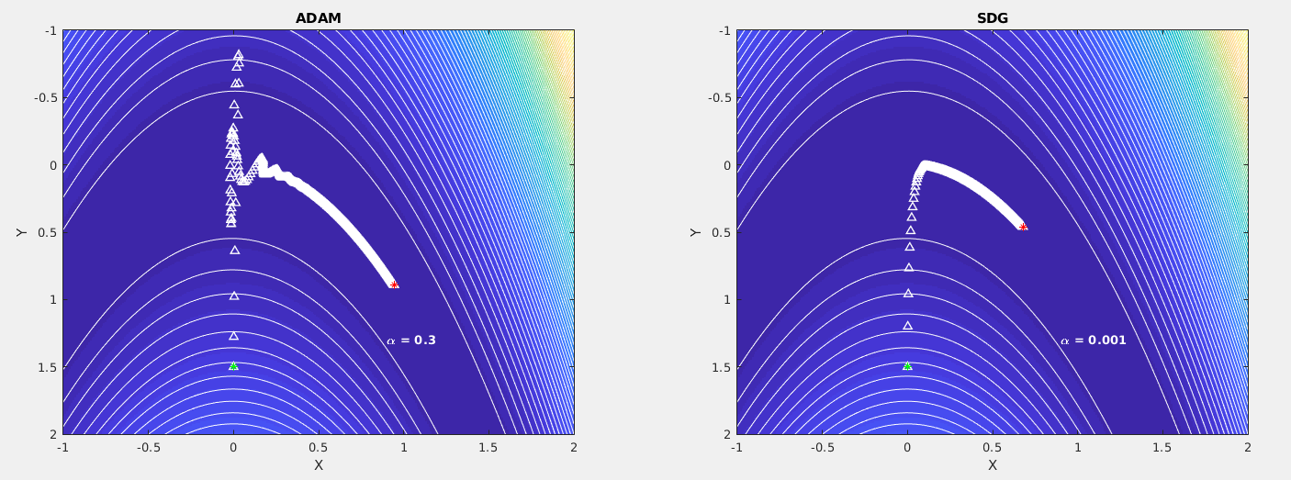



Adam for Rosenbrock function
1000 iteration
Adam method
Steepest decent

Slide 36
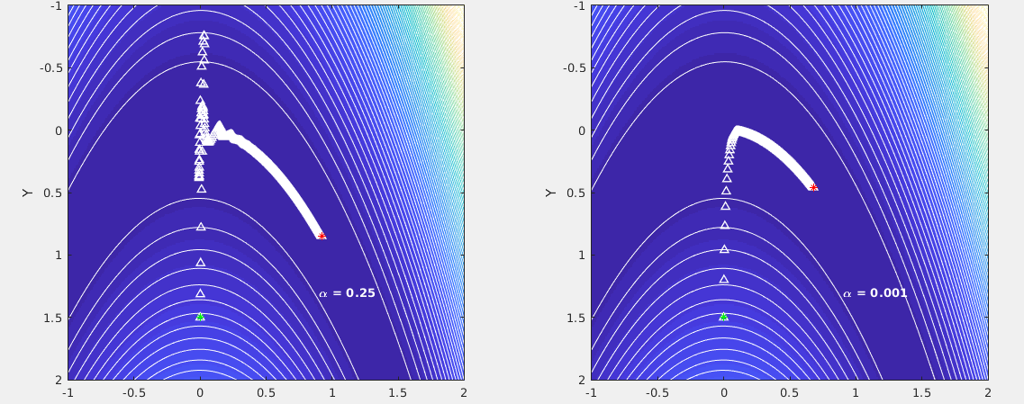
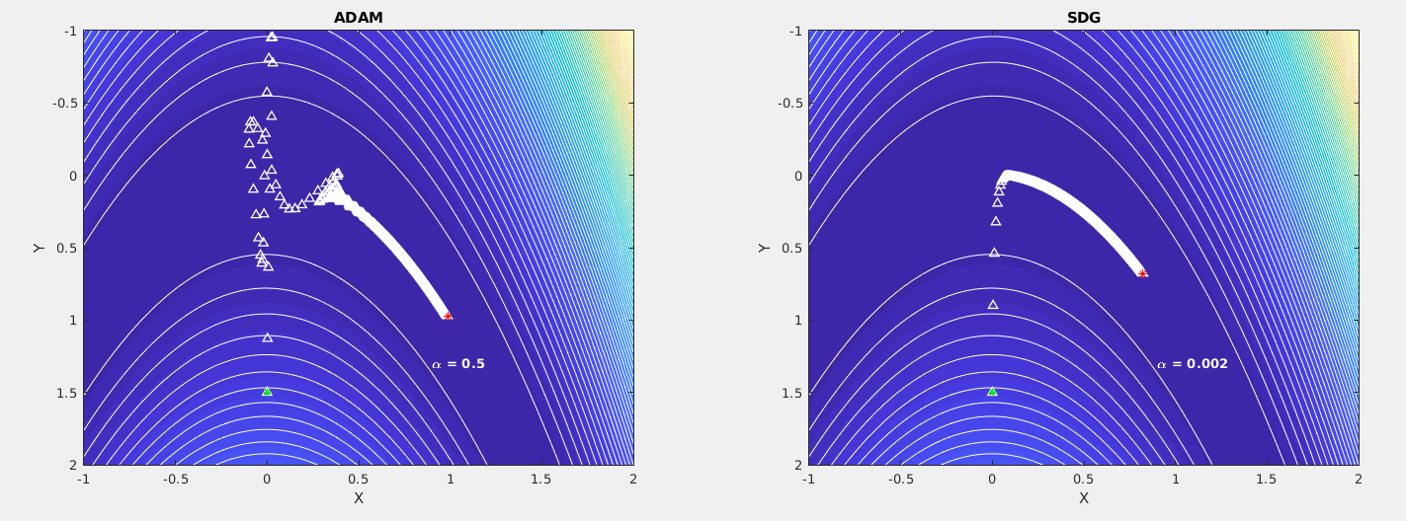
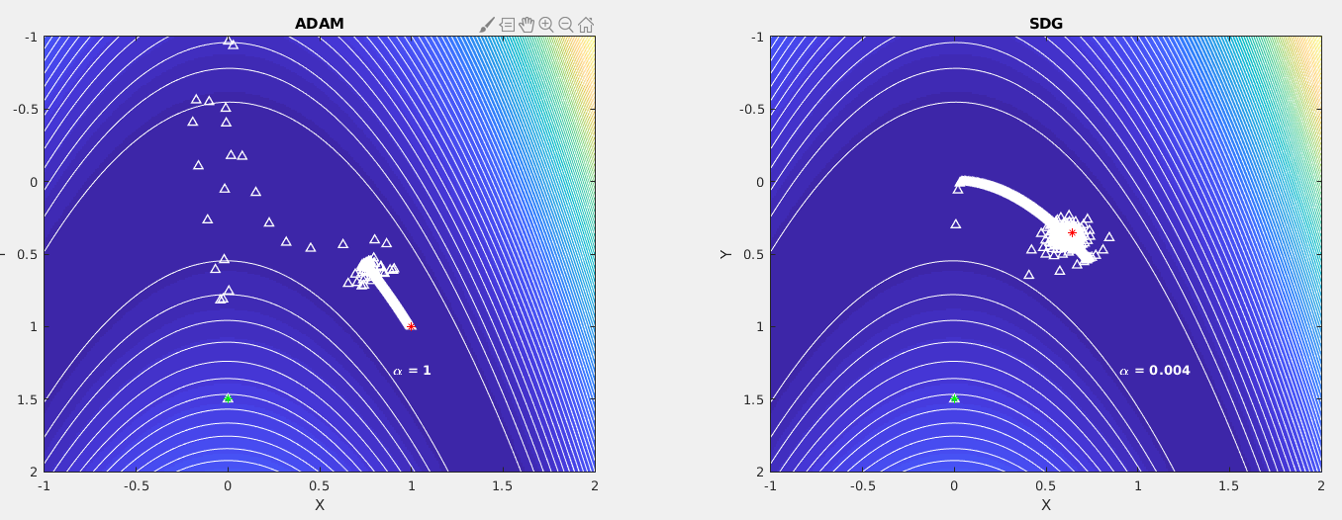







Try different step lengths
same start point
Same iteration number
Adam:
  Alpha=0.25, 0.5, 1
SDG:
  Alpha =1e-3. 2e-3, 4e-3
Adam: converge fast, not sensitive to step length
SDG: slow, sensitive to step length

Slide 37
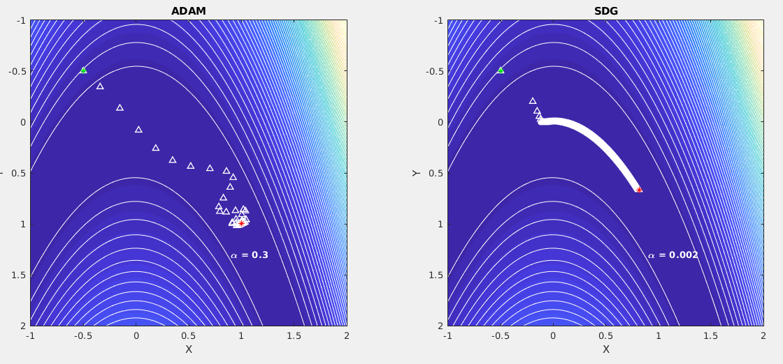
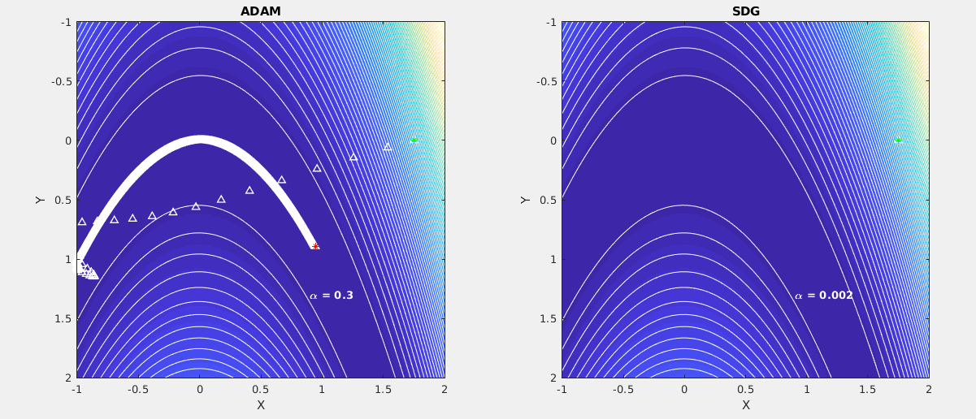
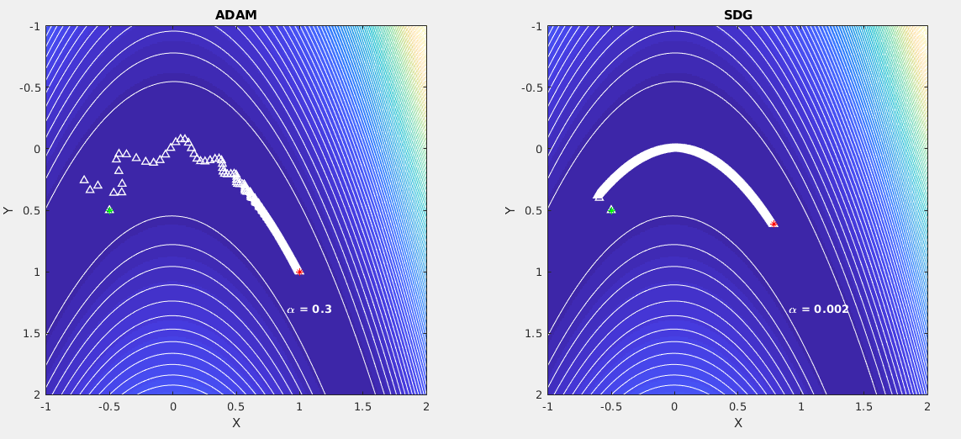





Try different start points
same start points
Same iteration number
Invariant step length
Adam:
  Alpha=0.3
SDG:
  Alpha=2e-3
Adam: For different start points, no need change alpha
SDG: diff alpha for different start points, sometime instable

Slide 38


Comparison Step Lengths
Shi will describe Adam next time 10 minutes before class
https://twitter.com/alecrad
http://cs231n.github.io/neural-networks-3/#ada

Slide 39
Comparison Step Lengths
http://cs231n.github.io/neural-networks-3/#ada
RMSprop. RMSprop is a very effective, but currently unpublished adaptive learning rate method. Amusingly, everyone who uses this method in their work currently cites slide 29 of Lecture 6 of Geoff Hinton’s Coursera class. The RMSProp update adjusts the Adagrad method in a very simple way in an attempt to reduce its aggressive, monotonically decreasing learning rate. In particular, it uses a moving average of squared gradients instead, giving:
cache = decay_rate * cache + (1 - decay_rate) * dx**2 x += - learning_rate * dx / (np.sqrt(cache) + eps)
Here, decay_rate is a hyperparameter and typical values are [0.9, 0.99, 0.999]. Notice that the x+= update is identical to Adagrad, but the cache variable is a “leaky”. Hence, RMSProp still modulates the learning rate of each weight based on the magnitudes of its gradients, which has a beneficial equalizing effect, but unlike Adagrad the updates do not get monotonically smaller.
Adam. Adam is a recently proposed update that looks a bit like RMSProp with momentum. The (simplified) update looks as follows:
m = beta1*m + (1-beta1)*dx v = beta2*v + (1-beta2)*(dx**2) x += - learning_rate * m / (np.sqrt(v) + eps)
Notice that the update looks exactly as RMSProp update, except the “smooth” version of the gradient m is used instead of the raw (and perhaps noisy) gradient vector dx. Recommended values in the paper are eps = 1e-8, beta1 = 0.9, beta2 = 0.999. In practice Adam is currently recommended as the default algorithm to use, and often works slightly better than RMSProp. However, it is often also worth trying SGD+Nesterov Momentum as an alternative. The full Adam update also includes a bias correction mechanism, which compensates for the fact that in the first few time steps the vectors m,v are both initialized and therefore biased at zero, before they fully “warm up”. With the bias correction mechanism, the update looks as follows:
# t is your iteration counter going from 1 to infinity m = beta1*m + (1-beta1)*dx mt = m / (1-beta1**t) v = beta2*v + (1-beta2)*(dx**2) vt = v / (1-beta2**t) x += - learning_rate * mt / (np.sqrt(vt) + eps)
Note that the update is now a function of the iteration as well as the other parameters. We refer the reader to the paper for the details, or the course slides where this is expanded on.
Adagrad is an adaptive learning rate method originally proposed by Duchi et al..
# Assume the gradient dx and parameter vector x cache += dx**2 x += - learning_rate * dx / (np.sqrt(cache) + eps)
Notice that the variable cache has size equal to the size of the gradient, and keeps track of per-parameter sum of squared gradients. This is then used to normalize the parameter update step, element-wise. Notice that the weights that receive high gradients will have their effective learning rate reduced, while weights that receive small or infrequent updates will have their effective learning rate increased. Amusingly, the square root operation turns out to be very important and without it the algorithm performs much worse. The smoothing term eps (usually set somewhere in range from 1e-4 to 1e-8) avoids division by zero. A downside of Adagrad is that in case of Deep Learning, the monotonic learning rate usually proves too aggressive and stops learning too early.

Slide 40
Comparison Step Lengths
http://cs231n.github.io/neural-networks-3/#ada
Step decay: Reduce the learning rate by some factor every few epochs. Typical values might be reducing the learning rate by a half every 5 epochs, or by 0.1 every 20 epochs. These numbers depend heavily on the type of problem and the model. One heuristic you may see in practice is to watch the validation error while training with a fixed learning rate, and reduce the learning rate by a constant (e.g. 0.5) whenever the validation error stops improving.
Exponential decay. has the mathematical form α=α0e−ktα=α0e−kt, where α0,kα0,k are hyperparameters and tt is the iteration number (but you can also use units of epochs).
1/t decay has the mathematical form α=α0/(1+kt)α=α0/(1+kt) where a0,ka0,k are hyperparameters and tt is the iteration number.
Momentum update is another approach that almost always enjoys better converge rates on deep networks. This update can be motivated from a physical perspective of the optimization problem. In particular, the loss can be interpreted as the height of a hilly terrain (and therefore also to the potential energy since U=mghU=mgh and therefore U∝hU∝h ). Initializing the parameters with random numbers is equivalent to setting a particle with zero initial velocity at some location. The optimization process can then be seen as equivalent to the process of simulating the parameter vector (i.e. a particle) as rolling on the landscape.
Nesterov Momentum is a slightly different version of the momentum update that has recently been gaining popularity. It enjoys stronger theoretical converge guarantees for convex functions and in practice it also consistenly works slightly better than standard momentum.
The core idea behind Nesterov momentum is that when the current parameter vector is at some position x, then looking at the momentum update above, we know that the momentum term alone (i.e. ignoring the second term with the gradient) is about to nudge the parameter vector by mu * v. Therefore, if we are about to compute the gradient, we can treat the future approximate position x + mu * v as a “lookahead” - this is a point in the vicinity of where we are soon going to end up. Hence, it makes sense to compute the gradient at x + mu * v instead of at the “old/stale” position x.
In practice, we find that the step decay is slightly preferable because the hyperparameters it involves (the fraction of decay and the step timings in units of epochs) are more interpretable than the hyperparameter kk. Lastly, if you can afford the computational budget, err on the side of slower decay and train for a longer time.

Slide 41
PYTHON Tutorial
http://cs231n.github.io/python-numpy-tutorial/

Slide 42

Summary
Non-Linear Problem & Partial Solution
w_{i}^{(k+1)} = w_{i} ^{(k)} – α 1/[X^{(k)T} X^{(k)}]_{ii}² (X^{(k)T}(t^{(k)}-t ))_{i}
Geometrical Meaning of Hessian
∂²ε(w)/∂α² =
s^{T} ∇ ∇^{T} ε s
Answer: s^{T}Hs is Curvature along s
Multi-Scale and Pooling

Slide 43



Summary
Neural Network Diagram
This is ½ the neural
network story
x₁
w₁₁
w₁₂
t₁
x₂
w₂₁
w₃₃
w₂₂
w₁₃
t₂
x₃
Step Length
g^{T}g
α=
g^{T}Hg

Slide 44

Summary
w^{(k+1)} = w^{(k)} - α H_{k}⁻¹ γ (Iterative Newton Formula)
ε = ½ w^{T} X^{T}X w - t^{T}Xw + ½t^{T}t
= ½ w^{T} X^{T}X w – t^{T} (Xw-t) - ½ t^{T}t
Hessian
Gradient
GaussNewton Optimization: w^{(k+1)} = w^{(k)} - α [X^{T}X]⁻¹ X^{T}(t^{(k)}-t )
k
k
k
Gradient Descent: w^{(k+1)} = w^{(k)} - α X^{T}(t^{(k)}-t )
k
Gradient: X^{T}(Xw^{(k)} – t)

Slide 45




Summary
w^{(k+1)} = w^{(k)} - α H_{k}⁻¹ γ (Iterative Newton Formula)
α = exact step length
α = Numerical Line Search
Momentum 1st-order Gradient Method
+ αv^{(k)}
w^{(k+1)}=w^{(k)} + ( βv^{(k+1)} )

