Slide 1
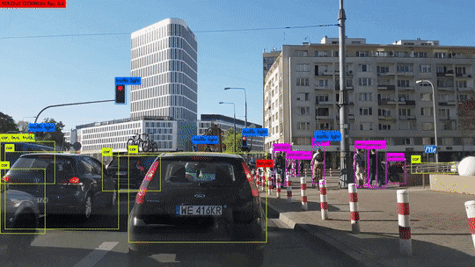
You Only Look Once (YOLO)
Shihang Feng + GTS

Slide 2
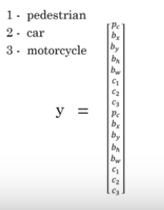

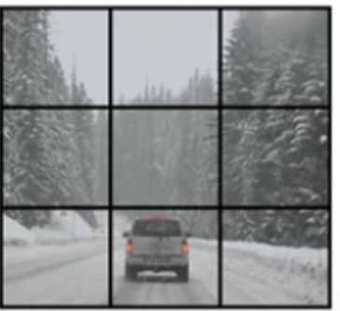
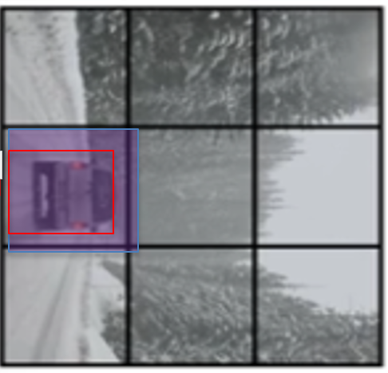
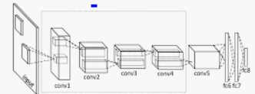
You Only Look Once (YOLO)
Target y
No car
car
3x3 cells (ROIs)
Assign 2 anchor boxes/cell
3x3x16
For one picture y is 3x3x2x8 flattened vector
16
9 cells
(4 coord.+4 classes)/BB
2 anchor boxes
3
3

Slide 3
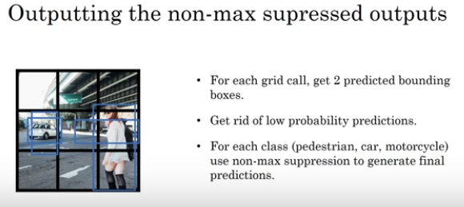
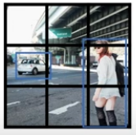
You Only Look Once (YOLO)
YOLO Predicting

Slide 4
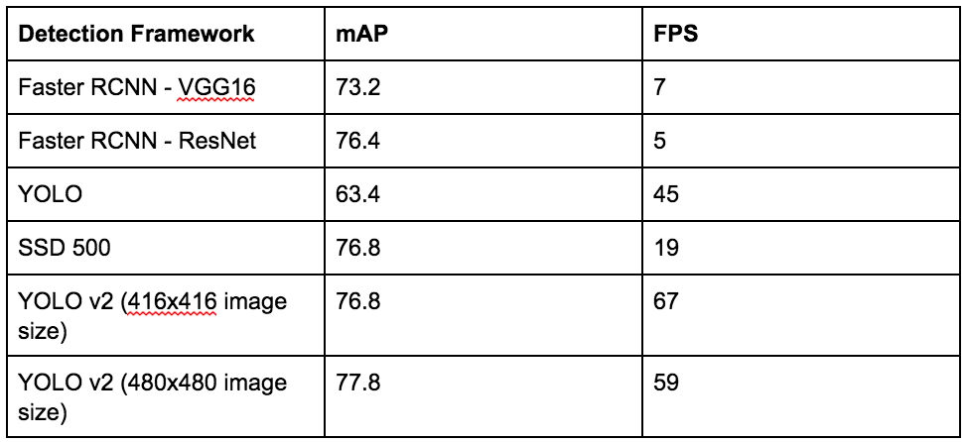
Comparison
Mean Average Precision
Frame per second

Slide 5
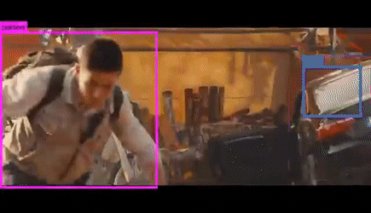
Conclusions
YOLO=Real-time Detection
https://www.youtube.com/watch?v=9s_FpMpdYW8
Advantage: Fast
Disadvantage: Small Object
Multi objects in same cell

Slide 6
You Only Look Once (YOLO)
Andrew Ng

Slide 7
Outline
Motivation
Key Idea of Yolo
Ugly Details: Anchor Boxes+Target Vector
Intersection-of-Union (IOU)
Loss Function

Slide 8
Comparison
Mean Average Precision
Frame per second

Slide 9
Outline
Motivation
Key Idea of Yolo
Ugly Details: Anchor Boxes+Target Vector
Intersection-of-Union (IOU)
Loss Function

Slide 10
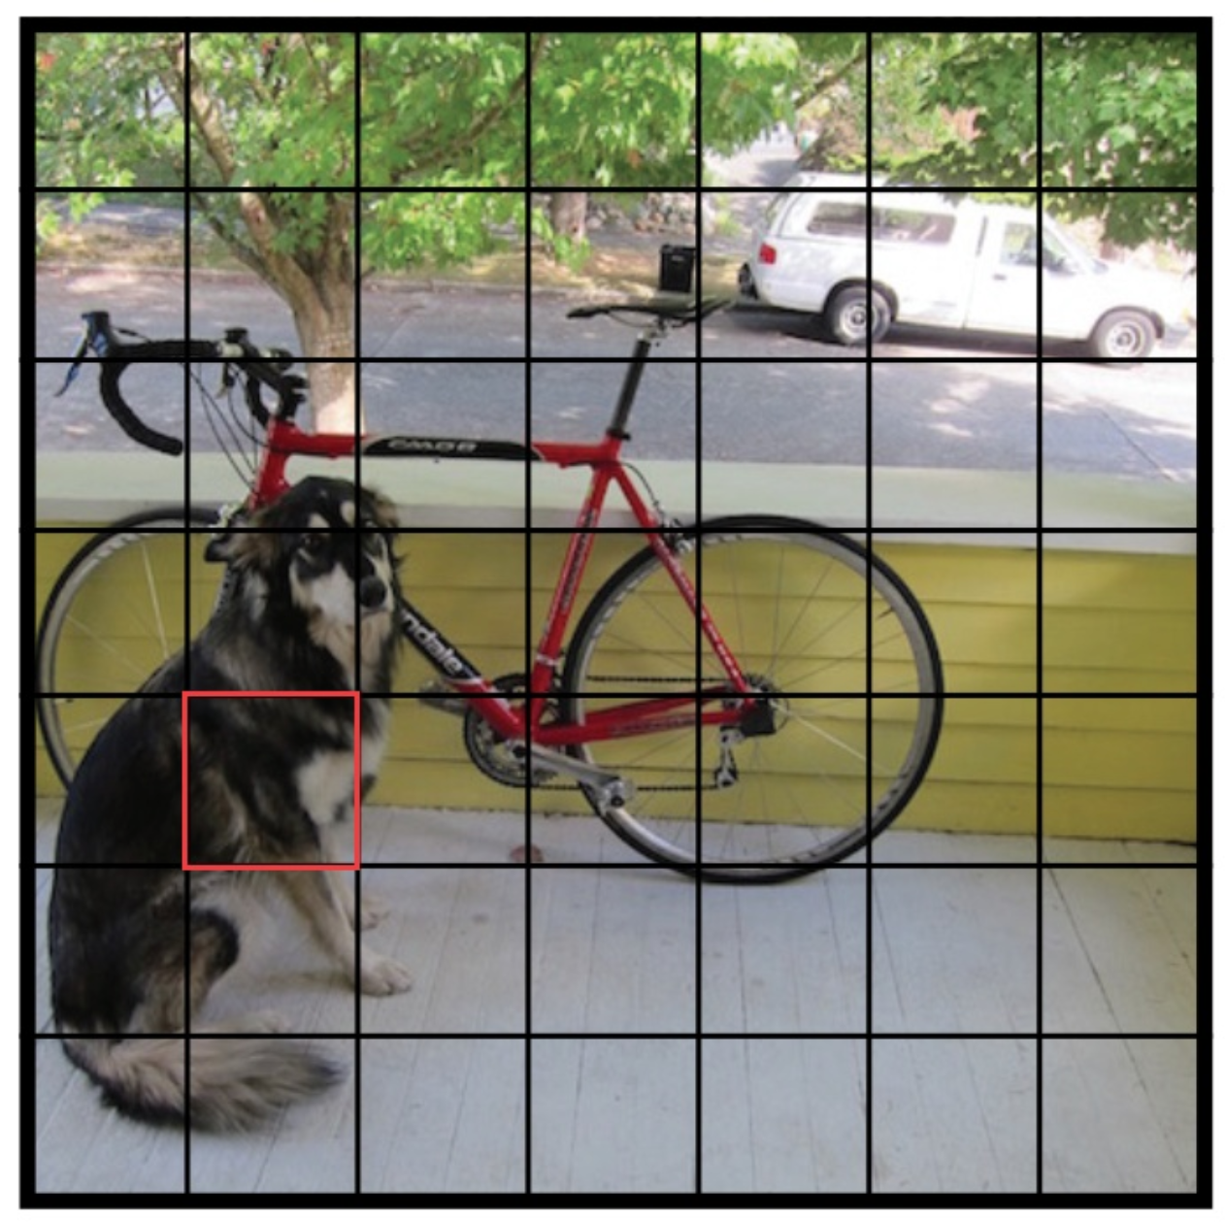
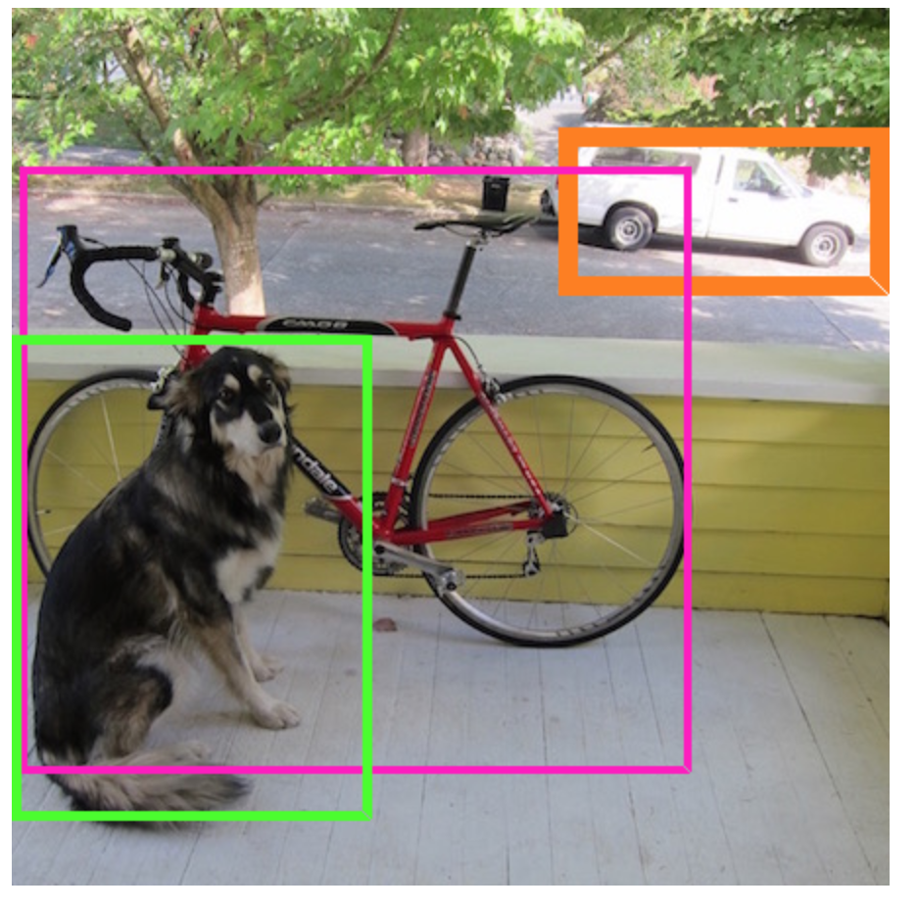
You Only Look Once (YOLO)
Yolo: Propose possible boxes + Classification +Localization
Starting Proposed
ROIs
We no longer need to use “selective”
search for proposed ROIs!
S*S cells
Dog Center
(ground
truth)
Hopefully all excess proposed ROIs
Merge to become groundtruth BBs
Ground truth BBs

Slide 11
Outline
Motivation
Key Idea of Yolo
Ugly Details: Anchor Boxes+Target Vector
Intersection-of-Union (IOU)
Loss Function

Slide 12

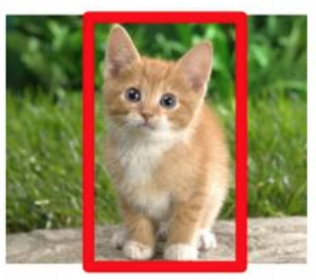
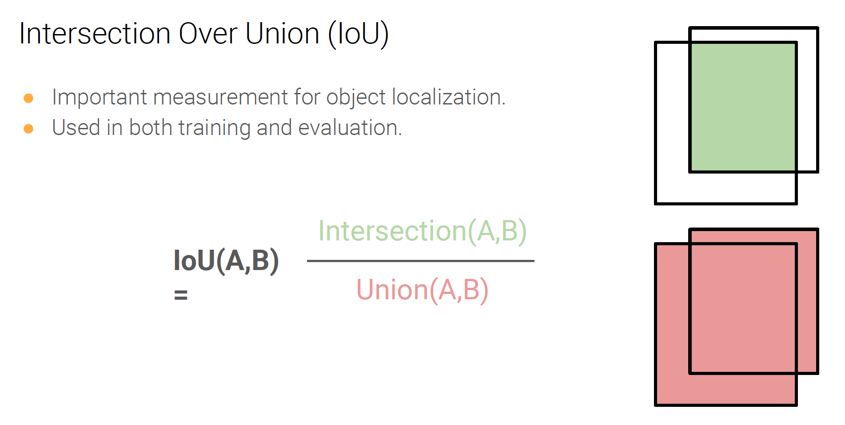
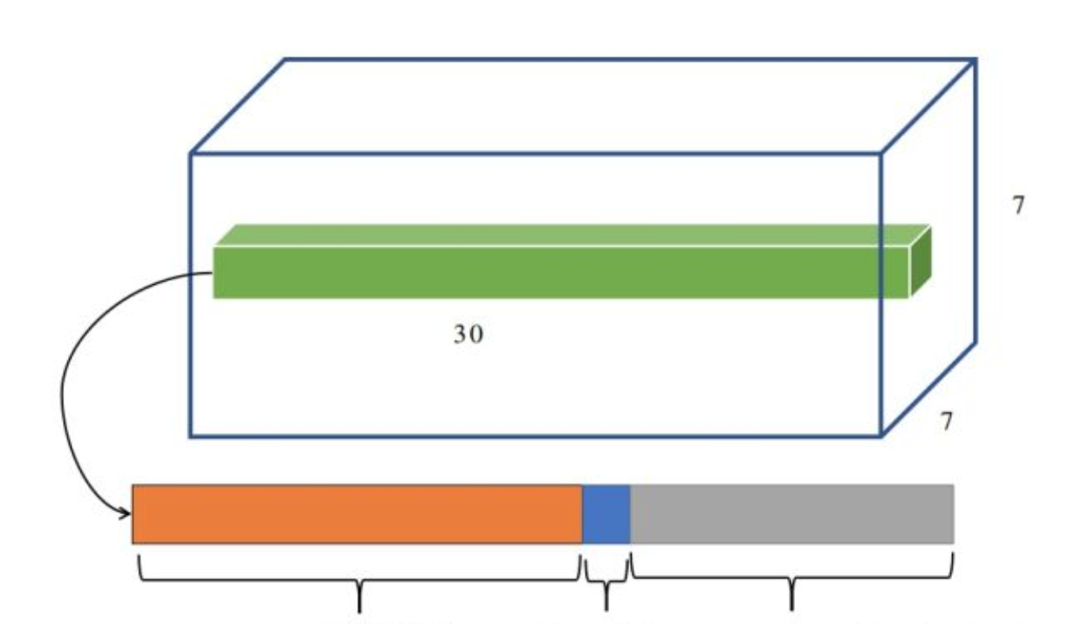
Bounding Box
Classification+Localization: Intersection of Union (IOU)
(x,y)
How close is intersection of two overlapping boxes?
h—height
(x,y,w,h)
w—width
IoU>0.7 positive
IoU<0.3 negative
0.3<IoU<0.7
Number used in training
Intersection of Union
Confidence=Pr(Object)*IOU If cell contains objects
Confidence=0 If cell doesn’t contain objects

Slide 13
Outline
Motivation
Key Idea of Yolo
Ugly Details: Anchor Boxes+Target Vector
Intersection-of-Union (IOU)
Loss Function

Slide 14
YOLO
Yolo: Propose possible boxes + Classification +Localization
20
Class Probability
2
Confidence
8
2*(x,y,h,w)
Assign 2 anchor boxes/cell
Confidence=Pr(Object)*IOU If cell contains objects
Confidence=0 If cell doesn’t contain objects

Slide 15
Outline
Motivation
Key Idea of Yolo
Ugly Details: Anchor Boxes+Target Vector
Intersection-of-Union (IOU)
Loss Function

Slide 16
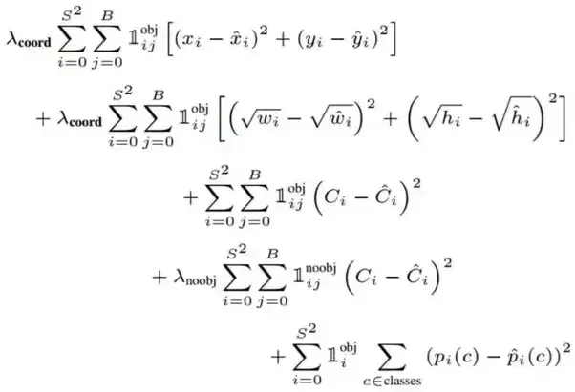
YOLO
Confidence=Pr(Object)*IOU If cell contains objects
Confidence=0 If cell doesn’tcontain objects
Loss function
Coordinate Loss
Confidence
Loss
20
Class Probability
2
Confidence
8
2*(x,y,h,w)
Classification Loss

Slide 17
Outline
Motivation
Key Idea of Yolo
Ugly Details: Anchor Boxes+Target Vector
Intersection-of-Union (IOU)
Loss Function & Confidence

Slide 18
Confidence Metric
Yolo: Propose possible boxes + Classification +Localization
20
Class Probability
2
Confidence
8
2*(x,y,h,w)
Confidence C=Pr(object)*IOU
Pr(Object) is the probability the box contains an object.
In the training, if box contains an object, Pr(object)=1, Confidence=IOU, otherwise Pr(object)=Confidence=0
In the test, only confidence score will be output, the high score means the window contain object and location is correct

Slide 19
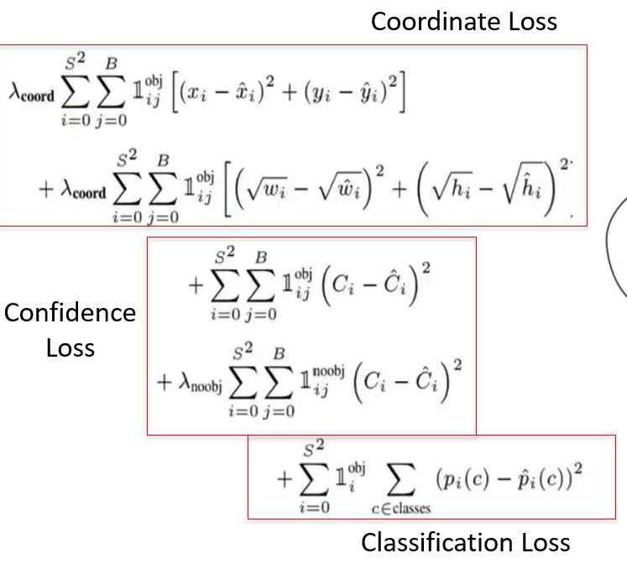
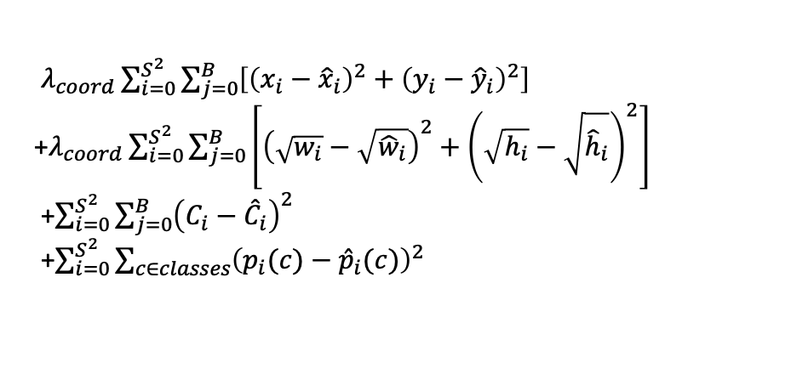
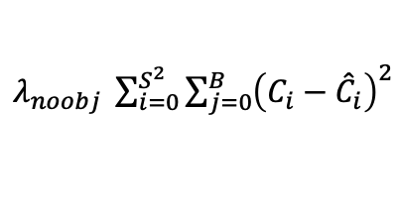

YOLO
i=cell #
j=BB #
$𝕀_{ij}^{obj}$=1, $𝕀_{ij}^{noobj}$=0 if i_{th} cell has a object center in it and the j_{th} bounding box has the
highest IoU among all the B bounding boxes with this cell, otherwise $𝕀_{ij}^{obj}$=0, $𝕀_{ij}^{noobj}$=1
Red box in the left image, $𝕀_{ij}^{obj}$=1, $𝕀_{ij}^{noobj}$=0
j BB index silent
Loss Function
S*S cells
$λ_{coord}\sum_{i=0}^{S^{2}}{\sum_{j=0}^{B}{\left[{\left(x_{i}−{\hat{x}}_{i}\right)}^{2}+{\left(y_{i}−{\hat{y}}_{i}\right)}^{2}\right]}}$
+$λ_{coord}\sum_{i=0}^{S^{2}}{\sum_{j=0}^{B}{\left[{\left(\sqrt{w_{i}}−\sqrt{{\hat{w}}_{i}}\right)}^{2}+{\left(\sqrt{h_{i}}−\sqrt{{\hat{h}}_{i}}\right)}^{2}\right]}}$
+$\sum_{i=0}^{S^{2}}{\sum_{j=0}^{B}{{\left(C_{i}−{\hat{C}}_{i}\right)}^{2}}}$
+$\sum_{i=0}^{S^{2}}{\sum_{c∈classes}{{\left(p_{i}(c)−{\hat{p}}_{i}(c)\right)}^{2}}}$
Confidence loss, coordinate loss and classification loss are calculated
Dog Center
Black box in the left image, $𝕀_{ij}^{obj}$=0, $𝕀_{ij}^{noobj}$=1
Loss Function
$λ_{noobj} \sum_{i=0}^{S^{2}}{\sum_{j=0}^{B}{{\left(C_{i}−{\hat{C}}_{i}\right)}^{2}}}$
Only confidence loss are calculated

Slide 20
Conclusions
YOLO=Real-time Detection
https://www.youtube.com/watch?v=9s_FpMpdYW8
Advantage: Fast
Disadvantage: Small Object
Multi objects in same cell

