Slide 1
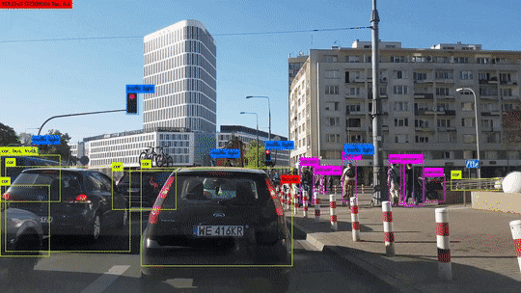
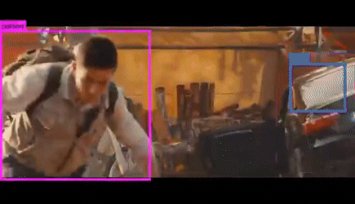
Region-CNN
Real-time Detection+Localization

Slide 2
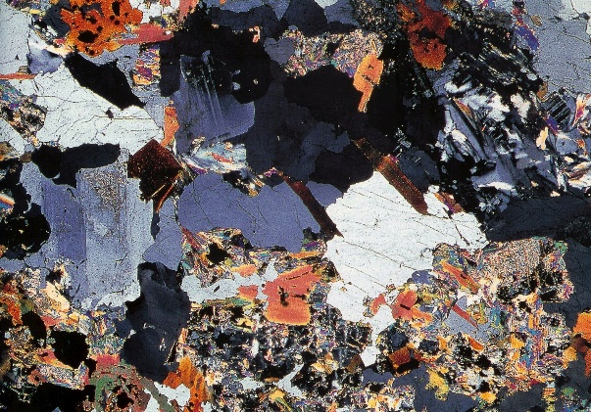
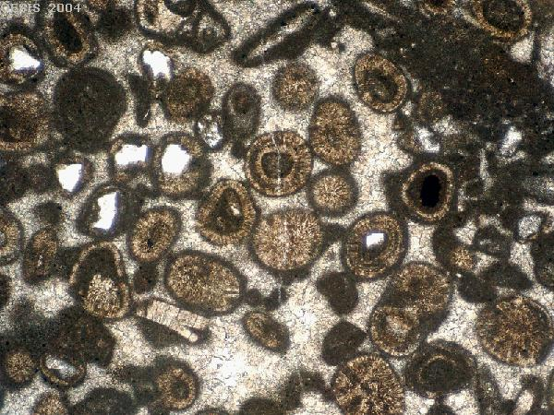
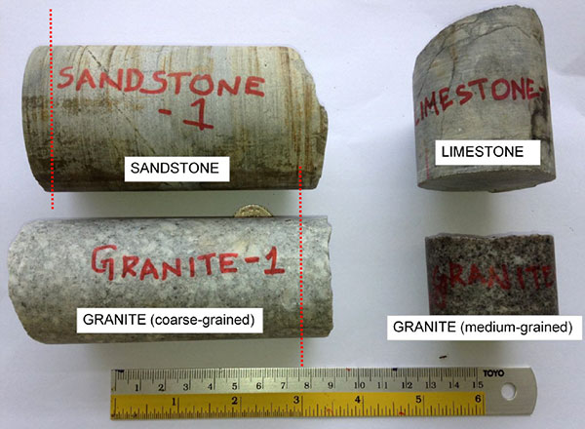
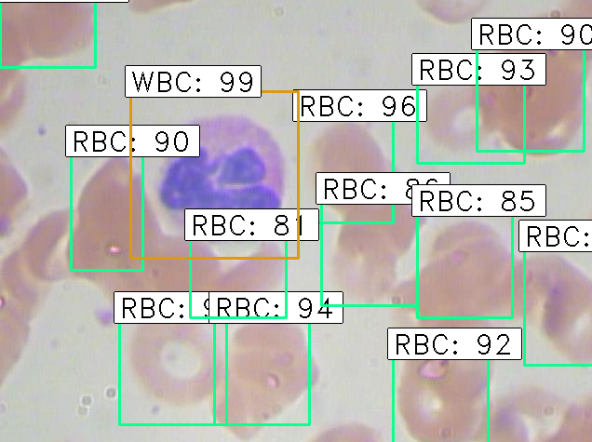
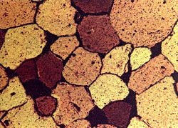
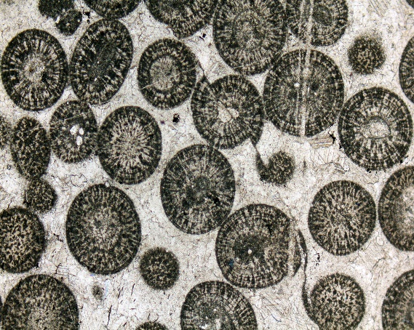
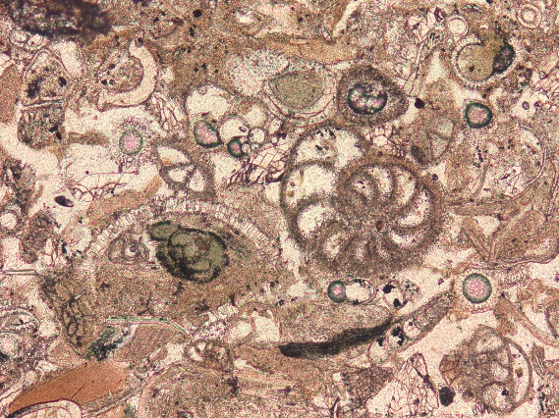
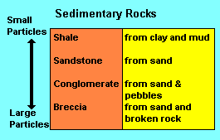
Region-CNN
Granite
Fossils
Sandstone porosity &
permeability
Oolites
More fossils

Slide 3
Outline
Introduction
Classification+Localization
Object Detection

Slide 4
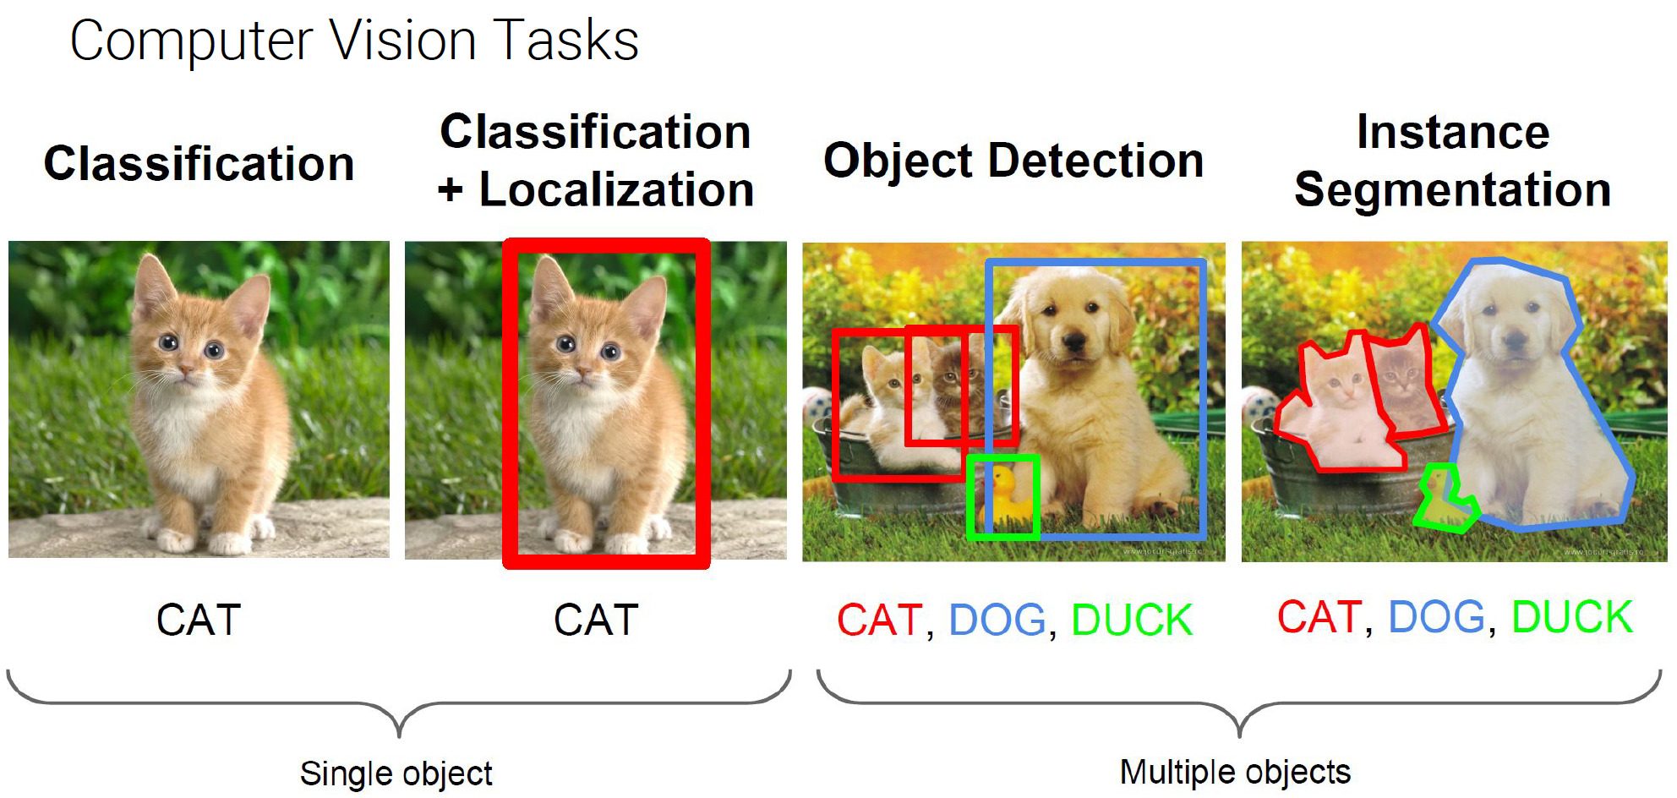
Classification+Localization
Classification &
cat
cat
dog

Slide 5
Outline
Introduction
Classification+Localization
Object Detection
: IOU

Slide 6

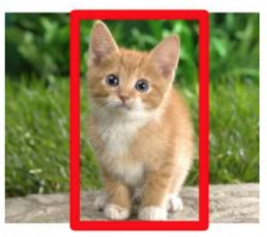
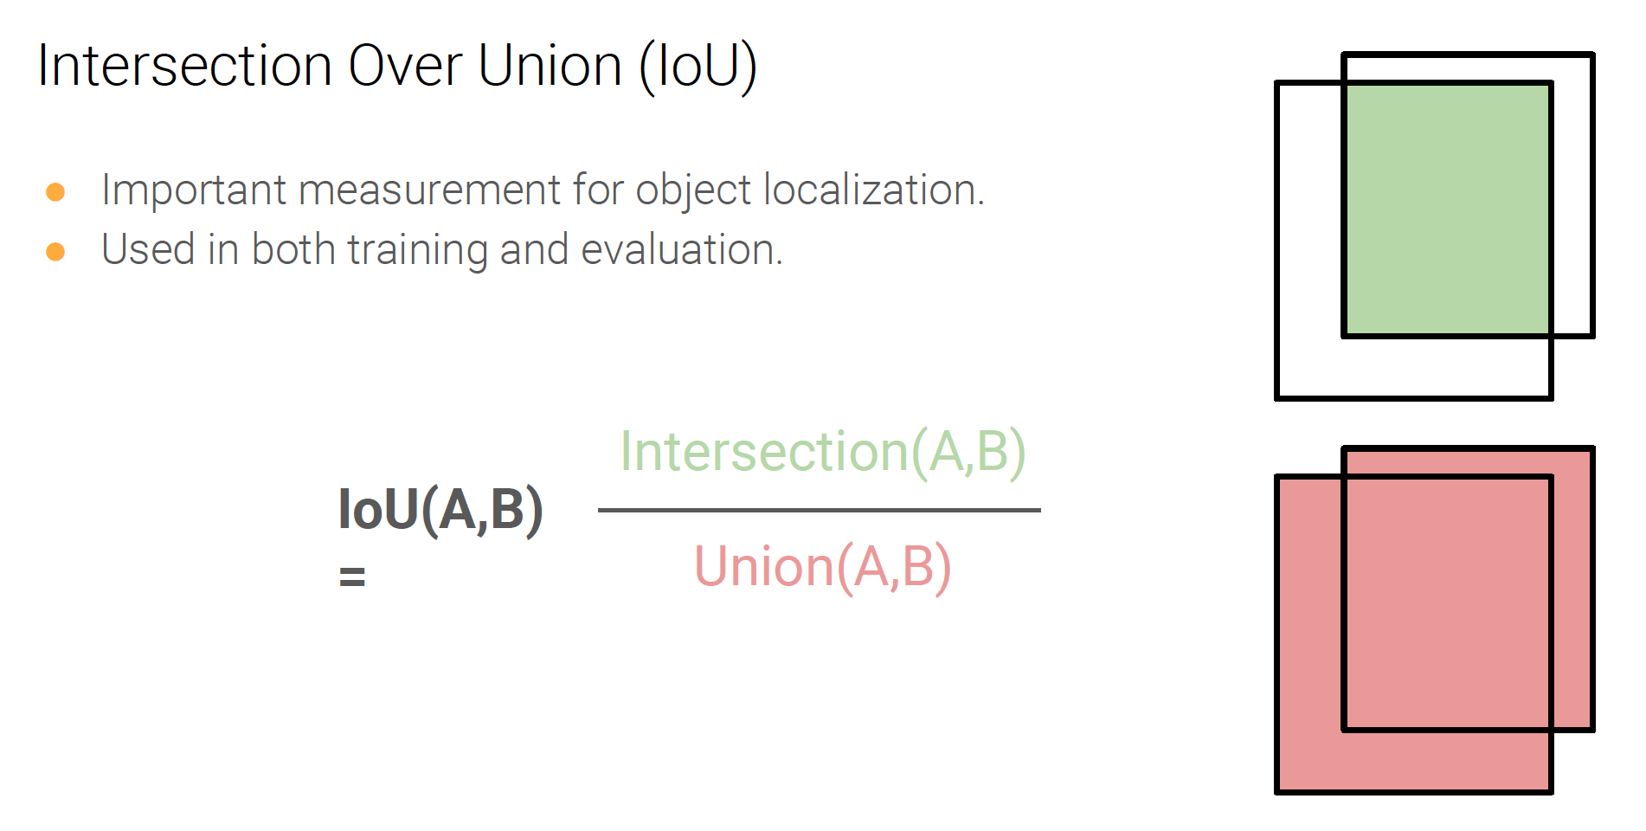
Bounding Box
Classification+Localization: IOU
(x,y)
How close is intersection of two overlapping boxes?
h—height
(x,y,w,h)
w—width
IoU>0.7 positive
IoU<0.3 negative
0.3<IoU<0.7
Number used in training
Intersection of Union

Slide 7
Outline
Introduction
Classification+Localization
Object Detection
: IOU
, Bounding Box + Class Vector

Slide 8
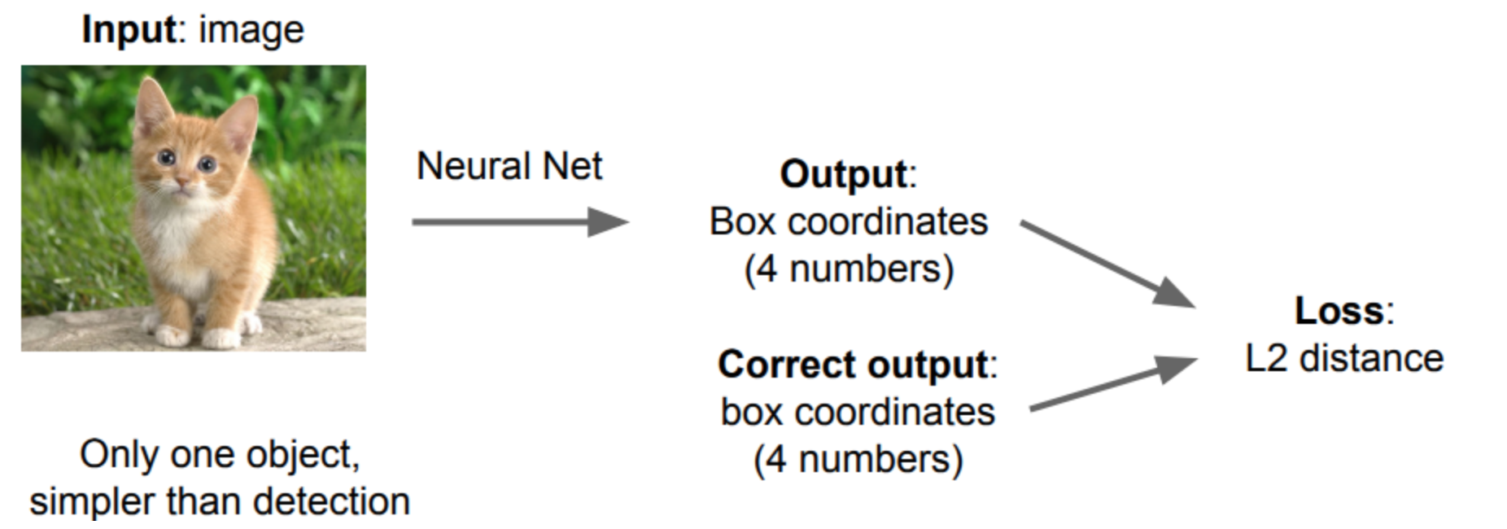

Classification+Localization:Goal= (x,y,w,h) of Bounding Box
Regression
OUTPUT Image
1
0
0
p
X
Y
Width
height
INPUT Image

Slide 9
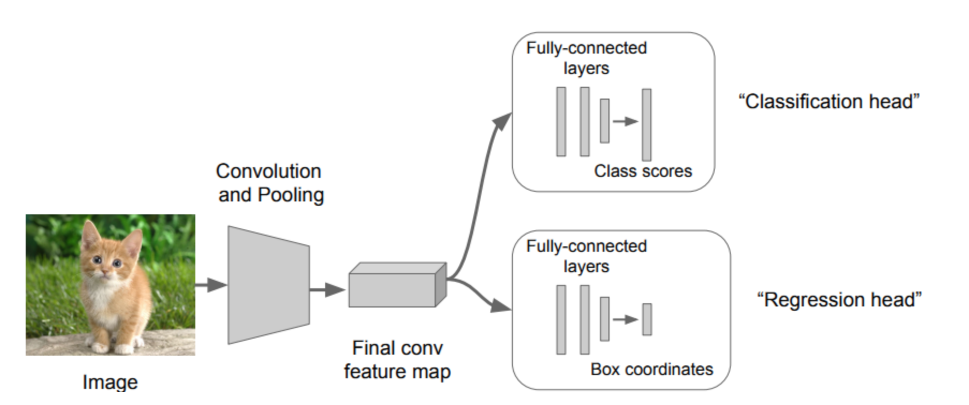
Classification+Localization: (x,y,w,h) & (c₁,c₂,c₃,p)
Target vector y
Easy if only one object
Not easy if many objects
1
0
0
p
X
Y
Width
height
Proposed Region of Interest (ROI)
OUTPUT Image
How many ROIs?
Each BB has a target vector
During Training we have a groundtruth y and predicted y for each BB

Slide 10
Outline
Introduction
Classification+Localization
Object Detection
  Region-CNN (R-CNN)

Slide 11
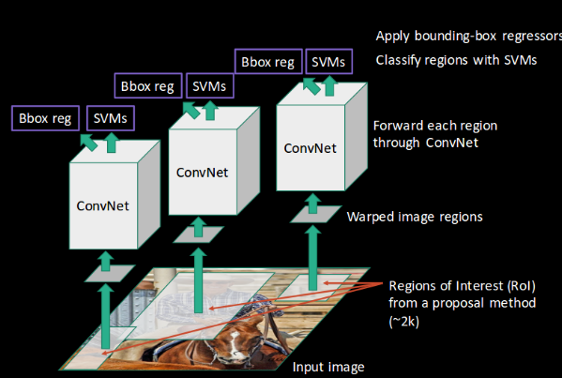
R-CNN & Regions of Interest (ROI)
Step 2: Warped to Smaller Images?
Why? Cost?
Step 1: ROIs selected
Specify more than needed!
Q1: How are ROIs selected? How many selected?
Are they selected by edge detectors? What
Are different methods for selective search?

Slide 12
R-CNN
Step 2: Warped to Smaller Images?
Why? Cost?
Step 1: ROIs selected
At least we know how many output
boxes need to be used
Q1: How are ROIs selected? How many selected?
Are they selected by edge detectors? What
Are different methods for selective search?

Slide 13
R-CNN
Problem: Too slow
Step 5: ConvNet→Bounding Box Regress
1
0
0
p
X
Y
Width
height
Step 4: ConvNet→SVM Classify
Step 3: Each Warped Region→ConvNet
Step 2: Warped to Smaller Images?
Why? Cost?
Each ROI has a CNN!!!
How do we get rid of extra BBs?
Step 1: ROIs selected
Kill BB when p~0

Slide 14

Outline
Introduction
Classification+Localization
Object Detection
  Region-CNN (R-CNN)
  Fast&Faster Region-CNN

Slide 15
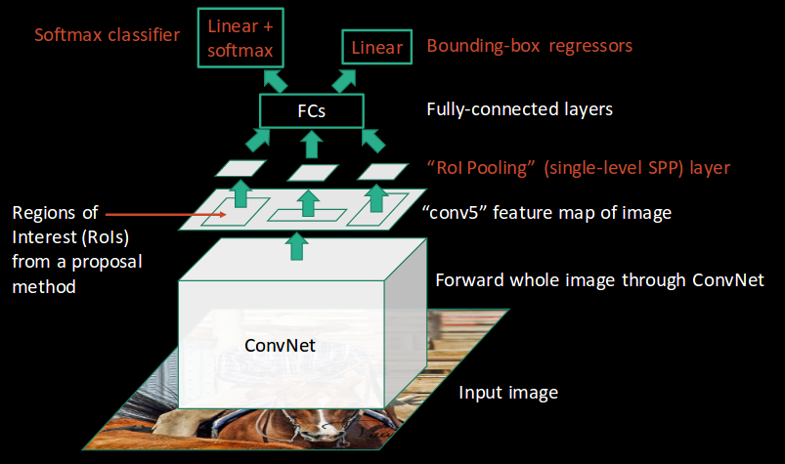
Fast R-CNN
Step 6: ConvNet→BB Regression
Step 5: FCN for each ROI
1
0
0
p
X
Y
Width
height
Step 4: ROI Pooling
Step 3: Grab feature maps in ROI
Step 2: Proposal ROIs
Step 1: Entire Image →CNN
Q1: How to get rid of extra ROIs?
Disadvantage: Selective Search is slow

Slide 16
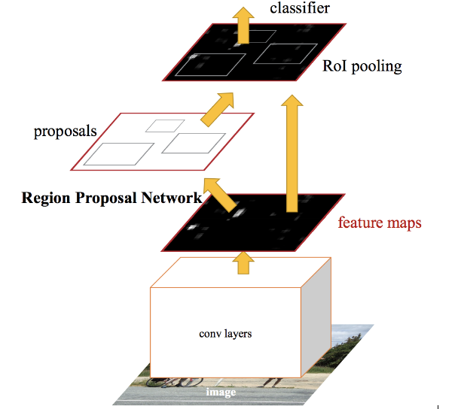
Faster R-CNN
Step 6: ConvNet→BB Regression
Step 5: FCN for each ROI
1
0
0
p
X
Y
Width
height
Step 4: ROI Pooling
Step 3: Grab feature maps in ROI
Step 2: Proposal ROIs
Step 1: Entire Image →CNN

Slide 17
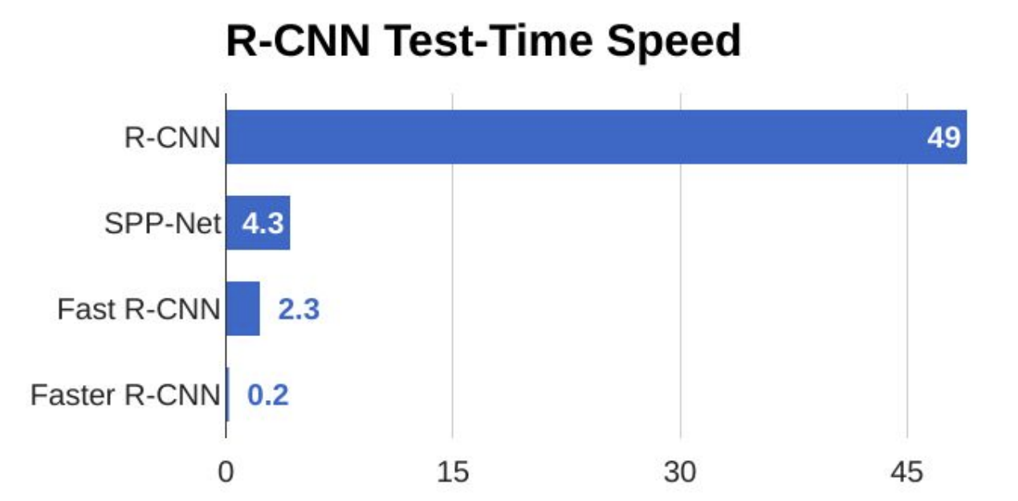
Faster R-CNN

Slide 18
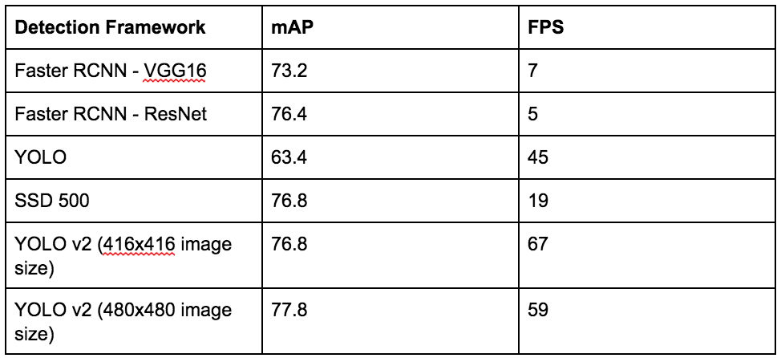
Comparison
Mean Average Precision
Frame per second

Slide 19
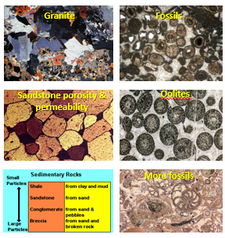
Conclusions
Thesis = Faster R-CNN +

Slide 20

Outline
Introduction
Classification+Localization
Object Detection
  Region-CNN (R-CNN)
  Selective Search

Slide 21




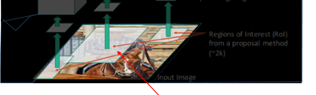
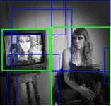
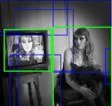
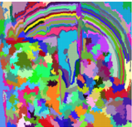
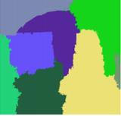
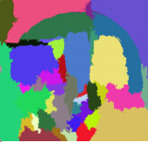
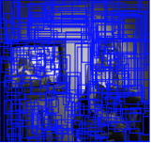
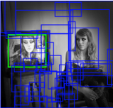
Selective Search or Proposed ROI
Larger Boxes
Selective Search
Capture All Scales
Diversification
Fast to Compute
Hierarchical Clustering Algorithm
Step 1. Segment: Segment an image into small regions
Propose Small Bounding Boxes
Step 2. Merge: Calculate the similarities between neighboring regions
The most similar regions are grouped together
Propose Larger Bounding Boxes
Step 3. Repeat step 2 until the whole image becomes a single region
https://www.koen.me/research/pub/vandesande-iccv2011.pdf
http://www.huppelen.nl/publications/selectiveSearchDraft.pdf

Slide 22
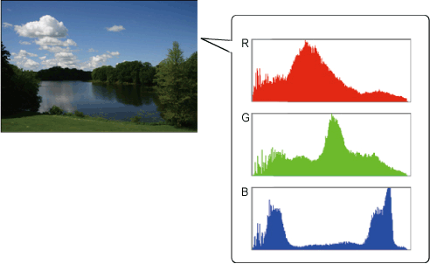













Merge Boxes
Who is PURPLE most similar to?
29
11
22
Similarity
66
30
$a∈\left\{0,1\right\}$ denotes if the similarity measure is used or not
1. Color Similarity
Sum over intensity index k
-- Color Histogram normalized using L1 norm
2. Texture Similarity
-- Texture Histogram normalized using L1 norm
Gaussian derivative in eight orientations
3. Size Similarity
(Encourage small regions to merge early)
-- The size of the whole image in pixels
If size(r_{i}) and size(r_{j}) is small, s_{size}(r_{i},r_{j}) is close to 1
4. Shape Compatibility
(Encourage tight connected regions to merge)
-- The size of the bounding box around r_{i} and r_{j}
s
If there is no gaps between region r_{i} and r_{j}, s_{fill}(r_{i},r_{j}) is close to 1
https://www.koen.me/research/pub/vandesande-iccv2011.pdf
http://www.huppelen.nl/publications/selectiveSearchDraft.pdf
5. Merge purple box with one of closest similarity

Slide 23
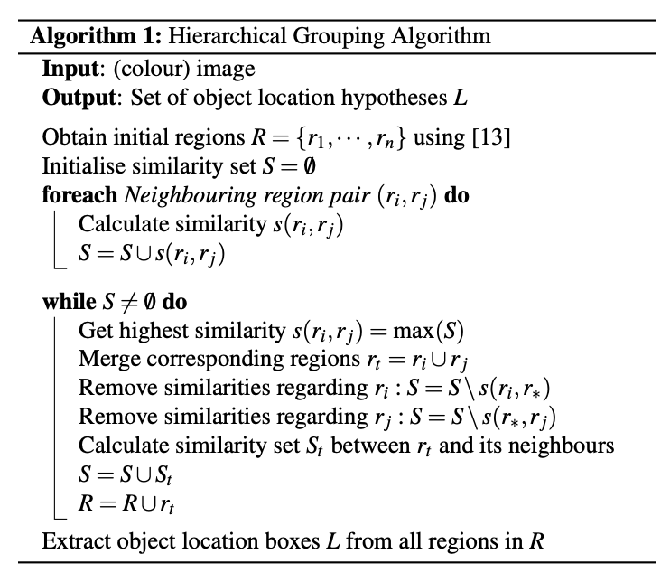
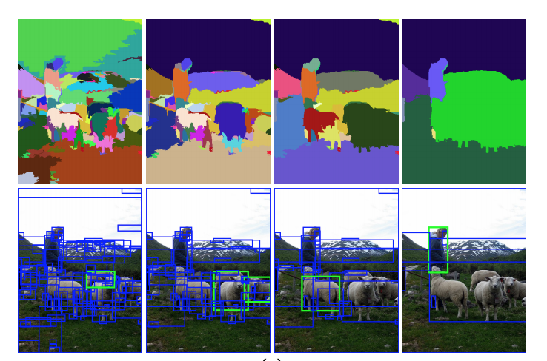
R-CNN
Selective Search

Slide 24
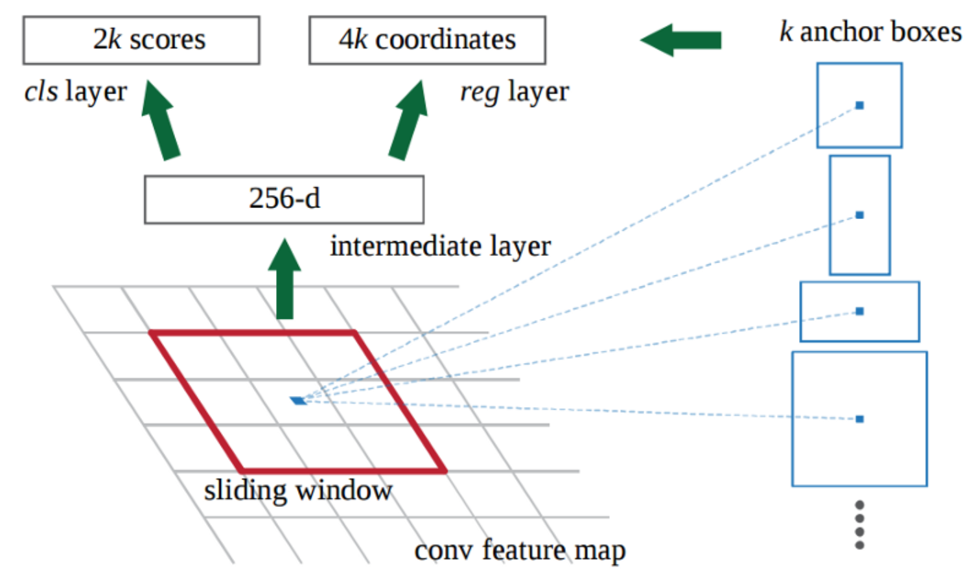
Region Proposal Network (RPN)
Contain object
Or
Not
Coordinate
x:y
1:1
1:2
2:1
2:2
Last feature layer in ZFnet: 256 ResNet: 512

Slide 25
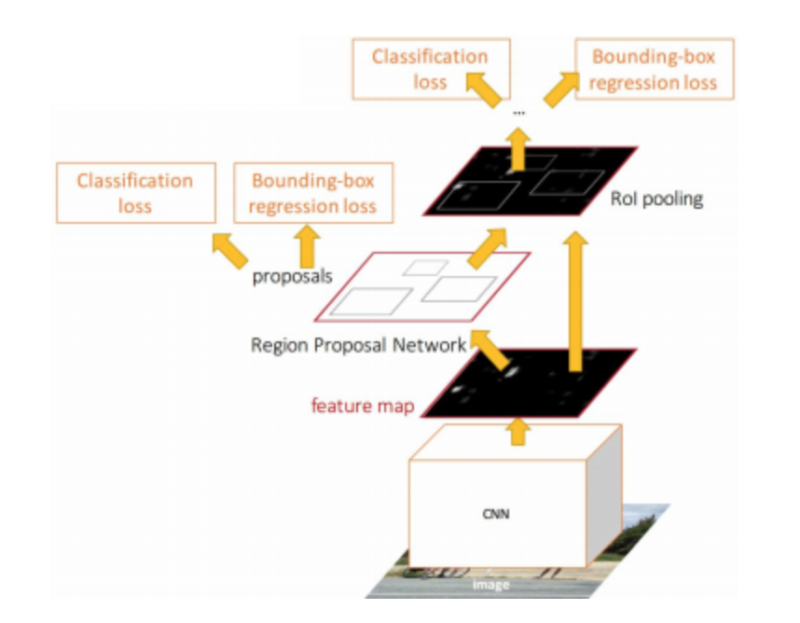
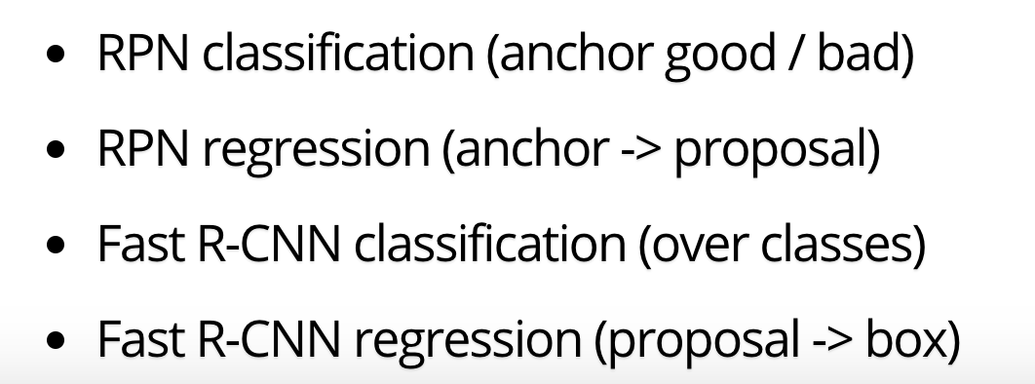
Faster R-CNN

