Slide 1
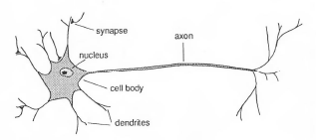
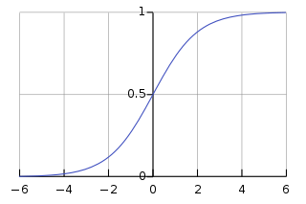
Neural Network
Neuron
x
W
y
x₁
x₂
.
.
x₃
y
σ( Σ_{j} W_{ij} x_{j} ) = y_{i}
σ(z)
Given: (x,y) s.t. y= σ(Wx)
Find: W
W
z
Soln: W = ]X^{T} X]⁻¹X^{T} y → Least squares soln.
Soln: W=X⁻¹ y
target
predictions
ε= ½Σ_{n} (y^{(n)}-σ(Wx^{(n)}))²
→ Steepest descent soln.

Slide 2
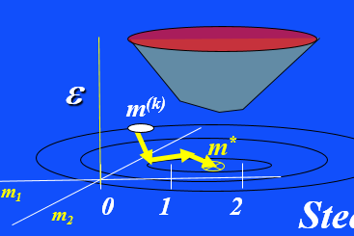
Least Squares Solutions & Steepest Descent

Slide 3
Outline
Overdetermined System of Equations
& Least Squares Solution
Iterative Steepest Descent Solution
Details: Geometric Interpretation
Summary

Slide 4
Least Squares Solution
Overdetermined System of Equations
Q: 2 eqns., 1 unknown. What is soln?
2x1
1x1
2x1
A: None. Inconsistent Eqns
m
m = 1
2m = 3
1 1
2 3
=
Lm = d
0 1 2
m
MxN
Nx1
Mx1
Underdetermined system
of eqns.: M<N
Overdetermined system
of eqns.: M>N

Slide 5
Least Squares Solution
Overdetermined System of Equations: 3 eqns, 2 unk.
2 unknowns &
3 equations
m₁=1
m₁=3/2
2
1
Best
compromise
m₁
1 0 1
0 3
0 1 1
m₂
=
m₂
m₂=0
Lm = d
0 1 2
m
MxN
Nx1
Mx1
m₁
Overdetermined system
of eqns.

Slide 6
Least Squares Solution
Overdetermined System of Equations: 3 eqns, 2 unk.
Least Squares Solution
2 unknowns &
3 equations
m that minimizes sum squared
Errors: ε = ½ (Lm-d)^{T}(Lm-d)
2
1
dot product of 1st row
with column vector
= ½ Σ_{i} ( Σ_{j}l_{ij}m_{j}-d_{i} )²
Best
compromise
m₁
1 0 1
0 3
0 1 1
m₂
=
r^{T}
r
m₂
Length² of
residual
Lm = d
0 1 2
m
Soln minimizes
Sum of squared errors
ε
MxN
Nx1
Mx1
m₂
m₁
1
Overdetermined system
of eqns.
0 1 2
m₁

Slide 7
Outline
Overdetermined System of Equations
& Least Squares Solution
Iterative Steepest Descent Solution
Vector Calculus Background
Details: Geometric Interpretation
Summary

Slide 8
m
Vector Calculus Background
dm₁
dm₁
dm₂
dm₁
m₁
m₂
1
0
dm
dm₁
d
dm₁
=
=
=
m
dm₁
dm₂
dm₂
dm₂
m₁
m₂
0
1
dm
dm₂
d
dm₂
=
=
=

Slide 9
m
Vector Calculus Background
dm₁
dm₁
dm₂
dm₁
m₁
m₂
1
0
dm
dm₁
d
dm₁
=
=
=
m₁
m₂
dm₁
dm₁
dm₂
dm₁
l₁₁ l₁₂
l₂₁ l₂₂
l₁₁ l₁₂
l₂₁ l₂₂
1
0
dLm
dm₁
d
dm₁
=
=

Slide 10
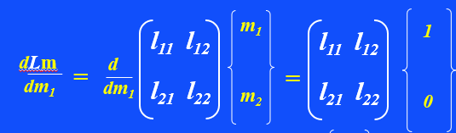
Vector Calculus Background
m₁
m₂
dm₁
dm₁
dm₂
dm₁
l₁₁ l₁₂
l₂₁ l₂₂
l₁₁ l₁₂
l₂₁ l₂₂
1
0
dLm
dm₁
d
dm₁
=
=

Slide 11
Vector Calculus Background
x^{T}Ly = y^{T}Lx →
If L is a symmetric matrix (i.e. L^{T}=L) then x^{T}Ly = (x^{T}Ly)^{T} = y^{T}L^{T} x = y^{T}Lx, or
dm^{T}Lm
dm₁
dm^{T} Lm +
dm₁
m^{T} L
dm
dm₁
dm^{T}Lm
dm₁
=
dm^{T} Lm
dm₁
dm^{T} Lm
dm₁
= 2
dm^{T}L^{T} L m
dm
m₁
m₂
l₁₁ l₁₂
l₂₁ l₂₂
dm^{T}Lm
dm₁
m₁ m₂
dm^{T}L^{T} L m
dm₁
d
dm₁
d
dm₁
2 L^{T} L m
= 2
0
+
=
= 2
m₁
m₂
l₁₁ l₁₂
l₂₁ l₂₂
= 2
m₁
m₂
dm₁
dm₁
dm₂
dm₁
l₁₁ l₁₂
l₂₁ l₂₂
1
0
l₁₁ l₁₂
l₂₁ l₂₂
m₁ m₂
dm^{T}L^{T} L m
dm₂
d
dm₂
d
dm₁
=
0 1
m₁ m₂
= 2

Slide 12
Vector Calculus Background
dm^{T}L^{T} L m
dm
2 L^{T} L m
m₁
m₂
l₁₁ l₁₂
l₂₁ l₂₂
= 2

Slide 13
dm^{T}L^{T} L m
dm
2 L^{T} L m
Vector Calculus Background
m₁
m₂
l₁₁ l₁₂
l₂₁ l₂₂
= 2
= ½ (Lm-d)^{T}(Lm-d)
= ½[(m^{T}L^{T}-d^{T})(Lm-d)]
= [½ m^{T}L^{T}Lm - m^{T}L^{T}d + d^{T}d]
∇ε = dε /dm = ½ d[m^{T} L^{T}Lm – m^{T} L^{T}d]/dm
= L^{T}Lm – L^{T}d
= 0
dε/dm =∇ε =0, set to zero because ∇ε= 0 at global minimum
L^{T}Lm = L^{T}d
Normal Equations

Slide 14
Outline
Overdetermined System of Equations
& Least Squares Solution
Iterative Steepest Descent Solution
Vector Calculus Background
Details: Geometric Interpretation
Derivative of Misfit Function
Summary

Slide 15
Least Squares Solution
Local minima
Least Squares Solution
= ½ (Lm-d)^{T}(Lm-d)
= ½[(m^{T}L^{T}-d^{T})(Lm-d)]
= ½ [m^{T}L^{T}Lm -2m^{T}L^{T}d +d^{T}d]
→ dε/m = L^{T}Lm –L^{T}d = 0
f(m)
am²
+ bm³
+ bm⁴
m
m that minimizes sum squared
Errors: ε = ½ (Lm-d)^{T}(Lm-d)
Quick & Dirty
Lm ~ d
L^{T} L^{T}
=
One minima, no local minima!
Why?
Now we have square NxN
Matrix so can take inverse
m = [L^{T}L]⁻¹L^{T}d
Soln minimizes
Sum of squared errors
ε
Rigorously
m₂
dε/dm=L^{T}(Lm-d)=0
1
Overdetermined System of Equations
m = [L^{T}L]⁻¹L^{T}d
0 1 2
m₁

Slide 16
Outline
Overdetermined System of Equations
& Least Squares Solution
Iterative Steepest Descent Solution
Details: Geometric Interpretation
Summary

Slide 17

∇ε(x,y)
Δh
T ⊥
Δr
Δh
<<0
Δr
3500 m
3445m
3450 m

Slide 18
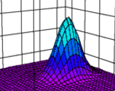
ε(r+dr) = ε(r) + ∇ε• dr + O(|dr|²)
∇ε = (𝜕 ε/𝜕 w₁, 𝜕 ε/𝜕 w₂)
r= (w₁, w₂ )
y
ε
w₂
b
∇ε
b
dr
x
w₁
m
ε (r+dr )
dε = [ε(r+dr)−ε(r)]dr = 0
dr
ε (r )
dε = ε(r+dr)−ε(r) = 0
Modeling eqn: y = mx + b
dr
Taylor
series
dε = ∇ε• dr = 0
→ ∇ε ⊥ dr
∇ε(w) = points uphill ⊥ to tangent at w=(m,b)=(w₁,w₂)
∂ε/∂w₁
If dr is || to contour then
∇ε(w) =
∂ε/∂w₂
dε = ∇ε• dr = 0 → ∇·ε ⊥ dr
OK, ∇ε is perpendicular to contour
Tangent, but why point uphill?
w^{(k+1)} = w^{(k)}- αL^{T}(d^{(k+1)} -d^{(k)})

Slide 19
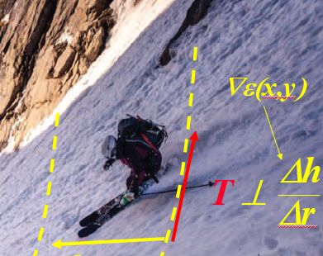
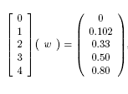
Gradient ∇ε
y
ε
b
∇ε
x
m
Why does ∇ε point uphill?
If dr points uphill then dε = ε_{up}-ε_{lower}= ∇ε• dr >0 → ∇ε points uphill
ε_{upper}
dε = [ε(r+dr)−ε(r)]>>0
dε = ∇ε• dr > 0
ε_{lower}
dr
∇ε || dr
Choose dr to be ⊥ to contour at r

Slide 20
Gradient -∇ε
y
ε
m₂
−∇ε
x
m₁
Modeling eqn: y = mx + b
Steepest
descent
direction
−∇ε(m) = points downhill hill ⊥ to tangent at m =(m₁,m₂)
∂ε/∂m₁
−∇ε(m) = -
∂ε/∂m₂

Slide 21
Outline
Overdetermined System of Equations
& Least Squares Solution
Iterative Steepest Descent Solution
Details: Ill-posed+Regularization
Details: Ill-posed+Regularization
Summary

Slide 22
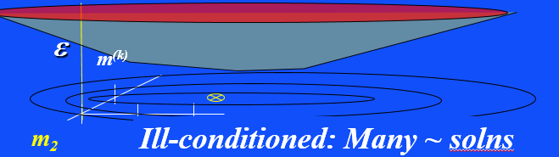
Least Squares Solution
Overdetermined System of Equations: 3 eqns, 2 unk.
Ill-posed

Slide 23
Least Squares Solution
Overdetermined System of Equations: 3 eqns, 2 unk.
Ill-posed

Slide 24

Least Squares Solution
+ Regularization
Damping parameter
Find: m that minimizes sum regularized squared
errors: ε = ½ (Lm-d)^{T}(Lm-d) + ½ λ m^{T}m
+λ||m-m₀||²
Model penalty
Data penalty
Gradient=0 at
dε/dm=L^{T}(Lm-d)+λ m =0
[L^{T}L+ λI]m - L^{T} d = 0
m = [L^{T}L+ λI]⁻¹L^{T}d
λ$≠$0
ε
Overdetermined System of Equations
Ill-conditioned: Many ~ solns
m₂
m₁

Slide 25
Outline
Overdetermined System of Equations
& Least Squares Solution
Details: Ill-posed+Regularization
Iterative Steepest Descent Solution
Summary

Slide 26
Iterative Steepest Descent
+ Regularization
∇ε
-∇ε
Approximation λ =0, [L^{T}L]⁻¹ ≈ I & ill-conditioned so we didn’t reach bottom on one iteration
⁽⁰⁾
dε /dm = L^{T}(Lm - d)+λ m =0
Ending pt
Starting pt
Step length
m⁽¹⁾ = m⁽⁰⁾ - L^{T}(Lm⁽⁰⁾ -d)
α
Normally α ^{(k)} but often
we keep it same until it breaks
m⁽²⁾ = m⁽¹⁾ - L^{T}(Lm⁽¹⁾ -d)
α
For k=1:K
m^{(k+1)} = m^{(k)} - L^{T}(Lm^{(k)} -d)
ε
α
end
m⁽¹⁾
m⁽⁰⁾
m₂
m₁

Slide 27
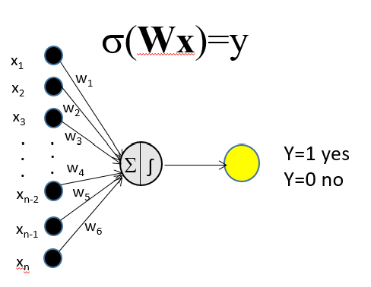
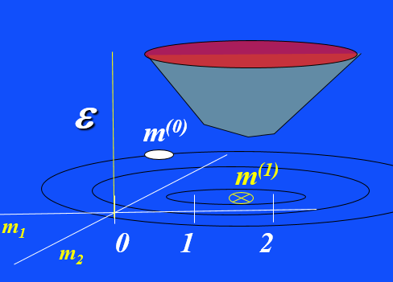
Iterative Steepest
Descent Code: min ε=||Lm-d||²
σ(x^{T}w)=y
Lm=d
m^{(k+1)} = m^{(k)}- αL^{T}(d^{(k)} –d*)
d*, m⁽⁰⁾ % Data & Starting model
For k=0:nit
d^{(k)} =Lm^{(k)} % Update pred. data
Δd=d^{(k)} -d* % Update residual
m^{(k+1)} =m^{(k)} -αL^{T}Δd % Update model
end
m⁽⁰⁾
Step length
Overdetermined System of Equations
m⁽²⁾
m⁽¹⁾

Slide 28
Preconditioned Steepest Descent
Recall Normal Eqns: L^{T}Lm* = L^{T}d
L^{T}Lm^{(k)} = L^{T}d^{(k)}
subtract
invert
L^{T}L(m*-m^{(k)}) = L^{T}(d-d^{(k)})
(m*-m^{(k)}) = [L^{T}L]⁻¹ L^{T}(d-d^{(k)})
rearrange
m^{(k+1)} = m^{(k)} - [L^{T}L]⁻¹ L^{T}(d^{(k)} -d)
α
Newton Gradient Descent
Step length α
α
m_{i}^{(k+1)} = m_{i}^{(k)} - L^{T}(d^{(k)} -d)_{i}
Precondioned Steepest
Descent
ε
[L^{T}L]_{ii}
m_{i}^{(k+1)} = m_{i}^{(k)} - αL^{T}(d^{(k)} -d)_{i}
Diagonal Approximation
Steepest Descent
m^{(k+1)}
For k=1:K
[L^{T}L]_{ij} ≈ δ_{ij} l_{ij}
m^{(k+1)} = m^{(k)} - L^{T}(Lm^{(k)} -d)
α
m^{(k)}
[L^{T}L]_{ij}⁻¹ ≈ δ_{ij} /[L^{T}L]_{ij}
m₂
m₁
end

Slide 29
Outline
Overdetermined System of Equations
& Least Squares Solution
Iterative Steepest Descent Solution
Details: Ill-posed+Regularization
Details: Ill-posed+Regularization
Summary
Ill-posed Example

Slide 30
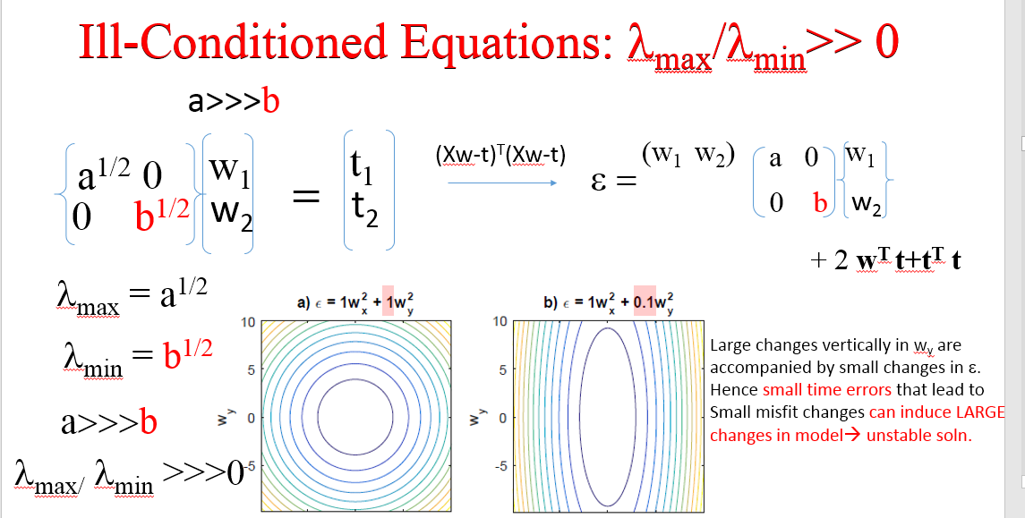
eigenvalue
1
0
1
0
0
1
0
1
a^{1/2}
b^{1/2}
Ill-conditioned if κ = λ_{max}/λ_{min} >10⁴
Overdetermined System of Equations
w_{x}
w_{x}
Ill-conditioned if κ>10⁴

Slide 31
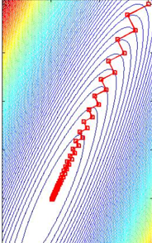
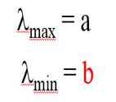
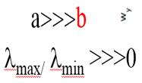
ε= 1/2 w^{T}[X^{T}X]w
+ ….
ε = aw₁² + bw₂²
w₁ ² + 0.9w₂²
w₁ ² + 0.1w₂²
w₁ ² + 0.1w₂²
Fast
convergence
w₂
w₂
Slow
convergence
w₁
w₁
Ill-conditioned if κ>10⁴

Slide 32
ε= 1/2 w^{T}[X^{T}X]w
+ ….
ε = aw₁² + bw₂²
Q: How do we fix this problem?
w₁ ² + 0.1w₂²
Precondition data by dividing by variance σ of x_{i}
w₂
w₂
Overdetermined System of Equations
w₁
w₁
Ill-conditioned if κ>10⁴

Slide 33
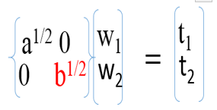
How can we avoid ill-conditioning
for Neural Networks?
1. Variance division of X
2. Demean X
Ill-conditioned if κ > 10⁴
X
W
t
3. Balance Data Types
Δm=X^{T}Δt = X^{T}Δt + X^{T}Δt
Matrix-vector
notation
XW = t
w₂
w_{N}

Slide 34




How can we avoid ill-conditioning
for Neural Networks?
0
0 ……… 0
1/(a²+b²+…y²)^{1/2}
1/(a²+b²+…y²)^{1/2}
0 0 ……… 0
1. Variance division of X
0 0 ……… 0
1/(a²+b²+…y²)^{1/2}
2. Demean X
0 0 0 ------ 0
Scale input:
Normalize
by variance
Ill-conditioned if κ > 10⁴
0 0 0 …….
1/(z²)^{1/2}
X
W
t
3. Balance Data Types
Δm=X^{T}Δt = X^{T}Δt + X^{T}Δt
If w_{N} units cm, z is in km and a,b,c,.. are in
km then z<<<a,b,c…
Matrix-vector
notation
XW = t
X→ Two types (dog & cats) input data with different units
d₁ 0
w₁
t₁
t₂
t_{N}
w₂
.
d₂ 0
.
0<x_{i}<255
.
0<x_{i}<30
0<x_{i}<255
0<x_{i}<255
.
=
.
.
density
density
probability
probability
0 255
0 255
0 c
w₁
r_{M}² = (cw₂-t_{M})²
w₁
r_{i}² = (d_{i}w₁-t_{i})²
w₂
Multiply by 99
w₂
ε = r₁²+r₂²…r_{N-1}²+r_{M}²

Slide 35
Outline
Overdetermined System of Equations
& Least Squares Solution
Iterative Steepest Descent Solution
Details: Ill-posed+Regularization
Details: Ill-posed+Regularization
Bias Term
Summary
Ill-posed Example

Slide 36
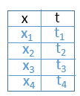

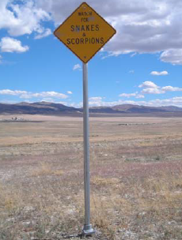



Motorcycle Time Trials
t
x
Modeling eqn: t = mx + b

Slide 37
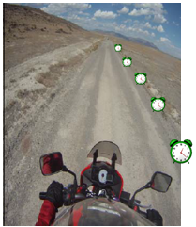
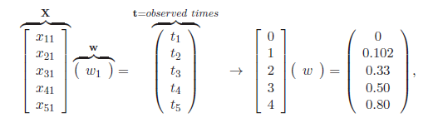

Motorcycle Time Trials
X m + b = t
In this case w=(m,b)^{T}
X m = t
Clock error
Inconsistent, why?
1
1
1
1
1
t
b
m
What is X with bias term included?
x
Modeling eqn: t = mx + b
No bias term b! Why?
Bias term needed to generalize linear model.
Otherwise we assume line goes through origin.
If we demean data then bias not so important.

Slide 38
Outline
Overdetermined System of Equations
& Least Squares Solution
Iterative Steepest Descent Solution
Details: Ill-posed+
Details: Overfitting
Summary

Slide 39
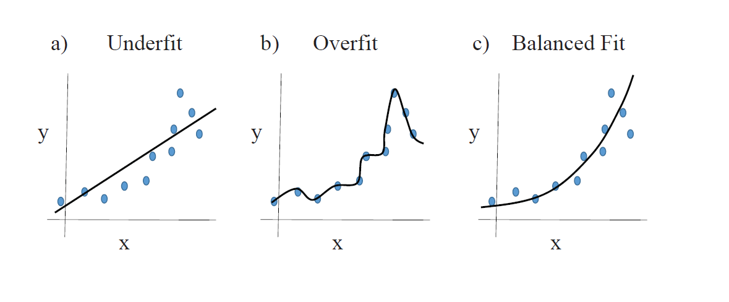
Normal Equations and LS Solution
Do not Make Model more
Complex than Data (too many unknowns)
Overfitting: y = ax +bx² +cx³ + dx⁹
Underfitting
Balanced Fit
Underfit
Overfit
Balanced fit
Fitting to both
signal & noise
Fitting to signal
& ignoring noise

Slide 40
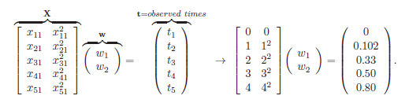
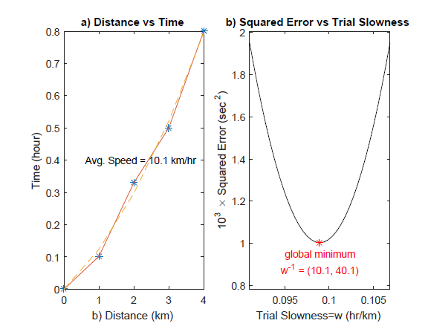
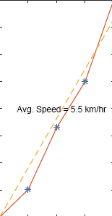
Normal Equations and LS Solution
Do not Make Model more
Complex than Data Deserve
Overfitting: t = w₁x + w₂x²
Quadratic Model
Xw = t
Quadratic Model
X w = t
Linear Model
Xw = t

Slide 41
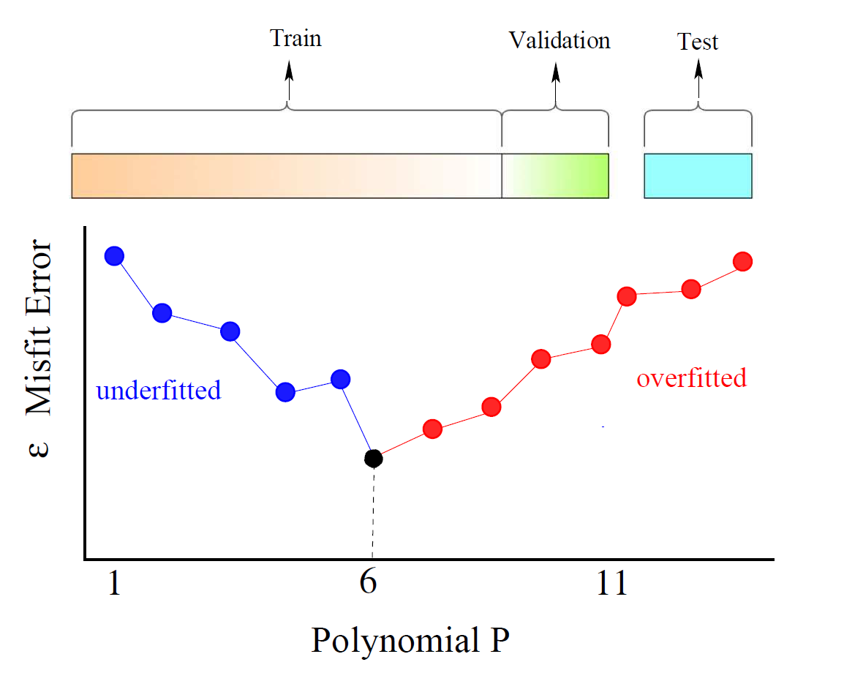
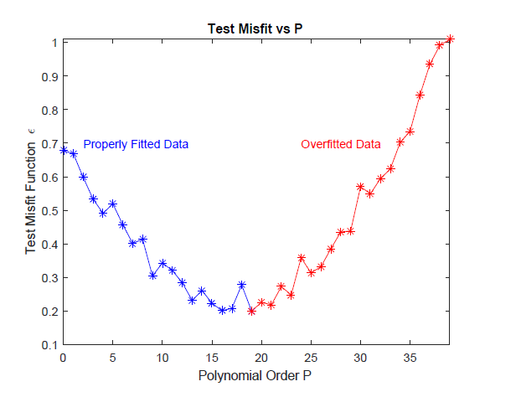
Normal Equations and LS Solution
Do not Make Model more Complex
than Data Deserve
Overfitting SanityTest
Step 1: Break up training data into 90%
validation data and 10% test data
Step 2: Set P=small number and
find w for validation data.
Compute misfit ε( P ).
Validation Misfit Function ε(P)
P*
Step 3: Identify overfit P*, use
Model with P*-1=6 to train data
overfitted
overfit
t = w₁ x
+ w₂ x² ….. + w_{p} x^{P}
t = w₁^{P} x
t = w₁^{P=1} x

Slide 42
Outline
Overdetermined System of Equations
& Least Squares Solution
Iterative Steepest Descent Solution
Details: Overfitting
Summary

Slide 43

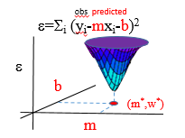
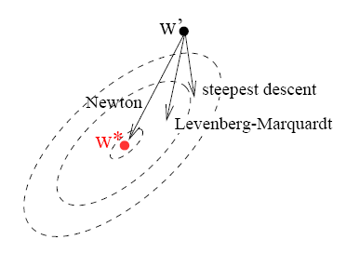
Summary
≅
Xw=t: Overdetermined, Ill-Cond. & Inconsistent
Normal Equations: [X^{T}X]m=X^{T}d
∇ε=0
Least Squares Solution: m=[X^{T}X]⁻¹ X^{T}d
Regularized Least Squares: m=[X^{T}X+αI]⁻¹ X^{T}d
Overfitting: Complexity of predicted &
actual models should be similar.
Bias term: Most general linear model y=mx+b
affine
Conditioning: Balance data types, demean+normalize input

Slide 44
Summary (cont.)
ε = ½ (L Δm –Δd)^{T}(L Δm –Δd)
Sum of squared residuals
= ½ Δm^{T} L^{T}L Δm – Δm^{T}L^{T} Δd + ½ Δd^{T}Δd
=0 → Δm=[L^{T}L]⁻¹L^{T}Δd
= L^{T}L Δm_{i} – L^{T}Δd_{i}
𝜕ε
𝜕 Δm_{i}
Hessian
Gradient
Gradient is zero at bullseye
Expand ε in Taylor series @ m
Newton Optimization: m^{(k+1)} = m^{(k)} - α [L^{T}L]⁻¹ L^{T}(d^{(k)}-d )
ε(m+Δm) = ½Σ_{i} Σ _{j} 𝜕 ²ε Δm_{i} Δm_{j}
+ Σ_{i} 𝜕ε Δm_{i}
+ ε(m)…
𝜕Δm_{i} 𝜕Δm_{j}
𝜕Δm_{i}
Derivative of ε w/r to Δm_{i}
Lets move in this direction
𝜕ε
𝜕 Δm_{i}
Σ _{j} 𝜕 ²ε Δm_{j}
=
𝜕ε
Gradient Descent: m^{(k+1)} = m^{(k)} - α L^{T}(d^{(k)}-d )
+
𝜕Δm_{i} 𝜕Δm_{j}
𝜕Δm_{i}
Hessian
Gradient

Slide 45
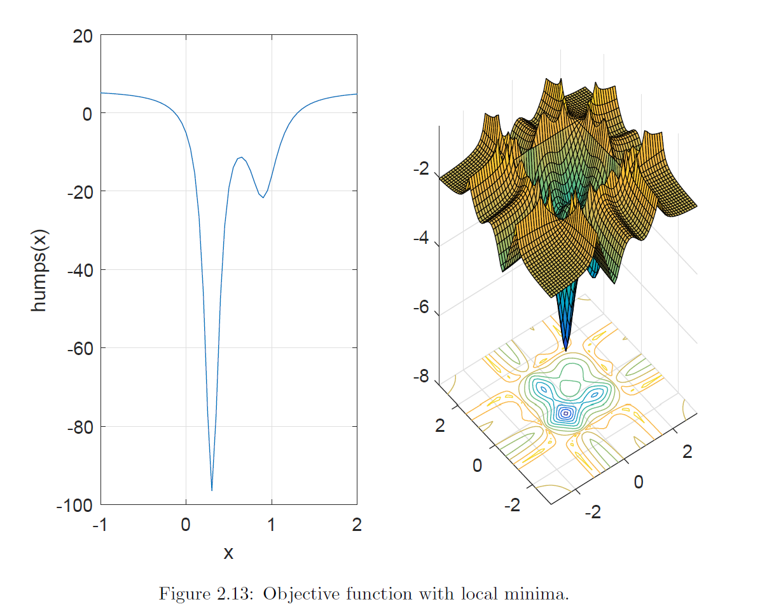
Summary
Problem: Non-linearity & local minima

Slide 46
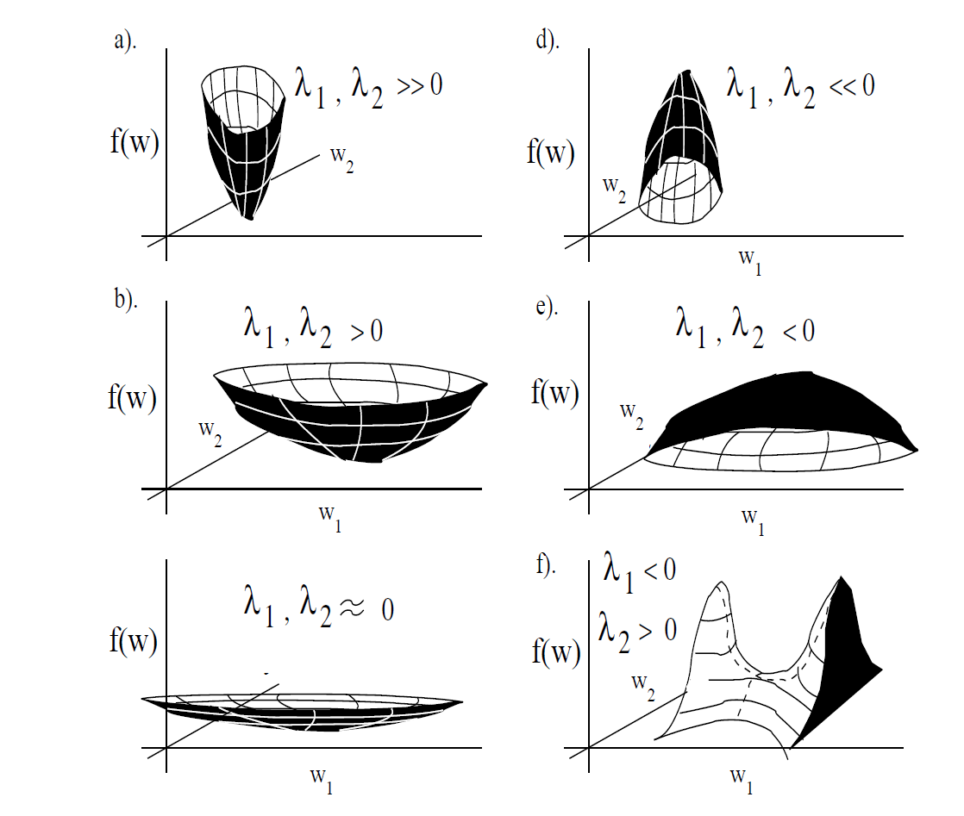
ε = ½ m^{T} [X^{T}X]m
ε(m₀+e_{i}) −ε(m₀)=∇ε ·e_{i} = [X^{T}X]m₀ e_{i}
e₂
= [X^{T}X]e_{i}·e_{i}
m₀
e₁
= λ_{i} e_{i}·e_{i} = λ_{i}

Slide 47
Summary
≅
Xw=t: Overdetermined, Ill-Cond. & Inconsistent
Normal Equations: [X^{T}X]m=X^{T}d
∇ε=0
Least Squares Solution: m=[X^{T}X]⁻¹ X^{T}d
Regularized Least Squares: m=[X^{T}X+αI]⁻¹ X^{T}d
Overfitting: Complexity of predicted &
actual models should be similar.
Bias term: Most general linear model y=mx+b
Conditioning: Balance data types, demean+normalize input

Slide 48

Outline
(ending 09/06 Sunday end)
Ε₁= (dx/dz)²+(dy/dz)²
Overdetermined System of Equations
Iterative Steepest Descent Solution
If λ>>>0 where do I end up?
Details: Ill-posed+Regularization
z(x,y)*
If λ~0 where do I end up?
Tushar’s house
Summary
y
x
5.015 km
Jerry, I live on Hiway 76
At elevation z= 5 km
+near (x,y)=(0,0)
5.01 km
ε = ½ (z-5km)²
+ λ(x²+y²)
Damping term

Slide 49
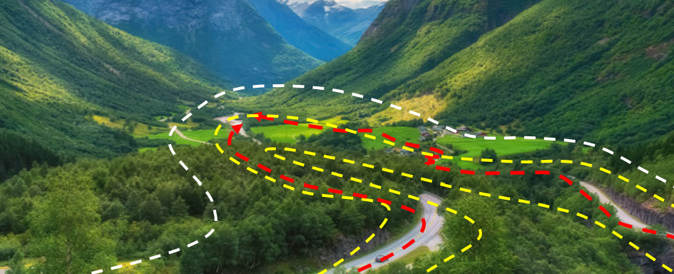
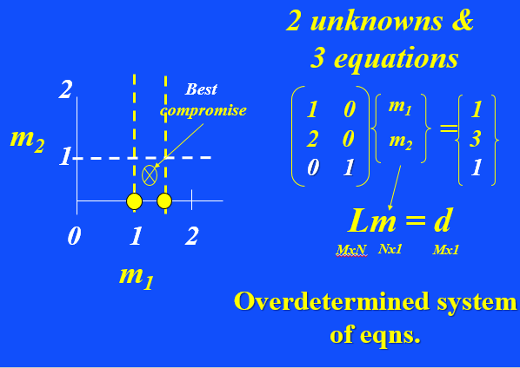
Overdetermined System of Equations: 3 eqns, 2 unk.
Ill-posed
2 unknowns &
3 equations
ε = ½ (Lm-d)^{T}(Lm-d)
1
m₂
Columns nearly same
m₁
1 1 1
2 2
1 1.01 1.005
=
m₂
0 1
m
Lm = d
m₁
MxN
Nx1
Mx1
Overdetermined system
of eqns.

Slide 50
Outline
Overdetermined System of Equations
Iterative Steepest Descent Solution
Details: Geometric Interpretation
Summary

Slide 51
Least Squares Solution
Linear model: L does not
depend on m
Lm=d
m that minimizes sum squared
Errors: ε = ½ (Lm-d)^{T}(Lm-d)
Correct model m⁽¹⁾ & data d⁽¹⁾
m ->m⁽¹⁾ -m⁽⁰⁾
Choose wrong
m⁽⁰⁾ s.t. Lm⁽⁰⁾ = d⁽⁰⁾
→m⁽¹⁾ = [L^{T}L]⁻¹L^{T} d
→m⁽⁰⁾ = [L^{T}L]⁻¹L^{T} d⁽⁰⁾
d ->d⁽¹⁾ -d⁽⁰⁾
m⁽¹⁾ -m⁽⁰⁾= [L^{T}L]⁻¹L^{T} (d⁽¹⁾ -d⁽⁰⁾)
ε
m⁽⁰⁾
m⁽¹⁾ =m⁽⁰⁾- [L^{T}L]⁻¹L^{T}(d⁽⁰⁾-d⁽¹⁾)
m⁽¹⁾
[L^{T}L]_{ij} ⁻¹ ~ α δ_{ij}/[L^{T}L]_{ii}
[L^{T}L]⁻¹ ~ α I
m^{(k+1)} = m^{(k)}- αL^{T}(d^{(k)} -d)
m₁
m = [L^{T}L]⁻¹L^{T}d
0 1 2
Steepest descent formula
Preconditioned S.D.
m₂

Slide 52
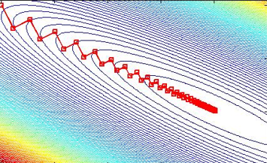
Least Squares Solutions
Iterative Steepest Descent Least Squares Solution
Least Squares Solution
m that minimizes sum squared
Errors: ε = ½ (Lm-d)^{T}(Lm-d)
Residual = Δd
ε
Gradient = L^{T} Δd
m^{(k)}
Recall dε/dm=L^{T}(Lm-d)
m*
m^{(k+1)} = m^{(k)}- αL^{T}(d^{(k)} –d*)
m₁
0 1 2
Steepest descent formula
m₂

Slide 53
Iterative Steepest
Descent Code: min ε=||Lm-d||²
σ(x^{T}w)=y
Lm=d
m^{(k+1)} = m^{(k)}- αL^{T}(d^{(k)} –d*)
d*, m⁽⁰⁾ % Data & Starting model
For k=0:nit
d^{(k)} =Lm^{(k)} % Update pred. data
Δd=d^{(k)} -d* % Update residual
m^{(k+1)} =m^{(k)} -αL^{T}Δd % Update model
end
m⁽⁰⁾
Step length
Overdetermined System of Equations
m⁽²⁾
m⁽¹⁾

Slide 54


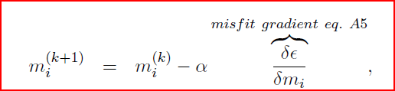
Iterative Steepest Descent
Step 1:
Step 2:
Step 3:
L^{T}Δd^{(k)}

Slide 55
Iterative Least Squares Code
m^{(k+1)} = m^{(k)}- αL^{T}(d^{(k+1)} -d^{(k)})
d*, m % Data & Starting model
For k=1:nit
d=Lm % Update pred. data
Δd=d*-d % Update residual
m=m-αL^{T}Δd % Update model
end
Overdetermined System of Equations

Slide 56
MATLAB SD Least Squares Diffraction Stack Migration
Unlike RTM, Kirchhoff
not bothered by rabbit ears
p=p0 % Data without direct wave
m=adjoint(p,c) % Initial reflectivity model
c % Velocity model
for i=1:niter
p=forward(m,c) % Kirchhoff predicted data
dP=p-p0 % data residual
dm =adjoint(dP,c) % migrate residual
m = m –alpha*dm % Update model
end
-
=
alpha=step(p,p0,c,m) % step length

Slide 57
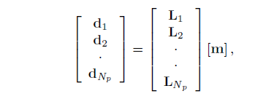
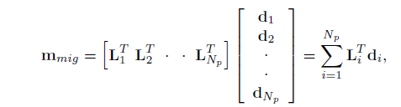
m^{mig} =L^{T} d
d=Lm
Iterative Least Squares Migration
One reflectivity model m
explains all shot gathers!
Overdetermined
Liability: wrong velocity model inconsistently smears reflectivity
#1
#10
CSG #1
CSG #10
wrong velocity model
wrong velocity model
Wrong v(x,z) will misposition reflector for src on left vs src on right. Inconsistent
set of equations so reflector will be blurred in trying to explain all CSGs

Slide 58
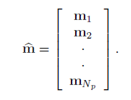
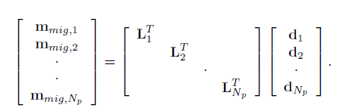
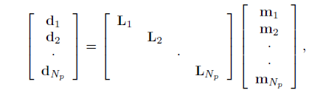
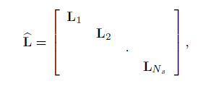
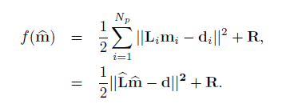

m=L^{T} d
d=Lm
d=Lm
Iterative Least Squares Migration
Many reflectivity models m
explains all shot gathers!
Underdetermined
Misfit+regularization
Advantage: correct migration images prior to stacking
Penalize CIG images if they are different

Slide 59
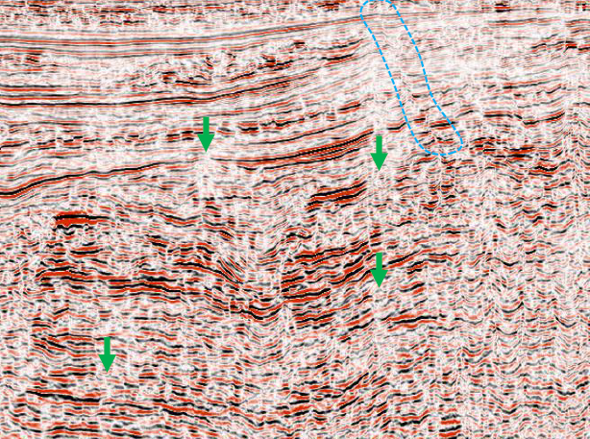
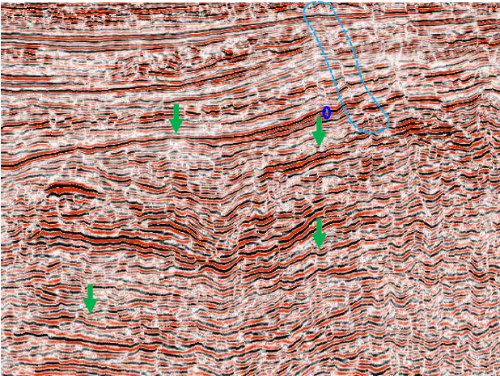
m=L^{T} d
d=Lm
d=Lm
Iterative Least Squares Migration
Mig. Image with No CIG Statics
Mig. Image with CIG Statics
Advantage: correct migration images prior to stacking

Slide 60
LSM
Theory: Overdetermined vs Underdetermined
Workflow: Diffraction Stack vs RTM
Sensitivity: LSM sensitivity to Δv(x,z)
Dot Product Test: (Lm,d)=(m,L^{T} d)
Examples
Summary

Slide 61
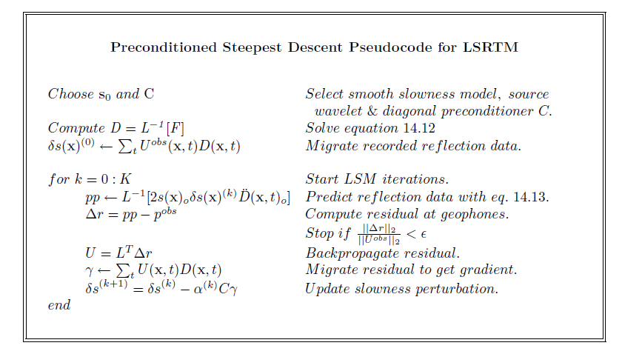


Iterative Least Squares Migration

Slide 62
LSM
Theory: Overdetermined vs Underdetermined
Workflow: Diffraction Stack vs RTM
Sensitivity: LSM sensitivity to Δv(x,z)
Dot Product Test: (Lm,d)=(m,L^{T} d)
Examples
Summary

Slide 63
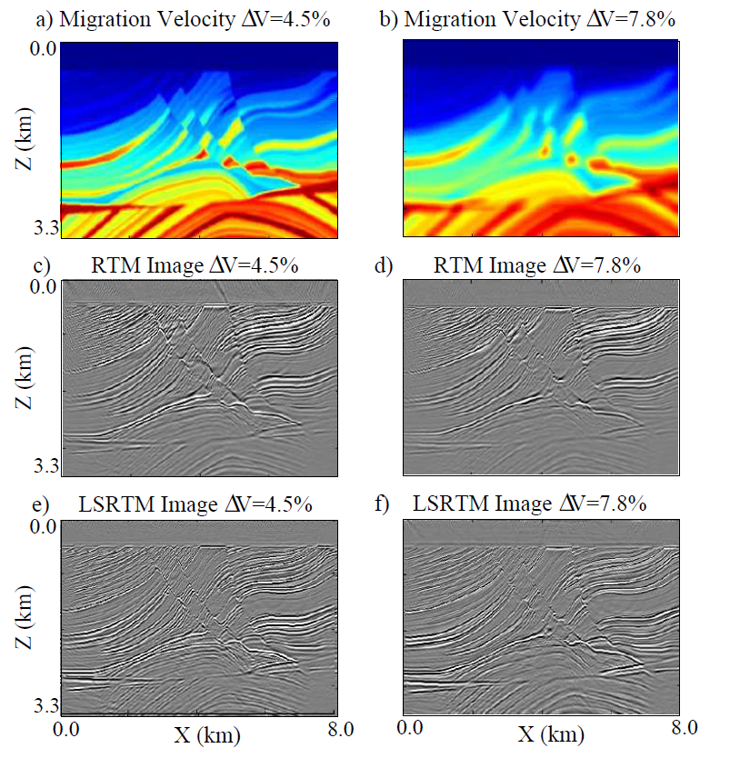
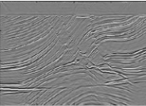
Sensitivity to V(x,z) Error

Slide 64
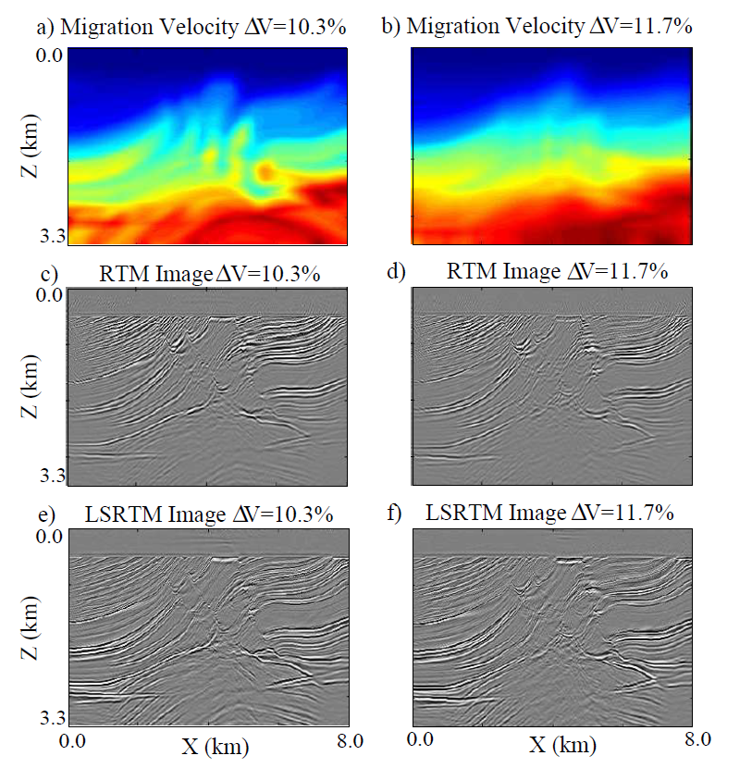
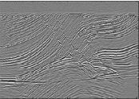
Sensitivity to V(x,z) Error

Slide 65
LSM
Theory: Overdetermined vs Underdetermined
Workflow: Diffraction Stack vs RTM
Sensitivity: LSM sensitivity to Δv(x,z)
Dot Product Test: (Lm,d)=(m,L^{T} d)
Examples
Summary

Slide 66
Dot Products and Adjoint Operators
∑
Recall: (u,u) = u* u
i
i
i
∑
∑
Recall: (v,Lu) = v* ( L u )
i
ij
j
i
j
∑
∑
=
[ L v* ]u
ij
i
j
j
i
=
∑
∑
= (L v,u)
[ L* v ]* u
j
i
ij
i
j
So adjoint of L is L ⬄
∑
L*
i
ij

Slide 67
Dot Product Test with CG code
Actual
model
Predicted
model
Actual
data
Predicted
data
T
T
T
d Lm =(d,Lm) = (Lm,d) = m L d
d=forward(m,c)
m=adjoint(d,c)
d d =
T
m
T
m
All migration codes should pass the dot product test

Slide 68
LSM
Theory: Overdetermined vs Underdetermined
Workflow: Diffraction Stack vs RTM
Sensitivity: LSM sensitivity to Δv(x,z)
Dot Product Test: (Lm,d)=(m,L^{T} d)
Examples
Summary

Slide 69
2D Poststack Data from Japan Sea
JAPEX 2D SSP marine data description:
Acquired in 1974,
Dominant frequency of 15 Hz.
0
TWT (s)
5
0
20
X (km)
Notes:
69

Slide 70
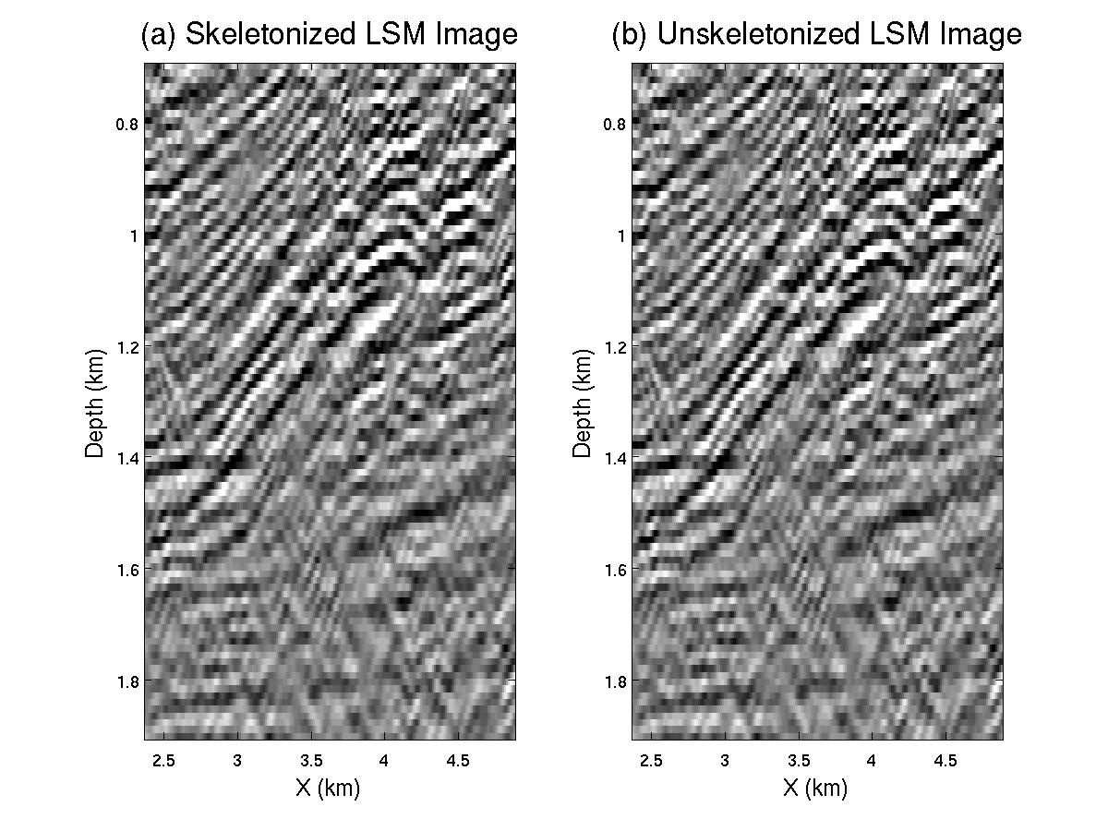
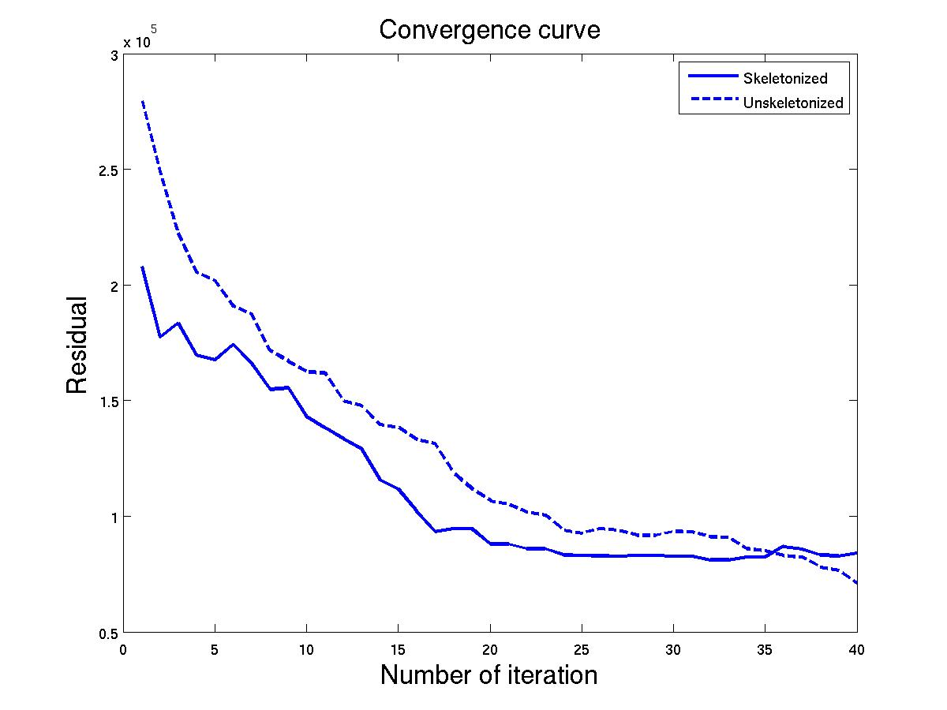
Multi-scale LSM Applied to JAPEX Data
Multi-scale (MS) LSM vs. Standard LSM
Convergence Curves
MS LSM Image
Standard LSM Image
X10 ⁵
0.7
0.7
3.0
Multi-scale LSM
Standard LSM
20 Hz
Depth (km)
Residual
25
30
32
34
36
38
1.9
1.9
40
0.5
2.4
4.9
2.4
4.9
0
X (km)
X (km)
Iteration
40
Notes:
I apply band-pass filter to data.
The frequency band increase with iteration
70

Slide 71
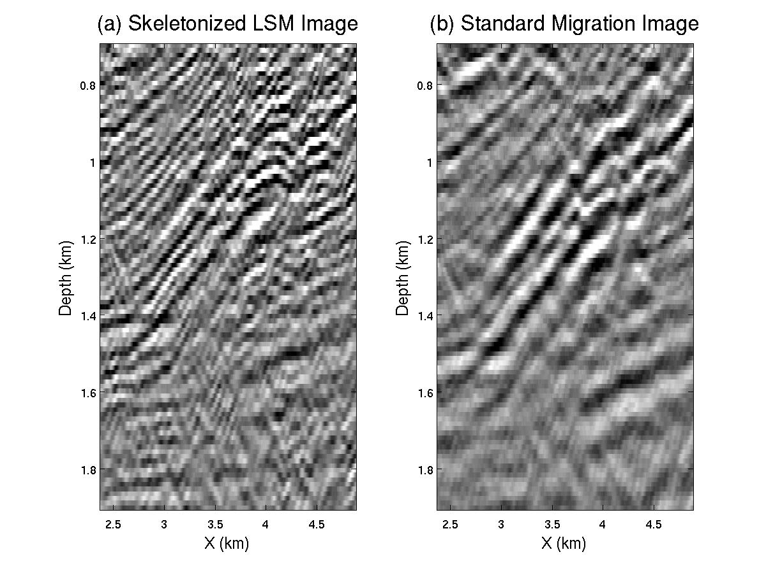
Poststack LSM vs. Kirchhoff Migration
LSM Image
Kirchhoff Migration Image
0.7
0.7
Depth (km)
Depth (km)
1.9
1.9
2.4
4.9
2.4
4.9
X (km)
X (km)

Slide 72

GOM Poststack KM vs LSM
Poststack LSM somewhat insensitive to Δv(x,z)

Slide 73

Prestack KM vs LSM
Prestack LSM sensitive to Δv(x,z)

Slide 74

Attenuation RTM vs LSM

Slide 75


Attenuation RTM vs LSM

Slide 76

Nonlinear LSRTM

Slide 77


Nonlinear LSRTM

Slide 78
LSM Summary
1. Prefer undetermined LSM if large Δv(xz)>>0
2. Biggest challenge: LSM sensitive Δv(x,z)
3. Q-LSM much better than LSM or RTM if Q<30
4. LSRTM cost O(20x) more than RTM
5. Multisource encoded O(LSRTM) cost = O(RTM)
6. Iterative LSM+DSO+FWI is future.

Slide 79
Iterative Steepest Descent
Linear model: L does not
depend on m
Lm=d
m that minimizes sum squared
Errors: ε = ½ (Lm-d)^{T}(Lm-d)
Correct model m⁽¹⁾ & data d⁽¹⁾
m ->m⁽¹⁾ -m⁽⁰⁾
Choose wrong
m⁽⁰⁾ s.t. Lm⁽⁰⁾ = d⁽⁰⁾
→m⁽¹⁾ = [L^{T}L]⁻¹L^{T} d
→m⁽⁰⁾ = [L^{T}L]⁻¹L^{T} d⁽⁰⁾
d ->d⁽¹⁾ -d⁽⁰⁾
m⁽¹⁾ -m⁽⁰⁾= [L^{T}L]⁻¹L^{T} (d⁽¹⁾ -d⁽⁰⁾)
ε
m⁽⁰⁾
m⁽¹⁾ =m⁽⁰⁾- [L^{T}L]⁻¹L^{T}(d⁽⁰⁾-d⁽¹⁾)
m⁽¹⁾
[L^{T}L]_{ij} ⁻¹ ~ α δ_{ij}/[L^{T}L]_{ii}
[L^{T}L]⁻¹ ~ α I
m^{(k+1)} = m^{(k)}- αL^{T}(d^{(k)} -d)
m₁
m = [L^{T}L]⁻¹L^{T}d
0 1 2
Steepest descent formula
Preconditioned S.D.
m₂

Slide 80
Least Squares Solutions
Iterative Steepest Descent Least Squares Solution
Least Squares Solution
m that minimizes sum squared
Errors: ε = ½ (Lm-d)^{T}(Lm-d)
Residual = Δd
ε
Gradient = L^{T} Δd
m^{(k)}
Recall dε/dm=L^{T}(Lm-d)
m*
m^{(k+1)} = m^{(k)}- αL^{T}(d^{(k)} –d*)
m₁
0 1 2
Steepest descent formula
m₂

