Slide 1
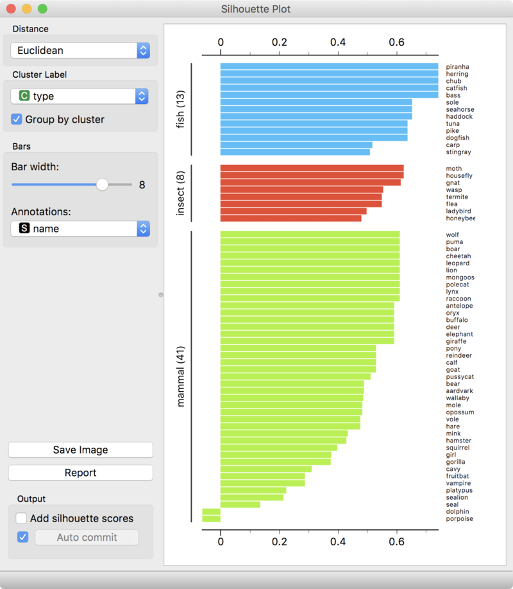
Silhouette Validation Method
Better
Better→
The technique provides a succinct graphical representation
of how well each object has been classified.[

Slide 2


Is the ith pt x_{ik} close to pts in its own cluster k?
d(i,j)=||x_{ik} - x_{jk}||→ distance between i and j points in K^{th} cluster
Average distance between x_{ij}
other pts in k cluster
|C_{k}| -1
j ε C_{k} , iεj
a(i) is small if pts are similar (i.e. close)
together so x_{ik} in correct cluster
# pts in k cluster
Indices of pts in k cluster
a(i) is a measure of how
dissimilar x_{ik} is to its own cluster
Is the ith pt x_{ij} similar (i.e. close) to j^{th} pts in other clusters?
Min 1/|C_{L}| Σ d(i,j)
a(i) is large if pts are far apart so
x_{ik} is not in correct cluster
b(i) =
L = K
j ε C_{L}
a(i) is small if pts
x_{ik} are similar to other pts cluster
The cluster with this smallest b(i)=mean dissimilarity is said to be the "neighboring cluster" of i because it is the next best fit cluster for point i.
If pt x_{ik} in Kth cluster
is very similar to pts in K^{th}
cluster then a(i)~0 is small
Silhouette (value) of one data point i
Not a good cluster if s(i) small,
Perhaps decrease # of clusters
If pt x_{ik} in K^{th} cluster
is highly disimilar to pts neigboring
Clusters then b(i)>>0 is large
-1 ≤ s(i) ≤ 1
Hence s(i) is ~1 large
→ so we conclude x_{ik} is well clustered

Slide 3
Silhouette Validation Method
Better
Better→
Good clustering if s(i) fat
The technique provides a succinct graphical representation
of how well each object has been classified.[
If pt x_{ik} in K cluster
is very similar to pts in K
Cluster then a(i)~0 is small
If pt x_{ik} in K cluster
is highly disimilar to pts in neigboring
Clusters then 1>b(i)>>0 is large
Bad clustering if s(i) is skinny
https://en.wikipedia.org/wiki/Silhouette_(clustering)

Slide 4
Silhouette Validation Method
Better
Better→
Good clustering is s(i) being fat
The mean s(i) over all points of a cluster is a measure of how tightly grouped all the points in the cluster are. Thus the mean s(i) over all data of the entire dataset is a measure of how appropriately the data have been clustered. If there are too many or too few clusters, as may occur when a poor choice of k is used in the clustering algorithm (e.g., k-means), some of the clusters will typically display much narrower silhouettes than the rest. Thus silhouette plots and means may be used to determine the natural number of clusters within a dataset. One can also increase the likelihood of the silhouette being maximized at the correct number of clusters by re-scaling the data using feature weights that are cluster specific.^{[2]}
Bad clustering if s(i) is skinny

Slide 5
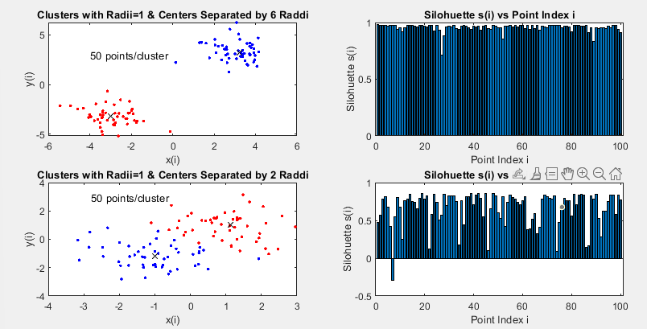
Silhouette Validation Matlab
Good clustering if s(i) is tall
Bad clustering if s(i) is short

Slide 6
Silhouette Validation Matlab
%Create 2 clusters with raddi=1 & centers 2 raddi apart
npts=50;mf=3;
X = [randn(npts,2)+mf*ones(npts,2); randn(npts,2)-mf*ones(npts,2)];
opts = statset('Display','final’);
%Compute labels cidx(i) for points and cluster centers ctrs for the clusters
[cidx, ctrs] = kmeans(X, 2, 'Distance','city', ...
'Replicates',5, 'Options',opts);
subplot(221);
plot(X(cidx==1,1),X(cidx==1,2),'r.', ...
X(cidx==2,1),X(cidx==2,2),'b.', ctrs(:,1),ctrs(:,2),'kx');
title(['Clusters with Radii=1 & Centers Separated by ',num2str(mf*2),' Raddi'])
xlabel('x(i)');ylabel('y(i)');
text(-4,3,[num2str(npts),' points/cluster'])
subplot(222);
s = silhouette(X, cidx, 'sqeuclid');
bar(s)
title('Silohuette s(i) vs Point Index i')
xlabel('Point Index i');ylabel('Silohuette s(i)')

