Slide 1
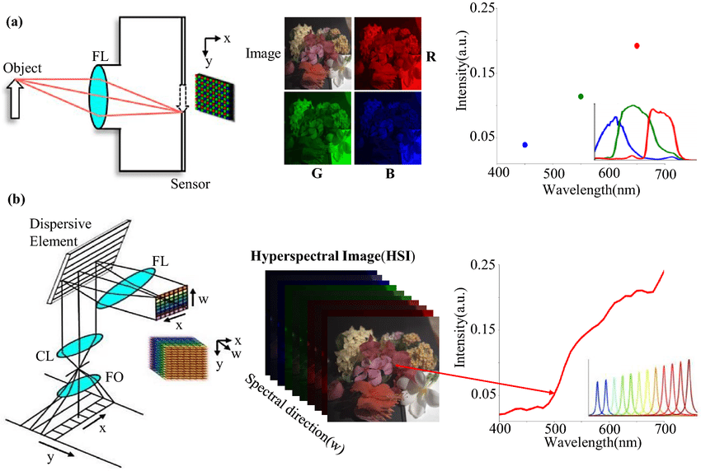
Photos → RGB Images → MATLAB Arrays

Slide 2
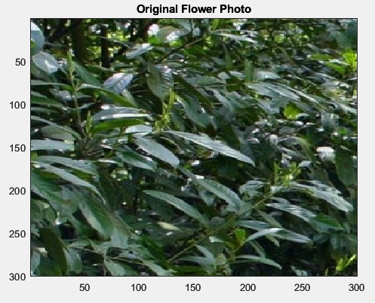

Slide 3
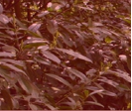
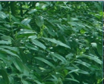
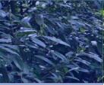
MATLAB Array Representation Im(Nx,Nz,3)
Im(nx,nz,1)
There are Nx*Nz points,
where each point
Is a 3x1 vector)
Im(nx,nz,2)
Im(nx,nz,3)
0-255
0-255
0-255
{Im(1,1,1), Im(1,1,2), Im(1,1,3)}

Slide 4
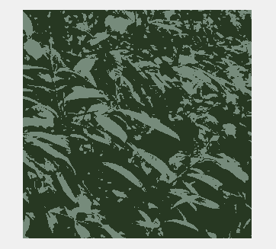
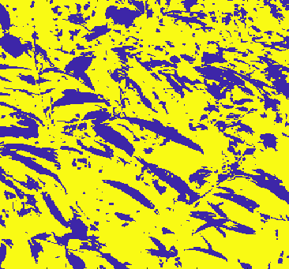
Flower Example
Cluster #
1
0
Two Clusters by
K-means
What??? points in the same cluster (e.g. Green)
are geographically separated from one another
Im(nx,nz,1)
Im(nx,nz,2)
{Im(1,1,1), Im(1,1,2), Im(1,1,3)}
These are not geographic coordinates, they
are RGB coordinates. So their separation is in RGB
space
Im(nx,nz,3)

Slide 5
Automatic Semblance Picking using Information Weighted Clustering Algorithms
Yuqing Chen (& GTS)
CSIM
King Abdullah University of Science and Technology

Slide 6
Outline
Motivation
Theory of Weighted Clustering Algorithms
Numerical Results
Conclusions

Slide 7
Outline
Motivation
Theory of Weighted Clustering Algorithms
Numerical Results
Conclusions

Slide 8
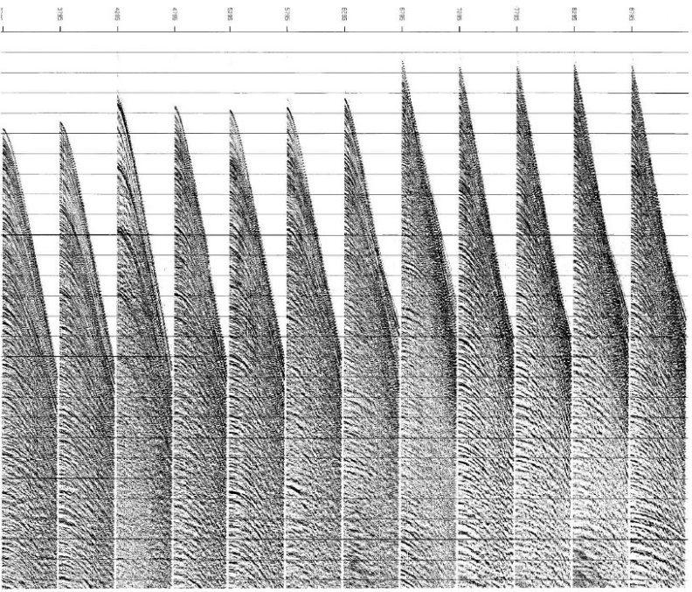
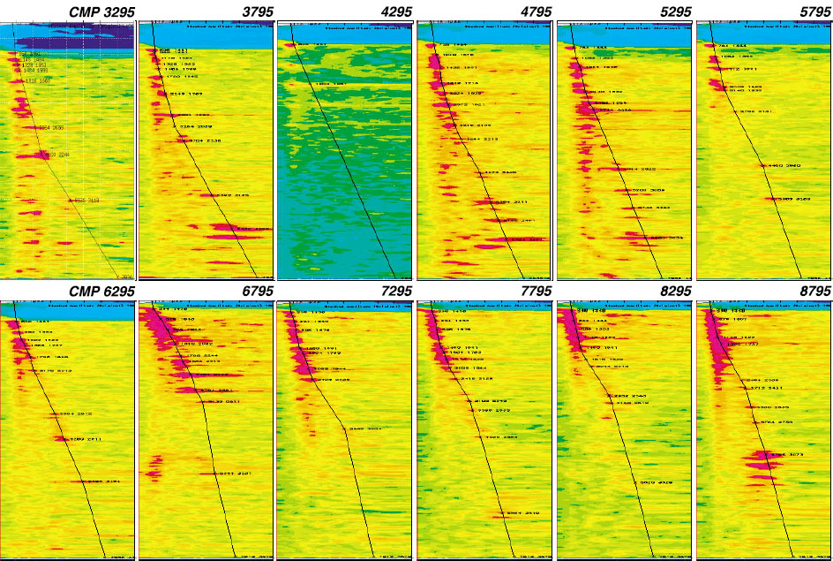
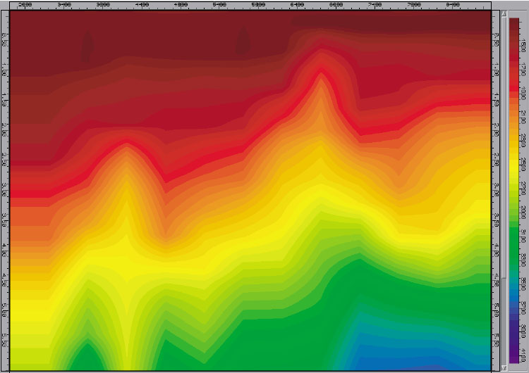
Motivation
Semblance picking is an important but tedious labor intensive processing procedure in the petroleum industry. For a large 3D dataset, this task becomes extremely time-consuming
CMP Gather
Velocity Spectrum Picking
NMO Velocity
(Cite from SEG Wikipedia)

Slide 9
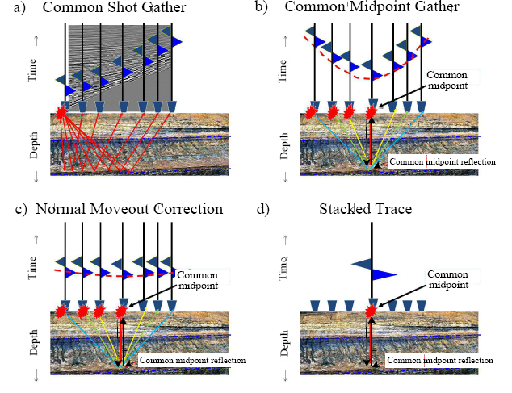
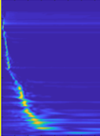
CMP Gathers + NMO →V_{NMO}
V_{NMO}
T(x)
T(x)=sqrt( (x/v_{NMO})² + T_{o}² )
T_{o}

Slide 10
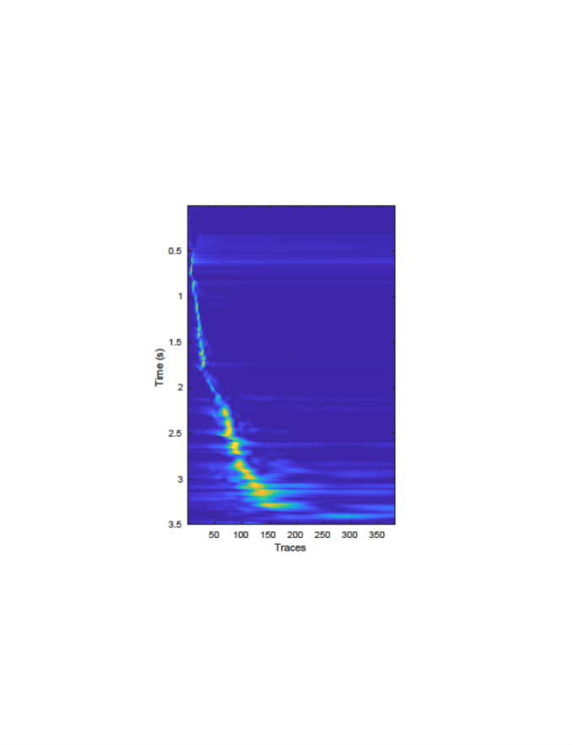
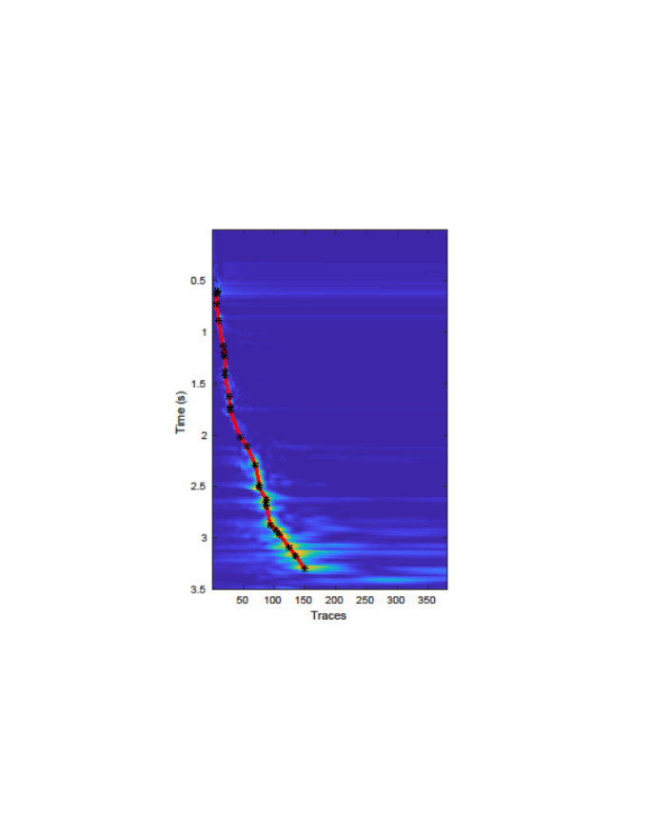
Solution
We present an automatic semblance picking technique based on the weighted clustering algorithm.
Velocity Spectrum
Velocity Spectrum
0
0
3.5
3.5
0
Velocity (km/s)
5.2
0
Velocity (km/s)
5.2

Slide 11
Outline
Motivation
Theory of Weighted Clustering Algorithms
Numerical Results
Conclusions

Slide 12








Steepest Descent Review
Predicted observed
Σ_{j} W_{ij} x_{j} = y_{i}
Given: (x,y) s.t. y= Wx
Find: W
Soln: W= X ⁻¹ y
Big misfit
error
How did we get W?
Initial guess
Model w⁽⁰⁾
ε
w₂
m^{(k)}
Smallest misfit error!
Our best soln w*.
Change in ε
ε
ε
ε
ε
$∂$
,
$∂$
,
$∂$
. . . .
$∂$
= ∇ε
= ( )
w*
Change in w_{i}
w₁
w₂
w₃
w_{N}
$∂$
$∂$
$∂$
$∂$
w₁
obs.-predicted
ε
Step 3: w^{(k+1)} = w^{(k)} - α∇ε
Step 1: ε= ½ ||y-Wx||²
Step 2: ∇ε=[Wx-y]∂(Wx)/ ∂w
-∇ε
Data Misfit or Objective Function
Gradient
Iterative Gradient Descent
ε = ½ (y -Wx)^{T}(y -Wx)
w₂
Recall: d½(mx-y)² = (mx-y)m
dx
w₁

Slide 13
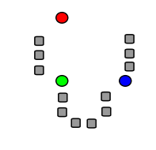
















2D feature
space
Theory: Standard K-means
Velocity Spectrum
Misfit Function
3x1 vectors
3D feature space
0
# pts in ith centroid
$$x=(t,v,AM)$$
m
$$ε=\frac{1}{2}\sum_{i=1}^{I}{\frac{1}{m_{i}}\sum_{j=1}^{{m }_{i}}{{\left\|C_{i}−x_{ij}\right\|}^{2}}}$$
Σ
^{i}
||C
x ||²
$$t :Time \left(s\right)$$
i
ij
$$v :Velocity \left(s\right)$$
$$AM:Magnitude$$
Time (s)
ith centroid
jth pt in ith centroid
# pts in ith centroid at kth iteration
Σ(C₁-x_{1 j})² + (C₂-x_{2 j})² +….(C_{i’}-x_{i’ j})² +…)
ε
$∂$
= Σ Σ (C_{i}-x_{i j})
$$\frac{1}{m_{i}}$$
3.5
C
0
5.2
$∂$
‘
‘
‘
Velocity (km/s)
i’
$$i=1$$
$$j=1$$
Steepest Descent
ε
m_{i}
m_{i}
$∂$
Σ (C_{i}-x_{ij})
Same step as in K-means: we take
average of points x_{ij} in i^{th} cluster with centroid C_{i}
to get the new centroid C_{i} . Then get the new members
of the new centroid C_{i}. Iterate.
Σ x_{ij}
C_{i} = C_{i} – α
= C_{i} -
$$\frac{1}{m_{i}}$$
$$\frac{1}{m_{i}}$$
= C_{i} – C_{i} +
C
$∂$
i
$$j=1$$
Step Length
$$j=1$$

Slide 14







Theory: Standard K-means
Misfit Function
3x1 vectors
Velocity Spectrum
$$x(t,v,M)$$
0
m
$$ε=\frac{1}{2}\sum_{i=1}^{I}{\frac{1}{m_{i}}\sum_{j=1}^{{m }_{i}}{{\left\|C_{i}−x_{ij}\right\|}^{2}}}$$
^{i}
||C
- x ||²
$$t :Time \left(s\right)$$
i
ij
$$v :Velocity \left(s\right)$$
$$AM:Magnitude$$
ith centroid
jth pt in ith centroid
Iterative updates
Time (s)
m^{(k)}
$$C_{i}^{(k+1)}=C_{i}^{(k}−\frac{1}{m_{i}}\sum_{j=1}^{m_{i}}{(C_{i}^{(k)}−{x }_{ij})}$$
^{i}
k=0, 1, 2…
C^{(k+1)} = C^{(k)}
(C^{(k)}
- x^{(k)} )
^{i}
^{i}
m^{(k)}
i
ij
^{i}
m^{(k)}
$$= \frac{1}{m_{i}}\sum_{j=1}^{m_{i}}{x_{ij}}$$
3.5
x^{(k)}
(Average)
0
Velocity (km/s)
5.2
m^{(k)}
ij
^{i}

Slide 15
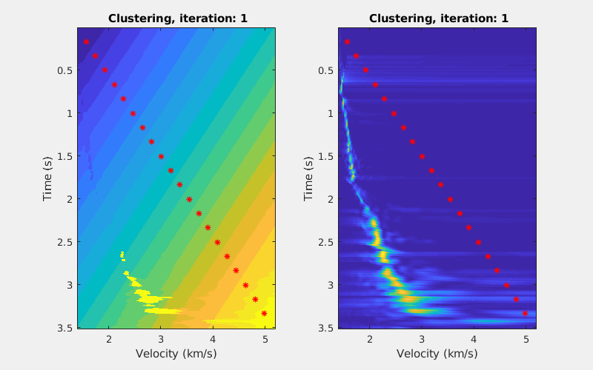
Theory: Standard K-means
(a) Different Classed and Centrals
(b) Velocity Spectrum and Picked Result

Slide 16
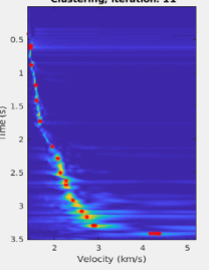

Probability Theory Review
Discrete Probability Mass Function (PMF) p_{i} :
1. 1≥ p_{i} ≥0 for i ε {0,1,…,N}
2. Σ_{i=1}^{N} p_{i} = 1
Fair Coin
Biased Coin
P_{i}
p_{i}
1
1/2
1
1/2
# of event types
2
i
2
i
Semblance Example :
A_{i} is the semblance amplitude of i^{th} pixel
e^{A}
_{i}
Softmax Probability Mass Function (PMF) p_{i} =
Σ_{j=1} e^{A}
^{N}
_{j}
$p_{ij}=\frac{e^{A_{ij}^{}}}{\sum_{j=1}^{m_{i}}{e^{A_{ij}}}} \&$ $\sum_{j=1}^{m_{i}}{p_{ij}}=$1
If a j^{th} point x_{ij} is in i^{th} Centroid then P_{ij} so

Slide 17
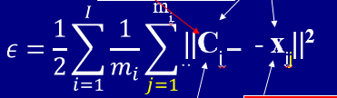
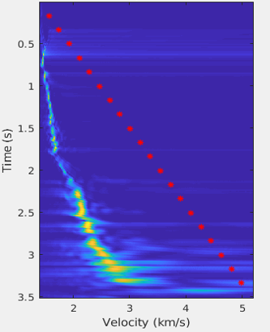
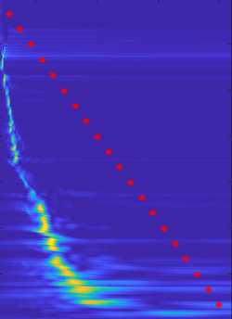

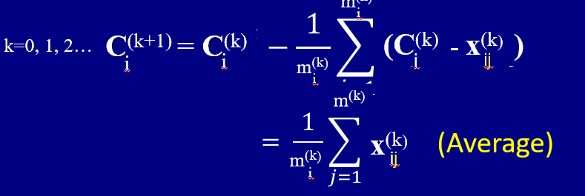


Theory: Weighted K-means
Fuzzy
Misfit Function
Softmax
ε = 0.5 Σ_{i} m_{i}⁻¹ Σ_{j} || C_{i} - x_{ij} ||²
$p_{ij}=\frac{e^{A_{ij}^{}}}{\sum_{j=1}^{m_{i}}{e^{A_{ij}}}} \&$ $\sum_{j=1}^{m_{i}}{p_{ij}}=$1
0.5 Σ_{i} m_{i}⁻¹ Σ_{j} || C_{i} - p_{ij} x_{ij} ||²
0.5 Σ_{i} m_{i}⁻¹ Σ_{j} || C_{i} - p_{ij} x_{ij} ||²
Iterative updates
(k)
$C_{i}^{(k+1)}=C_{i}^{(k)}−(C_{i}^{(k)}−\sum_{j=1}^{m_{i}}{p_{ij}x_{ij}}$)
(k)
(k)
(k)
$$= \sum_{j=1}^{m_{i}}{p_{ij}x_{ij}}$$
(k)
(k)
（Weighted Average）

Slide 18
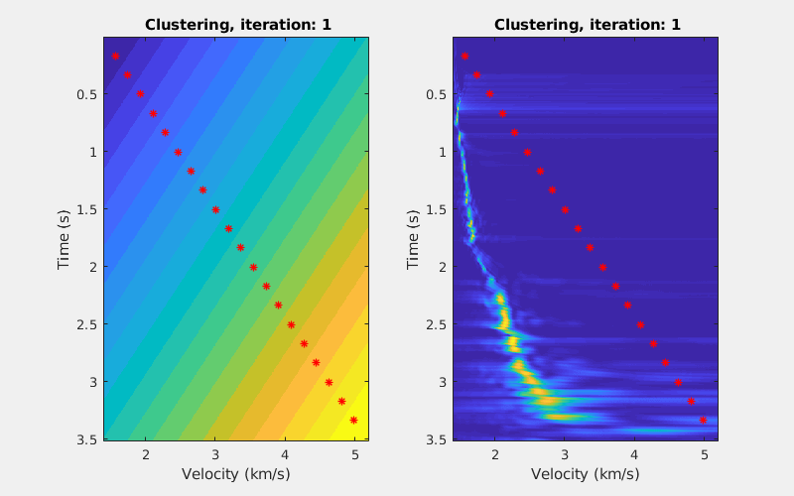
Theory: Weighted K-means
(a) Different Classed and Centrals
(b) Velocity Spectrum and Picked Result

Slide 19
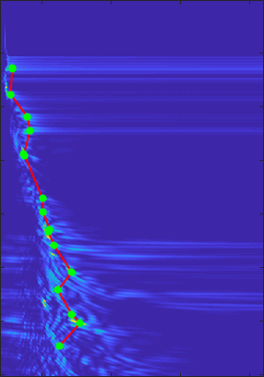
Theory: Local Tendency Regularization
Using local Tendency Regularization (LTR) to eliminate the picked outlier.
Velocity Spectrum
(a) Auto Pick w/o Regularization
0
Outliers..maybe
downgrade
Time (s)
Time (s)
3.5
1.5
5.2
Velocity (km/s)
Velocity (km/s)

Slide 20
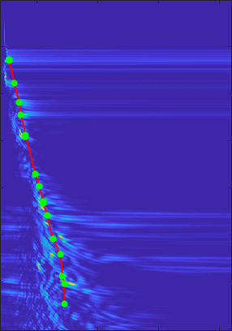
Theory: Local Tendency Regularization
Using local Tendency Regularization (LTR) to eliminate the picked outlier.
Velocity Spectrum
(a) Auto Pick w Regularization
0
Time (s)
Time (s)
3.5
1.5
5.2
Velocity (km/s)
Velocity (km/s)

Slide 21
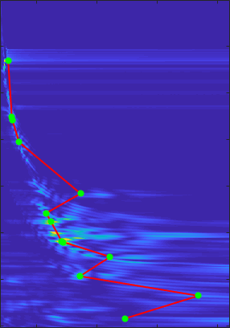
Theory: Local Tendency Regularization
Using local Tendency Regularization (LTR) to eliminate the picked outlier.
Velocity Spectrum
(b) Auto Pick w/o Regularization
0
Time (s)
Time (s)
3.5
1.5
5.2
Velocity (km/s)
Velocity (km/s)

Slide 22


Theory: Local Tendency Regularization
$$ε=\frac{1}{2}\sum_{i=1}^{K}{{\left\|C_{i}−\frac{1}{\sum_{j=1}^{m_{i}}{p_{ij}}}\sum_{j=1}^{m_{i}}{p_{ij}x_{ij}}\right\|}^{2}}$$
+ λ (|Σ_{i} (C_{i}^{priori} - C_{i})² (Regularization)
Using local Tendency Regularization (LTR) to eliminate the picked outlier.
Velocity Spectrum
(b) Auto Pick w Regularization
0
Time (s)
Time (s)
3.5
1.5
5.2
Velocity (km/s)
Velocity (km/s)

Slide 23
Outline
Motivation
Theory of Weighted Clustering Algorithms
Numerical Results
Conclusions

Slide 24
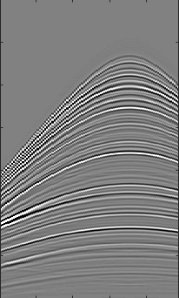
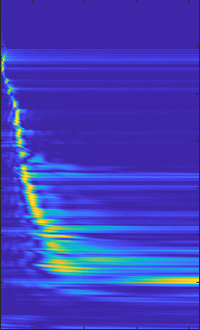
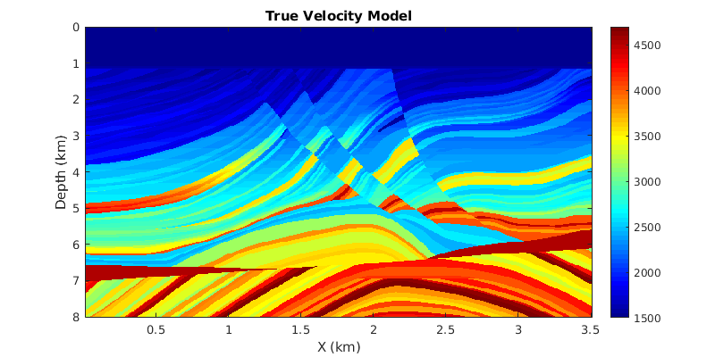
Marmousi Model
CMP Gather
Velocity Spectrum
True Velocity Model
km/s
0
0
4.8
Time (s)
Depth (km)
3.5
1.5
3.5
0
8
0
Traces (s)
86
0
Velocity (km/s)
5
X (km)

Slide 25
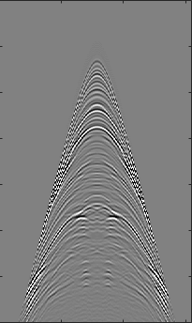
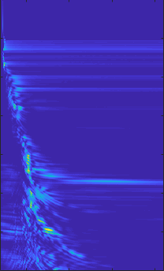
Synthetic Test
CMP Gather
Velocity Spectrum
True Velocity Model
km/s
0
0
4.8
Time (s)
Depth (km)
3.5
1.5
3.5
0
8
0
Traces (s)
300
0
Velocity (km/s)
5
X (km)

Slide 26
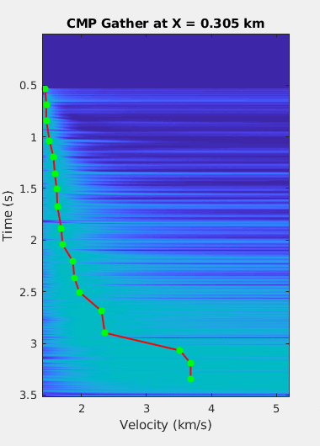
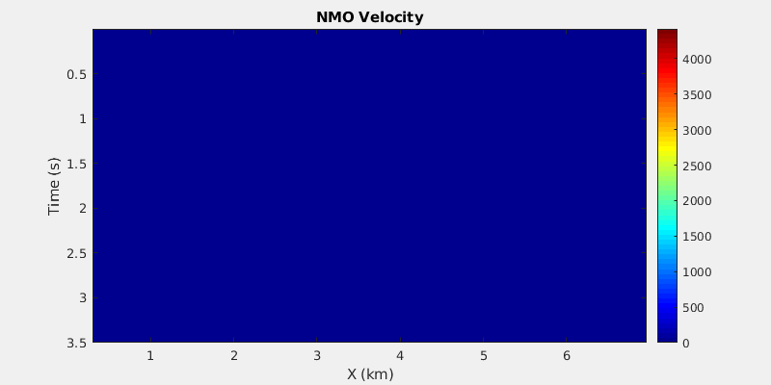
Synthetic Test
(1390 CMP gathers in total)

Slide 27
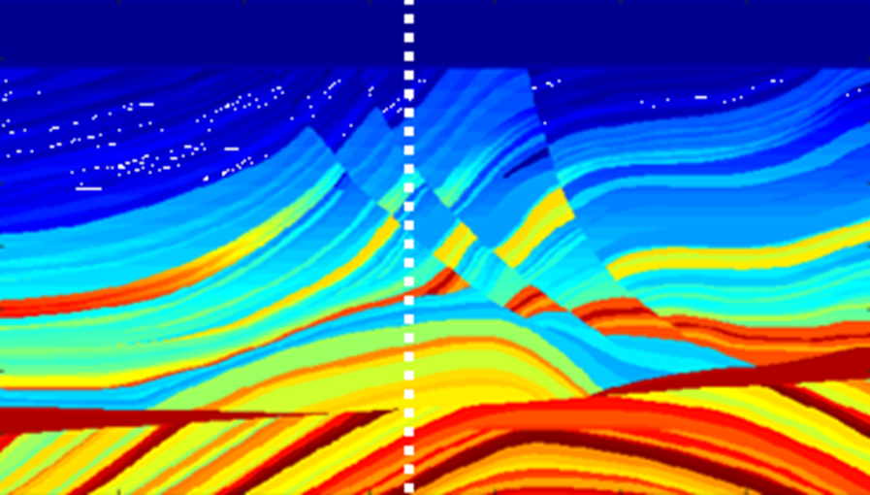
Synthetic Test

Slide 28
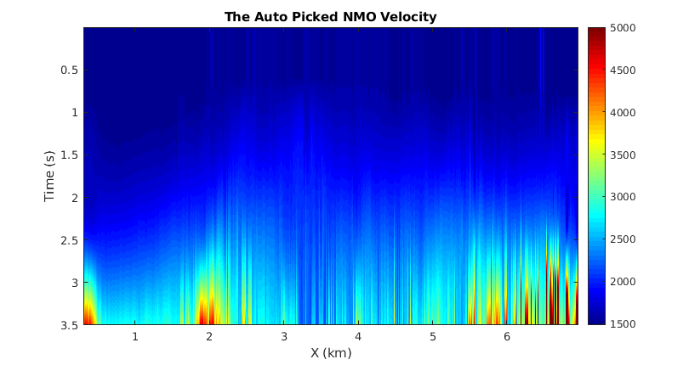
Synthetic Test

Slide 29
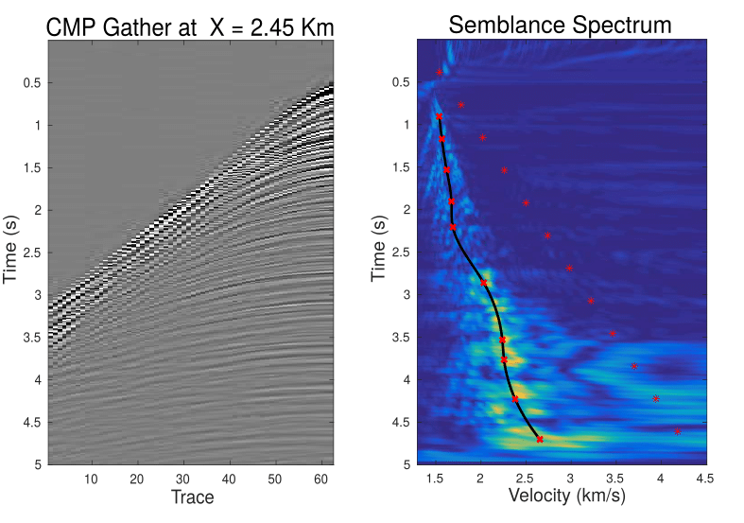
Field Data Test
CMP Gather
Auto Picked Result
0
0
Time (s)
Time (s)
5
5
0
60
1.3
4.5
Traces
Velocity (km/s)

Slide 30
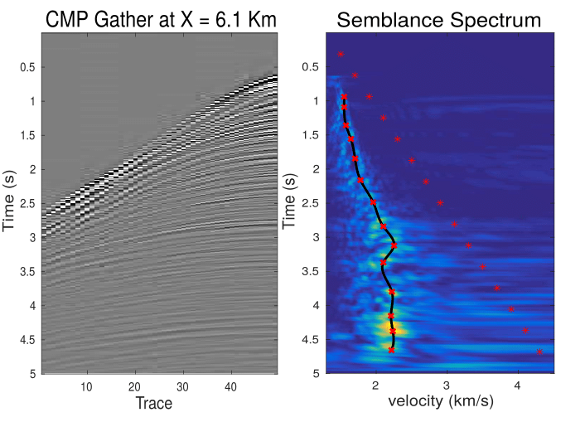
Field Data Test
CMP Gather
Auto Picked Result
0
0
Time (s)
Time (s)
5
5
0
60
1.3
4.5
Traces
Velocity (km/s)

Slide 31
Outline
Motivation
Theory of Weighted Clustering Algorithms
Numerical Results
Conclusions

Slide 32


Conclusion
Using weighted Clustering with local tendency regularization algorithm can
automatically picking semblance curve which dramatically reduced human
Labor.
More ‘rules’ need to be added to help distinguish between the good and
bad picks for better automatic picked result.

Slide 33


2D feature
space
Theory: Standard K-means
Misfit Function
3x1 vectors
3D feature space
Velocity Spectrum
# pts in ith centroid
$$x=(t,v,AM)$$
0
m
$$ε=\frac{1}{2}\sum_{i=1}^{I}{\frac{1}{m_{i}}\sum_{j=1}^{{m }_{i}}{{\left\|C_{i}−x_{ij}\right\|}^{2}}}$$
^{i}
||C
- x ||²
$$t :Time \left(s\right)$$
i
ij
$$v :Velocity \left(s\right)$$
$$AM:Magnitude$$
ith centroid
jth pt in ith centroid
Iterative updates
Time (s)
# pts in ith centroid at kth iteration
m^{(k)}
$$C_{i}^{(k+1)}=C_{i}^{(k}−\frac{1}{m_{i}}\sum_{j=1}^{m_{i}}{(C_{i}^{(k)}−{x }_{ij})}$$
^{i}
k=0, 1, 2…
C^{(k+1)} = C^{(k)}
(C^{(k)}
- x^{(k)} )
^{i}
^{i}
m^{(k)}
i
ij
^{i}
m^{(k)}
$$= \frac{1}{m_{i}}\sum_{j=1}^{m_{i}}{x_{ij}}$$
3.5
x^{(k)}
(Average)
0
Velocity (km/s)
5.2
m^{(k)}
ij
^{i}

