Slide 1

Support Vector Machine (binary)
x₃
New data
x₂
x₁
decision boundary (i.e. w_{ij}’s )
Part 1: Linear
Part 2: Dual Soln. + Non-Linear SVM
Lagrangian
Part 3: Kernel SVM
Part 4: Soft Margin SVM
Part 5: Summary

Slide 2
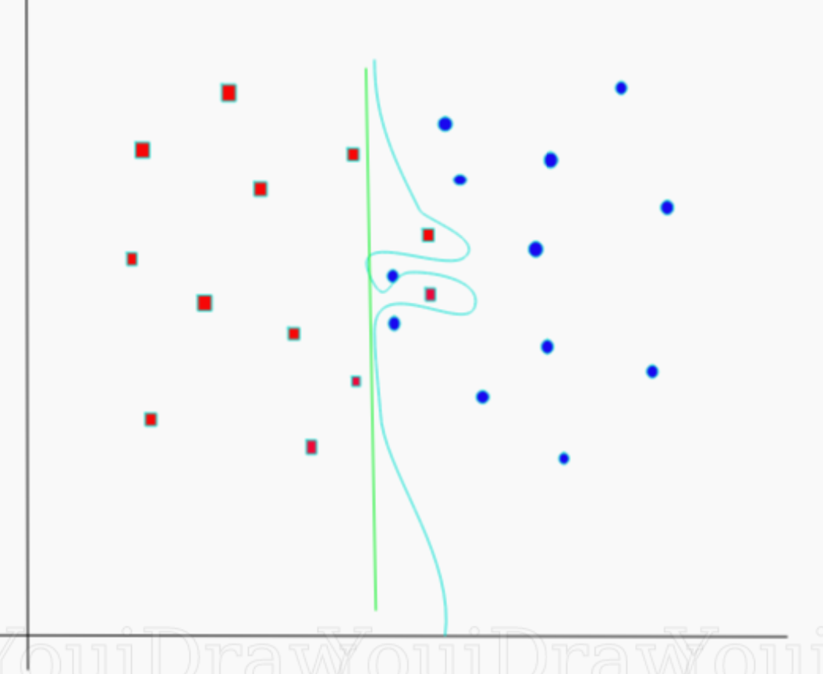
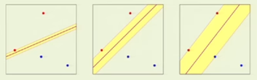
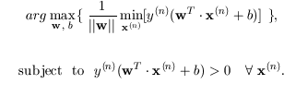
SVM Overfitting
Support Vector Machine
4
3
δ=1
2
1
Regularization Parameter C
Controls exactness of fit
1 2 3 4
Final Goal: Find (w,b) s.t.
import numpy as np
X = np.array([[-1, -1], [-2, -1], [1, 1], [2, 1]])
y = np.array([1, 1, 2, 2])
Input
from sklearn.svm import SVC
clf = SVC(kernel='linear')
clf.fit(X, y)
Train
Predict
prediction = clf.predict([[0,6]])

Slide 3



Soft Margin Classification
Sec. 15.2.1
Find w and b such that
Φ(w) =½ w^{T}w is minimized and for all {(x_{i} ,y_{i})}
y_{i} (w^{T}x_{i} + b) ≥ 1
  C : tradeoff parameter between reducing error
  (C>>>0) or increase margin thickness (C~0)
C
Slack variables->allowable errors
y_{i} (w^{T}x_{i} + b) $≥$ 1 – ξ_{i} & ξ_{i} $≥0$ ∀ i
y₅ (w^{T}x₅ + b) $≥$ 1 - ξ₅
y₅ (w^{T}x₅ + b) + y₅ (w^{T}Δx₅ + b) = y₅ (w^{T}x₅ + b) + ξ₅ $≥$ 1
Instead of ignoring x₅ we can move it!
What is mathematical formula for moving x₅?
Ah ha, much fatter, more robust margin thickness?
Penalty might be one misclassification (error) of x₅, but might be
worth it if you want to robustly label lots of new points ?
δ
If we could ignore then
Δx₅
x₅
What a waste with small δ,
just because of one point !
If C~0 then we allow many errors (shifted pts) to fatten margin
If C>>0 then we work hard to reduce errors (shifted pts) at
expense of thin margin

Slide 4
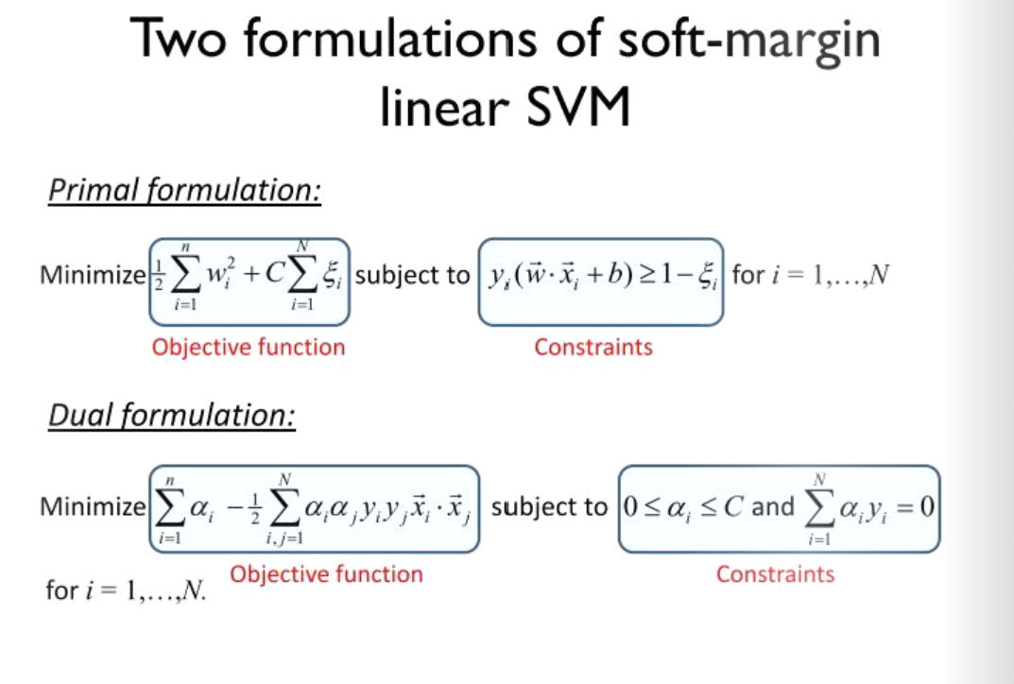
Soft Margin Classification
Sec. 15.2.1

