Slide 1
Support Vector Machine (binary)
x₃
New data
x₂
x₁
decision boundary (i.e. w_{ij}’s )
Part 1: Linear
Part 2: Dual Soln. + Non-Linear SVM
Lagrangian
Part 3: Kernel SVM
Part 4: Summary

Slide 2
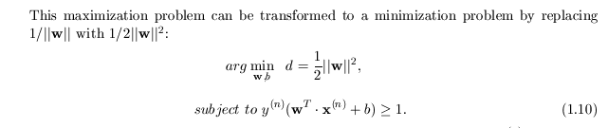
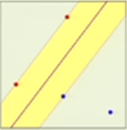
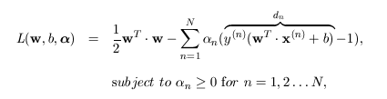


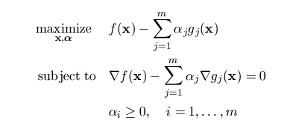



Dual Solution to SVM
Support Vector Machine
Support Vector Machine
regularizer
Find (w,b) s.t.:
+ λΣ_{n} (w^{T} •x^{(n)}+b)y^{(n)} - 1)
α_{n} =0 unless x_{n} is a support vector
where w^{T}x_{n} +b-1=0. Satisfying this for SVs→all x^{(n)}
Reduced Lagrangian
Find w,α that maximizes:
Find α that maximizes L(α) =
∂L/∂w_{i} = 0
∂L/∂b = 0
Solution: Quadratic Programming where we eliminate w,b in terms of α_{n}
Stationary
conditions
(2)
x^{(n)} ∀ support
vectors
Ah ha! Once QP finds α_{n}, then plug
into eq. 2 to get w. Then plug α_{n} into
w^{T}x+b=1 to get b. Now classify new data

Slide 3
Reduced Dual Solution to SVM
Support Vector Machine
Support Vector Machine
Find α_{n} s.t.:
NxN Matrix! Yikes,
N=#feature vectors.
QP needs O(N³) to solve
Correlation matrix=Dot products between x^{(n)} and x^{(m)}
α_{n} =0 unless x_{n} is a support vector
where w^{T}x_{n} +b-1=0
y⁽¹⁾ y⁽¹⁾ x⁽¹⁾• x⁽¹⁾ y⁽¹⁾ y⁽²⁾ x⁽¹⁾• x⁽²⁾ …… y⁽¹⁾ y^{(N)} x⁽¹⁾• x^{(N)}
y⁽²⁾ y⁽¹⁾ x⁽²⁾• x⁽¹⁾ y⁽²⁾ y⁽²⁾ x⁽²⁾• x⁽²⁾ …… y⁽²⁾ y^{(N)} x⁽²⁾• x^{(N)}
.… …. ….
y^{(N)} y⁽¹⁾ x^{(N)}• x⁽¹⁾ y^{(N)} y⁽²⁾ x^{(N)}• x⁽²⁾ …… y^{(N)} y^{(N)} x^{(N)}• x^{(N)}
maximize
1/2α^{T} α + (-1^{T})α
α
Hold everything! QP needs O(N³) to solve abone NxN matrix (N=# feature vectors) while the original primal problem only required Dx1 vector (w,b) costing O(M³). But if D<<<N so sounds like a horrible strategy unless D>>N. Well, D>>>N if we are solving non-linear (w,b) with high dimension, such as kernel method or small mini-batch

Slide 4
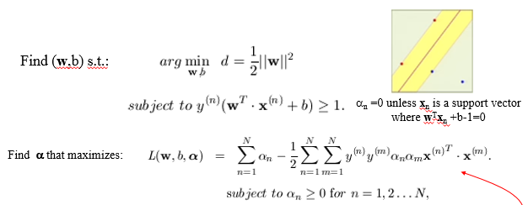

Summary: Dual Solution to SVM
Support Vector Machine
Support Vector Machine
Step 1: Transform Primal→Dual
Later, we learn
this is important for
Kernel trick for L be in
form of dot products
Step 2: Solve for α_{n} by QP
Step 3: Find w and b from α_{n} only for n associated with
support vectors (non-support vectors make matrix smaller)
w = Σ_{n} α_{n}y^{(n)}x^{(n)}
w^{T}x*+b = 1 → b = -w^{T}x*+1
Step 4: Classify new data x: w^{T}x+b-1>0 or w^{T}x+b-1<0?

Slide 5
Support Vector Machine (binary)
x₃
New data
x₂
x₁
decision boundary (i.e. w_{ij}’s )
Part 1: Linear
Part 2: Dual Soln. + Non-Linear SVM
Part 3: Kernel SVM
Part 4: Summary

Slide 6
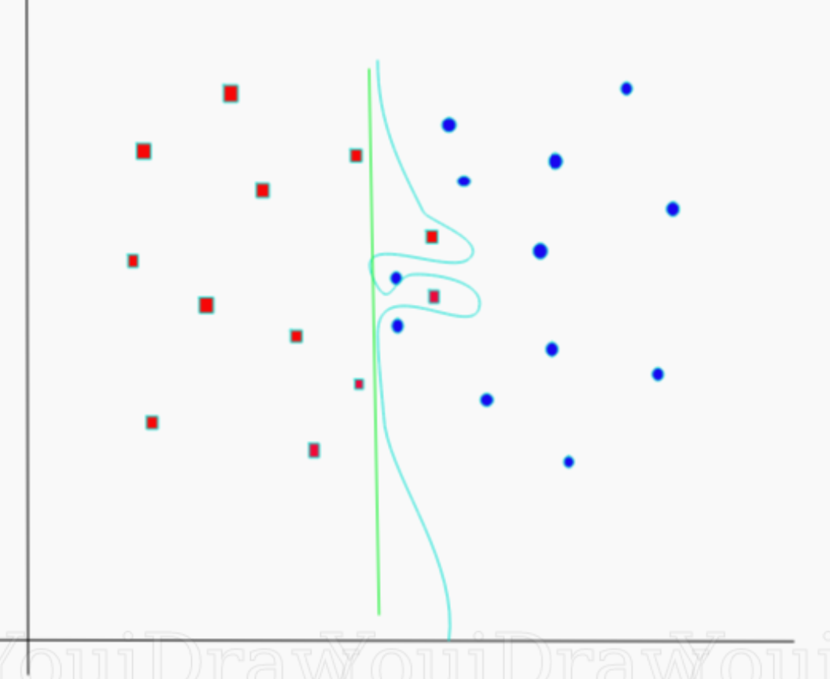
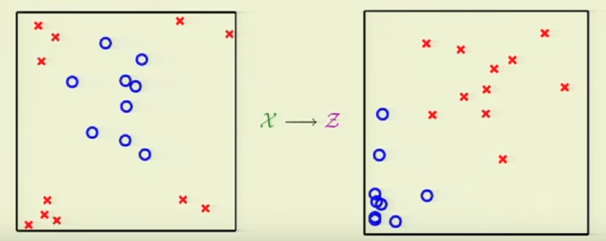


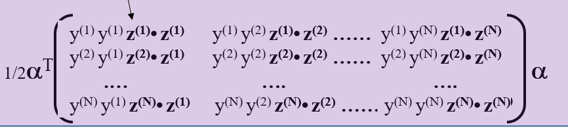
Non-Linear SVM
Support Vector Machine
Support Vector Machine
z₃
x₂
x₂
x₁
z₃
x
x
x
x
Pts on circle
map to same height
x₁
z₂
z₁
z₁
z₂
Step 1: Transform to z-space using polynomial transformation z_{i}=φ(x)_{i}
Step 2: (w,b) in in z-space
Penalty:
N_{z} > N_{x} → Higher costs
~
~
~
w = Σ_{n} α_{n}y^{(n)}z^{(n)} and w^{T} z+b=1
~
w = weighted sum of polynomials in (x^{(n)})^{p}
~
~
Step 3: For new pt x to be classified get x→z and plug into w^{T}z+b >0 or <0

Slide 7
Non-linear
Dual Solution to SVM
Support Vector Machine
Support Vector Machine
Non-linear Transform: x → z
Find α_{n} s.t.:
z^{(n)}• z^{(m)}
Correlation matrix=Dot products between x^{(n)} and x^{(m)}
Correlation matrix=Dot products between z^{(n)} and z^{(m)}
Recall: z^{(i)}=(ax₁^{(i)},bx₂^{(i)}, cx₁^{(i)2}+dx₂^{(i)3}…)
y⁽¹⁾ y⁽¹⁾ x⁽¹⁾• x⁽¹⁾ y⁽¹⁾ y⁽²⁾ x⁽¹⁾• x⁽²⁾ …… y⁽¹⁾ y^{(N)} x⁽¹⁾• x^{(N)}
y⁽²⁾ y⁽¹⁾ x⁽²⁾• x⁽¹⁾ y⁽²⁾ y⁽²⁾ x⁽²⁾• x⁽²⁾ …… y⁽²⁾ y^{(N)} x⁽²⁾• x^{(N)}
.… …. ….
y^{(N)} y⁽¹⁾ x^{(N)}• x⁽¹⁾ y^{(N)} y⁽²⁾ x^{(N)}• x⁽²⁾ …… y^{(N)} y^{(N)} x^{(N)}• x^{(N)}
y⁽¹⁾ y⁽¹⁾ z⁽¹⁾• z⁽¹⁾ y⁽¹⁾ y⁽²⁾ z⁽¹⁾• z⁽²⁾ …… y⁽¹⁾ y^{(N)} z⁽¹⁾• z^{(N)}
y⁽²⁾ y⁽¹⁾ z⁽²⁾• z⁽¹⁾ y⁽²⁾ y⁽²⁾ z⁽²⁾• z⁽²⁾ …… y⁽²⁾ y^{(N)} z⁽²⁾• z^{(N)}
.… …. ….
y^{(N)} y⁽¹⁾ z^{(N)}• z⁽¹⁾ y^{(N)} y⁽²⁾ z^{(N)}• z⁽²⁾ …… y^{(N)} y^{(N)} z^{(N)}• z^{(N)}
maximize
1/2α^{T} α + (-1^{T})α
α
~
~
~
w = Σ_{n} α_{n}y^{(n)}z^{(n)} and w^{T} z+b=1
~
~
Step 3: For new pt x to be classified get x→z and plug into w^{T}z+b >0 or <0

Slide 8
General Non-Linear SVM
Support Vector Machine
Support Vector Machine
Example I: Previously we did construction, specify z(x)→K(x,x’)
z = φ(x) = (1, x₁, x₂, x₁², x₂² , x₁ x₂ )
z’ = φ(y) = (1, y₁, y₂, y₁², y₂² , y₁ y₂ )
Easy K
Hard z
K(x, y)= z^{T} • z’ = 1+ x₁ y₁ + x₂ y₂ + x₁² y₁² + x₂²y₂² + x₁y₁ x₂y₂
Example II: Previously we did construction, now specify z(x)→K(x,x’).
How about specify K(x,y) and find z?
K(x, y) = (1+x^{T}y)² = (1+ x₁y₁ + x₂y₂)²
= (1+ x₁² y₁² + x₂² y₂² + 2x₁y₁ + 2x₂y₂ + 2x₁y₁ x₂y₂ )
z? Hard
z = φ(x) = (1, x₁² , x₂², √2 x₁, √2 x₂ , √2 x₁ x₂ )
z’ = φ(y) = (1, y₁² , y₂², √2 y₁, √2 y₂ , √2 y₁ y₂ )

Slide 9
General Non-Linear SVM
Support Vector Machine
Support Vector Machine
Example III: Gaussian kernel
K(x,x’) = exp(-(x-x’)²)
= exp(-x²)exp(-x’²)Σ_{k=1}^{infty} 2(x)^{k} (x’)^{k} /k!
= exp(-x²)exp(-x’²)[ 1 + 2xx’ +x² x’² + …]
Therefore z(x) = exp(-x²)[ 1 , √2x , x², …].
Infinite dimensional z !
Its ok, we only need K(x,x’) to classify new points!

Slide 10
Support Vector Machine (binary)
x₃
New data
x₂
x₁
decision boundary (i.e. w_{ij}’s )
Part 1: Linear
Part 2: Dual Soln. + Non-Linear SVM
Part 3: Kernel SVM
Part 4: Summary

Slide 11
Kernel
Non-linear
Dual Solution to SVM
Support Vector Machine
Support Vector Machine
Non-linear Transform: x → z
Find α_{n} s.t.:
z^{(n)}• z^{(m)}
Correlation matrix=Dot products between x^{(n)} and x^{(m)}
Correlation matrix=Dot products between z^{(n)} and z^{(m)}
Recall: z^{(i)}= φ(x^{(i)}) =(ax₁^{(i)},bx₂^{(i)}, cx₁^{(i)2}+dx₂^{(i)3}…)
z⁽¹⁾ ·z^{(N)}=φ(x⁽¹⁾)·φ(x^{(N)})=K(x⁽¹⁾, x^{(N})
y⁽¹⁾ y⁽¹⁾ x⁽¹⁾• x⁽¹⁾ y⁽¹⁾ y⁽²⁾ x⁽¹⁾• x⁽²⁾ …… y⁽¹⁾ y^{(N)} x⁽¹⁾• x^{(N)}
y⁽²⁾ y⁽¹⁾ x⁽²⁾• x⁽¹⁾ y⁽²⁾ y⁽²⁾ x⁽²⁾• x⁽²⁾ …… y⁽²⁾ y^{(N)} x⁽²⁾• x^{(N)}
.… …. ….
y^{(N)} y⁽¹⁾ x^{(N)}• x⁽¹⁾ y^{(N)} y⁽²⁾ x^{(N)}• x⁽²⁾ …… y^{(N)} y^{(N)} x^{(N)}• x^{(N)}
y⁽¹⁾ y⁽¹⁾ z⁽¹⁾• z⁽¹⁾ y⁽¹⁾ y⁽²⁾ z⁽¹⁾• z⁽²⁾ …… y⁽¹⁾ y^{(N)} z⁽¹⁾• z^{(N)}
y⁽²⁾ y⁽¹⁾ z⁽²⁾• z⁽¹⁾ y⁽²⁾ y⁽²⁾ z⁽²⁾• z⁽²⁾ …… y⁽²⁾ y^{(N)} z⁽²⁾• z^{(N)}
.… …. ….
y^{(N)} y⁽¹⁾ z^{(N)}• z⁽¹⁾ y^{(N)} y⁽²⁾ z^{(N)}• z⁽²⁾ …… y^{(N)} y^{(N)} z^{(N)}• z^{(N)}
maximize
1/2α^{T} α + (-1^{T})α
α
In general
y⁽¹⁾ y⁽¹⁾ K(x⁽¹⁾, x⁽¹⁾) y⁽¹⁾ y⁽²⁾ K(x⁽¹⁾, x⁽²⁾) ……. y⁽¹⁾ y^{(N)} K(x⁽¹⁾, x^{(N)})
y⁽²⁾ y⁽¹⁾ K(x⁽²⁾, x⁽¹⁾) y⁽²⁾ y⁽²⁾ K(x⁽²⁾, x⁽²⁾) …… y⁽²⁾ y^{(N)} K(x⁽¹⁾, x^{(N)})
.… …. ….
y^{(N)} y⁽¹⁾ K(x^{(N)}, x⁽¹⁾) y^{(N)} y⁽²⁾ K(x^{(N)}, x⁽²⁾) …… y^{(N)} y^{(N)} K(x^{(N)}, x⁽¹⁾)
maximize
1/2α^{T} α + (-1^{T})α
α
No Correlation needed, just specify K(x^{(n)},x^{(m)})

Slide 12
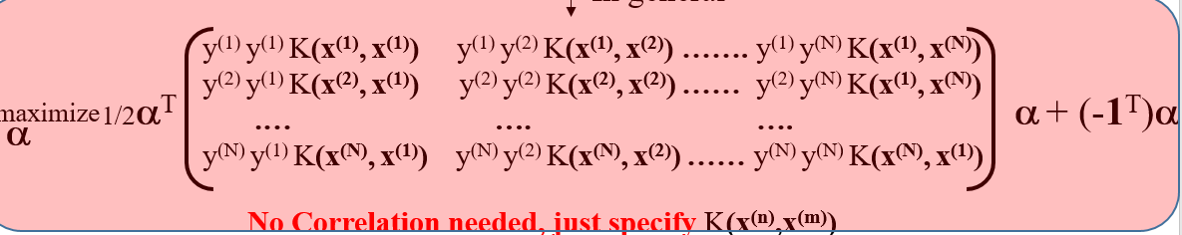
Dual Solution to SVM
Kernel
Support Vector Machine
Choose Gaussian Kernel:
K(x,x’) = exp(-(x-x’)²)
Step 1: Find α^{(n)} , ŵ & b in z-domain by QP
Step 2: Classify new x!
Problem: But once we get ŵ & b in z-domain we need z(x) to classify
new sample z! K(x,x’) doesn’t obviously give z.
If we had z then
ŵ=Σ_{n} α^{(n)} y^{(n)} z^{(n)} and g(x)=sign(ŵ^{T} •z + b) (eq. 1)
Wait a minute! Why did we choose K(x,x’)=exp(-(x-x’)²)?
Its ok, we only need K(x,x’) to classify new points!
x
How? Answer: ŵ=Σ_{n} α^{(n)} y^{(n)} z^{(n)} and g(x)=sign(ŵ^{T} •z + b)
Answer: Nearest neighbor interpolation!
obtained from dL/dw_{i} = 0
x=New point.
What class?
Substitute ŵ into g(x) gives g(x) = sign(Σ_{n} α^{(n)} y^{(n)} z^{(n)}•z + b)
Only nearest neighbor class counts
= sign(Σ_{n} α_{n} y_{n} K(x,x^{(n)} ) + b)→pred.
No need to find z, only specify K(x,x’)
b is obtained by setting z→z* so g(z*)=1 and find b

Slide 13
Support Vector Machine (binary)
x₃
New data
x₂
x₁
decision boundary (i.e. w_{ij}’s )
Part 1: Linear
Part 2: Dual Soln. + Non-Linear SVM
Part 3: Kernel SVM
Part 4: Summary

Slide 14
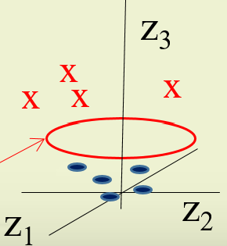
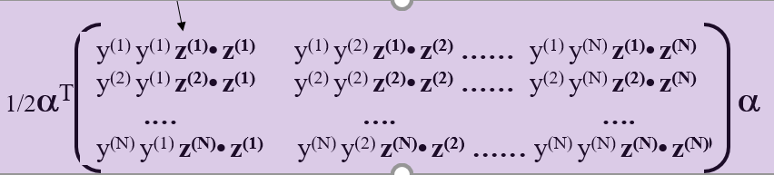
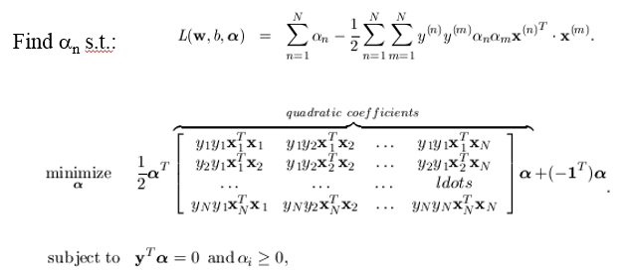

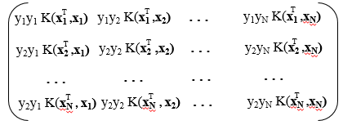
Summary: SVM
Linear SVM:
Going from lower dimension to higher allows us to find a
Decision surface, but at possible penalty of overfitting
Non-linear SVM:
Dual-Space SVM:
Kernel SVM:
Kernel trick: don’t compute ∞-dimensional
vector z(x), just specify K(x, x’) and find
α by QP. Then find prediction for new x by

Slide 15
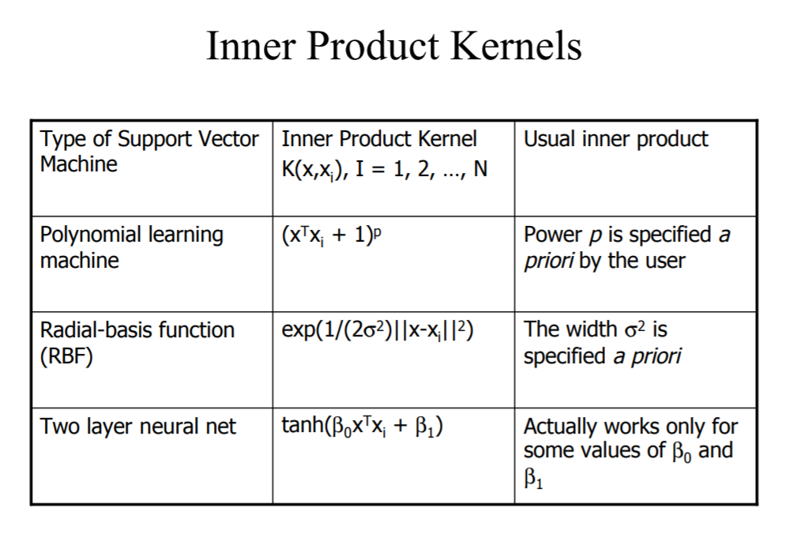
Summary: SVM

Slide 16
Resources
http://www.kernel-machines.org/
http://www.support-vector.net/
http://www.support-vector.net/icml-tutorial.pdf
http://www.kernel-machines.org/papers/tutorial-nips.ps.gz
http://www.clopinet.com/isabelle/Projects/SVM/applist.html

Slide 17
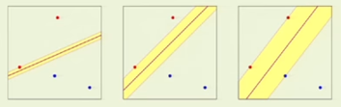
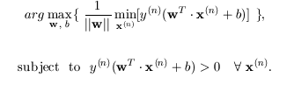
SVM Keras Code
Support Vector Machine
4
3
δ=1
2
1
C Controls exactness
of fit
1 2 3 4
Final Goal: Find (w,b) s.t.
import numpy as np
X = np.array([[-1, -1], [-2, -1], [1, 1], [2, 1]])
y = np.array([1, 1, 2, 2])
Input
from sklearn.svm import SVC
clf = SVC(kernel='linear')
clf.fit(X, y)
Train
Predict
prediction = clf.predict([[0,6]])

Slide 18



Soft Margin Classification
Sec. 15.2.1
Find w and b such that
Φ(w) =½ w^{T}w is minimized and for all {(x_{i} ,y_{i})}
y_{i} (w^{T}x_{i} + b) ≥ 1
  C : tradeoff parameter between reducing error
  (C>>>0) or increase margin thickness (C~0)
C
Slack variables->allowable errors
y_{i} (w^{T}x_{i} + b) $≥$ 1 – ξ_{i} & ξ_{i} $≥0$ ∀ i
y₅ (w^{T}x₅ + b) $≥$ 1 - ξ₅
y₅ (w^{T}x₅ + b) + y₅ (w^{T}Δx₅ + b) = y₅ (w^{T}x₅ + b) + ξ₅ $≥$ 1
Instead of ignoring x₅ we can move it!
What is mathematical formula for moving x₅?
Ah ha, much fatter, more robust margin thickness?
Penalty might be one misclassification (error) of x₅, but might be
worth it if you want to robustly label lots of new points ?
δ
If we could ignore then
Δx₅
x₅
What a waste with small δ,
just because of one point !
If C~0 then we allow many errors (shifted pts) to fatten margin
If C>>0 then we work hard to reduce errors (shifted pts) at
expense of thin margin

Slide 19
STOP

Slide 20
Soft Margin Classification
Sec. 15.2.1
If the training data is not linearly separable, slack variables ξ_{i} can be added to allow misclassification of difficult or noisy examples.
Allow some errors
  Let some points be moved to where they belong, at a cost
Still, try to minimize training set errors, and to place hyperplane “far” from each class (large margin)
ξ_{i}
ξ_{j}

Slide 21
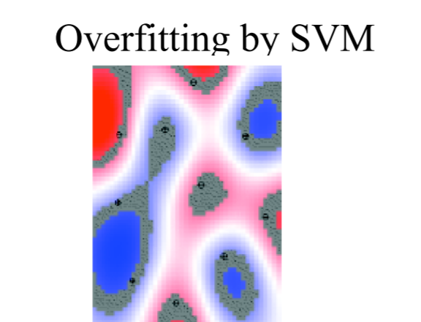
Summary: SVM

Slide 22
Soft Margin Classification Mathematically
Sec. 15.2.1
The old formulation:
The new formulation incorporating slack variables:
Parameter C can be viewed as a way to control overfitting
  A regularization term
Find w and b such that
Φ(w) =½ w^{T}w is minimized and for all {(x_{i} ,y_{i})}
y_{i} (w^{T}x_{i} + b) ≥ 1
Find w and b such that
Φ(w) =½ w^{T}w + CΣξ_{i} is minimized and for all {(x_{i} ,y_{i})}
y_{i} (w^{T}x_{i} + b) ≥ 1- ξ_{i} and ξ_{i} ≥ 0 for all i

Slide 23








Allowing errors in our solutions
We allow “error” ξ_{i} in classification; it is based on the output of the discriminant function w^{T}x+b
ξ_{i} approximates the number of misclassified samples
Class 2
Class 1

Slide 24
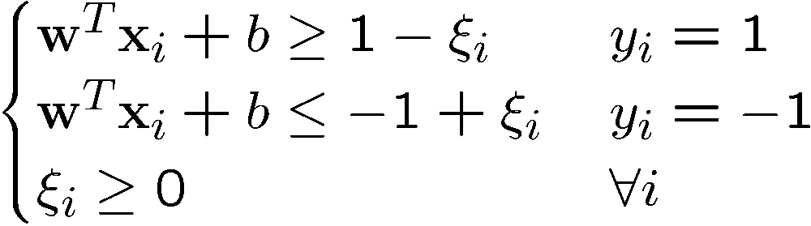
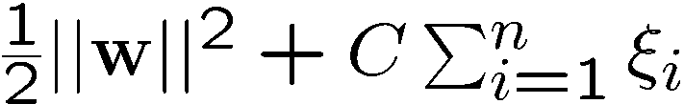
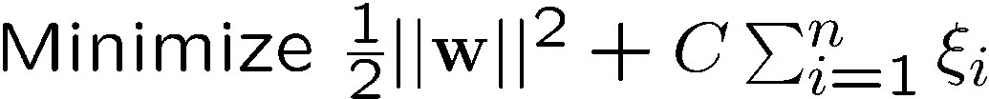
Soft Margin Hyperplane
If we minimize ∑_{i}ξ_{i}, ξ_{i} can be computed by
  ξ_{i} are “slack variables” in optimization
  Note that ξ_{i}=0 if there is no error for x_{i}
  ξ_{i} is an upper bound of the number of errors
We want to minimize
  C : tradeoff parameter between error and margin
The optimization problem becomes

Slide 25
Extension to Non-linear Decision Boundary
So far, we have only considered large-margin classifier with a linear decision boundary
How to generalize it to become nonlinear?
Key idea: transform x_{i} to a higher dimensional space to “make life easier”
  Input space: the space the point x_{i} are located
  Feature space: the space of φ(x_{i}) after transformation
Notes:
XOR: x_1, x_2, and we want to transform to x_1^2, x_2^2, x_1 x_2
It can also be viewed as feature extraction from the feature vector x, but now we extract more feature than the number of features in x.

Slide 26
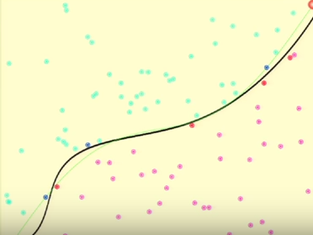

Summary: Kernel SVM
Support Vector Machine
Support Vector Machine
1. Pick suitable K(x,x’) = exp(-(x-x’)²) so that K symmetric
and positive semi-definite
Obj. Fcn. =Weighted sum of Gaussians
where we find optimal α_{n} for stationary ε
2. Solve for α_{n} the reduced Lagrangian
K(x^{(n)} ,x^{(m)} )
3. Classify new x by
g(x)= sign(Σ_{n} α_{n} y_{n} K(x,x_{n} ) + b)
Robust avg. sum over support
vectors in z-space
Exponential kernel ~ Only nearest neighbor class counts
K(x,x_{n} ) = exp(-(x-x_{n})²)
b is obtained by setting x→x* so g(x*)=1 and find b, where x*=support vector

Slide 27
Outline
Support Vector Machine
Support Vector Machine
Linear SVMt separator
Non-Linear SVMt separator
Dual Solutionseparator
Numerical Examples
Soft Margin SVM
Summary

Slide 28
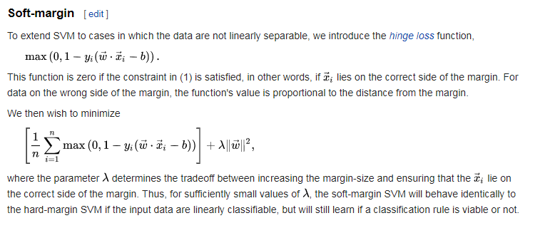
Soft Margin SVM

Slide 29
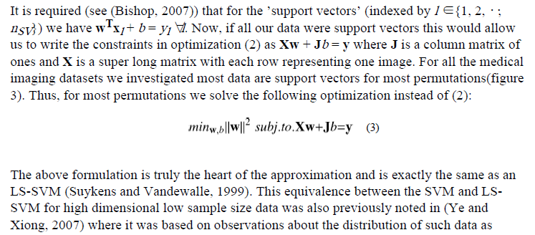
Soft Margin SVM
We start by noting that Vapnik Chervonenkis theory (Vapnik, 1995) dictates that linear classifiers shatter high dimension low sample size data. For example, 2 points labeled using any combination of positive and negative labels can always be separated by a line in 2D space.
Thus, when the dimensionality is in the millions while the sample sizes are in the hundreds,
one can always find ’hyperplanes’ (the high dimensional analogue to lines) that can separate
any possible labelling of points. Thus, when using linear SVMs, for any permutation of y
one can always find a separating hyperplane that perfectly separates the training data. This
allows us to use the hard margin SVM formulation from (Vapnik, 1995) instead of (1) for
further analysis in this paper.
Bilwaj Gaonkar and Christos Davatzikos, 2013,
Neuroimage. 2013 September ; 78: 270–283. doi:10.1016/
j.neuroimage.2013.03.066.
LS-SVM: If all x^{(n)} are support vectors then

Slide 30
Outline
Support Vector Machine
Support Vector Machine
Linear SVMt separator
Non-Linear SVMt separator
Dual Solutionseparator
Numerical Examples
Soft Margin SVM
Summary

Slide 31

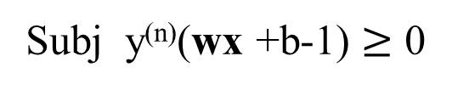
Primal & Dual Optimization Problems
With Inequality Constraints
Primal Problem
Dual Problem
Cheaper by quadratic programming
min f(w)=||W||²
max L = f(w) – α g(w)
w, b
w, α
Subj y^{(n)}(wx +b-1) $≥$ 0
Subj. L = ∇f(w) – α ∇g(w)=0
α$≥$ 0
w₂
f(w)
(wx +b-1)=0
w₁
w*=Minimum where
contours 1st “kiss”
Feasible
solutions

Slide 32
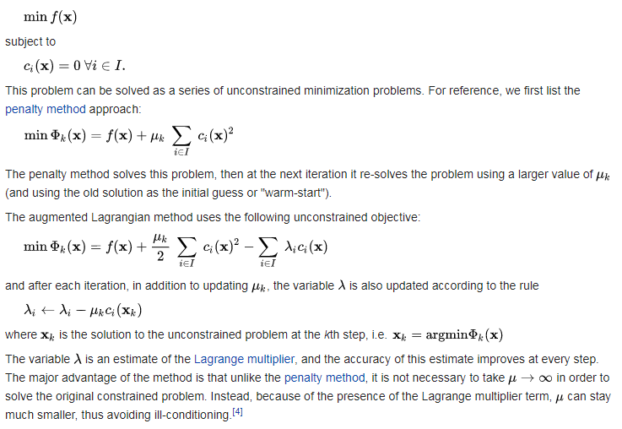
Augmnented Lagrangian

Slide 33
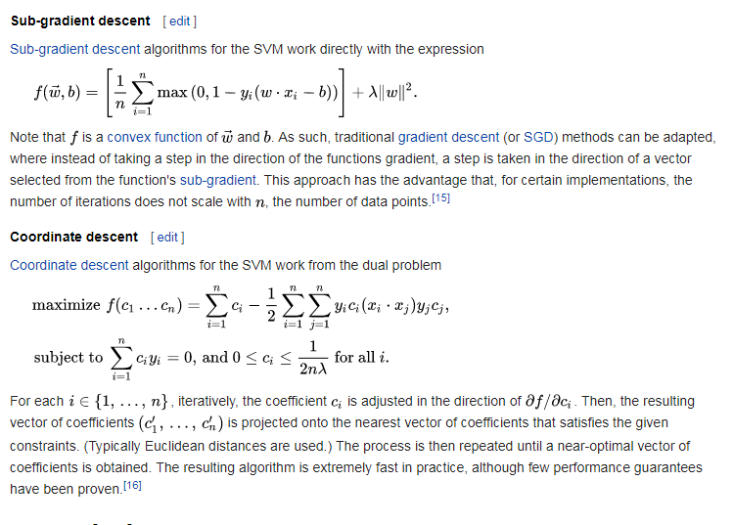
Gradient and Coordinate Descent

Slide 34
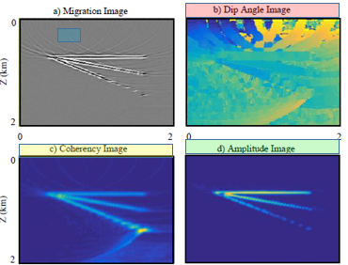

General Non-Linear SVM
Support Vector Machine
Support Vector Machine
x R^{D}
Dimension
of features
∋
Example I: Previously we transform x→z, specify z(x)→K(x,x’)
D’=6
z = φ(x) = (1, x₁, x₂, x₁², x₂² , x₁ x₂ )
z’ = φ(y) = (1, y₁, y₂, y₁², y₂² , y₁ y₂ )
Easy K
Hard z
K(x, y)= z^{T} • z’ = 1+ x₁ y₁ + x₂ y₂ + x₁² y₁² + x₂²y₂² + x₁y₁ x₂y₂
If D’ for z >>> D for x then big compute increase
Example II: Previously we did construction, now specify z(x)→K(x,x’).
How about specify K(x,y) and find z?
K(x, y) = (1+x^{T}y)² = (1+ x₁y₁ + x₂y₂)²
= (1+ x₁² y₁² + x₂² y₂² + 2x₁y₁ + 2x₂y₂ + 2x₁y₁ x₂y₂ )
z? Hard
z = φ(x) = (1, x₁² , x₂², √2 x₁, √2 x₂ , √2 x₁ x₂ )
z’ = φ(y) = (1, y₁² , y₂², √2 y₁, √2 y₂ , √2 y₁ y₂ )

Slide 35
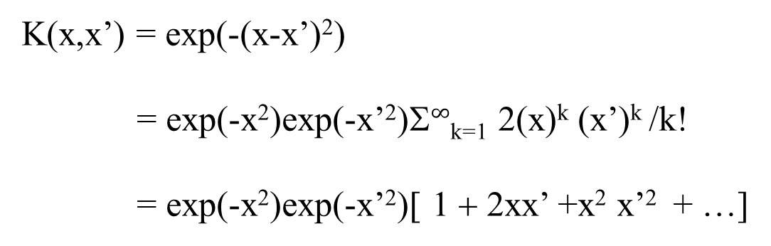
General Non-Linear SVM
Support Vector Machine
Support Vector Machine
Example III: Gaussian kernel
K(x,x’) = exp(-(x-x’)²)
= exp(-x²)exp(-x’²)Σ$∞$_{k=1} 2(x)^{k} (x’)^{k} /k!
= exp(-x²)exp(-x’²)[ 1 + 2xx’ +x² x’² + …]
Therefore z(x) = exp(-x²)[ 1 , √2x , x², …].
Infinite dimensional z !
Its ok, we only need K(x,x’) to classify new points!
Why? Answer: ŵ=Σ_{n} α^{(n)} y^{(n)} z^{(n)} and g(x)=sign(ŵ^{T} •z + b)
obtained from dL/dw_{i} = 0
Substitute ŵ into g(x) gives g(x) = sign(Σ_{n} α^{(n)} y^{(n)} z^{(n)}•z^{(n)} + b)
No need to find z, only specify K(x,x’)
= sign(Σ_{n} α_{n} y_{n} K(x,x^{(n)} ) + b)→pred.
b is obtained by setting x→x* so g(x*)=1 and find b

Slide 36
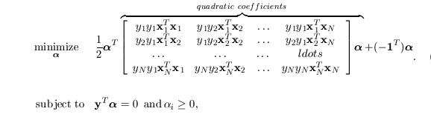

Kernel SVM
Support Vector Machine
Support Vector Machine
Find α_{n} s.t.:
T
…
T
T
y₁y₂ K(x₁ ,x₂)
y₁y_{N} K(x₁ ,x_{N})
y₁y₁ K(x₁ ,x₁)
T
…
T
T
y₂y₂ K(x₂ ,x₂)
y₂y_{N} K(x₂ ,x_{N})
y₂y₁ K(x₂ ,x₁)
…
…
…
…
T
…
T
T
y₂y₂ K(x_{N} , x₂)
y₂y_{N} K(x_{N} ,x_{N})
y₂y₁ K(x_{N} , x₁)
Substitute Gaussian kernel
K(x_{n} ,x_{m}) = exp(-(x_{n} –x_{m})²)
Because z_{n}z_{m}=ax_{n}x_{m} + bx_{n}² x_{n}^{2…..}
⁼ exp(-(x_{n} –x_{m})²)

Slide 37
General Non-Linear SVM
Support Vector Machine
Support Vector Machine
Step 1: Transform to z-space using polynomial transformation z_{i}=φ(x)_{i}
We did this
by construction
Step 2: (w,b) in in z-space
Penalty:
N_{z} > N_{x} → Higher costs
Dx1→D_{z}x1
~
Step 3: For new pt x to be classified get x→z(x) and plug into w^{T}z+b-1
Step 3: Transform Primal→Dual
~
~
~
z^{(n)}
~
z^{(n)T}
z^{(m)T}

Slide 38
General Non-Linear SVM
Support Vector Machine
Support Vector Machine
Step 3: Transform Primal→Dual
~
~
~
z^{(n)}
~
z^{(n)T}
z^{(m)T}

Slide 39
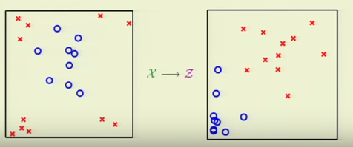
General Non-Linear SVM
Support Vector Machine
Support Vector Machine
Step 3: Transform Primal→Dual
NxN matrix to invert, not a D_{z}xD_{z}
~
~
z^{(n)}
~
z^{(n)T}
z^{(m)}
N
Two good things:
1. O(NxN) rather than much larger O(D_{z}xD_{z}) matrix
2. Instead of an explicit construction of φ(x)_{i}=z_{i} we
only need to specify k(x^{(n)},x^{(m)})=z^{(n)T}•z^{(m)} without tedious
specification of φ(x)_{i}=z_{i}, which could be infinite dimensional.
T
T
T
y₁y₁ z₁ •z₁
y₁y₂ z₁ •z₂ …… y₁y₂ z₁ •z_{N}
T
T
T
y₂y₁ z₁ •z₂
y₂y₂ z₂ •z₂ …… y₂y_{N} z₂ •z_{N}
…
…
…
…
T
T
T
y_{N}y₁ z_{N}•z₁
y_{N}y₂ z_{N} •z₂ …… y_{N}y_{N} z_{N} •z_{N}

Slide 40
Optimization Problem and Lagrangian Optimization Problem
Q:Why α>0?
A: ∇g and ∇f
same direction!
f(x)
g(x)= -(x²+y²)^{1/2} +3
3 4 5
2 1 0 -1
x*=Minimum where
contours 1st “kiss” at green
Lagrangian: L(x,α)=f(x) - αg(x)
Kiss: ∇L(x,α)=∇f(x) - α∇g(x)=0

Slide 41
Optimization Problem and Lagrangian Optimization Problem
Q:Why α>0?
A: ∇g and ∇f
same direction!
f(x)
Kiss curve ∇L=0
where α=|∇f|/|∇g|
α goes from 0 at purple dot
to increase along purple-dash curve → red dot
Parameterize x=x(α)
along purple-dash curve
dL/dα=0
g(x)= -(x²+y²)^{1/2} +3
dL/dα<0
dL/dα>0
L(x)
3 4 5
x*
x(α)
dL/dα=-g(x)
2 1 0 -1
Q: Why maximize L?
A: dL/dα<0 to left of x*
and >0 to right of x*
x*=Minimum where
contours 1st “kiss” at green
Lagrangian: L(x,α)=f(x) - αg(x)
Kiss: ∇L(x,α)=∇f(x) - α∇g(x)=0
Problem! ∇L(x,α)=∇f(x) - α∇g(x)=0 kisses at many other points besides x*
Solution: dL(x*,α)/dα=0 at x* and dL/dα<0 to left of x*
and >0 to right of x*

Slide 42
Optimization Problem and Lagrangian Optimization Problem
Q:Why α>0?
A: ∇g and ∇f
same direction!
f(x)
Kiss curve
∇L=0
f(x)
g(x)= (x²+y²)^{1/2} -3
3 4 5
3 4 5
2 1 0 -1
2 1 0 -1
x*=Minimum where
contours 1st “kiss” at green
x*=Minimum where
contours 1st “kiss” at green
Lagrangian: L(x,α)=f(x) - αg(x)
Kiss: ∇L(x,α)=∇f(x) - α∇g(x)=0
dL/dα=0
Therefore, L(x,α) is a maximum at x* along
Kiss curve where ∇L(x,α)=0
L(x)
dL/dα>0
dL/dα>0
x

Slide 43
Kiss curve
∇L=0
f(x)
Q:Why α>0?
A: ∇g and ∇f
same direction!
g(x)= -(x²+y²)^{1/2} +3
3 4 5
2 1 0 -1
x*=Minimum where
contours 1st “kiss” at green
dL/dα=0
Therefore, L(x,α) is a maximum at x* along
Kiss curve where ∇L(x,α)=0
L(x)
dL/dα>0
dL/dα>0
x

Slide 44
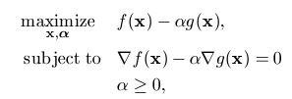

Kiss curve
∇L=0
f(x)
g(x)= (x²+y²)^{1/2} -3
3 4 5
Q:Why α>0?
A: ∇g and ∇f
same direction!
2 1 0 -1
x*=Minimum where
contours 1st “kiss” at green
dL/dα=0
Therefore, L(x,α) is a maximum at x* along
Kiss curve where ∇L(x,α)=0
L(x)
dL/dα>0
dL/dα>0
x

Slide 45


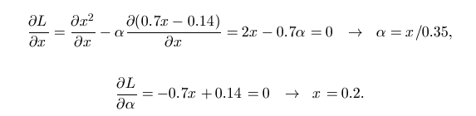
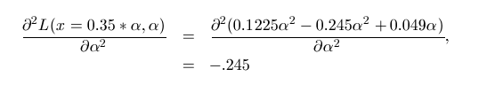
Optimization Problem and Lagrangian Optimization Problem
0.2
L(x,α)
α=.02
α=.01
0
x*=.2
0 0.5 1
x
Ah-ha, purple curve must be a maximum at blue point x*=.2

Slide 46
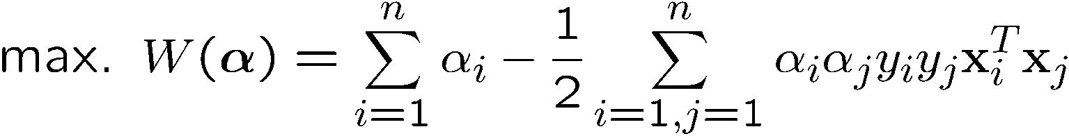
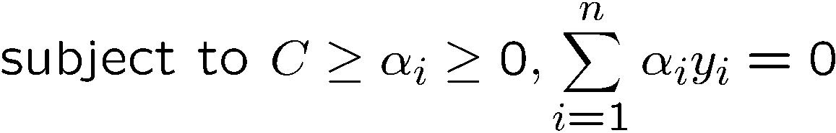
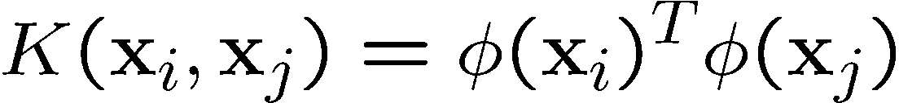
The Kernel Trick
Recall the SVM optimization problem
The data points only appear as inner product
As long as we can calculate the inner product in the feature space, we do not need the mapping explicitly
Many common geometric operations (angles, distances) can be expressed by inner products
Define the kernel function K by

Slide 47
An Example for φ(.) and K(.,.)
Suppose φ(.) is given as follows
An inner product in the feature space is
So, if we define the kernel function as follows, there is no need to carry out φ(.) explicitly
This use of kernel function to avoid carrying out φ(.) explicitly is known as the kernel trick

Slide 48
More on Kernel Functions
Not all similarity measures can be used as kernel function, however
  The kernel function needs to satisfy the Mercer function, i.e., the function is “positive-definite”
This implies that
    the n by n kernel matrix,
    in which the (i,j)-th entry is the K(x_{i}, x_{j}), is always positive definite
This also means that optimization problem can be solved in polynomial time!

Slide 49

Examples of Kernel Functions
Polynomial kernel with degree d
Radial basis function kernel with width σ
  Closely related to radial basis function neural networks
  The feature space is infinite-dimensional
Sigmoid with parameter κ and θ
  It does not satisfy the Mercer condition on all κ and θ
Notes:
Despite violating Mercer condition, the sigmoid kernel function can still work

Slide 50
Non-Linear SVM
Support Vector Machine
Support Vector Machine
Linear SVM doesn’t work if x^{(n)} not separable
z₂
x₂
Non-linear
Mapping
such as z₁ =x₁²
z₂= x₁ +x₂⁴
x₁
z₁
Apply Linear SVM
in z-domain to get (w,b)*

Slide 51
Support Vector Machine
Support Vector Machine
Step 1: Transform to z-space using polynomial transformation z_{i}=φ(x)_{i}
Step 2: Linear SVM in z-space
Penalty:
N_{z} > N_{x} → Higher costs

