Slide 1
Support Vector Machine (binary)
x₃
New data
x₂
x₁
decision boundary (i.e. w_{ij}’s )
Part 1: Linear
Part 2: Dual Soln. + Non-Linear SVM
Part 3: Kernel SVM
Part 4: Summary

Slide 2
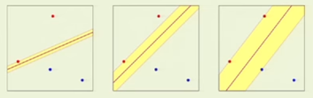

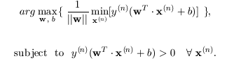

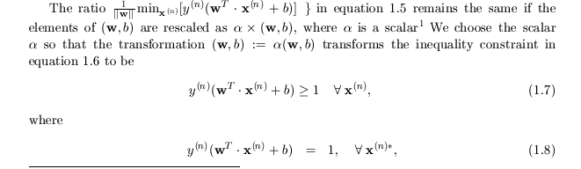

Linear SVM Theory
Support Vector Machine
4
20
3
15
δ=1
2
10
1
5
1 2 3 4
5 10 15 20
Final Goal: Find (w,b) s.t.
Scale x^{(n)} so minimum margin thickness δ=min|w^{T}·x^{(n)}+b| =1
Hence max 1/||w|| with norm x interpreted as → margin thickness
Equivalently min||w|| with norm x interpreted as → inverse margin thickness
Points x_{n}* on margin boundary are support vectors
*

Slide 3
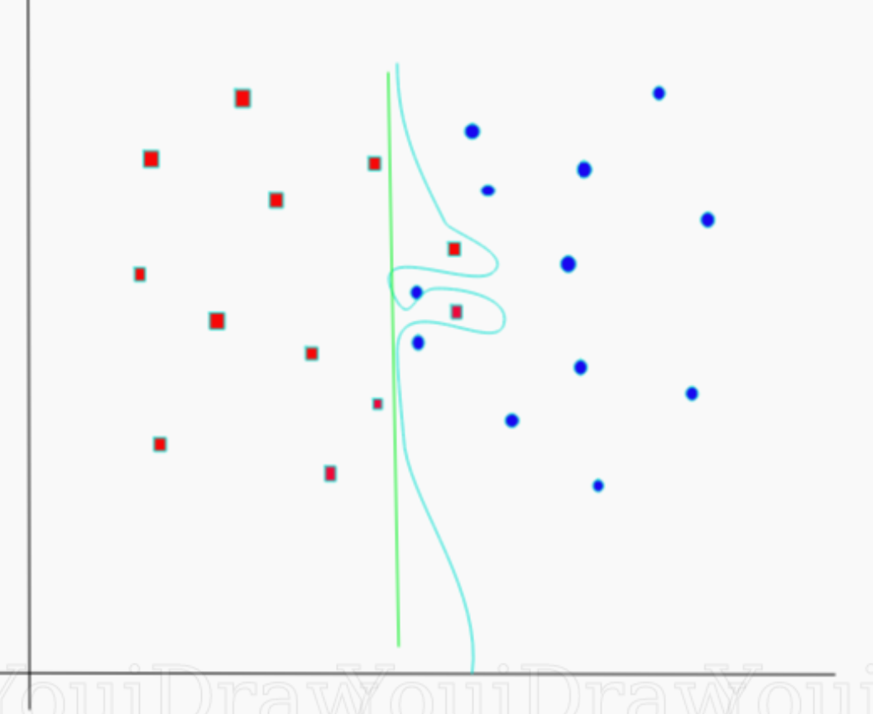
SVM Keras Code
Support Vector Machine
4
3
δ=1
2
1
Controls exactness
of fit
1 2 3 4
Final Goal: Find (w,b) s.t.
import numpy as np
X = np.array([[-1, -1], [-2, -1], [1, 1], [2, 1]])
y = np.array([1, 1, 2, 2])
Input
from sklearn.svm import SVC
clf = SVC(kernel='linear')
clf.fit(X, y)
Train
Predict
prediction = clf.predict([[0,6]])

Slide 4
Support Vector Machine (binary)
x₃
New data
x₂
x₁
decision boundary (i.e. w_{ij}’s )
Part 1: Linear
Part 2: Dual Soln. + Non-Linear SVM
Example
Part 3: Kernel SVM
Part 4: Summary

Slide 5
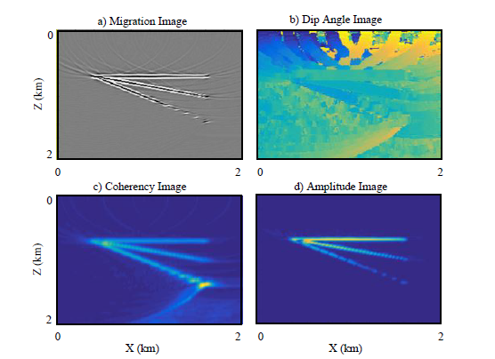
SVM Numerical Example
[(x₁,x₂,x₃),y]=[(dip, coherency,amp), noise/signal]
Support Vector Machine
Support Vector Machine
X₁ x₂ x₃ x₄ y
1 2 -2 3 1
5 -1 5 1 0
.
.
.
.
.
.
.
.
.
.
.
.
.
.
.
.
.
.
.
.
-2 -3 9 1 1
Yuqing Chen

Slide 6
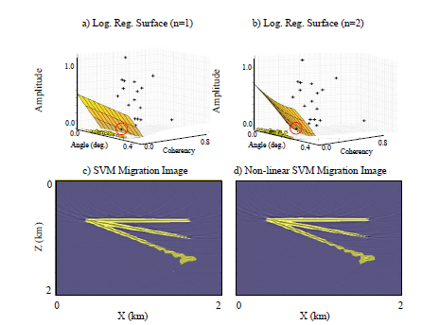
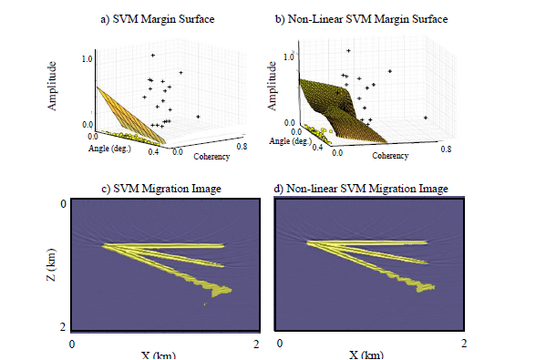
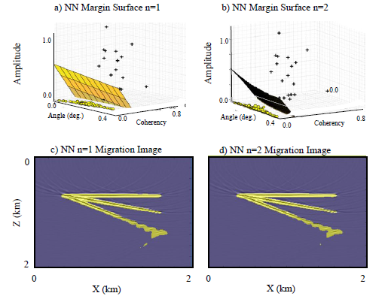
Numerical Example
Support Vector Machine
Support Vector Machine
Log. Reg. n=1 Migration Image
Log. Reg. n=2 Migration Image
Yuqing Chen

Slide 7
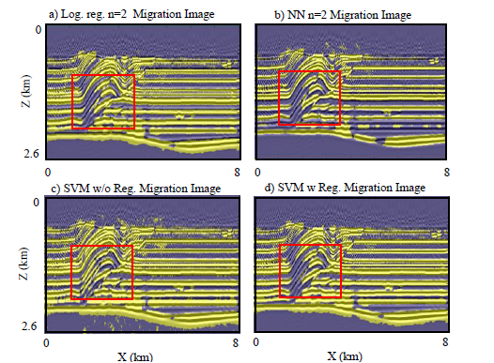
Numerical Example
Support Vector Machine
Support Vector Machine
Yuqing Chen

Slide 8
Support Vector Machine (binary)
x₃
New data
x₂
x₁
decision boundary (i.e. w_{ij}’s )
Part 1: Linear
Part 2: Dual Soln. + Non-Linear SVM
Part 3: Kernel SVM
Part 4: Summary

Slide 9
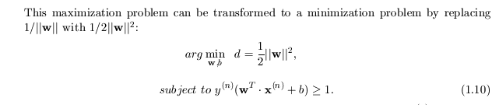
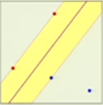
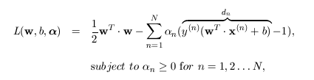
Dual Solution to SVM
Best solution is when all the d_{n}
are positive. So we can’t
just add it to ||w||². We have to subtract it!
Support Vector Machine
Support Vector Machine
Primal Problem:
regularizer
Find (w,b) s.t.:
+ λΣ_{n} (w^{T} •x^{(n)}+b)y^{(n)} - 1)
α_{n} =0 unless x_{n} is a support vector
where w^{T}x_{n} +b-1=0
Dual Problem:
Find α,w,b that maximizes:
and ∇L = 0
For a highly non-linear SVM it is sometimes too expensive→optimal (w,b).
It can be shown that replacing the Primal problem with Dual problem
can sometimes reduce computational cost of finding (w,b) and
classifying new pairs (x^{(n)},y^{(n)}).
However, main importance of dual formulation is that it leads to an objective function
with arguments x^{(n)} ·x^{(k)} → Kernel trick

Slide 10
Support Vector Machine (binary)
x₃
New data
x₂
x₁
decision boundary (i.e. w_{ij}’s )
Part 1: Linear
Part 2: Dual Soln. + Non-Linear SVM
Lagrangian
Part 3: Kernel SVM
Part 4: Summary

Slide 11
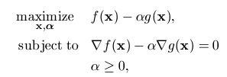

Primal & Dual Optimization Problems
With Inequality Constraints
Primal Problem
Dual Problem
Sometimes cheaper by quadratic programming
f(x)
valley
g(x)= -(x²+y²)^{1/2} +3
-1 0 1
2 1 0 -1
x*=Soln where
contours 1st “kiss”
Feasible
solutions
mountain

Slide 12
Optimization Problem and Lagrangian Optimization Problem
3 mysteries: why minus?
Why α>0? Why maximize?
L = f(x) – αg(x)
∇L = ∇f(x) – α∇g(x)=0
f(x)
g(x)= -(x²+y²)^{1/2} +3
-1 0 1
Q:Why α>0?
A: ∇g and ∇f
same direction!
Q:Why α>0?
A: ∇g and ∇f
same direction!
2 1 0 -1
x*=Soln. where
contours 1st “kiss”
Lagrangian: L(x,α)=f(x) - αg(x)
∇L=0 if α=|∇f|/|∇g|>0
Kiss: ∇L(x,α)=∇f(x) - α∇g(x)=0

Slide 13
Optimization Problem and Lagrangian Optimization Problem
Q:Why α>0?
A: ∇g and ∇f
same direction!
3 mysteries: why minus?
Why α>0? Why maximize?
f(x)
g(x)= -(x²+y²)^{1/2} +3
3 4 5
2 1 0 -1
x*=Soln where
contours 1st “kiss” at green
Lagrangian: L(x,α)=f(x) - αg(x)
Kiss: ∇L(x,α)=∇f(x) - α∇g(x)=0

Slide 14
Optimization Problem and Lagrangian Optimization Problem
3 mysteries: why minus?
Why α>0? Why maximize?
Q:Why α>0?
A: ∇g and ∇f
same direction!
f(x)
Kiss curve ∇L=0
where α=|∇f|/|∇g|
α goes from 0 at purple dot
to increase along purple-dash curve → red dot
Parameterize x=x(α)
along purple-dash curve
dL/dα=g(x*)=0
g(x)= -(x²+y²)^{1/2} +3
dL/dα<0
dL/dα>0
L(x)
3 4 5
x*
x(α)
dL/dα=-g(x)
2 1 0 -1
x*=Soln where
contours 1st “kiss” at green
Q: Why maximize L?
A: dL/dα<0 to left of x*
and >0 to right of x*
Lagrangian: L(x,α)=f(x) - αg(x)
Kiss: ∇L(x,α)=∇f(x) - α∇g(x)=0
Problem! ∇L(x,α)=∇f(x) - α∇g(x)=0 kisses at many other points besides x*
Solution: dL(x*,α)/dα=g(x*)=0 at x* and dL/dα=g(x)<0 to left of x*
and >0 to right of x*

Slide 15
Optimization Problem and Lagrangian Optimization Problem
Q:Why α>0?
A: ∇g and ∇f
same direction!
f(x)
Kiss curve
∇L=0
f(x)
g(x)= (x²+y²)^{1/2} -3
3 4 5
3 4 5
2 1 0 -1
2 1 0 -1
x*=Minimum where
contours 1st “kiss” at green
x*=Minimum where
contours 1st “kiss” at green
Lagrangian: L(x,α)=f(x) - αg(x)
Kiss: ∇L(x,α)=∇f(x) - α∇g(x)=0
dL/dα=0
Therefore, L(x,α) is a maximum at x* along
Kiss curve where ∇L(x,α)=0
L(x)
dL/dα>0
dL/dα>0
x

Slide 16
Kiss curve
∇L=0
f(x)
Q:Why α>0?
A: ∇g and ∇f
same direction!
g(x)= -(x²+y²)^{1/2} +3
3 4 5
2 1 0 -1
x*=Minimum where
contours 1st “kiss” at green
dL/dα=0
Therefore, L(x,α) is a maximum at x* along
Kiss curve where ∇L(x,α)=0
L(x)
dL/dα>0
dL/dα>0
x

Slide 17
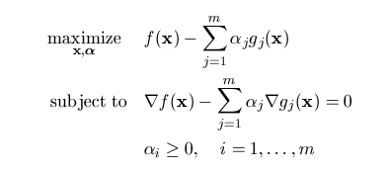
Summary
Optimization Problem and Lagrangian Dual Solution
duality
M Inequality Constraints

Slide 18
Support Vector Machine (binary)
x₃
New data
x₂
x₁
decision boundary (i.e. w_{ij}’s )
Part 1: Linear
Part 2: Dual Soln. + Non-Linear SVM
Lagrangian
Part 3: Kernel SVM
Part 4: Summary

