Slide 1
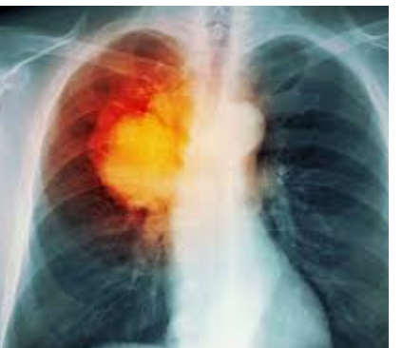
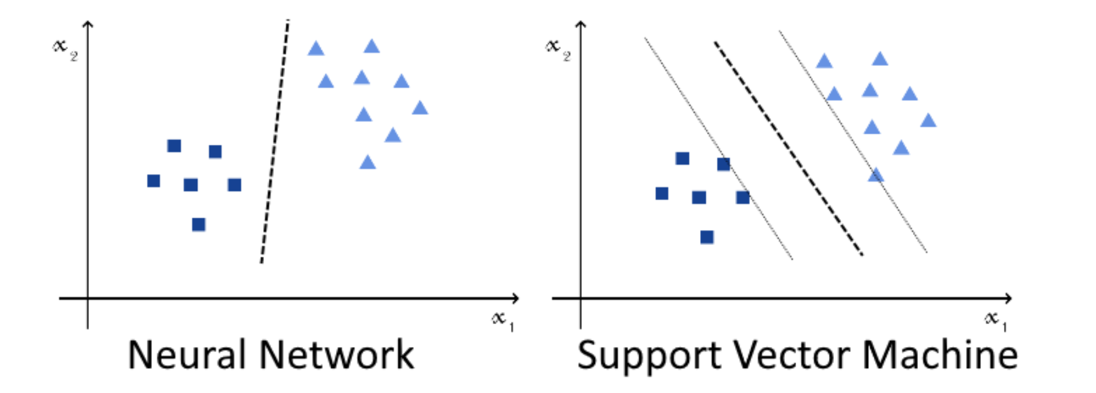
Support Vector Machine (SVM)
Support vector machines work by identifying the hyperplane that corresponds to the best possible separations among the closest observations belonging to distinct classes.
Might incorrectly classify
Future input cancer cases
Decision boundary
with fattest margin
More tolerant to input error
Advantages of SVM: Fast Training, Small training set, insensitive to initial weights, more
tolerant of input errors & classifications, guarantee convergence to
decision boundary
Disadvantages of SVM: Usually limited to binary classification, but can be multinomial

Slide 2
Outline
Support Vector Machine
Support Vector Machine
Introduction
Linear SVMt separator
Non-Linear SVMt separator
Dual Solutionseparator
Numerical Examples
Summary

Slide 3
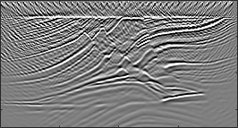
Geoscience SVM Application
Migration artifacts obscure the identification of the actual geology.
Migration Image with Artifacts
What is this mass??
Are they
reflectors??
1.0
Depth (km)
2.0
3.0
2.0
4.0
6.0
8.0
X (km)

Slide 4
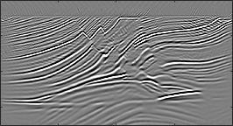
Geoscience SVM Application
Migration artifacts obscure the identification of the actual geology.
Migration Image without Artifacts
Yes! these
are reflectors!!
Oh! Those are
just artifacts!
1.0
Depth (km)
2.0
3.0
2.0
4.0
6.0
8.0
X (km)

Slide 5
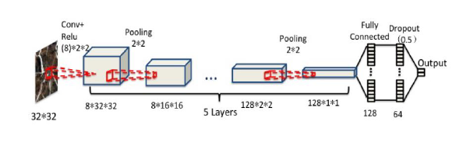
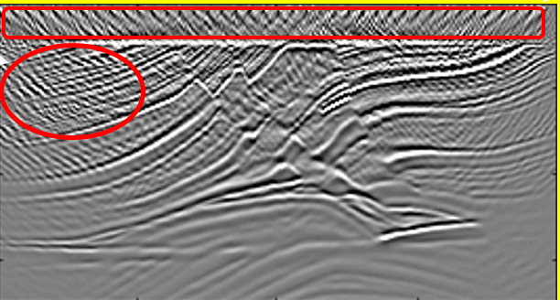
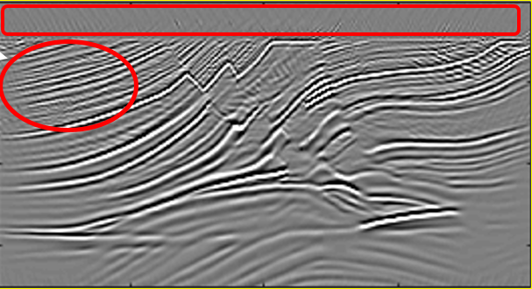
Neural Network
x₁
x₂
x₃
.
.
.
Y=1 cat
Support Vector Machine (binary)
Y=0 not a cat
x₃
New data
x₂
x₁
decision boundary (i.e. w_{ij}’s )

Slide 6
Support Vector Machine (binary)
Part 1: Linear SVM
x₃
New data
x₂
x₁
decision boundary (i.e. w_{ij}’s )

Slide 7
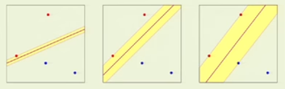
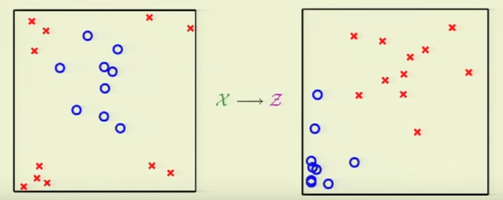
Key Idea of SVM
Support Vector Machine
δ₂=2
δ₃=3
δ₁=1
Find “Best” Separation Boundary
With Fattest Margin

Slide 8
Support Vector Machine
Support Vector Machine
Support Vector Machine
Given: O and
Not a good choice
Support vectors
Find: Classify Data
with Fattest Margin of
Decision BndryBest separator
Decision Bndry→cleanly separates two
classes of points
Find [w,b] maximizes margin length γ,
a constrained Lagrange multiplier problem
x2
γ
Margin γ =Distance closest
Pt to boundary
x1
Decision Boundary
Support vectors

Slide 9
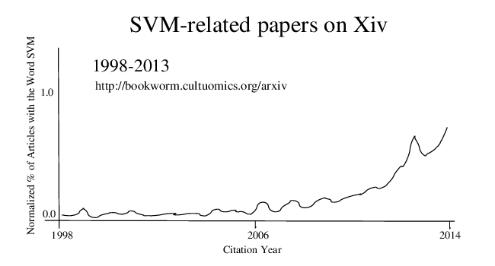

Slide 10
Outline
Support Vector Machine
Support Vector Machine
Introduction
Linear SVMt separator
Non-Linear SVMt separator
Dual Solutionseparator
Numerical Examples
Summary

Slide 11
Linear SVM Theory
Support Vector Machine
Given: Binary training data (x^{(i)},y^{(i)}) for i=[1,2,3…N]
Find: (w,b) that cleanly classifies (x^{(i)},y^{(i)}) with
fattest margin thickness
y^{(i)}=+/-1
Testing: Use (w,b) to classify new (x^{(i)},y^{(i)})

Slide 12
Recall
Support Vector Machine
d
w⊥(x’-x)
^
^
^
w
Points x’ on a plane satisfy
0 = w·(x’-x)
^
^
x₃
= w·x’- w·x
x’- x
^
x
x’
= w·x’+ b
x₂
x₁

Slide 13
Linear SVM Theory
Support Vector Machine
Given. Training Data. {x^{(n)} , y^{(n)} }
x^{(n)}
d
Find {w , b} that separates yes/no
^
^
δ=w^{T}{x^{(n)} – x}
x^{(n)} - x
δ=w^{T}{x^{(n)} – x}
x₃
^
w
Testing: Use (w,b) to classify new x^{(i)}
x
w^{T}x^{(n)} + b > 0 for x^{(n)} above plane
w^{T}x^{(n)} + b < 0 for x^{(n)} below plane
x₂
Points x on
a plane satisfy
^
0=w·x+b
x₁
Perpendicular distance between x on margin plane and x^{(n)}
^
^
w = w^{T}/||w||
δ = w^{T}{x^{(n)} – x}
Add & subtract b to RHS
= 1/||w||{w^{T}x^{(n)} + b – (w^{T}x + b) }
| |
= 1/||w||{w^{T}x^{(n)} + b }

Slide 14
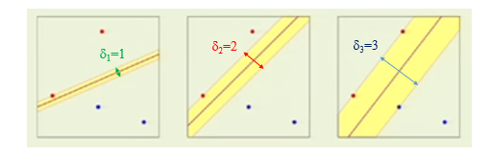
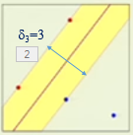

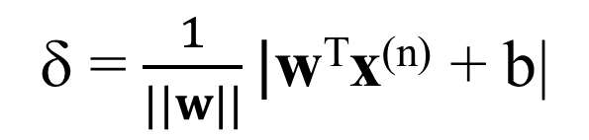
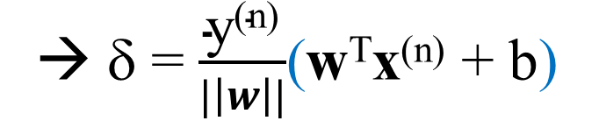
Linear SVM Theory
Support Vector Machine
Given. Training Data. {x^{(n)} , y^{(n)} }
x^{(n)}
d
Find {w , b} that separates yes/no
^
^
δ=w^{T}{x^{(n)} – x}
x^{(n)} - x
δ=w^{T}{x^{(n)} – x}
x₃
^
w
w^{T}x^{(n)} + b > 0 for x^{(n)} above plane
w^{T}x^{(n)} + b < 0 for x^{(n)} below plane
x
w^{T}x^{(n)} + b > 0 for x^{(n)} above plane
w^{T}x^{(n)} + b < 0 for x^{(n)} below plane
x₂
Points x on
a plane satisfy
^
0=w·x+b
Perpendicular distance between margin line and x^{(n)}
Derivatives hate
absolute value signs
Given Class=1 if above plane otherwise -1
→ δ = $\frac{\text{y}\text{(}\text{n}\text{)}}{|\left|w\right||}$(w^{T}x^{(n)} + b)
Finds points closest to decision line
Partial Goal: Given (w,b) s.t.
δ = $\frac{1}{||w||}|$w^{T}x^{(n)} + b|
Clean separation condition

Slide 15
Linear SVM Theory
Support Vector Machine
Partial Goal: Given (w,b) s.t.
Clean separation condition

Slide 16
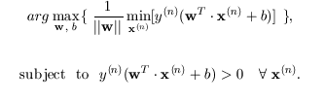
Linear SVM Theory
Support Vector Machine
δ₂=2
δ₃=3
δ₁=1
2δ
Partial Goal: Given (w,b) s.t.
This gives us δ for
a given (w,b)
Which (w,b) is best?
Clean separation condition
Final Goal: Find (w,b) s.t.
This finds δ which
Is fattest

Slide 17
Linear SVM Theory
Support Vector Machine
Final Goal: Find (w,b) s.t.
This finds δ which
Is fattest

Slide 18
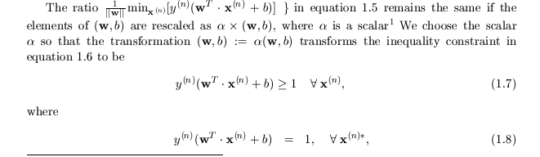

Linear SVM Theory
Support Vector Machine
4
20
3
15
δ=1
2
10
1
5
1 2 3 4
5 10 15 20
Final Goal: Find (w,b) s.t.
Scale x^{(n)} so minimum margin thickness δ=min|w^{T}·x^{(n)}+b| =1
Hence max 1/||w|| with norm x interpreted as → margin thickness
Equivalently min||w|| with norm x interpreted as → inverse margin thickness
Points x_{n}* on margin boundary are support vectors
*

Slide 19

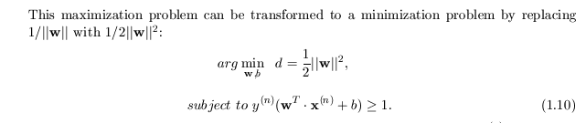
Linear SVM Theory
Support Vector Machine
Final Goal: Find (w,b) s.t.
by replacing
Quad.
Programming
Solution

Slide 20
Outline
Support Vector Machine
Support Vector Machine
Introduction
Summary
Linear SVMt separator
Non-Linear SVMt separator
Dual Solutionseparator
Numerical Examples
Summary

Slide 21
Summary
Might incorrectly classify
Future input cancer cases
Decision boundary
with fattest margin
More tolerant to input error
Advantages of SVM: Fast Training, Small training set, insensitive to initial weights, more
tolerant of input errors & classifications, guarantee convergence to
decision boundary
Disadvantages of SVM: Usually limited to binary classification, but can be multinomial

Slide 22
Support Vector Machine (binary)
Summary: Linear SVM Theory
Support Vector Machine
Goal: Find (w,b) s.t.
Training examples
Quad.
Programming
Solution
x₃
How do we
classify blue pt?
New data
Non-linear SVM
x₂
x₁
decision boundary (i.e. w_{ij}’s )

Slide 23
Outline
Support Vector Machine
Support Vector Machine
Linear SVMt separator
Non-Linear SVMt separator
Dual Solutionseparator
Numerical Examples
Summary

Slide 24
Non-Linear SVM
Support Vector Machine
Support Vector Machine
Linear SVM doesn’t work if x^{(n)} not separable
z₂
x₂
Non-linear
Mapping
such as z₁ =x₁²
z₂= x₁ +x₂⁴
x₁
z₁
Apply Linear SVM
in z-domain to get (w,b)*

Slide 25


Support Vector Machine
Support Vector Machine
Step 1: Transform to z-space using polynomial transformation z_{i}=φ(x)_{i}
Step 2: Linear SVM in z-space
Penalty:
N_{z} > N_{x} → Higher costs

Slide 26
Support Vector Machine
Support Vector Machine
x₂
x₁
z₃
x
x
x
x
Pts on circle
map to same height
z₁
z₂
Step 1: Transform to z-space using polynomial transformation z_{i}=φ(x)_{i}
Step 2: (w,b) in in z-space
Penalty:
N_{z} > N_{x} → Higher costs
Step 3: For new pt x to be classified get x→z and plug into w^{T}z+b >0 or <0

Slide 27
General Non-Linear SVM
Support Vector Machine
Support Vector Machine
Example I: Previously we did construction, specify z(x)→K(x,x’)
z = φ(x) = (1, x₁, x₂, x₁², x₂² , x₁ x₂ )
z’ = φ(y) = (1, y₁, y₂, y₁², y₂² , y₁ y₂ )
Easy K
Hard z
K(x, y)= z^{T} • z’ = 1+ x₁ y₁ + x₂ y₂ + x₁² y₁² + x₂²y₂² + x₁y₁ x₂y₂
Example II: Previously we did construction, now specify z(x)→K(x,x’).
How about specify K(x,y) and find z?
K(x, y) = (1+x^{T}y)² = (1+ x₁y₁ + x₂y₂)²
= (1+ x₁² y₁² + x₂² y₂² + 2x₁y₁ + 2x₂y₂ + 2x₁y₁ x₂y₂ )
z? Hard
z = φ(x) = (1, x₁² , x₂², √2 x₁, √2 x₂ , √2 x₁ x₂ )
z’ = φ(y) = (1, y₁² , y₂², √2 y₁, √2 y₂ , √2 y₁ y₂ )

Slide 28
General Non-Linear SVM
Support Vector Machine
Support Vector Machine
Example III: Gaussian kernel
K(x,x’) = exp(-(x-x’)²)
= exp(-x²)exp(-x’²)Σ_{k=1}^{infty} 2(x)^{k} (x’)^{k} /k!
= exp(-x²)exp(-x’²)[ 1 + 2xx’ +x² x’² + …]
Therefore z(x) = exp(-x²)[ 1 , √2x , x², …].
Infinite dimensional z !
Its ok, we only need K(x,x’) to classify new points!

Slide 29
Outline
Support Vector Machine
Support Vector Machine
Linear SVMt separator
Non-Linear SVMt separator
Numerical Examples
Summary

Slide 30
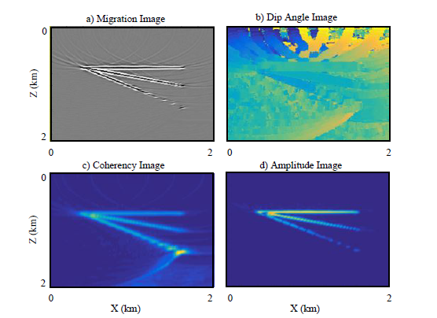
SVM Numerical Example
[(x₁,x₂,x₃),y]=[(dip, coherency,amp), noise/signal]
Support Vector Machine
Support Vector Machine
Yuqing Chen

Slide 31
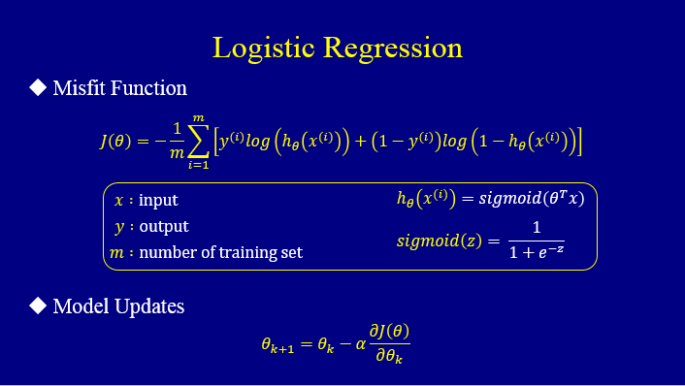
Method I:

Slide 32
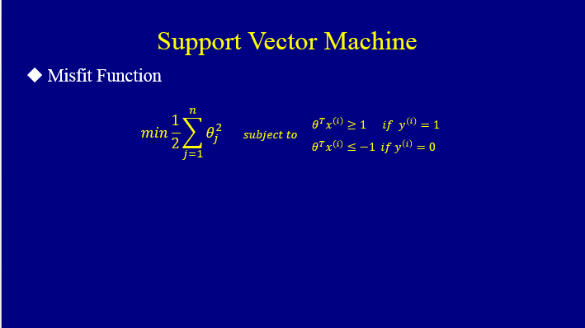
Method II: Support Vector Machine
min1/2 |w|²
Subject to w^{T}•x+b ≥ 1 if y^{(n)}=1
w^{T}•x+b ≤ 1 if y^{(n)}=-1

Slide 33
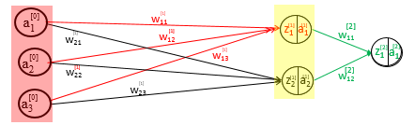
Method III: Neural Network
Neural Network
Coherency
Σ
Amplitude
Dipping Angle

Slide 34
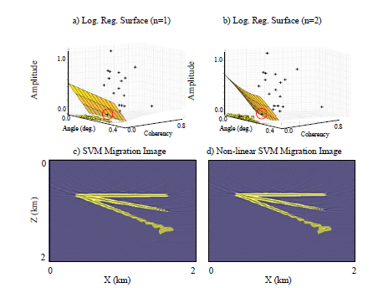
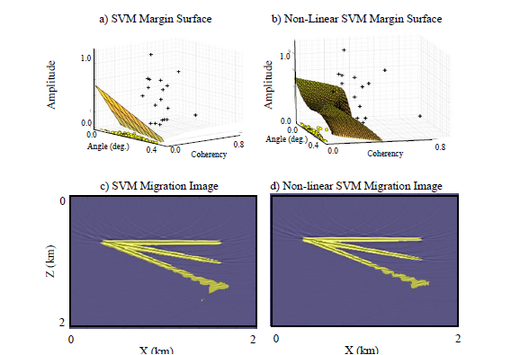
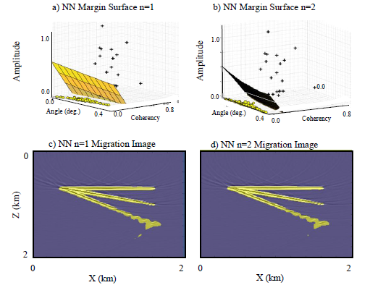
Numerical Example
Support Vector Machine
Support Vector Machine
Log. Reg. n=1 Migration Image
Log. Reg. n=2 Migration Image
Yuqing Chen

Slide 35
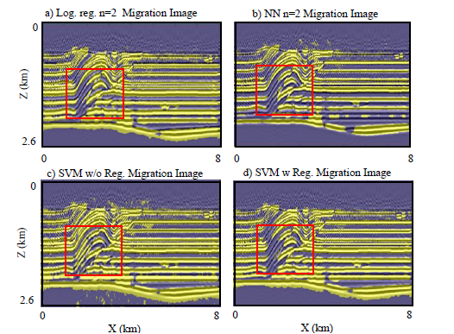
Numerical Example
Support Vector Machine
Support Vector Machine
Yuqing Chen

Slide 36
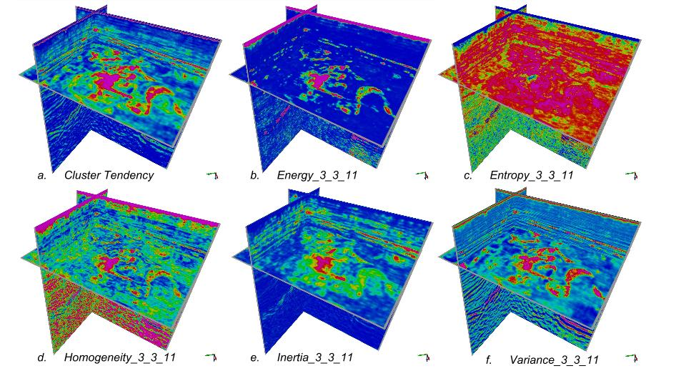
SVM Numerical Example
[(x₁,x₂,x₃),y]=[(dip, coherency,amp), noise/signal]
Support Vector Machine
Support Vector Machine

Slide 37
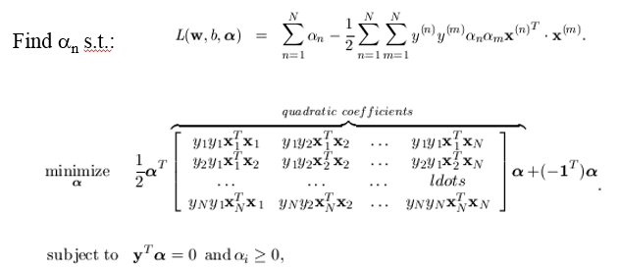
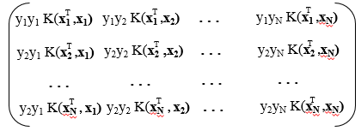
Summary
Linear SVM:
Non-linear SVM:
Dual-Space SVM:
Kernel trick: don’t compute ∞-dimensional
vector z(x), just specify K(x, x’) and find
α by QP. Then find prediction for new x by

