Slide 1
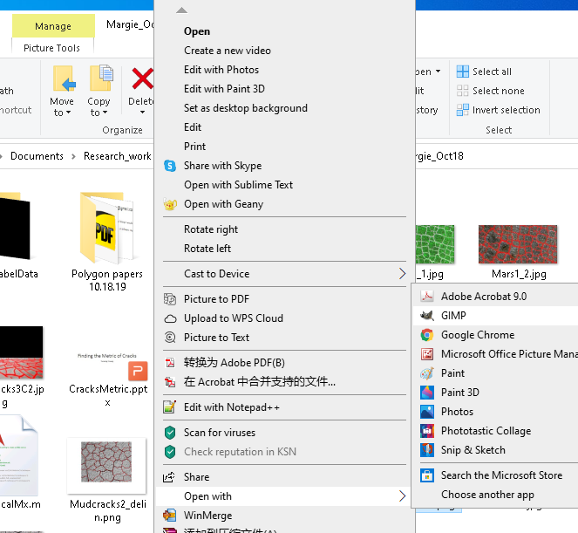
I) Labeling Mud Cracks w GIMP’s Fuzzy Select Tool
Documentation: https://www.gimp.org/docs/
Use Ctrl-z to revert to a former step whenever you made a mistake.
Zooming, by pressing:
+ - incrementally zoom in/out
1 2 3 … zoom 100% 200% 300% …
[Never mind the image file shown here, Mudcracks4.png, is different from Mudcracks3.jpg]
The eye (toggle) icon denotes that this entry is visible
The dark color
denotes this entry
is active
As the Layers tab is active,
clicking-on this [+] will
add a new layer.
If the Paths tab was active, then the [+] would add a new path instead.
To delete the active entry (here, the Layer)
Upon right-clicking on the photo of interest
(Mudcracks3.jpg here)

Slide 2
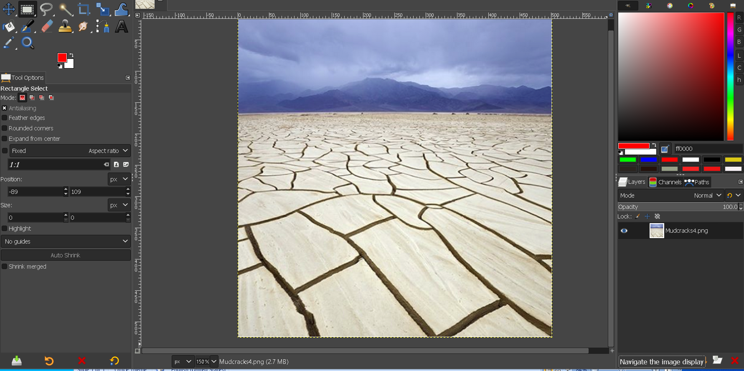
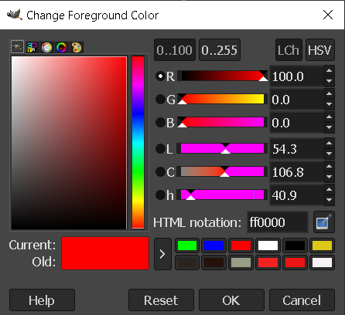
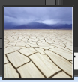
Tools:
Menu Edit -> Preferences: - Interface Icon Theme: bottom row “Custom icon size” You may enlarge the icons
Fuzzy Selet
Bucket
Fill
Clicking on the square pops up a color-changing window
=
Move the vertical bar to the right
(to enlarge the main image-window )
⬅➔
Background Color
Another way of panning:
(If you’re equipped with an external mouse)
Press and hold down the [space] bar,
Hold down left-mouse-button, and drag the mouse
Move the vertical bar to the left
=
⬅➔
appears at step 2
Clicking on this +
will bring up this
bird-view icon, which
you can move around
for panning the image
(the bird-view icon shows up actually overlapping the + )

Slide 3
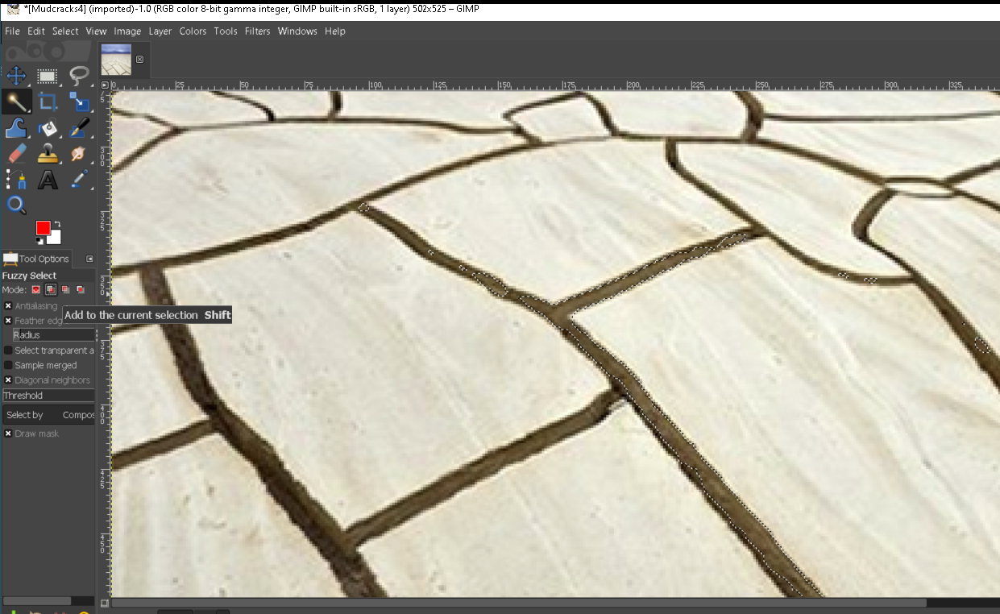
Choose
1
2
Building up the crack-selection by adding partial selection a step at a time
The boundary of selected region is characterized by ‘marching ants’.

Slide 4
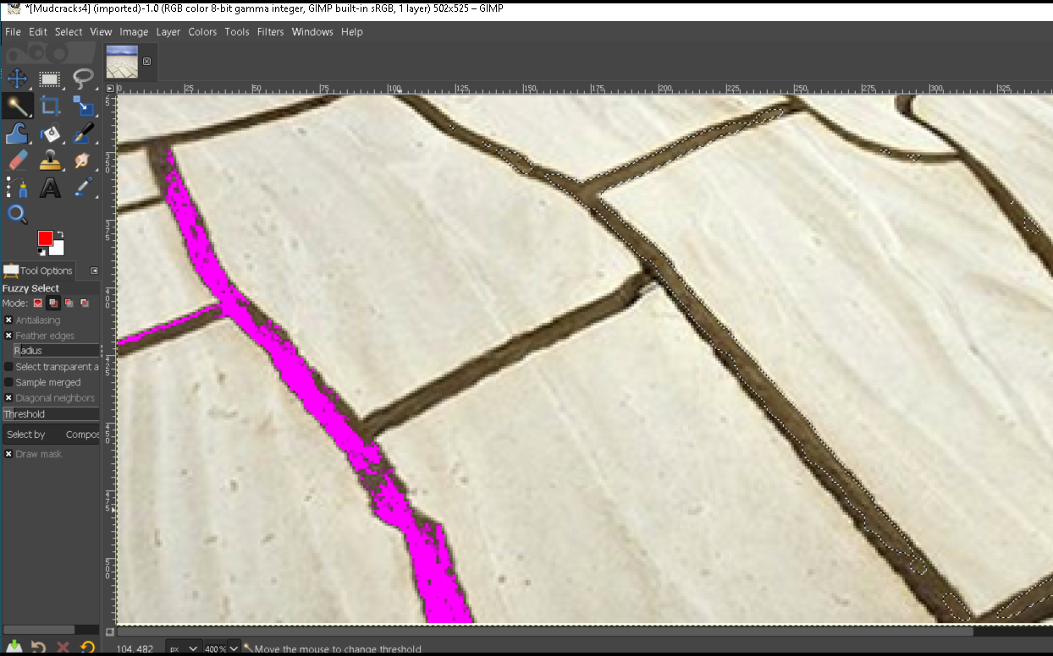
3. Move to a different location, click and then drag the Fuzzy Select Tool. The selected area is added to the final selection.
Pan and zoom in on the image if necessary.
Keep on going… until all cracks are selected
1. Click @ +
+
2. While holding down the left-mouse-button, drag the mouse. The farther to the right is the mouse dragged, the more inclusive is the Fuzzy Select Tool.
The purple denotes the selected region at this step

Slide 5
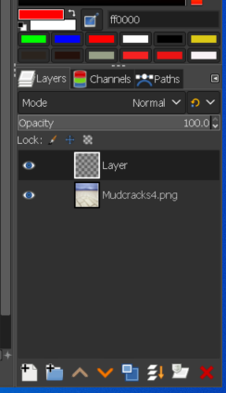
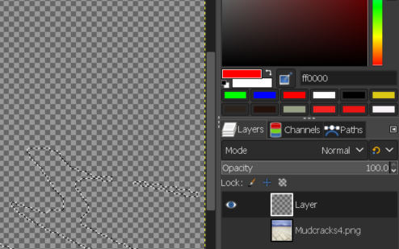
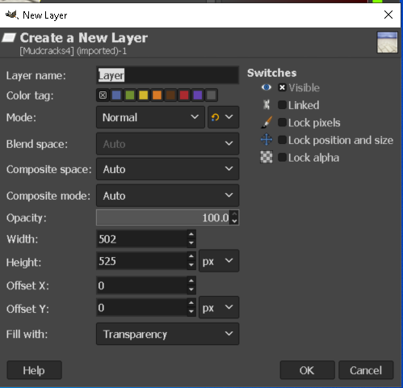
1. After almost all cracks have been selected, add a new Layer (make sure the Layers tab is active):
5. Now, only the new Layer is visible, and it contains the selection (evident by the marching-ants boundaries) we made earlier in the mud-crack image.
3. A New Layer appears:
2. A New Layer window pops up:
Make sure
to choose:
6. Select the Bucket Fill tool
(filling the foreground color, which is red) and then click in the marching-ants enclosed region.
4. Toggle off the Eye of layer Mudcracks:

Slide 6
7. The cracks that have been labeled appear in the new layer (w/ the bucket-filled color):

Slide 7
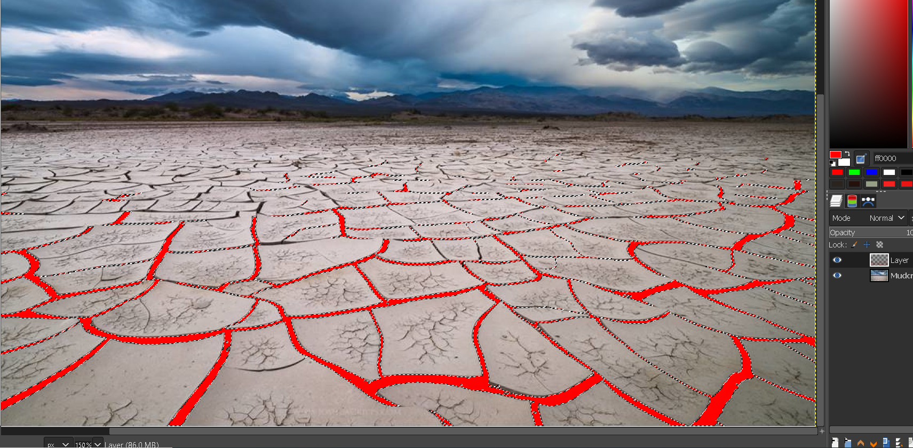
8. We can toggle on the Mudcracks3 layer to show the two layers in superposition. If some cracks are not labeled, we can keep labeling those missing cracks— the method is shown in slides 4. If more cracks have been labeled, delete this new Layer and create another one anew, which contains the larger set of labeled cracks.

Slide 8
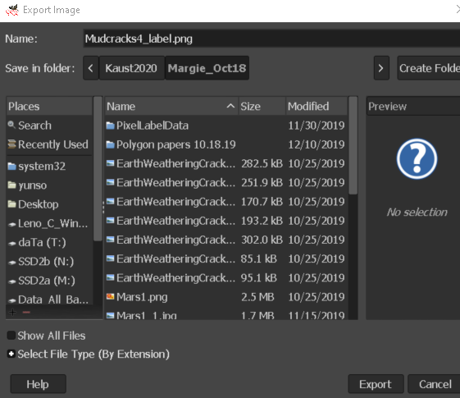
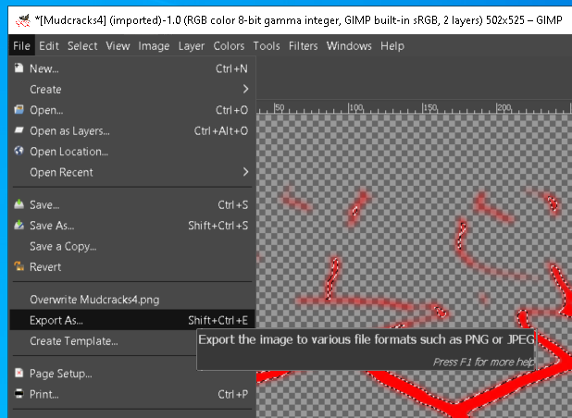
9. Say, we are satisfied with the crack-labels, we can export this label image as:
9a) Leave only the new Layer visible, by toggling off the Eye icon in front of Mudcracks
Otherwise the original picture could be overwritten
9c) In the pop-up window, change the file Name, then Export
9b) Menu File → Export As …

Slide 9
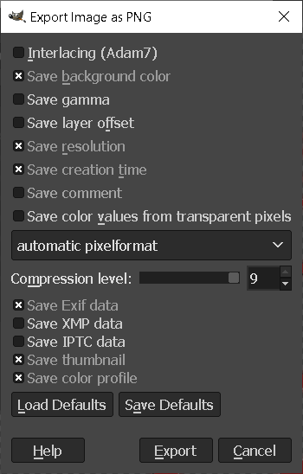
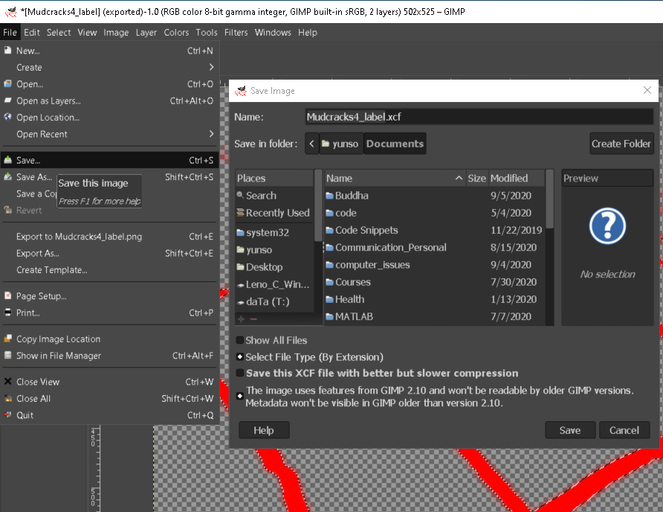
9d) Accept the defaults in the pop-up window.
9e) Save the GIMP source file by: Menu File → Save

Slide 10
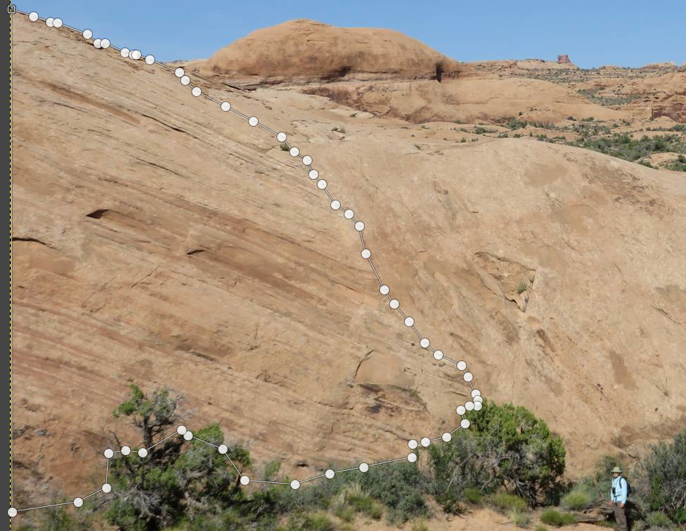
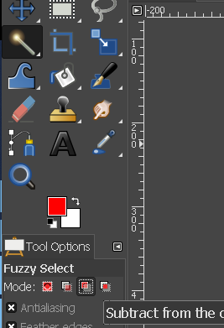
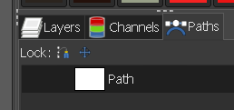
II) Area-labeling w enclosed Path
3iii) Convert this Path to Selection, by clicking-on in the very bottom row:
1. Open nrm_def_mass2.jpg w/ GIMP
3iia) On editing a path contour:
Move a node drag the node
Add a node Ctrl-click on segment
Delete a node select the node, then Shift-Ctrl-click
Delete a segment select it, then Shift-Ctrl-click
Join two nodes with a segment click on one node; Ctrl-click on the next one
2. We wish to label the big piece of rock, called “normal”, to the very left, occupying about a third of the rock wall right behind the bushes. A similar challenge is to label a car partially occluded by bushes.
4. Now the contour is turned into marching ants, denoting the selection.
Because this selection included vegetation, next, we use Fuzzy Select Tool to exclude the vegetation
3. Use Paths Tool to trace out the boundary of the “normal” rock, while including some bushes, so as to facilitate manual boundary-tracing.
3i) Under the Path tab:
a. Create a new path by clicking on at the very bottom row
b. On the newly created Path icon, right-click, choose Edit Path.
3ii) On the rock image ,
Shift-click, click, click, …, Esc, to trace out the boundary,
and Ctrl-click on the first node to close the contour.
Select this “subtract” Mode in Fuzzy Select’s Tool Options

Slide 11
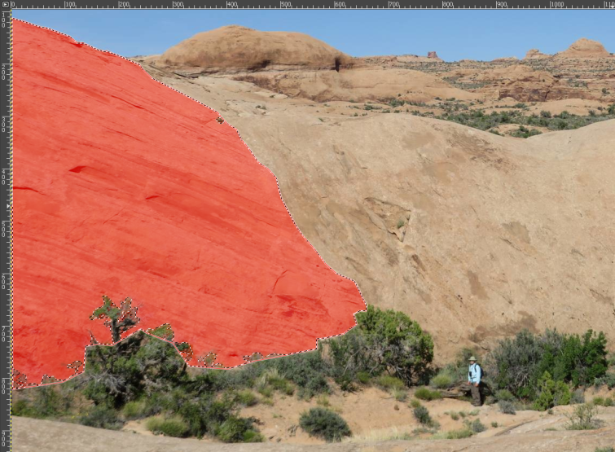
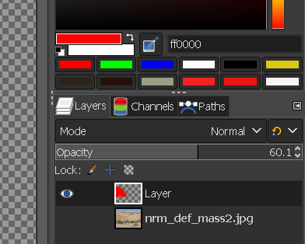
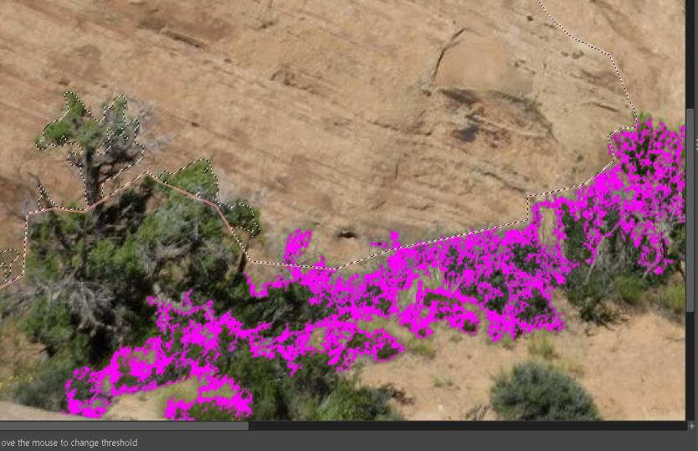
4i) Click the Fuzzy Select Tool on vegetation pixel inside the selection of “normal” rock, and drag. For details, refer to Slide 4
Recall to Ctrl-Z whenever you made a mistake.
A selection by the Fuzzy Select can finely bleed out of the “normal” rock selection, because the bled set is to be subtracted from the rock set, for instance:
5) Once we have arrived the updated selection, follow instructions in Slide 5 to get:
6) We can reduce the opacity of this red layer,
and then to show on top of the original image
8) Follow instructions in Slide 8 for exporting the label. Before this step, first change the opacity of the Layer [containing the red labels] to 100%
[both layers are visible]
8i) Follow (9e) in Slide 9 to save the GIMP source.
7) Now the superimposed images look like:
This can verify if the selection is reasonable

Slide 12
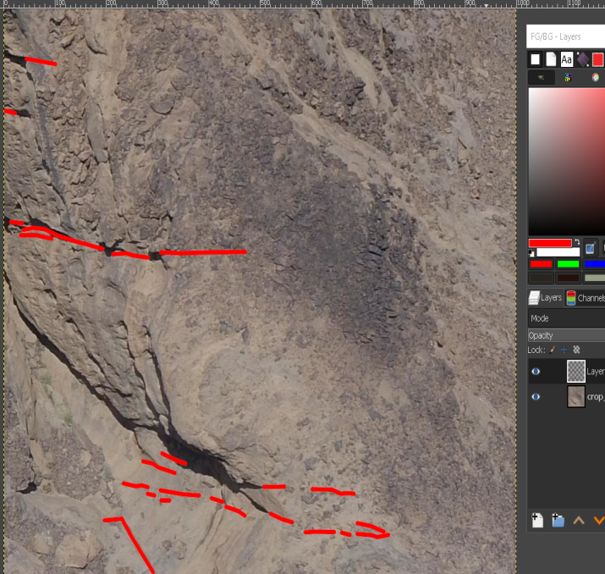
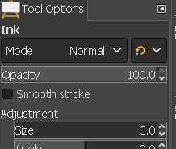
II|) Labeling Rock-cracks w [open] Paths
1. Open volcanic2zoomin.png w/ GIMP
3. Follow points (3i)—(3iia) in Slide 10, except that in (3ii), do not close the contour [using Ctrl-click on the first node]. Rather, repeat:
Shift-click, click, click, …, Esc
Shift-click, click, click, …, Esc
…
Shift-click, click, click, …, Esc
[each line represents a series of connected line segments]
2. Set up
menu Tools -> Paint tools-> Ink
In Tool Options (when Ink Tool is selected), set the Adjustment -> Size = 3.0
[Never mind the image shown here differs from volcanic2zoomin.png]
4. Export path
In Paths tab, right click and Export Path… (in *.svg)
5. Create a new layer
Select Layers tab, right click and New Layer…
6. Stroke to create path
select Paths tab, right click and Stroke Path…
[it strokes into the newly created Layer]
8. Export the crack labels
turn off all visible except the new layer
go to menu File -> Export As…
Set foreground color to red:
Stroked Path & image superimposed
menu Edit -> Preferences -> Tool Options : Save tool options
Re-edit previous crack labels
a) open image
b) import Path (that have been saved in a .svg file)
c) select the path icon, right-click and Edit Path
…
d) Export path, Create new layer, Stroke, Export layer overwriting the old

