Slide 1
Convolutional Sparse Coding for Noise Attenuation of Seismic Data
Zhaolun Liu*, Kai Lu, Lei Fu and Xiaodan Ge
KAUST
9/18/2018
Notes:
Good morning everyone. I will give a progress report of 3D Wave-Equation Dispersion Inversion.

Slide 2
Outline
Motivation
Theory
Numerical Results
Summary
Notes:
This is my outline. First is the Motivation.
Then is the theory part, next is numerical Examples,
and finally is the conclusion.

Slide 3
Outline
Motivation
Theory
Numerical Results
Summary
Notes:
This is my outline. First is the Motivation.
Then is the theory part, next is numerical Examples,
and finally is the conclusion.

Slide 4
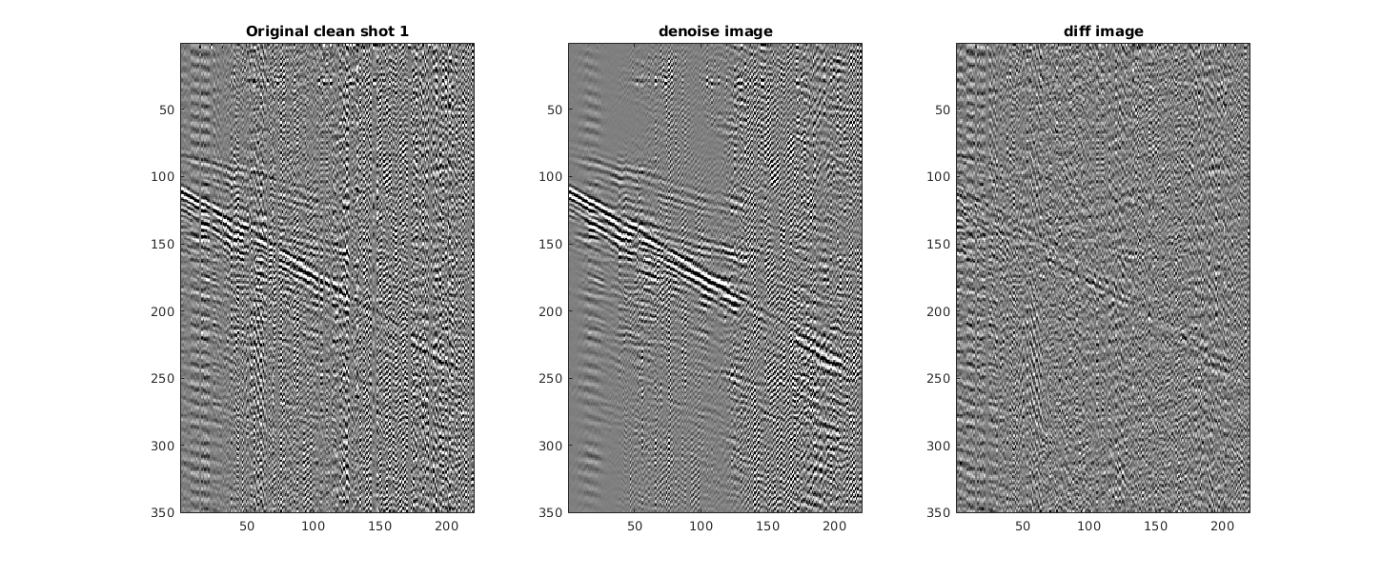
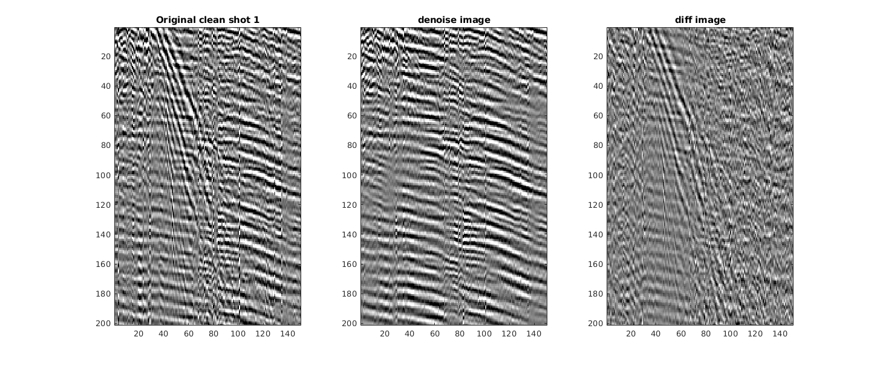
Problem: Noise in Seismic Data
Common Shot Gather
Common Shot Gather
0.2
0.6
T (s)
T (s)
1.2
1.4
0.8
Offset (km)
1.9
0.05
Offset (km)
0.35
Random + Coherent Noise
Surface Waves (Ground Roll)
Notes:
我们所面临的问题：地震资料中的噪声问题：这是一个典型的地震剖面可以看到

Slide 5
Background: Noise Attenuation Methods
Transform domain (Model-driven process)
  Wavelet, curvelet, hyperbolic Radon, seislet transform …
  Known basis function: wavelet, curvelet, seislet …
Problems:
  Inability to adapt to the complex seismic data
Sparse dictionary learning (data-driven process)
  Basis function is learned from the data (atom)
  Adapt to the complex seismic data
  Partition the seismic data into overlapped patches
Problems:
  Shifted versions of the same features in the learned features
Notes:
平移不变性

Slide 6
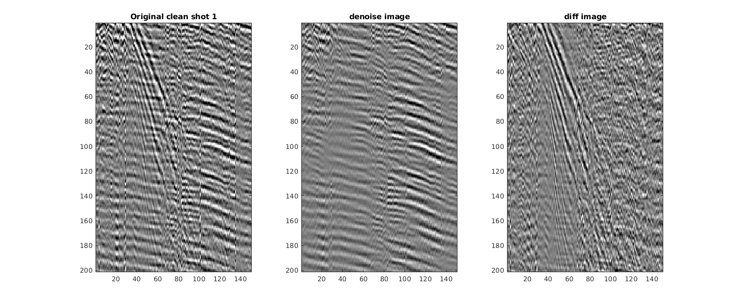
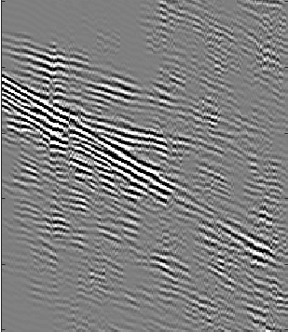
Solution: Convolutional sparse coding (CSC)
CSC operates on whole seismic images, thereby seamlessly capturing the correlation between local neighborhoods.
Denoised Common Shot Gather
Denoised Common Shot Gather
Common Shot Gather
Common Shot Gather
0.2
0.6
T (s)
T (s)
1.2
1.4
0.8
Offset (km)
1.9
0.05
Offset (km)
0.35

Slide 7
Outline
Motivation
Theory
Numerical Results
Summary
Notes:
This is my outline. First is the Motivation.
Then is the theory part, next is numerical Examples,
and finally is the conclusion.

Slide 8
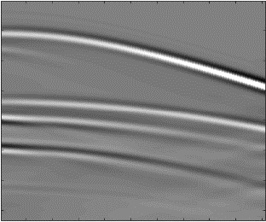
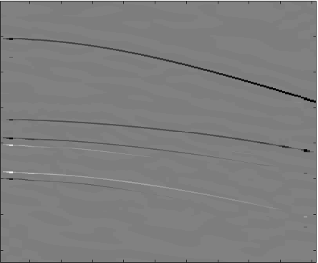
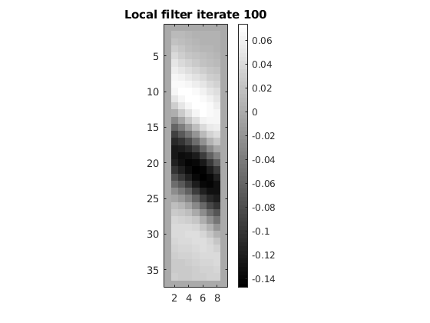
Theory: General Formulation of CSC
？
Multi data set
x
z
0.5
d
0.5
+ r
=
0
*
T (s)
T (s)
T (s)
0.2
2.7
0
0.06
2.7
0
X (km)
1
0
1
X (km)
X (km)
Notes:
The previous work is the 2D wave-equation dispersion inversion method. The problem is that it assumes a 2D medium. However, the real world is not 2D medium. The solution is 3D WD.

Slide 9


Theory: Solving for Coefficients z
Problem:
Solutions:
  The alternating direction method of minimizers (ADMM) （Details in the abstract ）
  Iterative shrinkage-thresholding algorithm (ISTA)
S(z)
0
-$β$
z
$$β$$
Notes:
软阈值函数

Slide 10
Theory: Solving for Filters d
Problem:
Solutions:
  The alternating direction method of minimizers (ADMM) （Details in the abstract ）
  Gradient Descent
Notes:
The previous work is the 2D wave-equation dispersion inversion method. The problem is that it assumes a 2D medium. However, the real world is not 2D medium. The solution is 3D WD.

Slide 11
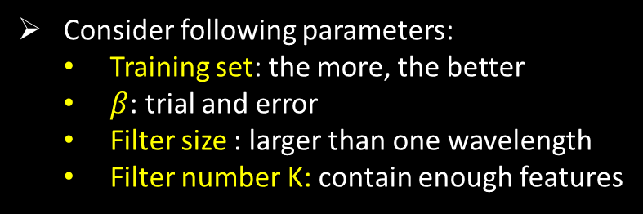


Workflow: CSC for Denoising
Training Phase
Denoising Phase
Low S/N ratio CSGs
High S/N ratio CSGs
Learned Filters D
Selected Filters $\tilde{D}$
Denoised CSGs
Consider following parameters:
  Training set: the more, the better
  $β$: trial and error
  Filter size : larger than one wavelength
  Filter number K: contain enough features
Consider following parameter:
  $β$: to control noise level
Notes:
The previous work is the 2D wave-equation dispersion inversion method. The problem is that it assumes a 2D medium. However, the real world is not 2D medium. The solution is 3D WD.

Slide 12
Outline
Motivation
Theory
Numerical Results
Summary
Notes:
This is my outline. First is the Motivation.
Then is the theory part, next is numerical Examples,
and finally is the conclusion.

Slide 13
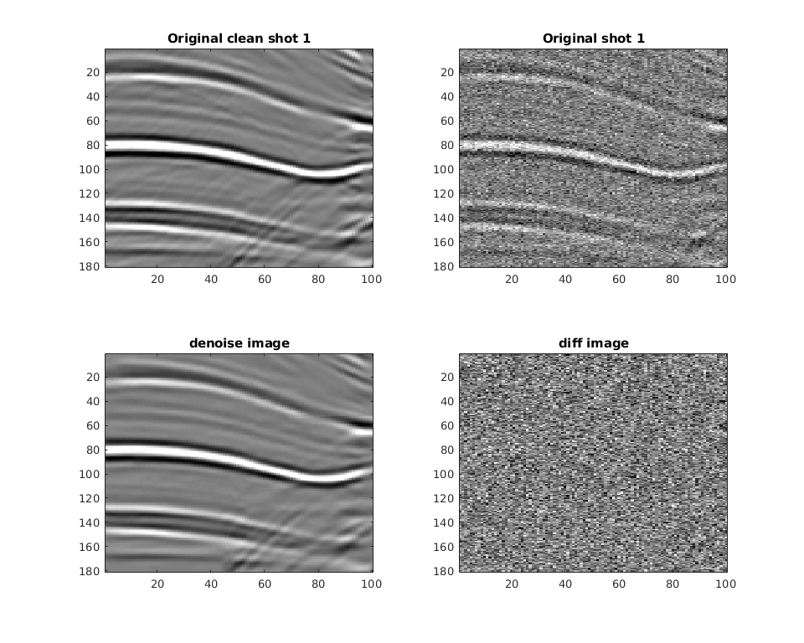
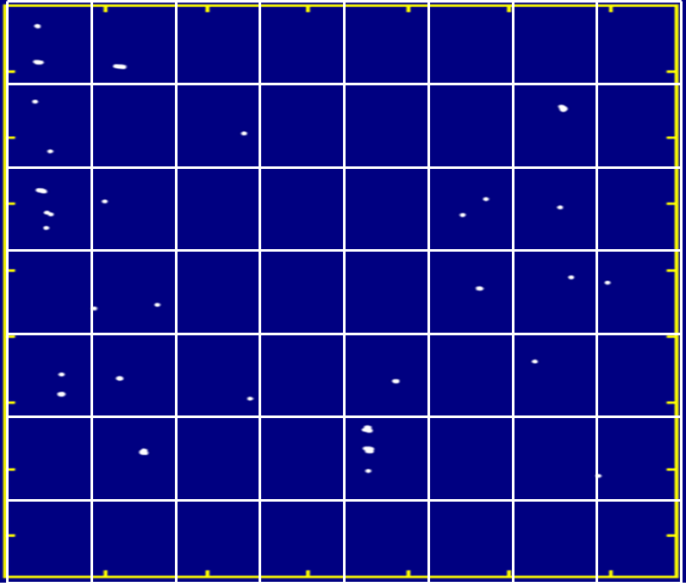
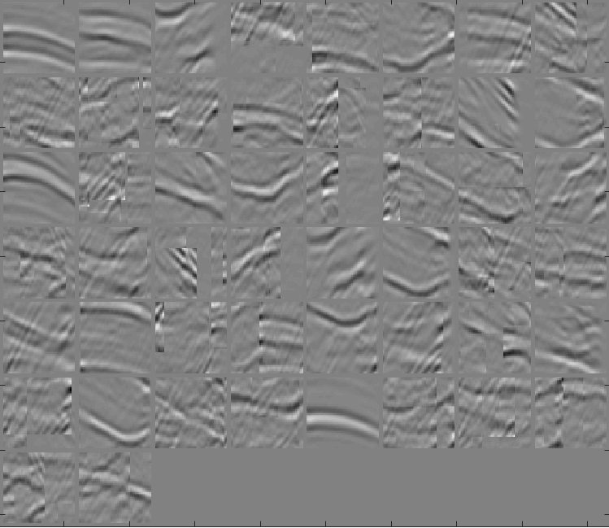


Synthetic Test: Training Phase
5 CSGs (size of 181$×$100)
30 filters (size of 55$×$55)
Coefficients z_{i,k}
Input Data x_{i}
1.6
Learned Features d_{k}
=
+r
*
T (s)
2.5
0.04
X (m)
2.04
Notes:
Need to be more simple

Slide 14
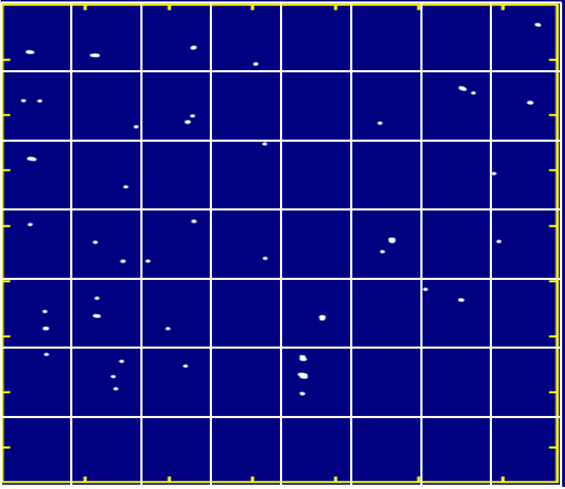
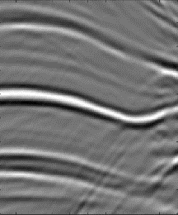
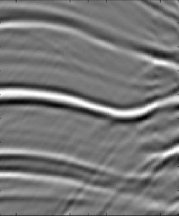
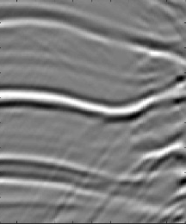
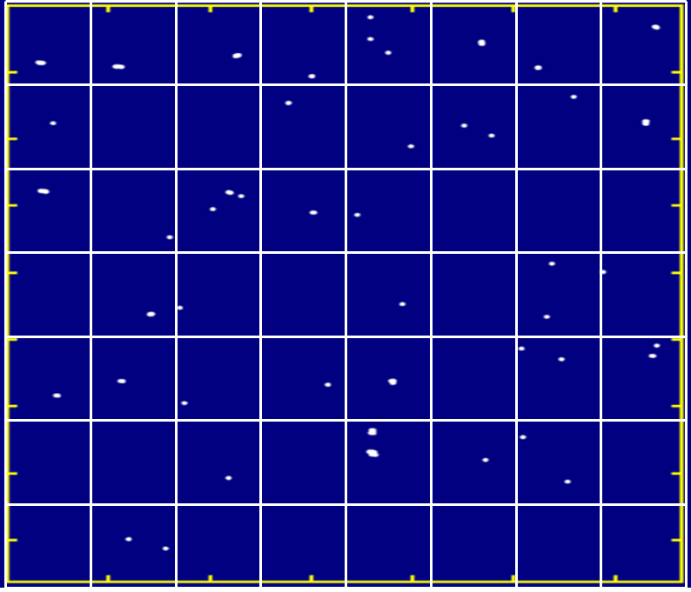
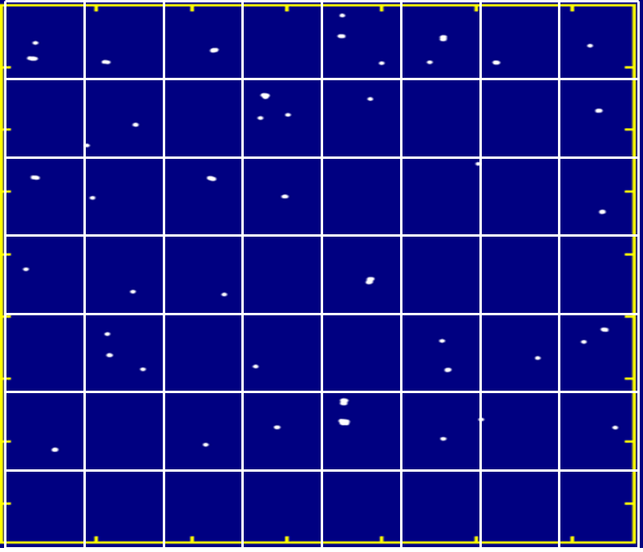
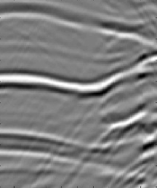
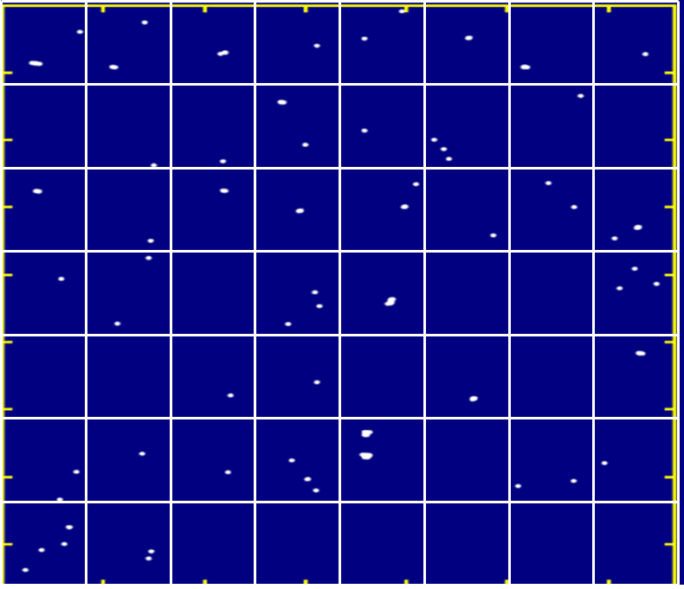


Synthetic Test: Training Phase
Coefficients z_{i,k}
Input Data x_{i} (181$×$100)
1.6
1
3
Learned Features d_{k}
(55$×$55)
T (s)
=
+r
2.5
5
7
*
1.6
T (s)
2.5
1.6
9
0.04
X (m)
2.04
T (s)
2.5
0.04
X (m)
2.04
Notes:
Need to be more simple

Slide 15
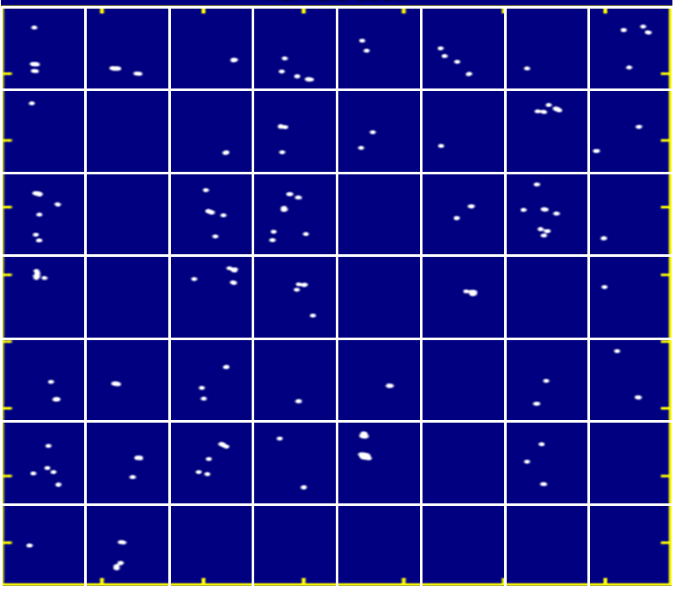
Synthetic Test: Denoising Phase
Data x with noise
Learned Features d_{k}
Coefficient z_{1,k}
Residual
1.6
1.6
+
=
*
T (s)
T (s)
2.5
2.5
0.04
X (m)
2.04
SNR = -1.76
1.6
Denoised Data
T (s)
SNR = 14.5
2.5
0.04
X (km)
2.04
Notes:
Calculated from Marmousi model
dt=0.006 s
dg=20 m
The 2D image size: 181 $×$ 100

Slide 16
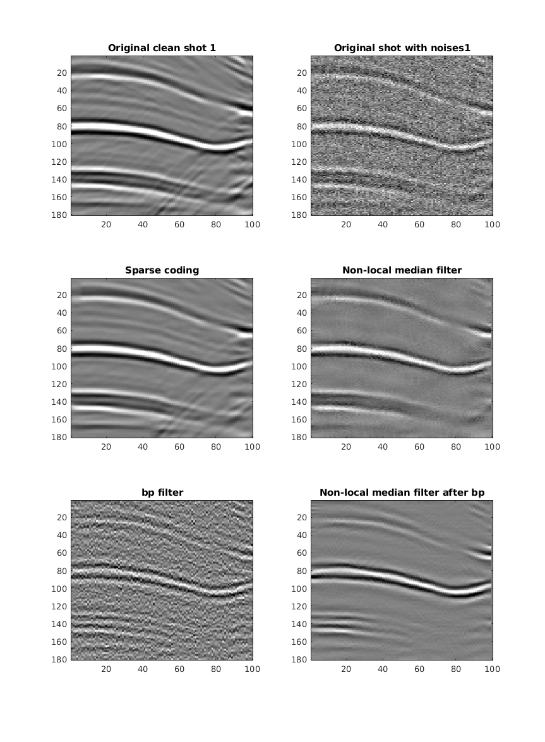
Synthetic Test: Comparison of Results
1.6
1.6
Raw Data
CSC
T (s)
T (s)
SNR = -1.76
SNR = 14.5
2.5
2.5
0.04
X (m)
2.04
0.04
X (km)
2.04
1.6
1.6
2D Median Filter
Bandpass
T (s)
T (s)
SNR = 0.036
SNR = 8.3843
2.5
2.5
0.04
X (m)
2.04
0.04
X (m)
2.04
Notes:
Calculated from Marmousi model
dt=0.006 s
dg=20 m
The 2D image size: 181 $×$ 100

Slide 17
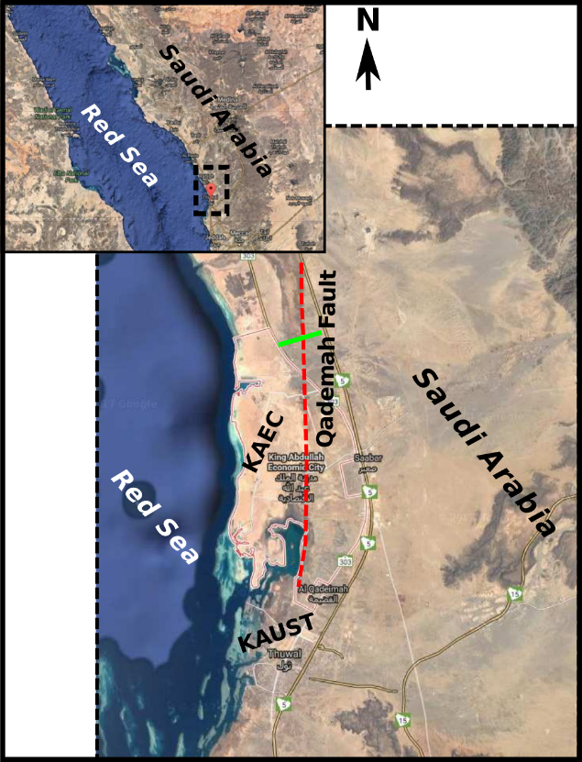
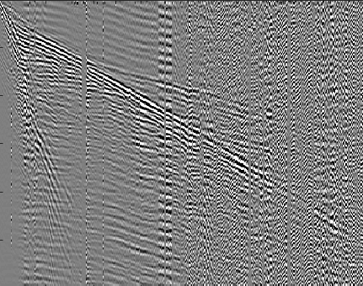
Field Data Test: Qademah Data Set
Study Area
Common Shot Gather
0
Area for Denoising
Area for Training
T (s)
1.2
0
0.2
1.3
1.9
X (km)
Notes:
Calculated from Marmousi model
dt=0.006 s
dg=20 m
The 2D image size: 181 $×$ 100

Slide 18
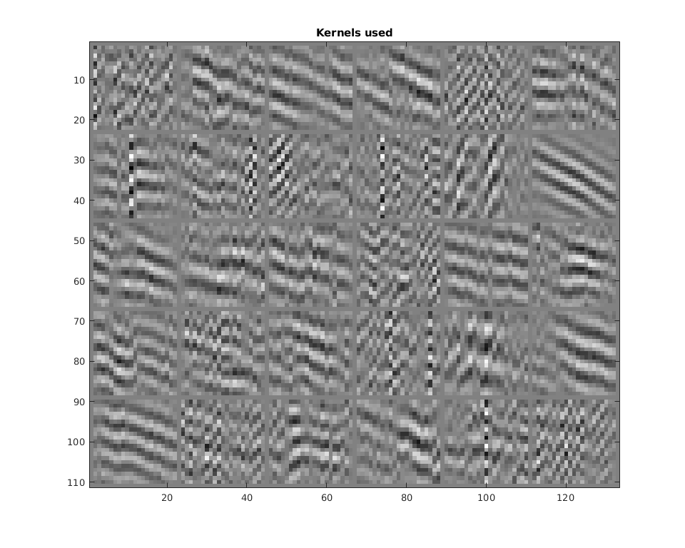
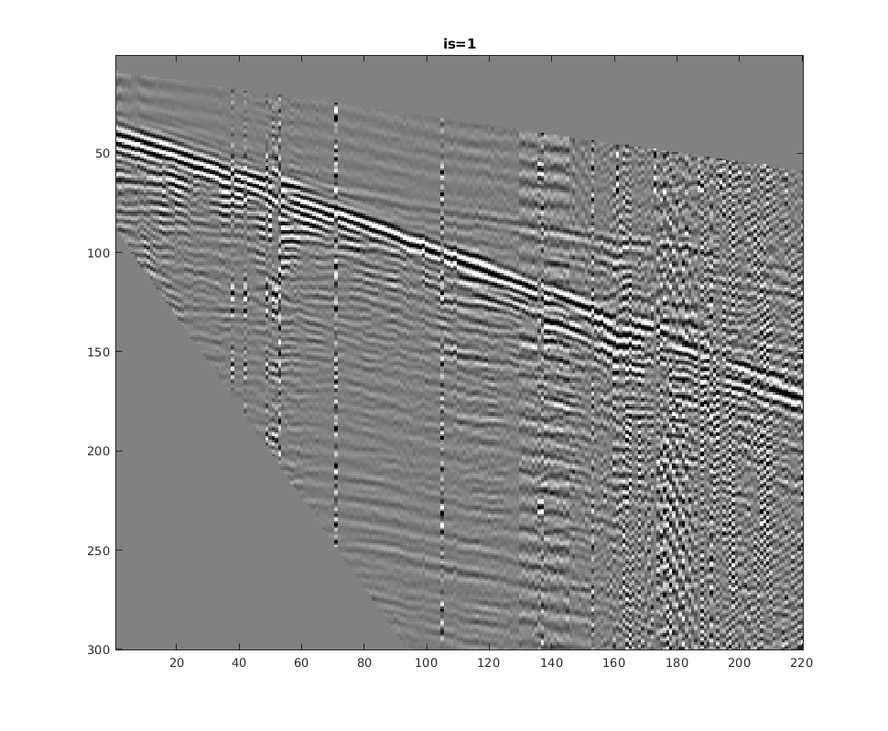
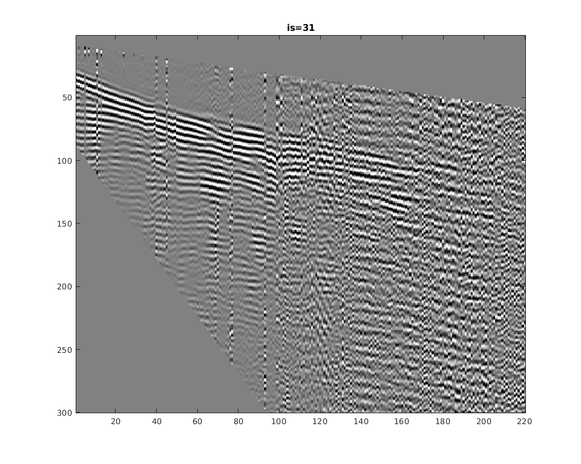

Field Data Test: Training Phase
Input Data x (near offset)
  Select 10 CSGs
  10 Hz~60 Hz
  Remove surface waves
Learned Filters d
  30 filters with size of 21$×$21
CSG No. 1
CSG No. 31
0
T (s)
1.2
0.2
X (km)
1.3
0.2
X (km)
1.3
Notes:
Calculated from Marmousi model
dt=0.006 s
dg=20 m
The 2D image size: 181 $×$ 100

Slide 19
Field Data Test: Denoise Phase
Denoising with all filters
0.2
Denoised Data
Learned Filters d
T (s)
Raw Data
0.2
1.2
0.2
Residual
T (s)
T (s)
1.2
0.8
Offset (km)
1.9
1.2
0.8
Offset (km)
1.9
Notes:
Calculated from Marmousi model
dt=0.006 s
dg=20 m
The 2D image size: 181 $×$ 100

Slide 20

Field Data Test: Denoise Phase
Denoising without the red filters
0.2
Denoised Data
Learned Filters d
T (s)
Raw Data
0.2
1.2
0.2
Residual
T (s)
T (s)
1.2
0.8
Offset (km)
1.9
1.2
0.8
Offset (km)
1.9
Notes:
Calculated from Marmousi model
dt=0.006 s
dg=20 m
The 2D image size: 181 $×$ 100

Slide 21

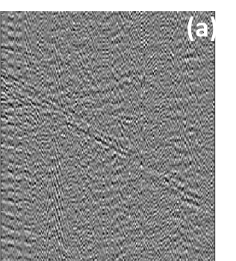
Field Data Test: Denoise Phase
Denoising without the red and yellow filters
0.2
Denoised Data
Learned Filters d
T (s)
Raw Data
0.2
1.2
0.2
Residual
T (s)
(b)
T (s)
1.2
0.8
Offset (km)
1.9
1.2
0.8
Offset (km)
1.9
Notes:
Calculated from Marmousi model
dt=0.006 s
dg=20 m
The 2D image size: 181 $×$ 100

Slide 22
Field Data Test: Denoise Phase
0.6
Denoised Data
Denoising for surface waves
Learned Filters d
T (s)
Raw Data
0.6
1.4
0.6
Residual
T (s)
1.4
T (s)
0.05
Offset (km)
0.35
1.4
0.05
Offset (km)
0.35
Notes:
Calculated from Marmousi model
dt=0.006 s
dg=20 m
The 2D image size: 181 $×$ 100

Slide 23
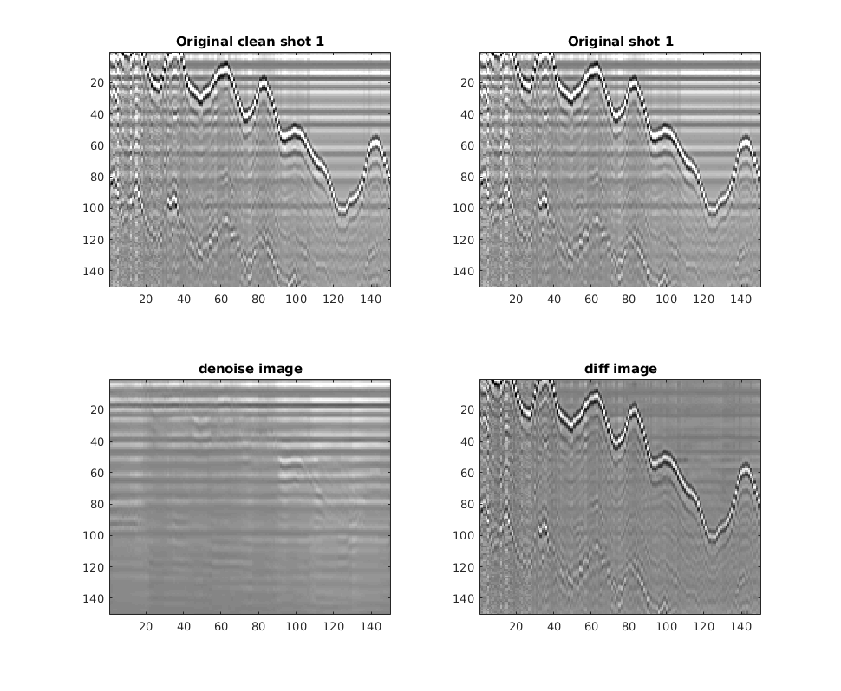
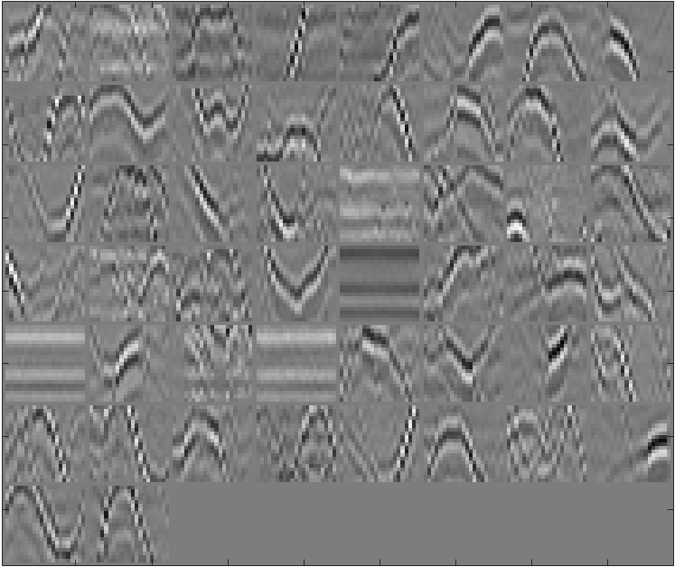
GPR Data Test
GPR Data
Learned Filters
150
150
Denoised Data
Residual
150
150
150
150

Slide 24
Outline
Motivation
Theory
Numerical Results
Summary
Notes:
This is my outline. First is the Motivation.
Then is the theory part, next is numerical Examples,
and finally is the conclusion.

Slide 25
Summary
A review of convolutional sparse coding
High SNR→ training→ learned filters → denoising
Random noise: sparsity
Coherent noise: exclude coherent noise features (manually)
Notes:
This is my outline. First is the Motivation.
Then is the theory part, next is numerical Examples,
and finally is the conclusion.

Slide 26
Acknowledgments
The sponsors of the Center for Subsurface Imaging and Modeling Consortium
For computer time, this research used the resources of the Supercomputing Laboratory at KAUST and the IT Research Computing Group
Notes:
This is my outline. First is the Motivation.
Then is the theory part, next is numerical Examples,
and finally is the conclusion.

Slide 27
Thank You Very Much!

