Slide 1
Why we need to do feature scaling?

Slide 2
Most of the times, your dataset will contain features highly varying in magnitudes, units and range. But since, most of the machine learning algorithms use Eucledian distance between two data points in their computations, this is a problem.
If left alone, these algorithms only take in the magnitude of features neglecting the units. The results would vary greatly between different units, 5kg and 5000gms. The features with high magnitudes will weigh in a lot more in the distance calculations than features with low magnitudes.
To supress this effect, we need to bring all features to the same level of magnitudes. This can be acheived by scaling.

Slide 3
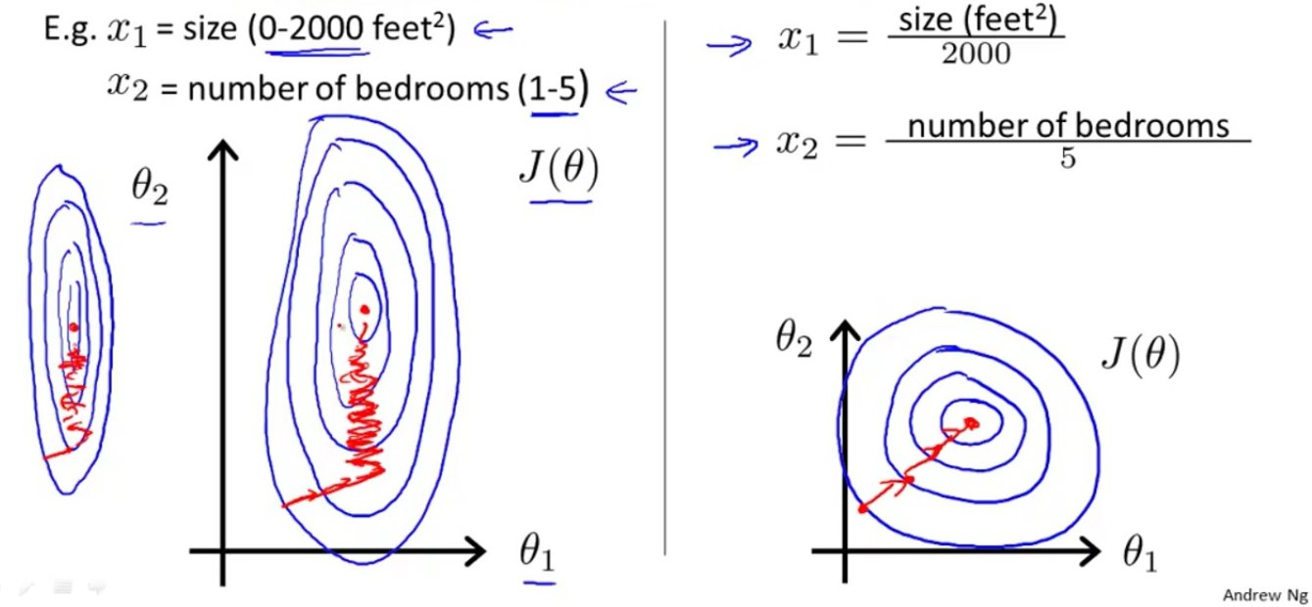

Slide 4
(1) Standardisation:
$$\overline{x}:mean$$
$$σ:Variance$$
Processed data has zero mean μ = 0 and standard deviation σ =1

Slide 5
(2) Mean Normalisation:
This distribution will have values between -1 and 1with μ=0.

Slide 6
Need more training data? Data Augmentation

Slide 7
1. Flip
Original Image
Flip horizontally
Flip vertically

Slide 8
2. Rotation
Original Image
rotated by 90 °
rotated by 180 °
rotated by 270 °

Slide 9
3. Scale
scaled outward by 10%
scaled outward by 20%
Original Image

Slide 10
4. Crop
cropped from the top-left
cropped from the bottom-right
Original Image

Slide 11
5. Gaussian Noise
Image with added Gaussian noise
Image with added Salt and Pepper noise
Original Image

