Slide 1
Support Vector Machine
Support Vector Machine
Support Vector Machine
Given: O and
Not a good choice
Support vectors
Find: Classify Data
with Fattest Margin of
Decision BndryBest separator
Decision Bndry→cleanly separates two
classes of points
Find [w,b] maximizes margin length γ,
a constrained Lagrange multiplier problem
x2
γ
Margin γ =Distance closest
Pt to boundary
x1
Decision Boundary
Support vectors

Slide 2
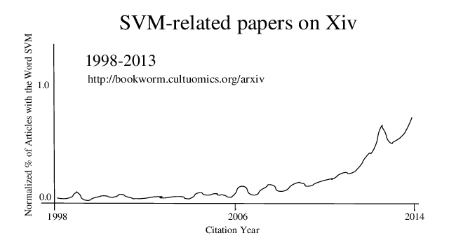

Slide 3
Outline
Support Vector Machine
Support Vector Machine
Linear SVMt separator
Non-Linear SVMt separator
Dual Solutionseparator
Numerical Examples
Summary

Slide 4
Linear SVM Theory
Support Vector Machine
Given: Binary training data (x^{(i)},y^{(i)}) for i=[1,2,3…N]
Find: (w,b) that cleanly classifies (x^{(i)},y^{(i)}) with
fattest margin thickness
y^{(i)}=+/-1

Slide 5
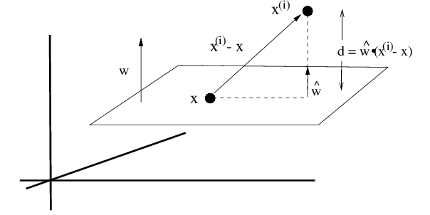
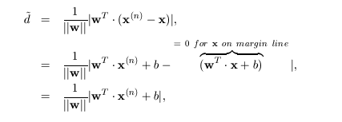
Linear SVM Theory
Support Vector Machine
Given. Training Data. {x^{(n)} , y^{(n)} }
x^{(n)}
d
Find {w , b}
d
x^{(n)} - x
^
d~w·{x^{(n)} – x}
^
w
w^{T}x^{(n)} + b > 0 for x^{(n)} above plane
w^{T}x^{(n)} + b < 0 for x^{(n)} below plane
^
0~w·{x+b}
Perpendicular distance between x on margin plane and x^{(n)}

Slide 6
Linear SVM Theory
Support Vector Machine
Given. Training Data. {x^{(n)} , y^{(n)} }
Find {w , b}
^
δ=|w•(x^{(n)}-x)|
w^{T}x^{(n)} + b > 0 for x^{(n)} above plane
w^{T}x^{(n)} + b < 0 for x^{(n)} below plane
Perpendicular distance between margin line and x^{(n)}
→ δ = $\frac{\text{y}\text{(}\text{n}\text{)}}{|\left|w\right||}$(w^{T}x^{(n)} + b)
Finds points closest to margin line
Partial Goal: Given (w,b) s.t.
δ = $\frac{1}{|\left|w\right||}$|w^{T}x^{(n)} + b|
Clean separation condition

Slide 7
Linear SVM Theory
Support Vector Machine
Partial Goal: Given (w,b) s.t.
Clean separation condition

Slide 8
Linear SVM Theory
Support Vector Machine
Partial Goal: Given (w,b) s.t.
This gives us δ for
a given (w,b)
Clean separation condition
Final Goal: Find (w,b) s.t.
This finds δ which
Is fattest

Slide 9
Linear SVM Theory
Support Vector Machine
Final Goal: Find (w,b) s.t.
This finds δ which
Is fattest

Slide 10
Linear SVM Theory
Support Vector Machine
Final Goal: Find (w,b) s.t.

Slide 11
Linear SVM Theory
Support Vector Machine
Final Goal: Find (w,b) s.t.
Quad.
Programming
Solution

Slide 12
Outline
Support Vector Machine
Support Vector Machine
Linear SVMt separator
Non-Linear SVMt separator
Dual Solutionseparator
Numerical Examples
Summary

Slide 13
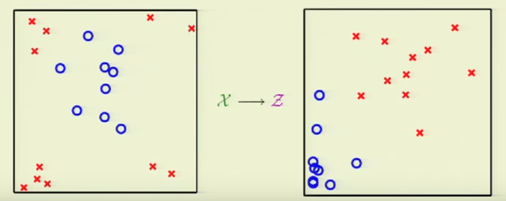
Non-Linear SVM
Support Vector Machine
Support Vector Machine
Linear SVM doesn’t work if x^{(n)} not separable

Slide 14
Non-Linear SVM
Support Vector Machine
Support Vector Machine
Step 1: Transform to z-space using polynomial transformation z_{i}=φ(x)_{i}
Step 2: Linear SVM in z-space
Penalty:
N_{z} > N_{x} → Higher costs

Slide 15
Summary: Non-Linear SVM
Support Vector Machine
Support Vector Machine
Step 1: Transform to z-space using polynomial transformation z_{i}=φ(x)_{i}
Step 2: (w,b) in in z-space
Penalty:
N_{z} > N_{x} → Higher costs
Step 3: For new pt x to be classified get x→z and plug into w^{T}z+b-1

Slide 16
Non-Linear SVM
Support Vector Machine
Support Vector Machine
Linear SVMt separator
Non-Linear SVMt separator
Dual Solutionseparator
Numerical Examples
Summary

Slide 17
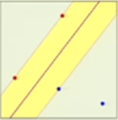
Dual Solution to SVM
Support Vector Machine
Support Vector Machine
regularizer
Find (w,b) s.t.:
+ λΣ_{n} (w^{T} •x^{(n)}+b)y^{(n)} - 1)
α_{n} =0 unless x_{n} is a support vector
where w^{T}x_{n} +b-1=0
Find α that maximizes:
Solution: Quadratic Programming where we eliminate w in terms of α_{n}
Stationary
conditions
(2)
x^{(n)} ∀ support
vectors
Ah ha! Once QP finds α_{n}, then plug
into eq. 2 to get w. Then plug α_{n} into
w^{T}x+b=1 to get b. Now classify new data

Slide 18
Dual Solution to SVM
Support Vector Machine
Support Vector Machine
Find α_{n} s.t.:
NxN Matrix! Yikes,
N=#feature vectors.
QP needs O(N³) to solve
Correlation matrix=Dot products between x^{(n)} and x^{(m)}
Hold everything! QP needs O(N³) to solve abone NxN matrix (N=# feature vectors) while the original primal problem only required Dx1 vector (w,b) costing O(M³). But D<<<N so sounds like a horrible strategy unless D>>N. Well, D>>>N if we are solving non-linear (w,b) with high dimension, such as kernel method.

Slide 19
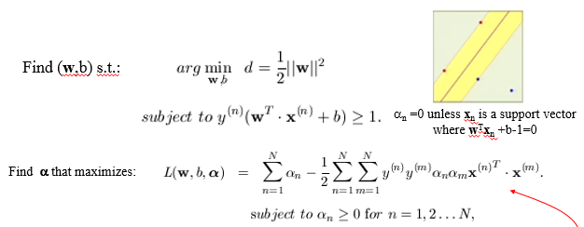
Summary: Dual Solution to SVM
Support Vector Machine
Support Vector Machine
Step 1: Transform Primal→Dual
Step 2: Solve for α_{n} by QP
Step 3: Find w and b from α_{n} only for n associated with
support vectors (non-support vectors make L smaller)
w = Σ_{n} α_{n}y^{(n)}x^{(n)} and w^{T} x+b=1
Step 4: Classify new data x: w^{T}x+b-1>0 or w^{T}x+b-1<0?

Slide 20
Outline
Support Vector Machine
Support Vector Machine
Linear SVMt separator
Non-Linear SVMt separator
Dual Solutionseparator
Numerical Examples
SVM with General Kernels
Soft Margin SVM
Summary

Slide 22
min1/2 |w|²
Subject to w^{T}•x+b ≥ 1 if y^{(n)}=1
w^{T}•x+b ≤ 1 if y^{(n)}=1

Slide 23
Neural Network
Intercept term
Coherency
Amplitude
Dipping Angle

Slide 24
Neural Network
Misfit Function
$$J\left(θ\right)=−\frac{1}{m}\sum_{i=1}^{m}{\sum_{k=1}^{K}{\left[y_{k}^{(i)}log\left({\left(h_{θ}\left(x^{(i)}\right)\right)}_{k}\right)+\left(1−y_{k}^{(i)}\right)log\left(1−{\left(h_{θ}\left(x^{(i)}\right)\right)}_{k}\right)\right]}}$$
$K :number of Layer$s

Slide 25
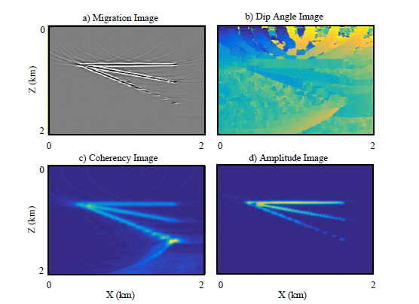
SVM Numerical Example
[(x₁,x₂,x₃),y]=[(dip, coherency,amp), noise/signal]
Support Vector Machine
Support Vector Machine
Yuqing Chen

Slide 26
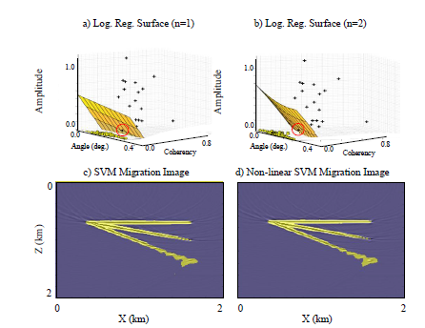
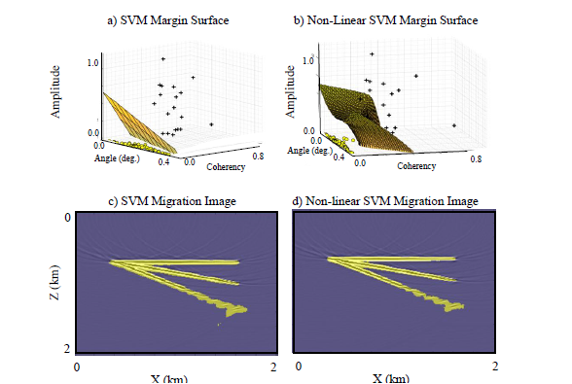
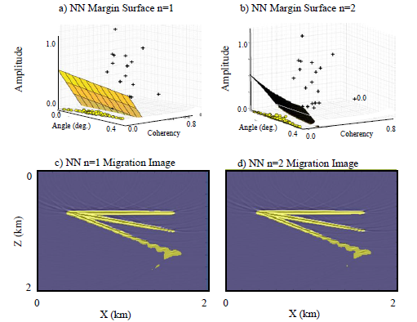
Numerical Example
Support Vector Machine
Support Vector Machine
Log. Reg. n=1 Migration Image
Log. Reg. n=2 Migration Image
Yuqing Chen

Slide 27
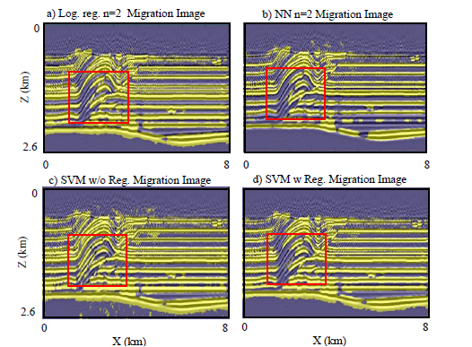
Numerical Example
Support Vector Machine
Support Vector Machine
Yuqing Chen

Slide 28
Outline
Support Vector Machine
Support Vector Machine
Linear SVMt separator
Non-Linear SVMt separator
Dual Solutionseparator
Numerical Examples
SVM with General Kernels
Soft Margin SVM
Summary

Slide 29
General Non-Linear SVM
Support Vector Machine
Support Vector Machine
Step 1: Transform to z-space using polynomial transformation z_{i}=φ(x)_{i}
We did this
by construction
Step 2: (w,b) in in z-space
Penalty:
N_{z} > N_{x} → Higher costs
Dx1→D_{z}x1
~
Step 3: For new pt x to be classified get x→z(x) and plug into w^{T}z+b-1
Step 3: Transform Primal→Dual
~
~
~
z^{(n)}
~
z^{(n)T}
z^{(m)T}

Slide 30
General Non-Linear SVM
Support Vector Machine
Support Vector Machine
Step 3: Transform Primal→Dual
~
~
~
z^{(n)}
~
z^{(n)T}
z^{(m)T}

Slide 31
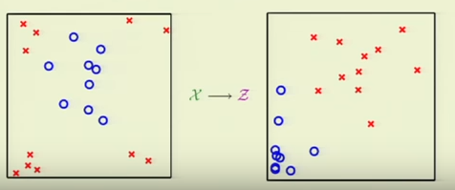
General Non-Linear SVM
Support Vector Machine
Support Vector Machine
Step 3: Transform Primal→Dual
NxN matrix to invert, not a D_{z}xD_{z}
~
~
z^{(n)}
~
z^{(n)T}
z^{(m)}
N
Two good things:
1. O(NxN) rather than much larger O(D_{z}xD_{z}) matrix
2. Instead of an explicit construction of φ(x)_{i}=z_{i} we
only need to specify k(x^{(n)},x^{(m)})=z^{(n)T}•z^{(m)} without tedious
specification of φ(x)_{i}=z_{i}, which could be infinite dimensional.
T
T
T
y₁y₁ z₁ •z₁
y₁y₂ z₁ •z₂ …… y₁y₂ z₁ •z_{N}
T
T
T
y₂y₁ z₁ •z₂
y₂y₂ z₂ •z₂ …… y₂y_{N} z₂ •z_{N}
…
…
…
…
T
T
T
y_{N}y₁ z_{N}•z₁
y_{N}y₂ z_{N} •z₂ …… y_{N}y_{N} z_{N} •z_{N}

Slide 32
General Non-Linear SVM
Support Vector Machine
Support Vector Machine
Example I: Previously we did construction, specify z(x)→K(x,x’)
z = φ(x) = (1, x₁, x₂, x₁², x₂² , x₁ x₂ )
z’ = φ(y) = (1, y₁, y₂, y₁², y₂² , y₁ y₂ )
Easy K
Hard z
K(x, y)= z^{T} • z’ = 1+ x₁ y₁ + x₂ y₂ + x₁² y₁² + x₂²y₂² + x₁y₁ x₂y₂
Example II: Previously we did construction, specify z(x)→K(x,x’).
How about specify K(x,y) and find z?
K(x, y) = (1+x^{T}y) = (1+ x₁y₁ + x₂y₂)²
= (1+ x₁² y₁² + x₂² y₂² + 2x₁y₁ + 2x₂y₂ + 2x₁y₁ x₂y₂ )
z? Hard
z = φ(x) = (1, x₁² , x₂², √2 x₁, √2 x₂ , √2 x₁ x₂ )
z’ = φ(y) = (1, y₁² , y₂², √2 y₁, √2 y₂ , √2 y₁ y₂ )

Slide 33
General Non-Linear SVM
Support Vector Machine
Support Vector Machine
Example III: Gaussian kernel
K(x,x’) = exp(-(x-x’)²)
= exp(-x²)exp(-x’²)Σ_{k=1}^{infty} 2(x)^{k} (x’)^{k} /k!
= exp(-x²)exp(-x’²)[ 1 + 2xx’ +x² x’² + …]
Therefore z(x) = exp(-x²)[ 1 , √2x , x², …].
Infinite dimensional z !
Its ok, we only need K(x,x’) to classify new points!
~
~
b obtained by substituting w into and solving for b in terms K(x,x’)
= 1
Why? Answer: ŵ=Σ_{n} α_{n} y_{n} z_{n} and g(x)=sign(ŵ^{T} •z + b)
obtained from dL/dw_{i} = 0
Substitute ŵ into g(x) gives g(x) = sign(Σ_{n} α_{n} y_{n} z^{T}•z_{n} + b)
No need to find z, only specify K(x,x’)
= sign(Σ_{n} α_{n} y_{n} K(x,x_{n} ) + b)→pred.

Slide 34
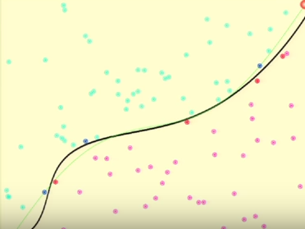
Summary: Kernel SVM
Support Vector Machine
Support Vector Machine
1. Pick suitable K(x,x’) = exp(-(x-x’)²) so that K symmetric
and positive semi-definite
2. Solve for α_{n} the reduced Lagrangian
K(x_{n},x_{m})
T
…
T
T
y₁y₂ K(x₁ ,x₂)
y₁y_{N} K(x₁ ,x_{N})
y₁y₁ K(x₁ ,x₁)
T
T
…
T
T
y₁y₁ z₁ •z₁
y₁y₂ z₁ •z₂ …… y₁y₂ z₁ •z_{N}
T
T
y₂y_{N} K(x₂ ,x_{N})
y₂y₁ K(x₂ ,x₁)
y₂y₂ K(x₂ ,x₂)
T
T
T
y₂y₁ z₁ •z₂
y₂y₂ z₂ •z₂ …… y₂y_{N} z₂ •z_{N}
…
…
…
…
…
…
…
…
T
T
…
T
y_{N}y₁ z_{N}•z₁
y_{N}y₂ z_{N} •z₂ …… y_{N}y_{N} z_{N} •z_{N}
T
T
T
y₂y_{N} K(x_{N} ,x_{N})
y₂y₁ K(x_{N} , x₁)
y₂y₂ K(x_{N} , x₂)
3. Classify new x by
g(x)= sign(Σ_{n} α_{n} y_{n} K(x,x_{n} ) + b)
Sum over support
vectors in z-space
K(x,x_{n} ) = exp(-(x-x_{n})²)
~
~
b obtained by substituting w into and solving for b in terms K(x,x’)
= 1

Slide 35
Outline
Support Vector Machine
Support Vector Machine
Linear SVMt separator
Non-Linear SVMt separator
Dual Solutionseparator
Numerical Examples
Soft Margin SVM
Summary

Slide 36
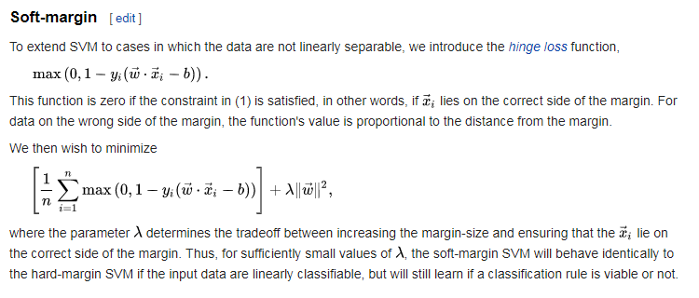
Soft Margin SVM

Slide 37
Outline
Support Vector Machine
Support Vector Machine
Linear SVMt separator
Non-Linear SVMt separator
Dual Solutionseparator
Numerical Examples
Soft Margin SVM
Summary

Slide 38
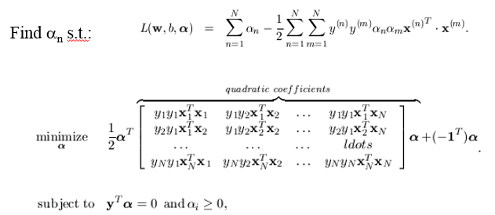
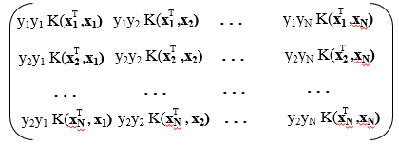
Summary
Linear SVM:
Non-linear SVM:
Dual-Space SVM:
Kernel trick: don’t compute ∞-dimensional
vector z(x), just specify K(x, x’) and find
α by QP. Then find prediction for new x by

Slide 39
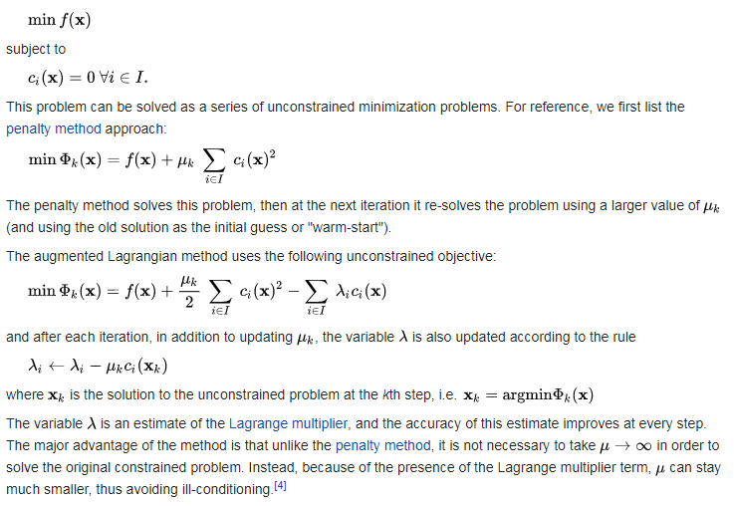
Augmnented Lagrangian

Slide 40
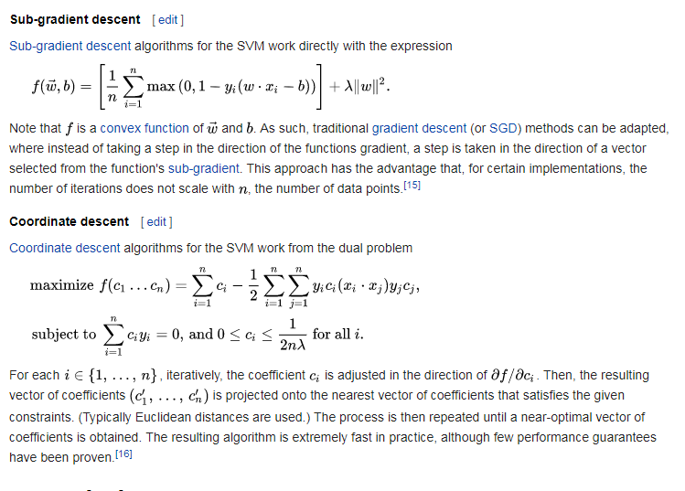
Gradient and Coordinate Descent

