Slide 1
Neural Network LAB
Function introductions
Setup input and output & initializing parameters
Training
Feed-forward & backpropagation (gradientnn.m)

Slide 2
Neural Network LAB
Function introductions
Setup input and output & initializing parameters
Training
Feed-forward & backpropagation (gradientnn.m)

Slide 3
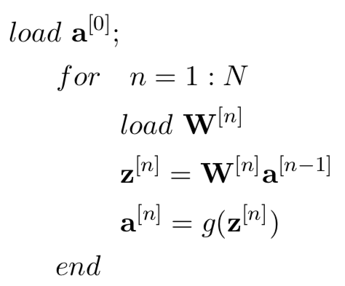
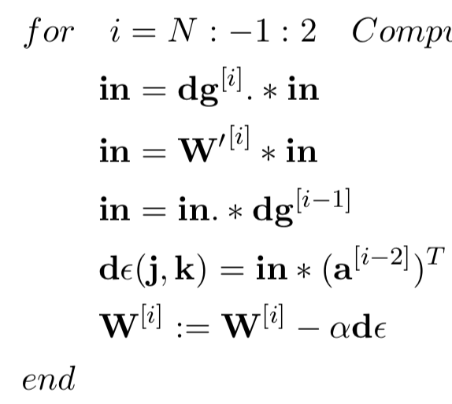
Function Introduction
gradientnn.m - Neural network cost function and gradient calculation
Feed-forward Operation
Backpropagation Operation
(Chapter 5)
(Chapter 5)

Slide 4
Function Introduction
gradientnn.m - Neural network cost function and gradient calculation
misfit.m - Objective function and gradient with rexpected to predicted output
(currently have likelihood and L2)
L2:
Likelihood:
(Chapter 4)

Slide 5
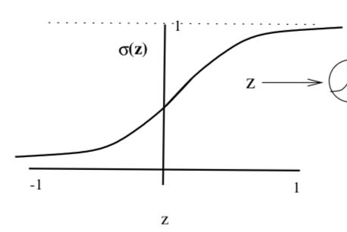
Function Introduction
gradientnn.m - Neural network cost function and gradient calculation
misfit.m - Objective function and gradient with rexpected to predicted output
(currently have likelihood and L2)
activation.m - activation function and gradient with repected to Z
(currently use sigmoid and ReLU)
(Chapter 1)
(Chapter 4)

Slide 6
Function Introduction
gradientnn.m - Neural network cost function and gradient calculation
misfit.m - Objective function and gradient with rexpected to predicted output
(currently have likelihood and L2)
activation.m - activation function and gradient with repected to Z
(currently use sigmoid and ReLU)
Displaynn.m - predict the output and plot

Slide 7
Neural Network LAB
Function introductions
Setup input and output & initializing parameters
Training
Feed-forward & backpropagation (gradientnn.m)

Slide 8
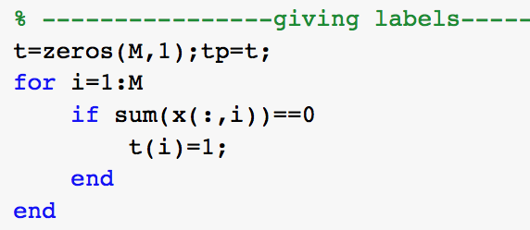
Setup input and output
Input:
(number of examples)
(number of features)
0
0
0
0
0
0
1
0
0
0
0
1
1
0
0
…
X =
Output:
…
t =
1
0
0

Slide 9
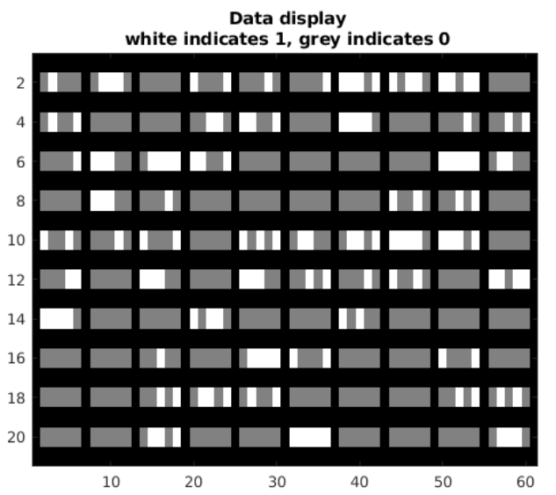
Setup input and output
Input:
White indicates 1, grey indicates 0
0
0
1
0
0
0
0
0
0
1
0
1
1
0
0
1
0
1
0
0
Output:
1 or 0

Slide 10
Initializing parameters
Initializing parameter:
15
10
5
5
layer_size = [ 5, 15, 10, 5, 1 ]
bias
1
Input feature numbers
Nodes in each hidden layer
Output label
1
5 + 1
w^{[1]}=
Random number
(0 ~ 0.1)
15
a^{[0]}
a^{[3]}
a^{[1]}
a^{[2]}
w^{[1]} a^{[0]}=a^{[1]}

Slide 11
Initializing parameters
Initializing parameter:
15
10
5
5
1
layer_size = [ 5, 15, 10, 5, 1 ]
bias
1
Input feature numbers
Nodes in each hidden layer
Output label
1
?
w^{[2]}=
Random number
(0 ~ 0.1)
?
a^{[0]}
a^{[3]}
a^{[1]}
a^{[2]}

Slide 12
Initializing parameters
Initializing parameter:
15
10
5
5
1
layer_size = [ 5, 15, 10, 5, 1 ]
bias
1
Input feature numbers
Nodes in each hidden layer
Output label
1
15 + 1
w^{[2]}=
Random number
(0 ~ 0.1)
10
a^{[0]}
a^{[3]}
a^{[1]}
a^{[2]}
w^{[2]} a^{[1]}=a^{[2]}

Slide 13
Neural Network LAB
Function introductions
Setup input and output & initializing parameters
Training
Feed-forward & backpropagation (gradientnn.m)

Slide 14
Neural Network LAB
Function introductions
Setup input and output & initializing parameters
Training
Feed-forward & backpropagation (gradientnn.m)

Slide 15
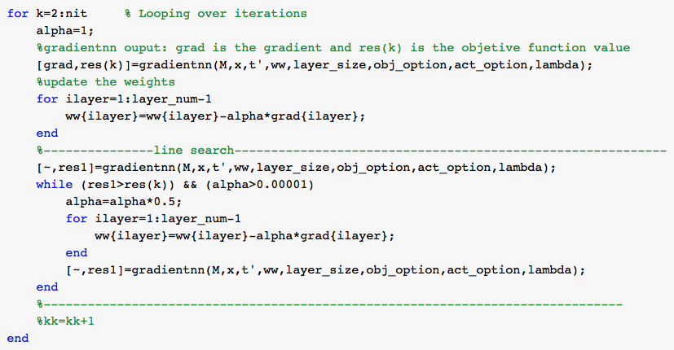
Steepest Decent for Neural Network

Slide 16
Function Introduction
gradientnn.m - Neural network cost function and gradient calculation
Feed-forward Operation
Backpropagation Operation
(Chapter 5)
(Chapter 5)

Slide 17
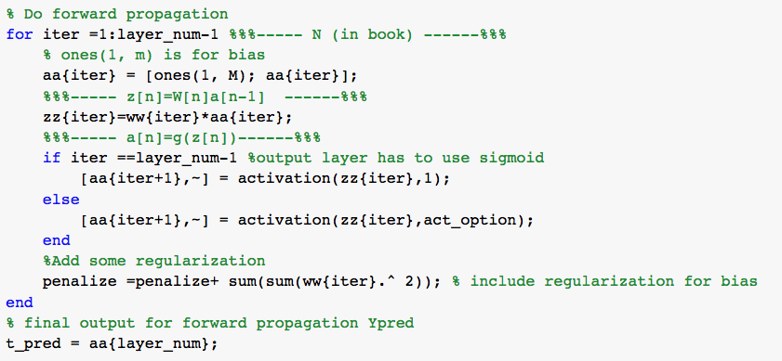
Feed-forward Propagation (in gradientnn.m)
Feed-forward Operation
bias
1
act_option = 1 for sigmoid
= 2 for ReLu
(Chapter 5)
regularization

Slide 18
Function Introduction
gradientnn.m - Neural network cost function and gradient calculation
Feed-forward Operation
Backpropagation Operation
(Chapter 5)
(Chapter 5)

Slide 19
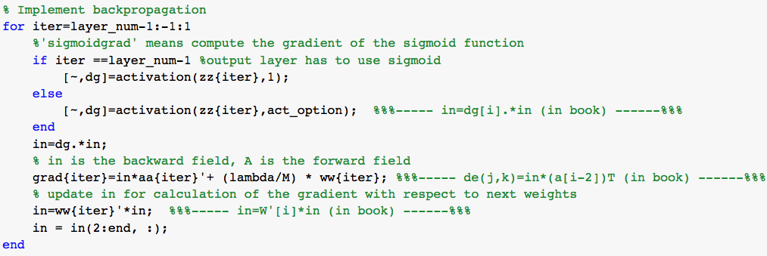
Backforward Propagation (in gradientnn.m)
Backpropagation Operation
(Chapter 5)
bias
1

Slide 20
Steepest Decent for Neural Network
alpha is ?

Slide 21
Steepest Decent for Neural Network
Line search for alpha

Slide 22
Exercise: multiclass
Input:
White indicates 1, grey indicates 0
1
3
0
2
1
1
4
3
4
0
5
Output:
0, 1, 2, 3, 4, 5 for how many “1” in x
(Remember to balance the number of each type before training)

