Slide 1
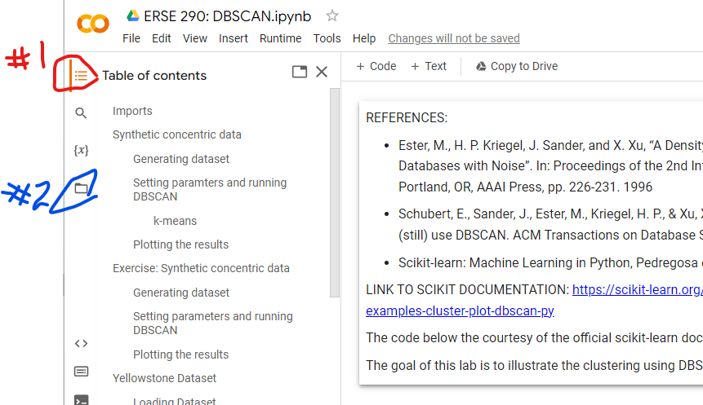
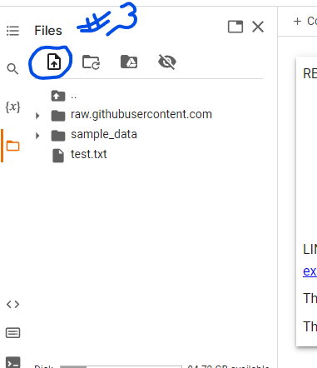
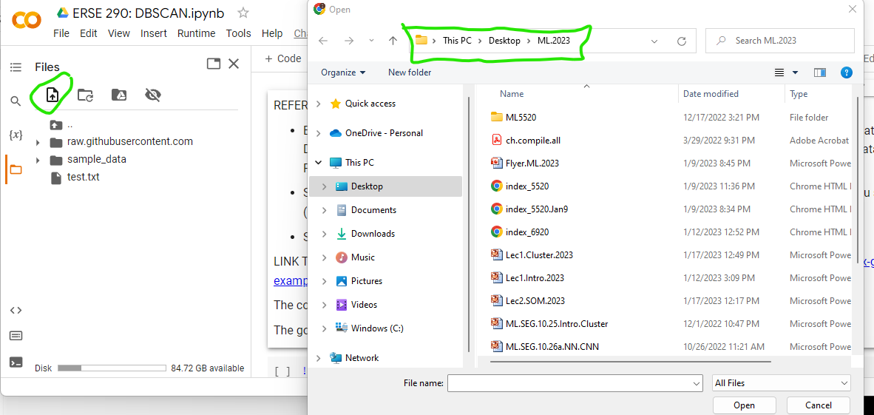
Downloading Your own Data into Colab
1. Open Colab and punch upper right circled box #1 below
2. Punch file icon #2
3. This will bring up .
Punch file icon #3
4. Punching icon #3 brings up your
Laptop files/folders. Find the data file
& punch it

