Slide 1
Colab- 3D DBScan
Professor: Dr. Schuster
TA: Mr. Shi
Student: Hamid Sadeghpour
First year PhD student
Civil and Environmental Engineering Department
University of Utah
Supervisor: Dr. Roshankhah

Slide 2
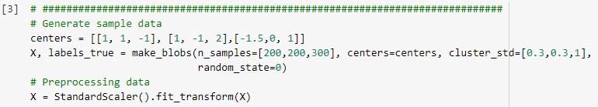
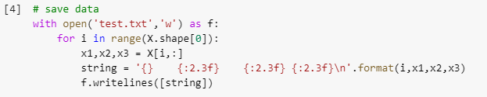
3D state for the DBScan code in Colab has been examined under the guidance of Mr. Shi.
After running Imports section in the Colab, in the generating dataset code, different values for the third dimension for the center points has been added.
In the save data section, value of “x3” is added to “x1,x2”; also, {:2.3f} to “string” section code.

Slide 3
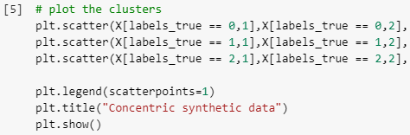
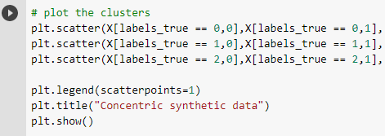
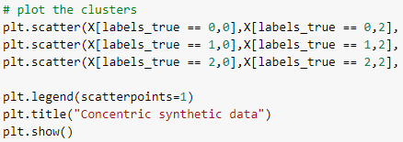


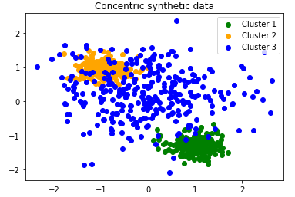
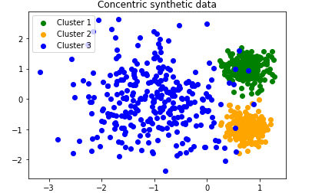
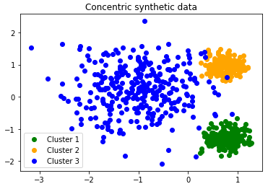
Within the “plot the clusters” section, because the Colab is capable of showing 2D plots, by altering the number of the second characteristic for the code “X[labels_true == 0,1” from 0 to 2, different dimensions of the plot for the dataset can be shown as following:

Slide 4
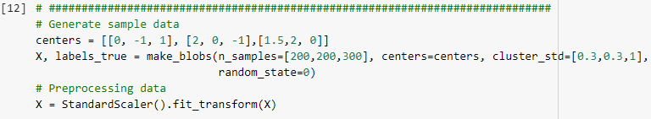



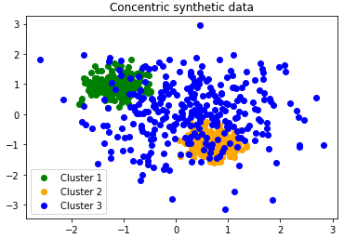
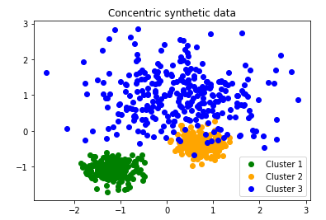
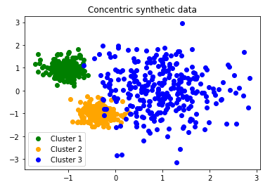
Changing the Centers’ values in the “generating dataset” section will result in different clustering and plots:

