Slide 1
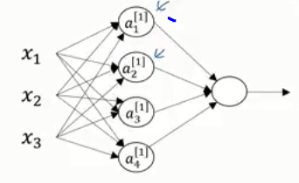
Vectorization of N.N. with N Layers+ M Training Examples
training
N(0)=3
N(1)=3
N(2)=3
N(3)=2
example #M
layer 0 layer 1 layer 2
layer 2 layer 3
Activation function can be sigmoid,
tanh, ReLU, etc..so we now call it g(z)
^{[0](M)}
….
^{[0](2)}
^{[0](1)}
a^{[2]}
a
a
a
a^{[1]}
a^{[2]}
a^{[3]}
training
layer [#]
example (#)
3x1
A^{[1]} = g(Z^{[1]})
a
M = # examples
^{[0](1)}
^{[0](M)}
^{[0](2)}
^{[0](1)}
Feedforward w/1 Example
for i=1:Nlayer
z^{[i]} =W^{[i]}'*a^{[i-1]} + b^{[i]};
a^{[i]} =1./(1+exp(- z^{[i]} ));
end
y^{pred} = z^{[Nlayer]}
a
a
a
N(1)xM
1
1
1
N(1)xM
^{[0](M)}
……
^{[0](2)}
^{[0](1)}
a
a
a
3=# features
2
2
2
^{[0](M)}
^{[0](2)}
^{[0](1)}
a
a
a
3
3
3
^{[1]}
b
w/Training
Set
Feedforward
for i=1:Nlayer
z^{[i]} =W^{[i]}'*a^{[i-1]} + b^{[i]};
a^{[i]} =1./(1+exp(- z^{[i]} ));
end
y^{pred} = z^{[Nlayer]}
layer 0
^{[1]}
N(i)xN(i-1)
b
W^{[1]}
A^{[0]}
1
= Z^{[1]}
+
^{[1]}
N(i)xM
Matlab
“broadcasting”
b
Z^{[i]} =W^{[i]}'*A^{[i-1]} + b^{[i]};
2
^{[1]}
N(i)xM
A^{[i]} =1./(1+exp(- Z^{[i]} ))
b
N(1)xN(0)
3xM
3
N(1)xM
N(1)x3
N(0)xM
N(Nlayer)xM
Last layer might
Not have activation
Y^{pred} = A^{[Nlayer]}

Slide 2
Neural Network LAB
Function introductions
Setup input and output & initializing parameters
Training
Feed-forward & backpropagation (gradientnn.m)

Slide 3
Neural Network LAB
Function introductions
Setup input and output & initializing parameters
Training
Feed-forward & backpropagation (gradientnn.m)

Slide 4
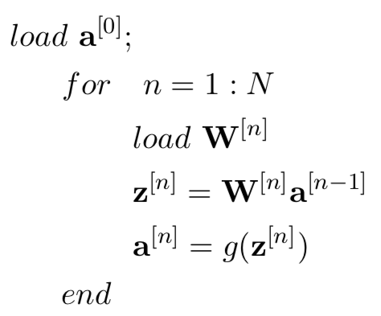
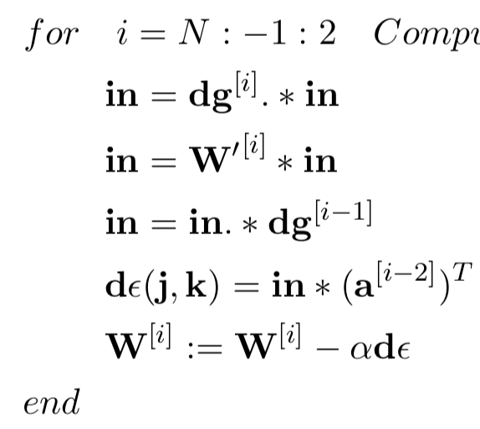
Function Introduction
gradientnn.m - Neural network cost function and gradient calculation
Feed-forward Operation
Backpropagation Operation
(Chapter 5)
(Chapter 5)

Slide 5
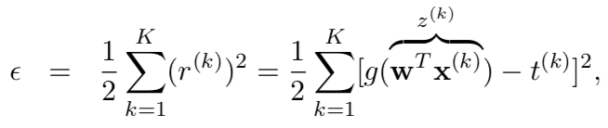


Function Introduction
gradientnn.m - Neural network cost function and gradient calculation
misfit.m - Objective function and gradient with rexpected to predicted output
(currently have likelihood and L2)
L2:
Likelihood:
(Chapter 4)

Slide 6

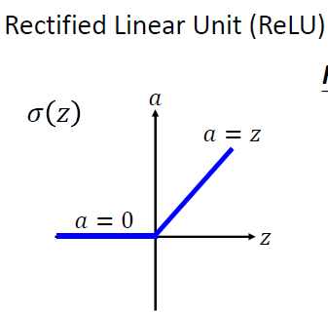
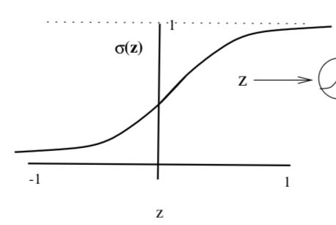
Function Introduction
gradientnn.m - Neural network cost function and gradient calculation
misfit.m - Objective function and gradient with rexpected to predicted output
(currently have likelihood and L2)
activation.m - activation function and gradient with repected to Z
(currently use sigmoid and ReLU)
(Chapter 1)
(Chapter 4)

Slide 7
Function Introduction
gradientnn.m - Neural network cost function and gradient calculation
misfit.m - Objective function and gradient with rexpected to predicted output
(currently have likelihood and L2)
activation.m - activation function and gradient with repected to Z
(currently use sigmoid and ReLU)
Displaynn.m - predict the output and plot

Slide 8
Neural Network LAB
Function introductions
Setup input and output & initializing parameters
Training
Feed-forward & backpropagation (gradientnn.m)

Slide 9
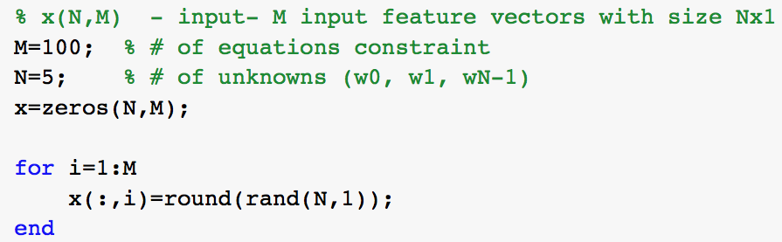
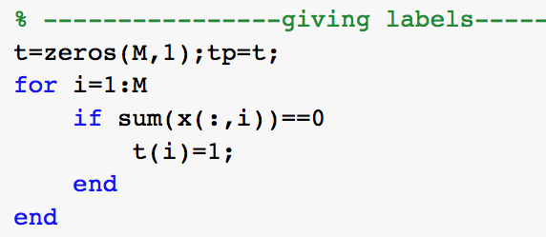
Setup input and output
Input:
(number of examples)
(number of features)
0
0
0
0
0
0
1
0
0
0
0
1
1
0
0
…
X =
Output:
…
t =
1
0
0

Slide 10
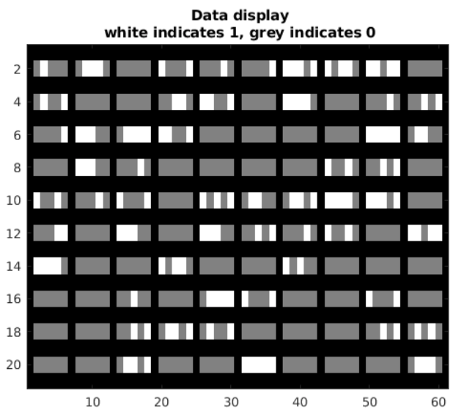
Setup input and output
Input:
White indicates 1, grey indicates 0
0
0
1
0
0
0
0
0
0
1
0
1
1
0
0
1
0
1
0
0
Output:
1 or 0

Slide 11
Initializing parameters
Initializing parameter:
15
10
5
5
layer_size = [ 5, 15, 10, 5, 1 ]
bias
1
Input feature numbers
Nodes in each hidden layer
Output label
1
5 + 1
w^{[1]}=
Random number
(0 ~ 0.1)
15
a^{[0]}
a^{[3]}
a^{[1]}
a^{[2]}
w^{[1]} a^{[0]}=a^{[1]}

Slide 12
Initializing parameters
Initializing parameter:
15
10
5
5
1
layer_size = [ 5, 15, 10, 5, 1 ]
bias
1
Input feature numbers
Nodes in each hidden layer
Output label
1
?
w^{[2]}=
Random number
(0 ~ 0.1)
?
a^{[0]}
a^{[3]}
a^{[1]}
a^{[2]}

Slide 13
Initializing parameters
Initializing parameter:
15
10
5
5
1
layer_size = [ 5, 15, 10, 5, 1 ]
bias
1
Input feature numbers
Nodes in each hidden layer
Output label
1
15 + 1
w^{[2]}=
Random number
(0 ~ 0.1)
10
a^{[0]}
a^{[3]}
a^{[1]}
a^{[2]}
w^{[2]} a^{[1]}=a^{[2]}

Slide 14
Neural Network LAB
Function introductions
Setup input and output & initializing parameters
Training
Feed-forward & backpropagation (gradientnn.m)

Slide 15
Neural Network LAB
Function introductions
Setup input and output & initializing parameters
Training
Feed-forward & backpropagation (gradientnn.m)

Slide 16
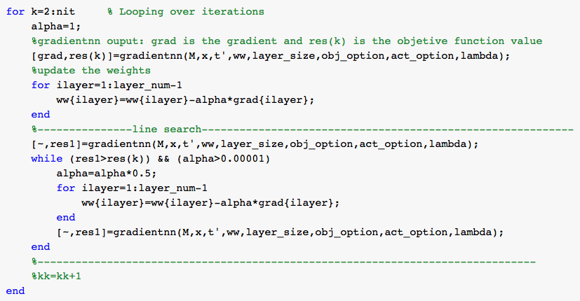
Steepest Decent for Neural Network

Slide 17
Function Introduction
gradientnn.m - Neural network cost function and gradient calculation
Feed-forward Operation
Backpropagation Operation
(Chapter 5)
(Chapter 5)

Slide 18
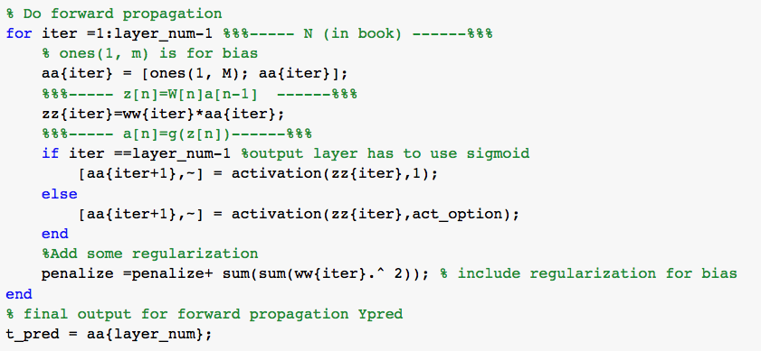
Feed-forward Propagation (in gradientnn.m)
Feed-forward Operation
bias
1
act_option = 1 for sigmoid
= 2 for ReLu
(Chapter 5)
regularization

Slide 19
Function Introduction
gradientnn.m - Neural network cost function and gradient calculation
Feed-forward Operation
Backpropagation Operation
(Chapter 5)
(Chapter 5)

Slide 20
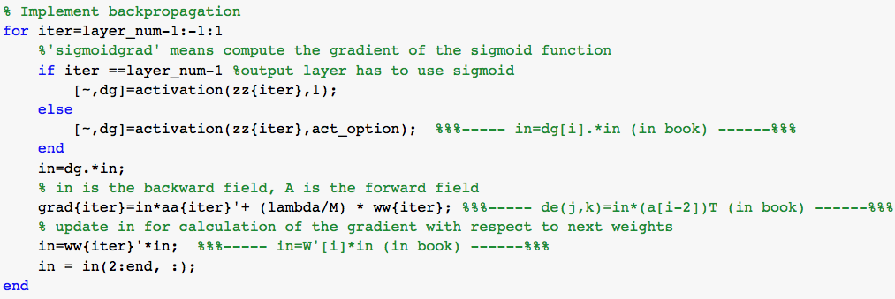
Backforward Propagation (in gradientnn.m)
Backpropagation Operation
(Chapter 5)
bias
1

Slide 21
Steepest Decent for Neural Network
alpha is ?

Slide 22
Steepest Decent for Neural Network
Line search for alpha

Slide 23
Exercise: multiclass
Input:
White indicates 1, grey indicates 0
1
3
0
2
1
1
4
3
4
0
5
Output:
0, 1, 2, 3, 4, 5 for how many “1” in x
(Remember to balance the number of each type before training)

